Slide 1
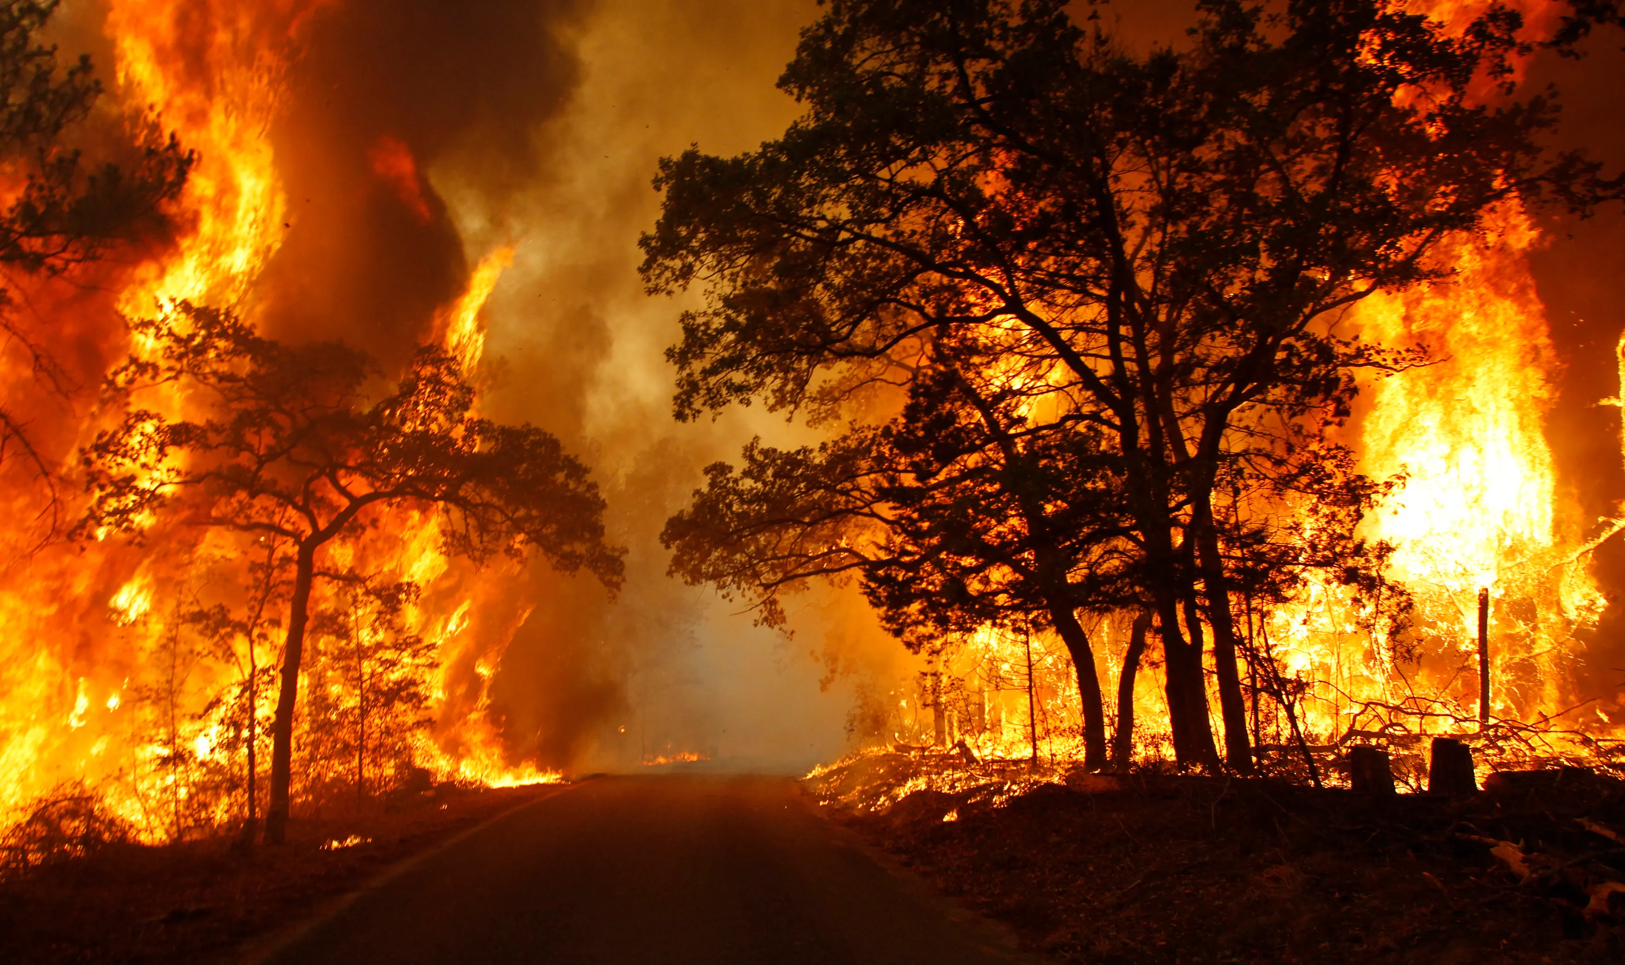
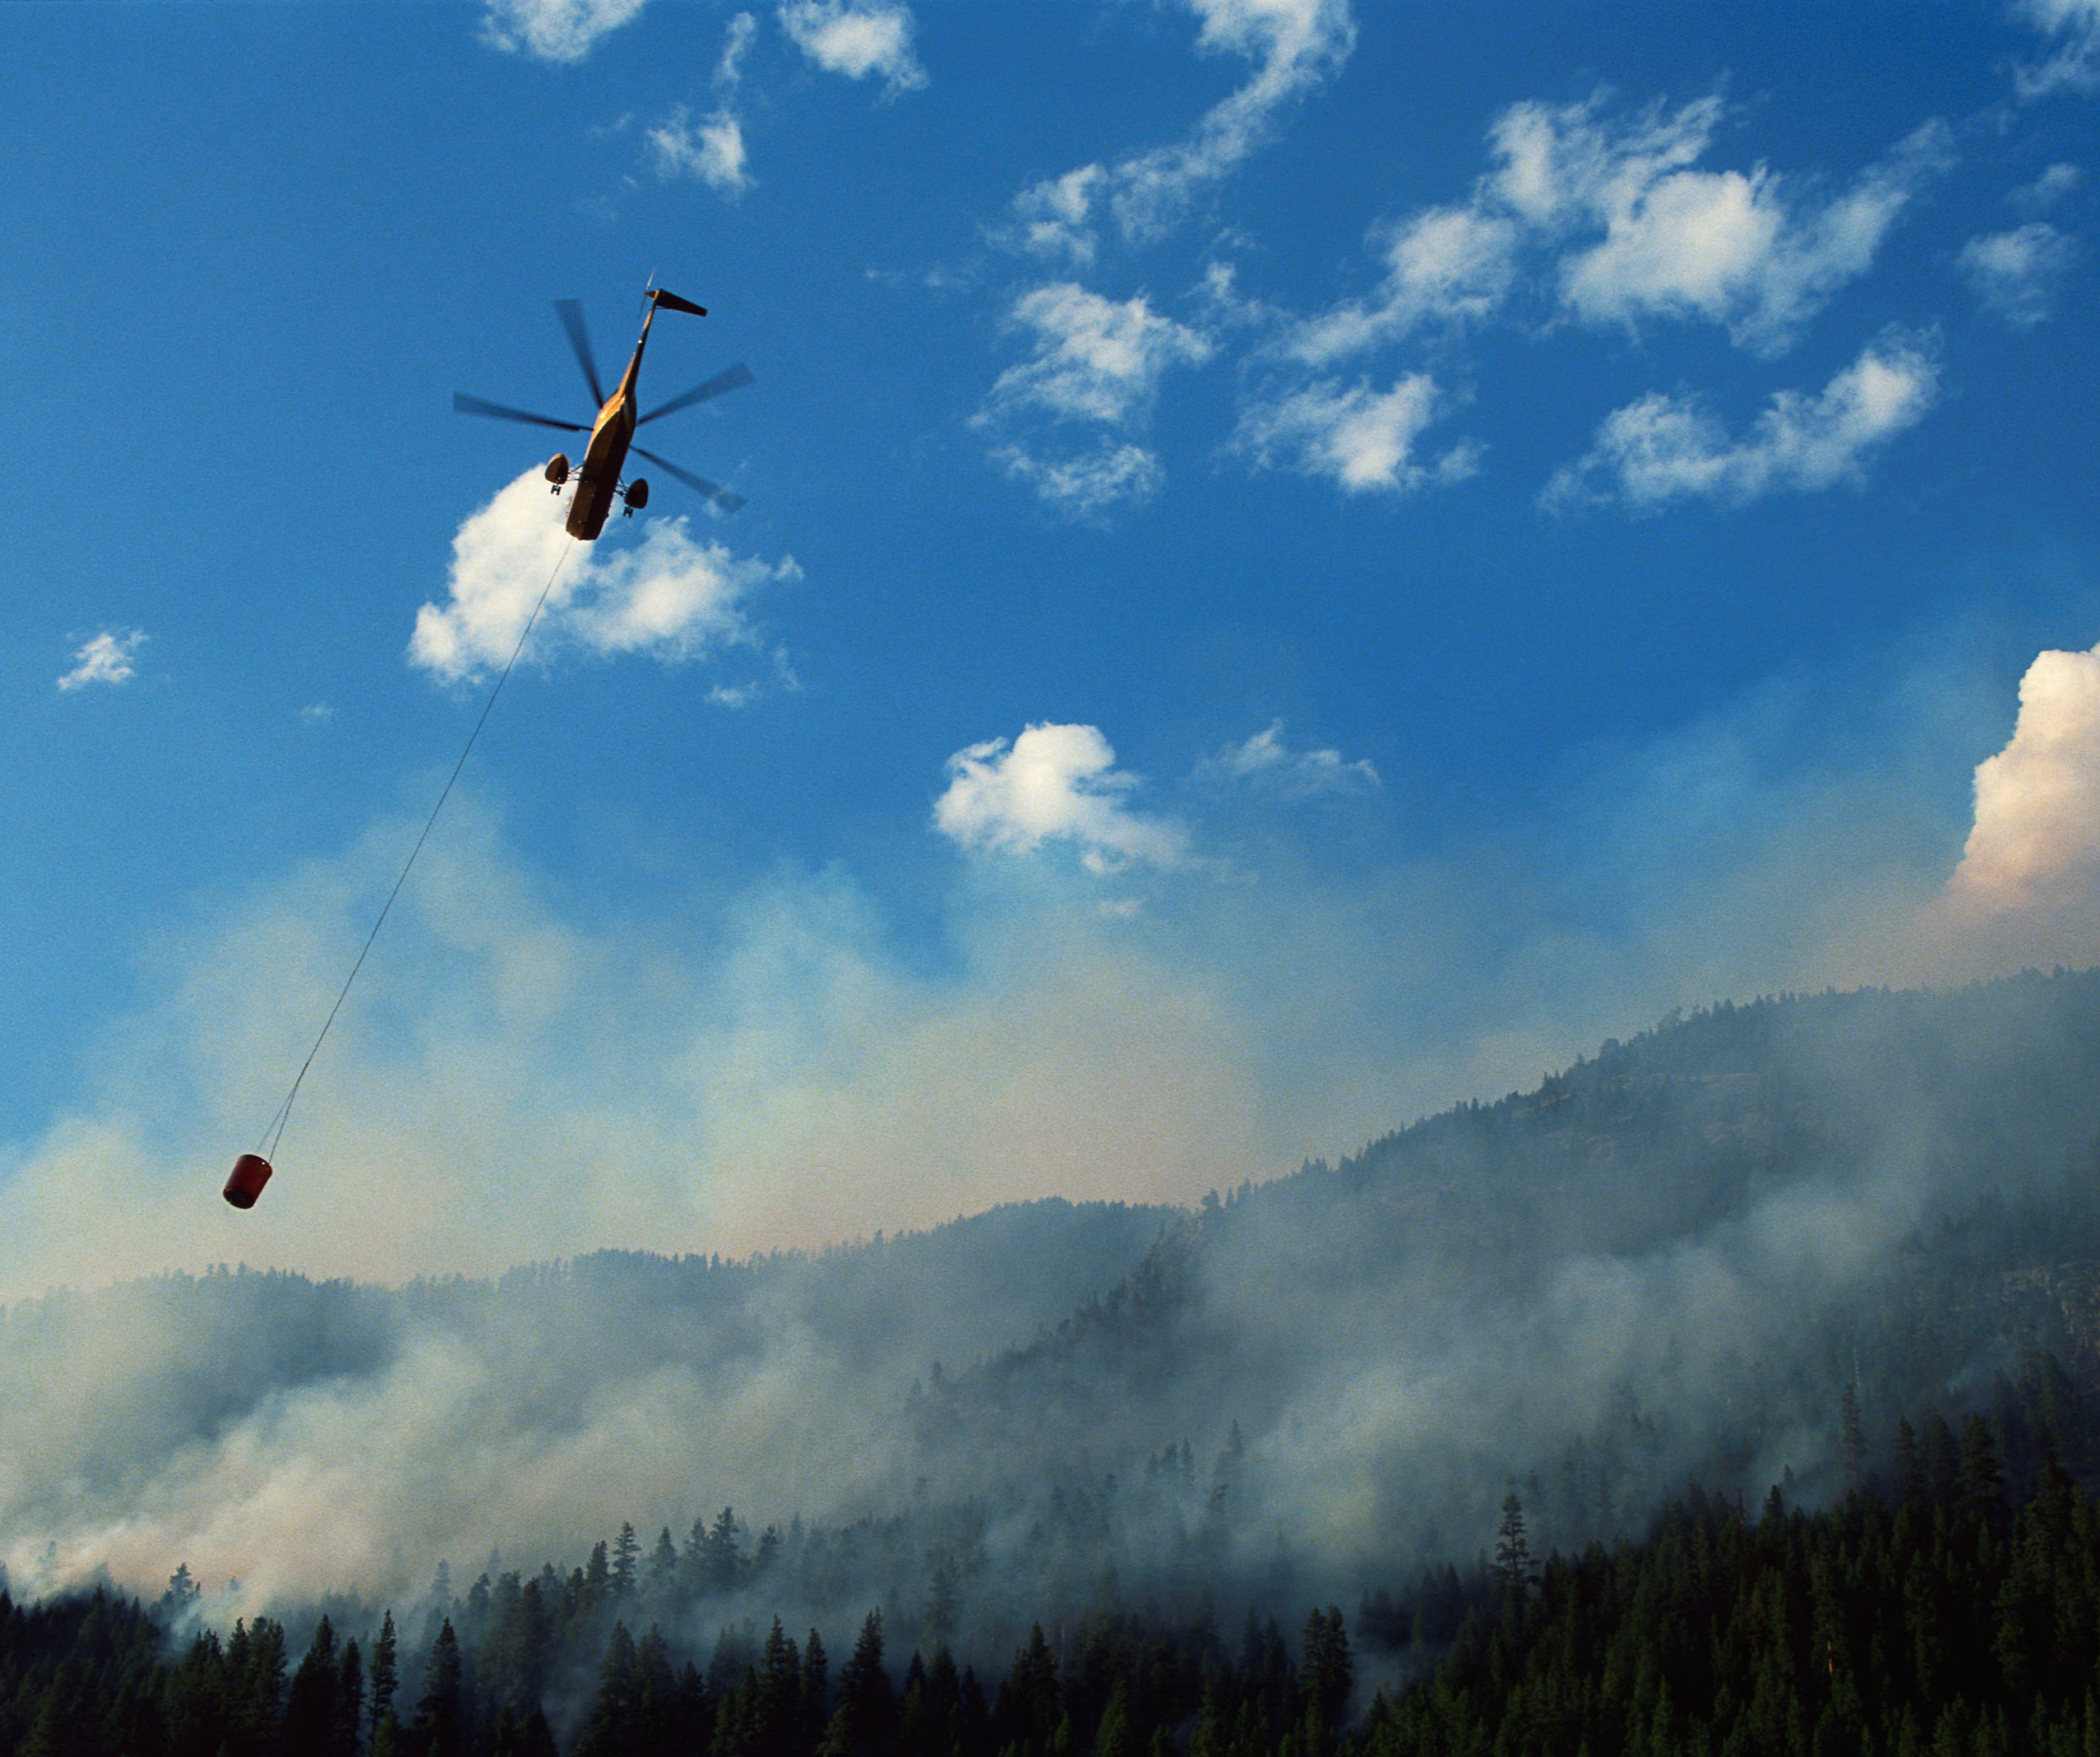
Environmental Disaster Monitoring & Analytics API
COMP3011 Coursework 1 Hao Ji
Notes:
This project is a FastAPI-based disaster event intelligence API for storing, ingesting, and analysing disaster data.

Slide 2
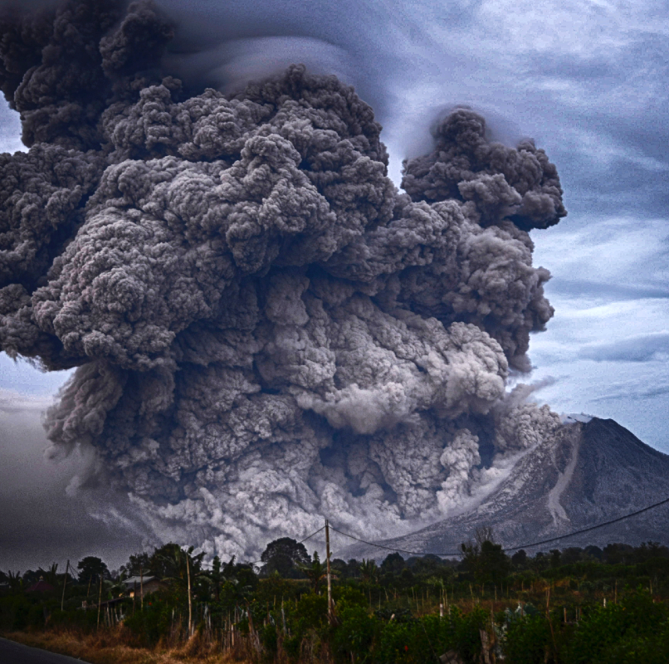
Problem & Objectives
Problem
External disaster APIs provide raw data but not a local intelligence system
A simple single-table CRUD API would be too limited
Objectives
Build a SQL-backed event management API
Ingest real wildfire and earthquake data
Track sources and ingestion runs
Provide analytics and risk assessment
Support authentication, testing, and deployment
Notes:
The goal is to build a data-driven API that aggregates disaster events and provides analytical insights.

Slide 3

System Architecture
Client / Swagger UI ↓ FastAPI Routes ↓ Auth Dependency ↓ CRUD / Service Layer ↓ SQLite Database
External APIs:
NASA EONET
USGS Earthquake API
↓
Ingestion Module → Database
Notes:
external data ingestion
database storage
REST endpoints
analytics queries

Slide 4
System Architecture
Core Data Model 1. disaster_events (main data) 2. source_metadata (source management) 3. ingest_runs (ingestion audit)
Notes:
external data ingestion
database storage
REST endpoints
analytics queries

Slide 5
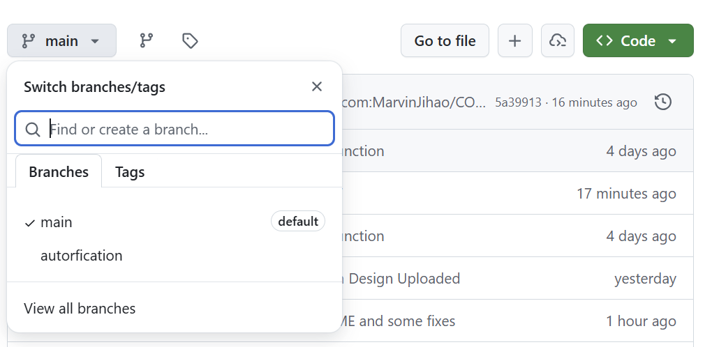
Version Control • Git used for development • Clear commit history • Available on GitHub repository
Notes:
Key features
• RESTful API with CRUD operations
• Integration with external disaster datasets
• Analytical endpoints for spatial and temporal insights

Slide 6
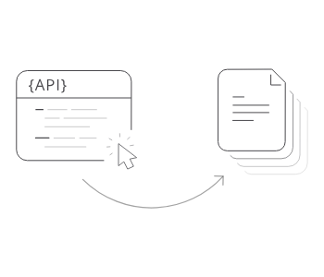
Key Features and Technical Quality
Core Features
• Full CRUD for disaster events • External ingestion (NASA EONET, USGS) • Analytics (summary, hotspots, risk assessment) • Health and database checks
Technical Quality
• HTTP Basic Authentication • Pydantic validation • Proper HTTP status codes • Automated tests (Pytest) • Deployment on PythonAnywhere
* Includes tests for authentication, invalid inputs, ingestion behaviour, and analytics correctness.
→ Please Refer to: API Documentation,
docs/api_documentation.pdf
Notes:
The API follows REST principles and provides full CRUD operations on disaster events.

Slide 7
Demo
Notes:
Key features
• RESTful API with CRUD operations
• Integration with external disaster datasets
• Analytical endpoints for spatial and temporal insights

