Slide 1
MACHINE LEARNING REPORT
2026 by Marvin Makhubela
Credit Card
Fraud Detection
Multi-model ML pipeline with LR · Random Forest · XGBoost · Ensemble
284,807
0.173%
4 Models
98.27%
Total Transactions
Fraud Rate
Compared
Best ROC-AUC

Slide 2
Project Overview
OBJECTIVE
DATASET
Detect fraudulent credit card transactions in a highly imbalanced dataset using multiple ML classifiers, then select the best model by PR-AUC.
European credit card transactions (Sep 2013). 284,807 rows with 492 fraud cases a 0.173% fraud rate, making class imbalance a core modelling challenge.
Pipeline Steps
01
02
03
04
05
Data Loading
Feature Eng.
Train/Test Split
Scaling
Modelling
Load raw CSV, inspect fraud rate
Hour sin/cos, Log Amount, quantile bins
Stratified 80/20, preserve fraud ratio
StandardScaler on all 33 features
LR · RF · XGB · Ensemble

Slide 3
Feature Engineering
33 features total — 28 PCA components + 5 engineered features
Hour
Log_Amount
Transaction hour of day (0–23) extracted from timestamp. Fraud patterns vary significantly by time of day.
Log-transformed transaction amount. Removes right skew and places very large and small amounts on a comparable scale.
Hour_sin / Hour_cos
Amount_Q
Cyclical encoding of hour using sine and cosine transforms, so midnight→1am is treated as close, not distant.
Quantile bin of transaction amount (quartile-based). Gives the model a discrete ordinal representation of spend level.
V1–V28 · 28 PCA-anonymised features supplied in the raw dataset, capturing latent transaction patterns whilst protecting cardholder privacy.

Slide 4
Model Performance Summary
Threshold selected to maximise F1 on validation set. Evaluation metric: PR-AUC (preferred for imbalanced data).
Model | Threshold | F1 | PR-AUC | ROC-AUC | Recall | Precision | TP / FP
Logistic Regression | 0.08084 | 0.0139 | 0.7118 | 0.9715 | 95.92% | 0.70% | 94 / 13,350
Random Forest | 0.00754 | 0.0213 | 0.8389 | 0.9826 | 95.92% | 1.08% | 94 / 8,649
XGBoost ★ BEST | 0.00500 | 0.1954 | 0.8776 | 0.9840 | 90.82% | 10.95% | 89 / 724
Ensemble | 0.02771 | 0.0135 | 0.8613 | 0.9738 | 95.92% | 0.68% | 94 / 13,685
Highest PR-AUC: 0.8776 XGBoost wins overall
Fewest False Positives: 724 XGBoost 19× fewer than LR
XGBoost Recall: 90.82% 5 fewer fraud caught vs others

Slide 5
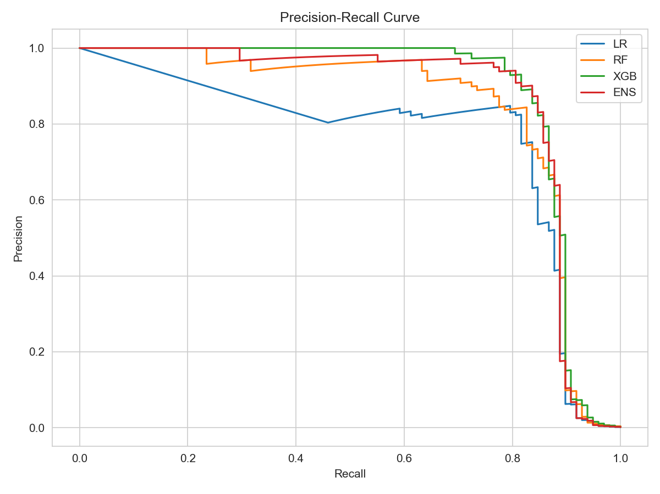
Precision-Recall Curve
Preferred metric for imbalanced datasets rewards high precision at high recall simultaneously.
XGBoost
PR-AUC = 0.8776 Best overall curve
Ensemble
PR-AUC = 0.8613 Strong but more FPs
Random Forest
PR-AUC = 0.8389 Solid tree baseline
Logistic Reg.
PR-AUC = 0.7118 Linear limits visible

Slide 6
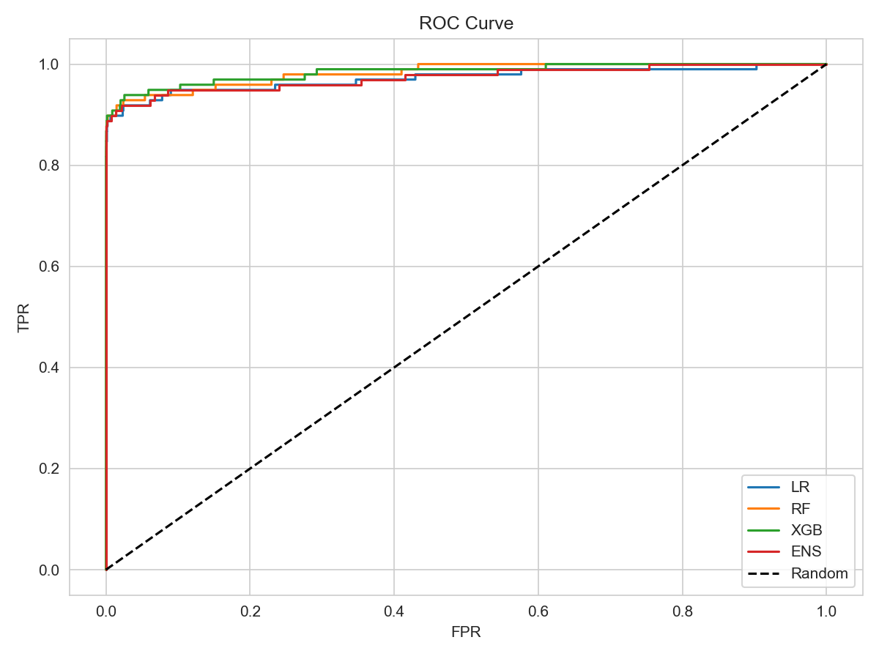
ROC Curve
All models perform exceptionally ROC-AUC ≥ 0.97 across the board, confirming strong discriminative power.
0.9840
XGBoost
0.9826
Random Forest
0.9715
Logistic Reg.
0.9738
Ensemble

Slide 7
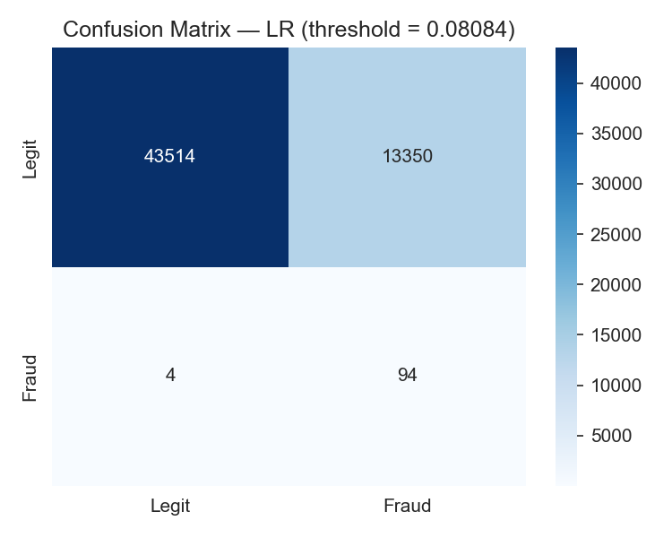
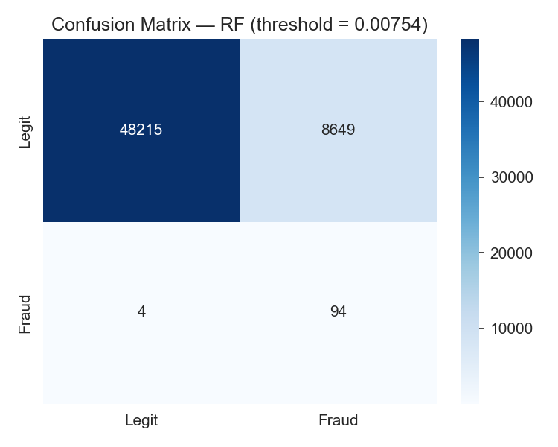
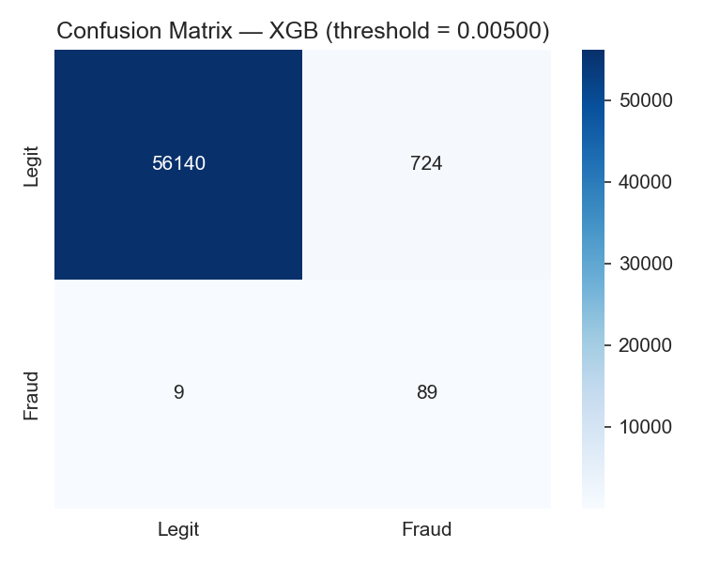

Confusion Matrices
Actual vs predicted at each model's optimal threshold
Logistic Regression
Random Forest
XGBoost
Ensemble

Slide 8
XGBoost Best Model Deep Dive
Highest PR-AUC (0.8776) and lowest false-positive count (724) selected as the production model.
0.8776
PR-AUC
0.9840
ROC-AUC
90.82%
Recall
10.95%
Precision
89
True Positives (fraud caught)
724
False Positives (false alerts)
scale_pos_weight = 1731.9 (imbalance ratio × 3) corrects for extreme class imbalance during XGBoost training

Slide 9
Business Impact Analysis
Why XGBoost's precision advantage matters operationally
False Positives (transactions incorrectly flagged as fraud)
Logistic Regression
13,350
Ensemble
13,685
Random Forest
8,649
XGBoost
724
XGBoost triggers 18× fewer false alerts than Logistic Regression reducing manual review workload, customer friction, and investigation cost.

Slide 10
Conclusions & Next Steps
Key Findings
Recommended Next Steps
XGBoost outperforms all models on PR-AUC (0.8776), the preferred metric for class-imbalanced fraud data.
1
SHAP explainability identify top features driving each prediction for compliance and auditability.
XGBoost reduces false positives by 18× vs Logistic Regression, slashing manual review burden.
2
SMOTE / cost-sensitive resampling may improve recall for the 5 missed frauds.
All models achieve ROC-AUC ≥ 0.97, confirming strong separability even without SMOTE oversampling.
3
Real-time inference API wrap XGBoost in a FastAPI or Flask service.
Cyclical hour encoding and log-transformed amount improved model signal meaningfully.
4
Monitoring track data drift and model degradation in production with Evidently or NannyML.
Threshold optimisation (min 0.005) was critical — default 0.5 threshold would miss most fraud.
5
Periodic retraining fraud patterns evolve; schedule monthly retraining on fresh labelled data.
Fraud Detection Pipeline · XGBoost Selected · PR-AUC 0.8776 · ROC-AUC 0.9840

