Slide 1
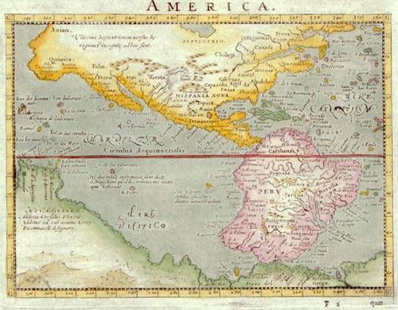
Introducing Uncertainty
(It is not the world that is imperfect, it is our knowledge of it)
R&N: Chap. 3, Sect 3.6 + Chap. 13

Slide 2
So far, we have assumed that:
  World states are perfectly observable,
  → the current state is exactly known
  Action representations are perfect,
  → states are exactly predicted
We will now investigate how an agent can cope with imperfect information
We will also study how limited resources (mainly time) affect reasoning
Occasionally, we will consider cases where the world is dynamic

Slide 3
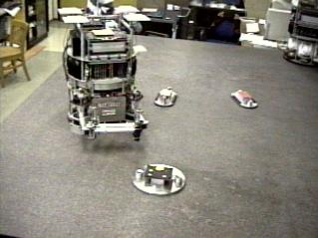
Introductory Example
A robot with imperfect sensing must reach a goal location among moving obstacles
(dynamic world)
Goal

Slide 4
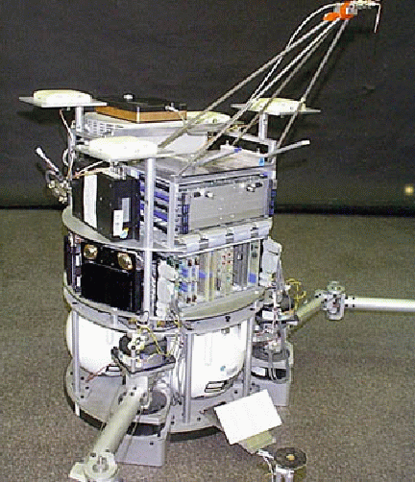
Robot created at
Stanford’s ARL Lab
to study issues
in robot control and
planning in no-gravity
space environment
air thrusters
gas tank
air bearing

Slide 5
Model, Sensing, and Control
The robot and the obstacles are represented as disks moving in the plane
The position and velocity of each disc are measured by an overhead camera every 1/30 sec
y
robot
obstacles
x

Slide 6
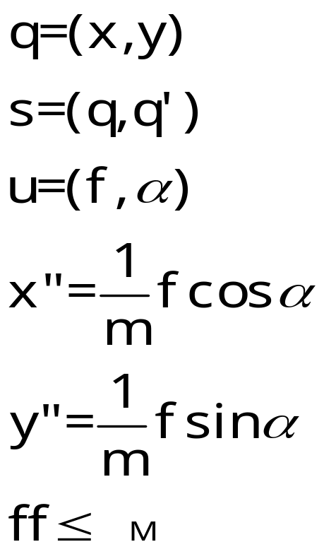
Model, Sensing, and Control
The robot and the obstacles are represented as disks moving in the plane
The position and velocity of each disc are measured by an overhead camera within 1/30 sec
The robot controls the magnitude f and the orientation α of the total pushing force exerted by the thrusters
y
f
robot
α
obstacles
x

Slide 7
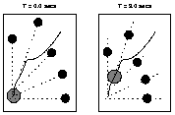
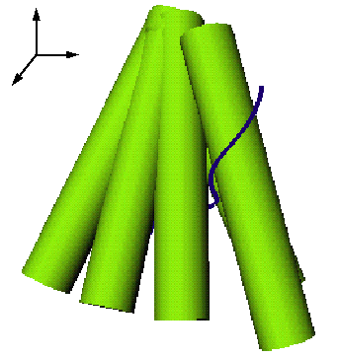
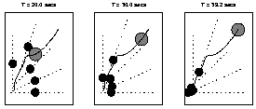
Motion Planning
The robot plans its trajectories in configuration×time space using a probabilistic roadmap (PRM) method
t
y
x
Obstacle map to cylinders in
configuration×time space

Slide 8
But executing this trajectory is likely to fail ...
The measured velocities of the obstacles are inaccurate
Tiny particles of dust on the table affect trajectories and contribute further to deviation
→ Obstacles are likely to deviate from their expected
trajectories
Planning takes time, and during this time, obstacles keep moving
→ The computed robot trajectory is not properly
synchronized with those of the obstacles
➔ The robot may hit an obstacle before reaching its goal
[Robot control is not perfect but “good” enough for the task]

Slide 9
But executing this trajectory is likely to fail ...
The measured velocities of the obstacles are inaccurate
Tiny particles of dust on the table affect trajectories and contribute further to deviation
→ Obstacles are likely to deviate from their expected
trajectories
Planning takes time, and during this time, obstacles are moving
→ The computed robot trajectory is not properly
synchronized with those of the obstacles
➔ The robot may hit an obstacle before reaching its goal
[Robot control is not perfect but “good” enough for the task]
Planning must take both uncertainty in world
state and time constraints into account

Slide 10
Dealing with Uncertainty
The robot can handle uncertainty in an obstacle position by representing the set of all positions of the obstacle that the robot think possible at each time (belief state)
For example, this set can be a disc whose radius grows linearly with time
Set of possible
positions at time 2T
Set of possible
positions at time T
Initial set of
possible positions
t = 0 t = T t = 2T

Slide 11
Dealing with Uncertainty
The robot can handle uncertainty in an obstacle position by representing the set of all positions of the obstacle that the robot think possible at each time (belief state)
For example, this set can be a disc whose radius grows linearly with time
The robot must plan to be
outside this disc at time t = T
t = 0 t = T t = 2T

Slide 12
Dealing with Uncertainty
The robot can handle uncertainty in an obstacle position by representing the set of all positions of the obstacle that the robot think possible at each time (belief state)
For example, this set can be a disc whose radius grows linearly with time
The forbidden regions in configuration×time space are cones, instead of cylinders
The trajectory planning method remains essentially unchanged

Slide 13
Dealing with Planning Time
t = 0
t = δ
planning
execution
Let t=0 the time when planning starts. A time limit δ is given to the planner
The planner computes the states that will be possible at t = δ and use them as the possible initial states
It returns a trajectory at some t < δ, whose execution will start at t = δ
Since the PRM planner isn’t absolutely guaranteed to find a solution within δ, it computes two trajectories using the same roadmap: one to the goal, the other to any position where the robot will be safe for at least an additional δ. Since there are usually many such positions, the second trajectory is at least one order of magnitude faster to compute

Slide 14
Are we done?
Not quite !
The uncertainty model may itself be incorrect, e.g.:
  There may be more dust on the table than anticipated
  Some obstacles have the ability to change trajectories
But if we are too careful, we will end up with forbidden regions so big that no solution trajectory will exist any more
So, it might be better to take some “risk”
The robot must monitor the execution of the
planned trajectory and be prepared to re-plan
a new trajectory

Slide 15
Are we done?
If an obstacle has an unexpected
position, the planner is called back
to compute a new trajectory.
Execution monitoring consists
of using the camera (at 30Hz)
to verify that all obstacles are
at positions allowed by the
robot’s uncertainty model
The robot must monitor the execution of the
planned trajectory and be prepared to re-plan
a new trajectory

Slide 16
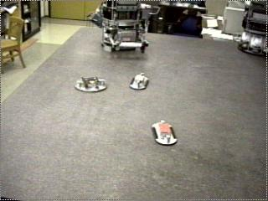
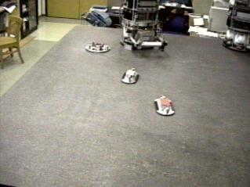
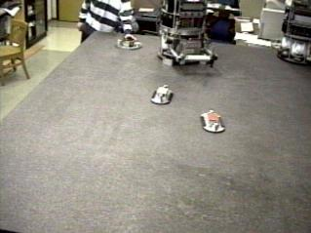
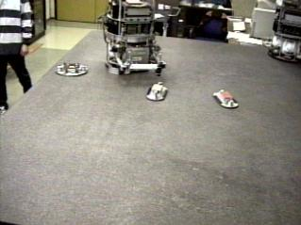
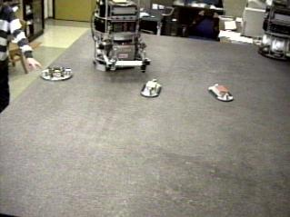
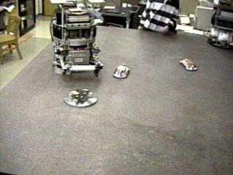
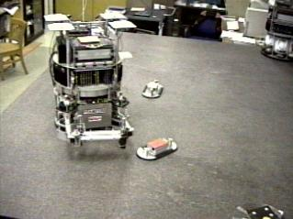
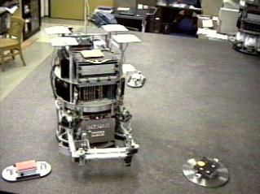
Experimental Run
X
Total duration : 40 sec

Slide 17
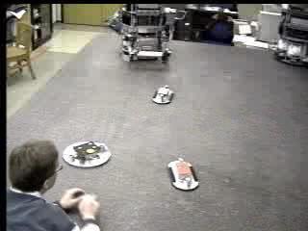

Experimental Run

Slide 18
Is this guaranteed to work?
Of course not :
Thrusters might get clogged
The robot may run out of air or battery
The granite table may suddenly break into pieces
Etc ...
[Unbounded uncertainty]

Slide 19
Sources of Uncertainty

Slide 20
The Real World and its Representation
3x3 matrix filled
with 1, 2, .., 8, and
‘empty’
Agent’s conceptualization
(→ representation language)
Real world
8-puzzle

Slide 21
The Real World and its Representation
Logic sentences using
propositions like
Block(A), On(A,B),
Handempty, ...
and connectives
Agent’s conceptualization
(→ representation language)
Real world
Blocks world

Slide 22
The Real World and its Representation
Geometric models
and equations
of motion
Agent’s conceptualization
(→ representation language)
Real world
Air-bearing robot
navigating among
moving obstacles

Slide 23
Who provides the representation language?
The agent’s designer
As of today, no practical techniques exist allowing an agent to autonomously abstract features of the real world into useful concepts and develop its own representation language using these concepts
Inductive learning techniques are steps in this direction, but much more is needed
The issues discussed in the following slides arise whether the representation language is provided by the agent’s designer or developed over time by the agent

Slide 24
First Source of Uncertainty:
The Representation Language
There are many more states of the real world than can be expressed in the representation language
So, any state represented in the language may correspond to many different states of the real world, which the agent can’t represent distinguishably
On(A,B) ∧ On(B,Table) ∧ On(C,Table) ∧ Clear(A) ∧ Clear(C)
A
A
A
B
C
C
B
B
C

Slide 25
First Source of Uncertainty:
The Representation Language
6 propositions On(x,y), where x, y = A, B, C and x ≠ y
3 propositions On(x,Table), where x = A, B, C
3 propositions Clear(x), where x = A, B, C
At most 2¹² states can be distinguished in the language [in fact much fewer, because of state constraints such as On(x,y) → ¬On(y,x)]
But there are infinitely many states of the real world
On(A,B) ∧ On(B,Table) ∧ On(C,Table) ∧ Clear(A) ∧ Clear(C)
A
A
A
B
C
C
B
B
C

Slide 26
→ An action representation may be incorrect ...
Stack(C,A)
P = Holding(C) ∧ Block(C) ∧ Block(A) ∧ Clear(A)
D = Clear(A), Holding(C)
A = On(C,A), Clear(C), Handempty
is likely not to have the described effects in case 3 because the precondition is “incomplete”
On(A,B) ∧ On(B,Table) ∧ On(C,Table) ∧ Clear(A) ∧ Clear(C)
A
A
A
B
C
C
B
B
C
1
2
3

Slide 27
... or may describe several alternative effects
Stack(C,A)
P = Holding(C) ∧ Block(C) ∧ Block(A) ∧ Clear(A)
[If On(A,x) ∧ (x ≠ Table)]
D = Clear(A), Holding(C)
A = On(C,A), Clear(C), Handempty
D = Holding(C), On(A,x)
A = On(C,Table), Clear(C), Handempty, On(A,Table),
Clear(A), Clear(x)
E₁
OR
E₂
On(A,B) ∧ On(B,Table) ∧ On(C,Table) ∧ Clear(A) ∧ Clear(C)
A
A
A
B
C
C
B
B
C
1
2
3

Slide 28
Observation of the Real World
Real
world
in some
state
Percepts
Interpretation of the
percepts in the
representation language
On(A,B)
On(B,Table)
Handempty
Percepts can be user’s inputs, sensory data (e.g., image
pixels), information received from other agents, ...

Slide 29

Second source of Uncertainty:
Imperfect Observation of the World
Observation of the world can be:
Partial, e.g., a vision sensor can’t see through obstacles (lack of percepts)
R₁
R₂
The robot may not know whether
there is dust in room R2

Slide 30
Second source of Uncertainty:
Imperfect Observation of the World
Observation of the world can be:
Partial, e.g., a vision sensor can’t see through obstacles
Ambiguous, e.g., percepts have multiple possible interpretations
A
On(A,B) ∨ On(A,C)
B
C

Slide 31
Second source of Uncertainty:
Imperfect Observation of the World
Observation of the world can be:
Partial, e.g., a vision sensor can’t see through obstacles
Ambiguous, e.g., percepts have multiple possible interpretations
Incorrect

Slide 32
Third Source of Uncertainty:
Ignorance, Laziness, Efficiency
An action may have a long list of preconditions, e.g.:
Drive-Car:
P = Have(Keys) ∧ ¬Empty(Gas-Tank) ∧ Battery-Ok ∧ Ignition-Ok ∧ ¬Flat-Tires ∧ ¬Stolen(Car) ...
The agent’s designer may ignore some preconditions
... or by laziness or for efficiency, may not want to include all of them in the action representation
The result is a representation that is either incorrect – executing the action may not have the described effects – or that describes several alternative effects

Slide 33
Representation of Uncertainty
Many models of uncertainty
We will consider two important models:
  Non-deterministic model:
  Uncertainty is represented by a set of possible values, e.g., a set of possible worlds, a set of possible effects, ...
  → The next two lectures
  Probabilistic model:
  Uncertainty is represented by a probabilistic distribution over a set of possible values
  → The following two lectures

Slide 34
Example: Belief State
In the presence of non-deterministic sensory uncertainty, an agent belief state represents all the states of the world that it thinks are possible at a given time or at a given stage of reasoning
In the probabilistic model of uncertainty, a probability is associated with each state to measure its likelihood to be the actual state
0.2
0.3
0.4
0.1

Slide 35
What do probabilities mean?
Probabilities have a natural frequency interpretation
The agent believes that if it was able to return many times to a situation where it has the same belief state, then the actual states in this situation would occur at a relative frequency defined by the probabilistic distribution
0.2
0.3
0.4
0.1
This state would occur
20% of the times

Slide 36
Example
Consider a world where a dentist agent D meets a new patient P
D is interested in only one thing: whether P has a cavity, which D models using the proposition Cavity
Before making any observation, D’s belief state is:
This means that D believes that a fraction p of patients have cavities
Cavity
¬ Cavity
p
1-p

Slide 37
Where do probabilities come from?
Frequencies observed in the past, e.g., by the agent, its designer, or others
Symmetries, e.g.:
  If I roll a dice, each of the 6 outcomes has probability 1/6
Subjectivism, e.g.:
  If I drive on Highway 280 at 120mph, I will get a speeding ticket with probability 0.6
  Principle of indifference: If there is no knowledge to consider one possibility more probable than another, give them the same probability

Slide 38
Non-Deterministic vs. Probabilistic
If the world is adversarial and the agent uses probabilistic methods, it is likely to fail consistently
If the world in non-adversarial and failure must be absolutely avoided, then non-deterministic techniques are likely to be more efficient computationally
In other cases, probabilistic methods may be a better option, especially if there are several “goal” states providing different rewards and life does not end when one is reached

Slide 39
Uncertainty and Errors
The uncertainty model may itself be incorrect
Representing uncertainty can reduce the risk of errors, but does not eliminate it entirely !!
Execution monitoring is required to detect errors and (hopefully) fix them [closed-loop execution]
  What to monitor?
  How to fix errors?

Slide 40
What to monitor?
Action monitoring:
  Check preconditions before executing an action and effects after
  Not very efficient (e.g., a precondition may have been false for a while)
Plan monitoring:
  Check the preconditions of the entire remaining plans
  → Triangle tables

Slide 41


Key-in-Box Problem
Grasp-Key-in-R₂
P = In(Robot,R₂) ∧ In(Key,R₂)
D = ∅
A = Holding(Key)
Lock-Door
P = Holding(Key)
D = Unlocked(Door)
A = Locked(Door)
Move-Key-from-R₂-into-R₁
P = In(Robot,R₂) ∧ Holding(Key) ∧ Unlocked(Door)
D = In(Robot,R₂), In(Key,R₂)
A = In(Robot,R₁), In(Key,R₁)
Put-Key-Into-Box
P = In(Robot,R₁) ∧ Holding(Key)
D = Holding(Key), In(Key,R₁)
A = In(Key,Box)
R₁
R₂

Slide 42
Triangle Table
Plan:
Grasp-Key-in-R₂, Move-Key-from-R₂-into-R₁,
Lock-Door, Put-Key-Into-Box
to achieve Locked(Door) ∧ In(Key, Box)
In(Robot,R₂)
In(Key,R₂)
Grasp-Key-in-R₂
In(Robot,R₂)
Unlocked(Door)
Holding(Key)
Move-Key-from-R₂-into-R₁
Holding(Key)
Lock-Door
Holding(Key)
In(Robot,R₁)
Put-Key-Into-Box
Locked(Door)
In(Key,Box)

Slide 43
Triangle Table
Propositions from the initial state
that are necessary to the applicability of actions in the plan and the achievement of the goal
In(Robot,R₂)
In(Key,R₂)
Grasp-Key-in-R₂
In(Robot,R₂)
Unlocked(Door)
Holding(Key)
Move-Key-from-R₂-into-R₁
Holding(Key)
Lock-Door
Holding(Key)
In(Robot,R₁)
Put-Key-Into-Box
Locked(Door)
In(Key,Box)

Slide 44
Triangle Table
Propositions achieved by Grasp-Key-in-R₂
that are necessary to the applicability of subsequent actions and the achievement of the goal
In(Robot,R₂)
In(Key,R₂)
Grasp-Key-in-R₂
In(Robot,R₂)
Unlocked(Door)
Holding(Key)
Move-Key-from-R₂-into-R₁
Holding(Key)
Lock-Door
Holding(Key)
In(Robot,R₁)
Put-Key-Into-Box
Locked(Door)
In(Key,Box)

Slide 45
Triangle Table
Propositions contained in initial state or achieved by actions of the plan that are necessary to the achievement of the goal
In(Robot,R₂)
In(Key,R₂)
Grasp-Key-in-R₂
In(Robot,R₂)
Unlocked(Door)
Holding(Key)
Move-Key-from-R₂-into-R₁
Holding(Key)
Lock-Door
Holding(Key)
In(Robot,R₁)
Put-Key-Into-Box
Locked(Door)
In(Key,Box)

Slide 46
Triangle Table
3rd kernel of the plan:
If all the propositions in it are true, the agent can proceed to execute the 3rd action of the plan (Lock-Door)
In(Robot,R₂)
In(Key,R₂)
Grasp-Key-in-R₂
In(Robot,R₂)
Unlocked(Door)
Holding(Key)
Move-Key-from-R₂-into-R₁
Holding(Key)
Lock-Door
Holding(Key)
In(Robot,R₁)
Put-Key-Into-Box
Locked(Door)
In(Key,Box)

Slide 47
Triangle Table
5rd kernel of the plan:
If all the propositions in it are true, the goal is achieved
In(Robot,R₂)
In(Key,R₂)
Grasp-Key-in-R₂
In(Robot,R₂)
Unlocked(Door)
Holding(Key)
Move-Key-from-R₂-into-R₁
Holding(Key)
Lock-Door
Holding(Key)
In(Robot,R₁)
Put-Key-Into-Box
Locked(Door)
In(Key,Box)

Slide 48
Execution Monitoring with Triangle Tables
Repeat:
Observe the world and identify the largest k such that all the propositions in the k^{th} kernel are true
If k = 0 then re-plan
Else execute the k^{th} action of the plan
Actions that fail are repeated
Actions that are not needed are skipped

Slide 49
But ...
Repeating an action that failed assumes that it may succeed next time. But what if the agent picked the wrong key in R₂?
Either the agent has more knowledge or sensors than it used so far, and it’s time to use them
Or it doesn’t have any of these, and it has no choice – fail or call another agent
[I do the same when my car does not start and I can’t figure out why]

Slide 50
On-Line Search
Sometimes uncertainty is so large that actions need to be executed for the agent to know their effects
Example: A robot must reach a goal position. It has no prior map of the obstacles, but its vision system can detect all the obstacles visible from a the robot’s current position

Slide 51
Assuming no obstacles in the unknown region and taking the shortest path to the goal is similar to searching with an admissible (optimistic) heuristics

Slide 52
Assuming no obstacles in the unknown region and taking the shortest path to the goal is similar to searching with an admissible (optimistic) heuristics

Slide 53
Assuming no obstacles in the unknown region and taking the shortest path to the goal is similar to searching with an admissible (optimistic) heuristics
Just as with classical search, on-line search may detect dead-ends and move to a more promising position (~ node
of search tree)

Slide 54
Suggestion
It’s time to refresh your memory on probability theory:
  axioms of probability
  random variable
  joint distributions
  conditioning
  independence
[R&N: Chap. 13, Sect. 13.3-6]
We will be using probabilities in a few lectures

