Slide 1
Adversarial Search and
Game Playing
(Where making good decisions requires respecting your opponent)
R&N: Chap. 6

Slide 2
Games like Chess or Go are compact settings that mimic the uncertainty of interacting with the natural world
For centuries humans have used them to exert their intelligence
Recently, there has been great success in building game programs that challenge human supremacy

Slide 3
Specific Setting
Two-player, turn-taking, deterministic, fully observable, zero-sum, time-constrained game
State space
Initial state
Successor function: it tells which actions can be executed in each state and gives the successor state for each action
MAX’s and MIN’s actions alternate, with MAX playing first in the initial state
Terminal test: it tells if a state is terminal and, if yes, if it’s a win or a loss for MAX, or a draw
All states are fully observable

Slide 4
Relation to Previous Lecture
Here, uncertainty is caused by the actions of another agent (MIN), who competes with our agent (MAX)

Slide 5
Relation to Previous Lecture
Here, uncertainty is caused by the actions of another agent (MIN), who competes with our agent (MAX)
MIN wants MAX to lose (and vice versa)
No plan exists that guarantees MAX’s success regardless of which actions MIN executes (the same is true for MIN)
At each turn, the choice of which action to perform must be made within a specified time limit
The state space is enormous: only a tiny fraction of this space can be explored within the time limit

Slide 6
Game Tree
MAX nodes
MAX’s play →
MIN nodes
MIN’s play →
Here, symmetries have been used to reduce the branching factor
Terminal state
(win for MAX) →

Slide 7
Game Tree
MAX’s play →
MIN’s play →
In general, the branching factor and the depth of terminal states are large
Chess:
Number of states: ~10⁴⁰
Branching factor: ~35
Number of total moves
in a game: ~100
Terminal state
(win for MAX) →

Slide 8
Choosing an Action: Basic Idea
Using the current state as the initial state, build the game tree uniformly to the maximal depth h (called horizon) feasible within the time limit
Evaluate the states of the leaf nodes
Back up the results from the leaves to the root and pick the best action assuming the worst from MIN
→ Minimax algorithm

Slide 9
Evaluation Function
Function e: state s → number e(s)
e(s) is a heuristic that estimates how favorable s is for MAX
e(s) > 0 means that s is favorable to MAX
(the larger the better)
e(s) < 0 means that s is favorable to MIN
e(s) = 0 means that s is neutral

Slide 10
Example: Tic-tac-Toe
e(s) = number of rows, columns, and diagonals open for MAX
− number of rows, columns, and diagonals open for MIN
8−8 = 0
6−4 = 2
3−3 = 0

Slide 11
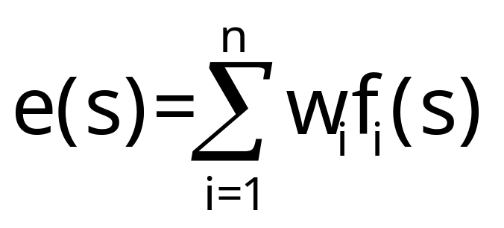
Construction of an
Evaluation Function
Usually a weighted sum of “features”:
Features may include
  Number of pieces of each type
  Number of possible moves
  Number of squares controlled

Slide 12
Backing up Values
Tic-Tac-Toe tree
at horizon = 2
1
Best move
-1
1
-2
6-5=1
5-5=0
6-5=1
5-5=1
4-5=-1
5-4=1
6-4=2
5-6=-1
5-5=0
5-6=-1
6-6=0
4-6=-2

Slide 13
Continuation
1
1
0
2
1
3
1
2
1
1
1
0
2
0
1
1
0
2
2
3
1
2
2
1
1
0

Slide 14
Why using backed-up values?
At each non-leaf node N, the backed-up value is the value of the best state that MAX can reach at depth h if MIN plays well (by the same criterion as MAX applies to itself)
If e is to be trusted in the first place, then the backed-up value is a better estimate of how favorable STATE(N) is than e(STATE(N))

Slide 15
Minimax Algorithm
Expand the game tree uniformly from the current state (where it is MAX’s turn to play) to depth h
Compute the evaluation function at every leaf of the tree
Back-up the values from the leaves to the root of the tree as follows:
  A MAX node gets the maximum of the evaluation of its successors
  A MIN node gets the minimum of the evaluation of its successors
Select the move toward a MIN node that has the largest backed-up value

Slide 16
Minimax Algorithm
Expand the game tree uniformly from the current state (where it is MAX’s turn to play) to depth h
Compute the evaluation function at every leaf of the tree
Back-up the values from the leaves to the root of the tree as follows:
  A MAX node gets the maximum of the evaluation of its successors
  A MIN node gets the minimum of the evaluation of its successors
Select the move toward a MIN node that has the largest backed-up value
Horizon: Needed to return a
decision within allowed time

Slide 17
Game Playing (for MAX)
Repeat until a terminal state is reached
Select move using Minimax
Execute move
Observe MIN’s move
Note that at each cycle the large game tree built to horizon h is used to select only one move
All is repeated again at the next cycle (a sub-tree of depth h-2 can be re-used)

Slide 18
Can we do better?
Yes ! Much better !
≥ 3
3
≤ -1
← Pruning
This part of the tree can’t have any effect on the value that will be backed up to the root
-1

Slide 19
Example

Slide 20
Example
The beta value of a MIN
node is an upper bound on
the final backed-up value.
It can never increase
β = 2
2

Slide 21
Example
The beta value of a MIN
node is an upper bound on
the final backed-up value.
It can never increase
β = 1
2
1

Slide 22
Example
α = 1
The alpha value of a MAX
node is a lower bound on
the final backed-up value.
It can never decrease
β = 1
2
1

Slide 23
Example
α = 1
β = 1
β = -1
2
1
-1

Slide 24
Example
α = 1
β = 1
β = -1
Search can be discontinued below
any MIN node whose beta value is
less than or equal to the alpha value
of one of its MAX ancestors
2
1
-1

Slide 25
Alpha-Beta Pruning
Explore the game tree to depth h in depth-first manner
Back up alpha and beta values whenever possible
Prune branches that can’t lead to changing the final decision

Slide 26
Alpha-Beta Algorithm
Update the alpha/beta value of the parent of a node N when the search below N has been completed or discontinued
Discontinue the search below a MAX node N if its alpha value is ≥ the beta value of a MIN ancestor of N
Discontinue the search below a MIN node N if its beta value is ≤ the alpha value of a MAX ancestor of N

Slide 27
Example
0
5
-3
3
3
-3
0
2
-2
3
5
2
5
-5
0
1
5
1
-3
0
-5
5
-3
3
2

Slide 28
Example
0
0
5
-3
3
3
-3
0
2
-2
3
5
2
5
-5
0
1
5
1
-3
0
-5
5
-3
3
2

Slide 29
Example
0
0
0
5
-3
3
3
-3
0
2
-2
3
5
2
5
-5
0
1
5
1
-3
0
-5
5
-3
3
2

Slide 30
Example
0
0
-3
0
5
-3
3
3
-3
0
2
-2
3
5
2
5
-5
0
1
5
1
-3
0
-5
5
-3
3
2

Slide 31
Example
0
0
-3
0
5
-3
3
3
-3
0
2
-2
3
5
2
5
-5
0
1
5
1
-3
0
-5
5
-3
3
2

Slide 32
Example
0
0
0
-3
0
5
-3
3
3
-3
0
2
-2
3
5
2
5
-5
0
1
5
1
-3
0
-5
5
-3
3
2

Slide 33
Example
0
0
3
0
-3
3
0
5
-3
3
3
-3
0
2
-2
3
5
2
5
-5
0
1
5
1
-3
0
-5
5
-3
3
2

Slide 34
Example
0
0
3
0
-3
3
0
5
-3
3
3
-3
0
2
-2
3
5
2
5
-5
0
1
5
1
-3
0
-5
5
-3
3
2

Slide 35
Example
0
0
0
0
3
0
-3
3
0
5
-3
3
3
-3
0
2
-2
3
5
2
5
-5
0
1
5
1
-3
0
-5
5
-3
3
2

Slide 36
Example
0
0
0
0
3
0
-3
3
5
0
5
-3
3
3
-3
0
2
-2
3
5
2
5
-5
0
1
5
1
-3
0
-5
5
-3
3
2

Slide 37
Example
0
0
0
0
3
2
0
-3
3
2
0
5
-3
3
3
-3
0
2
-2
3
5
2
5
-5
0
1
5
1
-3
0
-5
5
-3
3
2

Slide 38
Example
0
0
0
0
3
2
0
-3
3
2
0
5
-3
3
3
-3
0
2
-2
3
5
2
5
-5
0
1
5
1
-3
0
-5
5
-3
3
2

Slide 39
Example
0
0
2
0
2
0
3
2
0
-3
3
2
0
5
-3
3
3
-3
0
2
-2
3
5
2
5
-5
0
1
5
1
-3
0
-5
5
-3
3
2

Slide 40
Example
0
0
2
0
2
0
3
2
0
-3
3
2
0
5
-3
3
3
-3
0
2
-2
3
5
2
5
-5
0
1
5
1
-3
0
-5
5
-3
3
2

Slide 41
Example
0
0
0
2
0
2
0
3
2
0
-3
3
2
0
5
-3
3
3
-3
0
2
-2
3
5
2
5
-5
0
1
5
1
-3
0
-5
5
-3
3
2

Slide 42
Example
0
0
0
2
0
2
0
3
2
0
-3
3
2
5
0
5
-3
3
3
-3
0
2
-2
3
5
2
5
-5
0
1
5
1
-3
0
-5
5
-3
3
2

Slide 43
Example
0
0
0
2
0
2
0
3
2
1
0
-3
3
2
1
0
5
-3
3
3
-3
0
2
-2
3
5
2
5
-5
0
1
5
1
-3
0
-5
5
-3
3
2

Slide 44
Example
0
0
0
2
0
2
0
3
2
1
0
-3
3
2
1
-3
0
5
-3
3
3
-3
0
2
-2
3
5
2
5
-5
0
1
5
1
-3
0
-5
5
-3
3
2

Slide 45
Example
0
0
0
2
0
2
0
3
2
1
0
-3
3
2
1
-3
0
5
-3
3
3
-3
0
2
-2
3
5
2
5
-5
0
1
5
1
-3
0
-5
5
-3
3
2

Slide 46
Example
0
0
0
2
1
0
2
1
0
3
2
1
0
-3
3
2
1
-3
0
5
-3
3
3
-3
0
2
-2
3
5
2
5
-5
0
1
5
1
-3
0
-5
5
-3
3
2

Slide 47
Example
0
0
0
2
1
0
2
1
0
3
2
1
0
-3
3
2
1
-3
-5
0
5
-3
3
3
-3
0
2
-2
3
5
2
5
-5
0
1
5
1
-3
0
-5
5
-3
3
2

Slide 48
Example
0
0
0
2
1
0
2
1
0
3
2
1
0
-3
3
2
1
-3
-5
0
5
-3
3
3
-3
0
2
-2
3
5
2
5
-5
0
1
5
1
-3
0
-5
5
-3
3
2

Slide 49
Example
0
0
0
2
1
0
2
1
-5
0
3
2
1
-5
0
-3
3
2
1
-3
-5
0
5
-3
3
3
-3
0
2
-2
3
5
2
5
-5
0
1
5
1
-3
0
-5
5
-3
3
2

Slide 50
Example
0
0
0
2
1
0
2
1
-5
0
3
2
1
-5
0
-3
3
2
1
-3
-5
0
5
-3
3
3
-3
0
2
-2
3
5
2
5
-5
0
1
5
1
-3
0
-5
5
-3
3
2

Slide 51
Example
0
0
1
0
2
1
0
2
1
-5
0
3
2
1
-5
0
-3
3
2
1
-3
-5
0
5
-3
3
3
-3
0
2
-2
3
5
2
5
-5
0
1
5
1
-3
0
-5
5
-3
3
2

Slide 52
Example
1
0
1
0
2
1
2
0
2
1
-5
2
0
3
2
1
-5
2
0
-3
3
2
1
-3
-5
2
0
5
-3
3
3
-3
0
2
-2
3
5
2
5
-5
0
1
5
1
-3
0
-5
5
-3
3
2

Slide 53
Example
1
0
1
0
2
1
2
0
2
1
-5
2
0
3
2
1
-5
2
0
-3
3
2
1
-3
-5
2
0
5
-3
3
3
-3
0
2
-2
3
5
2
5
-5
0
1
5
1
-3
0
-5
5
-3
3
2

Slide 54
How much do we gain?
Consider these two cases:
α = 3
α = 3
3
β=-1
3
β=4
-1
(4)
4
-1

Slide 55
How much do we gain?
Assume a game tree of uniform branching factor b
Minimax examines O(b^{h}) nodes, so does alpha-beta in the worst-case
The gain for alpha-beta is maximum when:
  The MIN children of a MAX node are ordered in decreasing backed up values
  The MAX children of a MIN node are ordered in increasing backed up values
Then alpha-beta examines O(b^{h/2}) nodes [Knuth and Moore, 1975]
But this requires an oracle (if we knew how to order nodes perfectly, we would not need to search the game tree)
If nodes are ordered at random, then the average number of nodes examined by alpha-beta is ~O(b^{3h/4})

Slide 56
Heuristic Ordering of Nodes
Order the children of a node according to the values backed-up at the previous iteration

Slide 57
Other Improvements
Adaptive horizon + iterative deepening
Extended search: Retain k>1 best paths, instead of just one, and extend the tree at greater depth below their leaf nodes (to help dealing with the “horizon effect”)
Singular extension: If a move is obviously better than the others in a node at horizon h, then expand this node along this move
Use transposition tables to deal with repeated states
Null-move search

Slide 58
State-of-the-Art

Slide 59
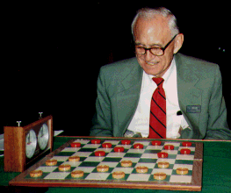
Checkers: Tinsley vs. Chinook
Name: Marion Tinsley
Profession: Teach mathematics
Hobby: Checkers
Record: Over 42 years loses only 3 games of checkers
World champion for over 40
years
Mr. Tinsley suffered his 4th and 5th losses against Chinook

Slide 60
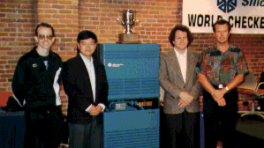
Chinook
First computer to become official world champion of Checkers!

Slide 61
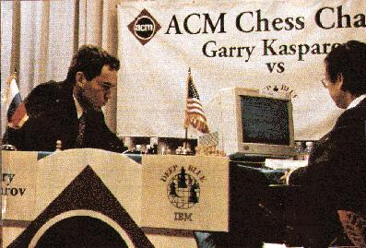
Chess: Kasparov vs. Deep Blue
Kasparov
5’10”
176 lbs
34 years
50 billion neurons
2 pos/sec
Extensive
Electrical/chemical
Enormous
Height
Weight
Age
Computers
Speed
Knowledge
Power Source
Ego
Deep Blue
6’ 5”
2,400 lbs
4 years
32 RISC processors
+ 256 VLSI chess engines
200,000,000 pos/sec
Primitive
Electrical
None
1997: Deep Blue wins by 3 wins, 1 loss, and 2 draws
Jonathan Schaeffer

Slide 62
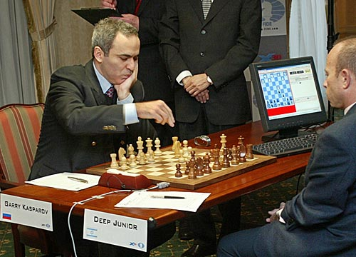
Chess: Kasparov vs. Deep Junior
Deep Junior
8 CPU, 8 GB RAM, Win 2000
2,000,000 pos/sec
Available at $100
August 2, 2003: Match ends in a 3/3 tie!

Slide 63
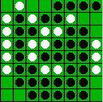
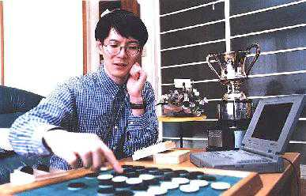
Othello: Murakami vs. Logistello
Takeshi Murakami
World Othello Champion
1997: The Logistello software crushed Murakami
by 6 games to 0

Slide 64
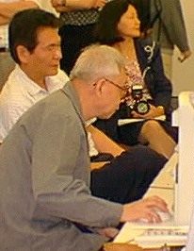
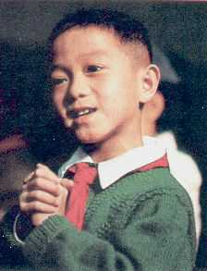
Go: Goemate vs. ??
Name: Chen Zhixing
Profession: Retired
Computer skills:
self-taught programmer
Author of Goemate (arguably the best Go program available today)
Gave Goemate a 9 stone
handicap and still easily
beat the program,
thereby winning $15,000
Jonathan Schaeffer

Slide 65
Go: Goemate vs. ??
Name: Chen Zhixing
Profession: Retired
Computer skills:
self-taught programmer
Author of Goemate (arguably the strongest Go programs)
Go has too high a branching factor for existing search techniques
Current and future software must rely on huge databases and pattern-recognition techniques
Gave Goemate a 9 stone
handicap and still easily
beat the program,
thereby winning $15,000
Jonathan Schaeffer

Slide 66
Secrets
Many game programs are based on alpha-beta + iterative deepening + extended/singular search + transposition tables + huge databases + ...
For instance, Chinook searched all checkers configurations with 8 pieces or less and created an endgame database of 444 billion board configurations
The methods are general, but their implementation is dramatically improved by many specifically tuned-up enhancements (e.g., the evaluation functions) like an F1 racing car

Slide 67
Perspective on Games: Con and Pro
Chess is the Drosophila of artificial intelligence. However, computer chess has developed much as genetics might have if the geneticists had concentrated their efforts starting in 1910 on breeding racing Drosophila. We would have some science, but mainly we would have very fast fruit flies.
John McCarthy
Saying Deep Blue doesn’t really think about chess is like saying an airplane doesn't really fly because it doesn't flap its wings.
Drew McDermott

Slide 68
Other Types of Games
Multi-player games, with alliances or not
Games with randomness in successor function (e.g., rolling a dice)
→ Expectminimax algorithm
Games with partially observable states (e.g., card games)
→ Search of belief state spaces
See R&N p. 175-180

