Slide 1
Making Decisions under Probabilistic Uncertainty
(Where an agent optimizes what it gets on average, but it may get more ... or less )
R&N: Chap. 17, Sect. 17.1–5

Slide 2
General Framework
An agent operates in some given finite state space
No goal state; instead, states provide rewards (positive, negative, or null) that quantify in a single unit system what the agent gets when it visits this state (e.g., a bag of gold, a sunny afternoon on the beach, a speeding ticket, etc...)
Each action has several possible outcomes, each with some probability; sensing may also be imperfect
The agent’s goal is to plan a strategy (here, it is called a policy) to maximize the expected amount of rewards collected

Slide 3
Two Cases
Uncertainty in action only
[The world is fully observable]
Uncertainty in both action and sensing
[The world is partially observable]

Slide 4
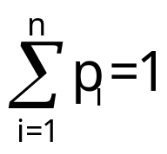
Action Model
Action a:
s ∈ S → a(s) = {s₁ (p₁), s₂ (p₂), ... , s_{n} (p_{n})}
probabilistic distribution
of possible successor states
[ ]
Markov assumption: The action model a(s) does not depend on what happened prior to reaching s

Slide 5
Starting very simple ...
s₀
S₀ describes many actual states of the real world. A₁ reaches s₁ in some states, s₂ in others, and s₃ in the remaining ones
If the agent could return to S₀ many times in independent ways and if at each time it executed A₁, then it would reach s₁ 20% of the times, s₂ 70% of the times, and s₃ 10% of the times
A₁
s₁
s₂
s₃
0.2
0.7
0.1

Slide 6
Introducing rewards ...
s₀
Assume that the agent receives rewards in some states (rewards can be positive or negative)
If the agent could execute A₁ in S₀ many times, the average (expected) reward that it would get is:
U₁(S₀) = 100x0.2 + 50x0.7 + 70x0.1
= 20 + 35 + 7
= 62
A₁
s₁
s₂
s₃
0.2
0.7
0.1
100
50
70 ← rewards associated with
states s₁, s₂, and s₃

Slide 7
... and a second action ...
s₀
U₁(S₀) = 62
U₂(S₀) = 78
If the agent chooses to execute A₂, it will maximize the average collected rewards
A₁
A₂
s₁
s₂
s₃
s₄
0.2
0.7
0.1/0.2 0.8
100
50
70 80

Slide 8
... and action costs
s₀
We may associate costs with actions, which are subtracted from the rewards
U₁(S₀) = 62 – 5 = 57
U₂(S₀) = 78 – 25 = 53
When in s₀, the agent will now gain more on the average by executing A₁ than by executing A₂
A₁
A₂
(5)
(25)
s₁
s₂
s₃
s₄
0.2
0.7
0.1/0.2 0.8
100
50
70 80

Slide 9
A complete (but still very simple) example: Finding Juliet
A robot, Romeo, is in Charles’ office and must deliver a letter to Juliet
Juliet is either in her office, or in the conference room. Each possibility has probability 0.5
Traveling takes 5 minutes between Charles’ and Juliet’s office, 10 minutes between Charles’ or Juliet’s office and the conference room
To perform his duties well and save battery, the robot wants to deliver the letter while minimizing the time spent in transit
Juliet’s off.
5min
Charles’ off.
10min
10min
Conf. room

Slide 10
States and Actions in Finding-Juliet Problem
States:
  S₀: Romeo in Charles’ office
  S₁: Romeo in Juliet’s office and Juliet here
  S₂: Romeo in Juliet’s office and Juliet not here
  S₃: Romeo in conference room and Juliet here
  S₄: Romeo in conference room and Juliet not here
  In this example, S₁ and S₃ are terminal states
Actions:
  GJO (go to Juliet’s office)
  GCR (go to conference room)
  The uncertainty in an action is directly linked to the uncertainty in Juliet’s location

Slide 11
State/Action Tree
s₀
Juliet’s off.
5min
Charles’ off.
10min
GCR
GJO
10min
Conf. room
10
5
s₄
s₃
s₂
s₁
100
100
In this example, only the terminal
states give positive rewards (say, 100)
The cost of each action
(~ negative reward of reached state) is its duration
GJO
GCR
10
10
s₁
s₃
100
100

Slide 12
State/Action Tree
s₀
Juliet’s off.
5min
0
Charles’ off.
10min
GCR
GJO
10min
Conf. room
10
5
s₄
s₃
s₂
s₁
-10
90
-5
95
In this example, only the terminal
states give positive rewards (say, 100)
The cost of each action
(~ negative reward of reached state) is its duration
GJO
GCR
10
10
s₁
s₃
90
90

Slide 13
State/Action Tree
s₀
Juliet’s off.
U(s₀) = max{85, 90}
5min
Charles’ off.
10min
GCR
GJO
10min
Conf. room
10
5
U(s₄) = 80
U(s₂) = 85
s₄
s₃
s₂
s₁
-10
90
-5
95
The computation of U (utility) at each non-terminal node resembles backing up the values of an evaluation function in adversarial search
GJO
GCR
10
10
s₁
s₃
90
90

Slide 14
State/Action Tree
s₀
Juliet’s off.
U(s₀) = max{85, 90}
5min
Charles’ off.
10min
GCR
GJO
10min
Conf. room
10
5
U(s₄) = 80
U(s₂) = 85
s₄
s₃
s₂
s₁
-10
90
-5
95
The computation of U (utility) at each non-terminal node resembles backing up the values of an evaluation function in adversarial search
The best choice in s₀ is to select GJO
GJO
GCR
10
10
s₁
s₃
90
90

Slide 15
Generalization
Inputs:
  Initial state s₀
  Action model
  Reward R(s) collected in each state s
A state is terminal if it has no successor
Starting at s₀, the agent keeps executing actions until it reaches a terminal state
Its goal is to maximize the expected sum of rewards collected (additive rewards)
Assume for a while that the same state can’t be reached twice (no cycles)
[finite state space → finite state/action tree]

Slide 16
Utility of a State
The utility of a state s measures its desirability:
If s is terminal:
U(s) = R(s)
If s is non-terminal:
U(s) = R(s) + max_{a∈Appl(s)}Σ_{s’∈Succ(s,a)}P(s’|a.s)U(s’)
[the reward of s augmented by the expected sum of rewards collected in future states]

Slide 17
U(s) = R(s) + max_{a∈Appl(s)}Σ_{s’∈Succ(s,a)} P(s’|a.s)U(s’)
Appl(s) is the set of all actions applicable to state s
Succ(s,a) is the set of all possible states after applying a to s
P(s’|a.s) is the probability of being in s’ after executing a in s
[the reward of s augmented by the expected
sum of rewards collected in future states]

Slide 18
Utility of a State
The utility of a state s measures its desirability:
If s is terminal:
U(s) = R(s)
If s is non-terminal,
U(s) = R(s) + max_{a∈Appl(s)}Σ_{s’∈Succ(s,a)}P(s’|a.s)U(s’)
[the reward of s augmented by the expected sum of rewards collected in future states]
There is no cycle

Slide 19
U(s) = R(s) + max_{a∈Appl(s)}Σ_{s’∈Succ(s,a)} P(s’|a.s)U(s’)

Slide 20
Utility with Action Costs
U(s) =
R(s) + max_{a∈Appl(s)}[-cost(a) + Σ_{s’∈Succ(s,a)} P(s’|a.s)U(s’)]

Slide 21
Optimal Policy
A policy is a function that maps each state s into the action to execute if s is reached
The optimal policy Π* is the policy that always lead to maximizing the expected sum of rewards collected in future states
(Maximum Expected Utility principle)
Π*(s) = arg max_{a∈Appl(s)}[-cost(a)+Σ_{s’∈Succ(s,a)} P(s’|a.s)U(s’)]
U(s) = R(s) + max_{a∈Appl(s)}[-cost(a) + Σ_{s’∈Succ(s,a)} P(s’|a.s)U(s’)]

Slide 22
Issues
What if the set of states reachable from the initial state is too large to be entirely generated (e.g., there is a time limit)?
How to deal with cycles (states that can be reached multiple times)?

Slide 23
What if the set of states reachable from the initial state is too large to be entirely generated (e.g., there is a time limit)?
  Expand the state/action tree to some depth h
  Estimate the utilities of leaf nodes
  [Reminiscent of evaluation function in game trees]
  Back-up utilities as described before (using estimated utilities at leaf nodes)

Slide 24
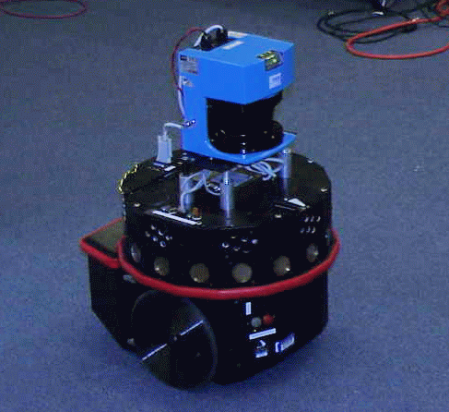
Target-Tracking Example
The robot must keep a target in its field of view
The robot has a prior map of the obstacles
But it does not know the target’s trajectory in advance
robot
target

Slide 25
Target-Tracking Example
Time is discretized into small steps of unit duration
At each time step, each of the two agents moves by at most one increment along a single axis
The two moves are simultaneous
The robot senses the new position of the target at each step
The target is not influenced by the robot (non-adversarial, non-cooperative target)
robot
target

Slide 26
Time-Stamped States
(no cycles possible)
([i,j], [u,v], t)
([i+1,j], [u,v], t+1)
([i+1,j], [u-1,v], t+1)
([i+1,j], [u+1,v], t+1)
([i+1,j], [u,v-1], t+1)
([i+1,j], [u,v+1], t+1)
right
State = (robot-position, target-position, time)
In each state, the robot can execute 5 possible actions :
{stop, up, down, right, left}
Each action has 5 possible outcomes (one for each possible action of the target), with some probability distribution
[Potential collisions are ignored for simplifying the presentation]

Slide 27
Rewards and Costs
The robot must keep seeing the target as long as possible
  Each state where it does not see the target is terminal
  The reward collected in every non-terminal state is 1; it is 0 in each terminal state
  [→ The sum of the rewards collected in an execution run is exactly the amount of time the robot sees the target]
  No cost for moving vs. not moving

Slide 28
Expanding the state/action tree
...
horizon 1
horizon h

Slide 29
Assigning rewards
Terminal states: states where the target is not visible
Rewards: 1 in non-terminal states; 0 in others
But how to estimate the utility of a leaf at horizon h?
...
horizon 1
horizon h

Slide 30
Estimating the utility of a leaf
...
d
robot
target
Compute the shortest distance d for the target to escape the robot’s current field of view
If the maximal velocity v of the target is known, estimate the utility of the state to d/v [conservative estimate]
horizon 1
horizon h

Slide 31
Selecting the next action
Compute the optimal policy over the state/action tree using estimated utilities at leaf nodes
Execute only the first step of this policy
Repeat everything again at t+1… (sliding horizon)
...
Real-time constraint: h is chosen so that a decision can be returned in unit time [A larger h may result in a better decision that will arrive too late !!]
horizon 1
horizon h

Slide 32
Pure Visual Servoing
Notes:
FOR EXAMPLE<
ALWAYS KEEP TARGET AT A FIXED DISTANCE DIRECTLY IN FORNT OF OBSERVER
NOT ENOUGH TO JUST USE PURE SERVOING
KNOW TARGET’S NXT MOVE
AND PLAN MOTION

Slide 33
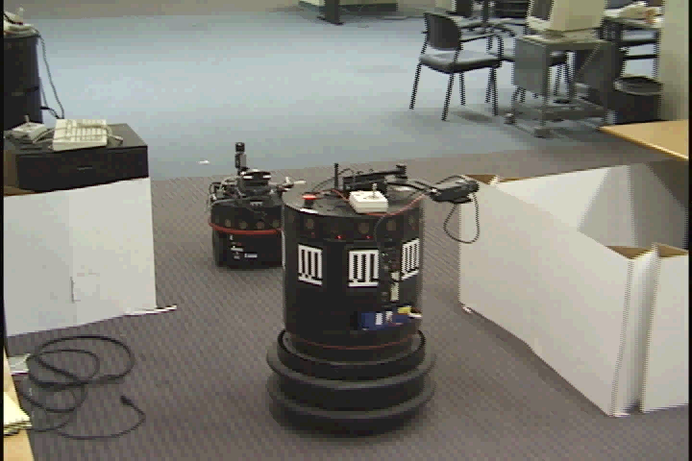
Pure Visual Servoing

Slide 34
Computing and Using a Policy
Notes:
ALSO ANALYSIS FOR TARGET MOTION AND PLAN MOTION

Slide 35
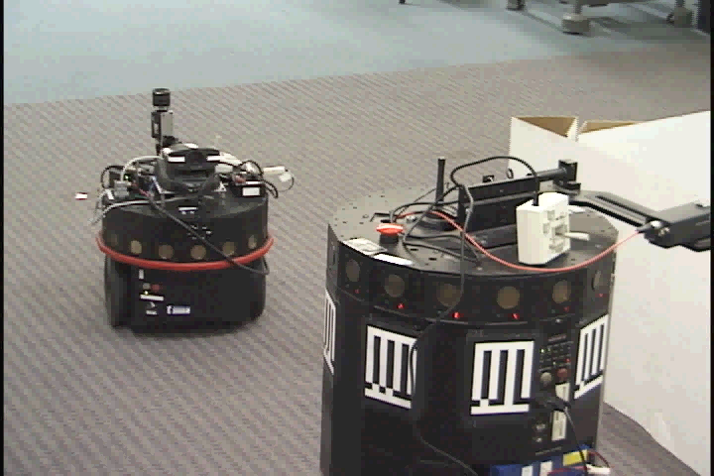
Computing and Using a Policy

Slide 36
In this target-tracking example stamping states by time is a “trick” to avoid cycles
If the probabilistic distribution of the target’s possible moves at each time step does not depend on past history (Markov assumption), then the best move of the robot at each time step should only depend on the robot’s and target’s current positions, not on time
To find this best move, we must remove the time stamp and handle cycles appropriately

Slide 37
Robot Navigation Example
3
square(3,2)
2
1
1
2
3
4
The robot (shown ) lives in a world described by a 4x3 grid of squares with square (2,2) occupied by an obstacle
A state is defined by the square in which the robot is located: (1,1) in the above figure
→ 11 states

Slide 38
Action (Transition) Model
3
U brings the robot to:
(1,2) with probability 0.8
(2,1) with probability 0.1
(1,1) with probability 0.1
2
1
1
2
3
4
In each state, the robot’s possible actions are {U, D, R, L}
For each action:
  With probability 0.8 the robot does the right thing (moves up, down, right, or left by one square)
  With probability 0.1 it moves in a direction perpendicular to the intended one
  If the robot can’t move, it stays in the same square
[This model satisfies the Markov condition]

Slide 39
Action (Transition) Model
3
L brings the robot to:
(1,1) with probability 0.8 + 0.1 = 0.9
(1,2) with probability 0.1
2
1
1
2
3
4
In each state, the robot’s possible actions are {U, D, R, L}
For each action:
  With probability 0.8 the robot does the right thing (moves up, down, right, or left by one square)
  With probability 0.1 it moves in a direction perpendicular to the intended one
  If the robot can’t move, it stays in the same square
[This model satisfies the Markov condition]

Slide 40
Terminal States, Rewards, and Costs
-.04
-.04
-.04
+1
3
-.04
-.04
-1
2
1
-.04
-.04
-.04
-.04
1
2
3
4
Two terminal states: (4,2) and (4,3)
Rewards:
  R(4,3) = +1 [The robot finds gold]
  R(4,2) = -1 [The robot gets trapped in quick sands]
  R(s) = -0.04 in all other states
Actions have zero cost
[actually, they are encoded in the negative rewards of non-terminal states]

Slide 41
State Utilities
0.81
0.87
0.92
+1
3
0.76
0.66
-1
2
1
0.71
0.66
0.61
0.39
1
2
3
4
The utility of a state s is the maximal expected amount of reward that the robot will collect from s and future states by executing some action in each encountered state, until it reaches a terminal state (infinite horizon)
Under the Markov and infinite horizon assumptions, the utility of s is independent of when and how s is reached
[It only depends on the possible sequences of states after s, not on the possible sequences before s]

Slide 42
(Stationary) Policy
+1
+1
3
3
-1
-1
2
2
1
1
1
2
3
4
1
2
3
4
A stationary policy is a complete map Π: state → action
For each non-terminal state it recommends an action, independent of when and how the state is reached
Under the Markov and infinite horizon assumptions, the optimal policy Π* is necessarily a stationary policy
[The best action in a state does not depends on the past]

Slide 43
(Stationary) Policy
+1
+1
3
3
-1
-1
2
2
1
1
1
2
3
4
1
2
3
4
A stationary policy is a complete map Π: state → action
For each non-terminal state it recommends an action, independent of when and how the state is reached
Under the Markov and infinite horizon assumptions, the optimal policy Π* is necessarily a stationary policy
[The best action in a state does not depends on the past]
Finding Π* is called an observable Markov Decision Problem (MDP)
The optimal policy tries to avoid
“dangerous” state (3,2)

Slide 44
Execution of Optimal Policy
Repeat:
s ← sensed state
If s is terminal then exit
a ← Π*(s)
Perform a
(Reactive agent algorithm)
+1
3
-1
2
1
1
2
3
4
Let the robot executes Π* many times from the same state s
Each run produces a sequence of states with some probability
Each possible sequence collects a certain amount of reward
The utility of s is the average amount of reward collected over the successive executions of Π*
It is maximal over all policies

Slide 45
Optimal Policies for Various R(s)
+1
+1
-1
-1
R(s) = -0.04
R(s) = -2
+1
+1
-1
-1
R(s) = -0.01
R(s) > 0

Slide 46
Defining Equations
+1
3
-1
2
1
1
2
3
4
If s is terminal:
U(s) = R(s)
If s is non-terminal:
U(s) = R(s) + max_{a∈Appl(s)}Σ_{s’∈Succ(s,a)}P(s’|a.s)U(s’)
[Bellman equation]
Π*(s) = arg max_{a∈Appl(s)}Σ_{s’∈Succ(s,a)}P(s’|a.s)U(s’)

Slide 47
Defining Equations
+1
3
The utility of s depends on
the utility of other states s’
(possibly, including s), and
vice versa
-1
2
1
1
2
3
4
If s is terminal:
U(s) = R(s)
If s is non-terminal:
U(s) = R(s) + max_{a∈Appl(s)}Σ_{s’∈Succ(s,a)}P(s’|a.s)U(s’)
[Bellman equation]
Π*(s) = arg max_{a∈Appl(s)}Σ_{s’∈Succ(s,a)}P(s’|a.s)U(s’)
The equations
are non-linear

Slide 48
Value Iteration Algorithm
0
0
0
+1
0.81
0.87
0.92
+1
3
3
0
0
-1
0.76
0.66
-1
2
2
1
0
0
0
0
1
0.71
0.66
0.61
0.39
1
2
3
4
1
2
3
4
Initialize the utility of each non-terminal states to U₀(s) = 0
For t = 0, 1, 2, ... do
U_{t+1}(s) = R(s) + max_{a∈Appl(s)}Σ_{s’∈Succ(s,a)}P(s’|a.s)U_{t}(s’)
for each non-terminal state s

Slide 49
Value Iteration Algorithm
0.81
0.87
0.92
+1
+1
3
3
0.76
0.66
-1
-1
2
2
1
0.71
0.66
0.61
0.39
1
1
2
3
4
1
2
3
4
Initialize the utility of each non-terminal states to U₀(s) = 0
For t = 0, 1, 2, ... do
U_{t+1}(s) = R(s) + max_{a∈Appl(s)}Σ_{s’∈Succ(s,a)}P(s’|a.s)U_{t}(s’)
for each non-terminal state s
For each non-terminal state s do
Π*(s) = arg max_{a∈Appl(s)}Σ_{s’∈Succ(s,a)}P(s’|a.s)U(s’)

Slide 50
Value Iteration Algorithm
0.81
0.87
0.92
+1
+1
3
3
0.76
0.66
-1
-1
Value iteration is essentially the same as computing the best move from each state using a state/action tree expanded to a large depth h (with estimated utilities of the non-terminal leaf nodes set to 0)
By doing the computation for all states simultaneously, it avoids much redundant computation
2
2
1
0.71
0.66
0.61
0.39
1
1
2
3
4
1
2
3
4
Initialize the utility of each non-terminal states to U₀(s) = 0
For t = 1, 2, ... do
U_{t+1}(s) = R(s) + max_{a∈Appl(s)}Σ_{s’∈Succ(s,a)}P(s’|a.s)U_{t}(s’)
for each non-terminal state s
For each non-terminal state s do
Π*(s) = arg max_{a∈Appl(s)}Σ_{s’∈Succ(s,a)}P(s’|a.s)U(s’)

Slide 51
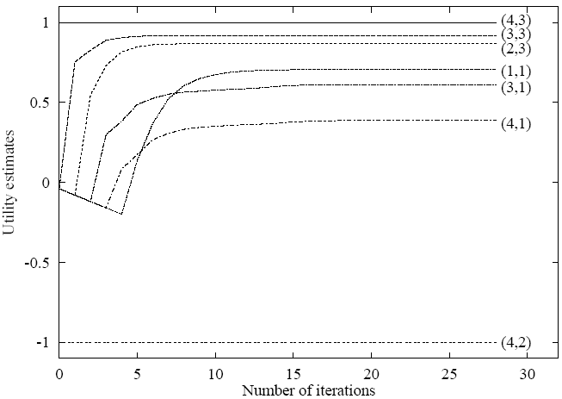
Convergence of Value Iteration
0.81
0.87
0.92
+1
3
0.76
0.66
-1
2
1
0.71
0.66
0.61
0.39
1
2
3
4

Slide 52
Convergence of Value Iteration
If:
  The number of states is finite
  There exists at least one terminal state that gives a positive reward and is reachable with non-zero probability from every other non-terminal state (connectivity of the state space)
  R(s) ≤ 0 at every non-terminal state
  The cost of every action is ≥ 0
Then value iteration converges toward an optimal policy if we wait long enough
But what if the above conditions are not verified? [E.g., “taxi-driver” example, where there is no terminal state]

Slide 53
Discount Factor
Idea: Prefer short-term rewards over long-term ones
If the execution of a policy from a state s₀ produces the sequence s₀, s₁, ..., s_{n} of states, then the amount of collected reward is
R(s₀) + γR(s₁) + ... + γ^{n}R(s_{n}) = Σ_{i=0,...,n} γ^{i}R(s_{i})
where 0 < γ < 1 is a constant called the discount factor
The defining equation of the utilities becomes:
U(s) = R(s) + γ max_{a∈Appl(s)}Σ_{s’∈Succ(s,a)}P(s’|a.s)U (s’)
Using a discount factor guarantees the convergence of V.I. in finite state spaces, even if there is no terminal states and reward/cost values for each state/action are arbitrary (but finite) [Intuition: The nodes in the state/action tree get less and less important as we go deeper in the tree]
In addition, using discount factor provides a convenient test to terminate V.I.(see R&N, p 621-623)

Slide 54
Remarks
Value iteration may give the optimal policy Π* long before the utility values have converged
There is only a finite number of possible policies
→ Policy iteration algorithm

Slide 55
Policy Iteration Algorithm
Pick any policy Π
changed? ← true
Repeat until ¬changed?
  [Policy evaluation] Solve the linear system
  U_{Π}(s) = R(s) + γ Σ_{s’∈Succ(s,Π(s))}P(s’|Π(s).s)U_{Π}(s’)
  changed? ← false
  [Policy improvement] For each state s do
    If max_{a∈Appl(s)}Σ_{s’∈Succ(s,a)}P(s’|a.s)U_{Π}(s’) >
    Σ_{s’∈Succ(s,Π(s))}P(s’|a.s)U_{Π}(s’)
    then
        Π(s) ← arg max_{a∈Appl(s)}Σ_{s’∈Succ(s,a)}P(s’|a.s)U_{Π}(s’)
        changed? ← true
If ¬changed? then return Π
often a sparse one

Slide 56
Finite vs. Infinite Horizon
If the agent must maximize the expected amount of collected award within a maximum number of steps h (finite horizon), the optimal policy is no longer stationary
→ We stamp states by time (step number)
just as in the target-tracking example
We compute the optimal policy over the
state/action tree expanded to depth h, in
which all leaf states are now terminal
[E.g., taxi driver at the end of his/her work day]

