Slide 1
Belief Networks
Russell and Norvig: Chapter 15
CS121 – Winter 2002

Slide 2
Other Names
Bayesian networks
Probabilistic networks
Causal networks

Slide 3
Probabilistic Agent
sensors
?
environment
agent
actuators
I believe that the sun
will still exist tomorrow
with probability 0.999999
and that it will be a sunny
with probability 0.6

Slide 4
Probabilistic Belief
There are several possible worlds that are
indistinguishable to an agent given some prior
evidence.
The agent believes that a logic sentence B is True with probability p and False with probability 1-p. B is called a belief
In the frequency interpretation of probabilities, this means that the agent believes that the fraction of possible worlds that satisfy B is p
The distribution (p,1-p) is the strength of B

Slide 5
Problem
At a certain time t, the KB of an agent is some collection of beliefs
At time t the agent’s sensors make an observation that changes the strength of one of its beliefs
How should the agent update the strength of its other beliefs?

Slide 6
Toothache Example
A certain dentist is only interested in two things about any patient, whether he has a toothache and whether he has a cavity
Over years of practice, she has constructed the following joint distribution:
 | Toothache | ¬Toothache
Cavity | 0.04 | 0.06
¬Cavity | 0.01 | 0.89

Slide 7
Toothache Example
 | Toothache | ¬Toothache
Cavity | 0.04 | 0.06
¬Cavity | 0.01 | 0.89
Using the joint distribution, the dentist can compute the strength of any logic sentence built with the proposition Toothache and Cavity
In particular, this distribution implies that
the prior probability of Toothache is 0.05
P(T) = P((T∧C)v(T∧¬C)) = P(T∧C) + P(T∧¬C)

Slide 8
New Evidence
 | Toothache | ¬Toothache
Cavity | 0.04 | 0.06
¬Cavity | 0.01 | 0.89
She now makes an observation E that indicates that a specific patient x has high probability (0.8) of having a toothache, but is not directly related to whether he has a cavity

Slide 9
Adjusting Joint Distribution
 | Toothache|E | ¬Toothache|E
Cavity|E | 0.04 | 0.06
¬Cavity|E | 0.01 | 0.89
 | 0.64 | 0.0126
 | 0.16 | 0.1874
She now makes an observation E that indicates that a specific patient x has high probability (0.8) of having a toothache, but is not directly related to whether he has a cavity
She can use this additional information to create a joint distribution (specific for x) conditional to E, by keeping the same probability ratios between Cavity and ¬Cavity
The probability of Cavity that was
0.01 is now (knowing E) 0.6526

Slide 10
Corresponding Calculus
 | Toothache | ¬Toothache
Cavity | 0.04 | 0.06
¬Cavity | 0.01 | 0.89
P(C|T) = P(C∧T)/P(T) = 0.04/0.05

Slide 11
Corresponding Calculus
 | Toothache|E | ¬Toothache|E
Cavity|E | 0.04 | 0.06
¬Cavity|E | 0.01 | 0.89
P(C|T) = P(C∧T)/P(T) = 0.04/0.05
P(C∧T|E) = P(C|T,E) P(T|E)
= P(C|T) P(T|E)
C and E are
independent given T

Slide 12
Corresponding Calculus
 | Toothache|E | ¬Toothache|E
Cavity|E | 0.04 | 0.06
¬Cavity|E | 0.01 | 0.89
 | 0.64 | 0.0126
 | 0.16 | 0.1874
P(C|T) = P(C∧T)/P(T) = 0.04/0.05
P(C∧T|E) = P(C|T,E) P(T|E)
= P(C|T) P(T|E)
= (0.04/0.05)0.8
= 0.64

Slide 13
Generalization
n beliefs X1,…,Xn
The joint distribution can be used to update probabilities when new evidence arrives
But:
The joint distribution contains 2^{n} probabilities
Useful independence is not made explicit
If the dentist knows that the patient has
a cavity (C), the probability of a probe
catching in the tooth (K) does not depend
on the presence of a toothache (T).
More formally:
P(T|C,K) = P(T|C) and P(K|C,T) = P(K|C)
Cavity
Toothache
Catch

Slide 14
Purpose of Belief Networks
Facilitate the description of a collection of beliefs by making explicit causality relations and conditional independence among beliefs
Provide a more efficient way (than by sing joint distribution tables) to update belief strengths when new evidence is observed

Slide 15
Alarm Example
Five beliefs
A: Alarm
B: Burglary
E: Earthquake
J: JohnCalls
M: MaryCalls

Slide 16
A Simple Belief Network
Burglary
Earthquake
causes
Intuitive meaning of arrow
from x to y: “x has direct
influence on y”
Alarm
Directed acyclic
graph (DAG)
effects
Nodes are beliefs
JohnCalls
MaryCalls

Slide 17
Assigning Probabilities to Roots
Burglary
P(B)
0.001
Earthquake
P(E)
0.002
Alarm
JohnCalls
MaryCalls

Slide 18
Conditional Probability Tables
Burglary
P(B)
0.001
Earthquake
P(E)
0.002
B | E | P(A|…)
TTFF | TFTF | 0.95 0.94 0.29 0.001
Alarm
Size of the CPT for a
node with k parents: 2^{k}
JohnCalls
MaryCalls

Slide 19
Conditional Probability Tables
Burglary
P(B)
0.001
Earthquake
P(E)
0.002
B | E | P(A|…)
TTFF | TFTF | 0.95 0.94 0.29 0.001
Alarm
JohnCalls
A | P(J|…)
TF | 0.90 0.05
MaryCalls
A | P(M|…)
TF | 0.70 0.01

Slide 20
What the BN Means
Burglary
P(B)
0.001
Earthquake
P(E)
0.002
B | E | P(A|…)
TTFF | TFTF | 0.95 0.94 0.29 0.001
Alarm
P(x1,x2,…,xn) = Π_{i=1,…,n}P(xi|Parents(Xi))
JohnCalls
A | P(J|…)
TF | 0.90 0.05
MaryCalls
A | P(M|…)
TF | 0.70 0.01

Slide 21
Calculation of Joint Probability
Burglary
P(B)
0.001
Earthquake
P(E)
0.002
B | E | P(A|…)
TTFF | TFTF | 0.95 0.94 0.29 0.001
P(J∧M∧A∧¬B∧¬E)
= P(J|A)P(M|A)P(A|¬B,¬E)P(¬B)P(¬E)
= 0.9 x 0.7 x 0.001 x 0.999 x 0.998
= 0.00062
Alarm
JohnCalls
A | P(J|…)
TF | 0.90 0.05
MaryCalls
A | P(M|…)
TF | 0.70 0.01

Slide 22
What The BN Encodes
Burglary
Earthquake
Alarm
For example, John does
not observe any burglaries
directly
JohnCalls
MaryCalls
Each of the beliefs JohnCalls and MaryCalls is independent of Burglary and Earthquake given Alarm or ¬Alarm
The beliefs JohnCalls and MaryCalls are independent given Alarm or ¬Alarm

Slide 23
What The BN Encodes
Burglary
Earthquake
For instance, the reasons why
John and Mary may not call if
there is an alarm are unrelated
Alarm
JohnCalls
MaryCalls
Each of the beliefs JohnCalls and MaryCalls is independent of Burglary and Earthquake given Alarm or ¬Alarm
The beliefs JohnCalls and MaryCalls are independent given Alarm or ¬Alarm
Note that these reasons could
be other beliefs in the network.
The probabilities summarize these
non-explicit beliefs

Slide 24
Structure of BN
The relation:
P(x1,x2,…,xn) = Π_{i=1,…,n}P(xi|Parents(Xi))
means that each belief is independent of its predecessors in the BN given its parents
Said otherwise, the parents of a belief Xi are all the beliefs that “directly influence” Xi
Usually (but not always) the parents of Xi are its causes and Xi is the effect of these causes
E.g., JohnCalls is influenced by Burglary, but not
directly. JohnCalls is directly influenced by Alarm

Slide 25
Construction of BN
Choose the relevant sentences (random variables) that describe the domain
Select an ordering X1,…,Xn, so that all the beliefs that directly influence Xi are before Xi
For j=1,…,n do:
  Add a node in the network labeled by Xj
  Connect the node of its parents to Xj
  Define the CPT of Xj
The ordering guarantees that the BN
will have no cycles
The CPT guarantees that exactly the
correct number of probabilities will
be defined: no missing, no extra
Use canonical distribution,
e.g., noisy-OR, to fill CPT’s

Slide 26
Locally Structured Domain
Size of CPT: 2^{k}, where k is the number of parents
In a locally structured domain, each belief is directly influenced by relatively few other beliefs and k is small
BN are better suited for locally structured domains

Slide 27
Inference In BN
P(X|obs) = Σe P(X|e) P(e|obs) where e is an
assignment of values to the evidence variables
Set E of evidence variables that are observed with new probability distribution, e.g., {JohnCalls,MaryCalls}
Query variable X, e.g., Burglary, for which we would like to know the posterior probability distribution P(X|E)
Note compactness
of notation!
J
M
P(B|…)
TTFF
TFTF
?
?
?
?
Distribution conditional to
the observations made

Slide 28
Inference Patterns
Burglary
Earthquake
Burglary
Earthquake
Basic use of a BN: Given new
observations, compute the new
strengths of some (or all) beliefs
Alarm
Diagnostic
Alarm
Causal
JohnCalls
MaryCalls
JohnCalls
MaryCalls
Other use: Given the strength of
a belief, which observation should
we gather to make the greatest
change in this belief’s strength
Burglary
Earthquake
Burglary
Earthquake
Alarm
Intercausal
Alarm
Mixed
JohnCalls
MaryCalls
JohnCalls
MaryCalls

Slide 29
Singly Connected BN
A BN is singly connected if there is at most one undirected path between any two nodes
Burglary
Earthquake
is singly connected
is singly connected
Alarm
is not singly connected
JohnCalls
MaryCalls

Slide 30
Types Of Nodes On A Path
diverging
Battery
linear
Radio
SparkPlugs
Gas
Starts
converging
Moves

Slide 31
Independence Relations In BN
diverging
Battery
linear
Radio
SparkPlugs
Gas
Given a set E of evidence nodes, two beliefs
connected by an undirected path are
independent if one of the following three
conditions holds:
1. A node on the path is linear and in E
2. A node on the path is diverging and in E
3. A node on the path is converging and
neither this node, nor any descendant is in E
Starts
converging
Moves

Slide 32
Independence Relations In BN
diverging
Battery
linear
Radio
SparkPlugs
Gas
Given a set E of evidence nodes, two beliefs
connected by an undirected path are
independent if one of the following three
conditions holds:
1. A node on the path is linear and in E
2. A node on the path is diverging and in E
3. A node on the path is converging and
neither this node, nor any descendant is in E
Starts
converging
Gas and Radio are independent
given evidence on SparkPlugs
Moves

Slide 33
Independence Relations In BN
diverging
Battery
linear
Radio
SparkPlugs
Gas
Given a set E of evidence nodes, two beliefs
connected by an undirected path are
independent if one of the following three
conditions holds:
1. A node on the path is linear and in E
2. A node on the path is diverging and in E
3. A node on the path is converging and
neither this node, nor any descendant is in E
Gas and Radio are independent
given evidence on Battery
Starts
converging
Moves

Slide 34
Independence Relations In BN
diverging
Battery
linear
Radio
SparkPlugs
Gas
Given a set E of evidence nodes, two beliefs
connected by an undirected path are
independent if one of the following three
conditions holds:
1. A node on the path is linear and in E
2. A node on the path is diverging and in E
3. A node on the path is converging and
neither this node, nor any descendant is in E
Gas and Radio are independent
given no evidence, but they are
dependent given evidence on
Starts or Moves
Starts
converging
Moves

Slide 35
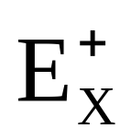
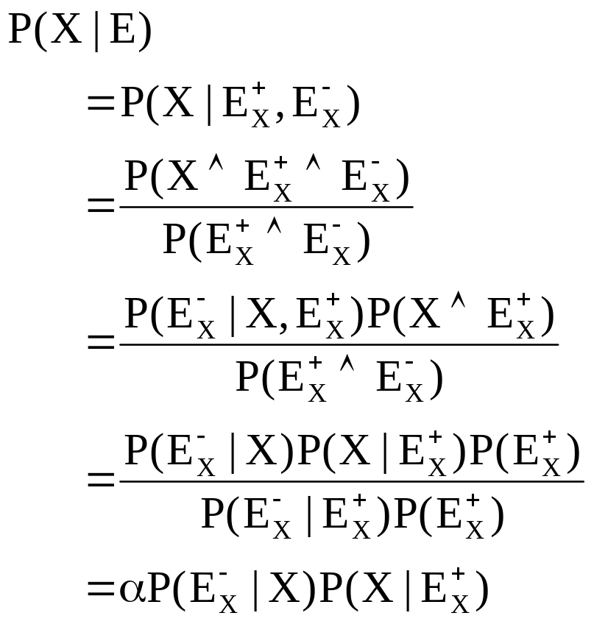
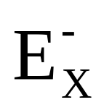
Answering Query P(X|E)
U1
Um
...
X
Y1
...
Yp

Slide 36
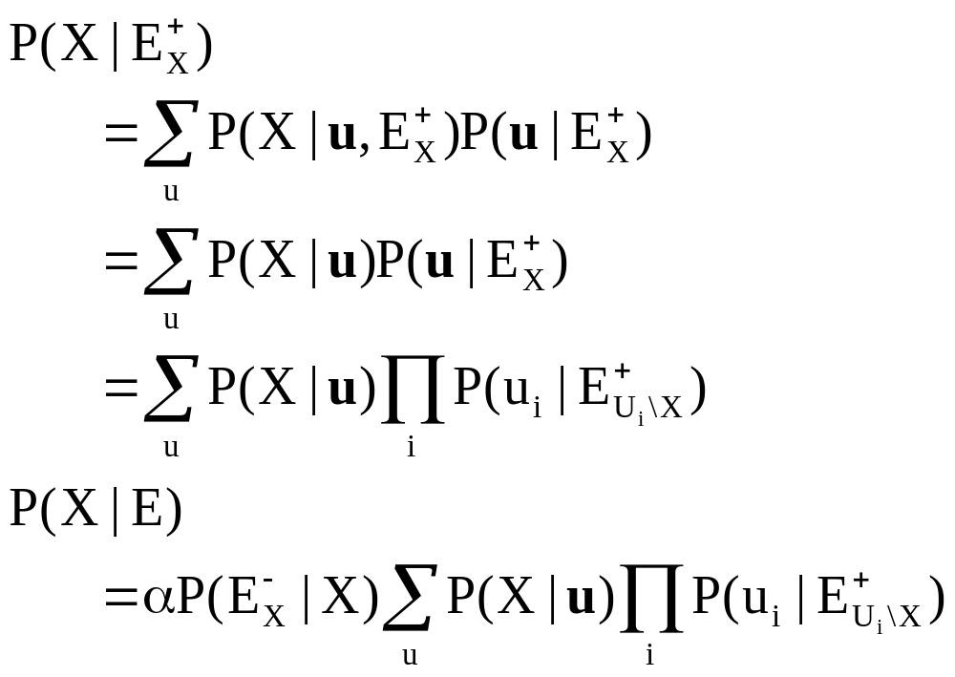
Computing P(X|E⁺)
X
Recursion ends when
reaching an evidence,
a root, or a leaf node
U1
Um
...
Recursive
back-chaining
algorithm
Given by the CPT
of node X
X
Y1
...
Yp
Same problem
on a subset of
the BN

Slide 37
Example: Sonia’s Office
O: Sonia is in her office
L: Lights are on in Sonia’s office
C: Sonia is logged on to her computer
O
P(O)
0.4
O
P(L|O)
O
P(C|O)
TF
0.6
0.1
L
C
TF
0.8
0.3
We observe L=True
What is the probability of C given this observation?
--> Compute P(C|L=T)

Slide 38
Example: Sonia’s Office
O
P(O)
0.4
O
P(L|O)
O
P(C|O)
TF
0.6
0.1
L
C
TF
0.8
0.3
P(C|L=T)

Slide 39
Example: Sonia’s Office
O
P(O)
0.4
O
P(L|O)
O
P(C|O)
TF
0.6
0.1
L
C
TF
0.8
0.3
P(C|L=T)
= P(C|O=T) P(O=T|L=T)
+ P(C|O=F) P(O=F|L=T)

Slide 40
Example: Sonia’s Office
O
P(O)
0.4
O
P(L|O)
O
P(C|O)
TF
0.6
0.1
L
C
TF
0.8
0.3
P(C|L=T)
= P(C|O=T) P(O=T|L=T)
+ P(C|O=F) P(O=F|L=T)
P(O|L) = P(O∧L) / P(L)
= P(L|O)P(O) / P(L)

Slide 41
Example: Sonia’s Office
O
P(O)
0.4
O
P(L|O)
O
P(C|O)
TF
0.6
0.1
L
C
TF
0.8
0.3
P(C|L=T)
= P(C|O=T) P(O=T|L=T)
+ P(C|O=F) P(O=F|L=T)
P(O|L) = P(O∧L) / P(L)
= P(L|O)P(O) / P(L)
P(O=T|L=T) = 0.24/P(L)
P(O=F|L=T) = 0.06/P(L)

Slide 42
Example: Sonia’s Office
O
P(O)
0.4
O
P(L|O)
O
P(C|O)
TF
0.6
0.1
L
C
TF
0.8
0.3
P(C|L=T)
= P(C|O=T) P(O=T|L=T)
+ P(C|O=F) P(O=F|L=T)
P(O|L) = P(O∧L) / P(L)
= P(L|O)P(O) / P(L)
P(O=T|L=T) = 0.24/P(L) = 0.8
P(O=F|L=T) = 0.06/P(L) = 0.2

Slide 43
Example: Sonia’s Office
O
P(O)
0.4
O
P(L|O)
O
P(C|O)
TF
0.6
0.1
L
C
TF
0.8
0.3
P(C|L=T)
= P(C|O=T) P(O=T|L=T)
+ P(C|O=F) P(O=F|L=T)
P(O|L) = P(O∧L) / P(L)
= P(L|O)P(O) / P(L)
P(O=T|L=T) = 0.24/P(L) = 0.8
P(O=F|L=T) = 0.06/P(L) = 0.2
P(C|L=T) = 0.8x0.8 + 0.3x0.2
P(C|L=T) = 0.7

Slide 44
Complexity
The back-chaining algorithm considers each node at most once
It takes linear time in the number of beliefs
But it computes P(X|E) for only one X
Repeating the computation for every belief takes quadratic time
By forward-chaining from E and clever bookkeeping, P(X|E) can be computed for all X in linear time
If successive observations are made over time,
the forward-chaining update is invoked after
every new observation

Slide 45
Multiply-Connected BN
E
To update the probability
of D given some evidence
E, we need to know how
both B and C depend on E
A
B
C
“Solution”:
D
A
But this solution takes exponential
time in the worst-case
In fact, inference with
multiply-connected BN is NP-hard
B,C
D

Slide 46
Stochastic Simulation
Cloudy
P(WetGrass|Cloudy)?
P(WetGrass|Cloudy)
= P(WetGrass ∧ Cloudy) / P(Cloudy)
Sprinkler
Rain
1. Repeat N times:
1.1. Guess Cloudy at random
1.2. For each guess of Cloudy, guess
Sprinkler and Rain, then WetGrass
2. Compute the ratio of the # runs where
WetGrass and Cloudy are True
over the # runs where Cloudy is True
WetGrass

Slide 47

Applications
http://excalibur.brc.uconn.edu/~baynet/researchApps.html
Medical diagnosis, e.g., lymph-node deseases
Fraud/uncollectible debt detection
Troubleshooting of hardware/software systems

Slide 48
Summary
Belief update
Role of conditional independence
Belief networks
Causality ordering
Inference in BN
Back-chaining for singly-connected BN
Stochastic Simulation

