Slide 1
Inductive Learning (1/2)
Decision Tree Method
(If it’s not simple, it’s not worth learning it)
R&N: Chap. 18, Sect. 18.1–3

Slide 2
Motivation
An AI agent operating in a complex world requires an awful lot of knowledge: state representations, state axioms, constraints, action descriptions, heuristics, probabilities, ...
More and more, AI agents are designed to acquire knowledge through learning

Slide 3
What is Learning?
Mostly generalization from experience:
“Our experience of the world is specific,
yet we are able to formulate general
theories that account for the past and
predict the future”
M.R. Genesereth and N.J. Nilsson,
in Logical Foundations of AI, 1987
→ Concepts, heuristics, policies
Supervised vs. un-supervised learning

Slide 4
Contents
Introduction to inductive learning
Logic-based inductive learning:
  Decision-tree induction
Function-based inductive learning
  Neural nets

Slide 5
Logic-Based Inductive Learning
Background knowledge KB
Training set D (observed knowledge)
that is not logically implied by KB
Inductive inference:
Find h such that KB and h imply D
h = D is a trivial, but
un-interesting solution
(data caching)

Slide 6

Rewarded Card Example
Deck of cards, with each card designated by [r,s], its rank and suit, and some cards “rewarded”
Background knowledge KB:
((r=1) v … v (r=10)) ⇔ NUM(r)
((r=J) v (r=Q) v (r=K)) ⇔ FACE(r)
((s=S) v (s=C)) ⇔ BLACK(s)
((s=D) v (s=H)) ⇔ RED(s)
Training set D:
REWARD([4,C]) ∧ REWARD([7,C]) ∧ REWARD([2,S]) ∧
¬REWARD([5,H]) ∧ ¬REWARD([J,S])

Slide 7
Rewarded Card Example
Deck of cards, with each card designated by [r,s], its rank and suit, and some cards “rewarded”
Background knowledge KB:
((r=1) v … v (r=10)) ⇔ NUM(r)
((r=J) v (r=Q) v (r=K)) ⇔ FACE(r)
((s=S) v (s=C)) ⇔ BLACK(s)
((s=D) v (s=H)) ⇔ RED(s)
Training set D:
REWARD([4,C]) ∧ REWARD([7,C]) ∧ REWARD([2,S]) ∧
¬REWARD([5,H]) ∧ ¬REWARD([J,S])
Possible inductive hypothesis:
h ≡ (NUM(r) ∧ BLACK(s) ⇔ REWARD([r,s]))
There are several possible
inductive hypotheses

Slide 8
Learning a Predicate
(Concept Classifier)
Set E of objects (e.g., cards)
Goal predicate CONCEPT(x), where x is an object in E, that takes the value True or False (e.g., REWARD)
Example:
CONCEPT describes the precondition of an action, e.g.,
Unstack(C,A)
E is the set of states
CONCEPT(x) ⇔
HANDEMPTY∈x, BLOCK(C) ∈x, BLOCK(A) ∈x,
CLEAR(C) ∈x, ON(C,A) ∈x
Learning CONCEPT is a step toward learning an action
description

Slide 9
Learning a Predicate
(Concept Classifier)
Set E of objects (e.g., cards)
Goal predicate CONCEPT(x), where x is an object in E, that takes the value True or False (e.g., REWARD)
Observable predicates A(x), B(X), … (e.g., NUM, RED)
Training set: values of CONCEPT for some combinations of values of the observable predicates

Slide 10
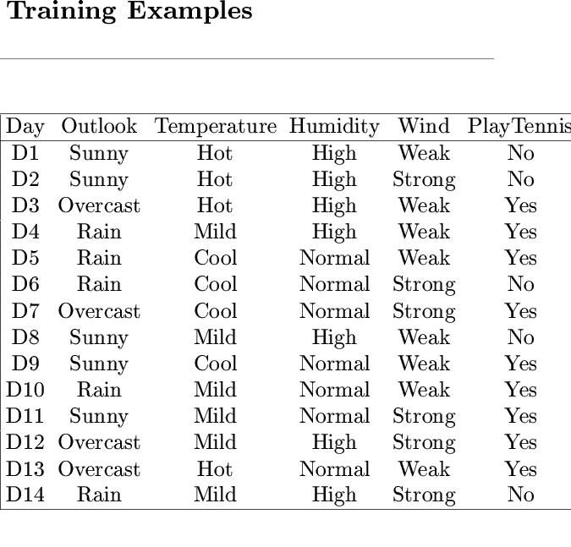
Example of Training Set

Slide 11
Example of Training Set
Ternary attributes
Goal predicate is PLAY-TENNIS
Note that the training set does not say whether
an observable predicate is pertinent or not

Slide 12
Learning a Predicate
(Concept Classifier)
Set E of objects (e.g., cards)
Goal predicate CONCEPT(x), where x is an object in E, that takes the value True or False (e.g., REWARD)
Observable predicates A(x), B(X), … (e.g., NUM, RED)
Training set: values of CONCEPT for some combinations of values of the observable predicates
Find a representation of CONCEPT in the form:
CONCEPT(x) ⇔ S(A,B, …)
where S(A,B,…) is a sentence built with the observable predicates, e.g.:
CONCEPT(x) ⇔ A(x) ∧ (¬B(x) v C(x))

Slide 13
Learning an Arch Classifier
These objects are arches:
(positive examples)
These aren’t:
(negative examples)
ARCH(x) ⇔ HAS-PART(x,b1) ∧ HAS-PART(x,b2) ∧
HAS-PART(x,b3) ∧ IS-A(b1,BRICK) ∧
IS-A(b2,BRICK) ∧ ¬MEET(b1,b2) ∧
(IS-A(b3,BRICK) v IS-A(b3,WEDGE)) ∧
SUPPORTED(b3,b1) ∧ SUPPORTED(b3,b2)

Slide 14
Example set
An example consists of the values of CONCEPT and the observable predicates for some object x
A example is positive if CONCEPT is True, else it is negative
The set X of all examples is the example set
The training set is a subset of X
a small one!

Slide 15
Hypothesis Space
An hypothesis is any sentence of the form:
CONCEPT(x) ⇔ S(A,B, …)
where S(A,B,…) is a sentence built using the observable predicates
The set of all hypotheses is called the hypothesis space H
An hypothesis h agrees with an example if it gives the correct value of CONCEPT

Slide 16
Inductive Learning Scheme
Inductive
hypothesis h
Training set D
-
-
-
+
+
-
-
-
-
+
+
+
+
-
-
+
+
+
+
-
-
-
+
+
Example set X
{[A, B, …, CONCEPT]}
Hypothesis space H
{[CONCEPT(x) ⇔ S(A,B, …)]}

Slide 17
Size of Hypothesis Space
n observable predicates
2^{n} entries in truth table defining
CONCEPT and each entry can be filled with True or False
In the absence of any restriction (bias), there are hypotheses to choose from
n = 6 → 2x10¹⁹ hypotheses!
2^{n}
2

Slide 18
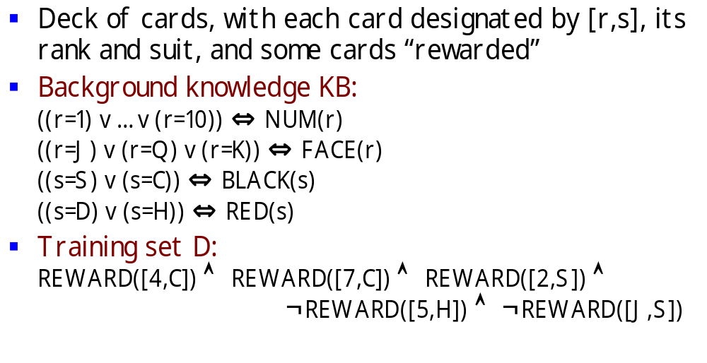
Multiple Inductive Hypotheses
h₁ ≡ NUM(r) ∧ BLACK(s) ⇔ REWARD([r,s])
h₂ ≡ BLACK(s) ∧ ¬(r=J) ⇔ REWARD([r,s])
h₃ ≡ ([r,s]=[4,C]) ∨ ([r,s]=[7,C]) ∨ [r,s]=[2,S])
⇔ REWARD([r,s])
h₄ ≡ ¬([r,s]=[5,H]) ∨ ¬([r,s]=[J,S]) ⇔ REWARD([r,s])
agree with all the examples in the training set

Slide 19
Multiple Inductive Hypotheses
Need for a system of preferences – called
a bias – to compare possible hypotheses
h₁ ≡ NUM(r) ∧ BLACK(s) ⇔ REWARD([r,s])
h₂ ≡ BLACK(s) ∧ ¬(r=J) ⇔ REWARD([r,s])
h₃ ≡ ([r,s]=[4,C]) ∨ ([r,s]=[7,C]) ∨ [r,s]=[2,S])
⇔ REWARD([r,s])
h₄ ≡ ¬([r,s]=[5,H]) ∨ ¬([r,s]=[J,S]) ⇔ REWARD([r,s])
agree with all the examples in the training set

Slide 20
Notion of Capacity
It refers to the ability of a machine to learn any training set without error
A machine with too much capacity is like a botanist with photographic memory who, when presented with a new tree, concludes that it is not a tree because it has a different number of leaves from anything he has seen before
A machine with too little capacity is like the botanist’s lazy brother, who declares that if it’s green, it’s a tree
Good generalization can only be achieved when the right balance is struck between the accuracy attained on the training set and the capacity of the machine

Slide 21
→ Keep-It-Simple (KIS) Bias
Examples
  Use much fewer observable predicates than the training set
  Constrain the learnt predicate, e.g., to use only “high-level” observable predicates such as NUM, FACE, BLACK, and RED and/or to have simple syntax
Motivation
  If an hypothesis is too complex it is not worth learning it (data caching does the job as well)
  There are much fewer simple hypotheses than complex ones, hence the hypothesis space is smaller

Slide 22
→ Keep-It-Simple (KIS) Bias
Examples
  Use much fewer observable predicates than the training set
  Constrain the learnt predicate, e.g., to use only “high-level” observable predicates such as NUM, FACE, BLACK, and RED and/or to have simple syntax
Motivation
  If an hypothesis is too complex it is not worth learning it (data caching does the job as well)
  There are much fewer simple hypotheses than complex ones, hence the hypothesis space is smaller
Einstein: “A theory must be as simple as possible,
but not simpler than this.”

Slide 23
→ Keep-It-Simple (KIS) Bias
Examples
  Use much fewer observable predicates than the training set
  Constrain the learnt predicate, e.g., to use only “high-level” observable predicates such as NUM, FACE, BLACK, and RED and/or to have simple syntax
Motivation
  If an hypothesis is too complex it is not worth learning it (data caching does the job as well)
  There are much fewer simple hypotheses than complex ones, hence the hypothesis space is smaller
If the bias allows only sentences S that are
conjunctions of k << n predicates picked from
the n observable predicates, then the size of
H is O(n^{k})

Slide 24
Putting Things Together
yes
Test
set
Object set
no
Evaluation
Example
set X
Goal predicate
Induced
hypothesis h
Training
set D
Observable
predicates
Learning
procedure L
Hypothesis
space H
Bias

Slide 25
Decision Tree Method

Slide 26
Predicate as a Decision Tree
The predicate CONCEPT(x) ⇔ A(x) ∧ (¬B(x) v C(x)) can
be represented by the following decision tree:
Example:
A mushroom is poisonous iff
it is yellow and small, or yellow,
big and spotted
x is a mushroom
CONCEPT = POISONOUS
A = YELLOW
B = BIG
C = SPOTTED
A?
True
False
B?
False
True
False
C?
True
True
False
True
False

Slide 27
Predicate as a Decision Tree
The predicate CONCEPT(x) ⇔ A(x) ∧ (¬B(x) v C(x)) can
be represented by the following decision tree:
Example:
A mushroom is poisonous iff
it is yellow and small, or yellow,
big and spotted
x is a mushroom
CONCEPT = POISONOUS
A = YELLOW
B = BIG
C = SPOTTED
D = FUNNEL-CAP
E = BULKY
A?
True
False
B?
False
True
False
C?
True
True
False
True
False

Slide 28
Training Set
Ex. # | A | B | C | D | E | CONCEPT
1 | False | False | True | False | True | False
2 | False | True | False | False | False | False
3 | False | True | True | True | True | False
4 | False | False | True | False | False | False
5 | False | False | False | True | True | False
6 | True | False | True | False | False | True
7 | True | False | False | True | False | True
8 | True | False | True | False | True | True
9 | True | True | True | False | True | True
10 | True | True | True | True | True | True
11 | True | True | False | False | False | False
12 | True | True | False | False | True | False
13 | True | False | True | True | True | True

Slide 29
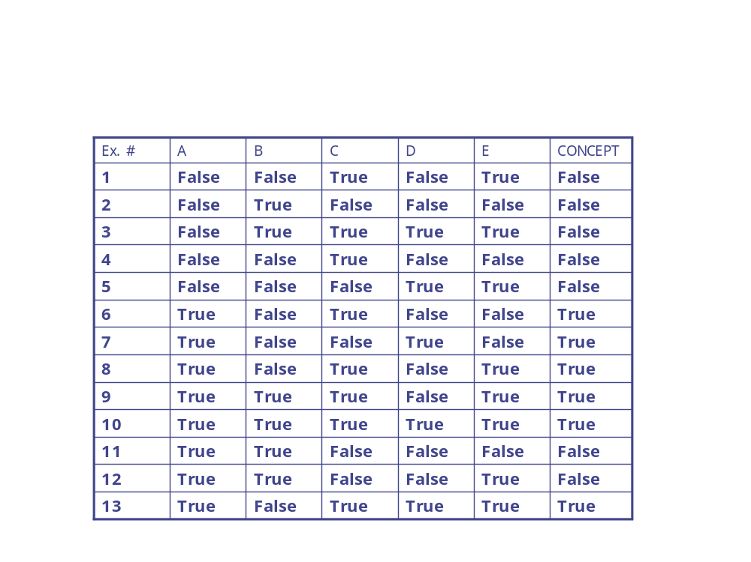
Possible Decision Tree
D
T
F
E
C
A
T
B
F
T
F
T
E
A
A
F
T
T
F

Slide 30
Possible Decision Tree
CONCEPT ⇔
(D∧(¬EvA))v(¬D∧(C∧(Bv(¬B∧((E∧¬A)v(¬E∧A))))))
D
T
F
E
C
CONCEPT ⇔ A ∧ (¬B v C)
T
F
A
B
A?
True
False
T
F
T
E
B?
False
True
False
C?
True
A
A
True
False
True
False
F
T
T
F

Slide 31
Possible Decision Tree
CONCEPT ⇔
(D∧(¬EvA))v(¬D∧(C∧(Bv(¬B∧((E∧¬A)v(¬E∧A))))))
D
T
F
E
C
CONCEPT ⇔ A ∧ (¬B v C)
T
F
A
B
A?
True
False
KIS bias → Build smallest decision tree
T
F
T
E
B?
False
True
False
C?
True
A
A
Computationally intractable problem
→ greedy algorithm
True
False
True
False
F
T
T
F

Slide 32
Getting Started:
Top-Down Induction of Decision Tree
The distribution of training set is:
True: 6, 7, 8, 9, 10,13
False: 1, 2, 3, 4, 5, 11, 12
Ex. # | A | B | C | D | E | CONCEPT
1 | False | False | True | False | True | False
2 | False | True | False | False | False | False
3 | False | True | True | True | True | False
4 | False | False | True | False | False | False
5 | False | False | False | True | True | False
6 | True | False | True | False | False | True
7 | True | False | False | True | False | True
8 | True | False | True | False | True | True
9 | True | True | True | False | True | True
10 | True | True | True | True | True | True
11 | True | True | False | False | False | False
12 | True | True | False | False | True | False
13 | True | False | True | True | True | True

Slide 33
Getting Started:
Top-Down Induction of Decision Tree
The distribution of training set is:
True: 6, 7, 8, 9, 10,13
False: 1, 2, 3, 4, 5, 11, 12
Without testing any observable predicate, we
could report that CONCEPT is False (majority rule)
with an estimated probability of error P(E) = 6/13
Assuming that we will only include one observable
predicate in the decision tree, which predicate
should we test to minimize the probability of error (i.e., the # of misclassified examples in the training set)? → Greedy algorithm

Slide 34
Assume It’s A
A
T
F
True:
False:
6, 7, 8, 9, 10, 13
11, 12
1, 2, 3, 4, 5
If we test only A, we will report that CONCEPT is True
if A is True (majority rule) and False otherwise
→ The number of misclassified examples from the
training set is 2

Slide 35
Assume It’s B
B
T
F
True:
False:
9, 10
2, 3, 11, 12
6, 7, 8, 13
1, 4, 5
If we test only B, we will report that CONCEPT is False
if B is True and True otherwise
→ The number of misclassified examples from the
training set is 5

Slide 36
Assume It’s C
C
T
F
True:
False:
6, 8, 9, 10, 13
1, 3, 4
7
1, 5, 11, 12
If we test only C, we will report that CONCEPT is True
if C is True and False otherwise
→ The number of misclassified examples from the
training set is 4

Slide 37
Assume It’s D
D
T
F
True:
False:
7, 10, 13
3, 5
6, 8, 9
1, 2, 4, 11, 12
If we test only D, we will report that CONCEPT is True
if D is True and False otherwise
→ The number of misclassified examples from the
training set is 5

Slide 38
Assume It’s E
E
T
F
True:
False:
8, 9, 10, 13
1, 3, 5, 12
6, 7
2, 4, 11
If we test only E we will report that CONCEPT is False,
independent of the outcome
→ The number of misclassified examples from the
training set is 6

Slide 39
Assume It’s E
E
T
F
True:
False:
8, 9, 10, 13
1, 3, 5, 12
6, 7
2, 4, 11
So, the best predicate to test is A
If we test only E we will report that CONCEPT is False,
independent of the outcome
→ The number of misclassified examples from the
training set is 6

Slide 40
Choice of Second Predicate
A
T
F
C
False
F
T
True:
False:
6, 8, 9, 10, 13
7
11, 12
→ The number of misclassified examples from the
training set is 1

Slide 41
Choice of Third Predicate
A
T
F
C
False
F
T
True
B
T
F
True:
False:
11,12
7

Slide 42
Final Tree
A
A?
True
False
True
False
C
False
B?
False
True
False
True
False
B
C?
True
True
True
False
True
False
True
False
False
True
CONCEPT ⇔ A ∧ (C v ¬B)
CONCEPT ⇔ A ∧ (¬B v C)

Slide 43
Top-Down
Induction of a DT
A
True
False
C
False
True
False
B
True
True
False
DTL(Δ, Predicates)
If all examples in Δ are positive then return True
If all examples in Δ are negative then return False
If Predicates is empty then return failure
A ← error-minimizing predicate in Predicates
Return the tree whose:
  - root is A,
  - left branch is DTL(Δ^{+A},Predicates-A),
  - right branch is DTL(Δ^{-A},Predicates-A)
False
True
Subset of examples
that satisfy A

Slide 44
Top-Down
Induction of a DT
A
True
False
C
False
True
False
B
True
True
False
DTL(Δ, Predicates)
If all examples in Δ are positive then return True
If all examples in Δ are negative then return False
If Predicates is empty then return failure
A ← error-minimizing predicate in Predicates
Return the tree whose:
  - root is A,
  - left branch is DTL(Δ^{+A},Predicates-A),
  - right branch is DTL(Δ^{-A},Predicates-A)
False
True
Noise in training set!
May return majority rule,
instead of failure

Slide 45
Comments
Widely used algorithm
Greedy
Robust to noise (incorrect examples)
Not incremental

Slide 46
Using Information Theory
Rather than minimizing the probability of error, many existing learning procedures minimize the expected number of questions needed to decide if an object x satisfies CONCEPT
This minimization is based on a measure of the “quantity of information” contained in the truth value of an observable predicate
See R&N p. 659-660

Slide 47
Miscellaneous Issues
Assessing performance:
  Training set and test set
  Learning curve
100
% correct on test set
size of training set
Typical learning curve

Slide 48
Miscellaneous Issues
Assessing performance:
  Training set and test set
  Learning curve
Overfitting
Risk of using irrelevant
observable predicates to
generate an hypothesis
that agrees with all examples
in the training set
100
% correct on test set
size of training set
Typical learning curve

Slide 49
Miscellaneous Issues
Assessing performance:
  Training set and test set
  Learning curve
Overfitting
  Tree pruning
Risk of using irrelevant
observable predicates to
generate an hypothesis
that agrees with all examples
in the training set
Terminate recursion when
# errors / information gain
is small

Slide 50
Miscellaneous Issues
Assessing performance:
  Training set and test set
  Learning curve
Overfitting
  Tree pruning
Risk of using irrelevant
observable predicates to
generate an hypothesis
that agrees with all examples
in the training set
The resulting decision tree + majority rule may not classify correctly all examples in the training set
Terminate recursion when
# errors / information gain
is small

Slide 51
Miscellaneous Issues
Assessing performance:
  Training set and test set
  Learning curve
Overfitting
  Tree pruning
Incorrect examples
Missing data
Multi-valued and continuous attributes

Slide 52
Applications of Decision Tree
Medical diagnostic / Drug design
Evaluation of geological systems for assessing gas and oil basins
Early detection of problems (e.g., jamming) during oil drilling operations
Automatic generation of rules in expert systems

