Slide 1
Inductive Learning (2/2)
Neural Nets
R&N: Chap. 20, Sec. 20.5

Slide 2
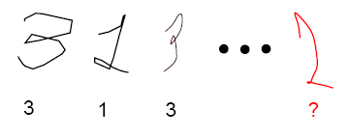
Function-Learning Formulation
Goal function f
Training set: (x^{(i)}, f(x^{(i)})), i = 1,…,n
Inductive inference: find a function h that fits the points well
Same Keep-It-Simple bias
f(x)
x

Slide 3
Perceptron
(The goal function f is a boolean one)
x₂
+
+
+
+
-
-
x₁
-
+
x₁
-
Σ
x_{i}
y
w₁ x₁ + w₂ x₂ = 0
w_{i}
-
g
x_{n}
y = g(Σ_{i=1,…,n} w_{i} x_{i})

Slide 4
Perceptron
(The goal function f is a boolean one)
+
+
+
?
-
x₁
-
-
-
Σ
+
x_{i}
w_{i}
y
+
g
-
x_{n}
y = g(Σ_{i=1,…,n} w_{i} x_{i})

Slide 5
Unit (Neuron)
x₁
Σ
x_{i}
w_{i}
y
g
x_{n}
y = g(Σ_{i=1,…,n} w_{i} x_{i})
g(u) = 1/[1 + exp(-α×u)]

Slide 6
Neural Network
Network of interconnected neurons
x₁
Σ
x_{i}
y
x₁
w_{i}
g
Σ
x_{n}
x_{i}
y
w_{i}
g
x_{n}
Acyclic (feed-forward) vs. recurrent networks

Slide 7
Two-Layer Feed-Forward
Neural Network
w_{1j}
w_{2k}
Inputs
Hidden
layer
Output
layer

Slide 8
Backpropagation (Principle)
New example y^{(k)} = f(x^{(k)})
φ^{(k)} = outcome of NN with weights w^{(k-1)} for inputs x^{(k)}
Error function: E^{(k)}(w^{(k-1)}) = ||φ^{(k)} – y^{(k)}||²
w_{ij}^{(k)} = w_{ij}^{(k-1)} – ε×∂E^{(k)}/∂w_{ij} (w^{(k)} = w^{(k-1)} - ε×∇E)
Backpropagation algorithm:
Update the weights of the inputs to the last layer, then the weights of the inputs to the previous layer, etc.

Slide 9
Comments and Issues
How to choose the size and structure of networks?
  If network is too large, risk of over-fitting (data caching)
  If network is too small, representation may not be rich enough
Role of representation: e.g., learn the concept of an odd number
Incremental learning

Slide 10
Application of NN to
Motion Planning
(Climbing Robot)

Slide 11
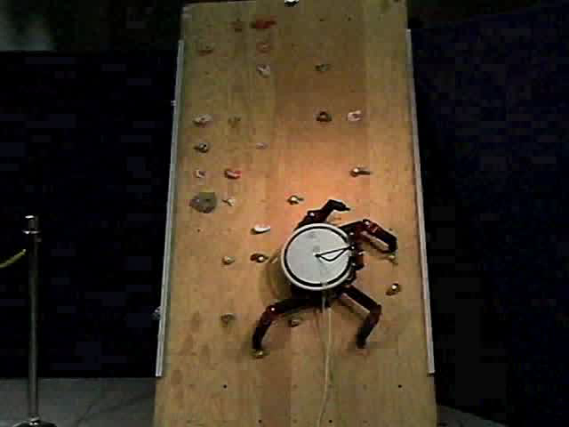

[Bretl, 2003]

Slide 12
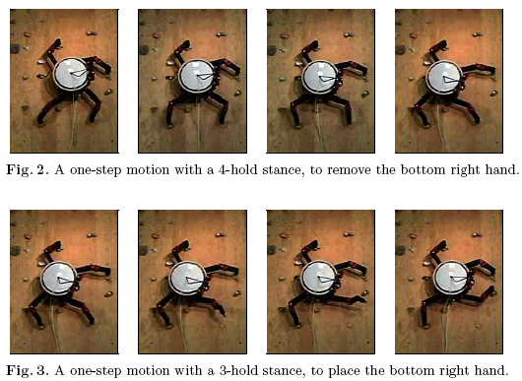
Transition
one-step planning
initial 4-hold
stance
...
3-hold
stance
...
...
one-step planning
breaking contact / zero force
4-hold
stance
...

Slide 13
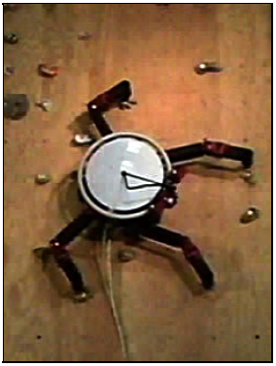
Idea: Learn Feasibility
Create a large database
of labeled transitions
Train a NN classifier
Θ : transition → {feasible, not feasible)
Learning is possible because:
Shape of a feasible space is mostly determined
by the equilibrium condition that depends on relatively few parameters

Slide 14
Creation of Database
Sample transitions at random
(by picking 4 holds at random
within robot’s limb span)
Label each transition – feasible
or infeasible – by sampling with
high time limit
→ over 95% infeasible transitions
Re-sample around feasible
transitions
→ 35-65% feasible transitions
~1 day of computation to create a
database of 100,000 labeled transitions

Slide 15
Training of a NN Classifier
NN with 9 input units, 100 hidden units, and 1 output unit
Training on 50,000 examples
(~3 days of computation)
Validation on the remaining 50,000 examples
→ ~78% accuracy (ε = 0.22)
→ 0.003ms average running time

Slide 16
Feasibility-Guided Search
one-step planning
initial 4-hold
stance
...
3-hold
stance
...
...
one-step planning
breaking contact / zero force
4-hold
stance
...
Uniform-cost search
with cost function:
[Θ(F₀ ∩ F₁)=non-feasible] → −ln(1−ε)
[Θ(F₀ ∩ F₁)=feasible] → −ln(ε)

Slide 17
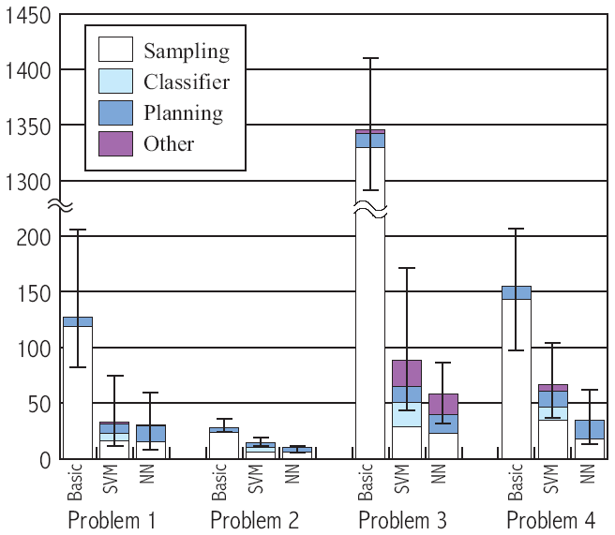
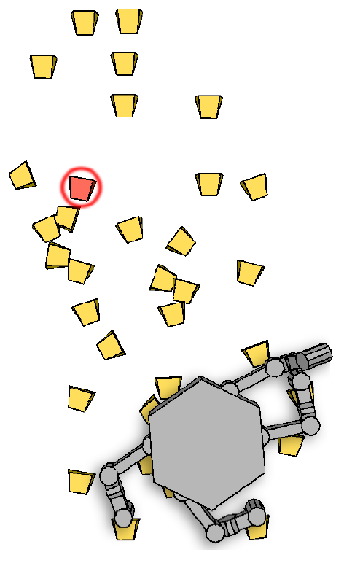
Performance Results
(time in
seconds)
# holds 34 14 34 17
# steps 10 24 20 10
Problem 1

Slide 18
Some Important Achievements in AI
Logic reasoning (data bases)
Search and game playing
Knowledge-based systems
Bayesian networks (diagnosis)
Machine learning and data mining
Planning and military logistics
Autonomous robots

Slide 19
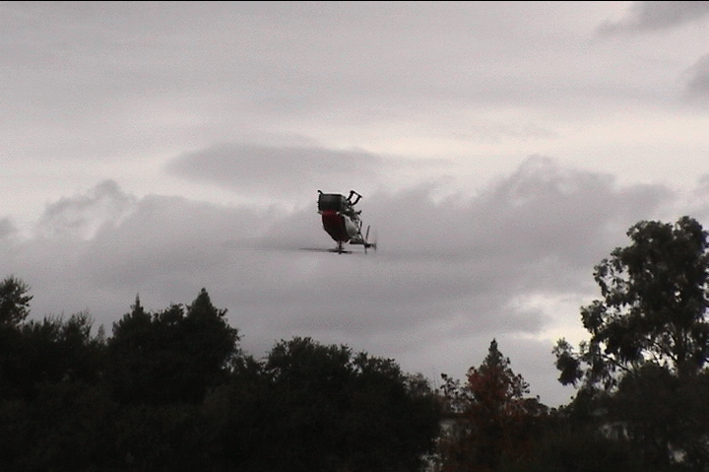
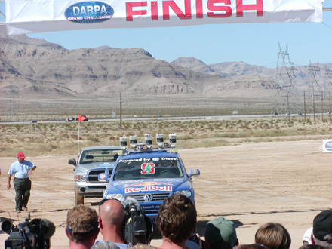
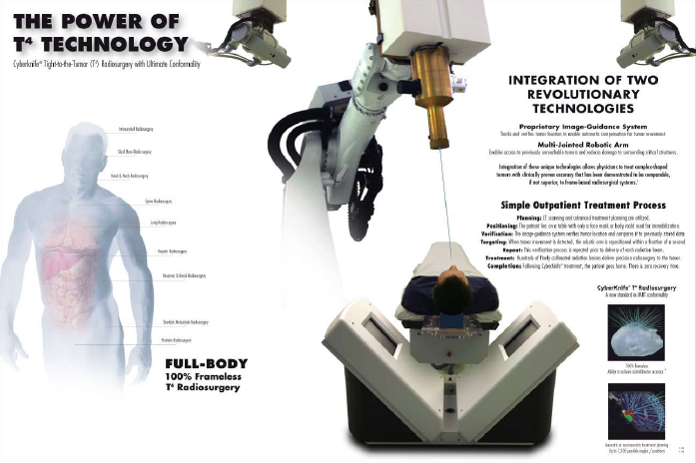
Un-supervised leaning
Treatment of uncertainty
Efficient constraint satisfaction

Slide 20
What Have We Learned?
Useful methods
Connection between fields, e.g., control theory, game theory, operational research
Impact of hardware (chess software → brute-force reasoning, case-base reasoning)
Relation between high-level (e.g., search, logic) and low-level (e.g., neural nets) representations: from pixels to predicates
Beyond learning: What concepts to learn?
What is intelligence? Impact of other aspects of human nature: fear of dying, appreciation for beauty, self-consciousness, ...
Should AI be limited to information-processing tasks?
Our methods are better than our understanding

Slide 21
What is AI?
Discipline that systematizes and automates intellectual tasks to create machines that:
Act like humans | Act rationally
Think like humans | Think rationally
90’s and 00’s
More formal and mathematical
What’s next?
How does the human brain operate?

Slide 22
Some Other AI Classes
Intros to AI: CS121 and CS221
CS 222: Knowledge Representation
CS 223A: Intro to Robotics
CS 223B: Intro to Computer Vision
CS 224M: Multi-Agent Systems
CS 224N: Natural Language Processing
CS 225A: Experimental Robotics
CS 227: Reasoning Methods in AI
CS 228: Probabilistic Models in AI
CS 229: Machine Learning
CS 257: Automated Deduction and Its Applications
CS 323: Common Sense Reasoning in Logic
CS 324: Computer Science and Game Theory
CS 326A: Motion Planning
CS 327A: Advanced Robotics
CS 328: Topics in Computer Vision
CS 329: Topics in AI

Slide 23
222
224M
224N
224S
224U
Knowledge
Representation
Multi-Agent
Systems
Natural Language Processing
+ Speech Recognition and Synthesis
227B
227
General
Game Playing
Reasoning
Methods in AI
221
121
228
228P
226A
223A
225A
225A
Probabilistic
Methods in AI
Statistical Techniques
in Robotics
Intro. to Robotics + Experimental Robotics
223B
229
Intro. to
Computer Vision
Machine Learning

