Slide 1
Evaluating Production Bottlenecks
Insights and Recommendations Through Downtime Analysis

Slide 2
Key Performance Indicators
Batches Produced
Delayed Batches
Days Lost
645
363
22
Total production runs
Experienced production delays
Total days lost to downtime
Downtime Factors
Unique Factors
Max Factors / Batch
885
13
4
Total contributing instances
Distinct downtime causes
Highest instances in one batch

Slide 3
Product Downtime Frequency
Downtime factor frequency by product
Eco-Cleaning Supplies see more downtime than Recyclable Packaging. GreenFoam Hand Soap had the most downtimes of any product, driven mainly by raw material shortages and machine breakdowns.
Frequency of downtime factors

Slide 4
Root Cause of Downtime
69%
31%
Non-Operator Factors
Operator Factors
Mainly cleaning and sanitation, raw material shortages, and machine breakdowns.
Mostly scheduling and coordination delays.

Slide 5
Downtime Trends (March–August 2025)
Most downtimes occurred in April and August, with the least in March.
March
April–July
Lowest downtime of the period.
Downward trend, though BioWipe Cleaning Sheets downtime kept rising.
April
August
Large spike, driven by GreenFoam Hand Soap and RePack Recycled Packaging Film.
High downtime again.

Slide 6
Consistent Downtime Causes
Frequency of downtime factors, count of instances
01 Cleaning / Sanitation Cycle
02 Raw Material Shortage
03 Scheduling / Coordination Delay
04 Machine Breakdown

Slide 7
Most Downtimes by Operator
Downtime frequency by operator
Delayed batches, % of batches run
Major factors: safety lockout/emergency stop, machine breakdown, scheduling and coordination delays, cleaning/sanitation, and raw material shortages.

Slide 8
Downtime Impact: Time Lost
Frequency drives cost
Downtime frequency directly correlates with total time lost.
Primary causes of lost time
Cleaning / sanitation, scheduling / coordination delays, and raw material shortage.
Most time lost
Paul, James and Emily experienced the most time wasted due to downtime.

Slide 9
Scheduling Gaps Identified
The analysis revealed gaps in how operators are scheduled for leading batch production.
Running two or more different products concurrently can be a significant cause of downtime.

Slide 10
Recommendations for Improvement
01
02
03
Supply Chain & Cleaning
Inventory & Alerts
Preventive Maintenance
Improve supply chain coordination and cleaning procedures to prevent delays.
Introduce real-time inventory tracking and automated low raw-material alerts.
Schedule maintenance for high-downtime machines.
04
05
06
Batch Scheduling
Operator Training & Workload
Downtime Reviews
Implement better tools and production sequencing rules to avoid overlaps.
Provide targeted training and review workload allocation for lead operators.
Implement reviews and early-warning systems for proactive action.

Slide 11
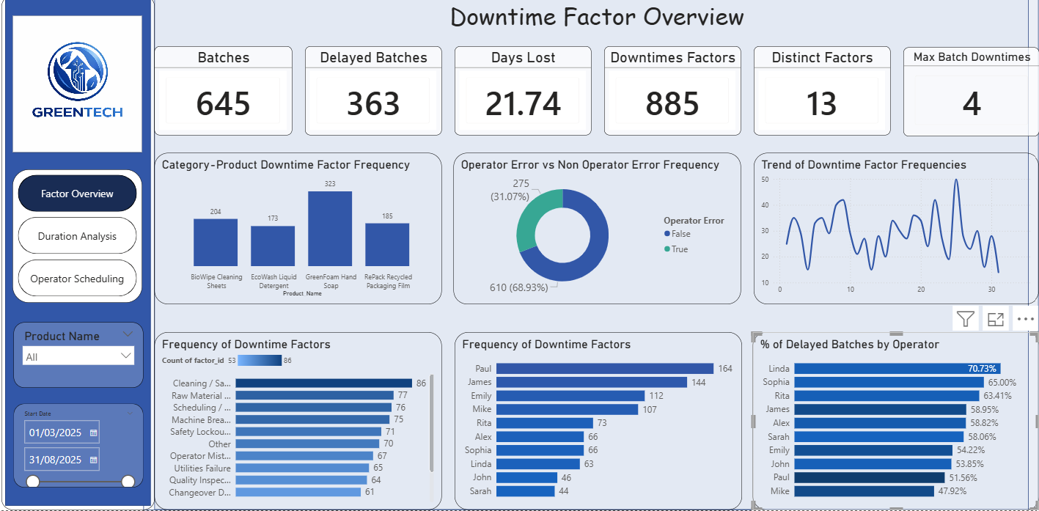
Appendix: Downtime Factor Overview

Slide 12
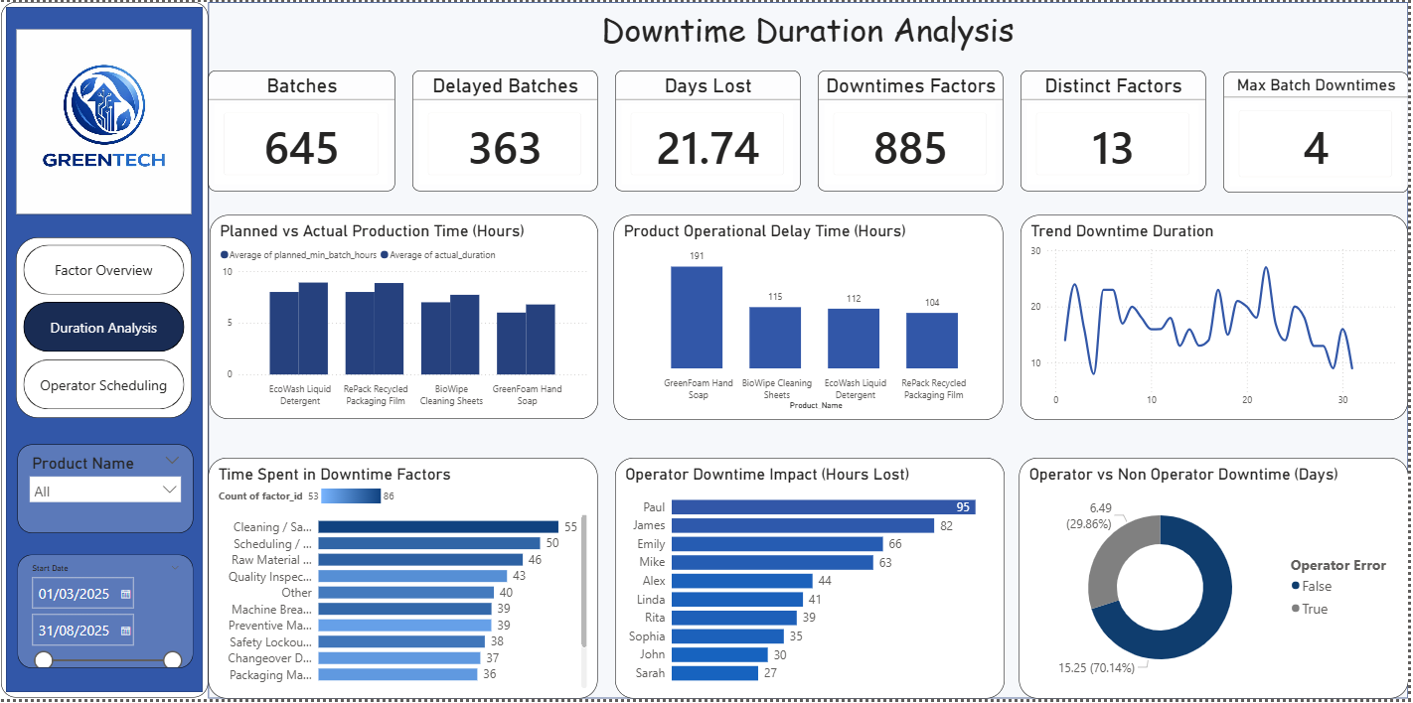
Appendix: Downtime Duration Analysis

Slide 13
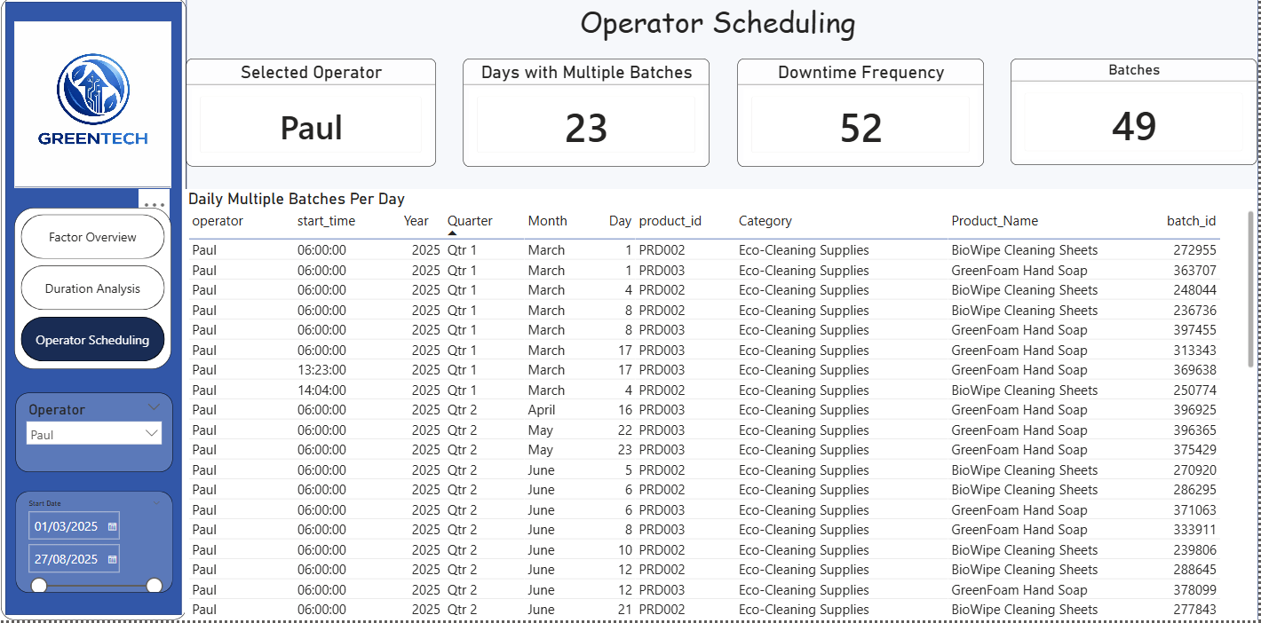
Appendix: Operator Scheduling

