Slide 1
X-ray Image Analysis Approach for Lithium-ion Battery Cells
Wenhao, Xu, 31/01/18
Master Thesis

Slide 2
Agenda
Image processing workflow
Image selection
Edge extraction workflow(X-direction)
Region of interest extraction
Fake edge removal
Electrode edge positioning through interpolation
Edge extraction workflow(Y-direction)
Problems and suggestions

Slide 3
Image processing workflow

Slide 4

Image selection: X-direction images
Function: images_to_process
Input: main path of images
Output: path of X-, Y-, and Z-direction images
The images in main path should be firstly classified into X, Y, and Z folders, otherwise this script doesn’t work

Slide 5
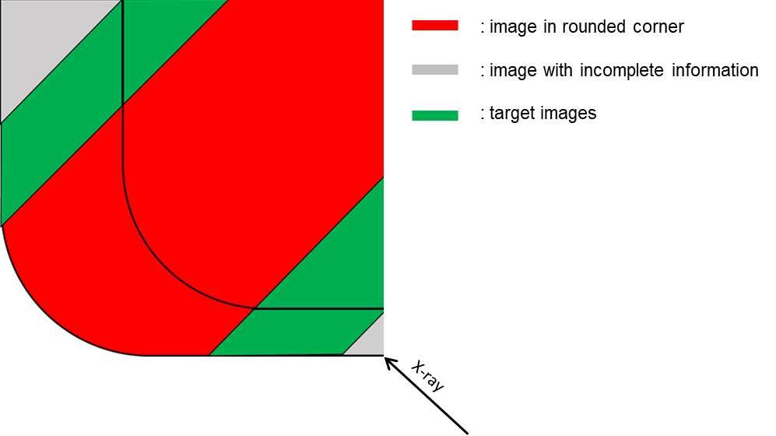
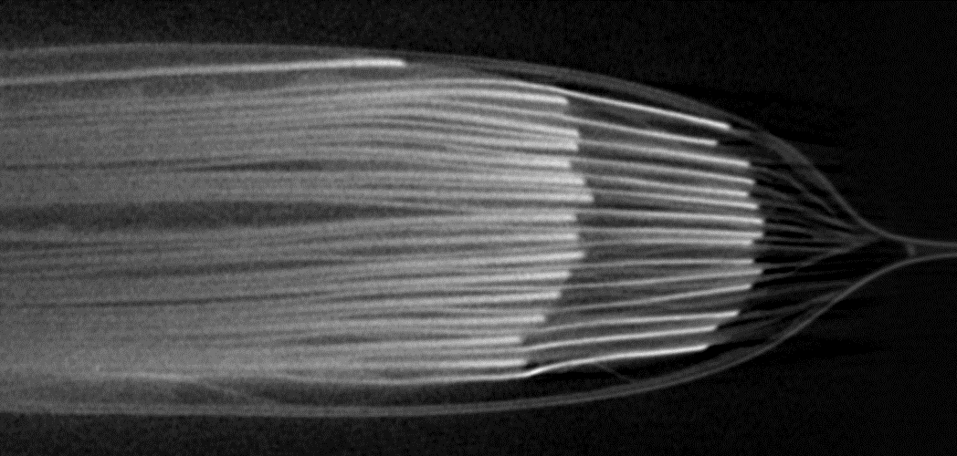
Image selection: X-direction images
electrode length>680
The X-images on both narrow and broad side are with electrode length more than 680 pixel
X-ray

Slide 6
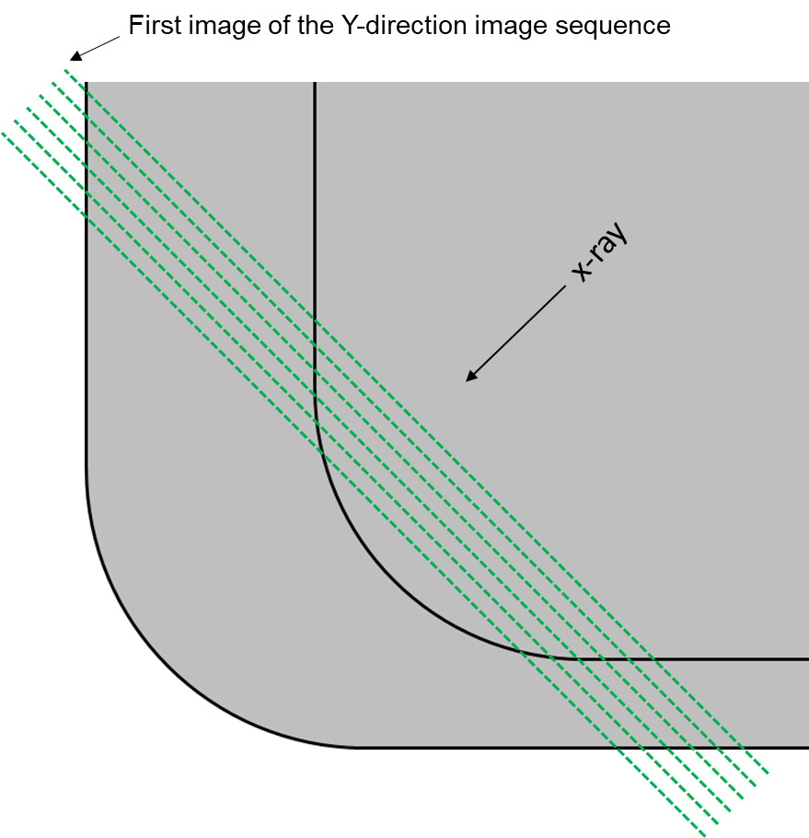
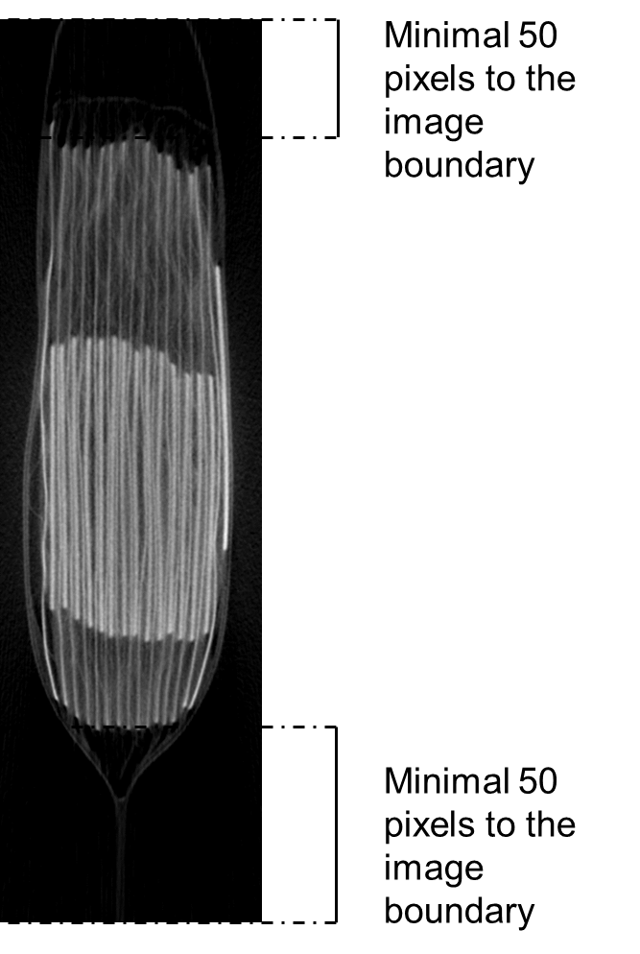
Image selection: Y-direction images
Images with minimal 50 pixels of distance to the image boundary are selected

Slide 7
Image selection: Z-direction images
10 images according to a constant interval from the Z-image sequence are selected

Slide 8
Edge extraction workflow

Slide 9
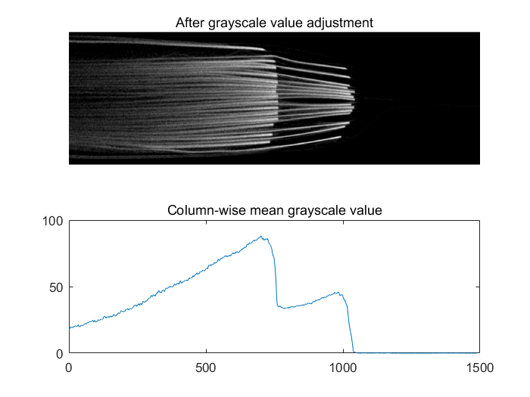
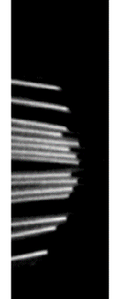
Region of interest extraction
Input: battery cell images, grayscale threshold, anode length
Output: anode and cathode regions, start column of the anode
Result of setting threshold = 10; anode_length = 70;
Cathode
Anode
threshold = 10
anode_length
start_column_of_anode

Slide 10

Fake edge removal
Extract the local region of electrode edge and examine if the region has the edge features
True edges:
The brightness in the left part should be larger than the right part
Set rules to remove fake edges:
mean brightness on the left - mean brightness on the right >30
the local region of electrode edge

Slide 11
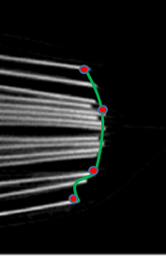
Electrode edge positioning through interpolation
Not all the electrode edges can be correctly extracted, thus we create a curve based on the already extracted edge points, and then extract the rest edge points from the curve.
Curve fitting through Harris points
Extract 15 points equidistantly from the curve

Slide 12
Edge extraction workflow(Y-direction)
Similar to the workflow for X-direction images

Slide 13
Problems and suggestions
Image selection (lack of standardization in image acquisition)
ROI extraction(hard to divide anodes from cathodes when analyzing abnormal images)
Edge extraction through interpolation

Slide 14
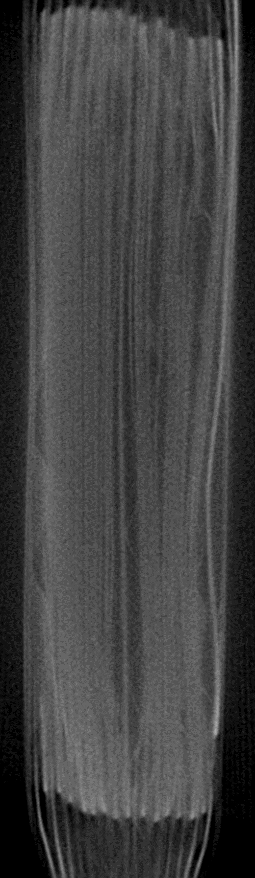
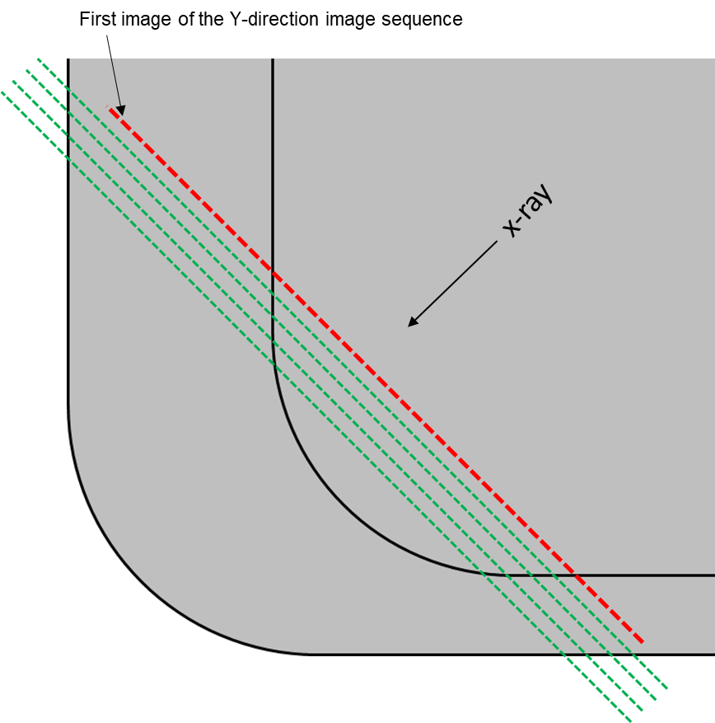
Problems: image selection
Missing anodes on the top
Image acquisition lack of standardization causes trouble for image selection
Missing anodes on the bottom

Slide 15
Problem: image selection
Suggestions:
Manual image selection.
Develop a GUI to select the images and verify if the images are properly selected.
When all the images are acquired in a same manner, it is possible to select images automatically using the method I used in the scripts, only thing to do is to adjust some parameters in the script.

Slide 16
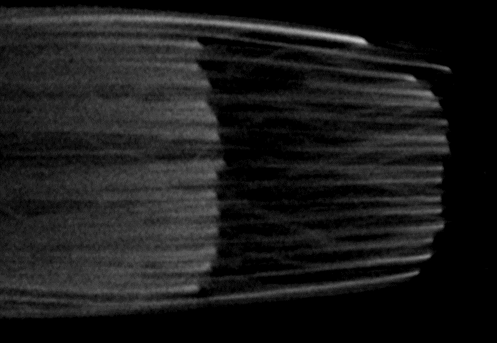
Problem: ROI extraction
Abnormal cathodes make it very hard to divide anodes from cathodes
Suggestions:
GUI based ROI extraction
Select a proper anode length respectively when analyzing images from different battery cell
anode_length

Slide 17
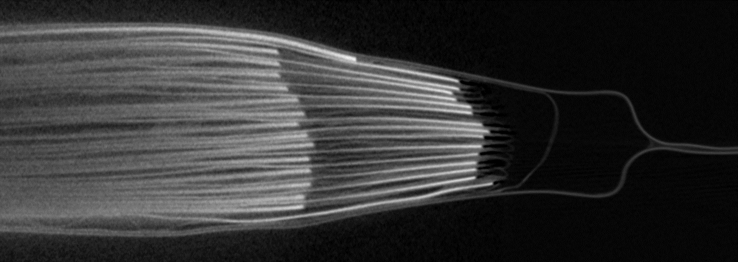
Problem: Edge extraction through interpolation
Image: zelle5_slices_X_1011
Second cathode
First cathode
In the scripts the cathode on the top will be judged as the first cathode
However, in this case, the vertical position of the first cathode is lower than the second cathode, this cause problems in sorting the cathodes and the script judged the actual first cathode as the second cathode.
This causes problems in interpolation

Slide 18
Problem: Edge extraction through interpolation
What I have done is to manually adjust the vertical position of the first cathode and make sure the first cathode being correctly recognized, and it is accomplished in interpol_fix script.
It is suggested to develop a method that can recognize the electrode edge correctly.
wrong
right
Wrong cathode recognition result in inaccurate electrode edge position

