Slide 1
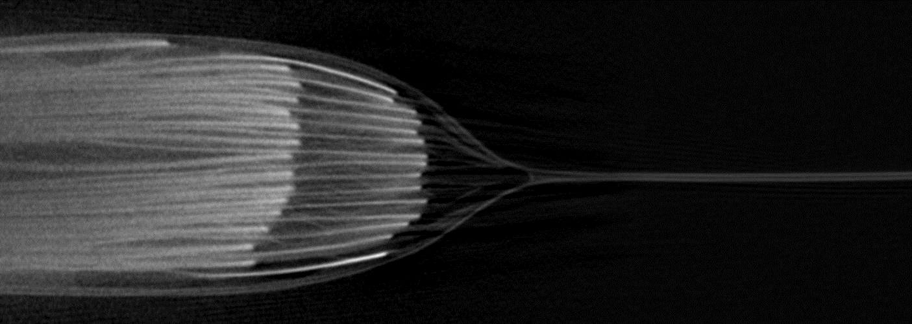
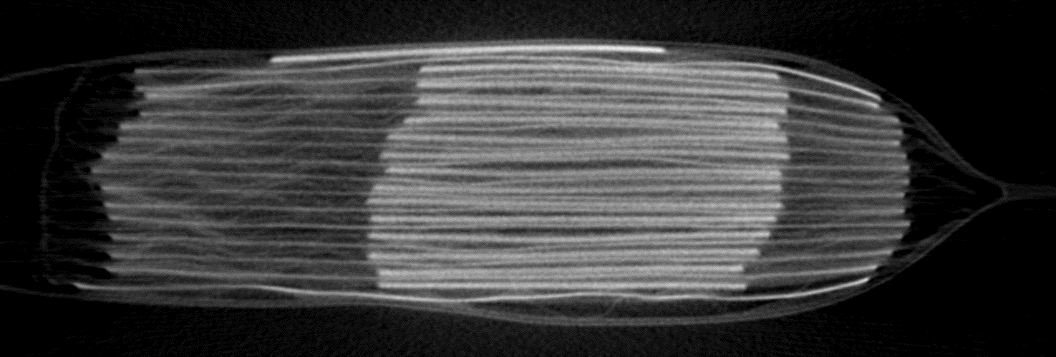
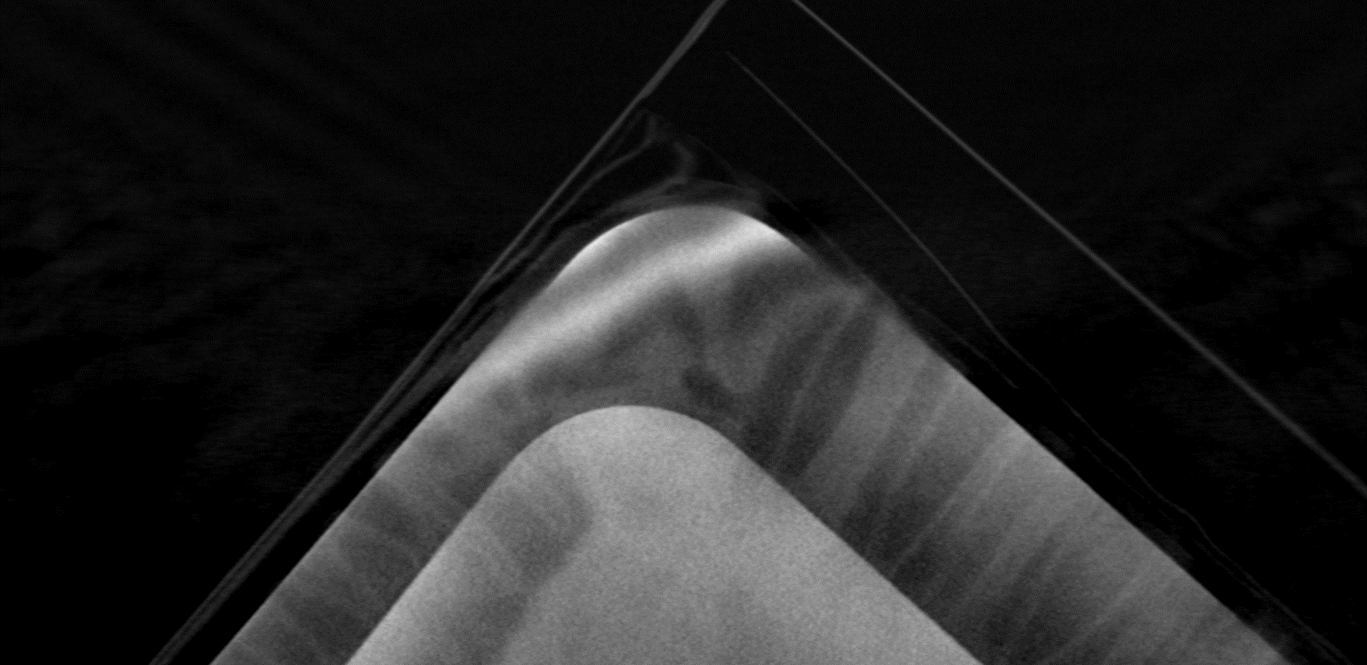
Distance from middle picture
Detector
Minmal electrode length
X-Ray
Minmal electrode length
Minmal distance to edge

