Slide 1
Towards accurate deep learning algorithms for remote healthcare monitoring using IoT

Slide 2
OUTLINE
CONTEXT
MOTIVATION AND OBJECTIVE
PROBLEMATIC RELATED WORK

Slide 3
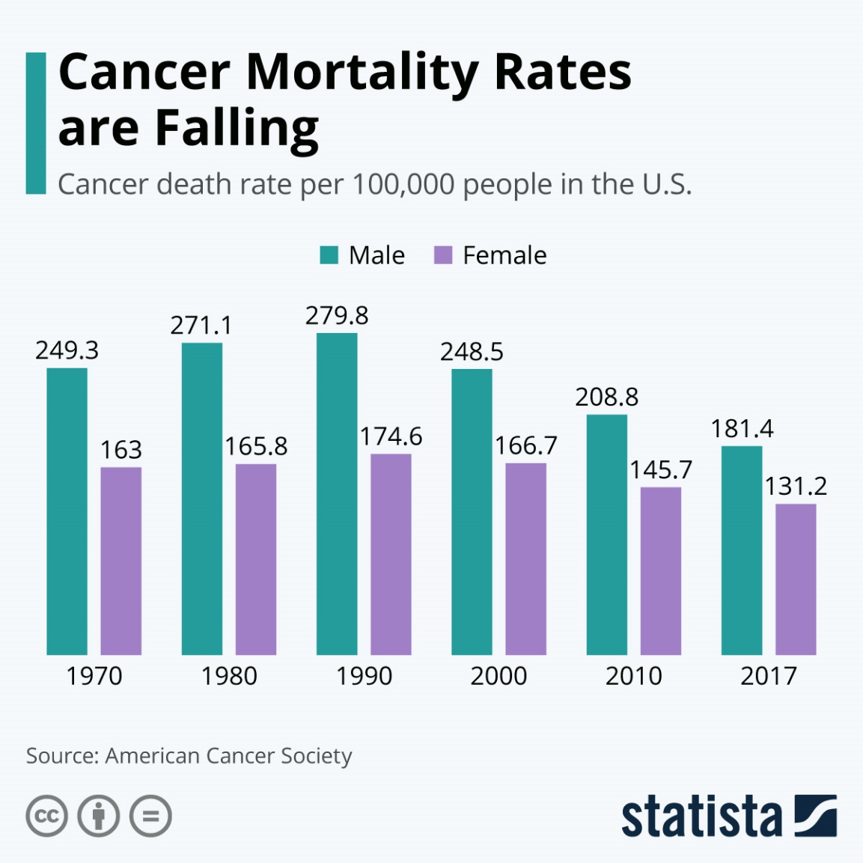

Context
Cancer is the second leading cause of death globally
It is responsible for an estimated 9.6 million deaths in 2018
About 1 in 6 deaths is due to cancer
It is defined by the rapid creation of abnormal cells that grow beyond their usual boundaries and spread to other organs, the latter process is referred to as metastasizing.
Metastases are a major cause of death from cancer

Slide 4
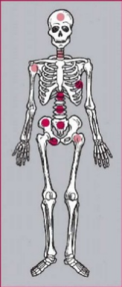
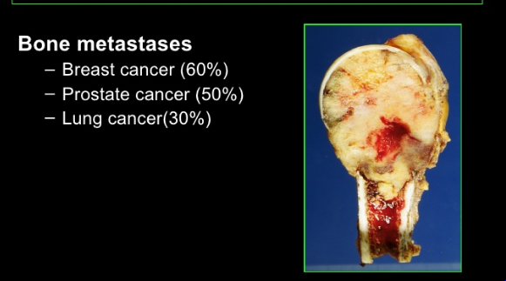
Context
Bone is the third most frequent site of metastasis, behind lung and liver ¹
70% of patients with breast or prostate cancer have bone metastases ²
Once bone metastases are diagnosed, the disease must be classified as incurable
Bone Metastases:
Cancers that originate in another site (Usually breast, prostate or lung) and spread to the bone
Table 1: Incidence of bone metastases at postmortem examination in different cancers [1]
Primary tumor Incidence of bone metastases (%)
Breast 65-75 Prostate 65-75
Thyroid Bladder Lung Melanoma | 60 40 30-40 14-45
[1] MACEDO, Filipa, LADEIRA, Katia, PINHO, Filipa, et al. Bone metastases: an overview. Oncology reviews, 2017
[2] O’SULLIVAN, Gerard J., CARTY, Fiona L., et CRONIN, Carmel G. Imaging of bone metastasis: an update. World journal of radiology, 2015

Slide 5


Motivation and objective
Quality of life and prolongation of survival are the important parameters that form the basis for further medical decision making.
Early detection of skeletal metastasis is critical :
accurate staging and optimal treatment
to allow the implementation of treatment strategies
to reduce the risk of complications
improve quality of life
Developing an algorithm to detect bone metastases based on medical images analysis

Slide 6
Problematic
How the proposed algorithm could be integrated into a CAD system of whole-body diagnosis in nuclear medicine
How to provide evidence that the clinical decision support system could be generalized to all the types of metastatic cancer
How we can offer interpretability and transparency in the classification process, while simultaneously increasing the accuracy of the model, and investigating new efficient AI architectures.
Notes:
CAD : Computer Aided Diagnosis

Slide 7
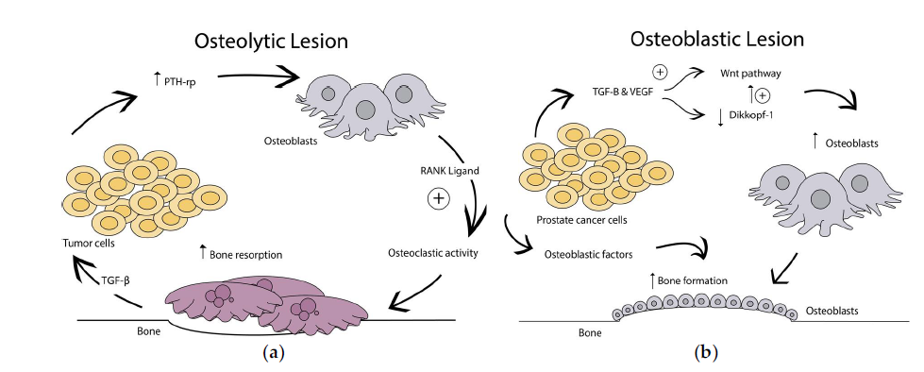
Related work
Types of bone metastases
Bone metastasis are classified as ¹ :
(a) Osteolytic lesions are caused by over activation of osteoclast bone resorption
(b) Osteoblastic lesions result from direct tumor stimulation of osteoblasts.
(c) Mixed
osteoclast
Bone metastatic lesions²
[1] GURKAN, Guray, SARIKAYA, Ismet, et SARIKAYA, Ali. Semiquantitative assessment of osteoblastic, osteolytic, and mixed lytic-sclerotic bone lesions on fluorodeoxyglucose positron emission tomography/computed tomography and bone scintigraphy. World Journal of Nuclear Medicine, 2019
[2] JINNAH, Alexander H., ZACKS, Benjamin C., GWAM, Chukwuweike U., et al. Emerging and established models of bone metastasis. Cancers, 2018

Slide 8
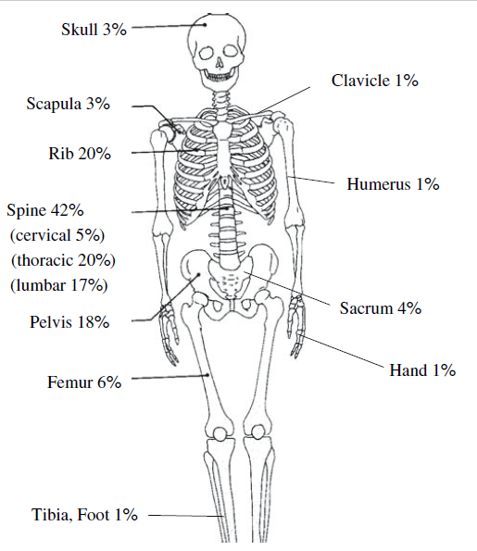
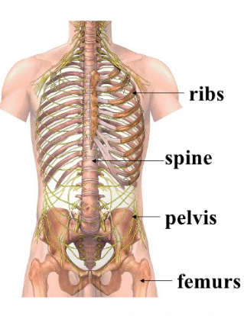
Related work
Distribution of bone metastases
Most sites for bone metastases¹
Anatomic localization of skeletal metastases from lung cancer²
[1] HAMAOKA, Tsuyoshi, MADEWELL, John E., PODOLOFF, Donald A., et al. Bone imaging in metastatic breast cancer. Journal of Clinical Oncology, 2004
[2] SUGIURA, Hideshi, YAMADA, Kenji, SUGIURA, Takahiko, et al. Predictors of survival in patients with bone metastasis of lung cancer. Clinical orthopaedics and related research, 2008

Slide 9
Related work
Bone metastases images
There are different types of images:
Computed Tomography (CT)
Single photon Emission Computed Tomography (SPECT)
Magnetic-Resonance Imaging (MRI)
Positron Emission Tomography (PET)
Scintigraphy Skeletal (SS)
X-ray
Table 2: Sensitivity and specificity of imaging modalities in bone metastasis [1]
Imaging modality 18F NaF-PET/CT MRI SPECT 18F FDG-PET CT SS | Sensitivity(%) 100 95 87 98 74 78 | Specificity(%) 97 90 91 56 56 48
[1] O’SULLIVAN, Gerard J., CARTY, Fiona L., et CRONIN, Carmel G. Imaging of bone metastasis: an update. World journal of radiology, 2015, vol. 7, no 8, p. 202

Slide 10
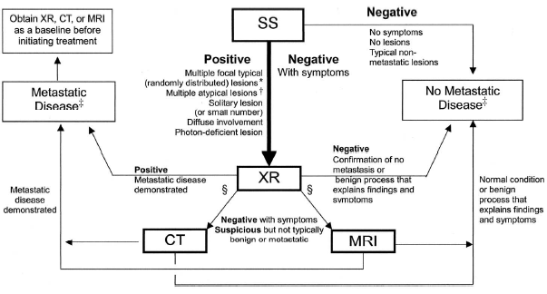
Related work
Algorithm of detection of bone metastases
HAMAOKA, Tsuyoshi, MADEWELL, John E., PODOLOFF, Donald A., et al. Bone imaging in metastatic breast cancer. Journal of Clinical Oncology, 2004

Slide 11
Related work
State of the art
Paper | Method | Image type | disease | Dataset | advantages | Disadvantages
[1] | RF | 18F-NaF PET/CT | Castrate resistant prostate cancer | 1751 NaF PET/CT images from 37 patients . | -- Fast and effective classification of instance. -- Robustness for irrelevant attributes. . | **Assumes that similar instance with similar attribute has similar classification. **Complexity is high.
[2]
 |  | CT | mangioma, osteoblastoma osteochondroma, osteoid osteoma and osteogenic sarcoma | 79 CT scans
RF: random Forest

Slide 12
Related work
State of the art
Paper | Method | Image type | disease | Dataset | advantages | Disadvantages
[3] | SVM For segmentation | CT | Primary tumor | 100 bone lesions | **Less Computational complexity. **Easy to control the frequency of error and complexity. | Small dataset
[4] | K-means for the extraction of bone tumor part Mean intensity for bone cancer detection | MRI | Bone cancer | 400 MRI images from radiology Assistant website | Applicable for DICOM images | k-means cannot build non-convex shaped clusters and the number of cluster needs to be predefined.
SVM: Support Vector Machine
DICOM: digital imaging communication of medicine

Slide 13
Related work
State of the art
Paper | CNN Architecture | Software | Image type | disease | Dataset | advantages | Disadvantages
[5] | RGB-CNN | Tensorflow | SS | prostate cancer | 778 whole body scintigraphy image | **less running time **reduced architectural complexity | the use of a small dataset
[6] | Best-CNN |  |  | Breast cancer | 408 bone scan images

Slide 14
Related work
State of the art
Paper | Method | Image type | disease | Dataset | advantages | Disadvantages
[7] | CNN U-Net architecture. | CT | Bone cancer | (1) 16,218 slices of CT images from 32 scans in 16 patients; (2) 12,529 slices of CT images from 20 scans in 20 patients (3) 270 slices of CT images from 27 scans in 20 patients | Model tested in three separate datasets | the dataset is not reported a low dose scan
mean Dice coefficient of 0.947 ± 0.013
RICAP : Random image cropping and patching for data augmentation
Notes:
The in-house dataset included 16,218 slices of CT images comprising 32 scans that were obtained in 16 patients and performed at our institute. All scans had been performed as follow-up assessment for malignancy (lung cancer, n = 3, breast cancer, n = 2, other, n = 11). Among the 16 patients, 9 patients had known sites of bone metastases

Slide 15
Related work
State of the art
Paper | Dataset available | Accuracy
[1] | NO | 91%
[2] | NO | 91,47%
[3] | NO | 86%
[4] | NO | 95%
[5] | NO | 91.42% ± 1.64%
[6] | NO | 92.50%
[7] | NO | ----

Slide 16
References
[1]PERK, Timothy, BRADSHAW, Tyler, CHEN, Song, et al. Automated classification of benign and malignant lesions in 18F-NaF PET/CT images using machine learning. Physics in Medicine & Biology, 2018, vol. 63, no 22, p. 225019.
[2] MISHRA, Anindita et SUHAS, M. V. Classification of benign and malignant bone lesions on CT images using Random Forest. In : 2016 IEEE International Conference on Recent Trends in Electronics, Information & Communication Technology (RTEICT). IEEE, 2016. p. 1807-1810.
[3]KUMAR, Rishav et SUHAS, M. V. Classification of benign and malignant bone lesions on CT imagesusing support vector machine: A comparison of kernel functions. In : 2016 IEEE International Conference on Recent Trends in Electronics, Information & Communication Technology (RTEICT). IEEE, 2016. p. 821-824
[4] AVULA, Madhuri, LAKKAKULA, Narasimha Prasad, et RAJA, Murali Prasad. Bone cancer detection from mri scan imagery using mean pixel intensity. In : 2014 8th Asia Modelling Symposium. IEEE, 2014. p. 141-146
[5] PAPANDRIANOS, Nikolaos, PAPAGEORGIOU, Elpiniki I., et ANAGNOSTIS, Athanasios. Development of Convolutional Neural Networks to identify bone metastasis for prostate cancer patients in bone scintigraphy. Annals of Nuclear Medicine, 2020, p. 1-9.
[6]PAPANDRIANOS, Nikolaos, PAPAGEORGIOU, Elpiniki, ANAGNOSTIS, Athanasios, et al. A Deep-Learning Approach for Diagnosis of Metastatic Breast Cancer in Bones from Whole-Body Scans. Applied Sciences, 2020, vol. 10, no 3, p. 997
[7] NOGUCHI, Shunjiro, NISHIO, Mizuho, YAKAMI, Masahiro, et al. Bone segmentation on whole-body CT using convolutional neural network with novel data augmentation techniques. Computers in Biology and Medicine, 2020, p. 103767

Slide 17
Thank you for your attention

Slide 20
Related work
State of the art
Convolutional Neural Network (CNN) algorithm that efficiently and quickly classifies bone scintigraphy images, by determining the presence or absence of prostate cancer metastasis.
was used for bone scintigraphy image included 778 sequential male patients who underwent whole-body bone scans.A nuclear medicine physician classified all the cases into 3 categories: (1) normal, (2) malignant, and (3) degenerative,
,(overall classification accuracy = 91.42% ± 1.64%).
PAPANDRIANOS, Nikolaos, PAPAGEORGIOU, Elpiniki I., et ANAGNOSTIS, Athanasios. Development of Convolutional Neural Networks to identify bone metastasis for prostate cancer patients in bone scintigraphy. Annals of Nuclear Medicine, 2020, p. 1-9.

Slide 21
The main advantages of the proposed RGB-CNN architecture
are described as follows:
(1) RGB-CNN can efficiently train a model on a small dataset: regardless of the relevant literature, in which CNNs
can work properly and effectively only when large datasets of medical images are available, in this nuclear medical image analysis problem with a small dataset, the proposed RGB-CNN model is proven to be able to
be trained efficiently, too.
(2) RGB-CNN reduces architecture complexity: it comes with a simpler architecture, exhibiting better performance
than other well-known CNN architectures in the field of medical image analysis, and also operates with less running time, due to its reduced architectural complexity.
Some potential limitations of this research study include:
the use of a small dataset, since most of the notable accomplishments of deep learning are typically based on very large amounts of data,
and (ii) no explanation on the decisions is provided. These limitations will be addressed in our future work.
PAPANDRIANOS, Nikolaos, PAPAGEORGIOU, Elpiniki I., et ANAGNOSTIS, Athanasios. Development of Convolutional Neural Networks to identify bone metastasis for prostate cancer patients in bone scintigraphy. Annals of Nuclear Medicine, 2020, p. 1-9.

Slide 22
Related work
State of the art
Google Colab [31],
included OpenCV, which was used
for loading and manipulating images, Glob, for reading filenames from a folder, Matplotlib, for plot visualizations Numpy, for all mathematical and array operations.
Moreover, Python was used for coding, Keras (with Tensorflow
[32]) for programming the CNN, with data normalization,
data splitting, confusion matrices and classification
reports carried out with Sci-Kit Learn
PAPANDRIANOS, Nikolaos, PAPAGEORGIOU, Elpiniki I., et ANAGNOSTIS, Athanasios. Development of Convolutional Neural Networks to identify bone metastasis for prostate cancer patients in bone scintigraphy. Annals of Nuclear Medicine, 2020, p. 1-9.

Slide 23
