Slide 1
Machine Learning Applications in Medical Diagnosis
Case Study: Bone metastases
¹Marwa Afnouch, ¹Olfa gaddour, ²Ihsen Alouani, ²Abdelmalik Taleb Ahmed, ¹Mohamed Abid
1Computer& Embedded Systems Research Lab, National Engineering school of Sfax (ENIS), University of Sfax, Tunisia
²Université Polytechnique Hauts de France ,University of Lille, France
{marwa,afnouch, olfa.gaddour}@enis.tn ,{Ihsen.Alouani, taleb}@uphf.fr,{mohamed.abid_ces} @yahoo.fr

Slide 2
OUTLINE
CONTEXT
MOTIVATION AND OBJECTIVE
PROBLEM STATEMENT
RELATED WORK
PROPOSED APPROACH
FUTURE WORK

Slide 3
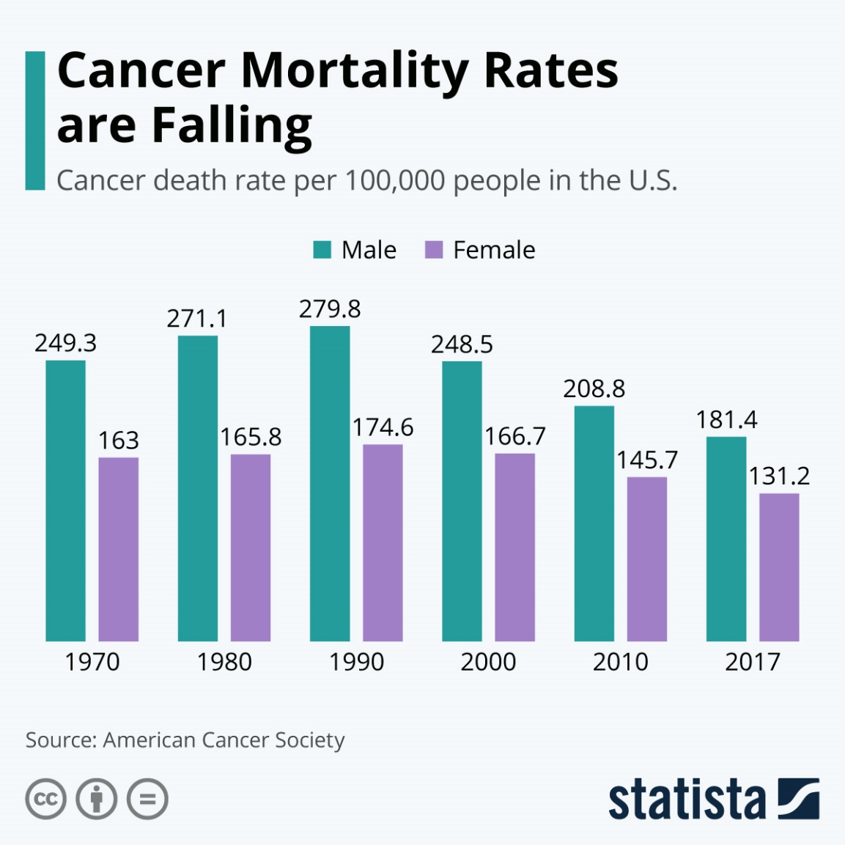

Context
Cancer is the second leading cause of death globally
It is responsible for an estimated 9.6 million deaths in 2018
About 1 in 6 deaths is due to cancer
It is defined by the rapid creation of abnormal cells that grow beyond their usual boundaries and spread to other organs, the latter process is referred to as metastasizing.
Metastases are a major cause of death from cancer

Slide 4
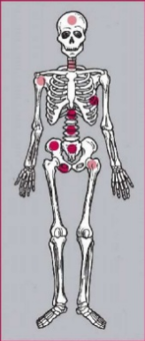
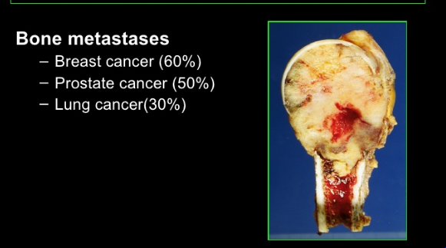
Context
Bone is the third most frequent site of metastasis, behind lung and liver ¹
70% of patients with breast or prostate cancer have bone metastases ²
Once bone metastases are diagnosed, the disease must be classified as incurable
Bone Metastases:
Cancers that originate in another site (Usually breast, prostate or lung) and spread to the bone
Table 1: Incidence of bone metastases at postmortem examination in different cancers [1]
Primary tumor Incidence of bone metastases (%)
Breast 65-75 Prostate 65-75
Thyroid Bladder Lung Melanoma | 60 40 30-40 14-45
[1] MACEDO, Filipa, LADEIRA, Katia, PINHO, Filipa, et al. Bone metastases: an overview. Oncology reviews, 2017
[2] O’SULLIVAN, Gerard J., CARTY, Fiona L., et CRONIN, Carmel G. Imaging of bone metastasis: an update. World journal of radiology, 2015

Slide 5


Motivation and objective
Quality of life and prolongation of survival are the important parameters that form the basis for further medical decision making.
Early detection of skeletal metastasis is critical :
accurate staging and optimal treatment
to allow the implementation of treatment strategies
to reduce the risk of complications
improve quality of life
Developing an algorithm to detect bone metastases based on medical images analysis

Slide 6
Problem statement
How the proposed algorithm could be integrated into a CAD system of whole-body diagnosis in nuclear medicine
How to provide evidence that the clinical decision support system could be generalized to all the types of metastatic cancer
How we can offer interpretability and transparency in the classification process, while simultaneously increasing the accuracy of the model, and investigating new efficient AI architectures.
Notes:
CAD : Computer Aided Diagnosis

Slide 7
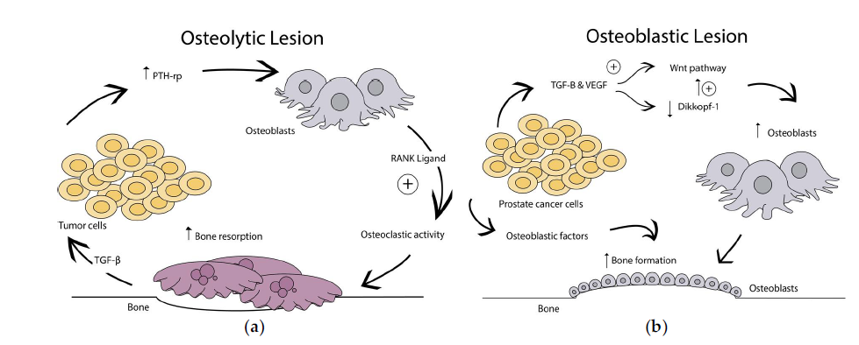
Related work
Types of bone metastases
Bone metastasis are classified as ¹ :
(a) Osteolytic lesions are caused by over activation of osteoclast bone resorption
(b) Osteoblastic lesions result from direct tumor stimulation of osteoblasts.
(c) Mixed
osteoclast
Bone metastatic lesions²
[1] GURKAN, Guray, SARIKAYA, Ismet, et SARIKAYA, Ali. Semiquantitative assessment of osteoblastic, osteolytic, and mixed lytic-sclerotic bone lesions on fluorodeoxyglucose positron emission tomography/computed tomography and bone scintigraphy. World Journal of Nuclear Medicine, 2019
[2] JINNAH, Alexander H., ZACKS, Benjamin C., GWAM, Chukwuweike U., et al. Emerging and established models of bone metastasis. Cancers, 2018

Slide 8
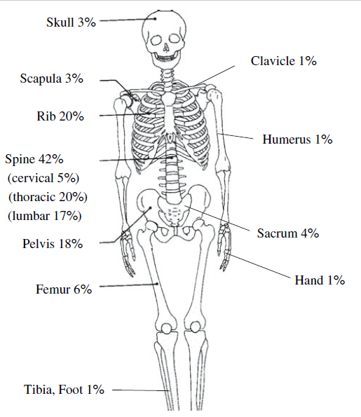
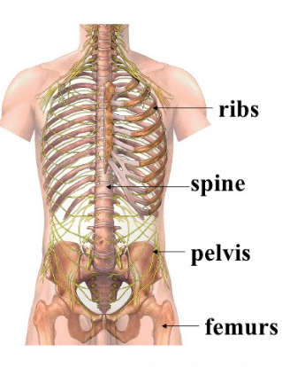
Related work
Distribution of bone metastases
Most sites for bone metastases¹
Anatomic localization of skeletal metastases from lung cancer²
[1] HAMAOKA, Tsuyoshi, MADEWELL, John E., PODOLOFF, Donald A., et al. Bone imaging in metastatic breast cancer. Journal of Clinical Oncology, 2004
[2] SUGIURA, Hideshi, YAMADA, Kenji, SUGIURA, Takahiko, et al. Predictors of survival in patients with bone metastasis of lung cancer. Clinical orthopaedics and related research, 2008
Notes:
Benign lesions and bone metastases have often similar imaging features so the location of a lesion can help to distinguish between them
Ribs, spine , pelvis and femurs are the most sites for bone metastases

Slide 9
Related work
Bone metastases images
There are different types of images:
Computed Tomography (CT)
Single photon Emission Computed Tomography (SPECT)
Magnetic-Resonance Imaging (MRI)
Positron Emission Tomography (PET)
Scintigraphy Skeletal (SS)
X-ray
Table 2: Sensitivity and specificity of imaging modalities in bone metastasis [1]
Imaging modality 18F NaF-PET/CT MRI SPECT 18F FDG-PET CT SS | Sensitivity(%) 100 95 87 98 74 78 | Specificity(%) 97 90 91 56 56 48
[1] O’SULLIVAN, Gerard J., CARTY, Fiona L., et CRONIN, Carmel G. Imaging of bone metastasis: an update. World journal of radiology, 2015, vol. 7, no 8, p. 202

Slide 10
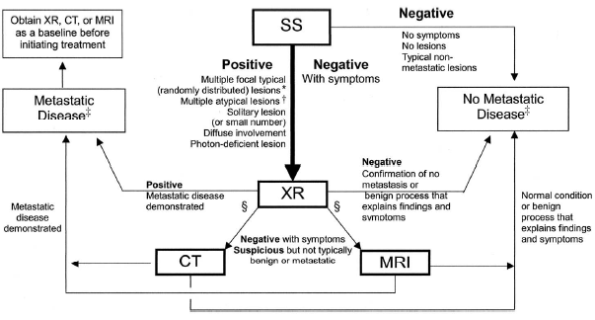
Related work
Algorithm of detection of bone metastases
HAMAOKA, Tsuyoshi, MADEWELL, John E., PODOLOFF, Donald A., et al. Bone imaging in metastatic breast cancer. Journal of Clinical Oncology, 2004

Slide 11
Related work
Studies | Year | ML Method | Dataset | Classification problem | Results
[1] | 2020 2020 | CNN CNN | 586 Whole body bone scan images | 2 classes: Bone metastasis in prostate patient or not | 97,38% classification testing accuracy and 95,8% average sensitivity
[2] |  |  | 778 bone scan images | Find Bone metastasis in prostate patient or not 3 classes: (a) benign, (b) malignant And (c) degenerative | overall classification accuracy 91.61% ± 2.46% accuracy regarding normal, malignant and degenerative changes: 91.3%, 94.7% and 88.6%
[3] |  |  |  |  | overall classification accuracy = 91.42% ± 1.64%
[4] |  |  | 408 bone scan images | 2 classes : Bone metastasis in breast cancer patient or not | Classification accuracy 92.5% Sensitivity 95%
[5] |  |  | 778 bone scan images | 2 classes: Bone metastasis in prostate patient or not | 97.41% accuracy rate, error rate (2.59%)
2020
CNN
2020
CNN
[1] PAPANDRIANOS,et al. Bone metastasis classification using whole body images from prostate cancer patients based on convolutional neural networks application. PloS one, 2020
[2] PAPANDRIANOS et al. Efficient Bone Metastasis Diagnosis in Bone Scintigraphy Using a Fast Convolutional Neural Network Architecture. Diagnostics, 2020
[3] PAPANDRIANOS et al. Development of Convolutional Neural Networks to identify bone metastasis for prostate cancer patients in bone scintigraphy. Annals of Nuclear Medicine, 2020
[4] PAPANDRIANOS et al. A Deep-Learning Approach for Diagnosis of Metastatic Breast Cancer in Bones from Whole-Body Scans. Applied Sciences, 2020
[5] NTAKOLIA, Charis, DIAMANTIS, Dimitrios E., PAPANDRIANOS, Nikolaos, et al. A Lightweight Convolutional Neural Network Architecture Applied for Bone Metastasis Classification in Nuclear Medicine: A Case Study on Prostate Cancer Patients. In : Healthcare. Multidisciplinary Digital Publishing Institute, 2020.

Slide 12
Related work
Studies | Year | ML Method | Dataset | Classification problem | Results
[6] | 2020 | Deep CNNs | 15,474 bone scan images from 13,811 patients (9595 benign and 5879 malignant) | 2 classes: absence or presence of bone metastasis | accuracy of 89.00%, F1-score of 0.893, and Sensitivity of 92.00%
[7] | 2020 | Semisupervised learning | 1088 labeled and 18,560 unlabeled chest images from 9,280 patients | MaligNet is designed for lesion instance segmentation After detection of hotspots, the image is classified as metastasis or not | Classification task, MaligNet achieves a sensitivity of 0.657 and a specificity of 0.857 Segmentation task mean precision, mean sensitivity, and mean F1-score of 0.852, 0.856, and 0.848
[8] | 2020 | Deep learning | 139 Whole body bone scan images | The software automatically analyzed bone scintigraphy for the presence or absence of osseous metastasis in prostate patients, for the 12 body regions. | sensitivity 91.7% specificity 87.3% accuracy 89.2%
[6] PI, Yong, et al. Automated diagnosis of bone metastasis based on multi-view bone scans using attention-augmented deep neural networks. Medical Image Analysis, 2020
[7] APIPARAKOON, Terapap et al. MaligNet: Semisupervised Learning for Bone Lesion Instance Segmentation Using Bone Scintigraphy. IEEE Access, 2020
[8]AOKI, Yuki, et al. The utility of a deep learning-based algorithm for bone scintigraphy in patient with prostate cancer. Annals of Nuclear Medicine, 2020,
Notes:
Another automated diagnosis for BS was proposed
in [6] exploiting multi-view bone scans with attention-augmented deep neural networks. The model
contains three parts that aim to extract, aggregate, and classify high-level features in a data-driven
manner

Slide 13
Related work
Studies | Year | ML Method | Dataset | Classification problem | Results
[9] | 2020 | CNN | 18FDG PET/CT images of 24 patients | bone lesion segmentation of metastatic breast cancer | Bone segmentation achieves a mean Dice score of 0,94 ± 0,03
[10] | 2020 | CNN | 1281 serum Raman spectra from 427 patients | recognize prostate cancer patients with bone metastases. | mean training accuracy of 99.51% ± 0.23%, mean testing accuracy of 81.70% ± 2.83%, mean testing sensitivity of 80.63% ± 5.07%, and mean testing specificity of 82.82% ± 2.94%.
[9] MOREAU et al. Deep learning approaches for bone and bone lesion segmentation on 18FDG PET/CT imaging in the context of metastatic breast cancer. In : 2020 42nd Annual International Conference of the IEEE Engineering in Medicine & Biology Society (EMBC). IEEE, 2020.
[10] SHAO et al. Deep convolutional neural networks combine Raman spectral signature of serum for prostate cancer bone metastases screening. Nanomedicine: Nanotechnology, Biology and Medicine, 2020, vol. 29, p. 102245.
Notes:
Another automated diagnosis for BS was proposed
in [6] exploiting multi-view bone scans with attention-augmented deep neural networks. The model
contains three parts that aim to extract, aggregate, and classify high-level features in a data-driven
manner

Slide 14
Related work
Paper | Remarks | Data availability | Accuracy >=90%
[1-5] | less running time reduced architectural complexity small dataset → Over-fitting | No | ++
[6] | Large dataset | No | --
[7] | Detect and identify bone lesion using a few number of labeled data with large number of unlabeled images | No | --
[8] | Detect metastasis in 12 regions in the whole body | No | --
[9] | The use of hybrid images PET/CT => high sensitivity / specificity | No | --
[10] | Less running time | No | --
Our position | Large dataset | Yes | ++

Slide 15
Proposed Approach
Load images
Normalization
Preprocessing
Shuffle
Split the dataset
Training Dataset
Testing Dataset
Build a CNN Architecture
Select hyper parameters
Convolutional Neural Network
Define the functions and layers (RELU and number of nodes).
Train the CNN
Validation Procedure
Final Predict Model
Testing & Evaluation
Complete testing phase
Calculate metrics
Notes:
Step 2: Data normalization. It is common to follow a normalization process (feature scaling)
in most machine learning algorithms [70]. The min-max normalization process normalizes the
dataset values within the (0,1) to ensure that all feature data are in the same scale for training
and testing. The data normalization process also assists the convergence of the back propagation
algorithm.

Slide 16
Future Work
Annotate the collected database
Test the approach with ANN
Extend it with CNN by varying the number of layers and number of nodes per layer
Combine medical images with their reports using NLP
Detection of all types of bone metastasis ➔ generalized algorithm

Slide 17
Thank you for your attention

Slide 18
Work Progress
Certification From Coursera: Deep Learning Specialization
Attendance workshop Blockchain in IoT: ENSI Manouba
Attendance English and pedagogy courses at ENIS school
Attendance the following courses:
Initiation à la recherche ( Prof responsable: Hafedh Trabelsi)
Business Intelligence ( Prof responsable: Mounir ben Ayed)
Techniques Avancées pour le Débruitage du Signal et de l’image ( Prof responsable: Fathi Kallel)

