Slide 1
Fezziwig PROGRAM
IT stream Managers Weekly report | UI stream
BP2S Data Technology Office
Confidential - For internal use only

Slide 2
Agenda – UI Stream
Overall Status
Scope & Effort
Resources & Capacity
Scope Breakdown
Timeline
Epics Dashboard
Features Dashboard
Productivity
Risk & Issues
Deployments

Slide 3
UI STREAM - Overall status
Owner : José
Overall Status
Challenged
Key Milestones of Release 2021.1 - Sprints
Week ending
4 Dec | 11 Dec | 18 Dec | 25 Dec | 1 Jan | 8 Jan | 15 Jan | 22 Jan | 29 Jan | 5 Feb | 12 Feb | 19 Feb | 26 Feb | 5 Mar | 12 Mar
Milestones
SIT
SIT
SIT
SIT
SIT
SIT
SIT
Main Achievements
6 drops deployed on SIT Quality gate passed for all the new code and improved for legacy code
Main Issues / Risks | Impact
The current Release scope is still changing for UI team while we have only one Sprint left | H
Data refresh and P1 fix in DEV environment blocked the UI team for 34MD which impacted sprint 22 and will likely impact also the timeline end date for R2021.1 | H
Quality Center unplanned update blocked the QA activities in sprint 22 and is likely to impact also the sprint 23 and the timeline end date for R2021.1 | H
Account Mastering was added to the scope of Advanced Search for release 2021.1, which will impact the timeline end date by 5 days | H
Requirements are not finalized for release 2021.1, which is delaying estimations and bring risks for scope and timeline | H
Estimates are not finalized for release 2021.1, which brings risks for scope and timeline. | H
Capacity is not secured for release 2021.1, which brings risks for scope and timeline | H
Onboarding is slow, which put on risk the planned capacity increase for release 2021.1 and therefore indirectly impacts the previous points | H
E2E test milestones are not finalized for release 2021.1, which brings risks for time | H
Requirements are not started for release 2021.2, which is delaying estimations and impacting planning | H
Next Milestones and Delivery | Target Date | Status
Deployment of next drop increment in IST | TBD | WIP
Completion of epic: Effective Dating OW / UW – Security Mastering | TBD | WIP
L: Low, M: Medium, H: High

Slide 4
UI STREAM – Scope & estimates (High Level)
*Real-World Engineering Days (excluding QA)
Epic | Effort* | UI* | API* | Remarks
Portfolio Modifier – Exposure Adjustments | 104 | 37 | 67
Effective Dating OW / UW - Security Mastering | 99 | 39 | 60
Issuer Mastering | 23 | 9 | 14 | Additional feature requested: Viewing Issuer Details (7 MD = 5 UI + 2 API), not confirmed to be in-scope for this release yet
Generic Look Through | 20 | 11 | 9 | descoped
Advanced Searching and Filtering for SM (+AM, + IM) | 29 | 20 | 9 | Request confirmed to added to the scope now or AM and then IM Additional effort for AM: 7 days Addi0tional effort for IM: not confirmed yet
Email Notifications/ Alerts | 25 | 3 | 22 | descoped
Auditing and Reporting | 0 | 0 | 0 | descoped
Business effective dates on asset contributions (ICRMK–816) | 3.5 | 0.5 | 3 | ICMRK-816 for accounts descoped
TOTAL | 263.5 | 102.5 | 161
Risk: The extra effort the new feature is not added yet to the total effort and the breakdown columns
Risk: Effort increased to 30 MD and therefore descoped from the release 2021.1
Risk: Effort for +AM is added already to the total effort and the breakdown columns
Effort for +IM effort because it is not confirmed in scope and not added yet

Slide 5
UI STREAM – pre-requisites (EPICS)
Color legend:Completed, On track, Challenged, Blocked, - na
Team | Epic (Team) | Overall | Requirements | UX | User Stories | Refinement | Data Dependencies | Remarks
White | Portfolio Modifier – Exposure Adjustments | ■ | ■ | ■ | ■ | ■
Orange | Effective Dating OW / UW – Security Mastering | ■ | ■ | ■ | ■ | ■
Orange | Issuer Mastering | ■ | ■ | ■ | ■ | ■ |  | Additional feature requested: Viewing Issuer Details (7 MD), Requirements and UX pending update – received 23 Feb One extra column requested by Sunna will need to be confirmed how to fill, otherwise will be a new story in next sprint
White | Advanced Searching & Filtering | ■ | ■ | ■ | ■ | ■
Orange | Business effective dates on account and asset contributions (ICRMK–816) | ■ | ■ | ■ | ■ | ■ |  | Requirements and wireframe are missing
 | Overall | ■ | ■ | ■ | ■
Risk: The capacity for the added feature is not secured yet
Risk: Effort in creased to 30 MD and therefore descoped from the release 2021.1
Risk: The requirements, UX and user stories are not available yet for refinement
Risk: Only ICMRK-816 to be included in the current release – Sprint 25

Slide 6
UI STREAM – Scope & ESTIMATES (breakdown) ^{(1/2)}
*Real-World Engineering Days (excluding QA)
Epic | Effort* | Features breakdown | Effort* | Remarks
Portfolio Modifier – Exposure Adjustments | 104 | Create & Send for Approval | 27.5 | + Date Validations + Synthetic Acct creation
 |  | List | 5 | repurpose existing screen
 |  | View / Edit | 15
 |  | List Approve, Approve / Reject | 7.5
 |  | Bulk Upload / Update | 18.5
 |  | Visualize priori to approval | 6 | Light version
 |  | Inactivate | 4 | with approval process
 |  | BR Validations | 5.5
 |  | Simulation | 10 | Don’t need to be ready before start of E2E
 |  | Clone, Export | 5
Effective Dating OW / UW – Security Mastering | 99 | Create UW/OW, Send for Approval | 21
 |  | View / Edit a specific record | 21
 |  | List of OW/UW for an ISIN | 9.5 | to replace FFMA, Under, BNPP records view
 |  | List Approve + Approve / Reject | 11.5
 |  | Visualize priori to approval | 8.5 | Light version
 |  | Inactivate | 4 | with approval process
 |  | Migrate data | 3 | bnp_asset to new table for existing FFM, FFMUNder, BNPP
 |  | Bulk Upload, Update | 20.5

Slide 7
UI STREAM – Scope & ESTIMATES (breakdown) ^{(2/2)}
*Real-World Engineering Days (excluding QA)
Epic | Effort* | Features breakdown | Effort* | Remarks
Issuer Mastering | 23 | Issuers List | 6 | List, Sorting, Pagination, Normal Filter
 |  | UW/OW list of Issuer | 0 | Reuse OW /UW for Securities
 |  | View and Edit Issuer’s UW/OW | 2 | Reuse with minor adjustments
 |  | Bulk UW/OW Issuers | 2 | Reuse with minor adjustments
 |  | View Security | 5 | Only for Golden Record
 |  | Create UW/OW for Issuer | 8 | Reuse with minor adjustments API – to get Issuer Metadata, All issuers, Save validation
 |  | Approve/reject UW/OW for issuer | 0 | Reuse
 |  | Inactivate UW/OW for Issuer | 0 | Reuse
 |  | Pre-visu OW/OW for Issuer | 0 | Reuse
 |  | Send for approval OW/OW for Issuer | 0 | Reuse
 |  | Viewing Issuer Details | 7 | Added feature (capacity not confirmed)
Advanced Searching for SM | 22 | Search Drawer Component - SM (fields, primary, secondary) | 12
 |  | Search Tag -SM | 3
 |  | Hierarchical fields, Dropdowns complexity | 5
 |  | Tab Management (Session Storage, Filter specific to Tabs) | 2
Business effective dates on assets contributions (ICRMK–816) | 3.5 | List View | 3.5 | Added feature (capacity not confirmed)
Risk: extra effort needed for additional fields for Eff. Dating U/O TBD (Balaji)
Risk: The team estimates this as 3 story points! (QA effort)
Risk: we have not secured the capacity for added scope of AM and IM and for the added feature of Viewing Issuer Details
Risk: Only ICMRK-816 to be included in the current release
Risk: Effort in creased to 30 MD and therefore descoped from the release 2021.1

Slide 8
UI STREAM – Team Capacity
Baseline Capacity – incl. Vacations and Holidays
UI Team | Sprint 18 | Sprint 19 | Sprint 20 | Sprint 21 | Sprint 22 | Sprint 23 | Sprint 24 | Sprint 25
White | 18.2 | 13.2 | 10.0 | 12.7 | 17.3 | 18.2 | 20.5 | 25.0
Orange | 13.7 | 10.9 | 11.4 | 8.6 | 9.6 | 15.0 | 15.5 | 17.1
TOTAL | 31.9 | 24.1 | 21.4 | 21.4 | 26.8 | 33.2 | 35.9 | 42.1
Remarks
The required capacity for the full scope is not secured yet 1 developers was lost from the onboarding pipeline and no replacement is identified yet
The capacity shown here (MD) is for new features development only (excl. time for non-engineering tasks, bug fixing, production support and unplanned tasks)
Capacity Check
 | effort | capacity | diff
UI | 105 | 121 | 16
API | 162 | 92 | -70
TOTAL | 267 | 213 | -54
Risk: The required capacity is not secured. In particular, on the API developers side
Team 2 - White
Released without replacement (10)
Team 1 –Orange
Sudhakar | G | SM | Chennai
Catherine | Allix | BA | Paris
Jean-Marie | Gagnaire | FS DEV | Paris
Haripriya | PS | FS DEV | Chennai
Lahcen | Elalem | API DEV | Paris
Mariyappan | MUTHABISHEGAM | API DEV | Chennai
Zied | ECHEIKH | FS DEV | Paris
Manish | JHA | FS DEV | Paris
Xavier | Auberon | QA | Paris
Senthil | NARAYANASAMY | QA | Chennai
Saravanakumar | VELLAICHAMY | DEV API | Chennai
Ranjita | S | DEV API | Chennai
Saravana | GURU | DEV API | Chennai
Venkanna | AVIDODDY | DEV API | Chennai
Kaushik | Pugazhendi | DEV UI | Chennai
Radhi | Ayari | DEV UI | Paris
Vinod | Devireddy | DEV UI | Chennai
Stephen | Moore | BA | Dublin
Agalya | R | QA | Chennai
Mathumitha | MOHAN | SM / BA | London
Guylaine | Schorter | SM | Paris
David | Duret | BA | Paris
Kumaresan | Jayaraman | FS DEV | Chennai
Ramesh | Ulaganathan | FS DEV | Chennai
Ramesh | ARUMUGAM | UI DEV | Chennai
Ariharasubashini | S | FS DEV | Chennai
Saravanan | Meenakshisundaram | QA | Chennai
Ramana | CHANDAR | QA | Chennai

Slide 9
UI STREAM - Timeline
Risk: Capacity not secured for AM and IM
Is better to start w/ SM for perf. reasons
Risk: Capacity not secured for feature: Viewing Issuer Details estimated at 7 MD
Month
Nov
December
January
February
March
Apr
Week ending
27
4
11
18
25
1
8
18
22
29
5
12
19
26
5
12
19
26
2
9
16
23
30
stabilization
Sprints
Sprint 18
Sprint 19
Sprint 20
Sprint 21
Sprint 22
Sprint 23
Sprint 24
Sprint 25
Sprint 26
Sprint 27
Sprint 28
Portfolio Modifier - Exposure Adjustments
Adv. Searching for SM
Working on R 2021.2
+Search AM
+Search IM
Features
Effective Dating OW / UW – Security Mastering
Issuer Mastering
+Viewing Issuer Details
ICMRK-816 Assets
ICMRK-816 Account
Risk: 34 MD lost due to DEV data refresh issue
Risk: Last sprint will be one week or may be 2 weeks to be confirmed with Karthick
Or else we will not have capacity for new change requests
SIT
drop 1
drop 2
drop 3
drop 4
drop 5
drop 6
drop 7
drop 8
Risk: extra effort needed for additional field “Parent Issuer Name” for IM TBD
UAT
drop 1 ED-UO
drop 2 PM-EA
Risk: extra effort needed for additional fields for Eff. Dating U/O
Tech. Check Doc
Q.G.
Aftercare
PROD
Tech. Check Doc
Q.G.
Aftercare
R2021.1
R1.4.1
Risk: The requirements for R2021.1 is not completed on time and the requirements for R2021.2 are not started yet!
Risk: ICMRK-816 re-estimated at 30 MD therefore moved to next release
Risk: requirements and wireframe not available yet (Balaji)
QA
Bug fixing (30%)
L3 support
Production Incidents (5%)
Refinements
Preparing R2021.1
Preparing R2021.2

Slide 10
UI STREAM – progress DASHBOARD
Features are shown on their ending sprint
Color legend:Completed, On track, Challenged, Blocked, - NA
Team | Epic | Epic | Sprint 18 | Sprint 19 | Sprint 20 | Sprint 21 | Sprint 22 | Sprint 23 | Sprint 24 | Sprint 25 | Pending (#US) | Total (#US) | Remarks
White | Portfolio Modifier – Exposure Adjustments | ■ | List View & filtering/sorting, View, Bulk Upload | Approval List, Export | Approve/Reject, Bulk Update | Create, Inactivate, Visu prior approval | Edit, Send for Approval, Clone, DC/BR impact | Simulation, Bugs fixing |  |  | 10 | 77 | Most features have bugs open
Orange | Effective Dating OW / UW – Security Mastering | ■ | List View & filtering/sorting | Create, Send for Approval, Approval list | Pagination View Approve & Reject | Edit, Inactivate, Previsu, Bulk approval, Hierarchy attribute | Bulk Upl/Upd, |  | Add new attributes in Securities U/O | Add new attributes in Bulk Upload | 1 | 29 | Add new attributes in Securities U/O and in Bulk Upload was pending with Data solution team
Orange | Issuer Mastering | ■ |  |  |  |  |  | List View Issuers, Create, Send for Approval U/O*, Approve/Reject O/U*, | List View U/O, Bulk Upl/Upd U/O, Update SM, View Edit U/O, Inactivate*, Previsu U/O* Bug fixing |  | 11 | 18 | (*) No DEV effort, only QA View Issuers Details : new requirement : Wireframe Wednesday 23 Feb ; Sprint 25 Change Request from FFMA : Parent Name in Issuer ; Sprint 25, Balji
White | Advanced Searching & Filtering | ■ |  |  |  |  |  |  | Hierarchical fields, Search Drawer, Search Tag, Tab Management |  | 42 | 45
Orange | Business effective dates on account and asset contributions (ICRMK–816) |  |  |  |  |  |  |  |  | List View | TBC | TBC | Requirement received and refinement should be done ; Tuesday 02 March to be confirmed
Risk: Only ICMRK-816 Assets to be included in Sprint 25
Risk: The requirements for ICMERK-816 are not available yet, estimated to 30MD → ICMRK – Account To be postponed to the next release

Slide 11
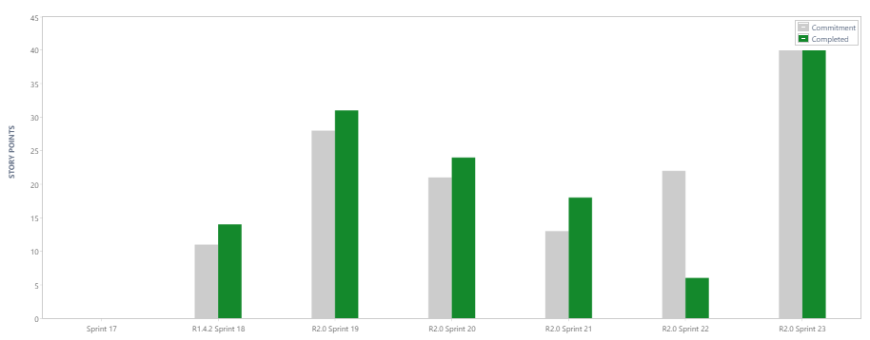
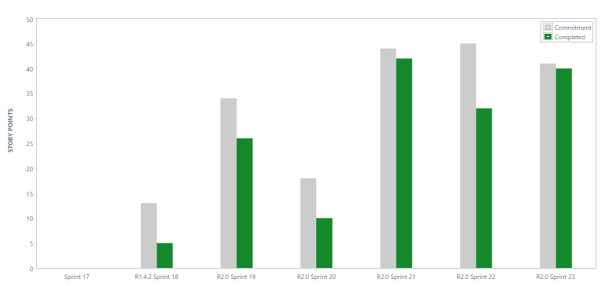
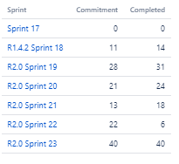
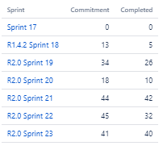
UI Team – Productivity ^{(orange & white)}
Risk: Vacations and sickness impacted productivity in sprints 20 and 21
Risk: Data environment issues
impacted productivity in sprint 22

Slide 12
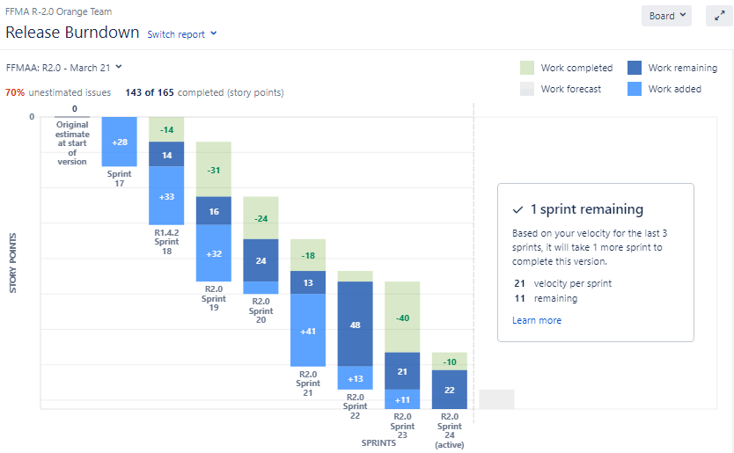
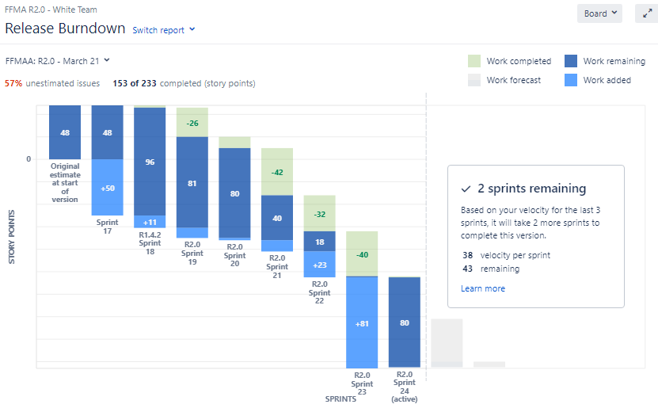
UI Team – Release Burndown ^{(orange & white)}
Risk: Only one Sprint is left in the current release but the scope still increasing due to new requirements added until the end of the release
Risk: Number of remaining sprints will keep increasing until all the requirements are known and estimated

Slide 13
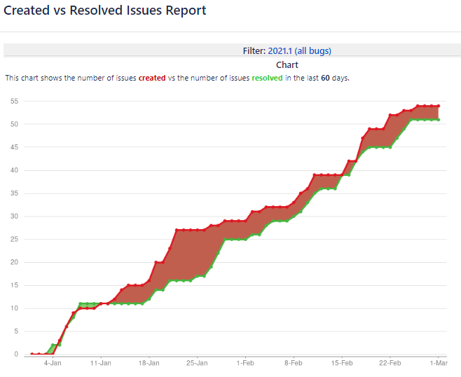
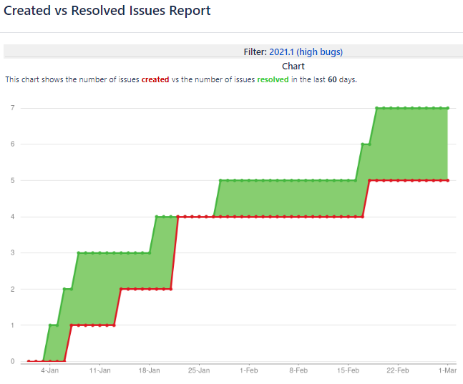
UI Team - Bugs fixing ^{(all & high )}
All severity levels
High-severity only (i.e. blocker and critical)

Slide 14
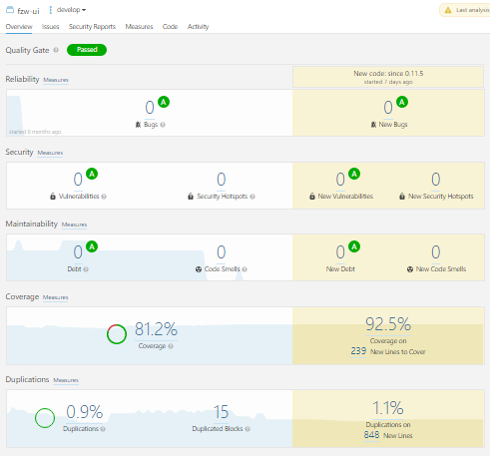
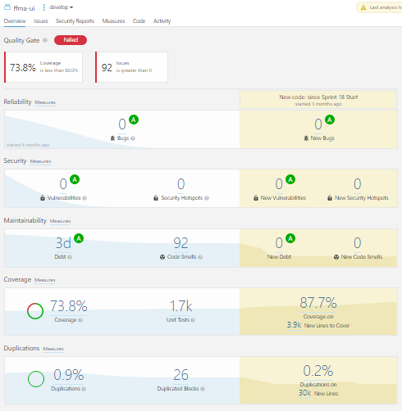
UI Team - Code Quality ^{(UI & API)}
Risk: Legacy code coverage and code smells will be addressed as part of technical debt in a future release

Slide 15
UI STREAM – Issues & Risks
L: Low, M: Medium, H: High
Issues and Risks | Impact | Likely | Mitigation Plan
Data refresh in DEV environment blocked the UI team which impacted the stories of sprint 22 and will likely impact the timeline end date for R2021.1 | H | 100% | Escalated Tracking progress UI re-planning to be done once the situation is restored
Quality Center unplanned update blocked the QA activities for the stories in sprint 22 and is likely to impact also the sprint 23 and the timeline end date for R2021.1 | H | 100% | Escalated Tracking progress UI re-planning to be done once the situation is restored
Account Mastering was added to the scope of Advanced Search for release 2021.1, which will impact the timeline end date by 5 days | H | 100% | Escalated Tracking progress UI re-planning is done with an expected increase of 5 days on the end date
Requirements are not finalized for release 2021.1, which is delaying estimations and bring risks for scope and timeline | H | 100% | Escalated
Estimates are not finalized for release 2021.1, which brings risks for scope and timeline. | H | 100% | Escalated
Capacity is not secured for release 2021.1, which brings risks for scope and timeline | H | 100% | Escalated Forecasted the secured capacity Expecting 2x more new joiners Selected candidate MVP epics which are likely to fit available
Onboarding is slow, which put on risk the planned capacity increase for release 2021.1 and therefore indirectly impacts the previous points | H | 100% | Escalated
E2E test milestones are not finalized for release 2021.1, which brings risks for time | H | 100% | Escalated
Requirements are not started for release 2021.2, which is delaying estimations and impacting planning | H | 100% | Escalated

Slide 16
UI Stream – Deployments
Version | IST Date (EOD) | UAT Date (10am CET) | Remarks
0.11.6 | 22-Feb | 24-Feb | Drop 6 of release 2021.1

Slide 17
Thank You

