Slide 1
Fezziwig PROGRAM
IT stream Managers Weekly report | UI stream
BP2S Data Technology Office
Confidential - For internal use only

Slide 2
Agenda – UI Stream
Overall Status
Scope & Effort
Resources & Capacity
Scope Breakdown
Timeline
Epics Dashboard
Features Dashboard
Productivity
Risk & Issues
Deployments

Slide 3
UI STREAM - Overall status
Owner : José
Overall Status
Challenged
Key Milestones of Release 2021.2 - Sprints
Week ending
09 Apr | 16 Apr | 23 Apr | 30 Apr | 07 Mai | 14 Mai | 21 Mai | 28 Mai | 04 Jun | 11 Jun
Milestones
SIT
SIT
SIT
SIT
SIT
Main Achievements
Quality gate passed for all the new code and improved for legacy code
Main Issues / Risks | Impact
E2E test milestones are not finalized for release 2021.2, which brings risks for time | H
Requirements started late for release 2021.2, which is delaying estimations and impacting planning | H
Next Milestones and Delivery | Target Date | Status
Deployment of next drop increment in IST | TBD | WIP
Completion of epic: Effective Dating OW / UW – Security Mastering | TBD | WIP
L: Low, M: Medium, H: High

Slide 4
UI STREAM – Scope & estimates (High Level)
*Real-World Engineering Days (excluding QA)
Epic | Effort* | UI* | API* | Remarks
Technical debt - Upgrade old Java Packages (XRAY) | 10 | 0 | 10
Time series – Accounts | 35 | 15 | 20
IDMTST - UI Enhancements | 10 | 5 | 5
Xref table updates in Datahub - UI Enhancements – Operations updates | 28 | 14 | 14
UI Enhancements approvals screen x2 / UI Risk Measurements timestamps | 5 | 4 | 1
Technical debt - Data API Upgrade | 15 | 0 | 15
Technical debt - Fund Structure optimization to improve performance | 30 | 20 | 10
Auditing and reporting | 15 | 0 | 15
TOTAL | 148 | 48 | 100

Slide 5
UI STREAM – pre-requisites (EPICS)
Color legend:Completed, On track, Challenged, Blocked, - na
Team | Epic (Team) | Overall | Requirements | UX | User Stories | Refinement | Data Dependencies | Remarks
Orange | Technical debt - Upgrade old Java Packages (XRAY) | ■ | ■ |  | ■ | ■
Orange | Time series – Accounts | ■ | ■ | ■ | ■ | ■
Orange | IDMTST - UI Enhancements | ■ | ■ | ■ | ■ | ■
White | Xref table updates in Datahub - UI Enhancements – Operations updates | ■ | ■ | ■ | ■ | ■
Orange | UI Enhancements approvals screen x2 / UI Risk Measurements timestamps | ■ | ■ | ■ | ■ | ■
White | Technical debt - Data API Upgrade | ■ | ■ |  | ■ | ■
White | Technical debt - Fund Structure optimization to improve performance | ■ | ■ |  | ■ | ■
White | Auditing and reporting | ■ | ■ | ■ | ■ | ■
 | Overall | ■ | ■ | ■ | ■ | ■

Slide 6
UI STREAM – Scope & ESTIMATES (breakdown) ^{(1/2)}
*Real-World Engineering Days (excluding QA)
Epic | Effort* | Features breakdown | Effort* | Remarks
Technical debt - Upgrade old Java Packages (XRAY) | 10 | Java Package Upgarde | 10
Time series – Accounts | 35 | Add TS Record | 5
 |  | TS AM Approval List | 4
 |  | TS AM Approve Reject | 6
 |  | TS AM Create Account | 5
 |  | TS AM Edit | 4
 |  | TS AM List View | 10
IDMTST - UI Enhancements | 10 | IDMTST | 10
Xref table updates in Datahub | 28 | Amend | 2
 |  | Approve/Reject | 4
 |  | Create | 4
 |  | Edit | 2
 |  | General | 3
 |  | Inactivating | 2
 |  | List View | 4
 |  | Pre-visualiation | 2
 |  | Send for Approval | 3
 |  | View | 2

Slide 7
UI STREAM – Scope & ESTIMATES (breakdown) ^{(2/2)}
*Real-World Engineering Days (excluding QA)
Epic | Effort* | Features breakdown | Effort* | Remarks
UI Enhancements approvals screen x2 / UI Risk Measurements timestamps | 5 | UI Enhancements approvals screen x2 / UI Risk Measurements timestamps | 5
Technical debt - Data API Upgrade | 15 | Data API Upgrade | 15
Technical debt - Fund Structure optimization to improve performance | 30 | Fund Structure optimization to improve performance | 30
Auditing and reporting | 15 |  | 15
Risk: We didn’t get any requirement yet for Auditing and reporting
Risk: Effort in creased to 30 MD and therefore descoped from the release 2021.1

Slide 8
UI STREAM – Team Capacity
Baseline Capacity – incl. Vacations and Holidays
UI Team | Sprint 26 | Sprint 27 | Sprint 28 | Sprint 29
White | 18.2 | 13.2 | 10.0 | 12.7
Orange | 13.7 | 10.9 | 11.4 | 8.6
TOTAL | 31.9 | 24.1 | 21.4 | 21.4
Remarks
We have stabilized the two teams by balancing the capacity in both teams according the new organisation
The capacity shown here (MD) is for new features development only (excl. time for non-engineering tasks, bug fixing, production support and unplanned tasks)
Capacity Check
 | effort | capacity | diff
UI | 48 | 60 | 12
API | 100 | 59 | -41
TOTAL | 148 | 119 | -29
Risk: The required capacity is not secured. In particular, on the API developers side
Team 1 –Orange
Team 2 - White
Sudhakar | G | SM | Chennai
Deepa | Elumalai | BA | Chennai
David | Duret | BA | Paris
Kumaresan | Jayaraman | FS DEV | Chennai
Ramesh | Ulaganathan | FS DEV | Chennai
Ramesh | ARUMUGAM | UI DEV | Chennai
Ariharasubashini | S | FS DEV | Chennai
Manish | JHA | FS DEV | Paris
Saravanan | Meenakshisundaram | QA | Chennai
Senthil | NARAYANASAMY | QA | Chennai
Guylaine | Schorter | SM | Paris
Catherine | Allix | BA | Paris
Jean-Marie | Gagnaire | FS DEV | Paris
Haripriya | PS | FS DEV | Chennai
Lahcen | Elalem | API DEV | Paris
Mariyappan | MUTHABISHEGAM | API DEV | Chennai
Zied | ECHEIKH | FS DEV | Paris
Xavier | Auberon | QA | Paris
Ramana | CHANDAR | QA | Chennai

Slide 9
UI STREAM - Timeline
Month
Apr
Mai
Juin
Week ending
9
16
23
30
7
14
21
28
4
11
Sprints
Sprint 26
Sprint 27
Sprint 28
Sprint 29
stabilization
Upgrade old Java Packages (XRAY)
Time Series for Accounts
IDMTST
Auditing and Reporting
Features
Xref table updates in Datahub
UI Enhancements approvals screen
Upgrade Data API
FS tactical fix to resolve performance issues
Risk: We are still doing Bug fixing that is supposed to be finished during the stabilization phase of the 21.1 release that is impacting the planning for 21.2 release
SIT
drop 1
drop 2
drop 3
drop 4
UAT
Tech. Check Doc
Q.G.
Aftercare
Tech. Check Doc
Q.G.
Aftercare
PROD
R2021.1
R2021.2
QA
Bug fixing (30%)
L3 support
Production Incidents (5%)
Refinements
Preparing R2021.2
Preparing R2021.3

Slide 10
UI STREAM – progress DASHBOARD
Features are shown on their ending sprint
Color legend:Completed, On track, Challenged, Blocked, - NA
Team | Epic | Epic | Sprint 26 | Sprint 27 | Sprint 28 | Sprint 29 | Pending (#US) | Total (#US) | Remarks
Orange | Technical debt - Upgrade old Java Packages (XRAY) | ■ | Xray upgrade |  |  |  | 1 | 1
Orange | Time series – Accounts | ■ | Add TS Record, TS AM Create Account, TS AM Approval List | TS AM Approve Reject, TS AM Edit, Add TS Record | TS AM Approve Reject,TS AM List View |  | 4 | 15
Orange | IDMTST - UI Enhancements | ■ |  |  | IDMTST-994, IDMTST-1415, IDMTST-1060, IDMTST-1182 | IDMTST-565, IDMTST-1085, IDMTST-1058 | 0 | 7
White | Xref table updates in Datahub - UI Enhancements – Operations updates | ■ | Create, Approve/Reject, Pre-visualization | Amend, General, List View, Send for Approval, View, Inactivating, Edit |  |  | 8 | 25
Orange | UI Enhancements approvals screen x2 / UI Risk Measurements timestamps | ■ |  |  | UI Enhancements approvals |  | - | -
White | Technical debt - Data API Upgrade | ■ |  |  | Data API Upgrade |  | 1 | 1
White | Technical debt - Fund Structure optimization to improve performance | ■ |  |  |  | Fund Structure optimization | 1 | 1
White | Auditing and reporting | ■ |  |  |  | Auditing and reporting(*) | - | -
Risk: To be checked for the requirement
Risk: Requirement are not available yet for Auditing and reporting

Slide 11
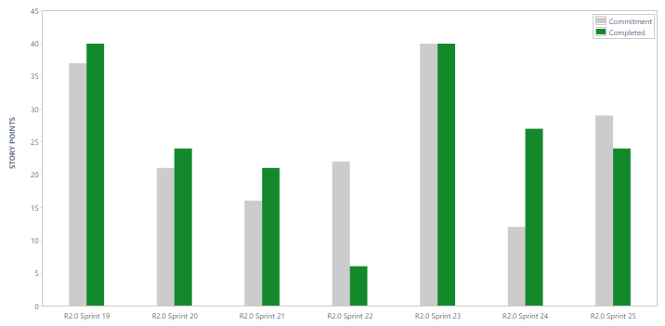
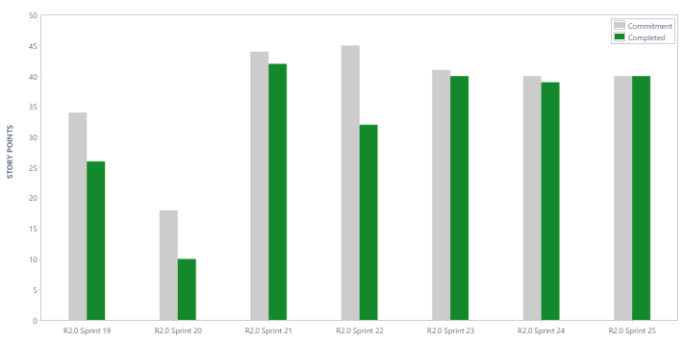
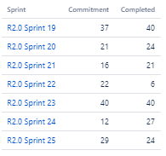
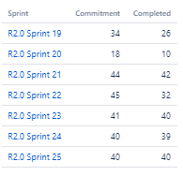
UI Team – Productivity ^{(orange & white)}

Slide 12
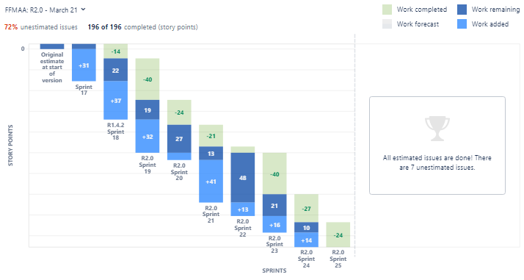
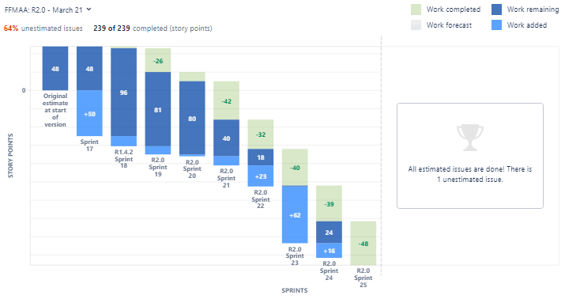
UI Team – Release Burndown ^{(orange & white)}

Slide 13
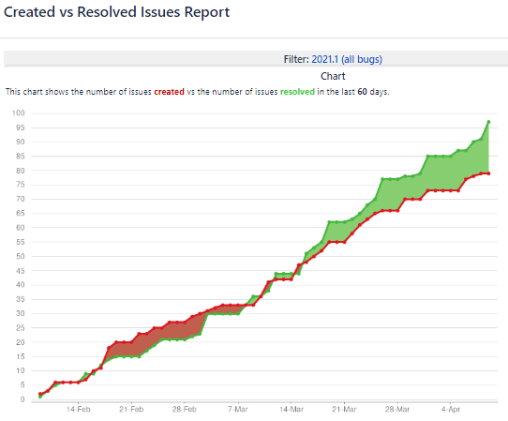
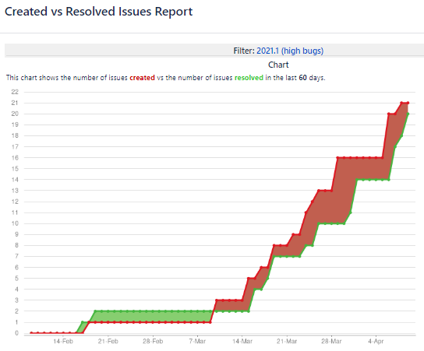
UI Team - Bugs fixing ^{(all & high )}
All severity levels
High-severity only (i.e. blocker and critical)

Slide 14
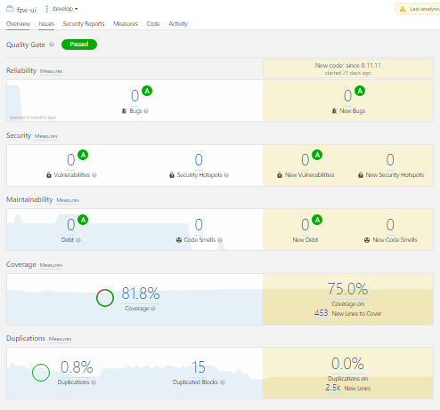
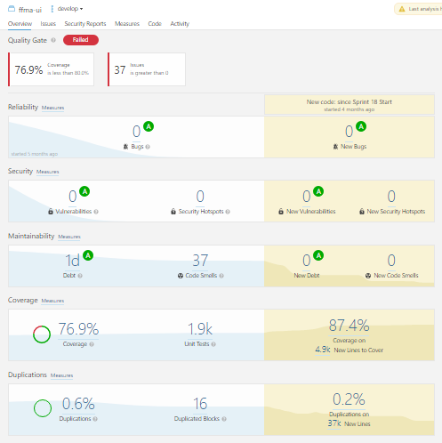
UI Team - Code Quality ^{(UI & API)}
Risk: Legacy code coverage and code smells will be addressed as part of technical debt in a future release

Slide 15
UI STREAM – Issues & Risks
L: Low, M: Medium, H: High
Issues and Risks | Impact | Likely | Mitigation Plan
E2E test milestones are not finalized for release 2021.1, which brings risks for time | H | 100% | Escalated
Requirements started late for release 2021.2, which is delaying estimations and impacting planning | H | 100% | Escalated

Slide 16
UI Stream – Deployments
Version | IST Date (EOD) | UAT Date (10am CET) | Remarks
0.11.18 | 09-Apr | 10-Apr | Drop 13 of release 2021.1

Slide 17
Thank You

