Slide 1
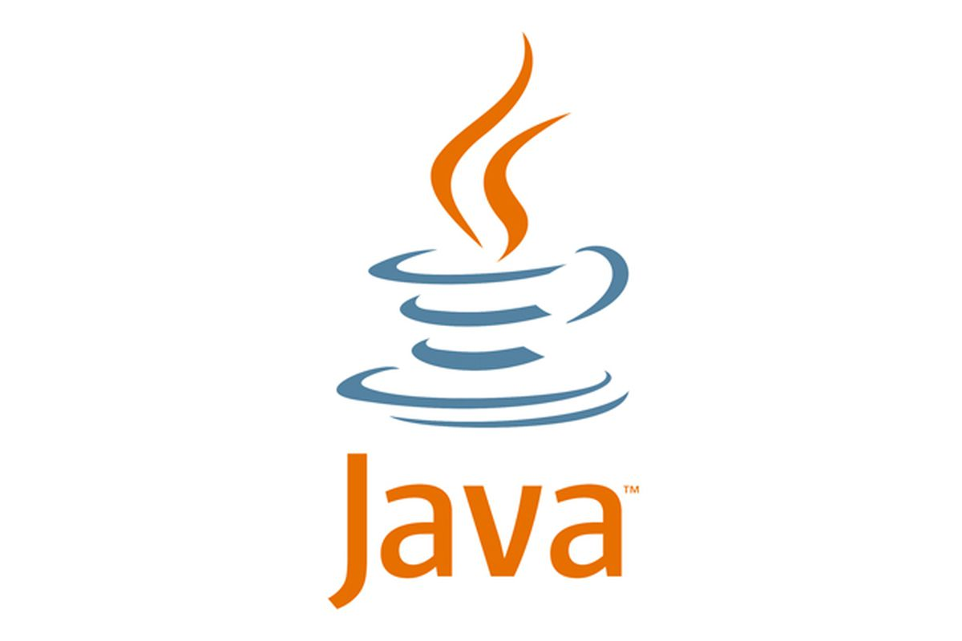
Marwa Safa

Slide 2
Objectives
Introduction to java
Java installation
Two important features of java
Creating java project
Creating java class
Java variables
Java data types
Java operator
Control statements
Arrays
Object oriented programming
Class
Object
Inheritance
Polymorphism
Abstraction
Encapsulation
Types of java variables
Java interface

Slide 3
Introduction to Java
Java is a multi-platform, object-oriented, programming language.
To work with Java, we need JDK(java development kit) & JRE(java runtime environment);
JDK means a complete java software.
JRE enables java programs to run on any computer.
Another important component of JDK is JVM. JVM is responsible for compiling and executing java programs.
JVM is not hardware it is not physical software too, it is a virtual software available in JRE.

Slide 4
How Java Works
Java is called platform independent because of Java Virtual Machine. As different computers with the different operating system have their JVM, when we submit a .class file to any operating system, JVM interprets the bytecode into machine level language.
JVM is the main component of Java architecture, and it is the part of the JRE (Java Runtime Environment).
JVM and JRE are subcomponents of JDK.
JVM is responsible for allocating the necessary memory needed by the Java program.
JVM is responsible for deallocating memory space.

Slide 5
What Is JVM
Java is a technology consisting of both a programming language and a software platform. To create an application using Java, you need to download the Java Development Kit (JDK), which is available for Windows, macOS, and Linux.
The Java Virtual Machine is called JVM, is an abstract computing machine or virtual machine interface that drives the java code.
Mostly in other Programming Languages, compiler produce code for a particular system, but Java compiler produce Bytecode for a Java Virtual Machine.
When we compile a Java program, then bytecode is generated. Bytecode is the source code that can be used to run on any platform.
Bytecode is an intermediary language between Java source and the host system.
It is the medium which compiles Java code to bytecode which gets interpreted on a different machine and hence it makes it Platform/Operating system independent.

Slide 6
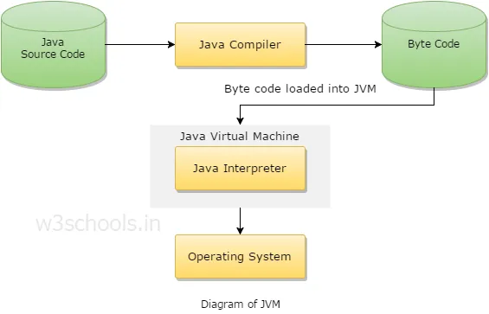
Diagram Of JVM
JVM generates a .class(Bytecode) file, and that file can be run in any OS.

Slide 7
Java Installation
After downloading and installing java we need to configure (set java path). Java configuration means Setting java to work from anywhere in our Computer. We have to tell the computer where java is.
Steps to configure:
Go to Java path (c:\program files\java)
Find the JDK bin folder copy the path and set it in Environment Variables.
HOW TO SET ENVIRONMENT VARIABLES?
Go to This PC (my computer)
Right click and click on properties
Click on advanced system setting

Slide 8
Two important features of Java
Java is platform independent
Platform independent means we can execute it on any operating system environments e.g., Windows, Linux MAC OS. When we save Java program it is saved by .Java extension, before we execute this program, we must compile it, when we compile this program, it is converted to machine language and saved by the extension .class.
Java is case sensitive language.
Upper case and lowercase have different meaning.

Slide 9
Creating a Java project
Steps to create java project
Go to IntelliJ IDE click on file
Click on new, then click on new Java project.
Enter Java name.
Note. SRC folder:- we can create our package (folder) where our all-java program is kept.
Right click on SRC folder create new package.
Enter package name.

Slide 10
Java primitive data types
Data Type | Size | Description
byte | 1 byte | Stores whole numbers from -128 to 127
short | 2 bytes | Stores whole numbers from -32,768 to 32,767
int | 4 bytes | Stores whole numbers from -2,147,483,648 to 2,147,483,647
long | 8 bytes | Stores whole numbers from -9,223,372,036,854,775,808 to 9,223,372,036,854,775,807
float | 4 bytes | Stores fractional numbers. Sufficient for storing 6 to 7 decimal digits
double | 8 bytes | Stores fractional numbers. Sufficient for storing 15 decimal digits
boolean | 1 bit | Stores true or false values
char | 2 bytes | Stores a single character/letter or ASCII values

Slide 11
Java non-primitive data types
In Java, non-primitive data types are also known as reference types. These data types are not predefined like primitive data types and are created by the programmer. They include:
Objects: Objects are instances of a class and are used to store data as well as behavior.
Arrays: Arrays are used to store a fixed number of elements of the same type.
Strings: Strings are used to represent a sequence of characters.
Classes: Classes are used to define objects and their behavior.
Interfaces: Interfaces are used to define a set of methods that a class must implement.
Enumerations: Enumerations are used to define a set of named constants.
Annotations: Annotations are used to add metadata to code elements.
These non-primitive data types are essential for building complex applications and data structures in Java.

Slide 12
Primitive types vs Non-primitive data types
Primitive types represent simple values and are stored on the stack, while Non-primitive types or reference types represent objects and arrays and are stored on the heap.
Primitive types are passed by value, while non-primitive types are passed by reference.

Slide 13
Java variables
Java variables are a memory container which hold data.
Example:
X = 100;
X – is the container.
100 – is the value.
In java we can not directly assign value to a variable first we need to specify what type of data we assign.
Example:
Int x = 100; This means x has stored the integer value of 100.

Slide 14
Arrays
When we store data using variables, we can only store one data in that memory Allocation. When ever we change the data the previous one will be deleted.
Ex. Int x = 100;
Then if we decide to change it and declare that x = 200; then 100 will be deleted and 200 is stored. As a variable can hold only one value. If we want to hold multiple values we need to create an Array. (Restriction: only the same data type)
Array is a collection of elements or values of the same datatype.
The advantage of array is we can store multiple value in a single variable.
Types of Arrays:-
Single dimension Array
Two-dimensional Array

Slide 15
Java Operators
Java operators are what perform some tasks on operands.
Example: X + Y = Z; (+ sign and the = sign are operators which perform addition operations on variables X and Y.)
There are many types of operators. But first we will show the use of basic operators they are:
arithmetic operators (+, - ,* ,/ ,%)
assignment =

Slide 16
Java Operators
The rest are:
Relational (<, >, >=, <=, !=, ==)
logical (&&, ||, !)
They are mostly used in if-else statements.
increment and decrement (++, --)
They are mostly used in loops
All of them are used in control statements which we will discuss shortly

Slide 17
Control Statements in Java
In java execution of program is performed from top to bottom due to this control statements enable us to execute anywhere we want in the program based on certain conditions.
TYPES OF CONTROL STATEMENTS
Conditional statements: whenever we want to execute part of program based on certain conditions.
Types of conditional statements:
If, if else, switch
Syntax:- if(condition)
{
Statements;
}
Syntax:- switch(variable)
{
case value 1: statements;
break;
case value 2: statements;
break;
}
While , do---while, for
Break, continue.

Slide 18
Control Statements in Java
Loop statements: To execute a group of statements repeatedly.
When we write a code if certain number of statements are repeated instead of writing it again and again, we use loop.
There are 4 different types of looping statements
while loop - While a condition is true and ONLY while the condition is true, loop/continue looping
Syntax: while(condition){
statements;
}
do while loop - Executes the loop first ALWAYS, and then checks the condition to see if it should continue looping
Syntax: do{
statements;
} while (condition);
for loop - Used when we know EXACTLY how many iterations we need to loop
Syntax: for(initialization; condition; Inc/dec){
statements;
}

Slide 19
Operations On Single Dimensional Array
Declare an array
Int[] a= new int [5];
Index is the location of the data in array, index starts from 0;
To access data in the array we need to mention array name and index.
Int[] myArray;
myArray = int [3];
int a[0]=100;
int a[1]=200;
int a[2]=300;
int[] a = {100,200,300};
Find size of an array.
myArray.length;
System.out.println(myArray.length()); the output will be array length (3);

Slide 20
Operations On Single Dimensional Array
Read single value from array
- Example: myArray[0] = 10;
Read multiple value from array
To read multiple value from array we need a looping statement.
for(I = 0; I < myArray.length(); i++)
{
System.out.println(myArray[i]);
}

Slide 21
Java Methods
A method is a reusable block of code which can be executed as many times as you want.
You can pass data, known as parameters, into a method.
Methods are used to perform certain actions, and they are also known as functions.
Why use methods? To reuse code: define the code once, and use it many times.
Parameters and Arguments
Information can be passed to methods as parameter. Parameters act as variables inside the method.
Parameters are specified after the method name, inside the parentheses. You can add as many parameters as you want, just separate them with a comma.
Return Values
The void keyword, used in the examples above, indicates that the method should not return a value. If you want the method to return a value, you can use a primitive data type (such as int, char, etc.) instead of void, and use the return keyword inside the method
Method Overloading
With method overloading, multiple methods can have the same name with different parameters

Slide 22
Creating a Java Class
To write a Java program we must first create a Java class.
Steps:-
Right click on the created package.
Click on new then new class
Enter class name
Class Naming convention
Start with upper case
No number to start with
No special character
No space

Slide 23
Types Of Java Variables
A variable is a container which holds the value while the Java Program is executed. A variable is assigned with a data type. Variable is a name of memory location. There are three types of variables in java: local, instance and static.
Local Variable: A variable declared inside the body of the method is called local variable. You can use this variable only within that method and the other methods in the class aren't even aware that the variable exists. A local variable cannot be defined with "static" keyword.
Instance Variable: A variable declared inside the class but outside the body of the method, is called an instance variable. It is not declared as static. It is called an instance variable because its value is instance-specific and is not shared among instances.
Static Variable: A variable that is declared as static is called a static variable. It cannot be local. You can create a single copy of the static variable and share it among all the instances of the class. Memory allocation for static variables happens only once when the class is loaded in the memory.

Slide 24
Static Keyword
The static keyword is used to create class-level variables and methods that can be accessed without creating an instance of the class.
When a variable or method is declared as static, it belongs to the class rather than to any instance of the class. This means that all objects of that class share the same static variable or method, and changes made to it affect all objects of that class.
Some common uses of static in Java include:
Creating constants that are shared by all instances of a class
Creating utility methods that do not depend on instance variables
Counting the number of objects created by a class using a static variable
It is important to note that static variables and methods cannot access non-static variables or methods in the same class. They can only access other static variables or methods, or static variables and methods in other classes.

Slide 25
What is OOPS?
OOP “Object Oriented Programming” is a popularly known and widely used concept in modern programming languages like Java. It is a programming concept that works on the principles of abstraction, encapsulation, inheritance, and polymorphism and that’s why it’s called OOPs (Object Oriented Programming System). The following are general OOPs concepts in Java:
CLASS: The class is one of the Basic concepts of OOPs which is a group of similar entities. It is only a logical component and not the physical entity. In oops the first important thing is class. What is class? Class is a collection of variables (attributes) and methods (Behaviors). Object is an instance of the class. Class is a category and object is a single occurrence of the class.
Example: Student, class ------ logical entity
john, object ------ physical entity.
Syntax : class Student{
variables;
methods;
}

Slide 26
Object
OBJECT: An object can be defined as an instance of a class, there can be multiple instances of a class in a program. An Object is one of the Java OOPs concepts which contains both the data and the function, which operates on the data. For example – chair, bike, marker, pen, table, car, etc. to use class level variables and methods we need to create object.
Where do we create object?
We create object only inside a main method and we create main method only inside a class.
Example:- public Static void main(string args[]){
ShoppingCart cart= new ShoppingCart();
}

Slide 27
Assigning data to class variables
By using object reference variable: creating object in the main method and assigning data to the class member variables.
By using methods: creating method in the main class which can take arguments and assign the data.
By using constructors: constructor is a method with same name with class and no return type even void.

Slide 28
Access Modifiers
In Java, access modifiers are keywords used to control the visibility and accessibility of classes, methods, and variables in a program. These are key to implementing OOP. There are four access modifiers in Java:
Public: Public members are accessible from anywhere in the program, including other classes and packages and also when they are imported in other application.
Private: Private members are only accessible within the same class. They cannot be accessed from outside the class, not even by subclasses.
Protected: Protected members are accessible within the same class, subclasses, and other classes in the same package.
Default (no keyword): Members with no access modifier (default) are accessible only within the same package.
Access modifiers are important for encapsulation and security in object-oriented programming. They help to ensure that only the intended classes or methods can access and modify certain data, while hiding it from other classes or users.

Slide 29
Encapsulation
Encapsulation: Encapsulation is one of the best Java OOPs concepts of wrapping the data and code. In this OOPs concept, the variables of a class are always hidden from other classes.
For every variables we need to create setters and getters. If we have 10 variables then, we need to create setter and getter for each variables. IntelliJ has a feature to create getter and setter.
Note : This key word in setter method is used to separate between the class variable and local parameters variable

Slide 30
Encapsulation
Encapsulation is rapping of data and methods into a single unit.
The purpose of encapsulation is security we can only access the variables using the method within the class.
Since we use methods to access the variables there are two concepts to know.
1. setters:-methods used to assign data to the variables.
2. getters:- methods used to return the data.
During encapsulation, the variables and methods are in a single class and the variables should be private.
syntax: private int x;
Note we can not access private variables from other classes.

Slide 31
What is Inheritance
INHERITANCE: Inheritance is one of the Basic Concepts of OOPs in which one object acquires the properties and behaviors of the parent object. It’s creating a parent-child relationship between two classes. It offers robust and natural mechanism for organizing and structure of any software. we use the key word extends to establish parent –child relationship
With inheritance, we can reuse the fields and methods of the existing class. Hence, inheritance facilitates Reusability and is an important concept of OOPs.
The idea behind inheritance in Java is that you can create new classes that are built upon existing classes. When you inherit from an existing class, you can reuse methods and fields of the parent class. Moreover, you can add new methods and fields in your current class also.

Slide 32
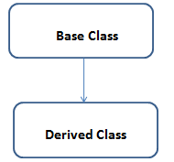
Types of Java supported Inheritance
Single Inheritance: When a Derived Class to inherit properties and behavior from a single Base Class, it is called as single inheritance.

Slide 33
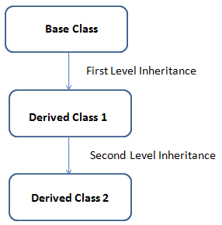
Types of Java supported Inheritance
Multi-Level Inheritance: A derived class is created from another derived class
Example of Multi-Level Inheritance

Slide 34
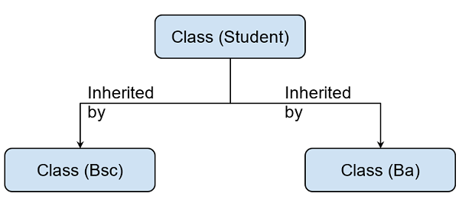
Types of Java supported Inheritance
Hierarchical Inheritance: The type of inheritance in which more than one derived class inherits the properties of the same base class is called hierarchical inheritance. There are multiple child classes and a single parent class.

Slide 35
Polymorphism
Polymorphism: Polymorphism refers to one of the OOPs concepts in Java which is the ability of a variable, object or function to take on multiple forms.
Polymorphism is possible because of overloading. Overloading is writing multiple methods with same name by differentiating the parameter. Polymorphism is theoretical concept which implemented using overloading
Rules during method overloading
Method name must be the same
Parameters should be different or if parameters are the same then data type should be different.

Slide 36
Abstraction
Abstraction: Abstraction is one of the OOP Concepts in Java which is an act of representing essential features without including background details. It is a technique of creating a new data type that is suited for a specific application.
We can implement abstraction on classes and methods. Abstract method means incomplete method. The child class is responsible to implement the incomplete methods.

Slide 37
What is Interface in Java
An Interface in Java programming language is defined as an abstract type used to specify the behavior of a class. A Java interface contains static constants and abstract methods. An Interface in Java programming language is defined as an abstract type used to specify the behavior of a class. A Java interface contains static constants and abstract methods.
Writing an interface is like writing a class. But a class describes the attributes and behaviors of an object and an interface contains behaviors that a class implements. Unless the class that implements the interface is abstract, all the methods of the interface need to be defined in the class.
An interface can contain any number of methods.
An interface is written in a file with a .java extension, with the name of the interface matching the name of the file.
The byte code of an interface appears in a .class file.
BUT All of the methods in an interface are abstract, also An interface is not extended by a class; it is implemented by a class. An interface can extend multiple interfaces.

Slide 38
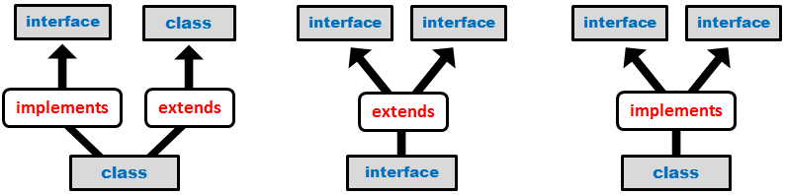
Implementing Interfaces
An interface is implicitly abstract. Each method in an interface is also implicitly abstract, so the abstract keyword is not needed. Methods in an interface are implicitly public.
When a class implements an interface, you can think of the class as signing a contract, agreeing to perform the specific behaviors of the interface. If a class does not perform all the behaviors of the interface, the class must declare itself as abstract.
A class uses the implements keyword to implement an interface. The implements keyword appears in the class declaration following the extends portion of the declaration.

Slide 39
Sorting in Java
What is sorting? Well its exactly what you would expect it to be. Arranging data. You can use various ordering criteria, common ones being sorting numbers from least to greatest or vice-versa.
There are 5 main sorting methods in Java:
Merge Sort
Heap Sort
Insertion Sort
Selection Sort
Bubble Sort

Slide 40
MergeSort
Merge sort is one of the most flexible sorting algorithms in java known to mankind (yes, no kidding). It uses the divide and conquers strategy for sorting elements in an array. It is also a stable sort, meaning that it will not change the order of the original elements in an array concerning each other. The underlying strategy breaks up the array into multiple smaller segments till segments of only two elements (or one element) are obtained. Now, elements in these segments are sorted and the segments are merged to form larger segments. This process continues till the entire array is sorted.
This algorithm has two main parts:
mergeSort() – This function calculates the middle index for the subarray and then partitions the subarray into two halves. The first half runs from index left to middle, while the second half runs from index middle+1 to right. After the partitioning is done, this function automatically calls the merge() function for sorting the subarray being handled by the mergeSort() call.
merge() – This function does the actual heavy lifting for the sorting process. It requires the input of four parameters – the array, the starting index (left), the middle index (middle), and the ending index (right). Once received, merge() will split the subarray into two subarrays – one left subarray and one right subarray. The left subarray runs from index left to middle, while the right subarray runs from index middle+1 to right. This function then merges the two subarrays to get the sorted subarray.

Slide 41
HeapSort
Heap sort is one of the most important sorting methods in java that one needs to learn to get into sorting. It combines the concepts of a tree as well as sorting, properly reinforcing the use of concepts from both. A heap is a complete binary search tree where items are stored in a special order depending on the requirement. A min-heap contains the minimum element at the root, and every child of the root must be greater than the root itself. The children at the level after that must be greater than these children, and so on. Similarly, a max-heap contains the maximum element at the root. For the sorting process, the heap is stored as an array where for every parent node at the index i, the left child is at index 2 * i + 1, and the right child is at index 2 * i + 2.
A max heap is built with the elements of the unsorted array, and then the maximum element is extracted from the root of the array and then exchanged with the last element of the array. Once done, the max heap is rebuilt for getting the next maximum element. This process continues till there is only one node present in the heap.
This algorithm has two main parts:-
heapSort() – This function helps construct the max heap initially for use. Once done, every root element is extracted and sent to the end of the array. Once done, the max heap is reconstructed from the root. The root is again extracted and sent to the end of the array, and hence the process continues.
heap() – This function is the building block of the heap sort algorithm. This function determines the maximum from the element being examined as the root and its two children. If the maximum is among the children of the root, the root and its child are swapped. This process is then repeated for the new root. When the maximum element in the array is found (such that its children are smaller than it) the function stops. For the node at index i, the left child is at index 2 * i + 1, and the right child is at index 2 * i + 2 (indexing in an array starts from 0, so the root is at 0).

Slide 42
InsertionSort
While insertion sort isn’t a much-optimized algorithm for sorting an array, it is one of the more easily understood ones. Implementation is pretty easy too. In insertion sort, one picks up an element and considers it to be the key. If the key is smaller than its predecessor, it is shifted to its correct location in the array.
Algorithm:
START
Repeat steps 2 to 4 till the array end is reached.
Compare the element at current index i with its predecessor. If it is smaller, repeat step 3.
Keep shifting elements from the “sorted” section of the array till the correct location of the key is found.
Increment loop variable.
END

Slide 43
SelectionSort
In selection sort, two loops are used. The inner loop one picks the minimum element from the array and shifts it to its correct index indicated by the outer loop. In every run of the outer loop, one element is shifted to its correct location in the array. It is a very popular sorting algorithm in python as well.
Algorithm:
START
Run two loops: an inner loop and an outer loop.
Repeat steps till the minimum element are found.
Mark the element marked by the outer loop variable as a minimum.
If the current element in the inner loop is smaller than the marked minimum element, change the value of the minimum element to the current element.
Swap the value of the minimum element with the element marked by the outer loop variable.
END

Slide 44
BubbleSort
The two algorithms that most beginners start their sorting career with would be bubble sort and selection sort. These sorting algorithms are not very efficient, but they provide a key insight into what sorting is and how a sorting algorithm works behind the scenes. Bubble sort relies on multiple swaps instead of a single like selection sort. The algorithm continues to go through the array repeatedly, swapping elements that are not in their correct location.
Algorithm:
START
Run two loops – an inner loop and an outer loop.
Repeat steps till the outer loop are exhausted.
If the current element in the inner loop is smaller than its next element, swap the values of the two elements.
END

Slide 45
Conclusion
It's also important to understand that Java is much different from JavaScript. JavaScript does not need to be compiled, while Java code does needs to be compiled. Also, JavaScript only runs on web browsers while Java can be run anywhere. New and improved software development tools are coming to market at a remarkable pace, displacing incumbent products once thought to be indispensable. In light of this continual turnover, Java’s longevity is impressive; more than two decades after its creation, Java is still the most popular language for application software development—developers continue to choose it over languages such as Python, Ruby, PHP, Swift, C++, and others. As a result, Java remains an important requirement for competing in the job market.

Slide 46
Java Interview Q&A
What are the differences between Heap and Stack Memory in Java?
Stack is generally used to store the order of method execution and local variables. In contrast, Heap memory is used to store the objects. After storing, they use dynamic memory allocation and deallocation.
What is the default value stored in Local Variables?
In Java, when you make the constructor of a class private, that particular class can generate only one object. This type of class is popularly known as a Singleton Class.

Slide 47
Java Interview Q&A
Explain the expected output of the following code segment?
public class Simplilearn
{
public static void main (String args[])
{
System.out.println(100 + 100 +"Simplilearn");
System.out.println("E-Learning Company" + 100 + 100);
}
}
The code will print out
200Simplilearn
E-Learning Company100100

Slide 48
Java Interview Q&A
Define Wrapper Classes in Java.
In Java, when you declare primitive datatypes, then Wrapper classes are responsible for converting them into objects(Reference types)
Define package in Java.
The package is a collective bundle of classes and interfaces and the necessary libraries and JAR files. The use of packages helps in code reusability.
Can you implement pointers in a Java Program?
Java Virtual Machine takes care of memory management implicitly. Java's primary motto was to keep programming simple. So, accessing memory directly through pointers is not a recommended action. Hence, pointers are eliminated in Java.

Slide 49
Java Interview Q&A
What is the difference between JDK, JRE, and JVM?
The difference between JDK, JRE & JVM is that;
JVM has a Just in Time (JIT) compiler tool that converts all the Java source code into the low-level compatible machine language. Therefore, it runs faster than the regular application.
JRE has class libraries and other JVM supporting files. But it doesn’t have any tool for java development such as compiler or debugger.
JDK has tools that are required to write Java Programs and uses JRE to execute them. It has a compiler, Java application launcher, and an applet viewer.

Slide 50

Thank You!

