Slide 1

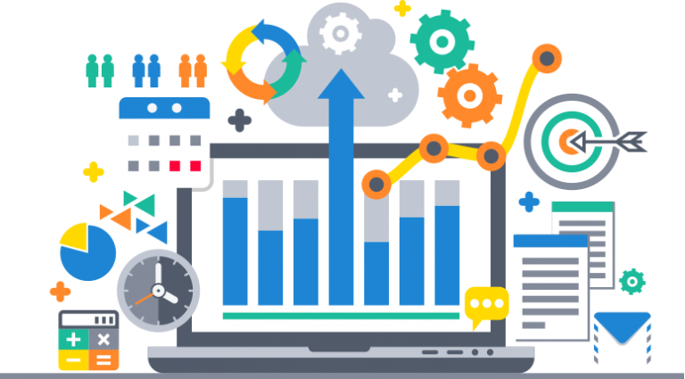
Project Name
6th Grade
Group
Data Analyst _DAT1_S9e
HR Dataset Analysis
Supervised By Eng
-Mohaned Elassal
-Yehya Adam

Slide 2
Project Process
01
02
03
04
Data Analysis
Data Cleaning
( Check data types – Rename Fields & Tables – check non values-duplicate values-visualization )
( Pandas- Numpy-Matplotlib- seaborn )
Forecasting With ML
Data Visualization in Dashboard
( Sklearn )
( Tableau )

Slide 3
Our Objective
HR data analysis for companies is to achieve a range of benefits that help improve employee management and strategic decision-making. These objectives include:-
1-
Enhancing Recruitment and Selection Processes
2-
Increasing Employee Retention
4-
Improving Employee Experience
3-
Boosting Productivity and Performance
5-
Supporting Strategic Decision-Making
6-
Forecasting Future Needs

Slide 4
Data Cleaning

Slide 5

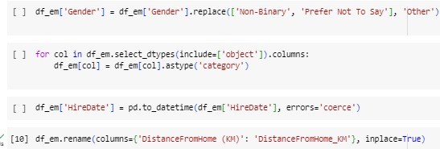
1-Data Cleaning
Python: Widely used for data analysis due to its powerful libraries such as:
Pandas: cleaning in Python. It is used for data manipulation and cleaning easily through simple commands to handle missing values, duplicates, and error correction

Slide 6
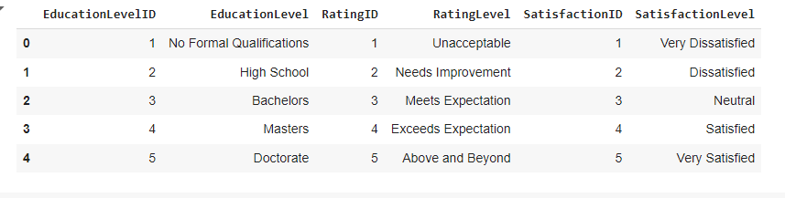
Concatenate The DataFrames
1-Reset Index
2- Concatenation
3- Saving to Excel
Tools
( Python _ Excel)

Slide 7
Data Analysis
02

Slide 8
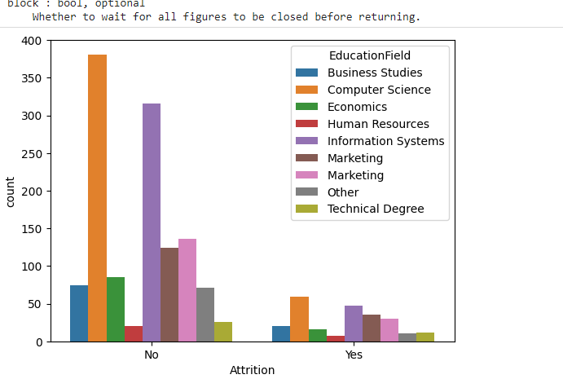
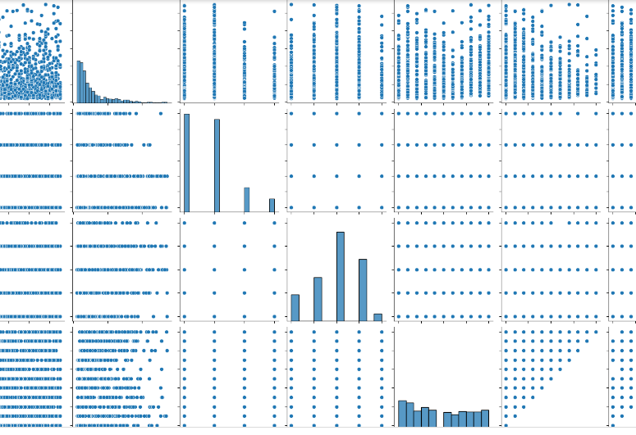
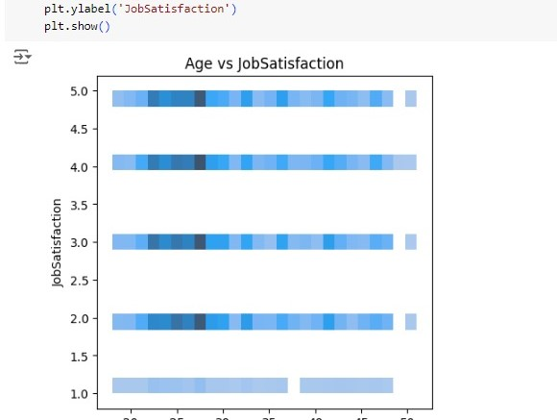

2-Data Analysis
Python: Widely used for data analysis due to its powerful libraries such as:
NumPy: For mathematical operations and arrays
Matplotlib and Seaborn: For creating visualizations.

Slide 9
Forecasting Using ML

Slide 10
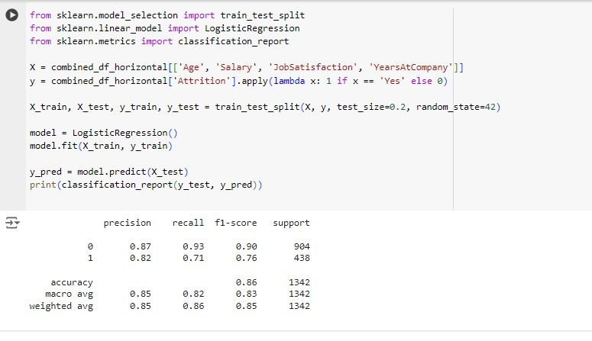
3-Forecasting Using ML
Steps for Forecasting with (sklearn.):
1-
Feature Selection and Split the Data:
2-
Choose a Model and Train the Model:
3-
Make Predictions:

Slide 11
Data Visualization
(Tableau)

Slide 12
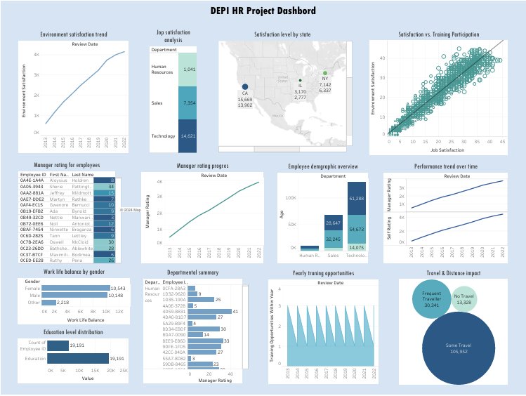

Slide 13
Recommendations

Slide 14
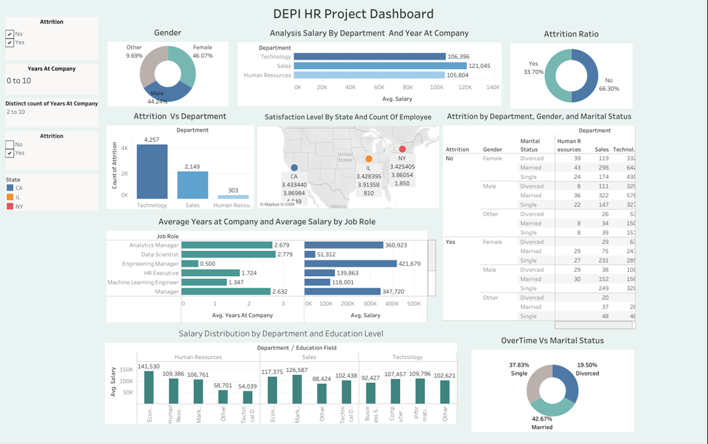

Slide 15


Marwa Hamada
Group
Data Analyst _DAT1_S9e
Team members
Wesam Karam
Heba El Gazzar
Menna Tarek
Saif Magdy

