Slide 1
PCA
Eng. Marwan Mostafa

Slide 2
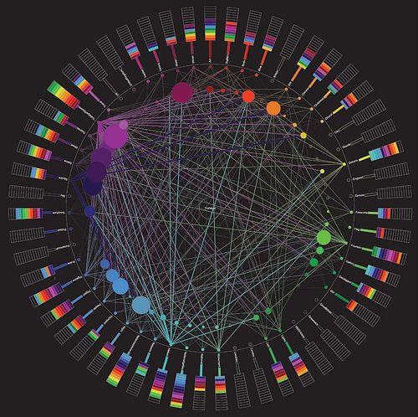
The problem ``Curse of Dimensionality``

Slide 3
Curse of Dimensionality
the volume of the space increases so fast that the available data become sparse.
organizing and searching data often relies on detecting areas where objects form groups with similar properties In high dimensional data, all objects appear to be sparse and dissimilar in many ways, which prevents common data organization strategies from being efficient.
dimensionality reduction algorithms to make the data “get to the point”.

Slide 4
Do all these Features are Super important !?

Slide 5
2-Dimensions
1-Dimensions
Projection
Feature with Most Spread (Variance)

Slide 6
Both Have nearly same Variance…
Y
F1
F2
X
Objective
Find axis direction such that variance of dimension (Xi) is Maximized
Steps
Rotate the points with angle Θ
Project The points on its axis

Slide 7
What I care About … not the length of the new axis… but the direction
So … We need to find a unit Vector … which captures most of the Variance where
||U1|| ² = 1
F1
F2
u1

Slide 8
X_{i}` is the projection of Xi on U1
X_{i}` = Proj _{u1} Xi
F1
U₁ . X_{i}
X_{i}` = ------------- = U₁ . Xi
||U₁||²
Xi
u1
X_{i}`
X_{i}` = U₁ ^{T} X_{i}
Any point of X_{i}
I can convert it to X_{i}`
Using U₁^{T}
Notes:
Scalar Projection of X_{i} on U1
Which is the Component of X_{i} in the U₁ Direction

Slide 10
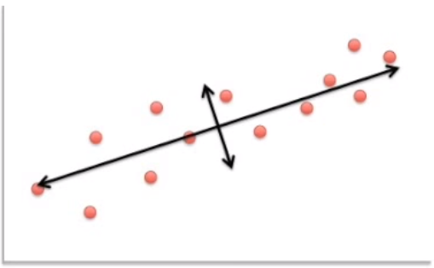
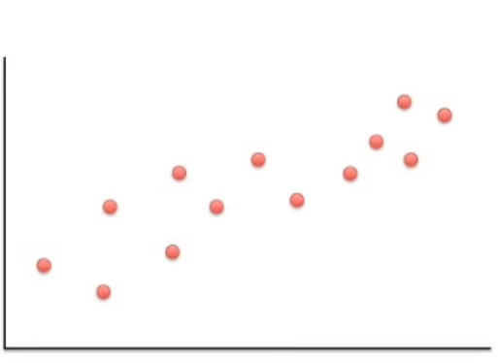
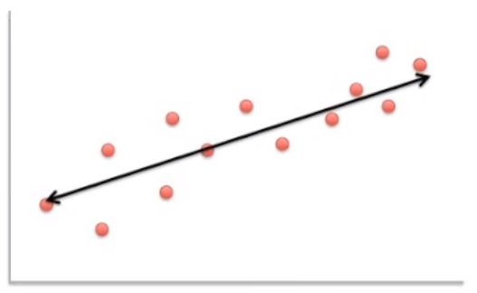

Slide 11
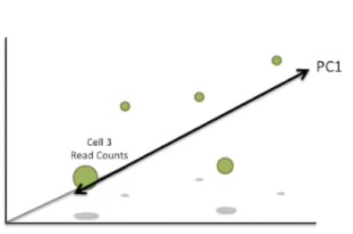
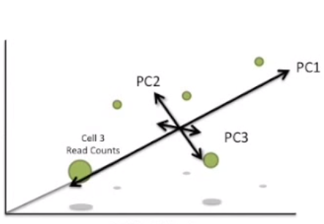
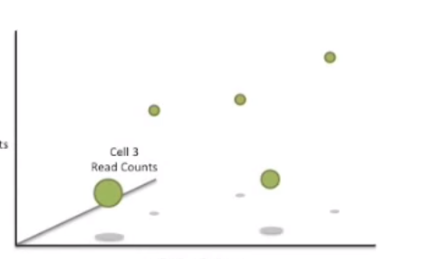
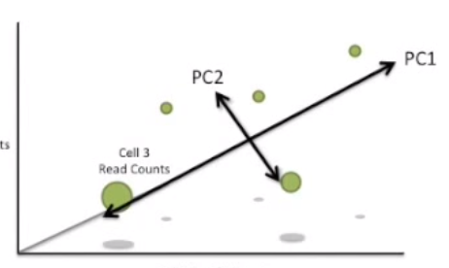

Slide 12
Objective
Find axis direction such that variance of dimension (Xi) is Maximized
Rotate the points with angle Θ
Project The points on its axis

Slide 13
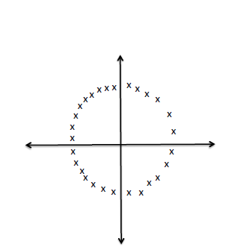
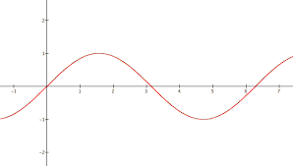
PCA Disadvantages
PCA is not designed to discover nonlinear structure.
Overlapping do occurs

