Slide 1
The process of design
scenarios task analysis
what is wanted
guidelines
principles
analysis
interviews
ethnography
what is there
vs.
what is wanted
precise specification
design
dialogue notations
implement
and deploy
evaluation
heuristics
prototype
architectures
documentation
help

Slide 2
Prototype

Slide 3
What is prototype?
It is experimental and incomplete designs which are cheaply and fast developed.
Why we need prototype?
Complexity of design means we don’t get it right first time
so we need testing design ideas and get their feed back in the early stage of development thus to reduce the time and cost iteration and prototypes to try out and evaluate

Slide 4
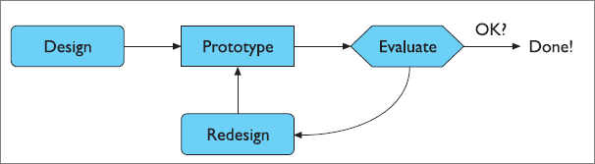
Role of prototyping

Slide 5
Example of prototyping advantages
Database program had novice & advanced users
Novice interface: spent huge effort and large
percentage of system code to build in lots of handholding for making queries
When released, found that most users moved rapidly from novice to expert, typing in own SQL
If could have seen this in advance, could have saved resources and lightened up the application

Slide 6
Forms of prototypes
Low level
Medium level
High level

Slide 7
1- Low level prototypes
Paper base
Use cardboard (sketch)
As one can imagine, the sketch technique is as simple as drawing the outward appearance of intended system on paper.
Storyboard
A series of sketches of key frames during interaction

Slide 8
Note !
Sketching in analysis step
Decide what to design
Get right design
Sketching in prototype step
Simulate of design
Get design right

Slide 9
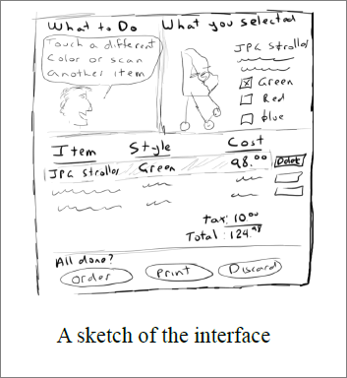
Use cardboard (mock up) Sketches
Example:
Buying using e-commerce interface

Slide 10
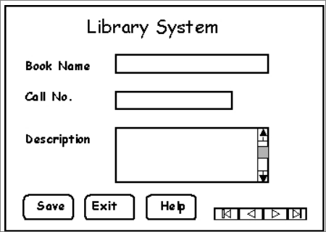
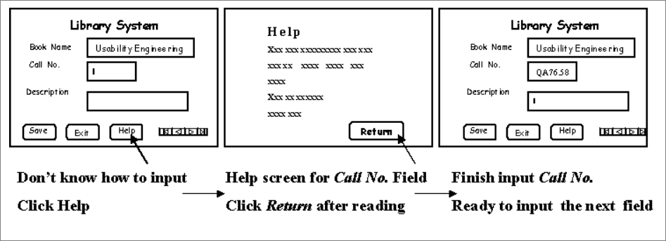
Storyboard Example 1

Slide 11
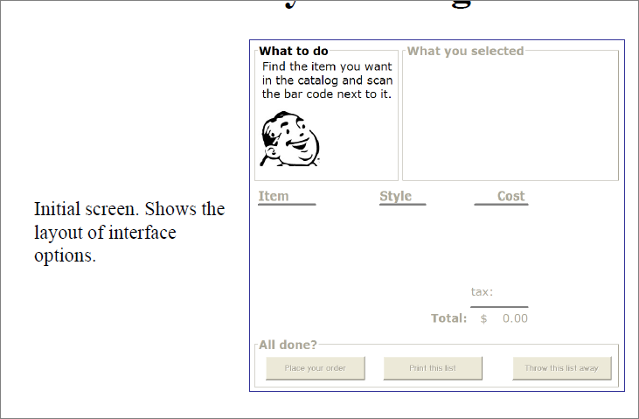
Example 2 of storyboard

Slide 12
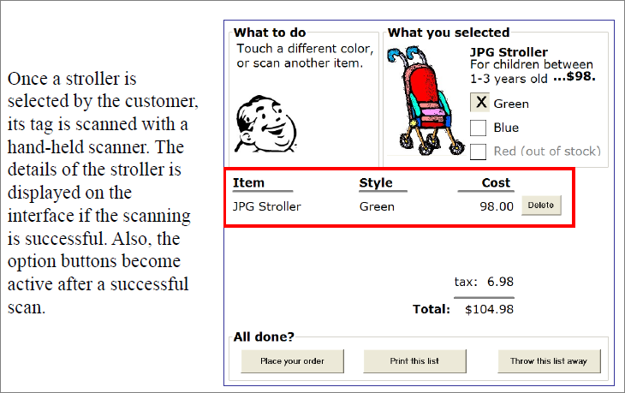

Slide 13
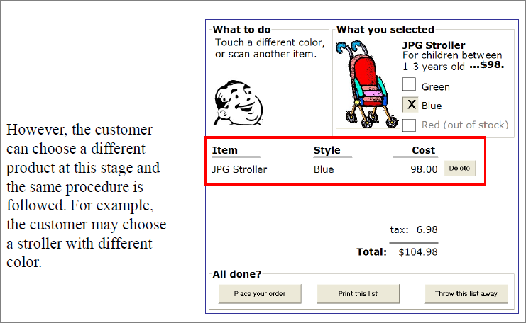

Slide 14
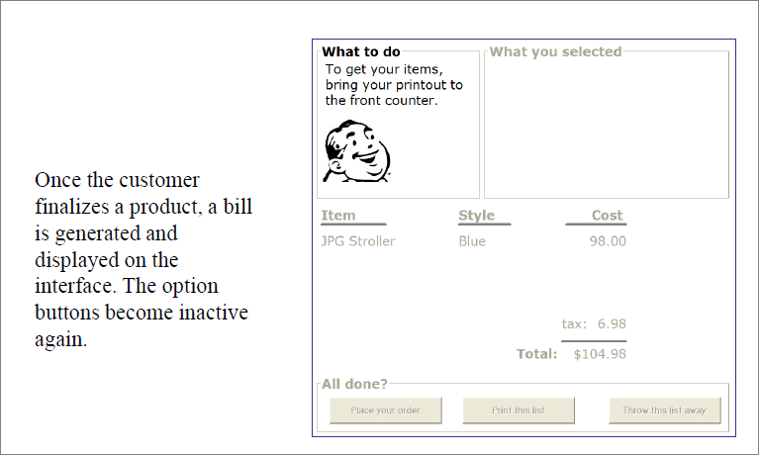

Slide 15
Advantage and disadvantage of low level
Advantage
Quick and cheap
Evaluate concept
Disadvantage
Difficult to end use
Limited error checking
Poor detailed

Slide 16
2- Medium level prototype
It is mixed fidelity (low and high)
Vertical Medium level prototypes (high)
Depth functionality
Ex: working of menu item
Horizontal Medium level prototypes (low)
Implementation without any functionality, no real task can be performed
Ex: first screen of interface

Slide 17
Medium fidelity prototypes
Using computers
Drawing tool (Photoshop)
Presentation (Power point )
Media tools (flash)
Interface builder (java)

Slide 18
Advantage and disadvantage of medium level
Advantage
More clearly and powerful than low fidelity
Simulate some but not all functionality of the system
More suitable for end user (look of final product)
Helpful in test
clearly defines
Disadvantage
time-consuming to create
managements may think it is real

Slide 19
High fidelity prototype
Software implementation of the design with full or most of the functionalities
Required money, manpower, time and effort
Done at the end
Disadvantage
More expensive
Time consuming to create

Slide 20
The wizard of Oz technique
A technique to test a system that does not exist
First used to test a system by IBM called the listening typewriter (1984)
Listening typewriter was much like modern day voice recognition systems. User inputs text by uttering the text in front of a microphone. The voice is taken as input by the computer, which then identifies the text from it.

Slide 21
The wizard of Oz technique
Implementing voice recognition system is too complex and time consuming
Before the developers embark on the process, they need to check if the “idea” is alright; otherwise the money and effort spent in developing the system would be wasted
Wizard of oz provides a mechanism to test the idea without implementing the system

Slide 22
The wizard of Oz technique
Suppose a user is asked to evaluate the listening typewriter
He is asked to sit in front of a computer screen
A microphone is placed in front of him
He is told that “whatever he speaks in front of the microphone will be displayed on the screen

Slide 23
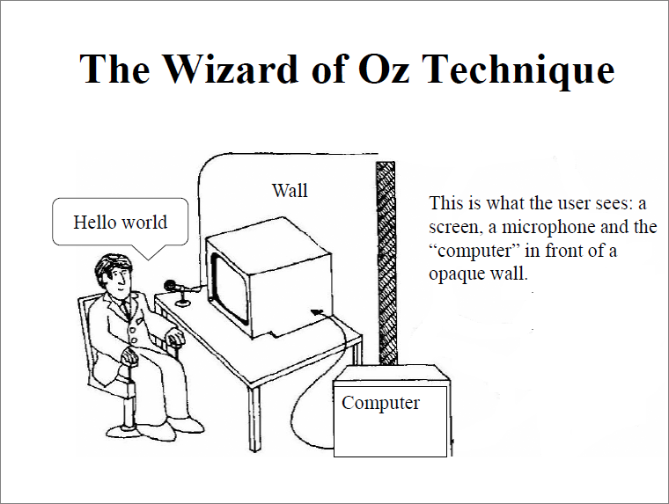

Slide 24
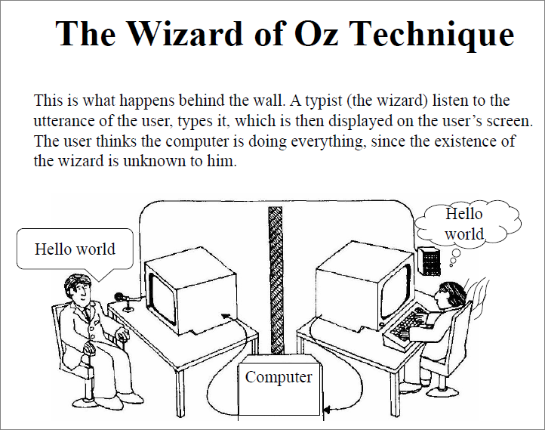

Slide 25
The relationship of prototypes and final products is as follows:
Throw-away
Prototypes only serve to elicit users' reaction and to evaluate design ideas. Prototypes will be thrown away in the later development phases. Such prototypes must be created rapidly and cheaply. Otherwise it will be too expensive to do prototyping.
Incremental
Product is built as separate modules. Each module is prototyped and tested, then added to the final system.
Evolutionary
A prototype is built from low-fidelity to high-fidelity, incorporating design changes, Eventually the prototype becomes the final product.

Slide 26
The process of design
scenarios task analysis
what is wanted
guidelines
principles
analysis
interviews
ethnography
what is there
vs.
what is wanted
precise specification
design
dialogue notations
implement
and deploy
evaluation
heuristics
prototype
architectures
documentation
help

Slide 27
Help and documentation user guidance

Slide 28
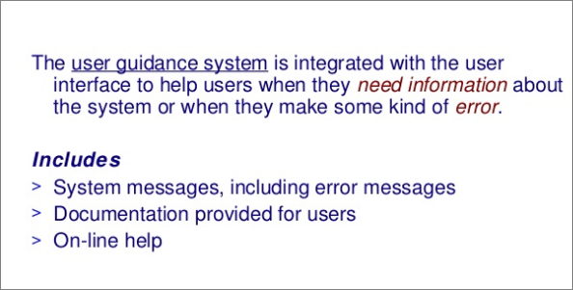
Help and documentation user guidance

Slide 29
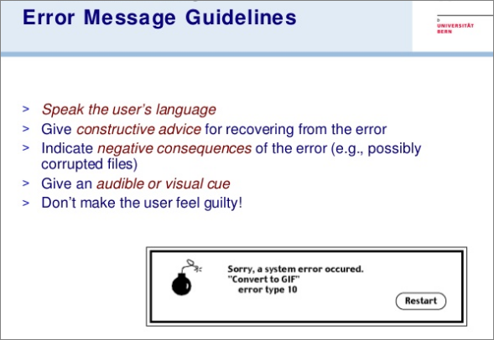

Slide 30
How to Make Your Form Error Messages

Slide 31
1- Avoid Negative Words
Words that have a negative tone have no place in form error messages.
Negative words can make users feel like they’ve made a huge mistake, leading them to think the situation is worse than it is.

Slide 32
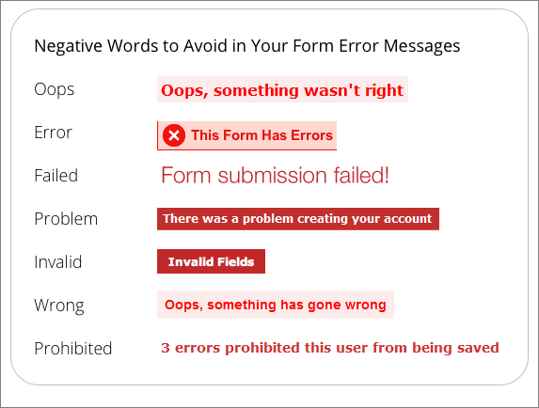

Slide 33
2- Highlight Error Fields in Orange or Yellow, Not Red
Red is the most common color used to highlight error fields. It’s effective in making them visible, but it can also associated with danger, which is not what you want users to feel when they make a mistake.
Orange and yellow are warm colors that not only make error fields visible, but they make users feel less alarmed when they see it.

Slide 34
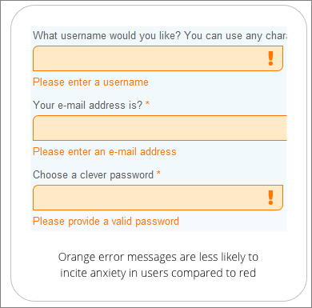

Slide 35
3- Specify Why Field Info Was Not Accepted
Sometimes it’s not enough for an error message to just tell users they made a mistake. Your error messages should tell users exactly why their information got rejected.
For example, an email field should tell users they need to include the ‘@’ symbol if the user leaves it off. It should also tell users to include the domain if they leave that off too. This is more helpful and specific than just telling users that the information they entered is not valid.

Slide 36
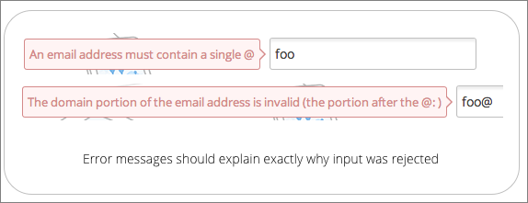

Slide 37
4- Avoid Error Summaries, Place Error Messages Next to Labels
Seeing a large summary of errors at the top of the page doesn’t make users feel comfortable about fixing them. It’s discouraging to read and forces users to have to recall those error messages when they go to the fields to correct their mistakes.
Error summaries magnify the seriousness of the mistakes when they’re grouped in a long bulleted list. When most users see that many errors at once, they’ll likely give up and forget about fixing them.

Slide 38
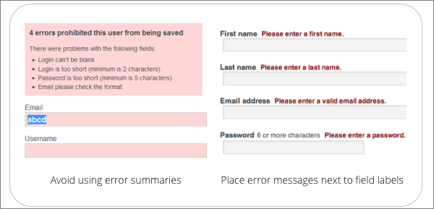

Slide 39
5- Show Error Messages One Field at a Time
An even less overwhelming approach is to highlight the error fields and display error messages one at a time when the user selects an error field. This allows users to correct their mistakes faster due to less noise and distraction on the form.
Callout bubble error messages pointing to the fields are an effective way to do this. However, your callout bubble should not obscure the label for the selected field. When the user selects a new error field, the callout bubble for the previous one should disappear, and a new one should appear.

Slide 40
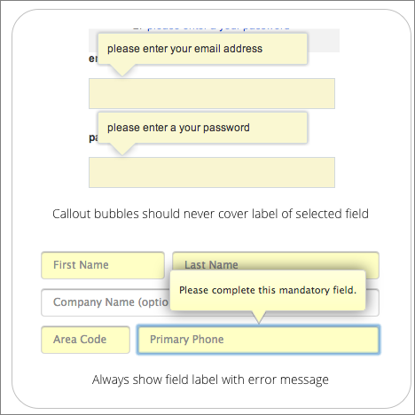

Slide 41
6- Validate Fields with Multiple Requirements Before Submission
Certain fields, such as username and password, have multiple input requirements for security reasons. Rather than giving users an error message with a long list of input requirements after submission, validate these fields beforehand. You can do this by placing a callout bubble next to the field. Each input requirement should light up green as the user’s input meets it.

Slide 42
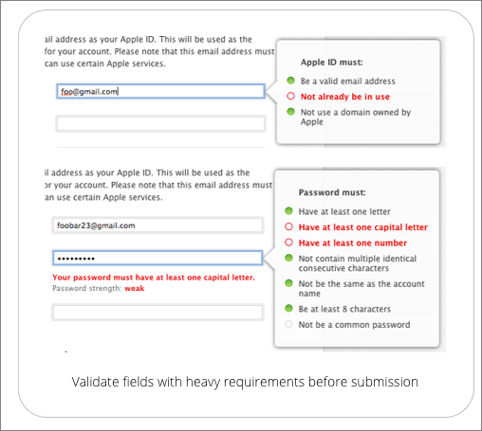

Slide 43
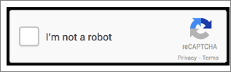

Slide 44
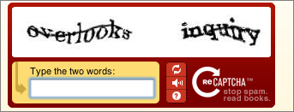
CAPTCHA
A CAPTCHA is a program that protects websites against bots by generating and grading tests that humans can pass but current computer programs cannot. For example, humans can read distorted text as the one shown below, but current computer programs can't:

Slide 45
universal design

Slide 46
Universal design overview
Designing systems to be used by anyone under any conditions
Multi-modal systems use more than one human input channel in the interaction
Speech
Touch
Handwriting
Gestures
Universal Design designing for diversity
Sensory, physical or cognitive disable
Different ages
Different cultures & backgrounds

Slide 47
Speech
Human beings have a great and natural mastery of speech
makes it difficult to appreciate the complexities
but
it’s an easy medium for communication

Slide 48
Speech Recognition Problems
Different people speak differently:
accent, intonation, stress, idiom, volume, etc.
Background noises can interfere.
People often “ummm.....” and “errr.....”
Words not enough - semantics needed as well
requires intelligence to understand a sentence

Slide 49
Speech Recognition: useful?
Single user or limited vocabulary systems e.g. computer dictation
Open use, general user, wide vocabulary systems … … still a problem e.g. some voice activated telephone systems
Great potential, however
when users hands are already occupied e.g. driving, manufacturing
for users with physical disabilities
lightweight, mobile devices

Slide 50
Non-Speech Sounds
boings, bangs, squeaks, clicks etc.
commonly used for warnings and alarms
Evidence to show they are useful
fewer typing mistakes with key clicks
video games harder without sound
Language/culture independent, unlike speech

Slide 51
Handwriting recognition
Handwriting is another communication mechanism which we are used to in day-to-day life
Technology
Handwriting consists of complex strokes and spaces
Captured by digitising tablet
strokes transformed to sequence of dots
large tablets available
suitable for digitising maps and technical drawings
smaller devices, some incorporating thin screens to display the information
PDAs such as Palm Pilot
tablet PCs

Slide 52
Handwriting recognition (ctd)
Problems
personal differences in letter formation
co-articulation effects
Breakthroughs:
stroke not just bitmap
special ‘alphabet’ – Graffeti on PalmOS
Current state:
usable – even without training
but many prefer keyboards!

Slide 53
gesture
applications
gestural input - e.g. “put that there”
sign language
technology
data glove
position sensing devices e.g MIT Media Room
benefits
natural form of interaction - pointing
enhance communication between signing and non-signing users
problems
user dependent, variable and issues of coarticulation

Slide 54
… plus …
age groups
older people e.g. disability aids, memory aids, communication tools to prevent social isolation
children e.g. appropriate input/output devices, involvement in design process
cultural differences
influence of nationality, generation, gender, race, class, religion, political persuasion etc. on interpretation of interface features
e.g. interpretation and acceptability of language, cultural symbols, gesture and colour

