Slide 1
Cognitive mode

Slide 2
Cognitive modeling
It is an area of computer science that deals with simulating human problem solving and mental task processes in a computerized model.
the processes that the brain uses to accomplish complex tasks including:
learning,
remembering,
thinking,
predicting,
problem solving,
decision making,
Planning.

Slide 3
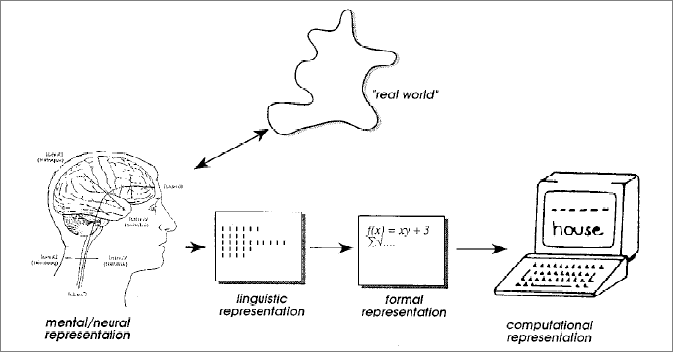

Slide 4
Cognitive mode
Cognitive science is concerned with understanding The goal of a cognitive model is to scientifically explain one or more of these basic cognitive processes, or explain how these processes interact.
Cognitive modeling is used in
computer game
User interface design.

Slide 5
Cognitive models
Cognitive models for HCI are mainly classified into:
Goal and task hierarchies
GOMS model
CCT model
Language representation
BNF
TAG

Slide 6
Goal and task hierarchies goals vs. tasks
goals – intentions
what you would like to be true
tasks – actions
how to achieve it

Slide 7
Goal and task hierarchies
The model allows a designer to getting direct user feedback on a design.
The models should be informed by previous analysis of users, to have some confidence in the model's ability to represent the way a user might think or interact.

Slide 8
Cognitive models
Cognitive models for HCI are mainly classified into:
Goal and task hierarchies
GOMS model
CCT model
Language representation
BNF
TAG

Slide 9
GOMS model
It is a predictive model of human performance
that can be used to improve the efficiency of human-machine interaction
by identifying and eliminating unnecessary user actions.

Slide 10
GOMS model GOMS stands for (Goals, Operators, Methods, and Selection).
A GOMS model is composed of: methods that are used to achieve specific goals. These methods are then composed of operators at the lowest level. The operators are specific steps that a user performs and are assigned a specific execution time. If a goal can be achieved by more than one method, then selection rules are used to determine the proper Method.

Slide 11
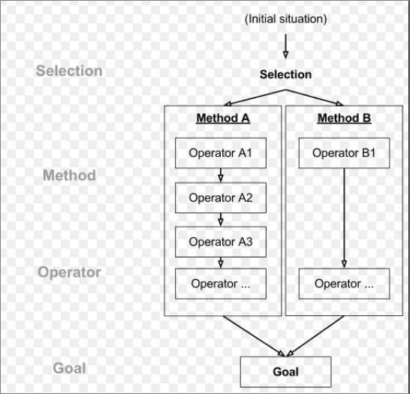

Slide 12
Cognitive models
Cognitive models for HCI are mainly classified into:
Goal and task hierarchies
GOMS model
CMN-GOMS,
NGOMSL,
PM-GOMS
CCT model
Language representation
BNF
TAG

Slide 13
1- CMN-GOMS This model can predict operator sequence as well as execution time. Example: CMN-GOMS has been used to model word processors
Goal : Edit text (initial situation)
Select :
method A: move text
Operator: cut
Method B: copy text
Operator: copy
Method C: delete text
operator :(del)

Slide 14
Cognitive models
Cognitive models for HCI are mainly classified into:
Goal and task hierarchies
GOMS model
CMN-GOMS,
NGOMSL,
PM-GOMS
CCT model
Language representation
BNF
TAG

Slide 15
NGOMSL
An analyst constructs an NGOMSL model by performing a top-down, breadth-first expansion of the user's top-level goals into methods, until the methods contain only primitive operators, typically keystroke-level operators.
This model explicitly represents the goal structure just like the CMN-GOMS and can so represent high-level goals.

Slide 16
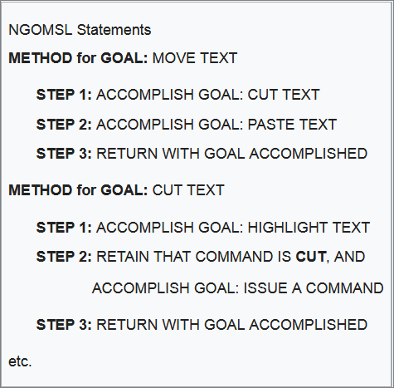

Slide 17
Cognitive models
Cognitive models for HCI are mainly classified into:
Goal and task hierarchies
GOMS model
CMN-GOMS,
NGOMSL,
PM-GOMS
CCT model
Language representation
BNF
TAG

Slide 18
CPM-GOMS
CPM-GOMS assumes that operators of the cognitive processor can work in parallel to each other. The most important point of CPM-GOMS is the ability to predict skilled behavior from its ability to model overlapping actions.

Slide 19
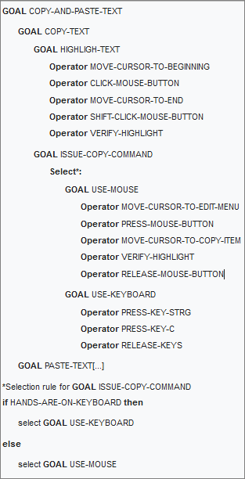

Slide 20
Disadvantages GOMS model
GOMS only applies to skilled users. It does not work for beginners or intermediates
the model doesn't apply to learning the system or a user using the system after a longer time of not using it
the lack of account for errors, even skilled users make errors but GOMS does not account for errors
Mental workload is not addressed in the model, making this an unpredictable variable.
User personalities, habits or physical restrictions (for example disabilities) are not accounted for in any of the GOMS models. All users are assumed to be exactly the same.

Slide 21
Cognitive models
Cognitive models for HCI are mainly classified into:
Goal and task hierarchies
GOMS
CCT
Language representation
BNF
TAG

Slide 22
2. Cognitive Complexity Theory (CCT)
User production rules, Production rules are of the form:
if condition then action
Example: inserting a space
(GOAL perform unit task)
(TEXT task is insert space)
(TEXT task is at 5 23)
(CURSOR 8 7)
IF (TEXT task is insert space)THEN
(executing insert space)
(LOOK-TEXT task is at %LINE=5 %COLUMN=23)))

Slide 23
Notes on CCT
Novice versus expert style rules
Error behaviour can be represented

Slide 24
Cognitive models
Cognitive models for HCI are mainly classified into:
Goal and task hierarchies
GOMS
CCT
Language representation
BNF
TAG

Slide 25
language notations
Understanding the user's behaviour and cognitive difficulty based on analysis of language between user and system.
Similar in emphasis to dialogue models

Slide 26
Cognitive models
Cognitive models for HCI are mainly classified into:
Goal and task hierarchies
GOMS
CCT
Language representation
BNF
TAG

Slide 27
Backus-Naur Form (BNF)
Very common notation from computer science
A purely syntactic view of the dialogue
Terminals
lowest level of user behaviour
e.g. CLICK-MOUSE, MOVE-MOUSE
Nonterminals
ordering of terminals
higher level of abstraction
e.g. select-menu, position-mouse
Basic syntax:
nonterminal ::= expression
An expression
contains terminals and nonterminals
combined in sequence (+) or as alternatives (|)

Slide 28
Example of BNF
Derivation ?
draw line ::= select line + choose points + last point
select line ::= pos mouse + CLICK MOUSE
choose points ::= choose one | choose one + choose points
choose one ::= pos mouse + CLICK MOUSE
last point ::= pos mouse + DBL CLICK MOUSE
pos mouse ::= NULL | MOVE MOUSE+ pos mouse

Slide 29
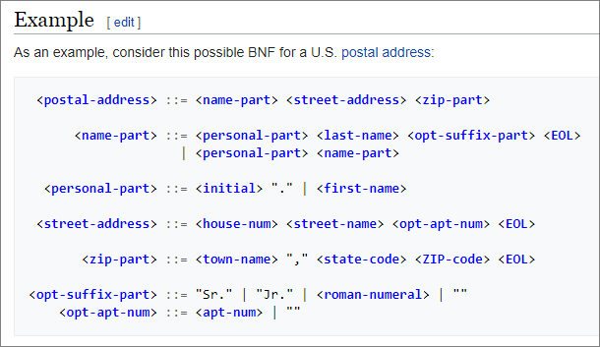
Derivation ?

Slide 30
Measurements with BNF
Number of rules (not so good)
Number of + and | operators
Complications
same syntax for different semantics
no reflection of user's perception
minimal consistency checking

Slide 31
Cognitive models
Cognitive models for HCI are mainly classified into:
Goal and task hierarchies
GOMS
CCT
Language representation
BNF
TAG

Slide 32
2. Task Action Grammar (TAG)
Making consistency more clear
Nonterminals are modified to include additional semantic features

Slide 33
Consistency in TAG
In BNF, three UNIX commands would be described as:
copy ::= cp + filename + filename | cp + filenames + directory
move ::= mv + filename + filename | mv + filenames + directory
link ::= ln + filename + filename | ln + filenames + directory
TGA order made explicit using a parameter, or semantic feature for file operations
Feature Possible values
Op = copy; move; link
Rules
file-op[Op] ::= command[Op] + filename + filename
| command[Op] + filenames + directory
command[Op = copy] ::= cp
command[Op = move] ::= mv
command[Op = link] ::= ln

Slide 34
Cognitive model
An advanced application of cognitive modeling is the creation of cognitive machines, which are AI programs that can be said to think for themselves.
One of the goals is to make human-computer interaction more like the interaction between two humans.
We had the massive computers that could compute the large amounts of data, but software that could realistically model how people think and make decisions was missing,
the problem was that early models followed logical processes that humans don't always adhere to, and failed to take into account variables that affect human cognition, such as fatigue, emotion, stress, and distraction.

