Slide 1
Project Proposal: NET FUSION
Team Members:
Marwan El-Khatib Abd El-Wares 21067890
Muhammad Hussam Abd Elazim 21067772
Roba Walaa El-din Ahmed 21035417
Zeinab khamis Elfewal 21016735
Supervisor: Eng. Samah Eisa

Slide 2
Introduction
This project aims to design and implement an integrated, scalable, and flexible enterprise network using Huawei Datacom technologies. The proposal outlines the project's motivation, objectives, methodology, and expected outcomes.

Slide 3
Problem Statement
Modern organizations require robust, scalable, and secure network infrastructures that support daily operations, security, and future expansion. Many networks fail due to poor planning, limited scalability, lack of documentation, faulty of devices and cables, and poor security.

Slide 4
Objectives
Gain comprehensive practical experience
Build a complete, organized, and scalable network
Understand corporate network structure (Access, Aggregation, Core layers)
Enable integration of new technologies after deployment
Develop planning, documentation, and security skills
Implement enterprise-grade services (DHCP and Telnet)

Slide 5
Scope of Work
Layer 2: Switching (Core, Aggregation and Access switches, STP protocol, Link Aggregation, VLAN, INTER-VLAN)
Layer 3: Routing (Routers, OSPF, NAT)
security techniques: ACLs, AAA
Network Services: DHCP, Telnet
LAN, WAN & WLAN implementation

Slide 6
Methodology
Planning & Design: Topologies, Devices selection
Implementation: Configured switches and routers, and implemented necessary protocols, including VLANs, WLAN, OSPF, Subnetting , AAA, Telnet, Spanning Tree Protocol (STP), and Link Aggregation (Eth-Trunk).
Testing & Verification: Connectivity, redundancy, security, performance
Documentation: Configurations, Topologies, guidelines

Slide 7
Completed Work
Layer 2: Implemented VLANs for network segmentation, and configured Link Aggregation (Eth-Trunk) and Spanning Tree Protocol (STP) for redundancy and increased bandwidth.
Layer 3: Set up OSPF for dynamic routing.
Security: Configured AAA and Telnet for enhanced network security and remote management.
Services: Successfully implemented IP address assignment.

Slide 8
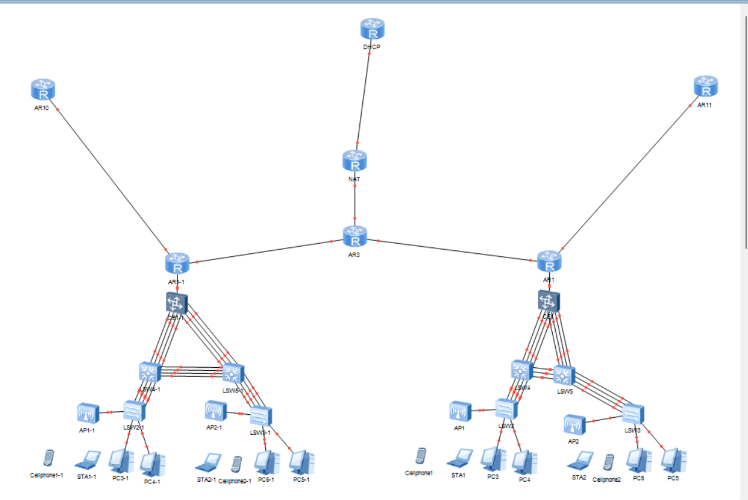
First trial Topology

Slide 9
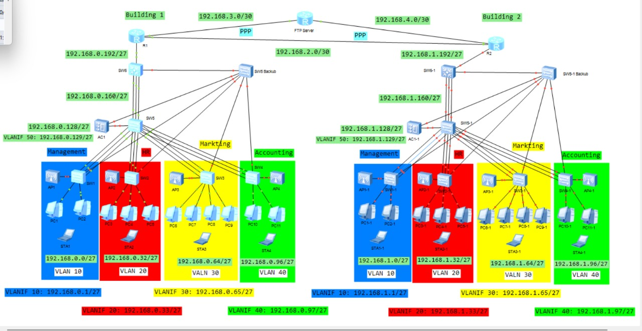
Updated topology

Slide 10
Project ROLES
Marawan:
ACs , OSPF , Static routing
Mohamed:
PPP , DHCP ,NAT
Roba:
VLANs , STP
Zeinab:
AAA ,ACL ,Link Aggregation

Slide 11
Expected Outcomes
Fully functioning enterprise-level network using Huawei Datacom
Enhanced understanding of network planning and implementation
Practical experience with security, routing, and switching
Scalable design that supports future technologies

Slide 12
Timeline
Planning & Design: Week 1 → Network diagrams and Topologies, requirements
Implementation: Week 2 → Configured network devices
Testing: Week 3 → Validation reports
Documentation: Week 4 → Final project report

Slide 13
next steps
Network Redundancy: Our next step is to enhance the network's resilience by implementing backup switches.
Purpose: These switches will serve as temporary replacements for the main switches, ensuring continuous network operation and minimizing downtime in case of a device failure.
Goal: This will make the network more robust, supporting our objective of building a scalable and reliable enterprise-level network

Slide 14
Resources Required
Huawei Datacom devices and tools (Switches, Routers, PCs, ACs and Cables )
Network simulation tools ( eNSP )
Documentation software (Word, PowerPoint)

Slide 15
Conclusion
This project will provide hands-on experience in enterprise networking with Huawei Datacom, equipping the team with practical knowledge in planning, implementation, and security while ensuring scalability for future growth.

Slide 16


