Slide 1
Selected topics in AI 2 Active Learning Task 2

Slide 2
Project analysis slide 2
Project data
MNIST dataset
CIFAR datasets
SVHN Dataset
The dataset consists of 60,000 color images of size 32 x 32 pixels, divided into 10 classes with 6,000 images per class. The classes in the CIFAR dataset are: airplane, automobile, bird, cat, deer, dog, frog, horse, ship, and truck. Like the MNIST dataset, CIFAR is often used as a benchmark for evaluating the performance of machine learning algorithms on image classification tasks.
It consists of a collection of 70,000 grayscale images of handwritten digits, each of size 28 x 28 pixels. The dataset is split into two parts: 60,000 images for training and 10,000 images for testing.
consists of over 600,000 images, each of size 32 x 32 pixels, and is divided into three sets: a training set of 73257 images, a test set of 26032 images, and an extra set of 531131 images. The digits in the images can appear in various sizes, colors, fonts, and orientations, and can be located anywhere within the image.

Slide 3
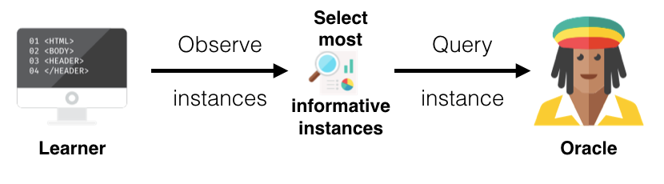
Project analysis slide 2
Query strategies
We use 5 Query strategies in the project :
Uncertainty Sampling
Entropy Sampling
Random Sampling
Margin Sampling
BALD-dropout sampling

Slide 4
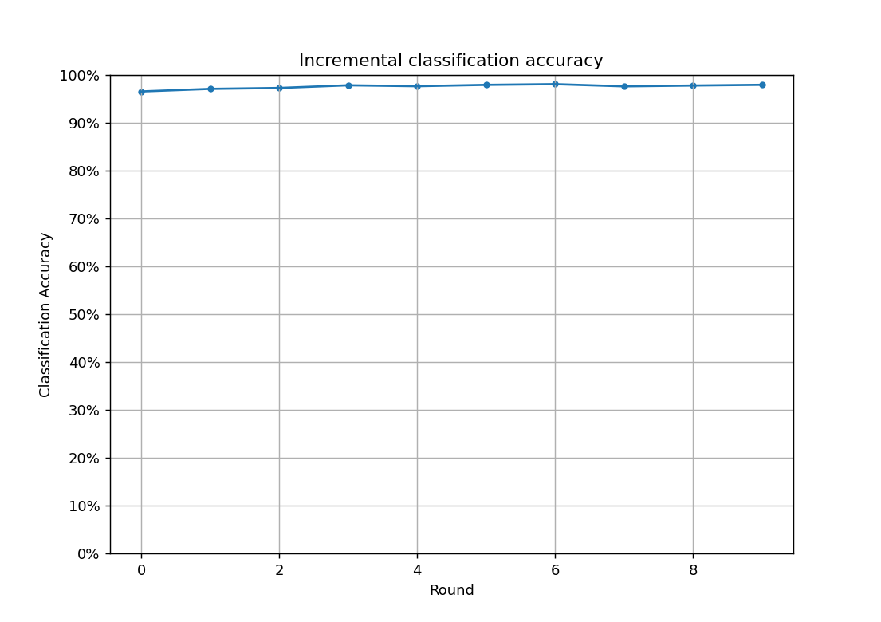
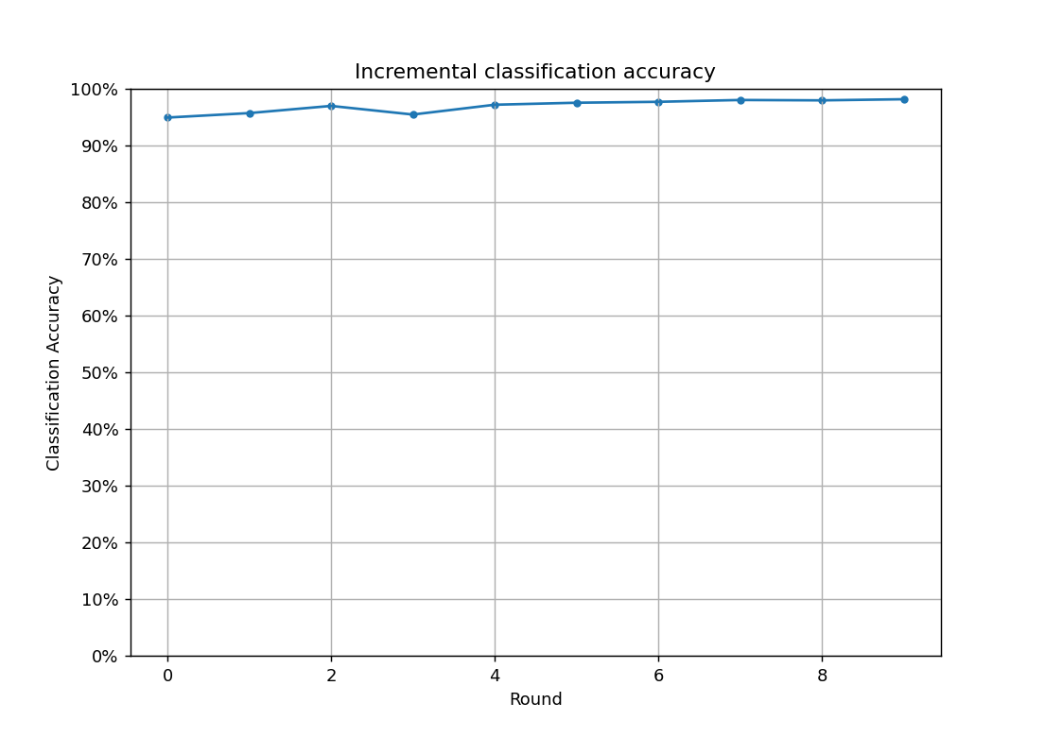
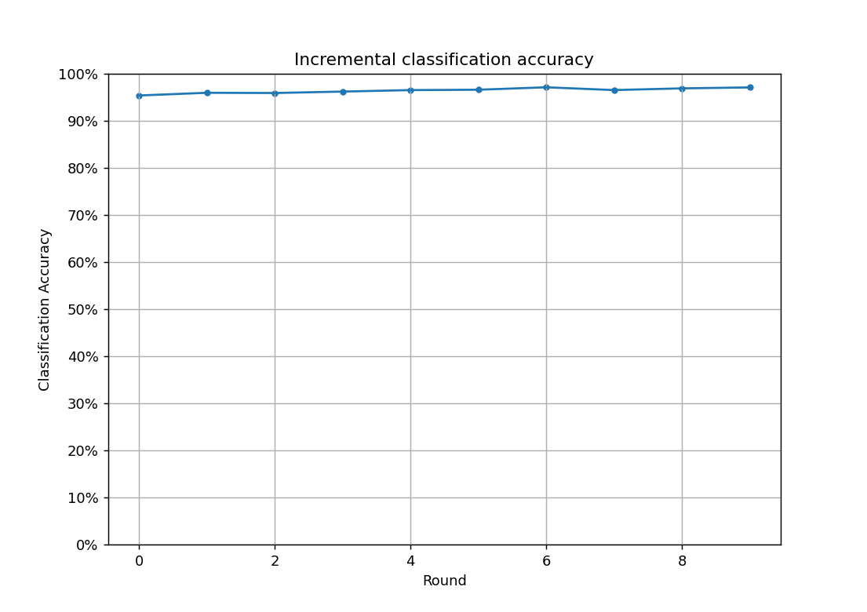
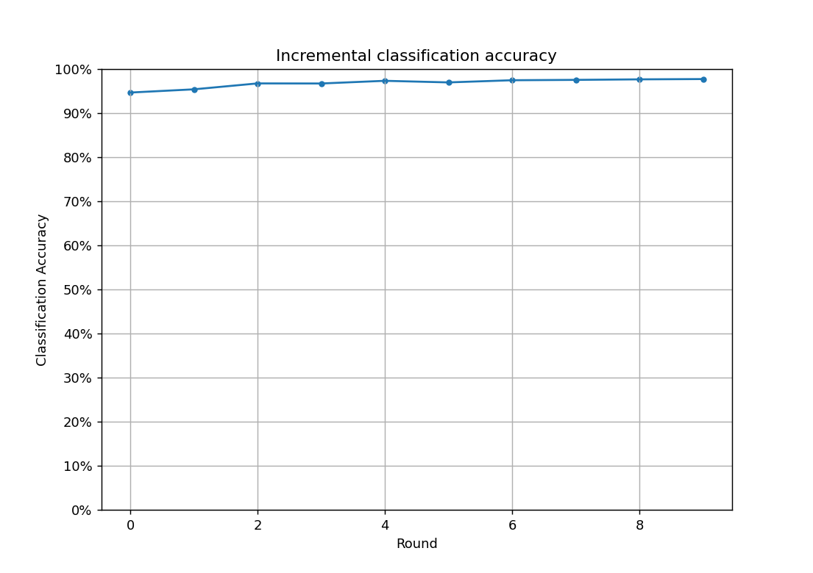
Project analysis slide 2
MNIST dataset
Applying DEEPAL using sampling strategy:

Slide 5
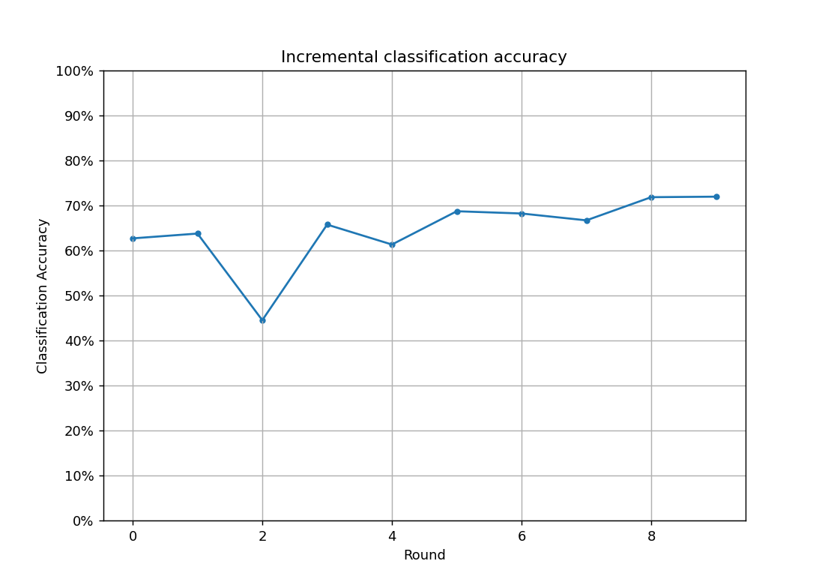
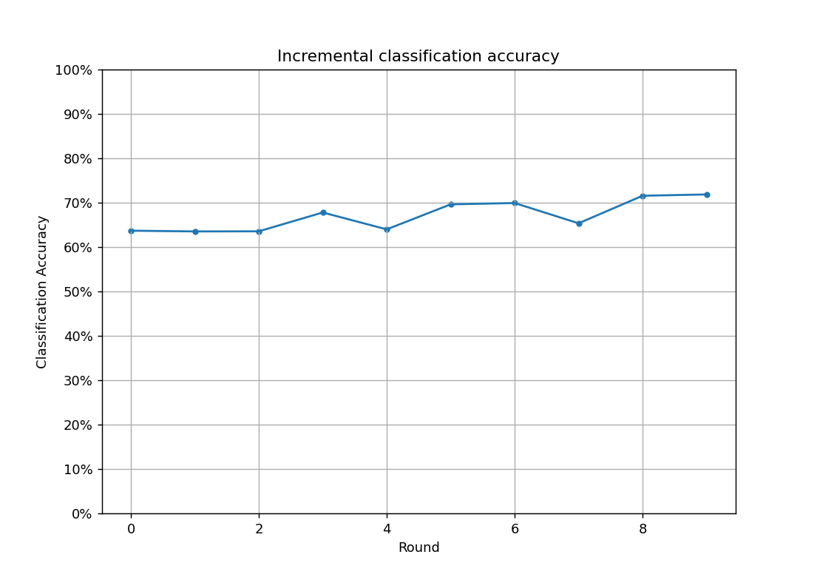
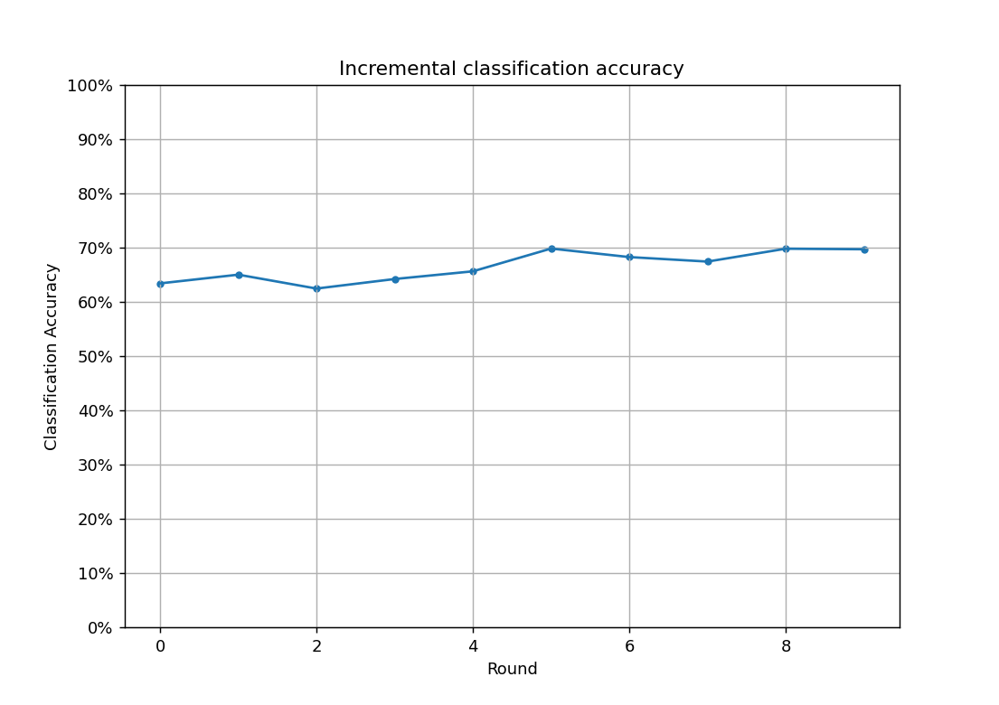
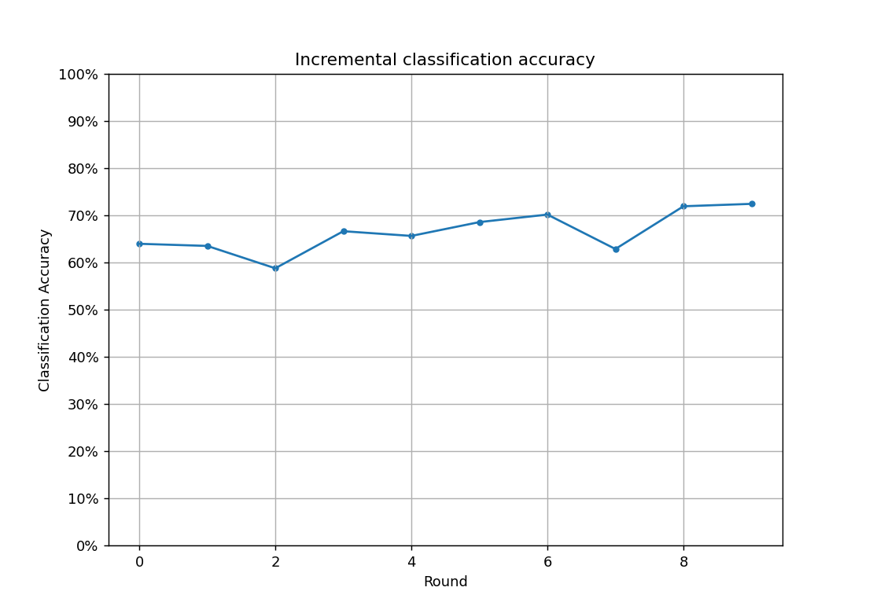
Project analysis slide 2
CIFAR dataset
Applying DEEPAL using sampling strategy:

Slide 6
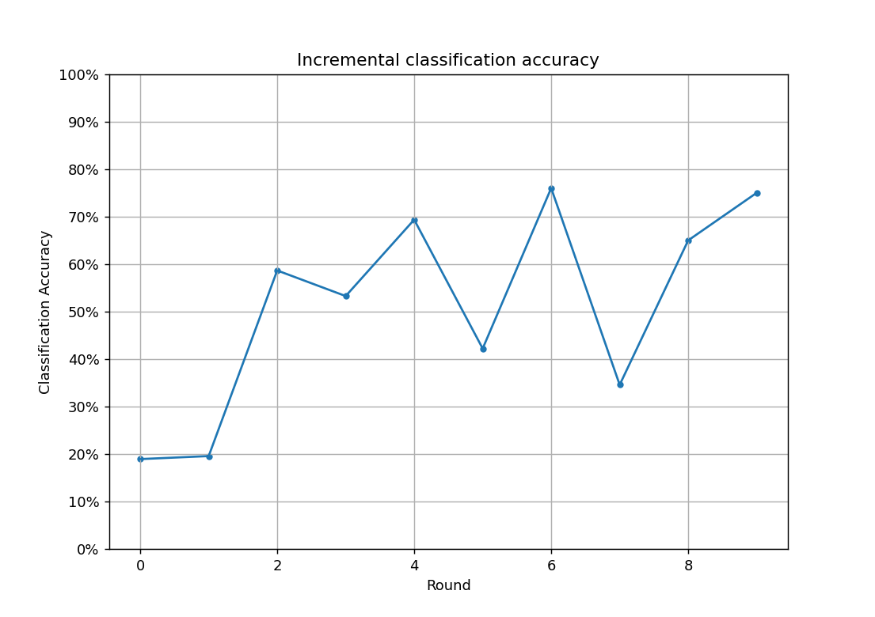
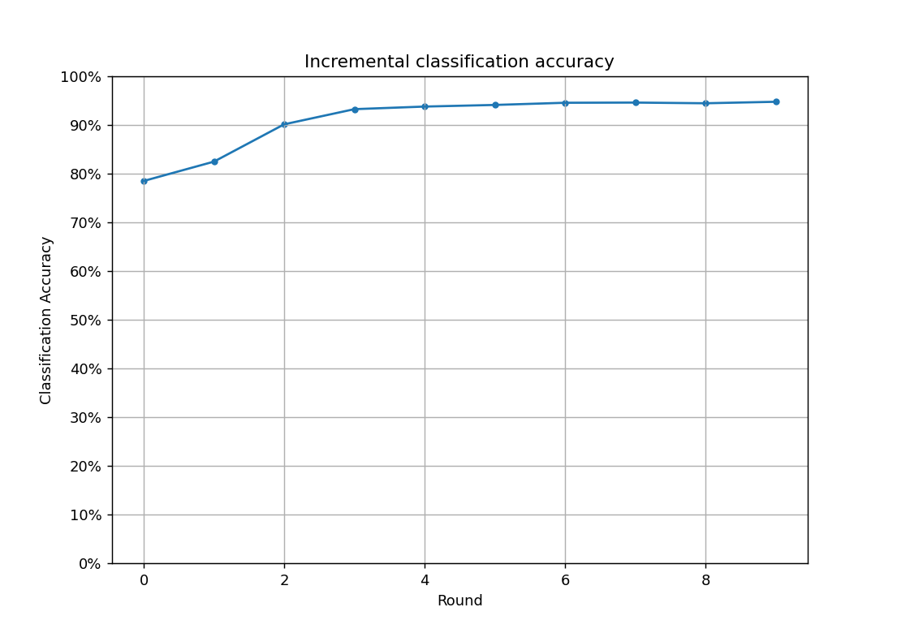
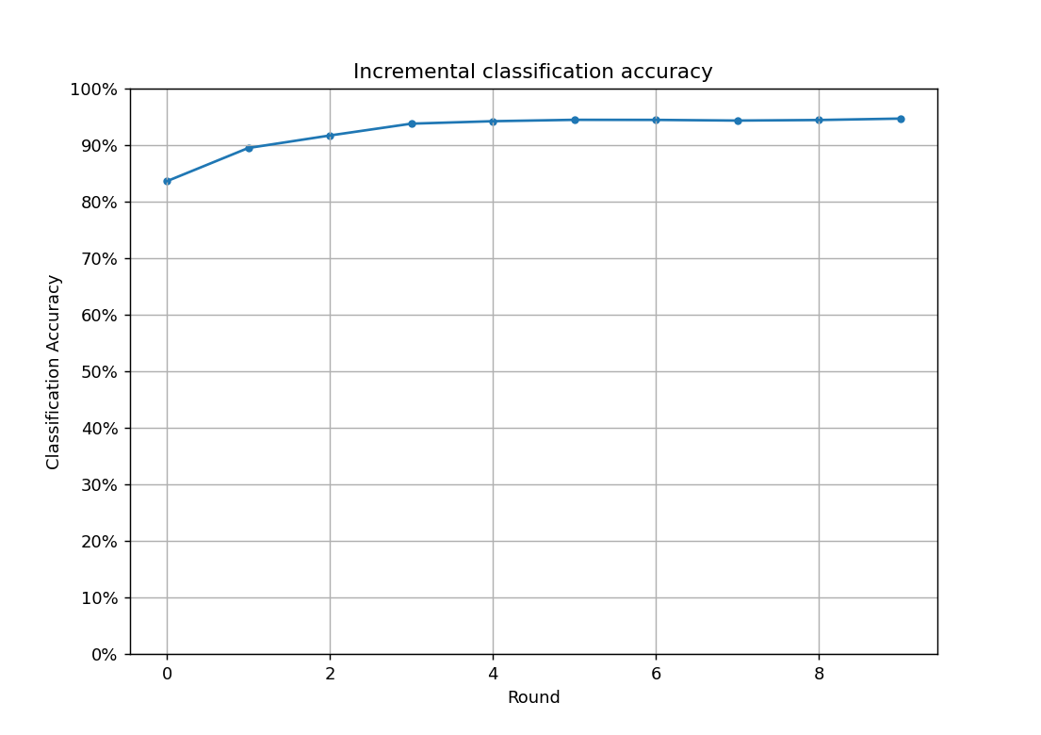
Project analysis slide 2
SVHN Dataset
Applying Active learning using uncertainty sampling strategy:

Slide 7
Project analysis slide 2
Conclusion
Each strategy in the uncertainty family doesn’t vary much as we can’t for sure say that one strategy is better than other overall however the active learning approaches as a whole are better in the factors of maintaining high score in evaluation metrics.
MNIST had the highest acc with low computing power while SVHN scored the highest variance in learning due to instability.

Slide 8
Thank You

