Slide 1

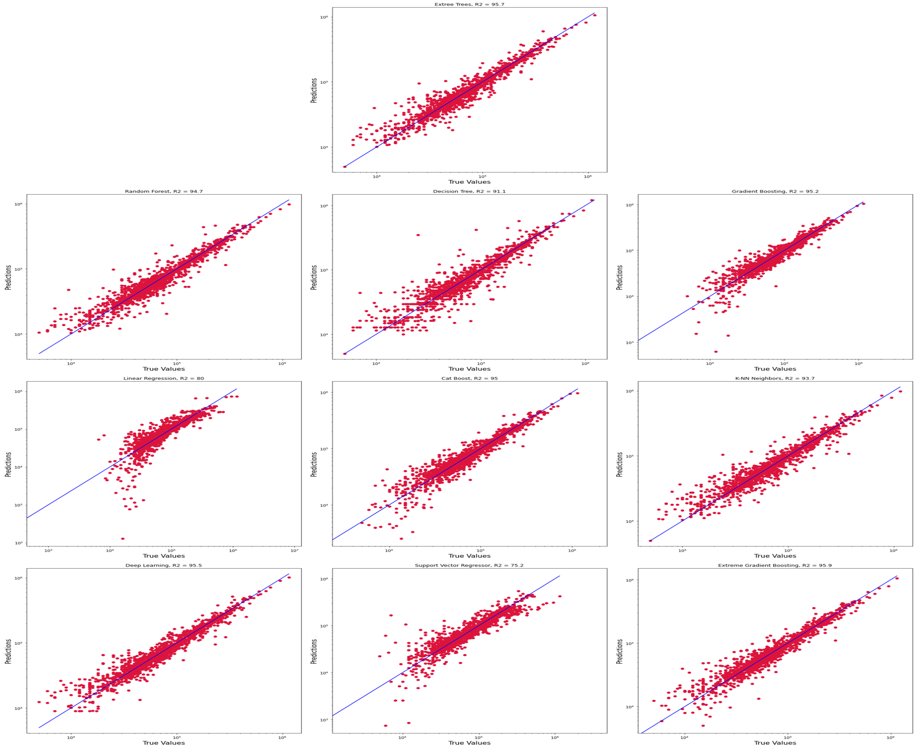
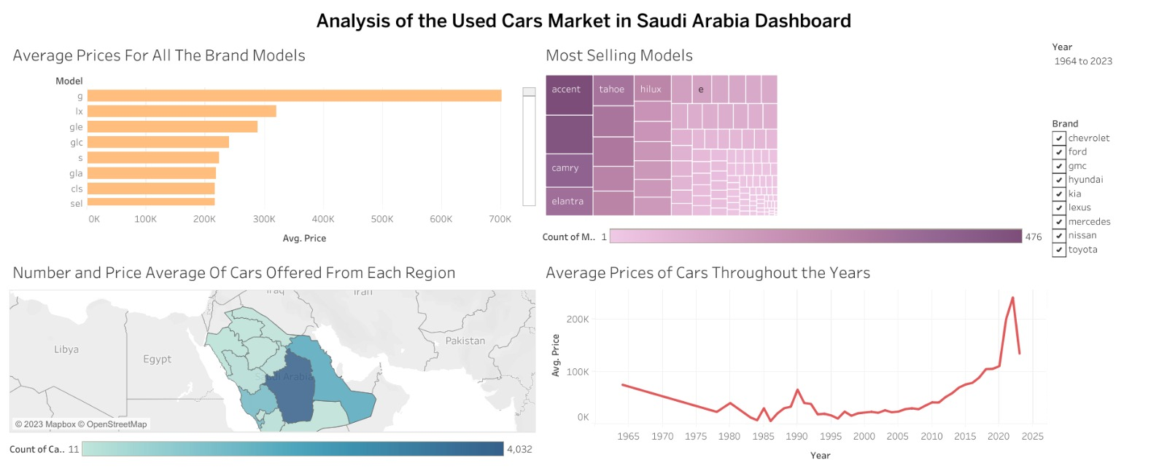
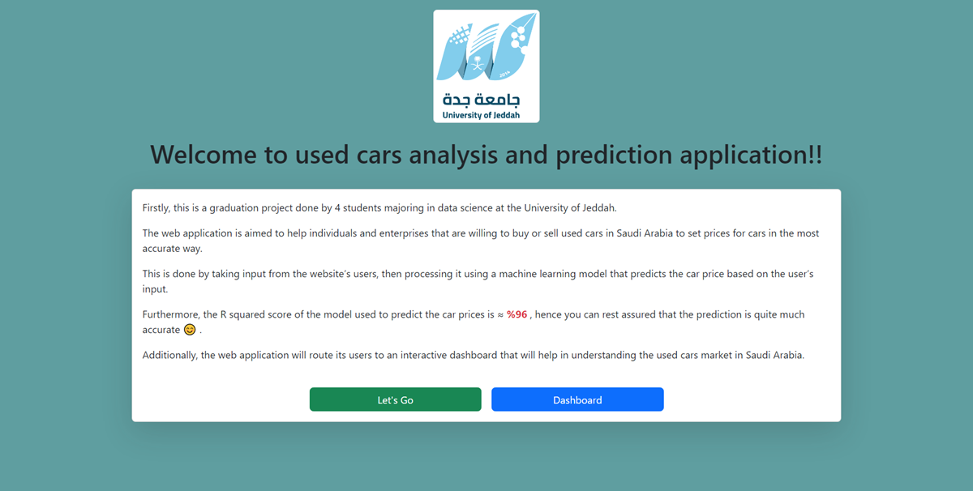
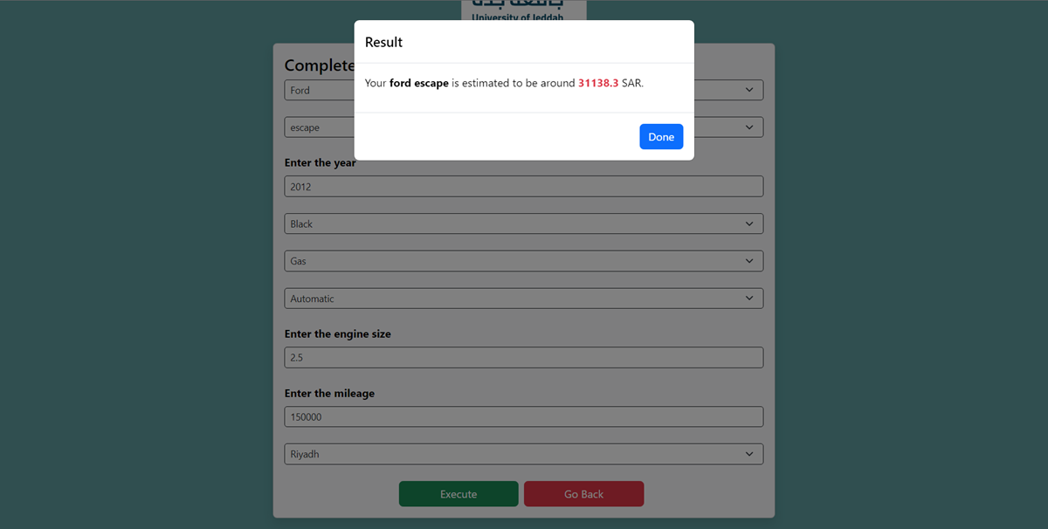
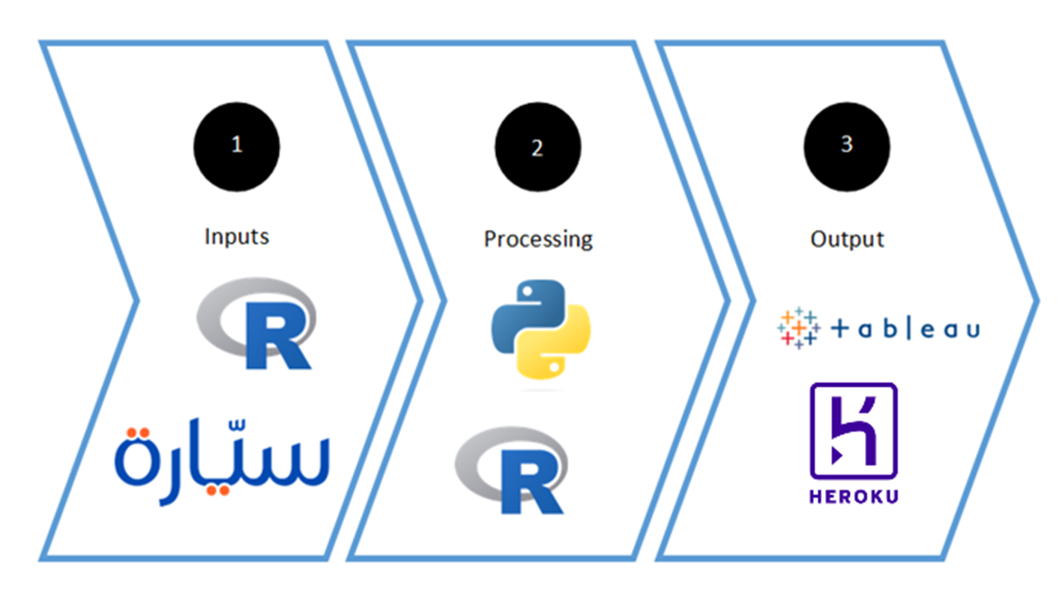
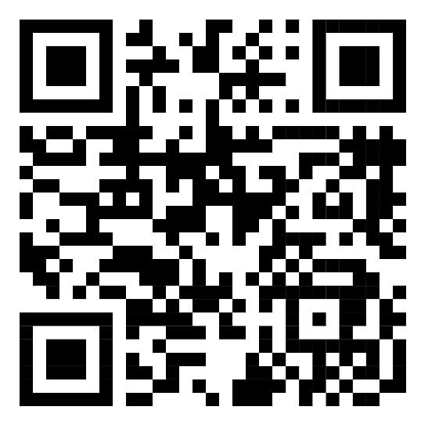
Analysis of the Used Car Market in Saudi Arabia Using Machine and Deep Learning
Abdulrhman Simbawa – Marwan Al-Ghamdi – Saeed Qahhas – Abdullah Al-Shareef
Supervised By Dr. Omar AL-Ghushairy
Department of Information Systems and Technology
Introduction
Results
Many people and businesses in the car sales industry in Saudi Arabia set the prices of used cars based either on intuition, asking experts in car sales, or other ways. The problem with these solutions is that they may lead to estimations that vary drastically from the prices that the cars are worth. To eliminate the price-setting problem, we can use historic data about the used cars that are being sold through websites that sell cars in Saudi Arabia to analyze the market and develop a solution that can help stakeholders predict accurate prices for used cars based on several inputs that affect the price. A machine learning model can predict continuous values, such as the price in our case, via several regression algorithms. Also, using deep learning techniques may give better accuracies than these models. As for the market study, an interactive dashboard will help summarize the most affecting factors on car prices. In this paper, we examine the use and application of multiple supervised machine learning and deep learning algorithms to predict how much a car is worth in Saudi Arabia. The predictions are based on data collected using web scrapping techniques from several sites that offer the service of buying and selling used cars in Saudi Arabia, such as Syarah.com, and Yallamotor.com. Examined algorithms varied among Decision tree, Xgboost, Gradient Boosting, Random Forest, Extra Trees, etc. The algorithms are then evaluated and compared using R squared score, Mean Absolute Error, and Mean Absolute Percentage Error to choose the best-performing algorithm out of the ten. All the algorithms scored a very high accuracy score. The Extra Trees algorithm was the best-performing algorithm with an R squared score of %95.7, a Mean Absolute Error of 10188.7, and a Mean Absolute Percentage Error of %14.7. consequently, this model will be deployed to a web application that can serve as a used car price estimator.
The results of the ten algorithms used will be shown as ‘actual vs. predicted’ graphs that indicate the accuracies of the predictions made on the test data. To help interpret the meaning of these graphs, you can use the following statement: The more the data points are near the line, the more the accuracy score is.
Conclusion
In conclusion, the chosen algorithm to be deployed on the web application is Extra Trees regressor, that is mainly because it scored an R squared score of %95.7, Mean Absolute Error of 10188.7, and Mean Absolute Percentage Error of %14.7, which is considered the best performing algorithm among the other nine algorithms. The web application uses the regressor by taking input from the user about a car, then displays a prediction of the car’s price as an output. Additionally, the web application will prompt the user to a dashboard that will help in understanding the used cars market in Saudi Arabia.
Objectives
Acquiring data on used cars across websites in Saudi Arabia.
Identifying the factors that affect the price of a car the most.
Building several regression machine learning models to predict the prices of cars and choosing the most accurate model.
Applying deep learning techniques to enhance the model built if possible.
Analyzing each car brand with the regression models individually and comparing them to make a solid and reliable study of the machine learning model used to predict car prices in Saudi Arabia.
Building a web solution to deploy our model on.
Building an interactive dashboard to derive insights into the used cars market in Saudi Arabia.
References
1 – Scikit-Learn Documentation
2 – Syarah.com
3 – Yallmotor.com
4 – Tableau.com
5 – Pandas Documentation
6 – Heroku.com
7 – Matplotlib Documentation
8 – Web scrapping using R, GitHub repository created by Steve Pittard
9 – (PDF) Used Cars Price Prediction using Supervised Learning Techniques (researchgate.net)
10 – Information | Free Full-Text | Application of Machine Learning Techniques to Predict the Price of Pre-Owned Cars in Bangladesh (mdpi.com)
Methodology
Link for the Web Application:
Input: used car data, which is collected and scrapped using R and Python libraries from websites that offer to buy and sell used cars in Saudi Arabia, such as Syarah.com, ksa.yallamotor.com, and carswitch.com.
Processing: Data cleaning and preprocessing using Python and R libraries, such as Pandas. Furthermore, machine learning models are applied and evaluated using Python libraries, such as Scikit-learn.
Output: A prediction of the price of a car based on the inputs on a web solution uploaded to the cloud using Heroku service to be open for use to the public. Furthermore, a dashboard that is built by Tableau shows details about the car market in Saudi Arabia.
Acknowledgements
We would like to express our special thanks and gratitude to Dr. Omar Al-Ghushairy our supervisor, for his guidance and advice given to us during the preparation of this paper.
We also thank the committee responsible for evaluating graduation projects for their advice when we first presented our project to them.

