Slide 1
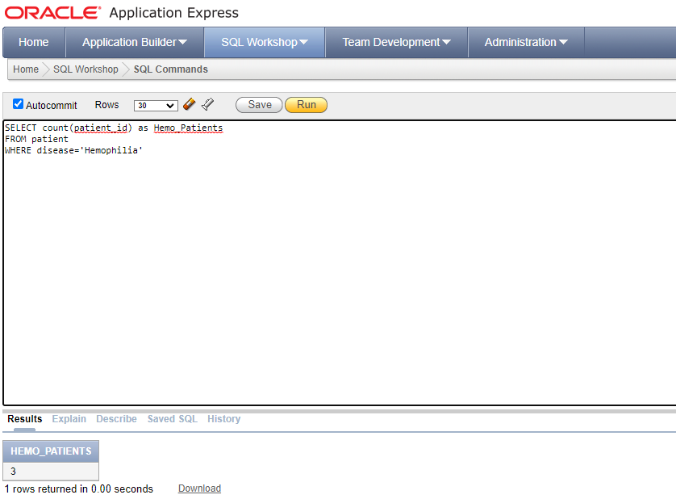
Query to find the number of patients suffering from Hemophilia disease
<visualization>
SELECT count(patient_id) AS Hemo_Patients
FROM patient
WHERE disease='Hemophilia'

Slide 2
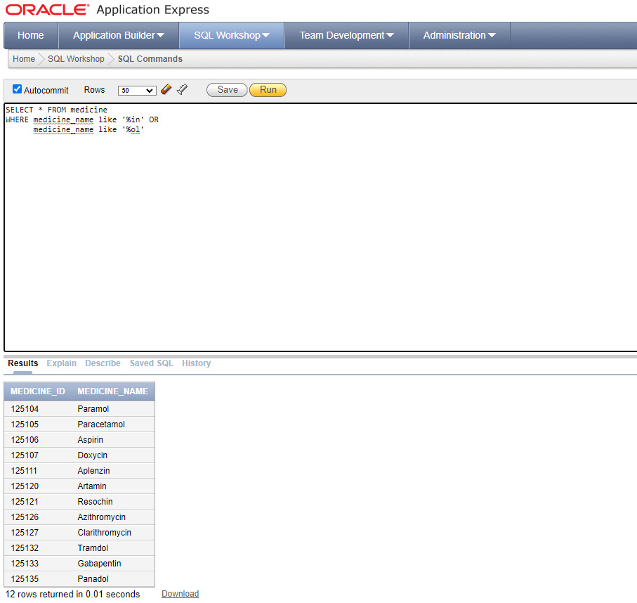
Query to find all painkillers from the medicines
<visualization>
SELECT * FROM medicine
WHERE medicine_name like '%in’ OR
medicine_name like '%ol'

Slide 3
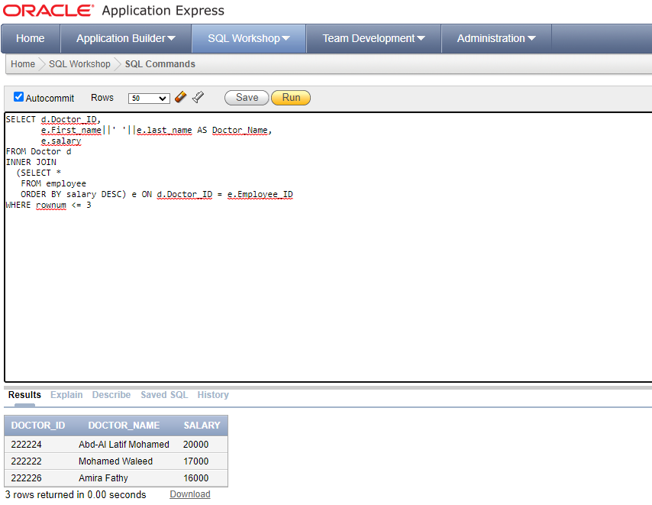
Query to find the 3 doctors with the highest salaries
<visualization>
SELECT d.Doctor_ID,
e.First_name||' '||e.last_name AS
Doctor_Name, e.salary
FROM Doctor d
INNER JOIN
(SELECT *
FROM employee
ORDER BY salary DESC) e ON
d.Doctor_ID = e.Employee_ID
WHERE rownum <= 3

Slide 4
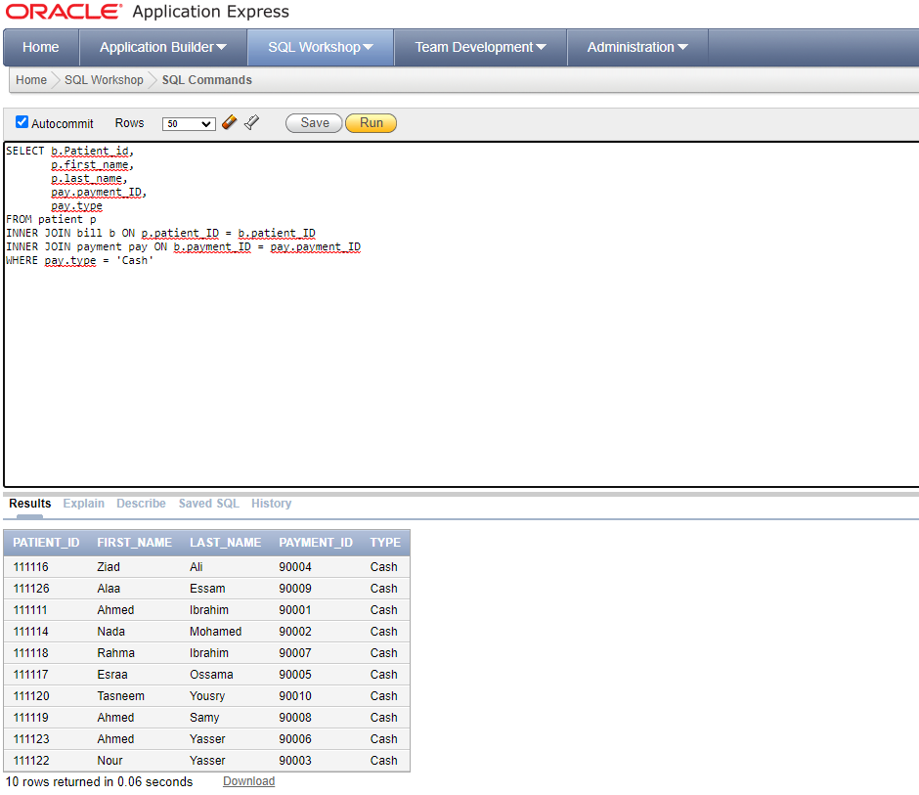
Query to find all patients who pay in cash
<visualization>
SELECT b.Patient_id,
p.first_name,
p.last_name,
pay.payment_ID,
pay.type
FROM patient p
INNER JOIN bill b
ON p.patient_ID = b.patient_ID
INNER JOIN payment pay
ON b.payment_ID = pay.payment_ID
WHERE pay.type = 'Cash'

