Slide 1
Project 2
Presentation
Maze Router (lee’s algoritm)
Rovan Adham - 900183804
Youssef Zohery - 900150781
Marwan Awad - 900172585

Slide 2
Overview
Technical background
Design and implementation
Examples
Problems/Limitations
Conclusions

Slide 3
Technical Background
Lee ‘s Algorithm is a breadth-first search-based solution for maze routing problems that finds all paths from S to T in path-length order.
It finds the minimum path.
Slow and requires a large memory for big layouts

Slide 4
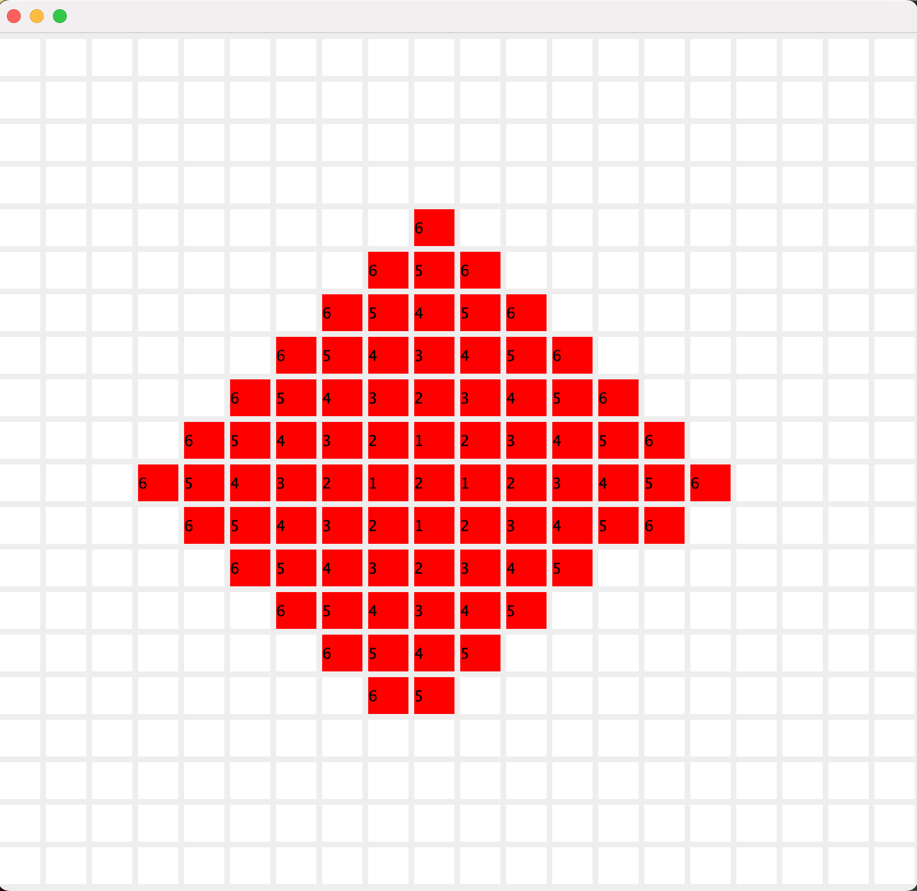
Design and Implementation
The first step is the breadth first search algorithm which is used to find the minimum distance/moves from one source pin the next.
The picture on the right highlighs an example of the what the breadth first search algorithm looks like in practice.

Slide 5
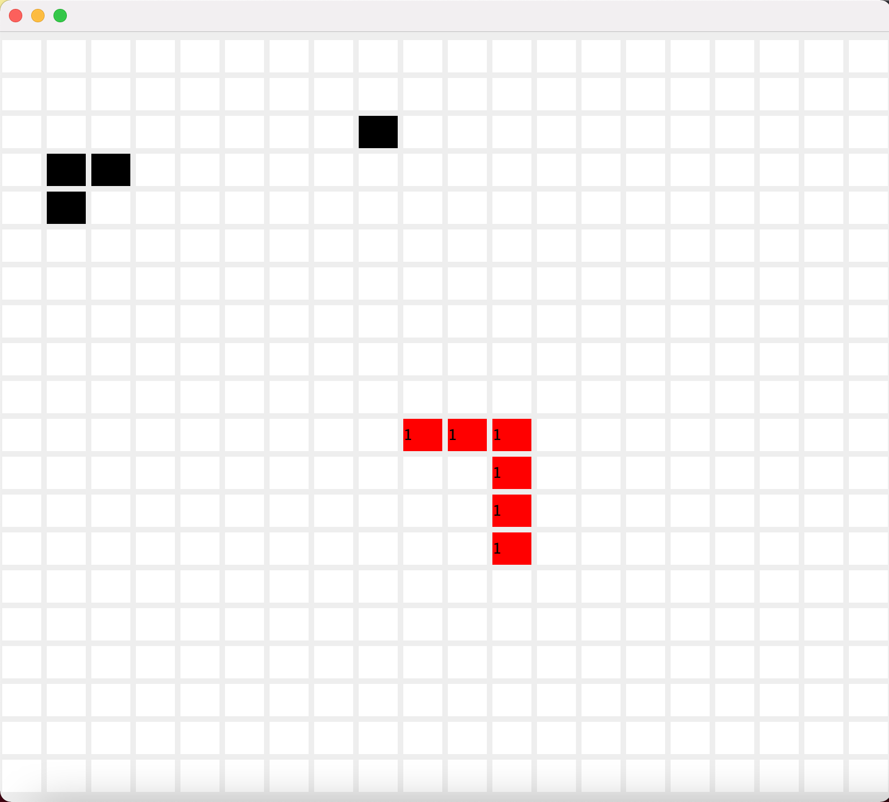
Design and Implementation
The second step of the path finder is a backtracking algorithm which takes in an array of all the possible moves of the path from the breadth first function and checks by moving in all 4 directions if the current path its one goes to the destination or not. If a count that increments with every move exceeds the minimum distance found then we go back a step and try a different direction until the destination is found.

Slide 6
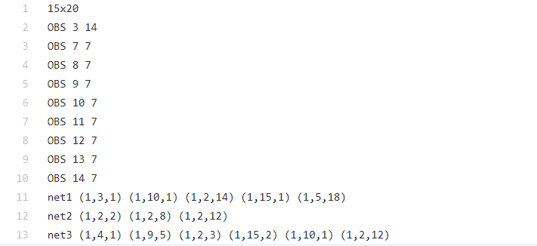
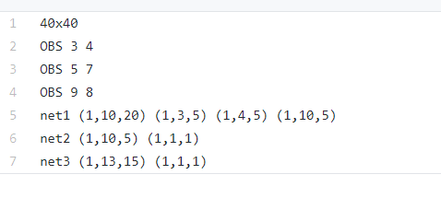
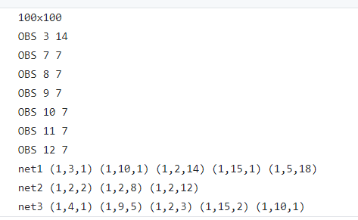
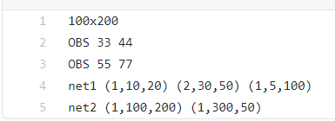

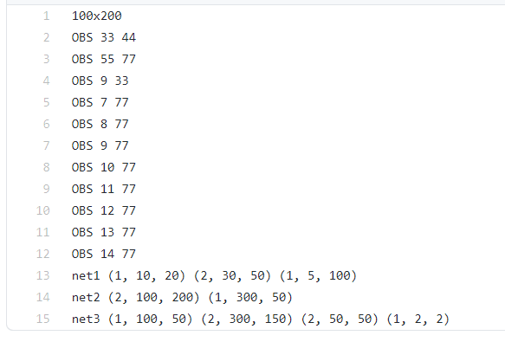
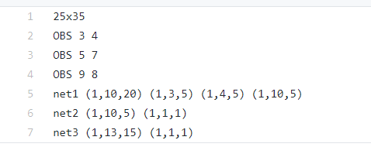
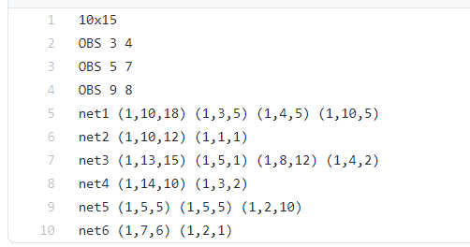
Examples
8 test files that contain different number of nets, pins, obstacles, grid sizes

Slide 7
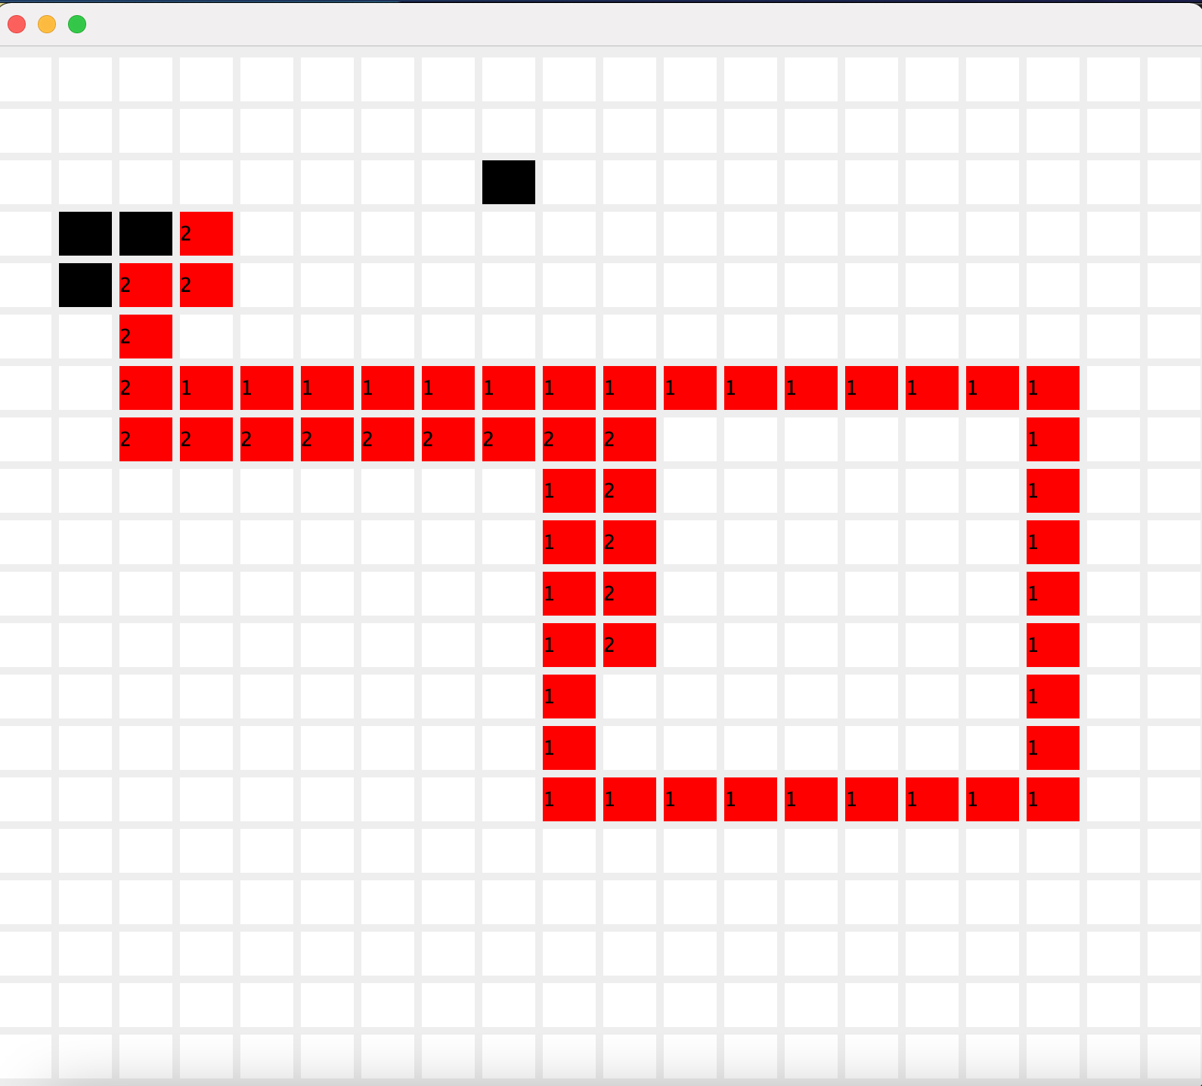
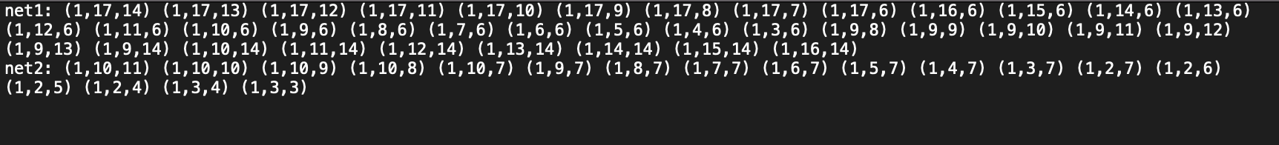
Output from example 5

Slide 8
Problems/Limitation
First worked in C++ and implemented 2 algorithms
Limitations in C++:
visualization
Switched to java
problems implementing 2nd layer
Due to the recursion checking all different possible paths, the longer the distance between every 2 points, the longer the code takes to run

Slide 9
Conclusion
Lee’s algorithm is good when finding the shortest distance but is not ideal when finding a path because the processing power needed for backtracking to find the path itself is too great especially with larger grids.

