Slide 1
Project 2
Presentation
Maze Router (lee’s algoritm)
Rovan Adham - 900183804
Youssef Zohery - 900150781
Marwan Awad - 900172585

Slide 2
Overview
Technical background
Design and implementation
Examples
Problems/Limitations
Conclusions

Slide 3
Technical Background
Lee ‘s Algorithm is a breadth-first search-based solution for maze routing problems that finds all paths from S to T in path-length order.
It finds the minimum path.
Slow and requires a large memory for big layouts

Slide 4
Design and Implementation

Slide 5
Design and Implementation

Slide 6
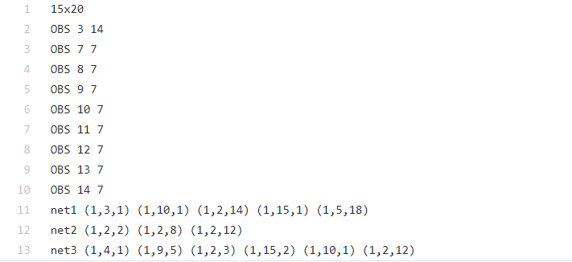
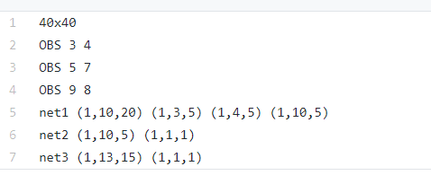
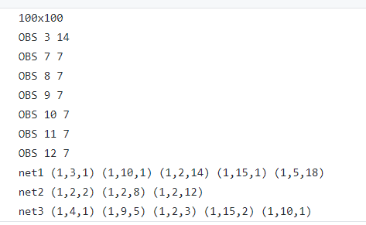
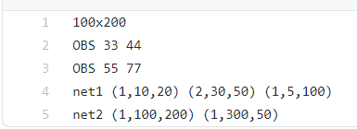

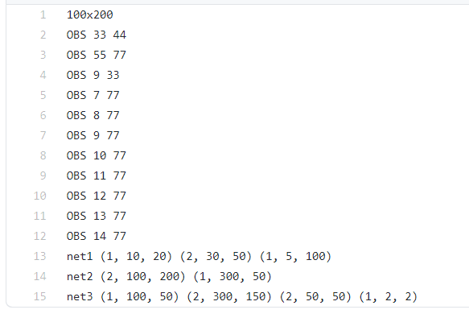
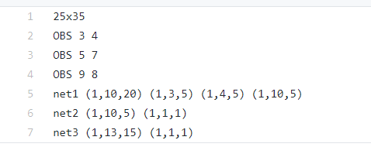
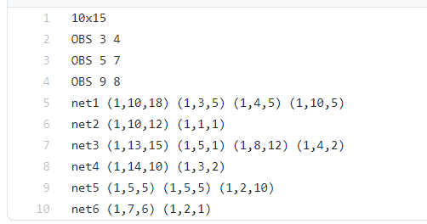
Examples
8 test files that contain different number of nets, pins, obstacles, grid sizes

Slide 7
Output

Slide 8
Visualization

Slide 9
Problems/Limitation
First worked in C++ and implemented 2 algorithms
Limitations in C++:
visualization
Switched to java
problems implementing 2nd layer

Slide 10
Conclusion

