Slide 1

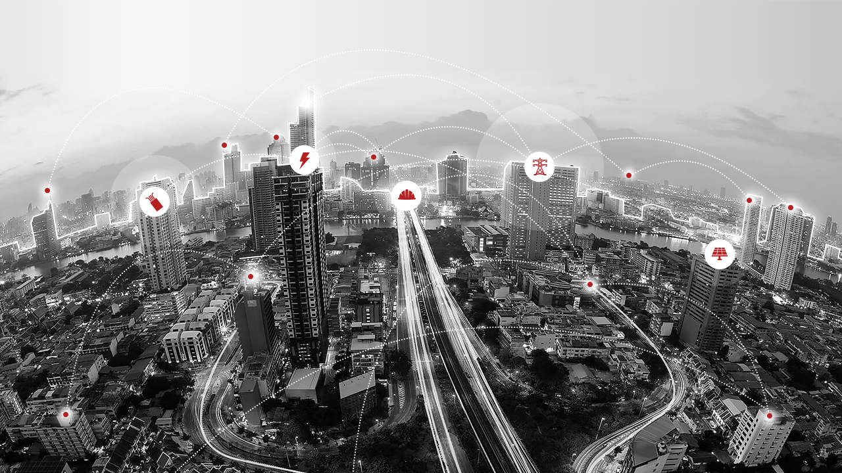
SpeakUp
“Provide a safe, easy and trusted channel”
ETC, ESC, UMC, Polymers, Cables Accessories & ECMEI

Slide 2
SpeakUp Scope
Issues (Operations/People/Process).
Ideas (Improvement/Productivity).
Project Proposal.
Safety Concern.
Employee Feedback / Complaint.
Digital Improvement / System Request.
Web portal + mobile-friendly view

Slide 3
SpeakUp Needs
Stakeholders & Roles
Reporting & dashboard design
Project sponsor: Sector HR Director.
Project Owner: Sector OD.
IT Projects & Applications Manager: Technical delivery, integrations, authentication.
HRBP (case owner): People-related investigations and implementation.
HSE Manager: Safety Escalations in Each BU.
Employees: End users who submit and receive feedback.
Submissions by BU (Bar Chart).
Submissions by type & category (Stacked Bar).
Top 10 Recurring Issues.
Status Breakdown (New / In Review / Actioned / Closed)

Slide 4
SpeakUp Flow
Employee Details
Type
Employee Code
Issue
Employee Name
Idea
Retention: 5 Year for suggestions).
Department
Project Proposal
BU
Safety Concern
Phone/Email
Emp Feedback
Sys Request
Notes:
Employee Data: (Employee Code – Employee Name – Department – BU – Phone/Email)
Type: (Scope) / For Ideas ( Idea title – Description – Department Responsible for Implementation) + Impact: (Improve/save/reduce what.. - Scope of Project [Function/Department/Bu] - Describe the impact – Sustain [ From 00 to 00].
Details: (Description)
Finish: Attachments

Slide 5
SpeakUp Flow
Employee Details
Type
Employee Code
Issue
Issue Title
Employee Name
Issue Type
(Operational / People / Process / Material / Equipment)
Department
Description of the Problem
BU
Impact Area
(Production / Quality / SLA / Cost / Delivery)
Phone/Email
Responsible Department
Root Cause (if known)
Proposed Solution
Notes:
Employee Data: (Employee Code – Employee Name – Department – BU – Phone/Email)
Type: (Scope) / For Ideas ( Idea title – Description – Department Responsible for Implementation) + Impact: (Improve/save/reduce what.. - Scope of Project [Function/Department/Bu] - Describe the impact – Sustain [ From 00 to 00].
Details: (Description)
Finish: Attachments

Slide 6
SpeakUp Flow
Employee Details
Type
Employee Code
Idea
Idea/Project Title
Employee Name
Description
Department
Responsible Dep
BU
Impact
Improve/Save/Reduce
Phone/Email
Scope
Functional, Departmental, BU
Describe The Impact
Sustainability
Notes:
Employee Data: (Employee Code – Employee Name – Department – BU – Phone/Email)
Type: (Scope) / For Ideas ( Idea title – Description – Department Responsible for Implementation) + Impact: (Improve/save/reduce what.. - Scope of Project [Function/Department/Bu] - Describe the impact – Sustain [ From 00 to 00].
Details: (Description)
Finish: Attachments

Slide 7
SpeakUp Flow
Employee Details
Type
Employee Code
Project Proposal
Project Title
Employee Name
Business Need
Department
Expected Benefits
(Financial, Operational, Safety, Compliance)
BU
Scope
(BU / Multi-BU / Corporate)
Phone/Email
Estimated Cost
Expected ROI
Key Stakeholders
Timeline
(Estimated Start–End Dates)
Notes:
Employee Data: (Employee Code – Employee Name – Department – BU – Phone/Email)
Type: (Scope) / For Ideas ( Idea title – Description – Department Responsible for Implementation) + Impact: (Improve/save/reduce what.. - Scope of Project [Function/Department/Bu] - Describe the impact – Sustain [ From 00 to 00].
Details: (Description)
Finish: Attachments

Slide 8
SpeakUp Flow
Employee Details
Type
Employee Code
Safety Concern
Safety Concern Title
Employee Name
Description of Concern
Department
(Unsafe Act / Unsafe Condition / Environmental / Health)
Category
(Unsafe Act / Unsafe Condition / Environmental / Health)
BU
Risk Level
(Low / Medium / High / Critical)
Phone/Email
Potential Impact
(Injury, Downtime, Damage, Environmental Harm)
Suggested Preventive or Corrective Action
Responsible Department
Upload Supporting Photo or File (optional)
Notes:
Employee Data: (Employee Code – Employee Name – Department – BU – Phone/Email)
Type: (Scope) / For Ideas ( Idea title – Description – Department Responsible for Implementation) + Impact: (Improve/save/reduce what.. - Scope of Project [Function/Department/Bu] - Describe the impact – Sustain [ From 00 to 00].
Details: (Description)
Finish: Attachments

Slide 9
SpeakUp Flow
Employee Details
Type
Employee Code
Emp Feedback
Feedback Title
Employee Name
Category
(Supervisor Behavior / Workload / Communication / Facilities / Policy / HR Process)
Department
Description
BU
Impact Area
(Personal, Departmental, Organizational)
Phone/Email
Responsible Department
Preferred Resolution Type
(Action Required / Feedback Only / Anonymous Share)
Confidentiality Level
(Public / Private / Anonymous)
Upload Supporting Photo or File (optional)
Notes:
Employee Data: (Employee Code – Employee Name – Department – BU – Phone/Email)
Type: (Scope) / For Ideas ( Idea title – Description – Department Responsible for Implementation) + Impact: (Improve/save/reduce what.. - Scope of Project [Function/Department/Bu] - Describe the impact – Sustain [ From 00 to 00].
Details: (Description)
Finish: Attachments

Slide 10
SpeakUp Submission
Submission Form (Employee)
Employee Code.
Anonymity flag (Yes/No).
BU.
Title/Band.
Category (Go To Scope).
Urgency (Low/Med/High).
Attachments (If Applicable)
Contact (optional: Email or Phone).
Retention: 5 Year for suggestions) per legal/HR policy.
Notes:
Employee Data: (Employee Code – Employee Name – Department – BU – Phone/Email)
Type: (Scope) / For Ideas ( Idea title – Description – Department Responsible for Implementation) + Impact: (Improve/save/reduce what.. - Scope of Project [Function/Department/Bu] - Describe the impact – Sustain [ From 00 to 00].
Details: (Description)
Finish: Attachments

Slide 11



