Slide 1

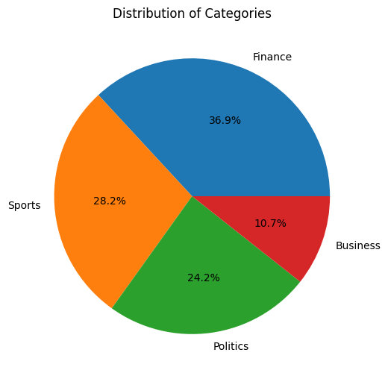
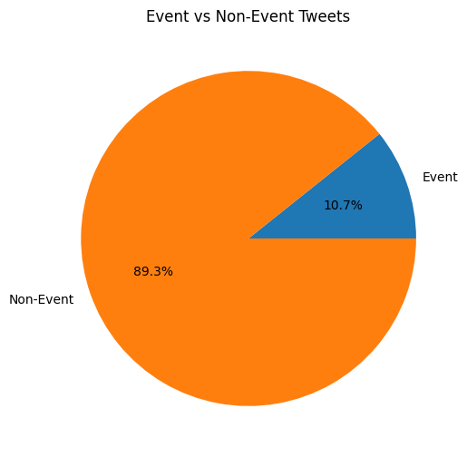
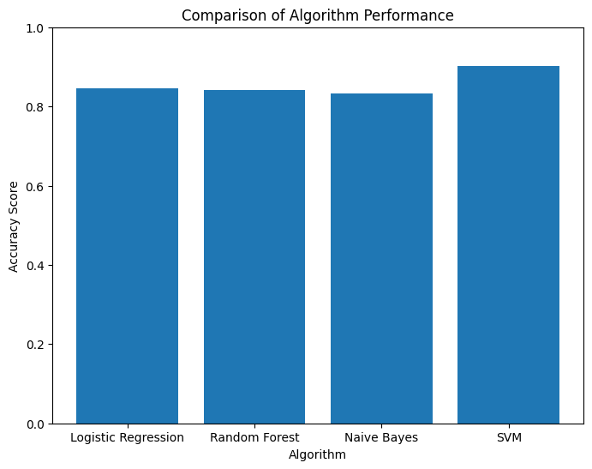
Event Detection on Social Media
INTime News Mobile Application for gathering news from all over the world in one place.
Faculty of Computer and Information Science, Information Systems Department.
Marwan Ahmed; Rana Hamdy; Hussien Ibrahem ; Sama Hesham; Ahmed Hamdy; Riham Mohsen;
INTRODUCTION
Abstract
Event detection on social media has become increasingly important in recent years, as social media has become a key source of information for individuals and organizations around the world. Social media platforms such as Twitter, Facebook, and Instagram have become important channels for people to share news, opinions, and experiences. This wealth of information has created new opportunities for event detection, which can be used to identify and monitor events as they unfold.
The significance of event detection on social media lies in its potential to provide insights into a wide range of events, including natural disasters, political events, public health emergencies, and others. By detecting events on social media, researchers and practitioners can gain insights into the characteristics of the events, such as their location, timing, and severity. This information can be used to inform decision-making in a variety of domains, including crisis management, public health, and marketing analysis.
Event detection on social media is a challenging and dynamic field that requires sophisticated algorithms and techniques to overcome the noise, ambiguity, and volume of data associated with social media platforms.
There have been several recent developments and discoveries in the field of event detection. Some of the main results and newly observed facts like Deep learning techniques such as CNN , RNN has shown promising results in event detection on social media. Emotion analysis involving identification and categorization of emotions in the messages also can improve the event detection process
Results
After Classification, we found that the data has been classified into 4 categories, each category has a certain percentage as we can see in Chart 1. Categories.
After Feature Extraction, we found that only 10.7% from the data are real events as we an see in Chart 2. Events ad Nonevents.
The accuracy of classification using SVM is the highest accuracy among all used algorithms as we can see in Chart3. Accuracy Chart. It as accuracy of 90% as we can see in Table 1. Classification Accuracy.
METHODS
Data Collection: The first stage of event detection. It involves collecting data from any social media platforms. In our case data is collected using Twitter API.
Preprocessing: Once the data is collected, it is preprocessed to remove noise and irrelevant information. This may involve techniques such as filtering out spam or removing duplicate posts.
Feature Extraction: After preprocessing, features are extracted from the data using Natural language processing technique to represent the content of the posts.
Classification: Once the features are extracted, the data is classified into different event categories. This can be done using machine learning algorithms such as support vector machines, decision trees, or neural networks
Postprocessing: After classification, postprocessing techniques are applied to refine the results and improve the accuracy of the event detection.
Visualization: Finally, the results of event detection are visualized to provide insights into the events and their characteristics.
References
Chart 1. Categories.
Chart 2. Events and Nonevents.
Algorithm | Accuracy
Naïve Bayes | 83%
Logistic Regression | 84%
Random Forest | 84%
SVM | 90%
Beccari, B. (2016). A Comparative Analysis of Disaster Risk, Vulnerability and Resilience Composite Indicators. PLoS Currents.
Boettcher, A. and Lee, D. (2012). Eventradar: A real-time local event detection scheme using twitter stream. In Green Computing and Communications (GreenCom), 2012 IEEE International Conference.
Ateş, M.A., Purchasing and Supply Management at the Purchase Category Level: strategy, structure and performance, Promoter(s): Prof.dr. J.Y.F. Wynstra & Dr. E.M. van Raaij.
Atefeh, F., Khreich, W.: A survey of techniques for event detection in twitter. Comput. Intell., 132–164 (2013).
C. Aggarwal, and P. Yu, A Framework for Clustering Massive Text and Categorical Data Streams, SDM, (2006).
T. Yang, R. Jin, Y. Chi, and S. Zhu, Combining link and content for community detection: a discriminative approach, KDD Conf., (2009).
Chart 3. Accuracy Chart.
Table 1. Classification Accuracy.
Conclusion
Event detection on social media is an important area that has the potential to provide information about events as they happen. The use of machine learning algorithms has made it possible to automate this process, but there are still many challenges that need to be addressed. These challenges include dealing with noisy and unstructured data, identifying relevant features and patterns, and handling the dynamic and evolving nature of social media content. Support Vector Machine is an effective machine learning algorithm for event detection on social media. The fact that it achieved an accuracy of 90% suggests that it is capable of accurately identifying events based on patterns and trends in social media data.
Acknowledgments
Supervisors:
Prof. Nagwa Badr
TA. Amra Ali

