Slide 1
Project Overview
What I Built
  • Integrated inpatient, outpatient, and beneficiary Medicare data
  • Engineered provider-level features (claims, reimbursements, patient mix)
  • Trained GradientBoostingClassifier with preprocessing pipeline
  • Evaluated results using ROC-AUC, PR-AUC, and Confusion Matrix

Slide 2
Data Preparation & Processing
Steps Performed
  • Combined inpatient, outpatient & beneficiary files
  • Imputed missing values using median
  • Applied StandardScaler for normalization
  • Extracted FraudLabel as target for supervised learning

Slide 3
Why Gradient Boosting Was Selected
Key Reasons Gradient Boosting Outperformed Others:
  • Achieved the highest PR-AUC (most important for fraud detection).
  • Sequential learning corrects previous tree mistakes.
  • Captures nonlinear patterns and feature interactions.
  • Excellent performance on tabular, imbalanced datasets.
  • More stable than Random Forest and more flexible than Logistic Regression.

Slide 4
Model Training
GradientBoostingClassifier
  • Handles nonlinear relationships well
  • Performs strongly on tabular data
  • Less sensitive to scaling issues
  • Proven performance in fraud detection problems

Slide 5
How Gradient Boosting Differs From Other Models
Model Differences:
  • Logistic Regression: Linear model, misses complex patterns.
  • Random Forest: Strong but builds trees independently, not sequentially.
  • Gradient Boosting: Each tree improves previous errors → superior fraud detection.

Slide 6
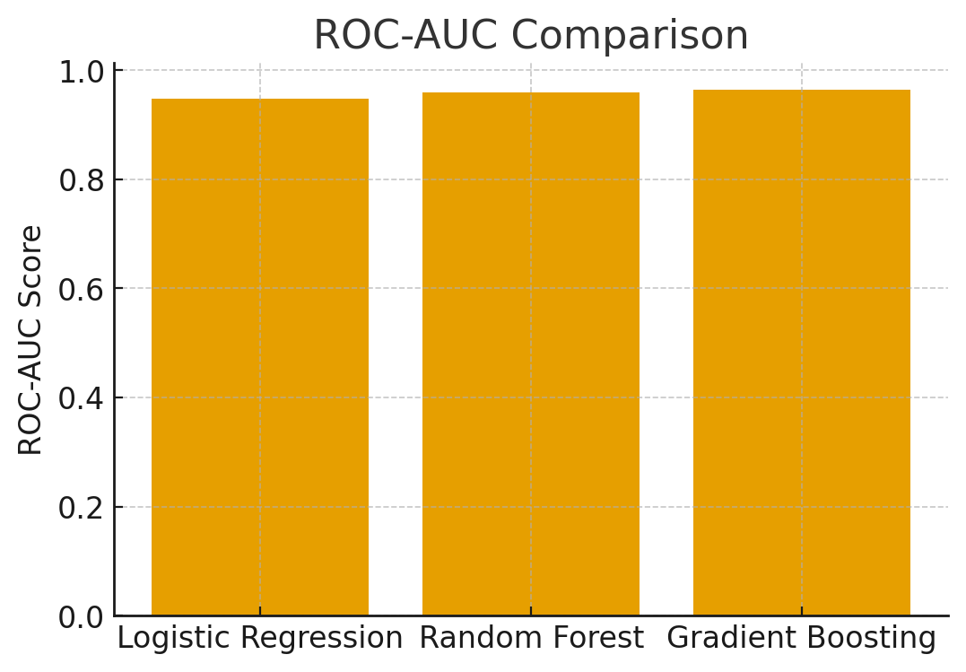
ROC-AUC Comparison Across Models

Slide 7
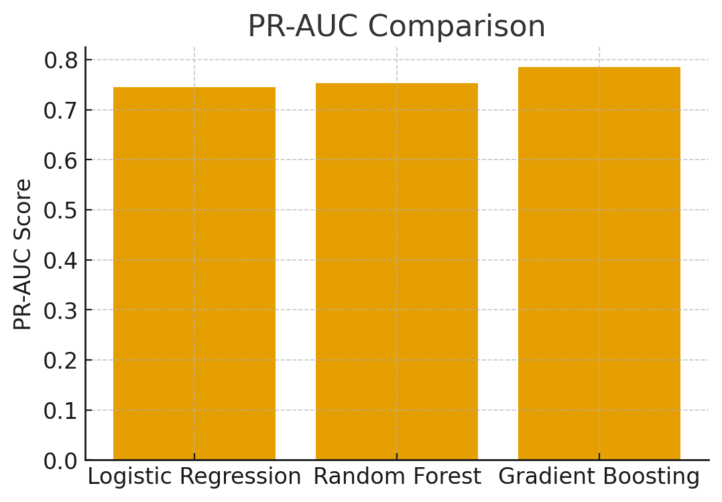
PR-AUC Comparison Across Models

Slide 8
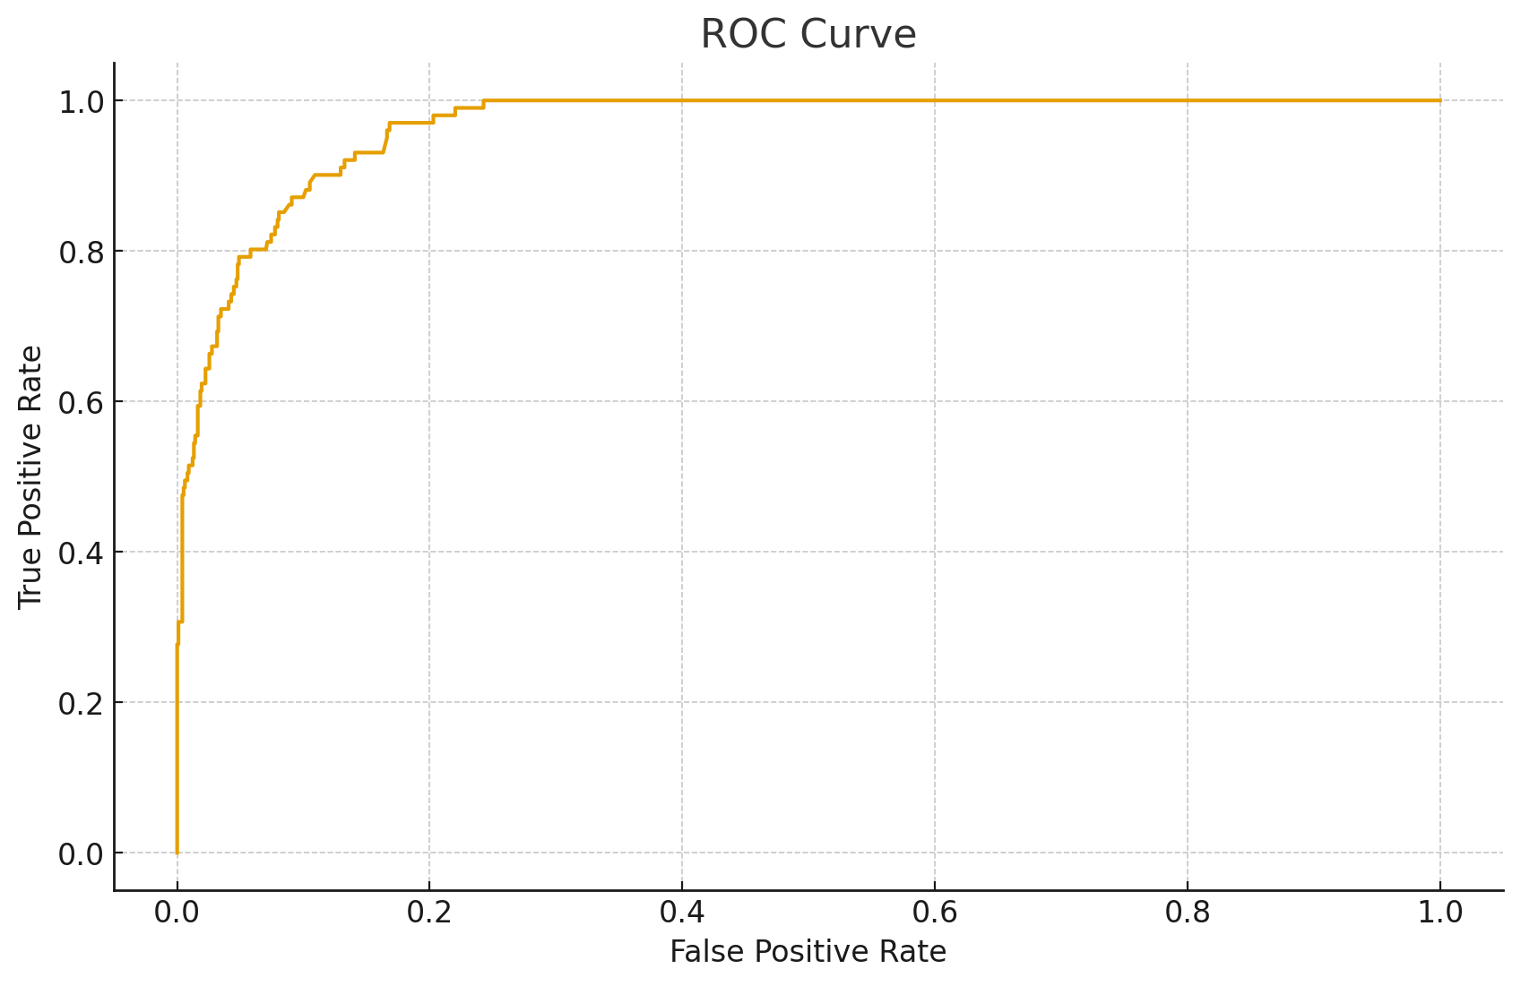
ROC Curve

Slide 9
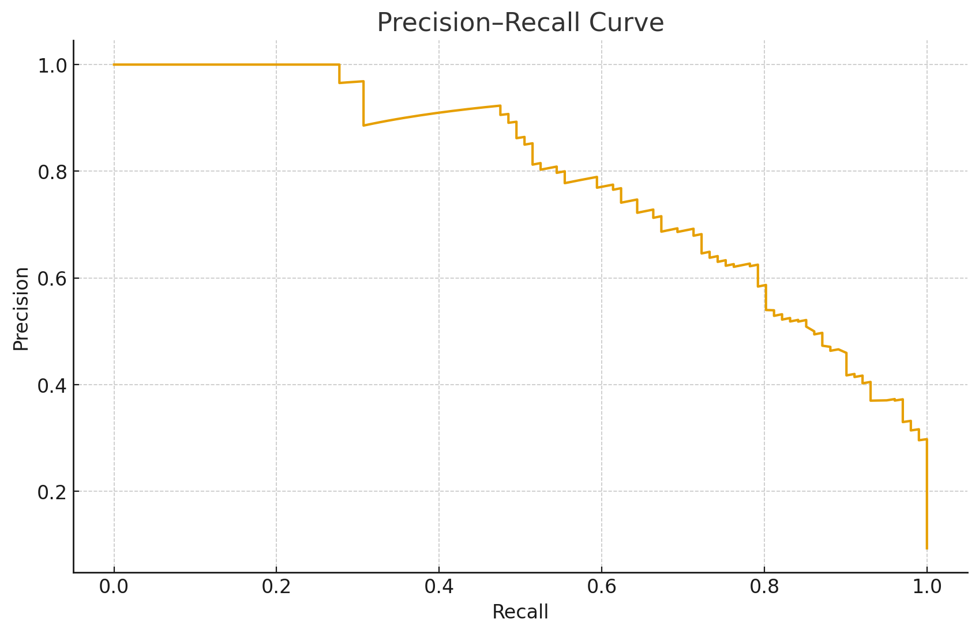
Precision–Recall Curve

Slide 10
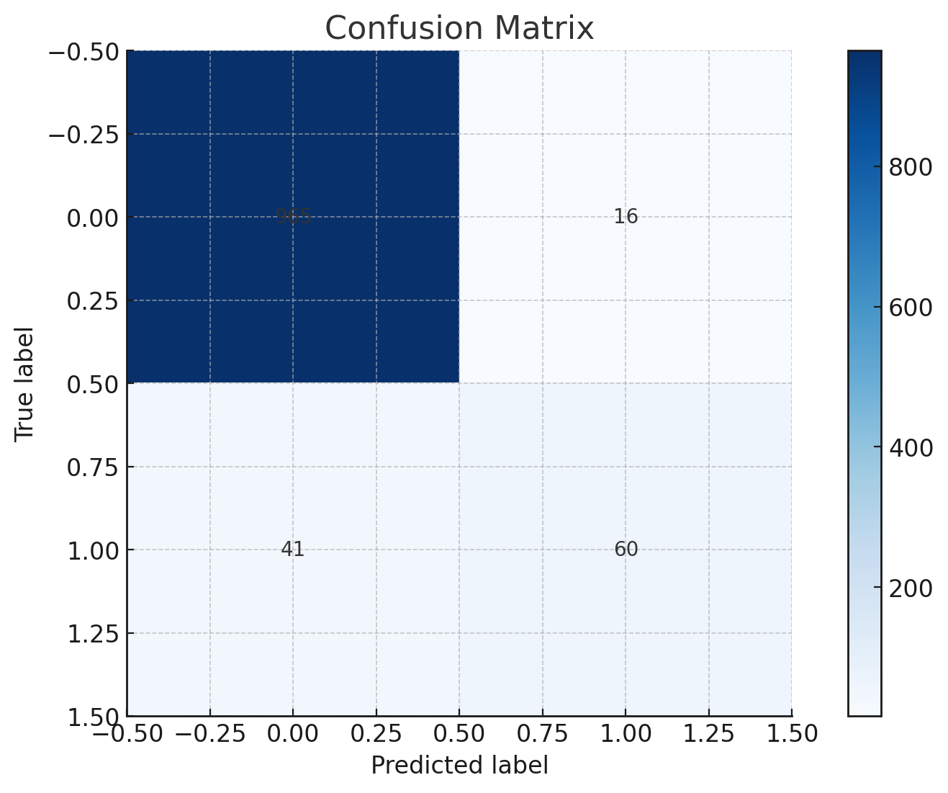
Confusion Matrix

Slide 11
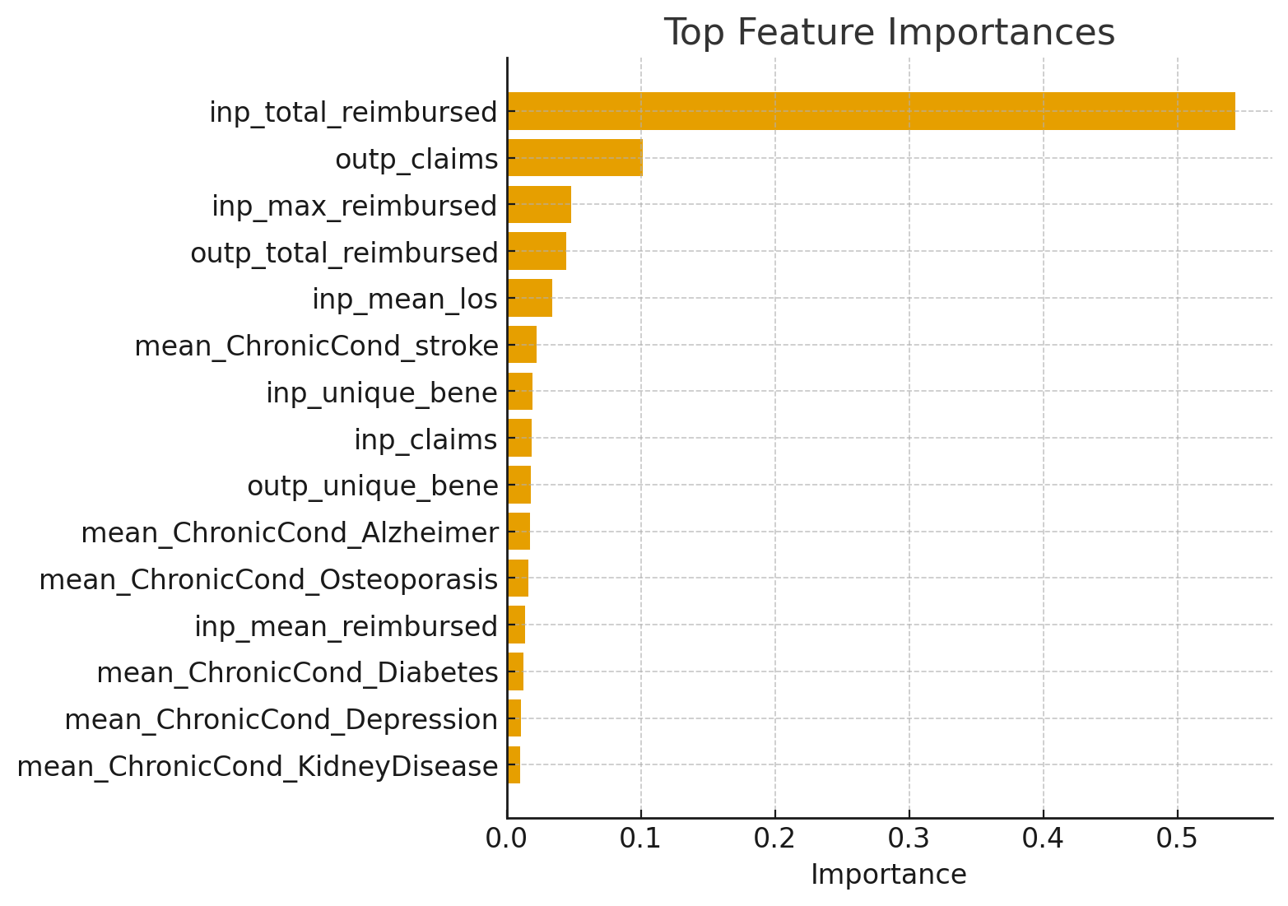
Top Feature Importances

Slide 12
Conclusion & Key Findings
What I Discovered
  • Model achieved strong ROC-AUC and PR-AUC performance
  • Indicates effective separation between fraud vs. non-fraud providers
  • Feature importance showed financial and claim-volume metrics matter most
  • Pipeline fully reproducible and scalable for deployment

Slide 13
Thank You
Questions?

