Slide 1

Our code explanation

Slide 2
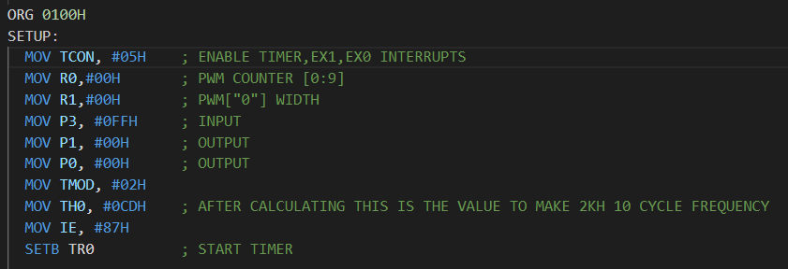


R0 counts each time timer interrupt has called
delay(ms) = (255 - init)*1μs
delay =$\frac{1}{2 Kh}$*10% = 0.05 ms
$$init=0xCD$$

Slide 3
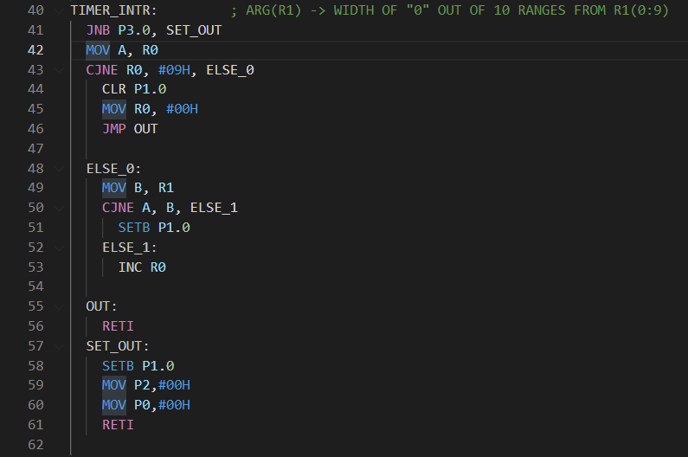
if R1 =0 and R0 =0, what will happen?
A = 0
jumps
B = 0
Is this affecting bad?
- Actually no because time to execute each instruction is in micro while our delay is in mili.
Time to call intr function
Time to set p1.0

Slide 4

If p3.0 ==0?
decoder

Slide 5
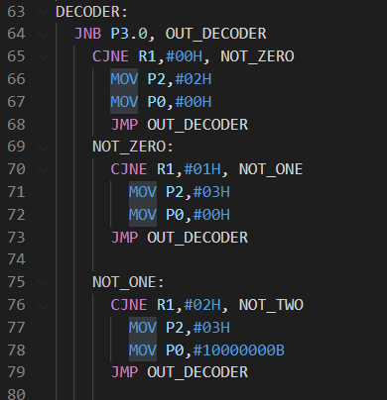
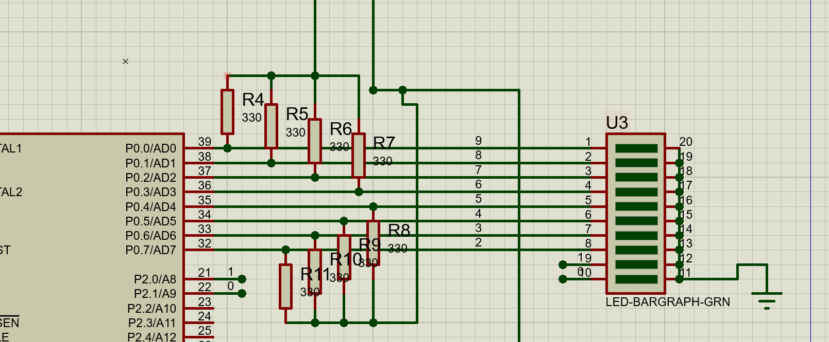

https://github.com/MarwanMagdy0/8051_motor_controller

