Slide 1
Lab1
HSV.
Noise.
Histogram.
Notes:
CMYK
Cyan, Magenta, Yellow, blacK

Slide 2
HSV

Slide 3
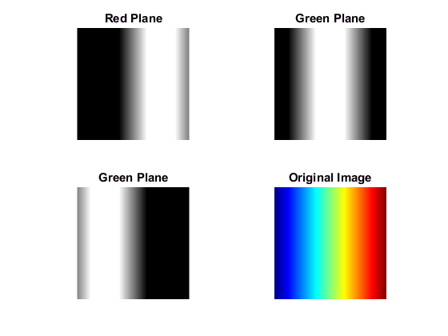
RGB Channels
Blue Plane

Slide 4
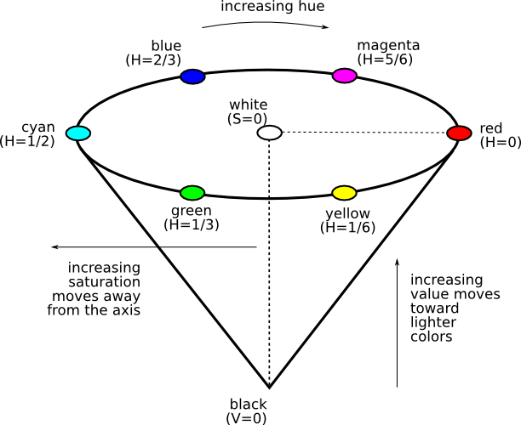
HSV
Notes:
Because the R, G, and B components of an object’s color in a digital image are all correlated with the amount of light hitting the object, and therefore with each other, image descriptions in terms of those components make object discrimination difficult. Descriptions in terms of hue/lightness/chroma or hue/lightness/saturation are often more relevant.

Slide 5
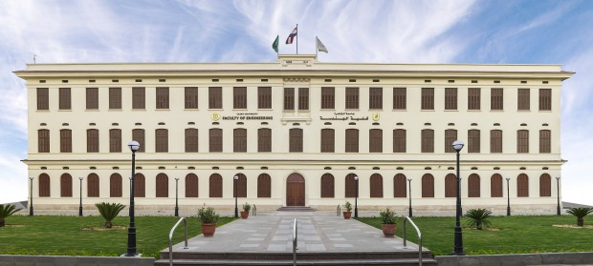
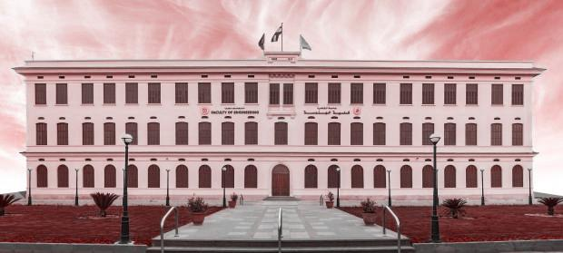
Hue
Notes:
The same Hue value for all pixels

Slide 6
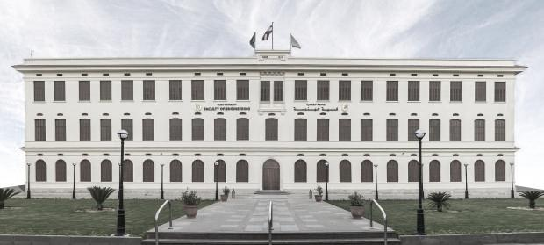
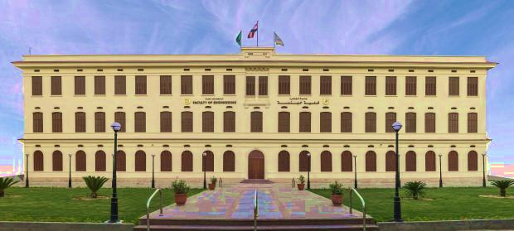
Saturation
Notes:
First image:

Slide 7
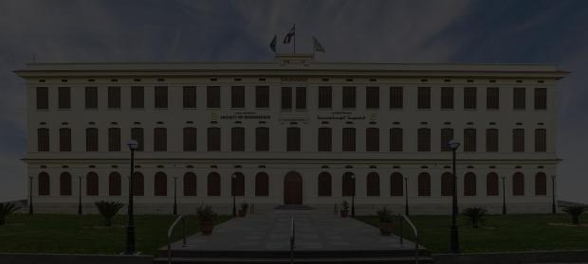
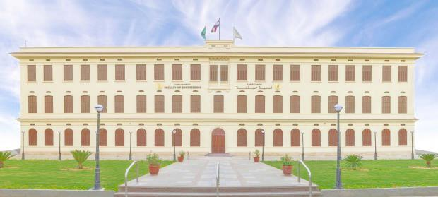
Value
Notes:
First image:

Slide 8
Req:
Show each channel alone.
What is the meaning of the result image?
Notes:
GS

Slide 9
Noise

Slide 10
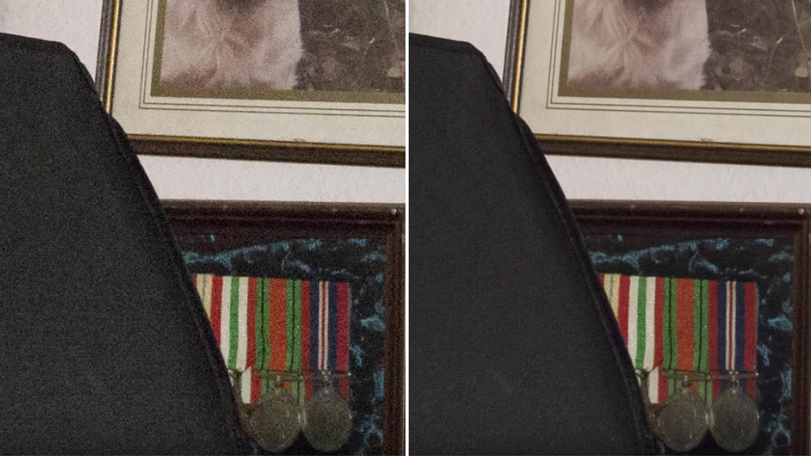
Noise

Slide 11
Req
Salt and pepper noise (ratio of pixels to affect).

Slide 12
Image Processing is different!!
Understand.
Quiz
Discussions.
Ask freely.
Grades is not the point!

