Slide 1
RADAR
Real-Time Vehicle Analysis System
Egyptian License Plate Detection · OCR · Seatbelt & Mobile Detection
YOLOv11m
YOLO26m
YOLO26s
Streamlit
LapSRN
Real-ESRGAN

Slide 2
The Problem
🚗
Traffic Enforcement
🔍
License Plate OCR
Manual monitoring of vehicles, license plates, and driver behavior is slow, error-prone, and requires significant human resources.
Egyptian plates have unique Arabic characters and dual-language format (Arabic + numbers). Traditional OCR struggles with this complexity.
📱
Driver Safety
⚡
Real-Time Processing
Seatbelt violations and mobile phone usage while driving are leading causes of accidents. Manual detection is inconsistent.
Traffic systems need fast, automated analysis that can process live feeds and images efficiently.
RADAR — Real-Time Vehicle Analysis System

Slide 3
01
System Architecture
How RADAR processes images end-to-end

Slide 4
End-to-End Pipeline
1
2
3
4
5
6
Image Input
Car Detection
Interior Analysis
Plate Detection
Super Resolution
OCR
Upload photo or capture from video
YOLO26s detects vehicles (car, bus, truck)
Seatbelt & mobile phone detection
YOLOv11m locates license plates
LapSRN & Real-ESRGAN enhance crops
3 models read characters (Arabic + numbers)
Roboflow-Style Live Filtering
All models run ONCE at minimum confidence (0.01) and cache results. Sidebar sliders filter cached results client-side — no model re-run on slider change. This gives real-time interactive filtering without GPU overhead.
RADAR — Real-Time Vehicle Analysis System

Slide 5
02
Our Models
Six specialized models working together

Slide 6
Model Arsenal
Plate Detector
OCR V1
OCR V2
YOLOv11m
1 classes
YOLOv11m
38 classes
YOLO26m
38 classes
Locate license plates in images
Character recognition (baseline)
Improved character recognition
OCR V2 Weighted
Car Detector
Seatbelt+Mobile
YOLO26m
38 classes
YOLO26s
3 classes
YOLOv11m
5 classes
Weighted loss for better precision
Vehicle detection (car/bus/truck)
Driver safety violation detection
RADAR — Real-Time Vehicle Analysis System

Slide 7
03
Plate Detection
YOLOv11m — Finding license plates in the wild

Slide 8
License Plate Detection
YOLOv11m | Fine-tuned on Egyptian car plates
Architecture
YOLOv11m (medium)
Why Plate-First Detection?
Input Size
640 × 640 pixels
▸ Detects plates in the full image before cropping — avoids missing small plates
Detection Target
Egyptian license plates
▸ Plates sorted by width (widest first) — best quality crop for OCR
Confidence Threshold
0.25
▸ Runs at cache-min confidence (0.01) then filtered client-side at 0.25
Output
Bounding box + confidence
▸ Single model handles all Egyptian plate styles (white, blue, old format)
Post-processing
Sorted widest-first for best OCR
RADAR — Real-Time Vehicle Analysis System

Slide 9
04
OCR Models
Reading characters from Egyptian license plates

Slide 10
The OCR Challenge
Egyptian plates have unique challenges
🔤
Dual Language
📊
38 Character Classes
Plates contain both Arabic letters and Latin/Arabic numerals — OCR must handle bidirectional text
10 digits + 28 Arabic letters with visually similar characters (e.g., ع vs غ, ص vs ض)
🔍
Low Resolution
🌤
Varied Conditions
Cropped plates from far vehicles are blurry — super-resolution enhancement is critical
Different lighting, angles, plate styles (white, blue), and degradation levels
RADAR — Real-Time Vehicle Analysis System

Slide 11
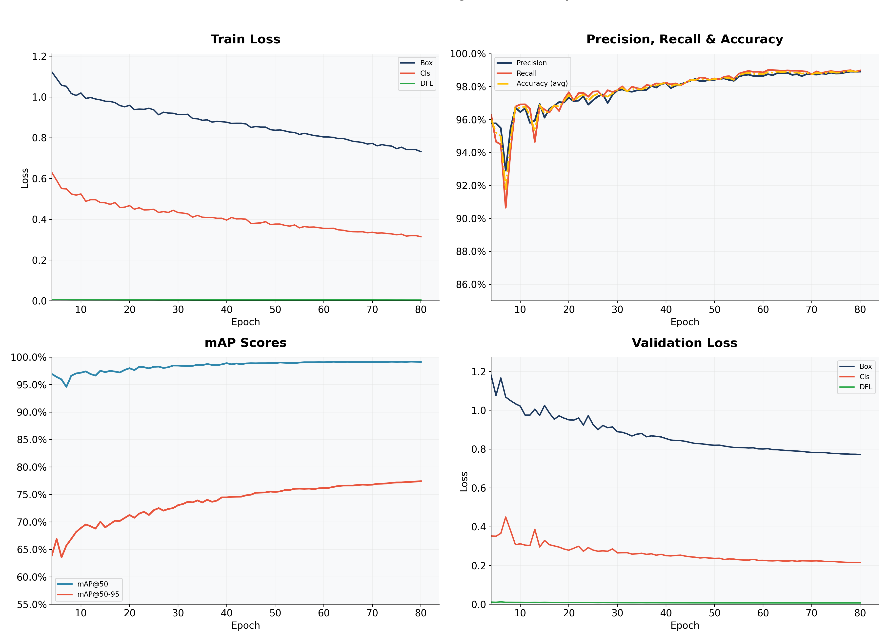
OCR V2 — Training Results
YOLO26m | 80 epochs | batch=16 | AdamW | characters_final dataset (9,324 images)
99.2%
77.4%
98.9%
99.0%
99.0%
mAP@50
mAP@50-95
Precision
Recall
Accuracy
Training Configuration
▸ Architecture: YOLO26m (medium)
▸ Dataset: characters_final — 9,324 images
▸ Image Size: 640 × 640
▸ Optimizer: AdamW, lr=0.01
▸ Augmentation: RandAugment + MixUp(0.1)
▸ Warmup: 3 epochs (removed from charts)
▸ Best epoch: 78 / 80
▸ Platform: Kaggle T4 GPU
RADAR — Real-Time Vehicle Analysis System

Slide 12
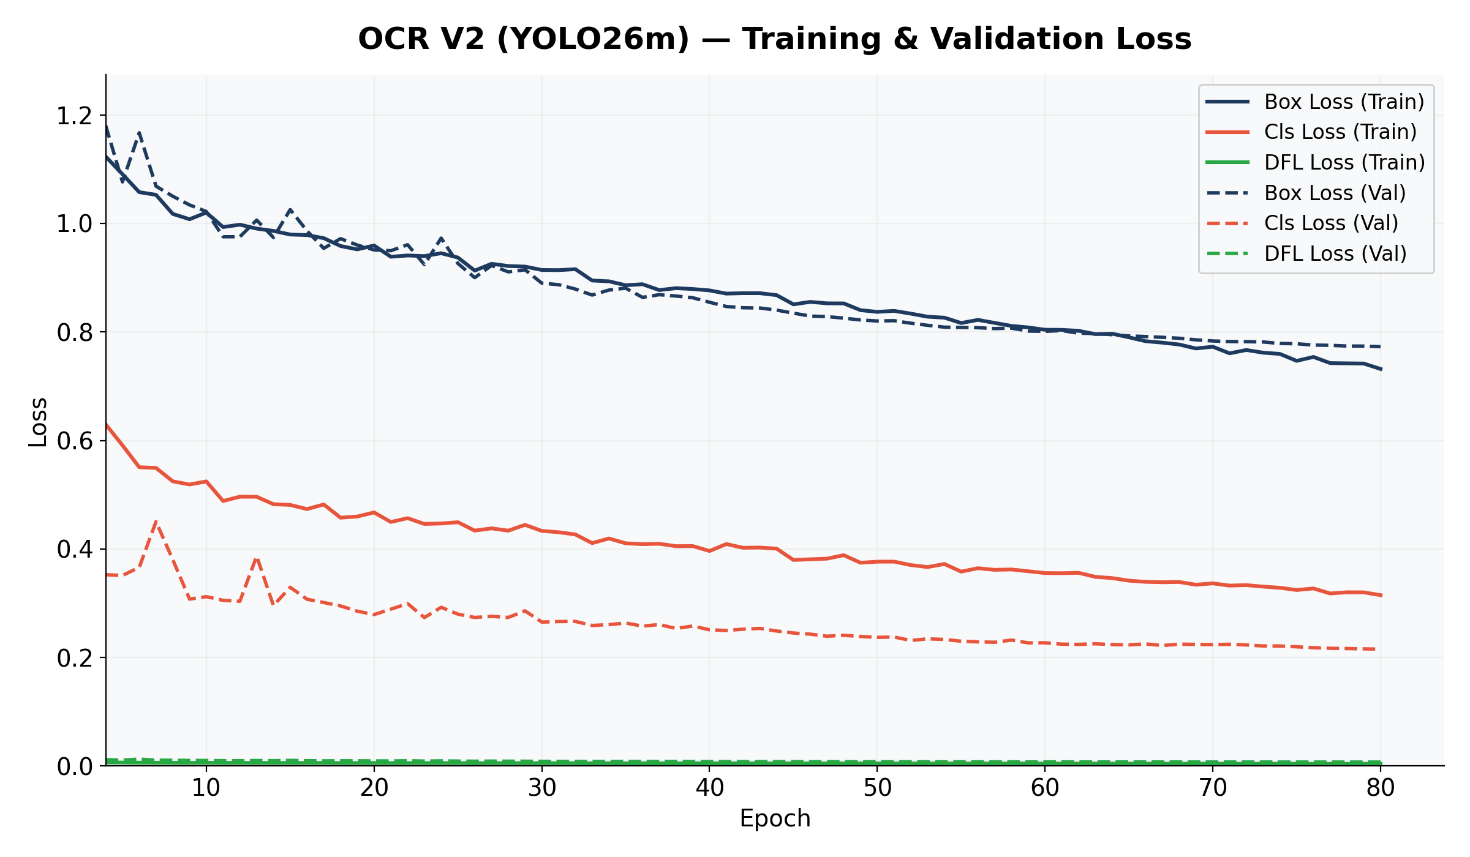
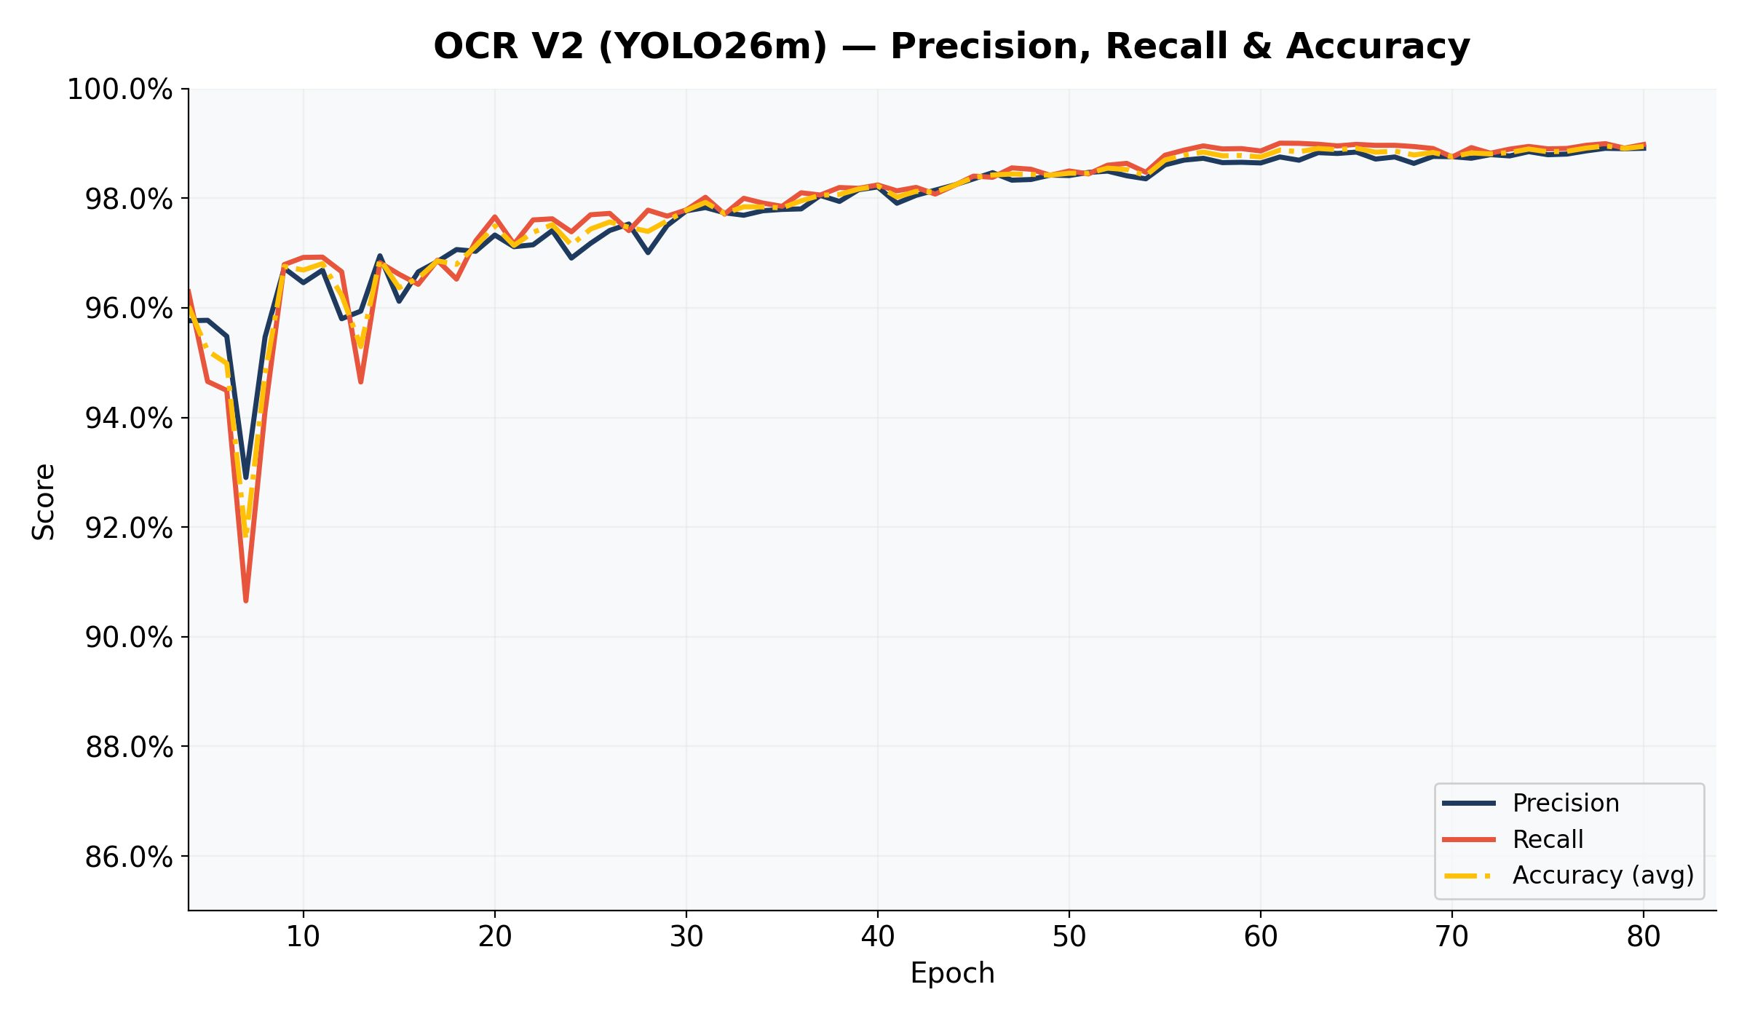
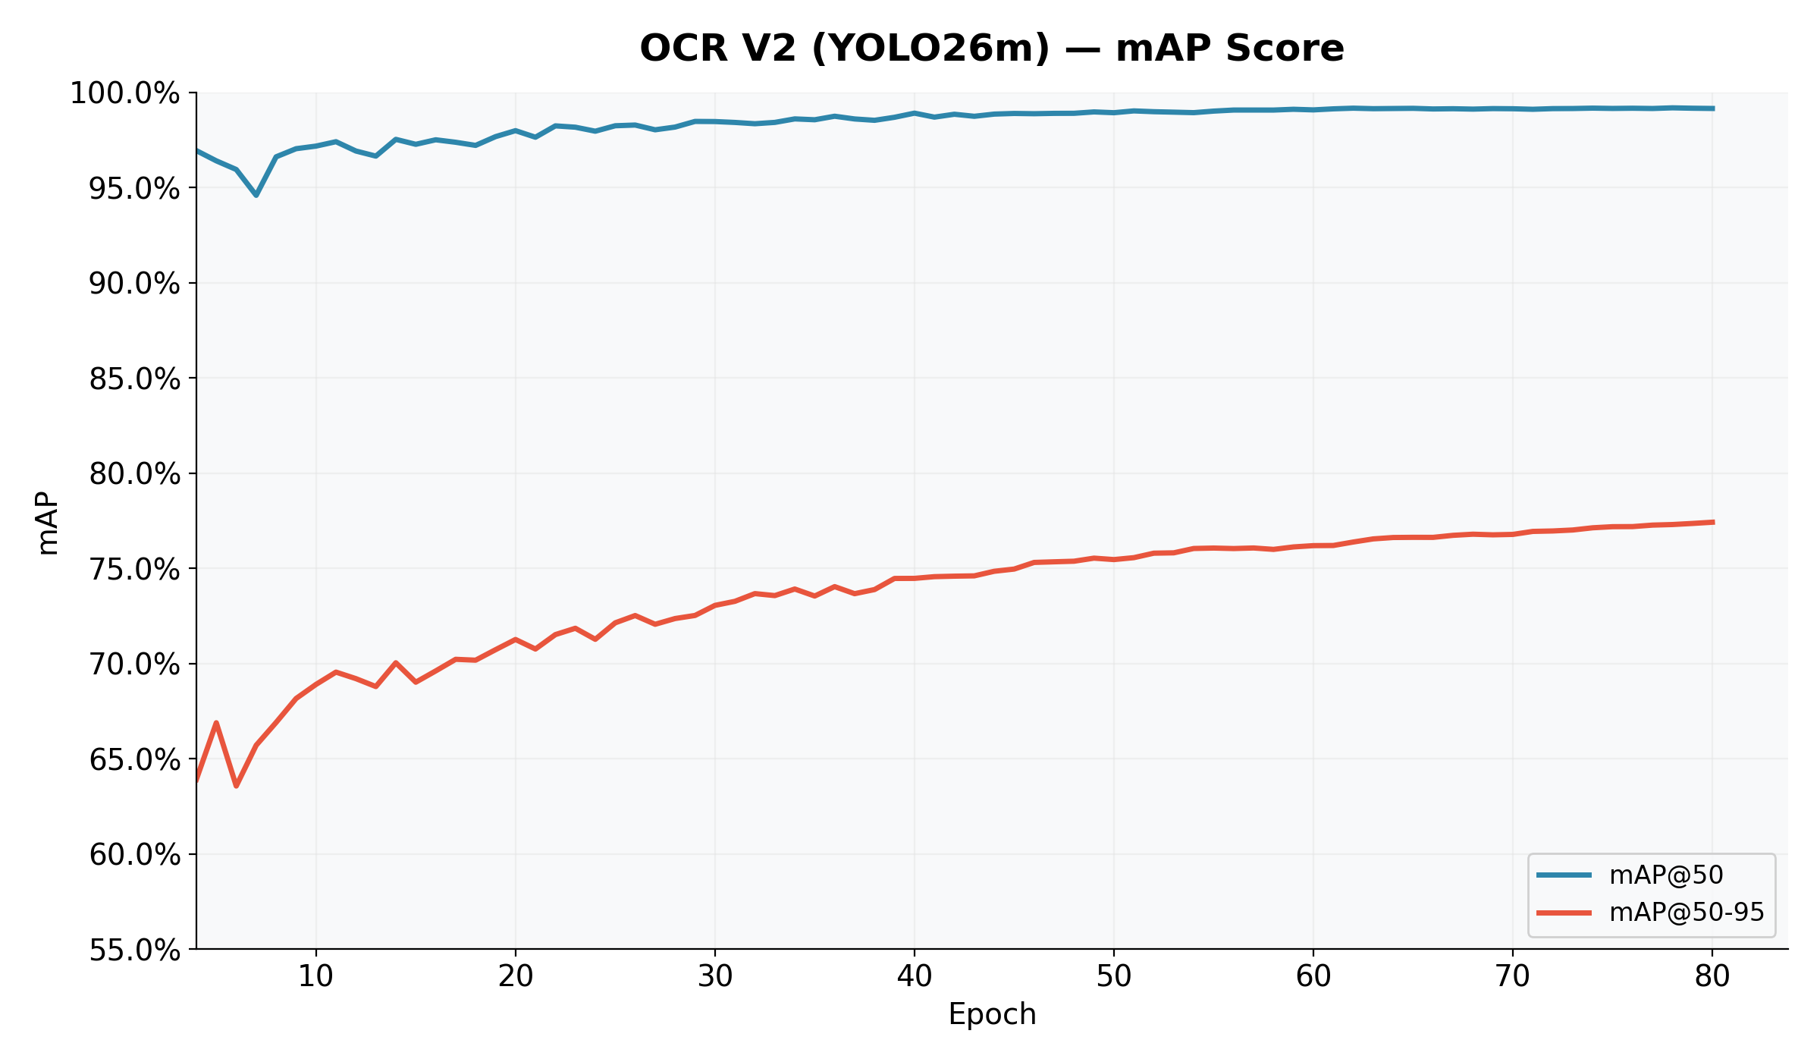
OCR V2 — Training Curves
RADAR — Real-Time Vehicle Analysis System

Slide 13
OCR Model Comparison
Three OCR models run side-by-side for best accuracy
OCR V1
OCR V2
OCR V2 Weighted-3
YOLOv11m
YOLO26m
YOLO26m
Baseline character model
Improved with characters_final dataset
Weighted BCE loss for class balance
Training Data
Training Data
Training Data
Egyptian plates dataset
9,324 images, 100 epochs
Same data, weighted training
Each model runs on 3 versions:
Each model runs on 3 versions:
Each model runs on 3 versions:
● Original crop
● Original crop
● Original crop
● LapSRN 2× enhanced
● LapSRN 2× enhanced
● LapSRN 2× enhanced
● Real-ESRGAN enhanced
● Real-ESRGAN enhanced
● Real-ESRGAN enhanced
💡 Total: 3 models × 3 enhancements = 9 OCR results per plate for maximum accuracy
RADAR — Real-Time Vehicle Analysis System

Slide 14
05
Super Resolution
AI-powered image enhancement for better OCR

Slide 15
AI Super-Resolution Pipeline
1
Original Crop
Raw plate crop from plate detector — may be blurry or pixelated, especially for distant vehicles
Baseline — no processing applied
2
LapSRN 2×
Laplacian Pyramid Super-Resolution Network — upscales 2× using deep learning. Fast inference, good for mild blur.
LapSRN_x2.pb — can crash on certain shapes, wrapped in try/except fallback
3
Real-ESRGAN
Real-World Super-Resolution GAN — handles complex degradations (blur, noise, compression artifacts). Higher quality but slower.
Excels at recovering text details from degraded plate images
RADAR — Real-Time Vehicle Analysis System

Slide 16
06
Seatbelt & Mobile Detection
Driver safety violation detection

Slide 17
Seatbelt & Mobile Detection
YOLOv11m | 78 epochs | batch=32 | 6,424 images | 5 classes
Detection Classes
Dataset Construction
person-noseatbelt
Driver/passenger without seatbelt
▸ Merged from 3 sources: v3 base + v2 mobile + v5 unique
person-seatbelt
Driver/passenger wearing seatbelt
▸ 6,424 images at 640 × 640 resolution
seatbelt
Seatbelt strap visible
▸ 484 mobile phone labels
▸ Train/Valid/Test split with balanced distribution
windshield
Windshield detection (context)
▸ Built from v3 base (NOT v4 which was 320×320)
mobile
Mobile phone in use
90.0%
54.3%
89.8%
86.6%
87.3%
mAP@50
mAP@50-95
Precision
Recall
Accuracy
RADAR — Real-Time Vehicle Analysis System

Slide 18
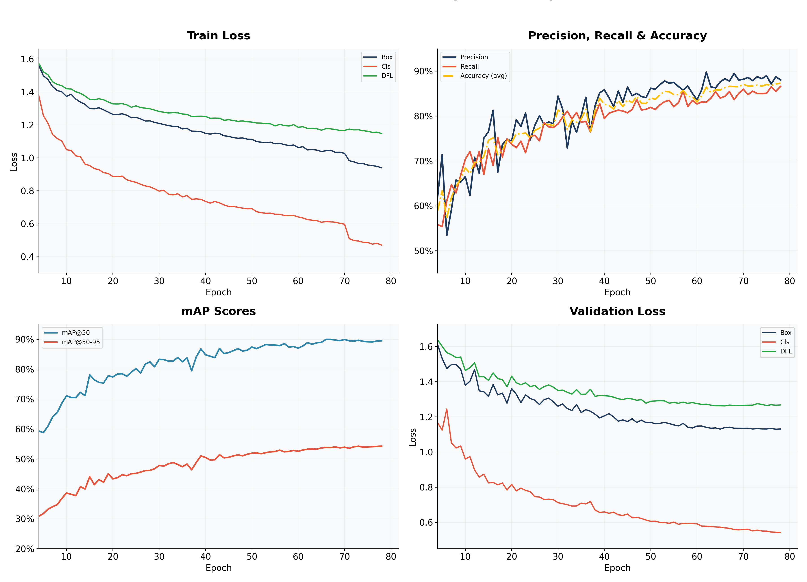
Seatbelt Model — Training Curves
Charts exclude first 3 warmup epochs | Y-axis scaled for visibility
RADAR — Real-Time Vehicle Analysis System

Slide 19
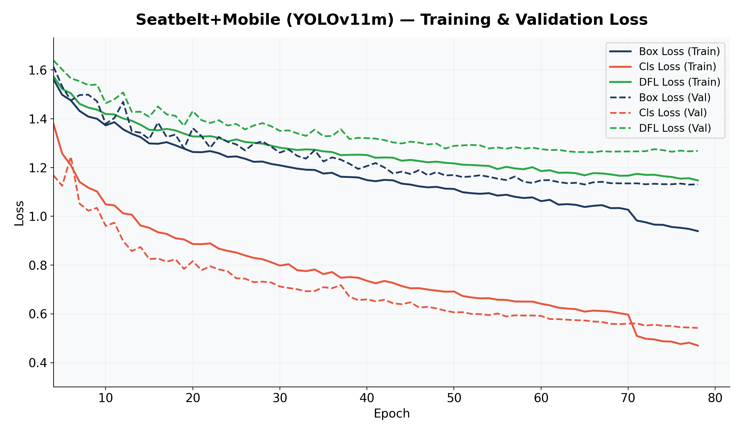
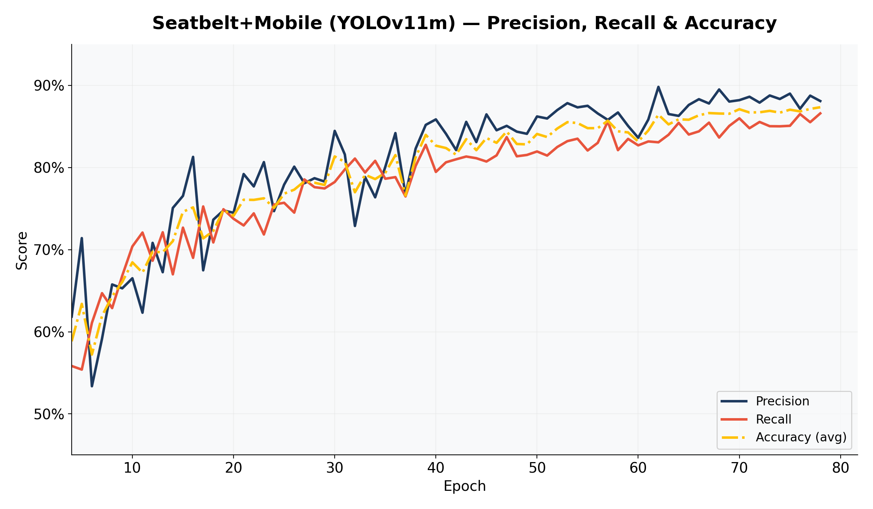
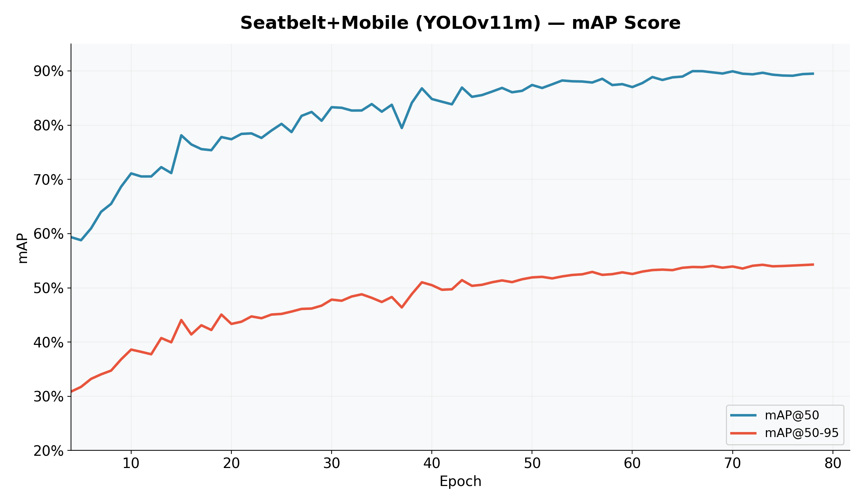
Seatbelt Model — Detailed Metrics
RADAR — Real-Time Vehicle Analysis System

Slide 20
07
Car Detection
YOLO26s — Vehicle detection & tracking

Slide 21
Vehicle Detection & Tracking
YOLO26s Car Detector
Video Pipeline
Architecture
YOLO26s (small — fast)
1
Scan all video frames for cars
Input Size
640 × 640
2
ByteTrack assigns track IDs per pass
Detection Classes
car (2), bus (5), truck (7)
3
Deduplication: IoU > 0.5 + frame proximity < 30
Tracking
ByteTrack for video frame tracking
4
Match cars by spatial proximity (NOT track ID across passes)
Confidence
0.4 threshold
5
Find plate crops for each unique car
Purpose
Locate vehicles before interior/plate analysis
6
Rank plate candidates by crop area
RADAR — Real-Time Vehicle Analysis System

Slide 22
08
Training Infrastructure
Kaggle T4 GPU — Training at scale

Slide 23
Training Infrastructure & Config
Hardware & Platform
Lessons Learned
Platform
Kaggle Notebooks (free T4 GPU)
Batch Size Matters
YOLOv11m batch=32 OOMs on T4 — use batch=16
GPU
NVIDIA Tesla T4 (16GB VRAM)
Class Weighting
Weighted BCE loss didn't improve results — normal training with more epochs was better
OCR V2 batch
16 (batch=32 OOMs for YOLOv11m)
Augmentation
Seatbelt batch
32 (fits for YOLOv11m at 640)
RandAugment + MixUp(0.1) gave best results
Warmup Removal
OCR V2 Time
~7 min/epoch × 80 = ~9 hours
First 3 epochs are warmup — exclude from analysis charts
Image Size
Seatbelt Time
~4 min/epoch × 78 = ~5 hours
Must match training imgsz=640 or predictions break
Roboflow Labels
Some exports have polygon data (>5 values/line) — truncate to first 5
RADAR — Real-Time Vehicle Analysis System

Slide 24
09
Live Demo
Streamlit Web Interface

Slide 25
Streamlit Web Interface
⚙️
Smart Sidebar
📷
Photo Mode
Real-time confidence sliders for all models (step=0.01). Model status indicators. Cache-min detection for instant filtering.
Upload PNG images → detect cars as clickable cards → interior analysis (seatbelt/mobile) → plate OCR with enhancement comparison.
🚗
Clickable Car Grid
🔤
9-Way OCR Comparison
Detected vehicles shown as image cards with green/red plate badge. Click to analyze. Filtered by confidence slider in real-time.
3 OCR models × 3 enhancement levels = 9 results per plate. Annotated images with per-class colored boxes and Franco labels.
🖼️
Sample Gallery
🏷️
Violation Badges
Built-in sample images gallery with compact expandable grid. Click any thumbnail to process.
Colored Streamlit badges: red 'No Belt', green 'Belt', red 'Phone'. Instant visual feedback for safety violations.
RADAR — Real-Time Vehicle Analysis System

Slide 26
Key Results
99.0%
87.3%
99.2%
OCR V2
Accuracy
Seatbelt
Accuracy
OCR V2
mAP@50
90.0%
9
<1s
Seatbelt
mAP@50
OCR Results
Per Plate
Per Image
Inference

Slide 27
Challenges We Faced
Video Tracking Unreliability
Class Imbalance in OCR
ByteTrack assigns fresh track IDs on each video pass. Cross-pass car matching requires spatial proximity (IoU), not track IDs. Video mode was removed pending a better approach.
Some Arabic characters appear far more frequently than others. Attempted weighted BCE loss — but normal training with more epochs performed better.
LapSRN Instability
GPU Memory Constraints
Super-resolution model crashes on certain image shapes (cv2.error in merge). Required try/except fallback to original image.
Kaggle T4 has 16GB VRAM. YOLOv11m batch=32 OOMs — had to use batch=16. This doubles training time.
Roboflow Label Format
Arabic Text Rendering
Some Roboflow YOLO exports include polygon data (>5 values per line). Had to truncate to standard format (class x y w h).
Bidirectional text (numbers LTR, Arabic RTL) requires careful handling. Used separate_chars() to split and reverse correctly.
RADAR — Real-Time Vehicle Analysis System

Slide 28
What's Next?
🎬
Video Mode Revival
High
🤖
Auto Mode
High
Revisit video processing with better tracking approach. Current plate-first method was too slow.
Automatically select best plate crop using sharpness scoring, not just area ranking.
🎨
Color Classification
Medium
⚡
Speed Estimation
Medium
K-means clustering for vehicle color detection. Config ready (COLOR_KMEANS_CLUSTERS), implementation pending.
Use car tracking between frames to estimate vehicle speed from video feeds.
🔄
Improved Deduplication
Medium
🚀
Model Optimization
Low
Current IoU-based dedup works, but visual similarity (feature matching) would be more robust.
Quantization and TensorRT for faster inference. Deploy on edge devices (Jetson, Coral).
RADAR — Real-Time Vehicle Analysis System

Slide 29
Thank You
Questions?
RADAR — Real-Time Vehicle Analysis System
Egyptian License Plate Detection · OCR · Seatbelt & Mobile Detection
YOLOv11m
YOLO26m
YOLO26s
Streamlit
LapSRN
Real-ESRGAN

