Slide 1

NTI · MACHINE LEARNING ACTIVITY DAY
OCTOBER 3, 2026
XGBOOST
eXtreme Gradient Boosting: from a simple idea to finding the Higgs boson
MARWAN MOHAMMED MOSTAFA · AMMAR IBRAHIM IBRAHIM · BELAL SALAH
github.com/Marwanamer005/XGboosting-
Notes:
Welcome. Today: what XGBoost is, how it works (with the math), and how we used it to find Higgs boson events in real CERN data.

Slide 2
Remember the last time you failed a quiz?
You didn't study everything again. You focused on what you got wrong.
That's exactly how XGBoost learns.
Notes:
Hook: ask the question and pause. Then: you only studied your mistakes. XGBoost does the same: every new tree studies only what the previous trees got wrong.

Slide 3
AGENDA
01
PART 1 · XGBOOST EXPLAINED
History · Trees & teams · How boosting works · Live demo · What makes it eXtreme · Safety features · Hyperparameters · Strengths · Use cases · Rivals
Three parts: the idea, the math, and our code.
02
PART 2 · THE MATH: HOW IT WORKS
How one tree is built · Objective, Taylor, g & h · Best leaf value & gain · A worked example · Classification vs regression
03
PART 3 · CODING: FINDING THE HIGGS BOSON
Install & import · Notebook roadmap · Data & EDA · Training · Results · Benchmark · What the model learned · Improving · Tips
…and then a Kahoot quiz! 😈
Notes:
Part 1 explains the idea so everyone can follow. Part 2 opens the hood: the math. Part 3 shows how we applied it to real CERN data in our notebook. Then a Kahoot.

Slide 4
01
PART ONE
XGBOOST EXPLAINED
The idea, the pieces and the knobs, no formulas yet.
Notes:
Part 1: what XGBoost is and why it works, explained without math.

Slide 5
From a research project to Kaggle's favourite tool
HISTORY OF XGBOOST
1997
2014
2015
2017
2001
2014
2016
2025
AdaBoost
Freund & Schapire: combine many weak models into a strong one (boosting).
Gradient boosting
Jerome Friedman: each new tree fits the gradient of the loss.
XGBoost is born
Tianqi Chen (University of Washington) releases it as an open-source research project.
Higgs Boson challenge
Kaggle + CERN ATLAS competition makes XGBoost famous; Python and R packages follow.
Kaggle's favourite
17 of 29 winning Kaggle solutions used it; every top-10 team at KDD Cup 2015 too.
The KDD paper
Chen & Guestrin publish 'XGBoost: A Scalable Tree Boosting System'.
Rivals arrive
Microsoft's LightGBM and Yandex's CatBoost build on the same ideas.
Version 3.0
Still actively developed; we used version 3.2 in our notebook.
← the breakthrough
Notes:
Each click moves the orange ball to the next milestone. The last click sends it back to 2014: the Higgs Boson challenge, where XGBoost became famous (we use the same kind of data in Part 3). Sources: XGBoost paper (Chen & Guestrin 2016), XGBoost documentation.

Slide 6

WHAT IS
XGBOOST?
Many small trees,
one strong model
Definition
eXtreme Gradient Boosting: an ensemble of decision trees built one after another. Each new tree corrects the mistakes of the trees before it.
Why it was developed
Classic gradient boosting was accurate but slow, overfit easily and could not handle missing values. XGBoost added speed, regularization and native missing-value handling.
Where it is used
Tabular data everywhere: fraud detection, credit scoring, churn, ranking and ads, insurance pricing, medical risk scores, physics.
Notes:
XGBoost = eXtreme Gradient Boosting. Key message: lots of weak, shallow trees, each fixing the errors of the previous ones. The picture: a relay team where every runner is a little better than the last.

Slide 7
The building block, and two ways to combine it
TREES & TEAMS
Bagging · Random Forest
size < 100 m² ?
→ average
deep, independent trees
yes
no
age < 20 years ?
rooms < 5 ?
less variance (noise cancels out)
−0.35
−0.15
+0.42
+0.12
Boosting · XGBoost
→ sum
shallow trees, one after another
split = a yes/no question about one feature
leaf value w = the number added to the prediction
A depth-2 tree for house prices: every path ends in a leaf value.
+
+
+
+
less bias: each tree fixes what the previous ones still get wrong
Notes:
A decision tree asks yes/no questions; each leaf holds a number w that is added to the prediction. Random Forest: many deep trees trained independently and averaged, which reduces variance. Boosting: many shallow (weak) trees trained one after another and added up, each fixing what is left, which reduces bias.

Slide 8
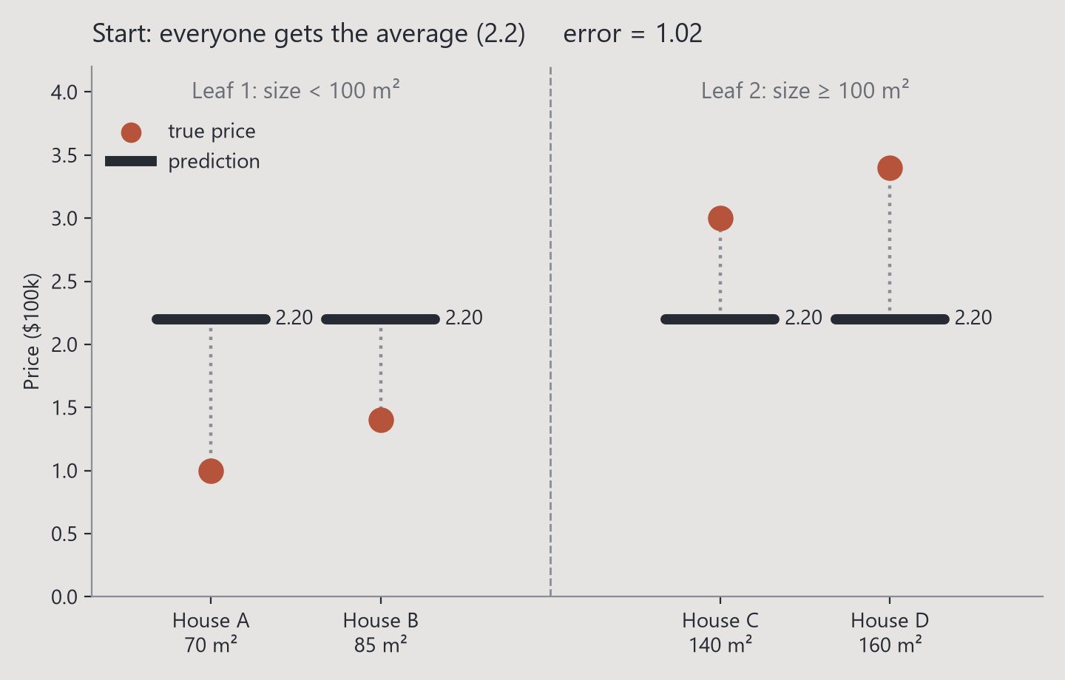
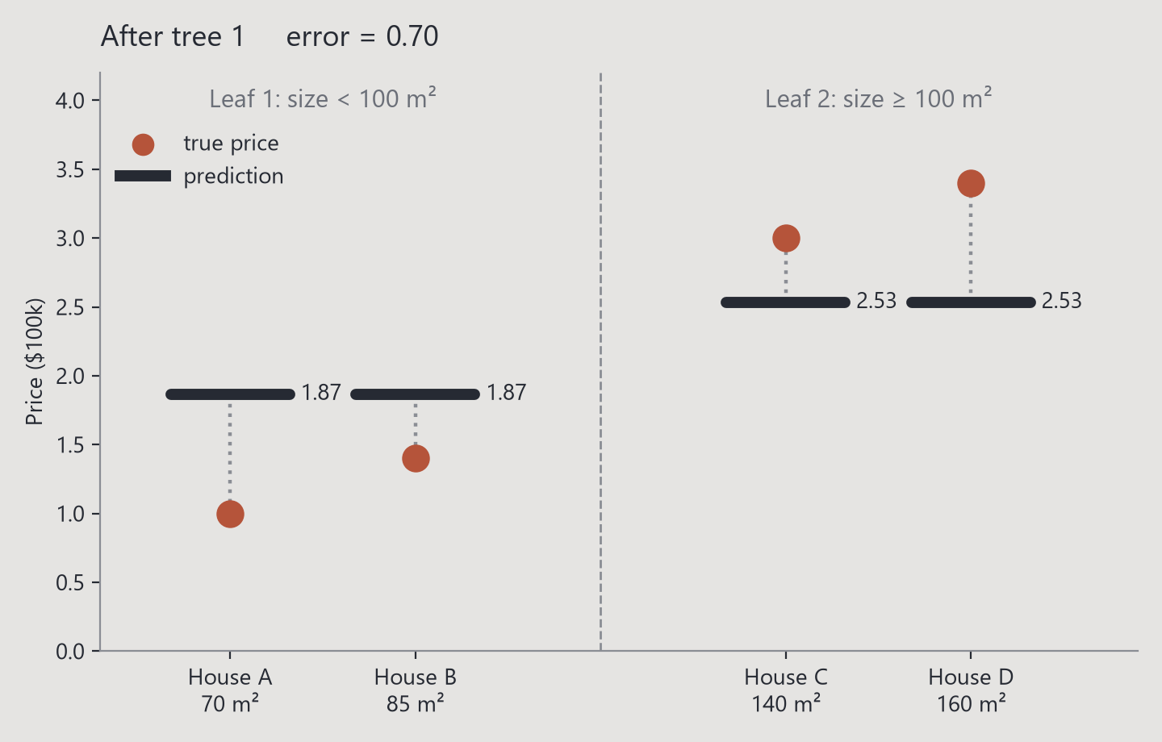
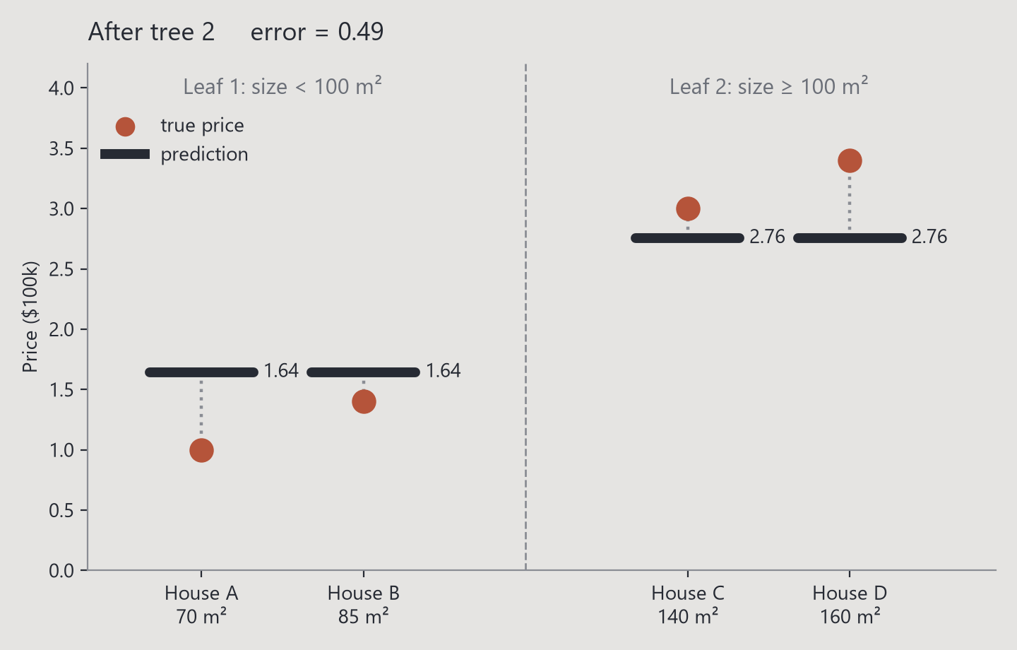
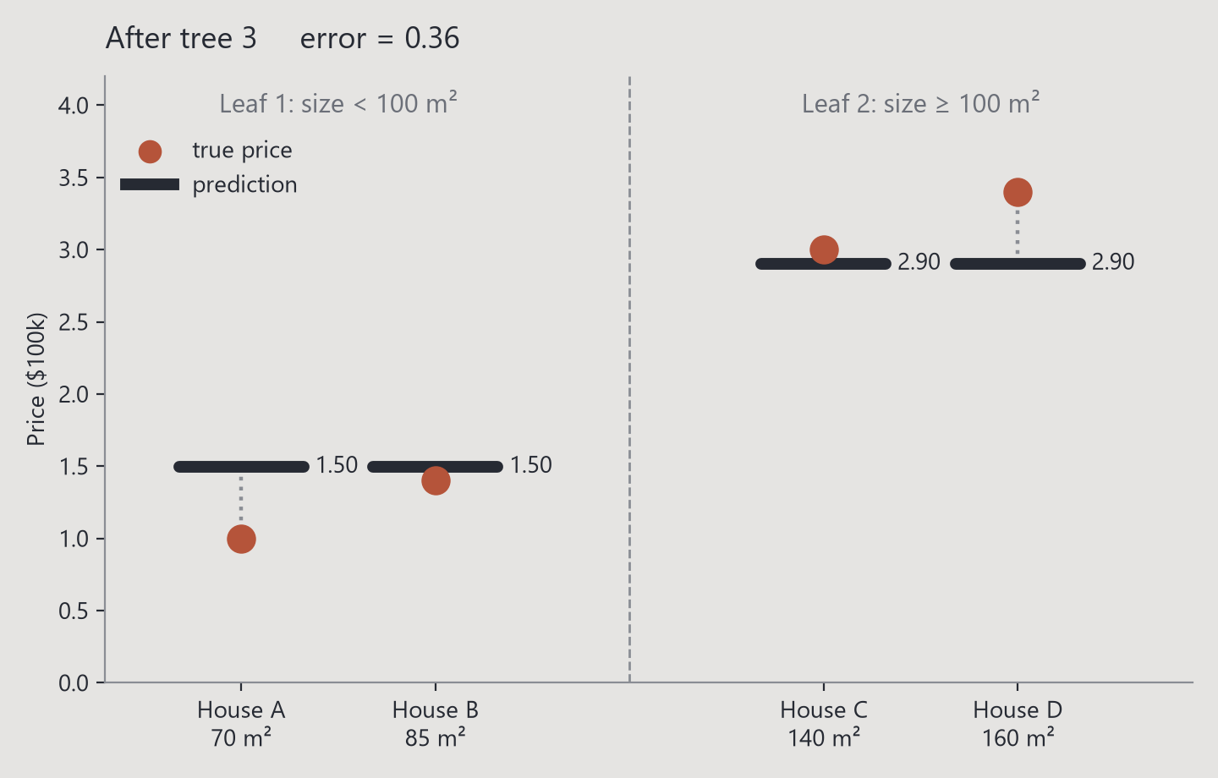
Learning from mistakes
HOW BOOSTING
WORKS
1. Start with one guess (the average)
2. Measure the errors (residuals)
3. Train a small tree on those errors
4. Add it, scaled by the learning rate η
5. Repeat for hundreds of trees
Boosting vs bagging
Random Forest grows deep trees independently and averages them. Boosting grows shallow trees one after another, each one fixing what is left.
Final prediction
The learning rate η keeps every step small, so no single tree dominates.
Notes:
Click through the plot: round 0 everyone gets 2.2. Each click adds one tree; the error drops 1.02 -> 0.70 -> 0.49 -> 0.36. Small houses go down, big houses go up.

Slide 9
TRY IT YOURSELF · INTERACTIVE
ROUND 0
BOOSTING, LIVE
λ = 1 η = 0.5 5 trees max
Leaf 1: size < 100 m²
Leaf 2: size ≥ 100 m²
1.02
error (RMSE)
error after each tree
Start
Every house gets the same first guess: the average price, 2.2.
Press ADD TREE: each new tree learns from the errors (residuals) of the current prediction.
2.20
2.20
2.20
2.20
House A
70 m²
House B
85 m²
House C
140 m²
House D
160 m²
◀ BACK
ADD TREE ▶
↺
λ = 5
● true price ($100k) ▬ prediction web version
Notes:
Interactive demo (λ = 1). Use the buttons in slideshow mode: ADD TREE adds the next tree, BACK goes back, ↺ resets, and the λ button switches to λ = 5 at the same round. Watch the bars slide toward the true prices (Morph transition) and read one leaf: G = sum of gradients, H = sum of hessians, w = −G/(H+λ). With λ = 5 the steps are smaller: regularization slows the learning down.

Slide 10
TRY IT YOURSELF · INTERACTIVE
ROUND 1
BOOSTING, LIVE
λ = 1 η = 0.5 5 trees max
Leaf 1: size < 100 m²
Leaf 2: size ≥ 100 m²
0.70
error (RMSE)
error after each tree
2.53
2.53
Tree 1 learns from the errors of round 0
Leaf 1 (houses A, B)
G = 1.20 + 0.80 = 2.00 H = 2
w = −G/(H+λ) = -0.67 change = η·w = -0.33
Leaf 2 (houses C, D)
G = (-0.80) + (-1.20) = -2.00 H = 2
w = −G/(H+λ) = +0.67 change = η·w = +0.33
1.87
1.87
House A
70 m²
House B
85 m²
House C
140 m²
House D
160 m²
◀ BACK
ADD TREE ▶
↺
λ = 5
● true price ($100k) ▬ prediction web version
Notes:
Interactive demo (λ = 1). Use the buttons in slideshow mode: ADD TREE adds the next tree, BACK goes back, ↺ resets, and the λ button switches to λ = 5 at the same round. Watch the bars slide toward the true prices (Morph transition) and read one leaf: G = sum of gradients, H = sum of hessians, w = −G/(H+λ). With λ = 5 the steps are smaller: regularization slows the learning down.

Slide 11
TRY IT YOURSELF · INTERACTIVE
ROUND 2
BOOSTING, LIVE
λ = 1 η = 0.5 5 trees max
Leaf 1: size < 100 m²
Leaf 2: size ≥ 100 m²
0.49
error (RMSE)
error after each tree
2.76
2.76
Tree 2 learns from the errors of round 1
Leaf 1 (houses A, B)
G = 0.87 + 0.47 = 1.33 H = 2
w = −G/(H+λ) = -0.44 change = η·w = -0.22
Leaf 2 (houses C, D)
G = (-0.47) + (-0.87) = -1.33 H = 2
w = −G/(H+λ) = +0.44 change = η·w = +0.22
1.64
1.64
House A
70 m²
House B
85 m²
House C
140 m²
House D
160 m²
◀ BACK
ADD TREE ▶
↺
λ = 5
● true price ($100k) ▬ prediction web version
Notes:
Interactive demo (λ = 1). Use the buttons in slideshow mode: ADD TREE adds the next tree, BACK goes back, ↺ resets, and the λ button switches to λ = 5 at the same round. Watch the bars slide toward the true prices (Morph transition) and read one leaf: G = sum of gradients, H = sum of hessians, w = −G/(H+λ). With λ = 5 the steps are smaller: regularization slows the learning down.

Slide 12
TRY IT YOURSELF · INTERACTIVE
ROUND 3
BOOSTING, LIVE
λ = 1 η = 0.5 5 trees max
Leaf 1: size < 100 m²
Leaf 2: size ≥ 100 m²
0.36
error (RMSE)
error after each tree
2.90
2.90
Tree 3 learns from the errors of round 2
Leaf 1 (houses A, B)
G = 0.64 + 0.24 = 0.89 H = 2
w = −G/(H+λ) = -0.30 change = η·w = -0.15
Leaf 2 (houses C, D)
G = (-0.24) + (-0.64) = -0.89 H = 2
w = −G/(H+λ) = +0.30 change = η·w = +0.15
1.50
1.50
House A
70 m²
House B
85 m²
House C
140 m²
House D
160 m²
◀ BACK
ADD TREE ▶
↺
λ = 5
● true price ($100k) ▬ prediction web version
Notes:
Interactive demo (λ = 1). Use the buttons in slideshow mode: ADD TREE adds the next tree, BACK goes back, ↺ resets, and the λ button switches to λ = 5 at the same round. Watch the bars slide toward the true prices (Morph transition) and read one leaf: G = sum of gradients, H = sum of hessians, w = −G/(H+λ). With λ = 5 the steps are smaller: regularization slows the learning down.

Slide 13
TRY IT YOURSELF · INTERACTIVE
ROUND 4
BOOSTING, LIVE
λ = 1 η = 0.5 5 trees max
Leaf 1: size < 100 m²
Leaf 2: size ≥ 100 m²
0.28
error (RMSE)
error after each tree
3.00
3.00
Tree 4 learns from the errors of round 3
Leaf 1 (houses A, B)
G = 0.50 + 0.10 = 0.59 H = 2
w = −G/(H+λ) = -0.20 change = η·w = -0.10
Leaf 2 (houses C, D)
G = (-0.10) + (-0.50) = -0.59 H = 2
w = −G/(H+λ) = +0.20 change = η·w = +0.10
1.40
1.40
House A
70 m²
House B
85 m²
House C
140 m²
House D
160 m²
◀ BACK
ADD TREE ▶
↺
λ = 5
● true price ($100k) ▬ prediction web version
Notes:
Interactive demo (λ = 1). Use the buttons in slideshow mode: ADD TREE adds the next tree, BACK goes back, ↺ resets, and the λ button switches to λ = 5 at the same round. Watch the bars slide toward the true prices (Morph transition) and read one leaf: G = sum of gradients, H = sum of hessians, w = −G/(H+λ). With λ = 5 the steps are smaller: regularization slows the learning down.

Slide 14
TRY IT YOURSELF · INTERACTIVE
ROUND 5
BOOSTING, LIVE
λ = 1 η = 0.5 5 trees max
Leaf 1: size < 100 m²
Leaf 2: size ≥ 100 m²
0.24
error (RMSE)
3.07
3.07
error after each tree
Tree 5 learns from the errors of round 4
Leaf 1 (houses A, B)
G = 0.40 + (-0.00) = 0.40 H = 2
w = −G/(H+λ) = -0.13 change = η·w = -0.07
Leaf 2 (houses C, D)
G = 0.00 + (-0.40) = -0.40 H = 2
w = −G/(H+λ) = +0.13 change = η·w = +0.07
1.33
1.33
House A
70 m²
House B
85 m²
House C
140 m²
House D
160 m²
◀ BACK
ADD TREE ▶
↺
λ = 5
● true price ($100k) ▬ prediction web version
Notes:
Interactive demo (λ = 1). Use the buttons in slideshow mode: ADD TREE adds the next tree, BACK goes back, ↺ resets, and the λ button switches to λ = 5 at the same round. Watch the bars slide toward the true prices (Morph transition) and read one leaf: G = sum of gradients, H = sum of hessians, w = −G/(H+λ). With λ = 5 the steps are smaller: regularization slows the learning down.

Slide 15
Gradient boosting + six upgrades
WHAT MAKES IT EXTREME
1
Regularized objective
loss + γ·T + ½λΣw²
Penalizes big trees and extreme leaf values.
2
Second-order math
Uses slope g and curvature h.
Exact best leaf value: w = −G/(H+λ).
3
Smart split search
The Gain formula scores every split.
Split only if Gain > γ (built-in pruning).
4
Randomness
subsample & colsample_bytree: each tree sees only part of the rows and columns.
5
Missing values
Learns the best direction for NaN at every split. No imputation needed.
6
Speed
Histograms, all CPU cores, cache-aware, GPU.
Paper: ~40× faster per tree than scikit-learn.
Notes:
Six things XGBoost adds to classic gradient boosting: 1) a penalty in the objective, 2) second-order g and h giving exact leaf values, 3) the gain formula with gamma as pruning, 4) row/column subsampling, 5) learned default direction for missing values, 6) systems speed-ups (the XGBoost paper: 0.68 s vs 28.5 s per tree for scikit-learn).

Slide 16
Two things XGBoost handles for you
BUILT-IN SAFETY FEATURES
1 · Missing values
2 · Overfitting brakes
income < 3,000 ?
max_depth keep trees shallow
min_child_weight, gamma refuse weak splits
reg_lambda, reg_alpha shrink leaf values
subsample, colsample_bytree add randomness
learning_rate + early stopping small steps, stop in time
NaN
yes branch
no branch
✓ more gain
✗ less gain
At every split XGBoost tries sending all missing values left, then right, and keeps the side with the higher gain as the default direction. Missing values often carry meaning, so the data decides where they belong.
train ≈ test
with the brakes:
the model generalizes
train ≫ test
without them:
the model memorizes
Notes:
Missing values: sparsity-aware split finding. For every split XGBoost tries both directions for the NaNs and keeps the better one. Overfitting: five kinds of brakes. With them, training and test scores stay close; without them, training gets perfect and test gets worse.

Slide 17
Hyperparameters · every knob, what it does, which way to turn it
THE CONTROL PANEL
POWER
↑ = more complex
BRAKE
↑ = simpler
Hyperparameter | Type | Default | What it controls | Turn it UP → | Good range
max_depth | POWER | 6 | How deep each tree can grow | More interactions, but overfits faster | 3 – 8
n_estimators | POWER | 100 | How many trees are added | More capacity: pair it with early stopping | 100 – 5000
learning_rate (η) | POWER | 0.3 | Size of each tree's step | Learns faster, but less stable | 0.01 – 0.1
min_child_weight | BRAKE | 1 | Minimum sum of h in a leaf | Refuses tiny, noisy leaves | 1 – 10+
gamma (γ) | BRAKE | 0 | Minimum gain to make a split | Fewer splits (pruning) | 0 – 5
reg_lambda (λ) | BRAKE | 1 | L2 penalty on leaf values | Smaller, more cautious leaf values | 1 – 10
reg_alpha (α) | BRAKE | 0 | L1 penalty on leaf values | Pushes weak leaves to exactly 0 | 0 – 1
subsample | BRAKE* | 1.0 | Share of rows per tree | *Lowering it adds randomness | 0.6 – 0.9
colsample_bytree | BRAKE* | 1.0 | Share of columns per tree | *Lowering it adds randomness | 0.5 – 0.9
scale_pos_weight | BALANCE | 1 | Weight of the positive class | Focuses on a rare class | ≈ negatives / positives
Notes:
POWER knobs make the model more complex: deeper trees, more trees, bigger steps. Turn them up and you risk overfitting. BRAKE knobs make it simpler: they refuse weak splits or shrink leaf values. Turn them up too far and you underfit. Subsample and colsample act as brakes when you LOWER them. scale_pos_weight balances rare classes.

Slide 18
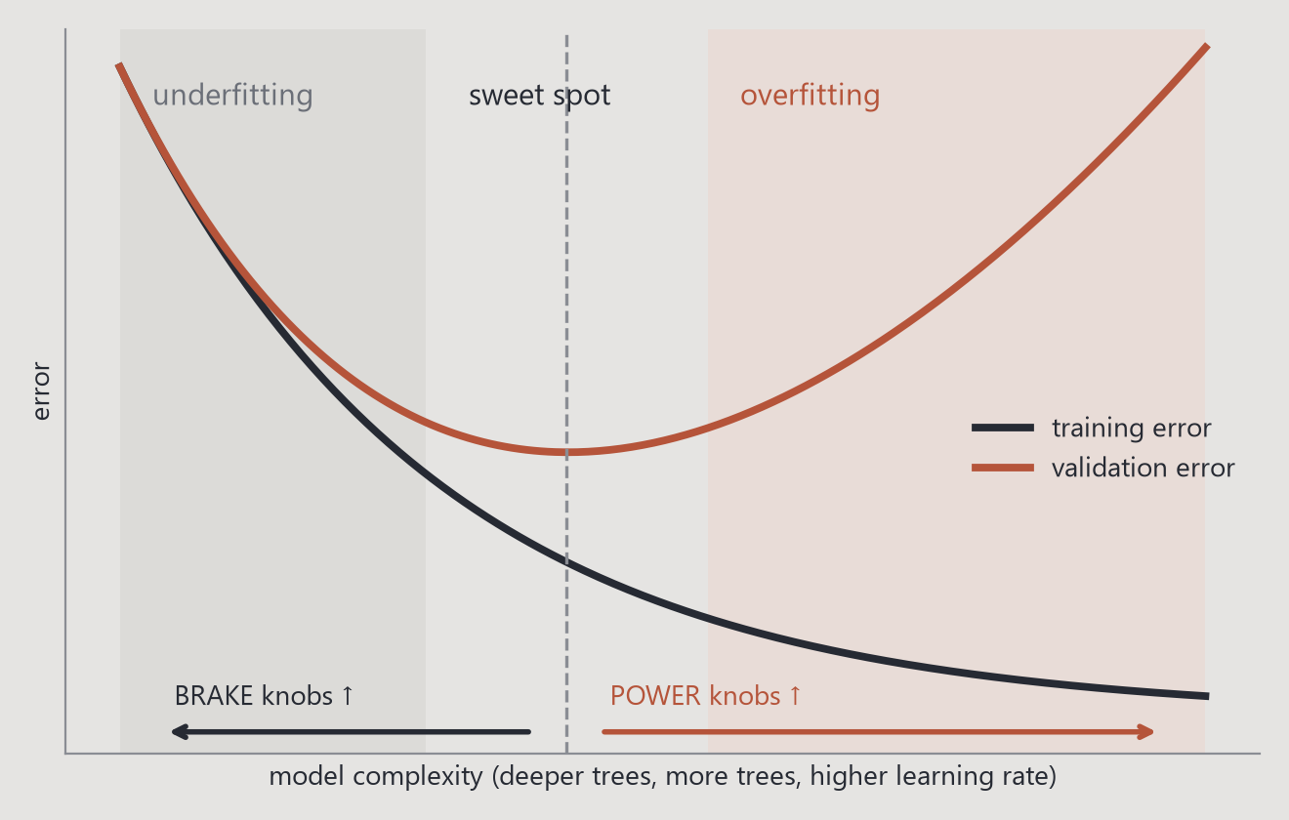
Find the sweet spot between underfitting and overfitting
TUNING RECIPE
Lower η,
add more trees
λ and α
penalties
6
subsample &
colsample_bytree
5
gamma
prune weak splits
4
max_depth &
min_child_weight
3
Fix η = 0.1
+ early stopping
2
Rule: tune on a validation set or with cross-validation, never on the test set. Use RandomizedSearchCV to try many combinations quickly.
1
Notes:
A practical order: fix the learning rate at 0.1 with early stopping, tune the tree shape (max_depth, min_child_weight), then gamma, then the randomness (subsample, colsample), then the penalties (lambda, alpha), and finally lower the learning rate and let early stopping add more trees. The curve on the right is the goal: the sweet spot where validation error is lowest.

Slide 19
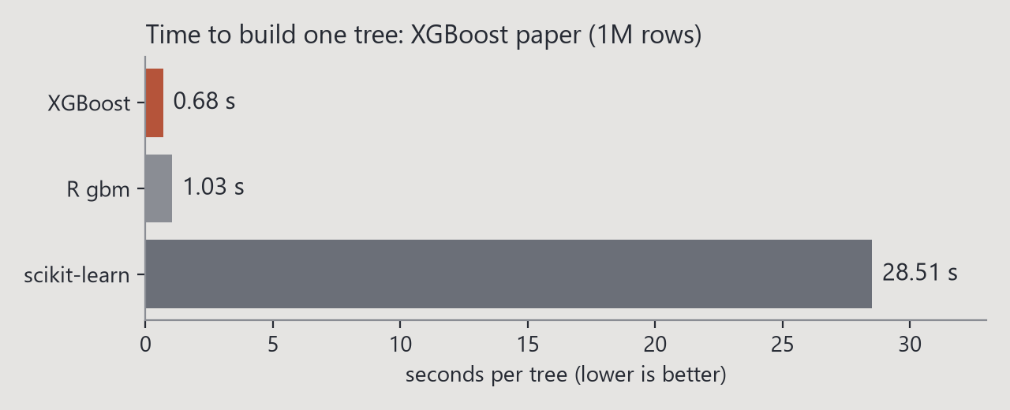
Great power comes
with great complexity
STRENGTHS &
LIMITATIONS
Strengths
Top accuracy on tabular data
Very fast (multithreaded, histograms)
Handles missing values natively
No scaling needed
Built-in regularization
Explainable with SHAP
Limitations
Many hyperparameters to tune
Can overfit without early stopping
Hard to read hundreds of trees directly
Weak on images, audio, raw text
Cannot extrapolate beyond the training range
Notes:
Top: speed from the XGBoost paper (seconds per tree). Bottom: the trade-off every boosted model must manage, underfitting vs overfitting.

Slide 20

Great fit
Structured / tabular data, medium to large size, mixed numeric and categorical features, missing values, sparse data, imbalanced classes.
Poor fit
Images, audio, raw text (deep learning wins), tiny datasets where a simple model is enough, tasks that need extrapolation.
Fraud detection · Credit scoring
Customer churn · House prices
Search ranking · Medical risk · Physics
“If your data fits in a spreadsheet, try XGBoost first.”
BEST USE CASES
Notes:
If your data fits in a spreadsheet, try XGBoost first.

Slide 21
XGBoost and the models presented today
MEET THE RIVALS
 | XGBoost Chen & Guestrin · 2014 | LightGBM Microsoft · 2016 | CatBoost Yandex · 2017 | Isolation Forest Liu, Ting & Zhou · 2008
Task | Classification, regression, ranking | Classification, regression, ranking | Classification, regression, ranking | Anomaly detection (no labels)
Core idea | Boosting, level-wise trees, uses g and h | Boosting, leaf-wise trees, histograms + GOSS / EFB | Boosting, symmetric trees, ordered boosting | Random trees: outliers get isolated in fewer splits
Training time | Fast (hist, multithreaded, GPU) | Fastest on big data | Slower to train, very fast to predict | Very fast (small sub-samples)
Memory | Medium | Low | Medium-high | Low
Model complexity | High: many trees + regularization | High: deep leaf-wise trees, can overfit small data | High, but balanced trees | Low: simple random trees
Categorical data | Encode first (or enable_categorical) | Native support | Best in class (native target stats) | Encode first
Missing values | Native: learns a direction | Native | Native | Usually imputed first
Interpretability | Medium: gain importance, SHAP | Medium: importance, SHAP | Medium-high: built-in SHAP, interactions | Medium: anomaly score = path length
Tuning effort | High: many knobs | High: num_leaves is critical | Low: great defaults | Very low
Key hyperparameters | max_depth, learning_rate, min_child_weight, subsample | num_leaves, learning_rate, min_data_in_leaf, feature_fraction | depth, learning_rate, l2_leaf_reg, iterations | n_estimators, max_samples, contamination
Best for | Tabular data, missing values, competitions | Very large datasets, speed | Many categorical features | Fraud / outlier detection without labels
Isolation Forest solves a different problem: it finds rare, unusual points without labels, so it complements boosting rather than competing with it.
Notes:
XGBoost, LightGBM and CatBoost are all gradient-boosted trees: they differ in how trees grow (level-wise vs leaf-wise vs symmetric), categorical handling and tuning effort. Isolation Forest is unsupervised anomaly detection: anomalies are separated by fewer random splits. Rule of thumb: XGBoost = safe all-rounder, LightGBM = speed on huge data, CatBoost = many categories, Isolation Forest = no labels / outliers.

Slide 22
02
PART TWO
THE MATH
How XGBoost really decides every split and every leaf value.
Notes:
Part 2: the math behind XGBoost, with a fully worked example.

Slide 23
The recipe XGBoost repeats for every tree
HOW ONE TREE IS BUILT
1
2
3
4
5
6
Compute g and h
for every training sample, from the current predictions
Scan the splits
every feature, every histogram bin: sum G and H left and right
Keep the best
highest Gain wins, plus the best side for missing values
Grow or stop
stop at max_depth, when H < min_child_weight, or Gain ≤ γ
Set leaf values
w = −G / (H + λ) for every leaf
Update & repeat
add η·w to the predictions, then build the next tree
↺ Repeat for the next tree. Early stopping watches the validation loss and stops when it no longer improves.
Notes:
The ball walks through the recipe: compute g and h, scan all splits with histograms, keep the best by Gain (including where NaN goes), stop by max_depth / min_child_weight / gamma, set w = -G/(H+lambda), add eta*w and repeat. The last click sends the ball back to step 1: the next tree.

Slide 24
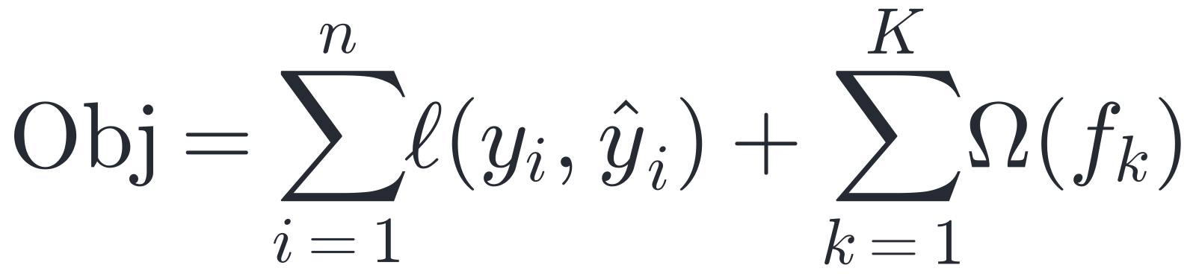
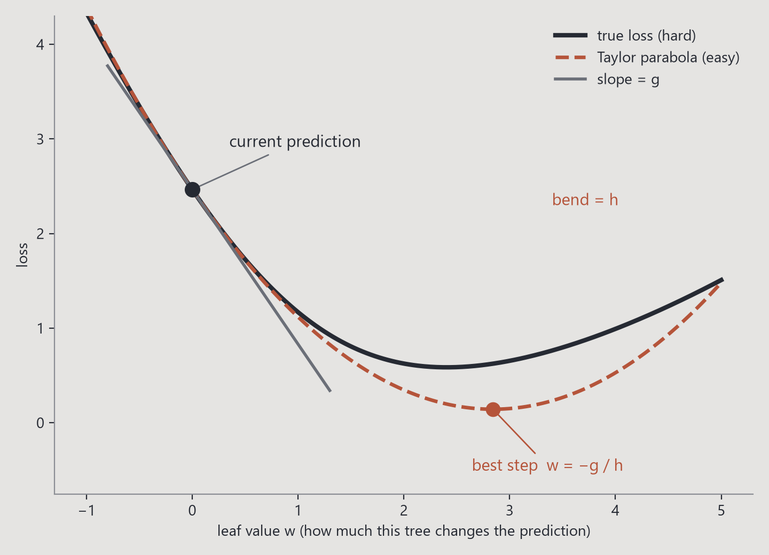
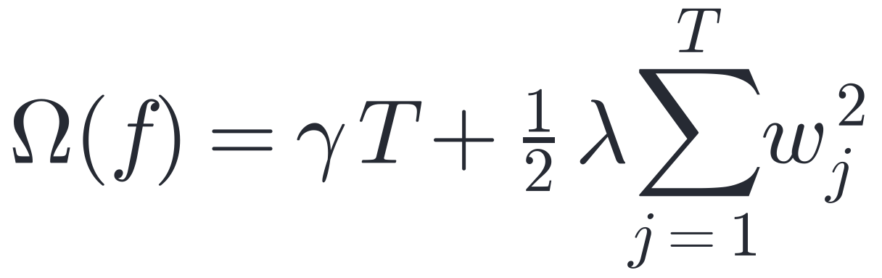
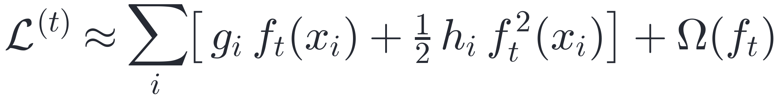
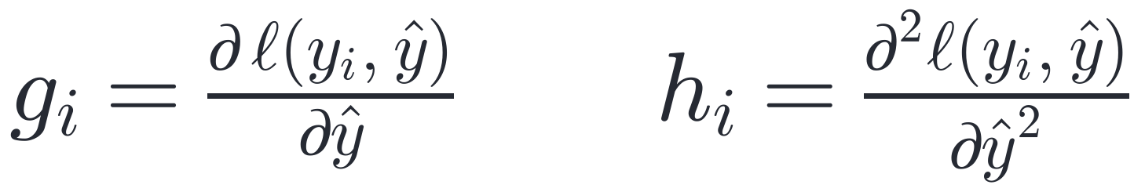
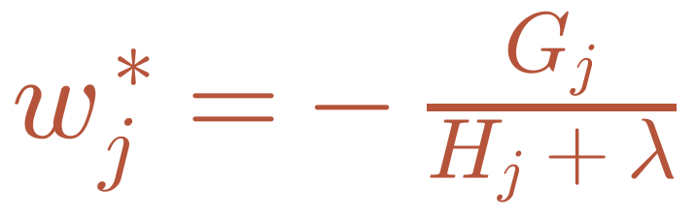
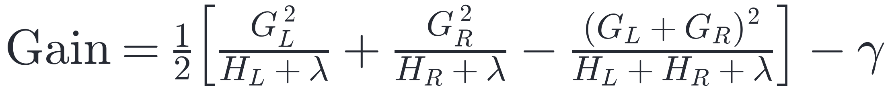
Slope, curvature and one formula
THE MATH BEHIND IT
1 Objective = loss + penalty
2 Taylor: replace the loss by a parabola
3 Best value for every leaf
4 Keep a split only if it gains enough
Notes:
1) XGBoost minimizes loss plus a penalty on tree size (gamma per leaf) and leaf values (lambda). 2) Near the current prediction any smooth loss looks like a parabola: g = slope (gradient), h = curvature (hessian). 3) Summing per leaf gives a parabola in w; its minimum is w* = -G/(H+lambda). 4) A split is kept only if the gain beats gamma. Classic GBM uses only g; XGBoost uses g AND h.

Slide 25
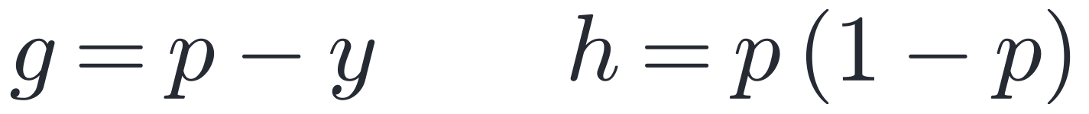
A worked example · classification (1 / 2)
LET'S DO ONE TREE BY HAND
Will a website visitor buy? (1 = yes, 0 = no)
1 Start: the same guess for everyone
Visitor | Minutes on site | Bought (y)
A | 2 | 0
B | 5 | 0
C | 12 | 1
D | 20 | 1
p₀ = 0.5 (log-odds z = 0)
2 Gradient and hessian of every visitor
A, B (y = 0): g = 0.5 − 0 = +0.5 h = 0.25
C, D (y = 1): g = 0.5 − 1 = −0.5 h = 0.25
+ g means 'predicted too high', − g 'too low'
Settings: λ = 1, γ = 0, learning rate η = 0.3, log loss
3 Before any split (all 4 together)
G = 0.5 + 0.5 − 0.5 − 0.5 = 0 H = 4 × 0.25 = 1.0
G = 0: one leaf for everyone would not help at all
Notes:
Four visitors, one feature. Everyone starts at p = 0.5. For log loss g = p - y and h = p(1-p). Buyers get g = -0.5 (the model is too low for them), non-buyers g = +0.5. Summed over everyone G = 0: no single leaf can improve, so we need a split.

Slide 26
A worked example · classification (2 / 2)
SPLIT, LEAF VALUES, UPDATE
minutes < 10 ?
4 Is the split worth it? Gain
½ [ 1.0²/(0.5+1) + (−1.0)²/(0.5+1) − 0²/(1+1) ] − 0
= ½ [ 0.667 + 0.667 − 0 ] = 0.67 > 0 ✓ split!
A, B
G = +1.0
H = 0.5
C, D
G = −1.0
H = 0.5
5 Best leaf values w = −G/(H+λ)
left: −1.0/(0.5+1) = −0.67 right: +1.0/1.5 = +0.67
6 Update with η = 0.3, then sigmoid
−0.67
+0.67
A, B: z = 0 + 0.3·(−0.67) = −0.2 → p = 0.45
C, D: z = 0 + 0.3·(+0.67) = +0.2 → p = 0.55
leaf values w
Every probability moved toward the truth. Log loss 0.693 → 0.598 after one tree. The next tree starts from p = 0.45 / 0.55.
Notes:
Split 'minutes < 10' separates non-buyers (G = +1, H = 0.5) from buyers (G = -1, H = 0.5). Gain = 0.67 > gamma = 0, so we split. Leaf values -0.67 and +0.67. With learning rate 0.3 the log-odds become -0.2 and +0.2, so probabilities 0.45 and 0.55: both moved toward the truth, and the log loss drops from 0.693 to 0.598. The next tree recomputes g and h from these new probabilities.

Slide 27
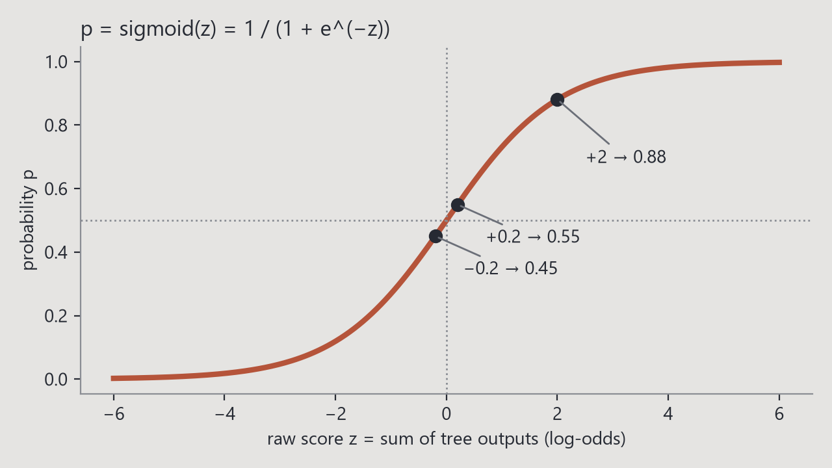
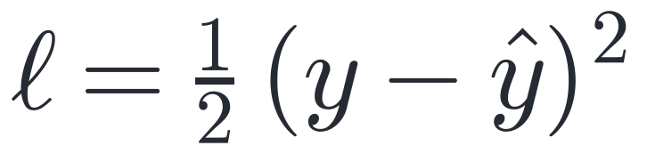
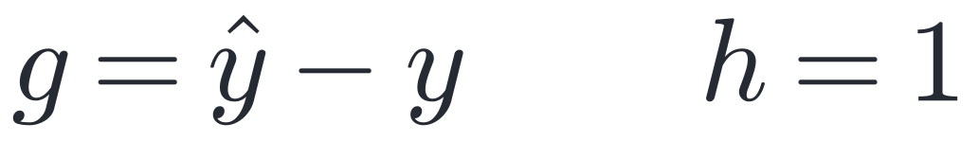
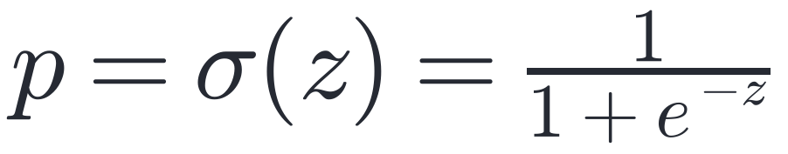
CLASSIFICATION
& REGRESSION
Same trees,
different loss
Classification
Regression
Multi-class and more
multi:softprob builds one tree per class each round and uses softmax. Ranking (rank:ndcg) and counts (count:poisson) work the same way: only g and h change.
Output: a probability between 0 and 1;
a threshold (often 0.5) gives the class
Output: a number (price, demand, mass…)
metrics: MAE, RMSE, R²
Notes:
The tree-building code never looks at the loss, only at g and h. Swap the loss and you switch task. For classification the trees add up log-odds and the sigmoid turns them into a probability (plot on the right).

Slide 28
03
PART THREE
CODING: THE HIGGS
Applying XGBoost to 250,000 simulated collisions from CERN.
Notes:
Part 3: our notebook, from installation to SHAP.

Slide 29
Everything you need to run XGBoost in Python
INSTALL & IMPORT
1 Install (terminal)
3 Train & predict (scikit-learn style)
pip install xgboost scikit-learn pandas shap
# or: conda install -c conda-forge py-xgboost
model = XGBClassifier(
n_estimators=3000,
learning_rate=0.05,
max_depth=6,
early_stopping_rounds=100,
eval_metric="logloss")
model.fit(X_train, y_train,
eval_set=[(X_val, y_val)])
proba = model.predict_proba(X_test)[:, 1]
# NaN can stay in X: no imputation needed
2 Import
import xgboost as xgb
from xgboost import XGBClassifier, XGBRegressor
Versions we used: xgboost 3.2 · scikit-learn 1.9 · pandas 3.0 · shap 0.51 · Python 3.11
GPU: add device="cuda". Native API: xgb.DMatrix + xgb.train.
Notes:
Install with pip (or conda). Import XGBClassifier for classification and XGBRegressor for regression; they work like any scikit-learn model. early_stopping_rounds plus an eval_set gives early stopping. Missing values can stay as NaN.

Slide 30
Higgs_Boson.ipynb in ten steps
OUR NOTEBOOK ROADMAP
0
1
2
3
4
Setup
xgboost 3.2, shap, sklearn
Dataset
818k events → 250k training rows
EDA
72.8% of rows miss a value; the mass bump
Preprocessing
−999 → NaN, drop Weight, 70/15/15 split
Default model
100 trees · AUC 0.906 in 0.6 s
5
6
7
8
9
Tuning
RandomizedSearchCV + early stopping: 778 trees
Evaluation
AUC 0.911 · overfitting check · AMS 3.34
Interpretation
SHAP: 125 GeV peak · tree checked by hand
Comparison
LR, RF, GBM, LightGBM · improved to 0.914 · regression R² 0.92
Conclusions
strengths, weaknesses, next steps
Highlighted: the XGBoost core (tune → evaluate → interpret). Every number on the next slides comes from this notebook.
Notes:
A map of the notebook. Each box is one part with its key result.

Slide 31
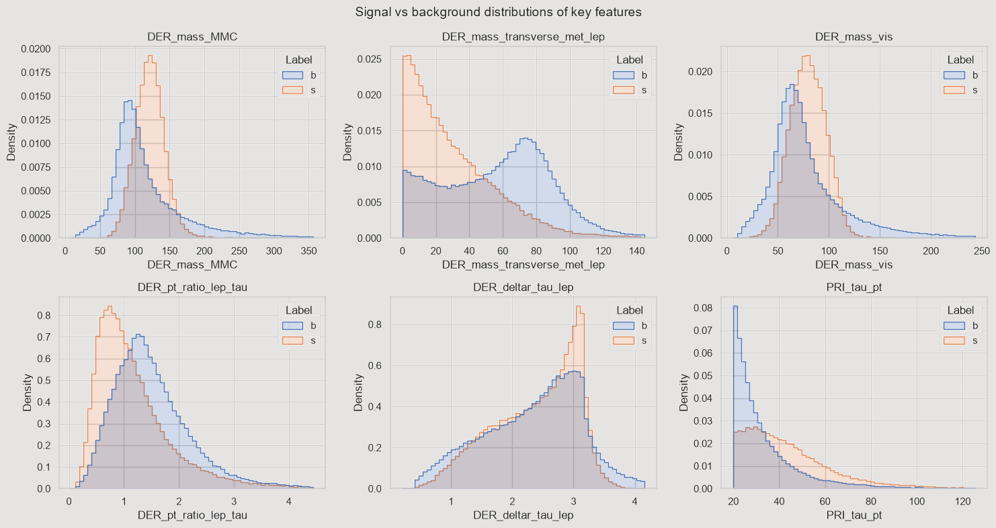
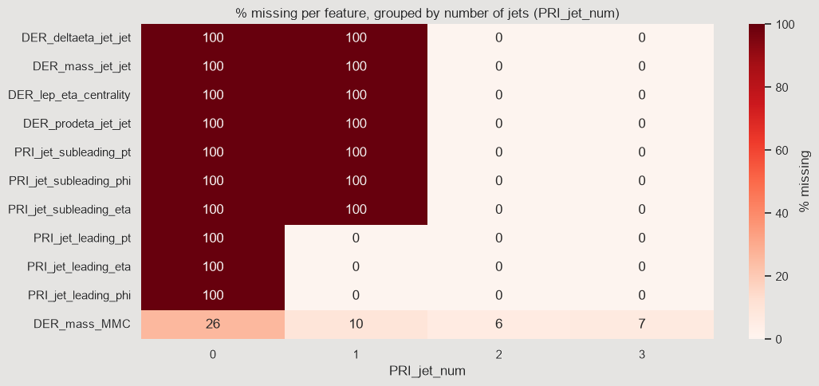
FINDING THE
HIGGS BOSON
250,000 collisions,
30 measurements
The data
ATLAS Higgs ML Challenge 2014 (CERN Open Data). Each row is one simulated proton collision: signal (Higgs, 34%) or background (66%).
Missing values with meaning
-999 = cannot be measured (e.g. no jets). 72.8% of rows have one. Signal is 39% when the mass exists, only 7% when it is missing.
Non-linear patterns
DER_mass_MMC peaks near 125 GeV for signal, yet its linear correlation with the target is only 0.01: a bump, not a line.
Notes:
Our dataset. The EDA showed three things that point to XGBoost: structured missing values, missingness that carries information, and non-linear relationships.

Slide 32
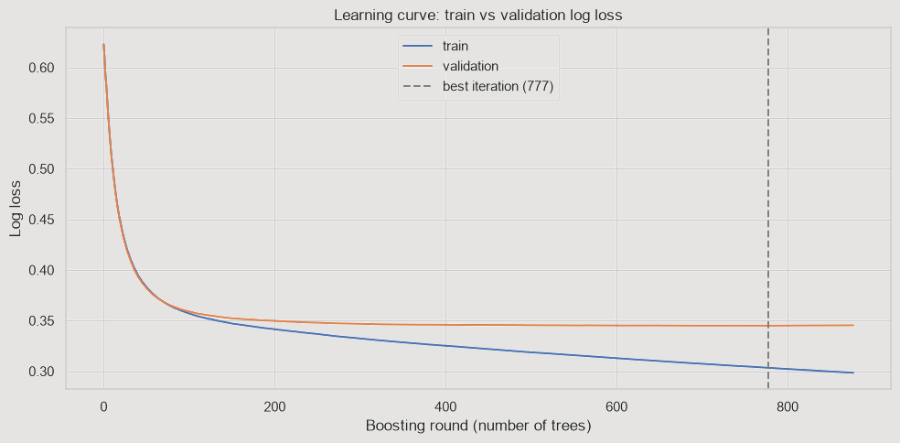
DATA &
TRAINING
PROCESS
Data is the fuel
of the model
Preprocessing
-999 → NaN (no imputation)
Target s → 1, b → 0
Drop Weight (it leaks the label)
No scaling · stratified 70 / 15 / 15 split
Tuning & early stopping
RandomizedSearchCV: 25 settings × 3 folds
on a 50k sample (36 s)
Final model: lr 0.05, stopped at 778 trees
when validation loss stopped improving
Overfitting check
Train AUC 0.937 vs test 0.911
5-fold CV: 0.910 ± 0.002
No early stopping → gap 0.068
Notes:
Every preprocessing step has a reason: trees don't need scaling, XGBoost handles NaN, Weight would let the model cheat. Early stopping picked 778 trees.

Slide 33
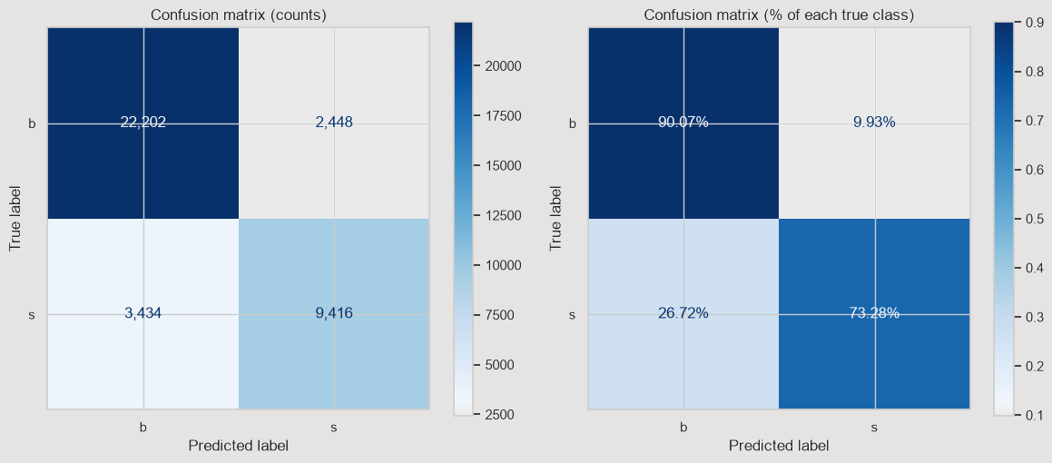
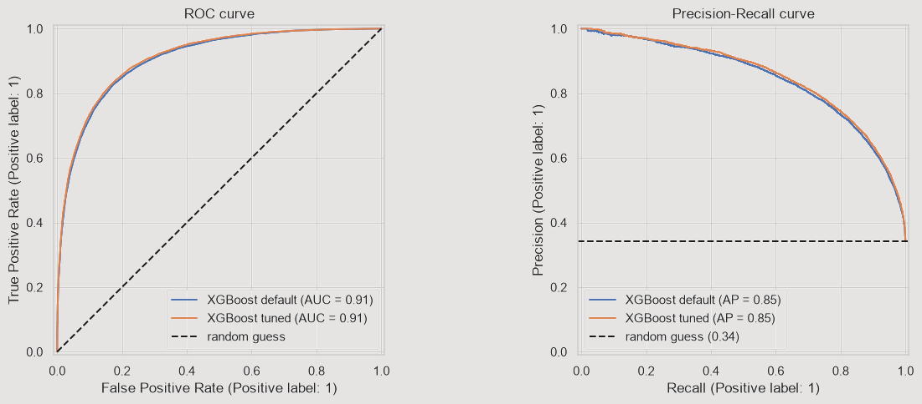
How well does it work?
RESULTS
0.911
test ROC-AUC
84.3%
accuracy
73%→83%
signal recall when the
threshold drops to 0.35
AMS 3.34
CERN's official metric
(threshold 0.86)
Background is recognised 90% of the time, signal 73%. When the model says 'Higgs', it is right 79% of the time. Tuning added +0.005 AUC: XGBoost's defaults are already strong.
Notes:
Headline: test ROC-AUC 0.911. The best threshold depends on the goal: 0.35 for best F1, 0.86 for the physicists' AMS metric. 2014 winner scored about 3.8 AMS on different data.

Slide 34
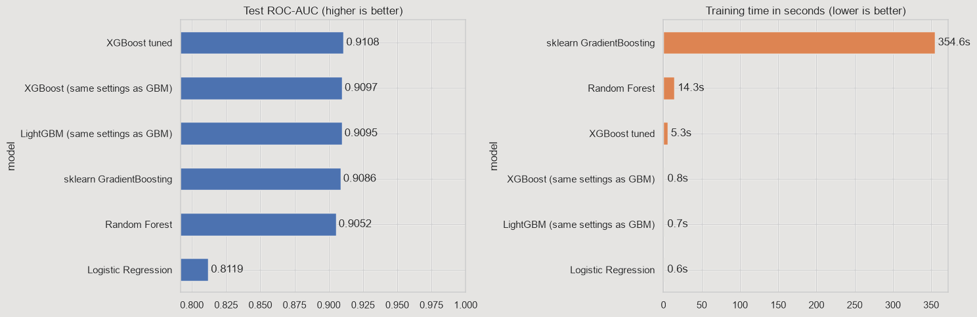
Same data,
same test set
≈ 400×
faster than sklearn's classic
gradient boosting, same settings
OUR BENCHMARK
Model | Test AUC | Train time
XGBoost (tuned) | 0.911 | 5.3 s
XGBoost (300 trees) | 0.910 | 0.8 s
LightGBM | 0.910 | 0.7 s
sklearn GBM | 0.909 | 355 s
Random Forest | 0.905 | 14.3 s
Logistic Regression | 0.812 | 0.6 s
Notes:
Boosting beats bagging (RF) and crushes the linear model. XGBoost and LightGBM are tied here. Speed: same 300 trees / depth 5, sklearn GBM 355 s vs XGBoost 0.8 s. The XGBoost paper shows the same pattern: 0.68 s per tree vs 28.5 s for scikit-learn on 1M Higgs events.

Slide 35
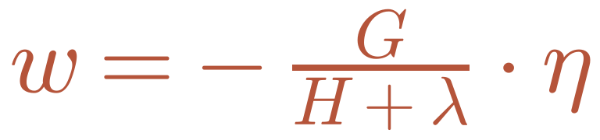
THEORY,
CHECKED IN CODE
We trained a tiny model (1 tree, depth 2) and computed its numbers by hand.
Split gain of the root (DER_mass_MMC < 96.4)
our formula: 26,310.79
leaf our formula XGBoost
0-3 −0.35336 −0.35336
0-4 −0.15231 −0.15231
0-5 +0.41832 +0.41832
0-6 −0.11985 −0.11985
✓
XGBoost: 26,310.79
Notes:
Proof that the formulas are exactly what XGBoost computes. Every event starts at p0 = 0.3427; g = p0 - y, h = p0(1-p0). Summed per leaf, -G/(H+lambda)*eta gives XGBoost's leaf values to 5 decimals, and the gain formula gives exactly its gain. (Notebook 7.5.)

Slide 36
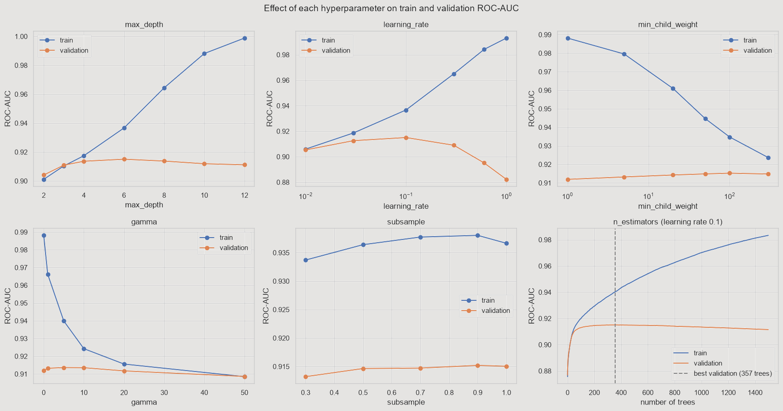
HYPERPARAMETERS ON OUR DATA
Underfit → sweet spot → overfit
When the train line keeps rising but validation falls, the model is memorising.
Best values here
depth ≈ 6, learning rate ≈ 0.1, min_child_weight ≈ 100 on deep trees.
Brakes work
Depth 12: train 0.999, validation drops. min_child_weight and gamma pull the two lines back together.
Notes:
Each panel changes one hyperparameter. Train vs validation. Learning rate 1.0 drops validation to 0.882. The n_estimators panel shows why early stopping matters.

Slide 37
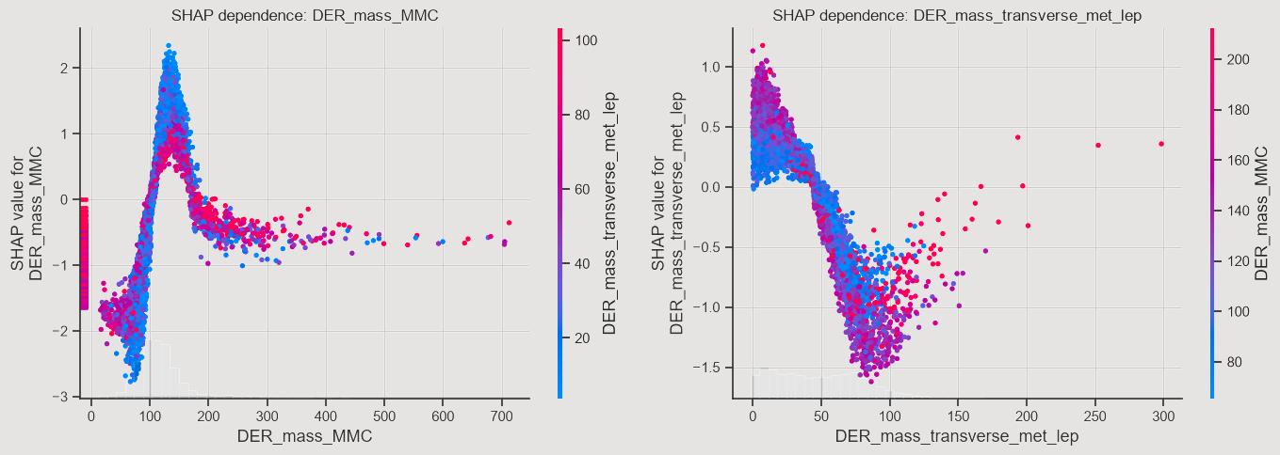
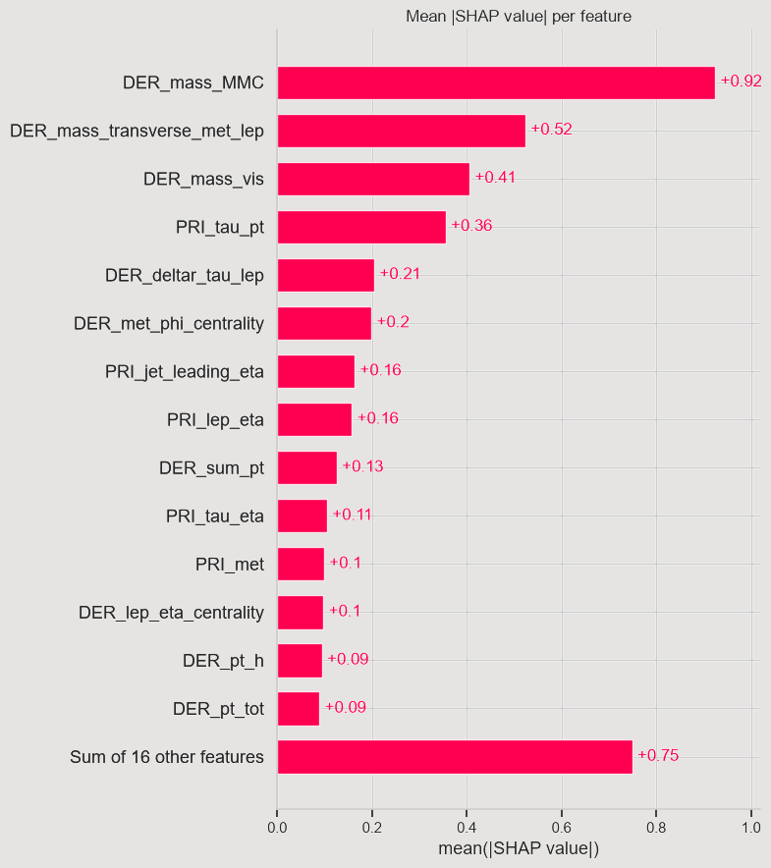
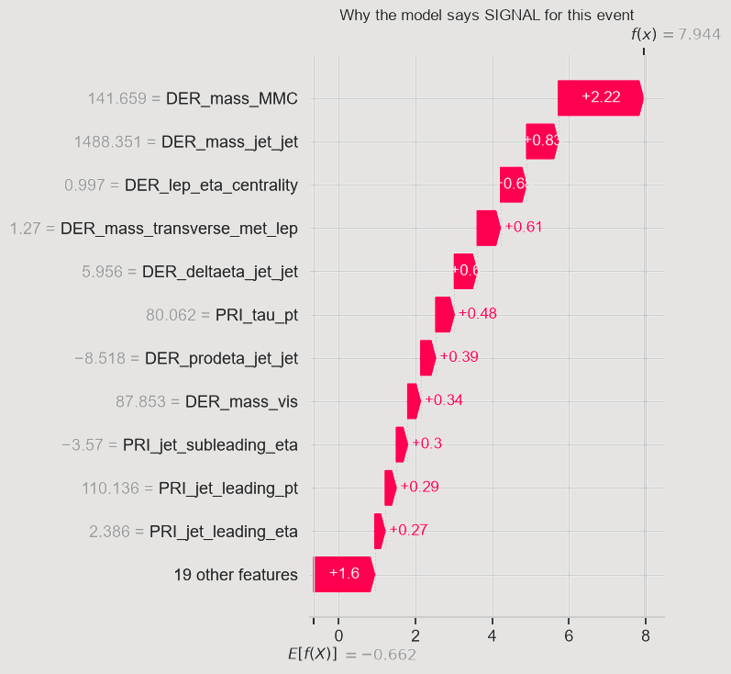
The model rediscovered
the Higgs mass
WHAT THE
MODEL LEARNED
A peak at 125 GeV
SHAP shows DER_mass_MMC pushes towards 'signal' only around 125 GeV, the mass of the Higgs boson. Nobody told the model that number.
Missing = background
Events with a missing mass get SHAP values of about −1 to −1.6: missingness itself is a clue, exactly as the EDA suggested.
Notes:
SHAP = how much each feature pushes one prediction up or down. Dependence plot: peak at ~125 GeV. Bottom: overall importance and one event explained.

Slide 38
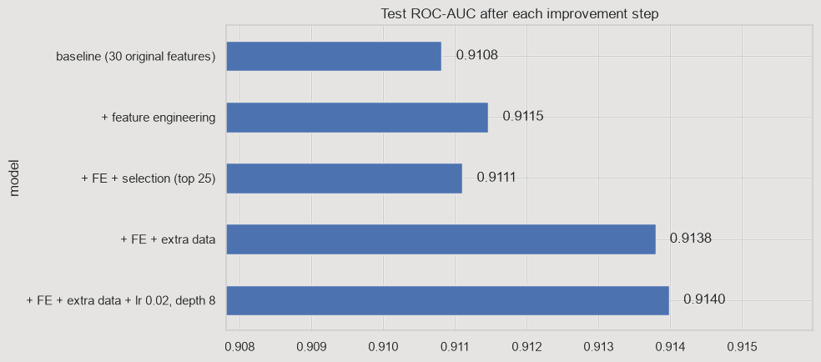
IMPROVING
THE MODEL
More data beats
more tuning
Feature engineering +0.0007
Angles between particles (dphi) instead of raw angles, |eta|, transverse mass. dphi_tau_lep became the 5th most important feature.
Feature selection ±0
Top 25 of 35 features by SHAP give the same score: about 10 features can go at no cost. Below 20 the score drops.
More data +0.003
Adding 568k extra labelled events (training only) gave the biggest jump: AUC 0.911 → 0.914. Differences < 0.001 are noise.
Notes:
Honest lesson: more data > feature engineering > more tuning.

Slide 39
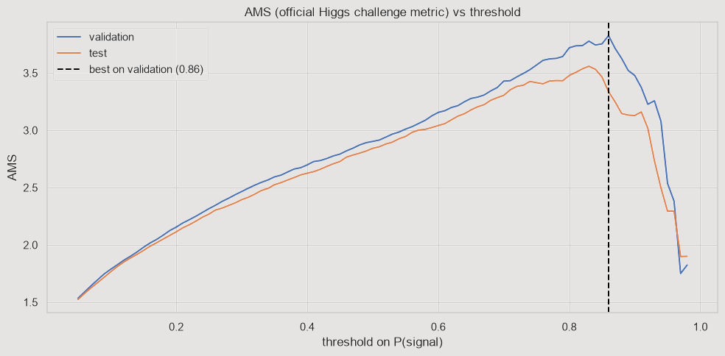
Preprocessing
No scaling needed. Leave missing values as NaN. Encode categoricals (one-hot or enable_categorical=True).
Tuning strategy
Fix lr 0.1 + early stopping → depth & min_child_weight → gamma → subsample → lambda/alpha → lower lr, more trees.
Common mistakes
Tuning on the test set · high learning rate without early stopping
very deep trees · leaking the target · ignoring class imbalance
Evaluate properly
Stratified split, separate validation set for early stopping, cross-validation for stability, and pick the threshold that matches your goal.
PRACTICAL TIPS
Notes:
If you remember one thing: always use early stopping on a validation set, and never touch the test set until the very end.

Slide 40

THANK YOU
TIME FOR A QUIZ 😈
▸ Open kahoot.it on your phone
▸ Enter the game PIN on the screen
▸ Code & notebook:
github.com/Marwanamer005/XGboosting-
Questions? Ask us anything about boosting, the math, or the Higgs boson.
Notes:
Many small trees, working as a team, caught the Higgs boson. Thank the audience, take questions, then launch the Kahoot.

Slide 41
TRY IT YOURSELF · INTERACTIVE
ROUND 0
BOOSTING, LIVE
λ = 5 η = 0.5 5 trees max
Leaf 1: size < 100 m²
Leaf 2: size ≥ 100 m²
1.02
error (RMSE)
error after each tree
Start
Every house gets the same first guess: the average price, 2.2.
Press ADD TREE: each new tree learns from the errors (residuals) of the current prediction.
2.20
2.20
2.20
2.20
House A
70 m²
House B
85 m²
House C
140 m²
House D
160 m²
◀ BACK
ADD TREE ▶
↺
λ = 1
● true price ($100k) ▬ prediction web version
Notes:
Interactive demo (λ = 5). Use the buttons in slideshow mode: ADD TREE adds the next tree, BACK goes back, ↺ resets, and the λ button switches to λ = 1 at the same round. Watch the bars slide toward the true prices (Morph transition) and read one leaf: G = sum of gradients, H = sum of hessians, w = −G/(H+λ). With λ = 5 the steps are smaller: regularization slows the learning down.

Slide 42
TRY IT YOURSELF · INTERACTIVE
ROUND 1
BOOSTING, LIVE
λ = 5 η = 0.5 5 trees max
Leaf 1: size < 100 m²
Leaf 2: size ≥ 100 m²
0.88
error (RMSE)
error after each tree
Tree 1 learns from the errors of round 0
Leaf 1 (houses A, B)
G = 1.20 + 0.80 = 2.00 H = 2
w = −G/(H+λ) = -0.29 change = η·w = -0.14
Leaf 2 (houses C, D)
G = (-0.80) + (-1.20) = -2.00 H = 2
w = −G/(H+λ) = +0.29 change = η·w = +0.14
2.34
2.34
2.06
2.06
House A
70 m²
House B
85 m²
House C
140 m²
House D
160 m²
◀ BACK
ADD TREE ▶
↺
λ = 1
● true price ($100k) ▬ prediction web version
Notes:
Interactive demo (λ = 5). Use the buttons in slideshow mode: ADD TREE adds the next tree, BACK goes back, ↺ resets, and the λ button switches to λ = 1 at the same round. Watch the bars slide toward the true prices (Morph transition) and read one leaf: G = sum of gradients, H = sum of hessians, w = −G/(H+λ). With λ = 5 the steps are smaller: regularization slows the learning down.

Slide 43
TRY IT YOURSELF · INTERACTIVE
ROUND 2
BOOSTING, LIVE
λ = 5 η = 0.5 5 trees max
Leaf 1: size < 100 m²
Leaf 2: size ≥ 100 m²
0.76
error (RMSE)
error after each tree
Tree 2 learns from the errors of round 1
Leaf 1 (houses A, B)
G = 1.06 + 0.66 = 1.71 H = 2
w = −G/(H+λ) = -0.24 change = η·w = -0.12
Leaf 2 (houses C, D)
G = (-0.66) + (-1.06) = -1.71 H = 2
w = −G/(H+λ) = +0.24 change = η·w = +0.12
2.47
2.47
1.93
1.93
House A
70 m²
House B
85 m²
House C
140 m²
House D
160 m²
◀ BACK
ADD TREE ▶
↺
λ = 1
● true price ($100k) ▬ prediction web version
Notes:
Interactive demo (λ = 5). Use the buttons in slideshow mode: ADD TREE adds the next tree, BACK goes back, ↺ resets, and the λ button switches to λ = 1 at the same round. Watch the bars slide toward the true prices (Morph transition) and read one leaf: G = sum of gradients, H = sum of hessians, w = −G/(H+λ). With λ = 5 the steps are smaller: regularization slows the learning down.

Slide 44
TRY IT YOURSELF · INTERACTIVE
ROUND 3
BOOSTING, LIVE
λ = 5 η = 0.5 5 trees max
Leaf 1: size < 100 m²
Leaf 2: size ≥ 100 m²
0.66
error (RMSE)
error after each tree
2.57
2.57
Tree 3 learns from the errors of round 2
Leaf 1 (houses A, B)
G = 0.93 + 0.53 = 1.47 H = 2
w = −G/(H+λ) = -0.21 change = η·w = -0.10
Leaf 2 (houses C, D)
G = (-0.53) + (-0.93) = -1.47 H = 2
w = −G/(H+λ) = +0.21 change = η·w = +0.10
1.83
1.83
House A
70 m²
House B
85 m²
House C
140 m²
House D
160 m²
◀ BACK
ADD TREE ▶
↺
λ = 1
● true price ($100k) ▬ prediction web version
Notes:
Interactive demo (λ = 5). Use the buttons in slideshow mode: ADD TREE adds the next tree, BACK goes back, ↺ resets, and the λ button switches to λ = 1 at the same round. Watch the bars slide toward the true prices (Morph transition) and read one leaf: G = sum of gradients, H = sum of hessians, w = −G/(H+λ). With λ = 5 the steps are smaller: regularization slows the learning down.

Slide 45
TRY IT YOURSELF · INTERACTIVE
ROUND 4
BOOSTING, LIVE
λ = 5 η = 0.5 5 trees max
Leaf 1: size < 100 m²
Leaf 2: size ≥ 100 m²
0.58
error (RMSE)
error after each tree
2.66
2.66
Tree 4 learns from the errors of round 3
Leaf 1 (houses A, B)
G = 0.83 + 0.43 = 1.26 H = 2
w = −G/(H+λ) = -0.18 change = η·w = -0.09
Leaf 2 (houses C, D)
G = (-0.43) + (-0.83) = -1.26 H = 2
w = −G/(H+λ) = +0.18 change = η·w = +0.09
1.74
1.74
House A
70 m²
House B
85 m²
House C
140 m²
House D
160 m²
◀ BACK
ADD TREE ▶
↺
λ = 1
● true price ($100k) ▬ prediction web version
Notes:
Interactive demo (λ = 5). Use the buttons in slideshow mode: ADD TREE adds the next tree, BACK goes back, ↺ resets, and the λ button switches to λ = 1 at the same round. Watch the bars slide toward the true prices (Morph transition) and read one leaf: G = sum of gradients, H = sum of hessians, w = −G/(H+λ). With λ = 5 the steps are smaller: regularization slows the learning down.

Slide 46
TRY IT YOURSELF · INTERACTIVE
ROUND 5
BOOSTING, LIVE
λ = 5 η = 0.5 5 trees max
Leaf 1: size < 100 m²
Leaf 2: size ≥ 100 m²
0.50
error (RMSE)
error after each tree
2.74
2.74
Tree 5 learns from the errors of round 4
Leaf 1 (houses A, B)
G = 0.74 + 0.34 = 1.08 H = 2
w = −G/(H+λ) = -0.15 change = η·w = -0.08
Leaf 2 (houses C, D)
G = (-0.34) + (-0.74) = -1.08 H = 2
w = −G/(H+λ) = +0.15 change = η·w = +0.08
1.66
1.66
House A
70 m²
House B
85 m²
House C
140 m²
House D
160 m²
◀ BACK
ADD TREE ▶
↺
λ = 1
● true price ($100k) ▬ prediction web version
Notes:
Interactive demo (λ = 5). Use the buttons in slideshow mode: ADD TREE adds the next tree, BACK goes back, ↺ resets, and the λ button switches to λ = 1 at the same round. Watch the bars slide toward the true prices (Morph transition) and read one leaf: G = sum of gradients, H = sum of hessians, w = −G/(H+λ). With λ = 5 the steps are smaller: regularization slows the learning down.

