Slide 1



Hotel Reservation
Marwa
Ashraf

Slide 2
Agenda
Introduction
Excel
Import Data
SQL Server
Summery

Slide 3

Introduction
Hotel reservation datasets are valuable resources for understanding booking patterns, guest preferences, and hotel operations. These datasets contain information about reservations made by guests, including details such as Arrival Date, No of Adults, Number of Children ,Room types, Number of Weekend Nights, Number of Week Night, Type of Meal Plan, and more. Analyzing this data can provide insights for hotel management to optimize pricing strategies, enhance guest experiences, and improve overall efficiency
3

Slide 4
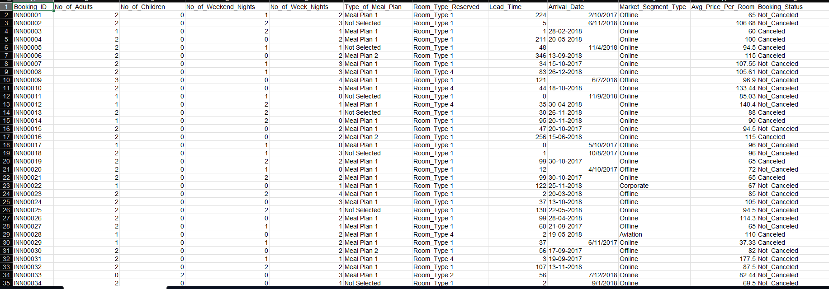
Excel
Dataset

Slide 5
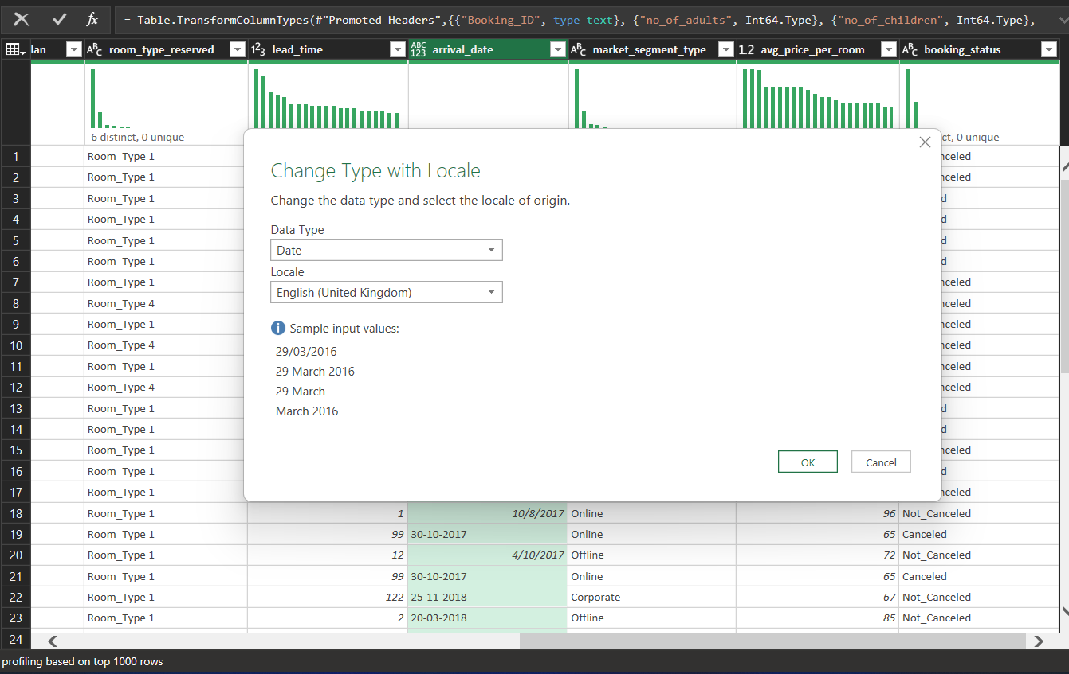
Transform Data by Power Query
5

Slide 6
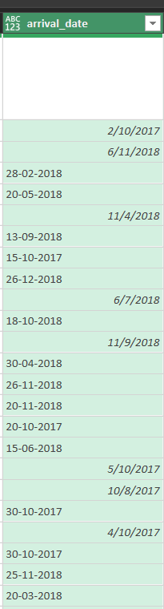
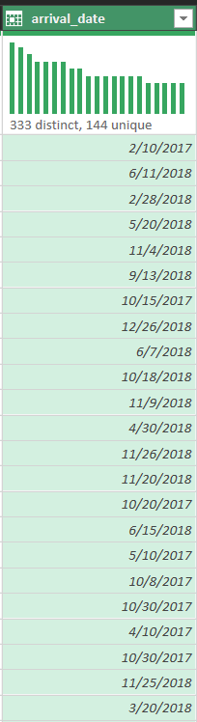
Transform Data by Power Query
We need to convert date From This
To The Right Format
6

Slide 7
Import Data From CSV File by SQL Server
By Task (Import )
7

Slide 8
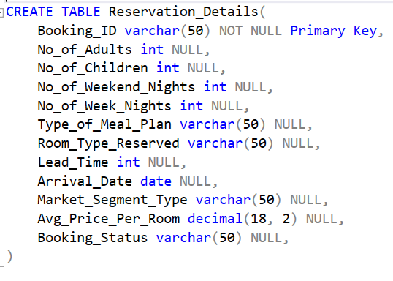
Import Dataset
First Create Database Then Create Table to Import Date on it
8

Slide 9
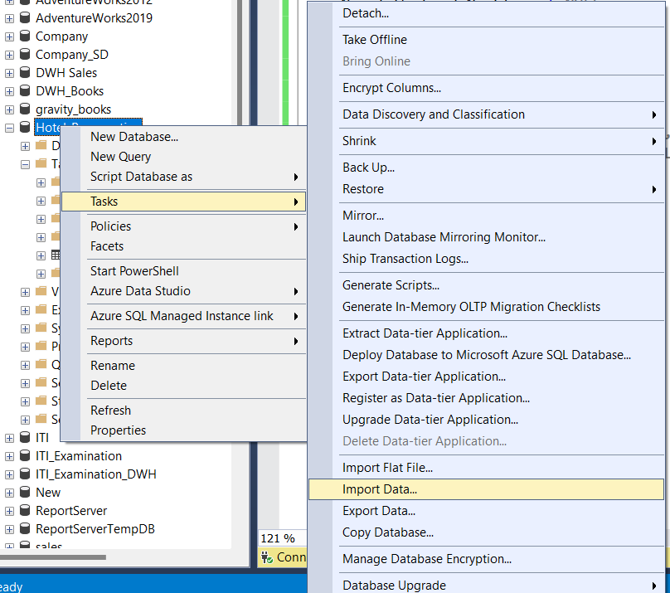
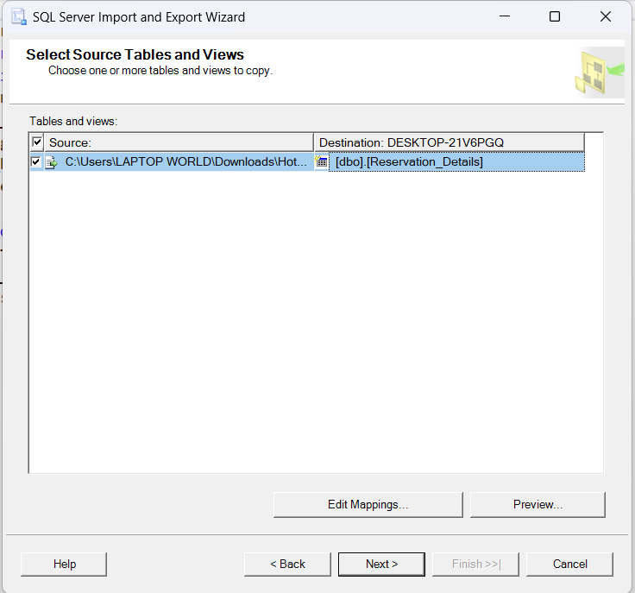
Import Dataset
Use Import From Tasks To Import Data From Csv File By select the right source and Destination
9

Slide 10
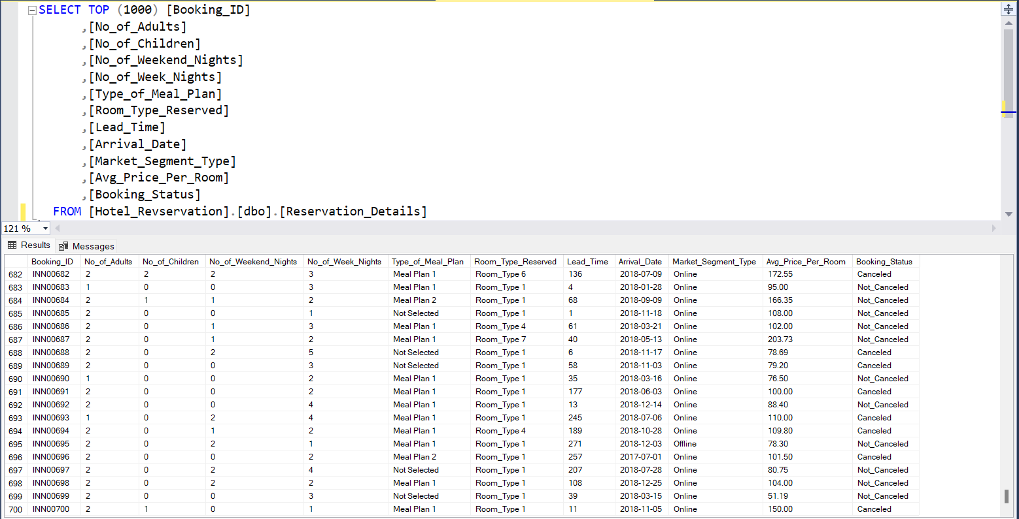
Import Dataset
Reservation Details Table With Fill of Date
10

Slide 11
SQL Query
By SQL Server
11

Slide 12
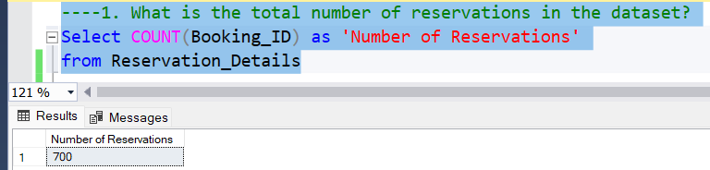
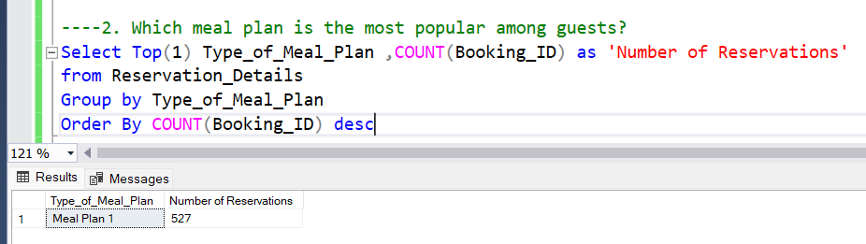
SQL Query
12

Slide 13
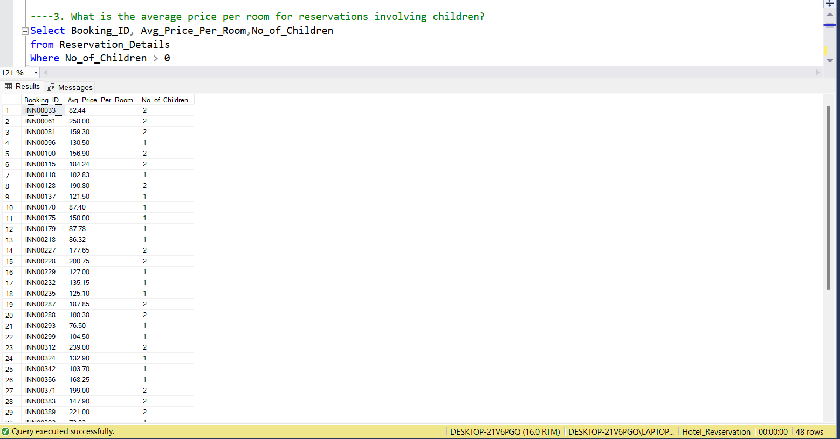
SQL Query
13

Slide 14
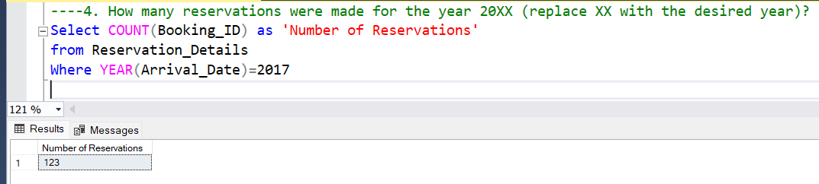
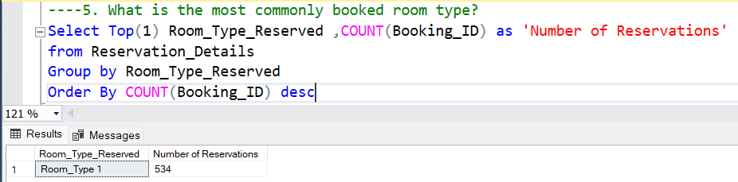
SQL Query
14

Slide 15
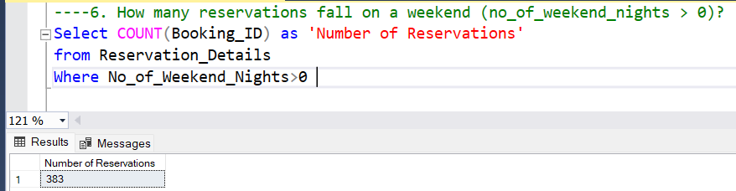
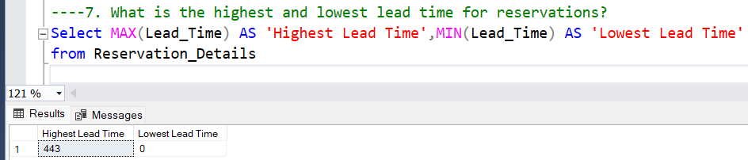
SQL Query
15

Slide 16
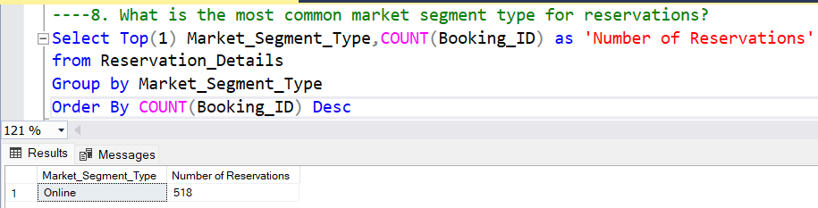
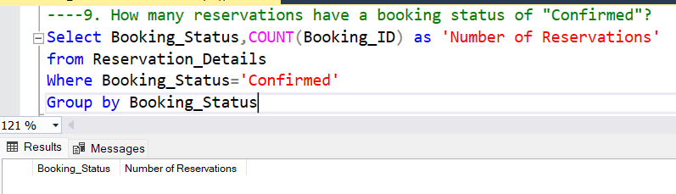
SQL Query
16

Slide 17
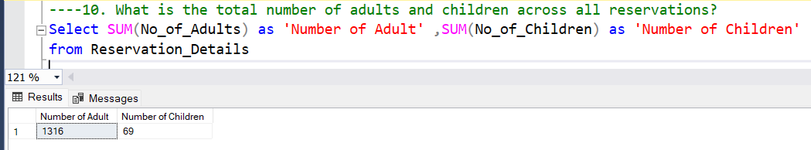
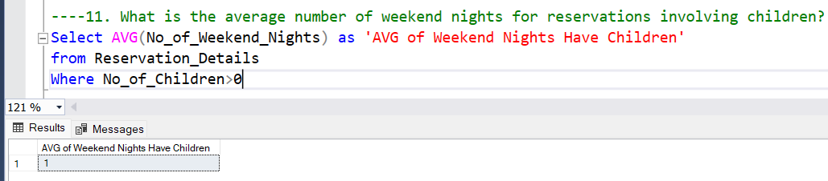
SQL Query
17

Slide 18
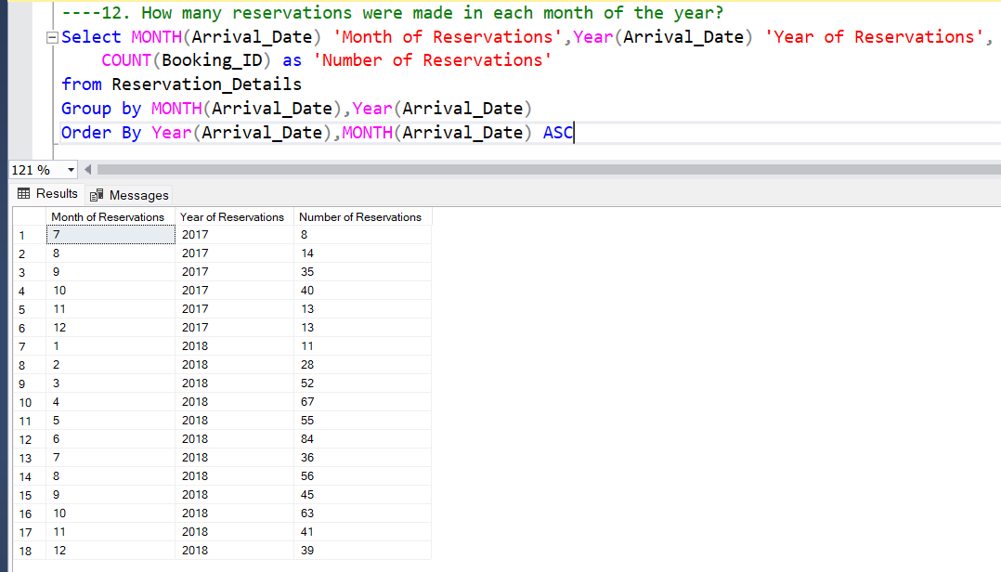
SQL Query
18

Slide 19
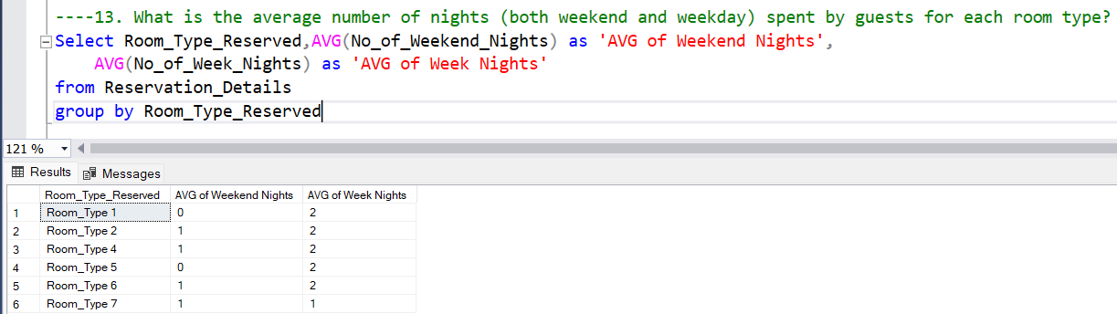
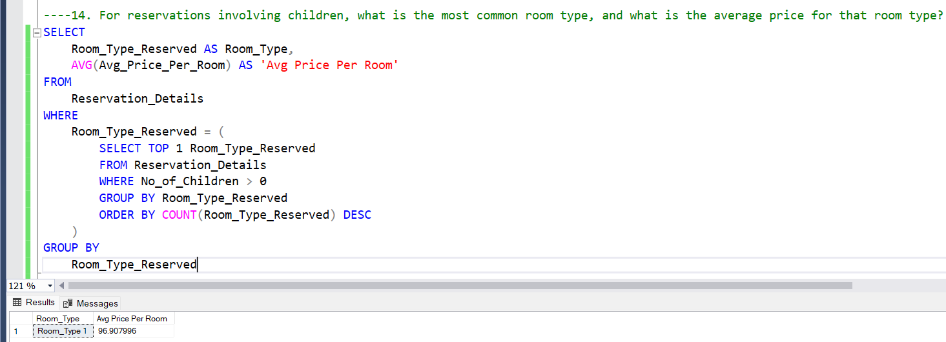
SQL Query
19

Slide 20
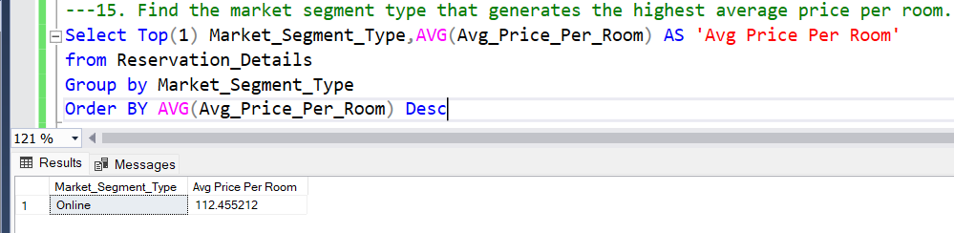
SQL Query
20

Slide 21
Summary
Importing CSV into SQL Server
Efficiency: Streamlines the process of importing large volumes of data from CSV files into SQL Server databases, saving time and effort in manual data entry.
Accuracy: Ensures data integrity by automating the import process, reducing the risk of errors associated with manual data transfer.
Scalability: Facilitates seamless integration of external data sources, enabling scalability and flexibility in managing diverse datasets for analysis and decision-making
21

Slide 22




Thank you
Marwa Ashraf
Marwaashraf5814@gmail.com

