Slide 1
Relational RDBMS
[ MySQL, PostgreSQL and SQL SERVER ]

Slide 2
What is Relational RDBMS ?
A relational database is a collection of data items with pre-defined relationships between them. These items are organized as a set of tables with columns and rows.
Tables are used to hold information about the objects to be represented in the database.

Slide 3
MySQL
MySQL:
is a very popular, open source database
is fast and stable
is available as a free and commercial software
is a great tool to learn about database

Slide 4
PostgreSQL
PostgreSQL is a powerful, open source object-relational database system
with over 30 years of active development
it has a strong reputation for reliability, feature robustness, and performance.

Slide 5
MS SQL Server
MS SQL Server is a database server
Product of Microsoft
Enables user to write queries and other SQL statements and execute them
Consists of several features. A few are
Query Analyzer
Profiler
Service Manager
Bulk Copy Program (BCP)

Slide 6
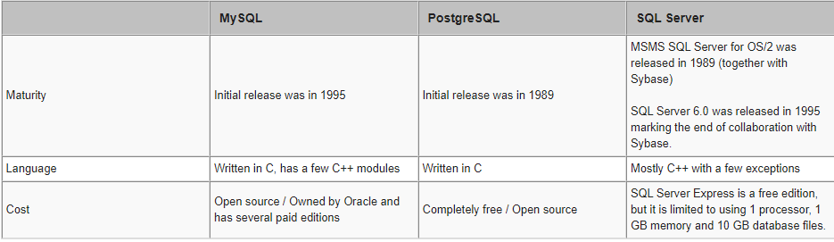
Comparison of MySQL vs. PostgreSQL vs. SQL Server

Slide 7
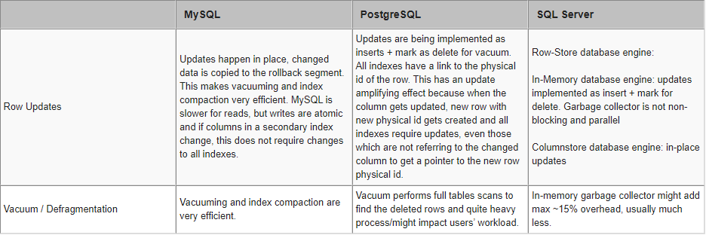

Slide 8
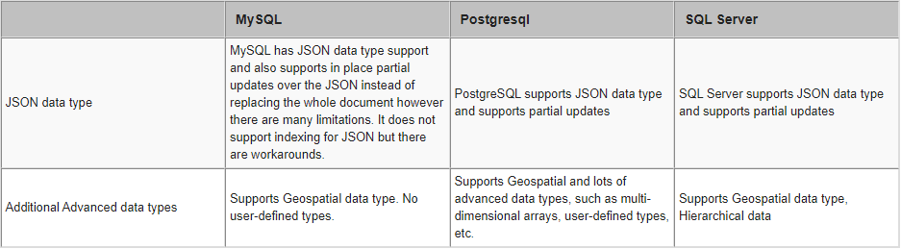
For more information:
https://www.mssqltips.com/sqlservertip/5745/compare-sql-server-mysql-and-postgresql-features/

