Slide 1
Shoot Tutorial
Honglei Han

Slide 2
Outline
New scene
3rd Person controller
Using Mecanim
Enemy patrol, and react
Weapon system
Adding interactive items
Dropping random items
UI

Slide 3
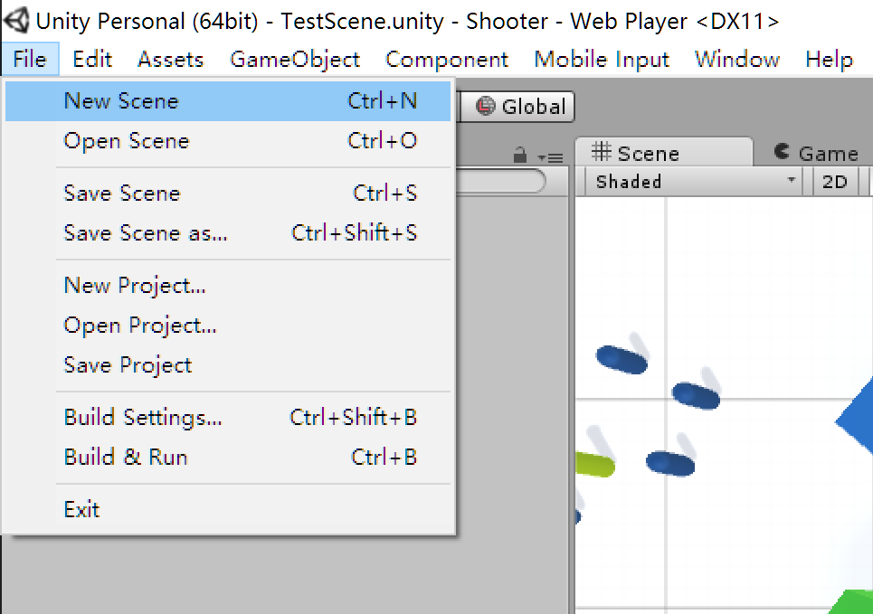
New scene

Slide 4
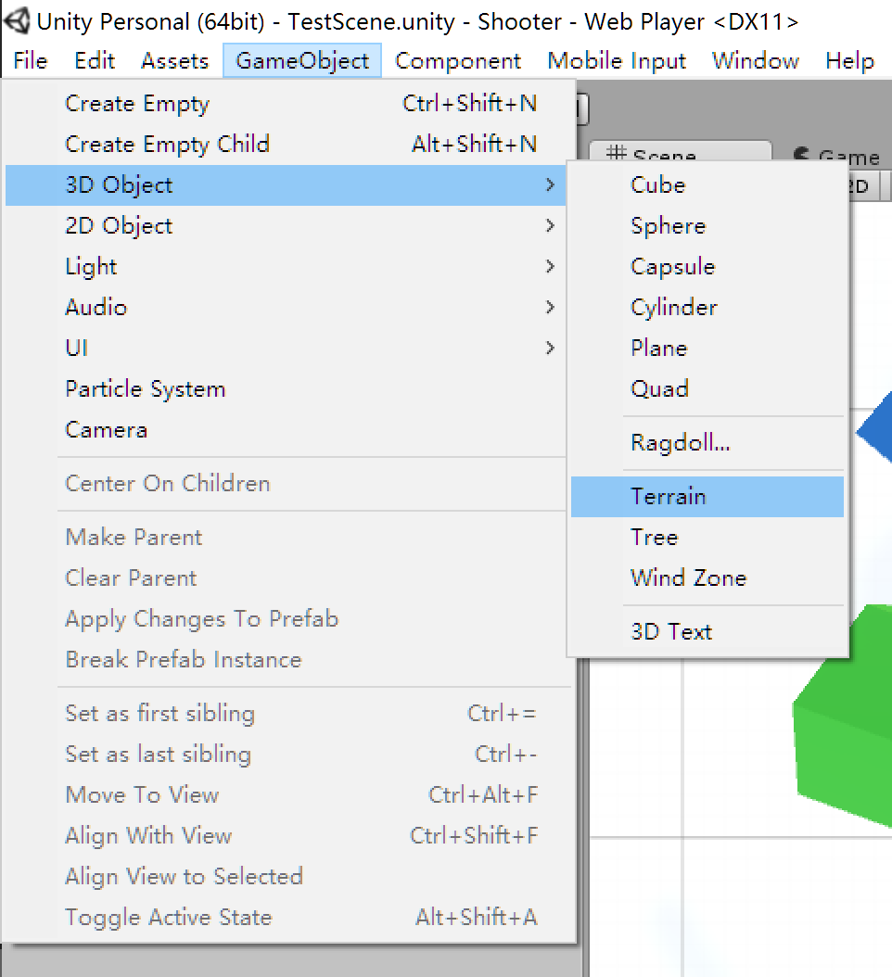
Add terrain

Slide 5
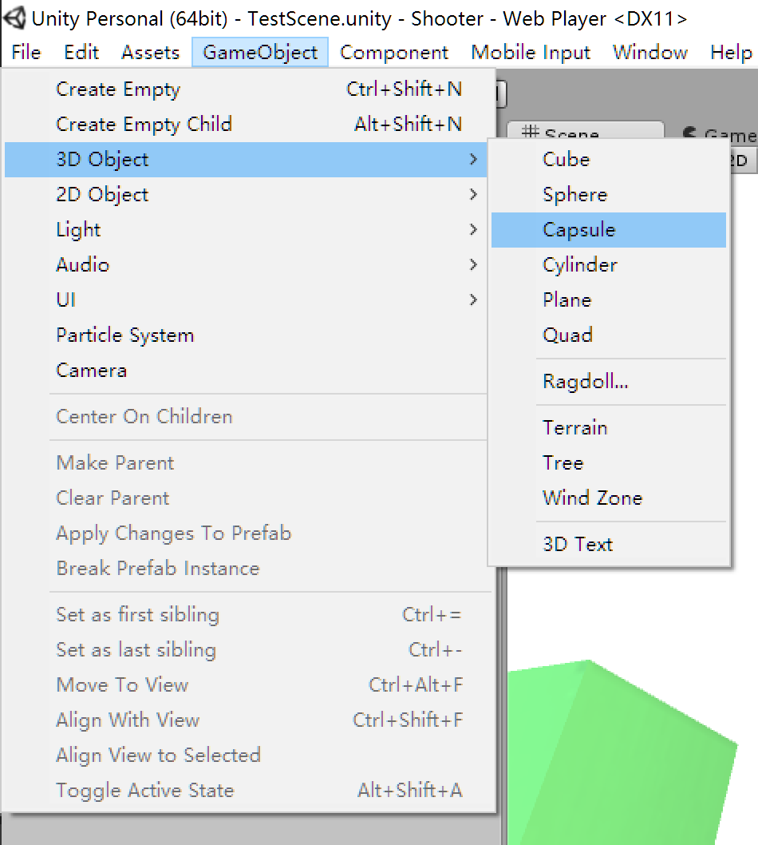
And other game objects

Slide 7
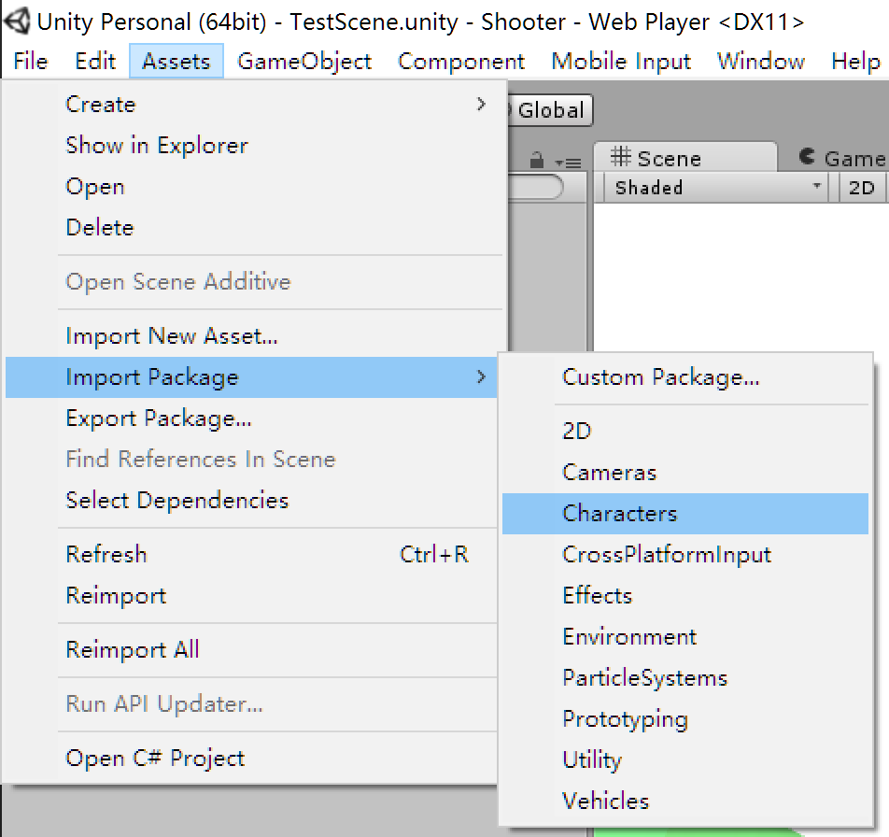
Drag a 3rd person controller into the scene

Slide 8
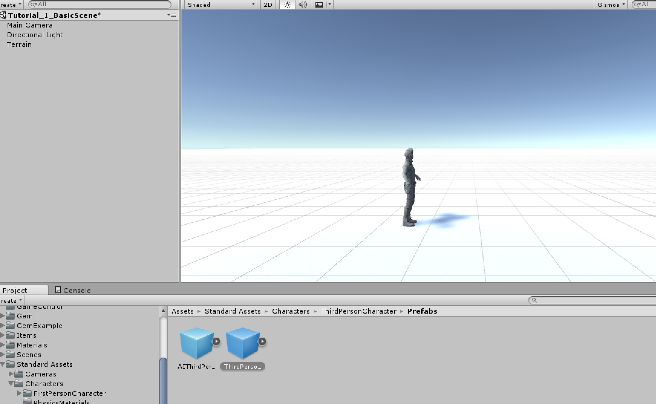

Slide 9
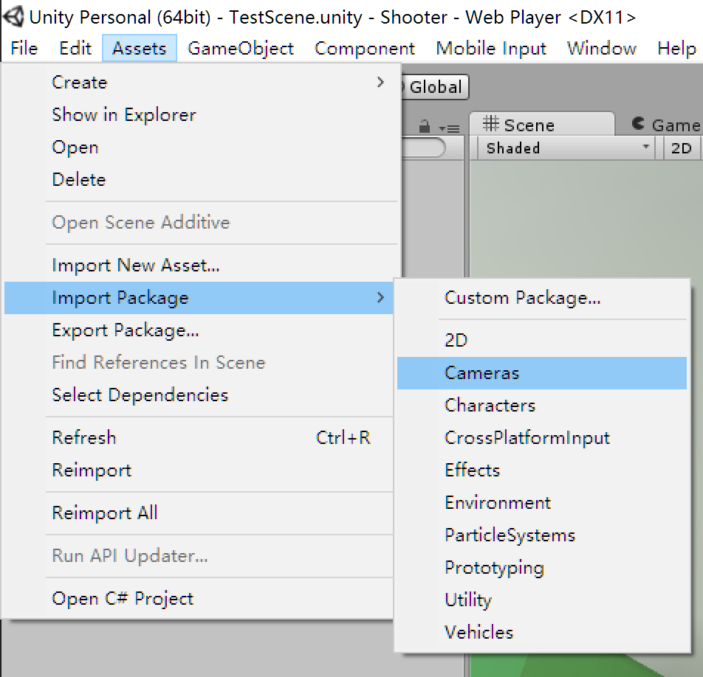
Configure a proper camera

Slide 10
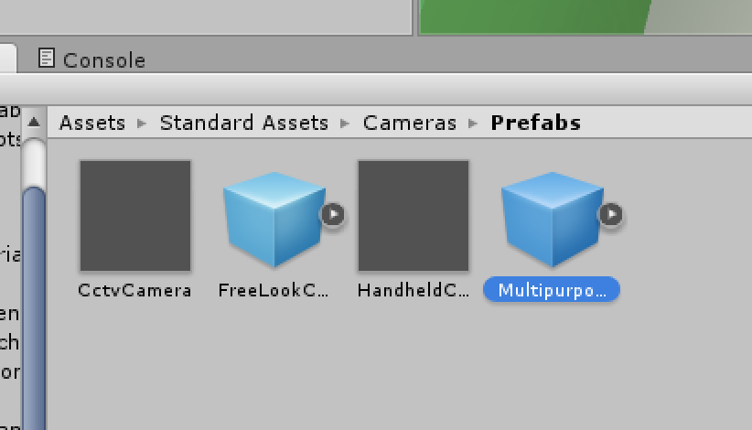

Slide 11
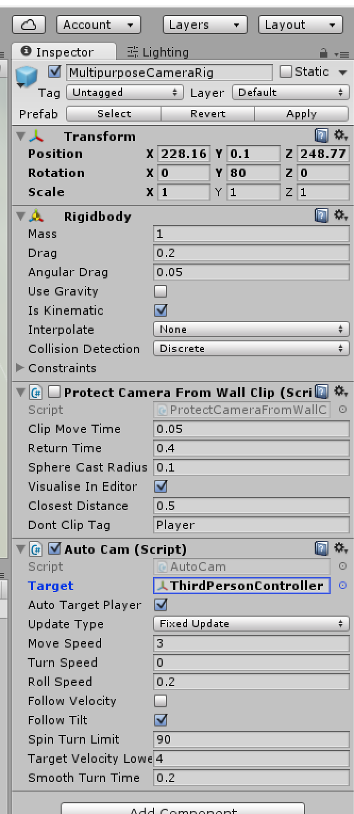
Setting proper parameters

Slide 13
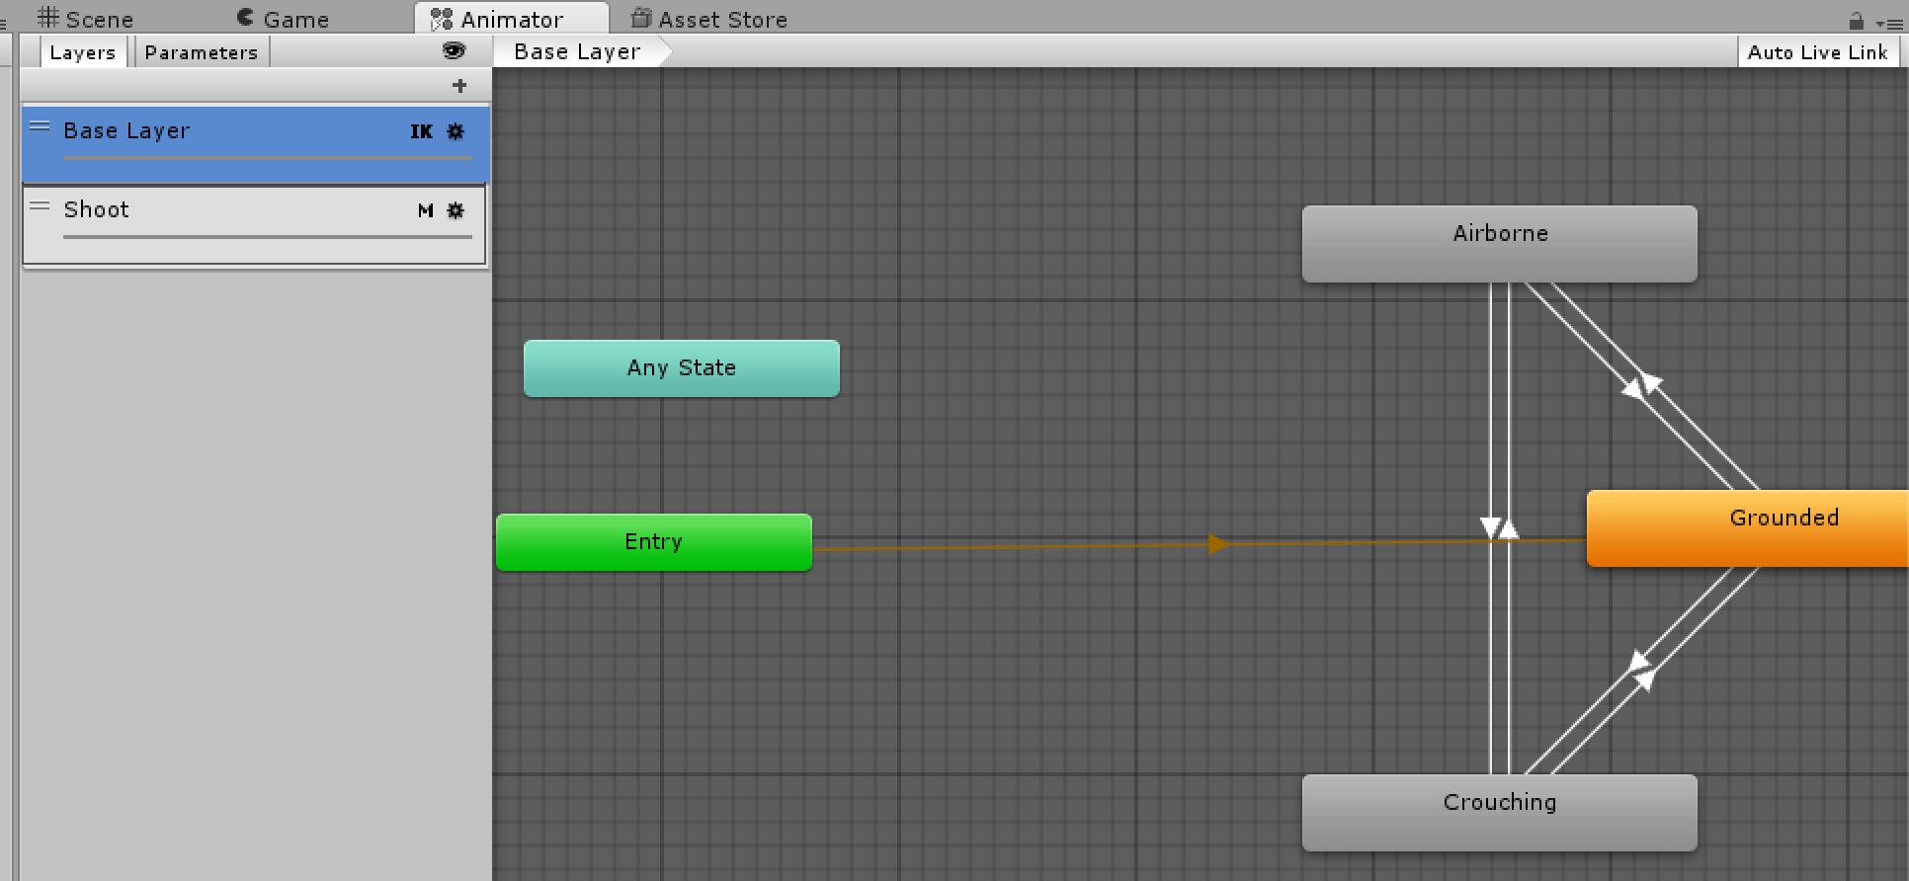
Using multi-layer animation

