Slide 1
Shooter Tutorial How to make a 3rd person controller shoot game using Unity 3D
Honglei Han

Slide 2
Outline
New scene
3rd Person controller
Using Mecanim
Enemy patrol, and react
Weapon system
Adding interactive items
Dropping random items
UI
Make it complete

Slide 3
Create a new game scene
Tutorial_1_BasicScene

Slide 4
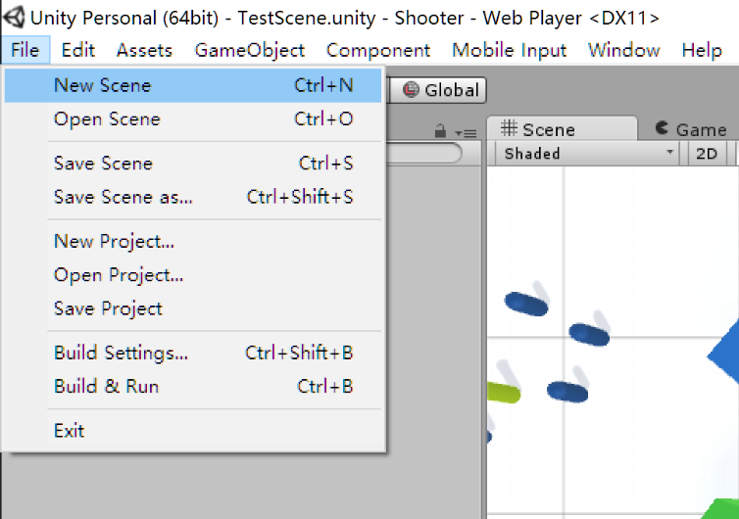
New scene

Slide 5
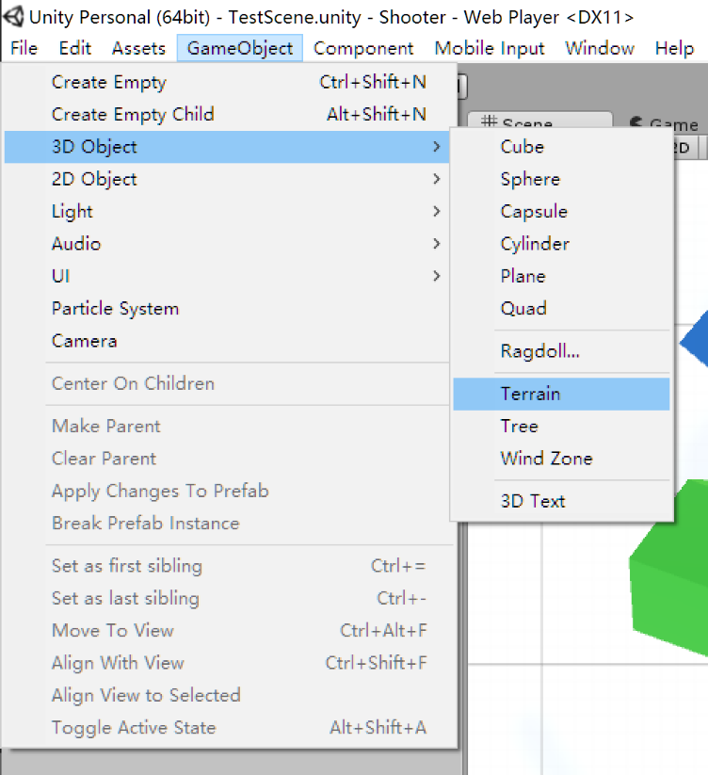
Add terrain

Slide 6
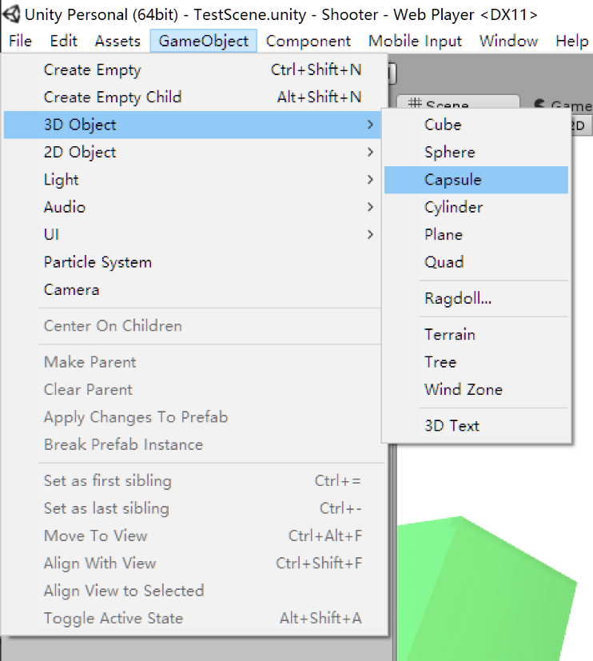
And other game objects

Slide 7
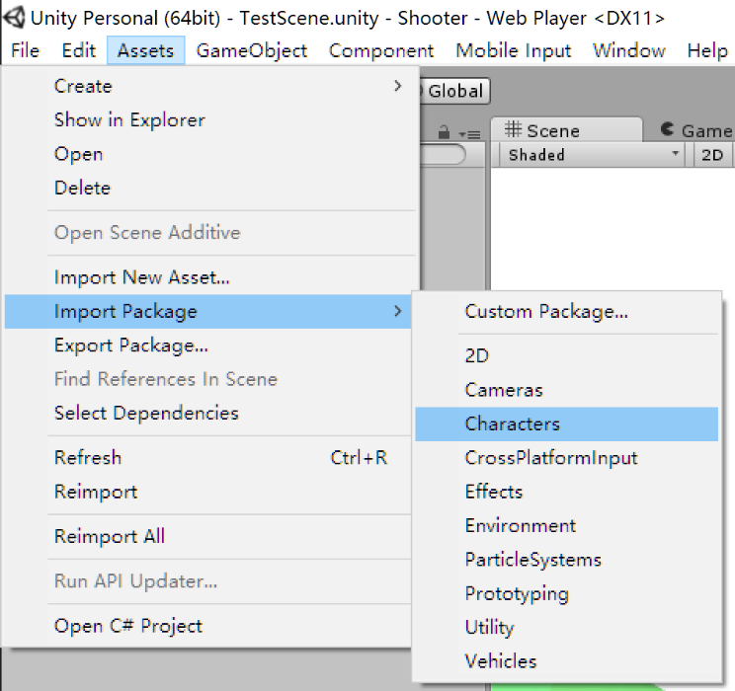
Drag a 3rd person controller into the scene

Slide 8
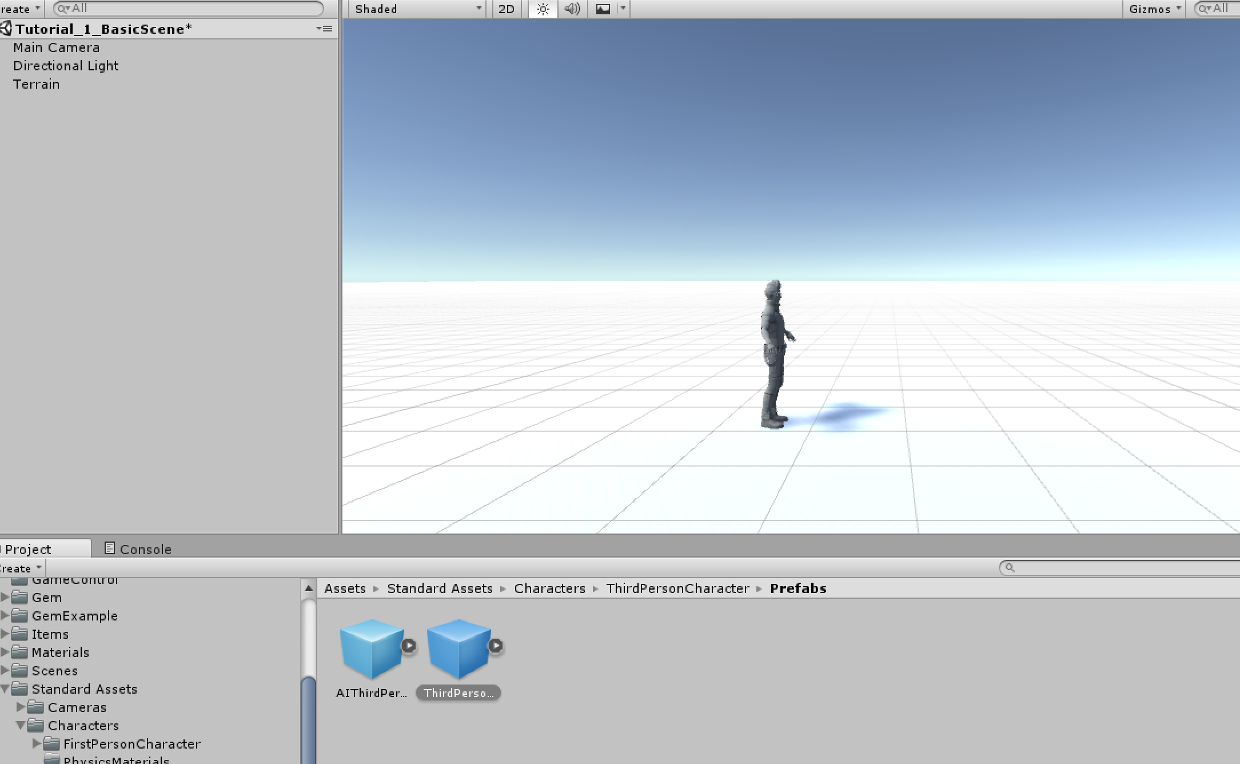

Slide 9
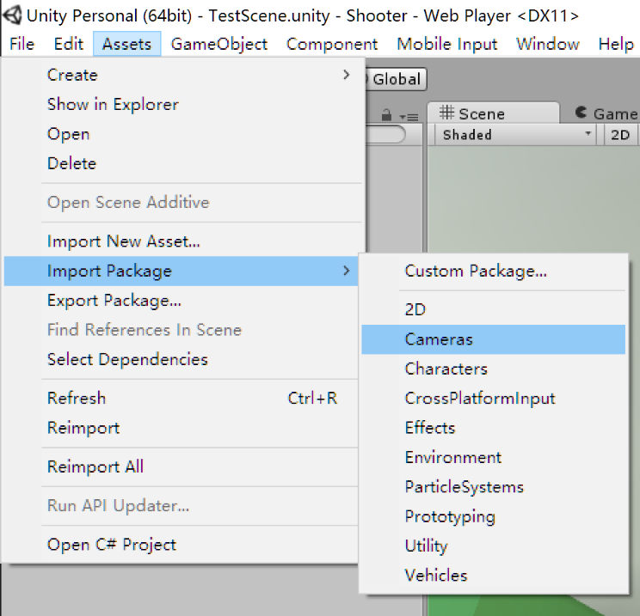
Configure a proper camera

Slide 10
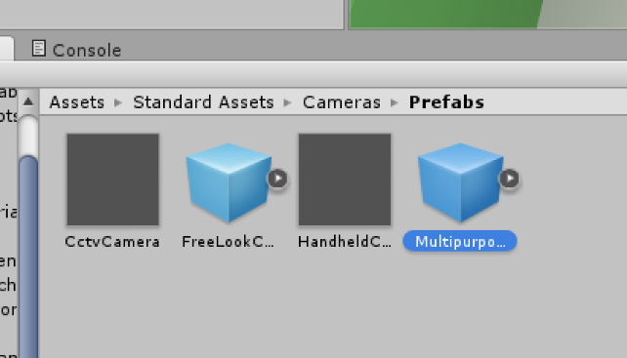

Slide 11
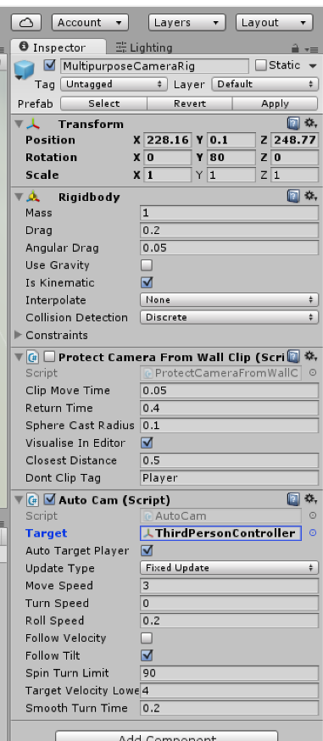
Setting proper camera parameters

Slide 12
Mecanim
Tutorial_2_Animation

Slide 13
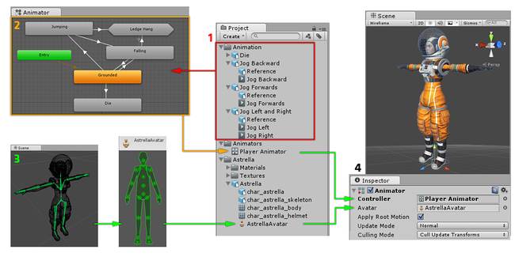
Animation clips are imported from an external source or created within Unity.
The animation clips are placed and arranged in an Animator Controller.
The rigged character model has a specific configuration of bones which are mapped to Unity’s common Avatar format.
When animating the character model, it has an Animator component attached

Slide 14
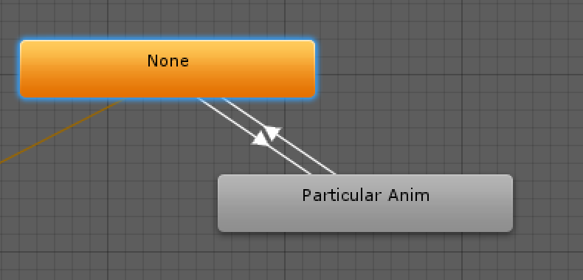
Animation Transitions

Slide 15
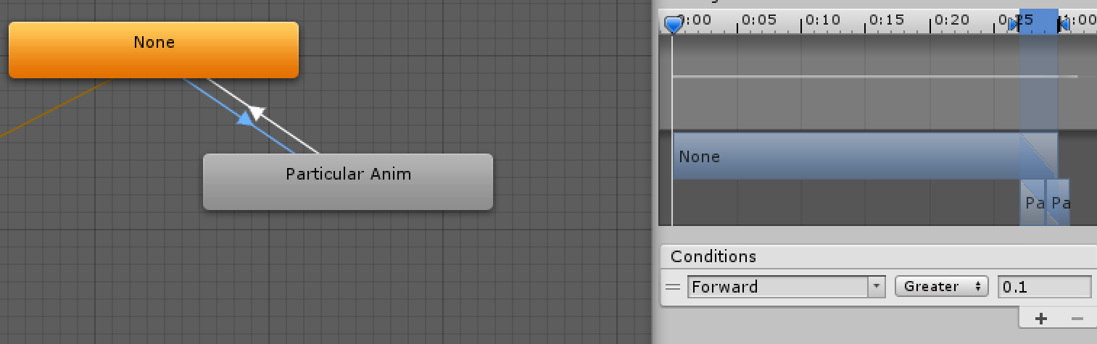
Use parameters to control state transit
The parameter can be retrieved through script

Slide 16
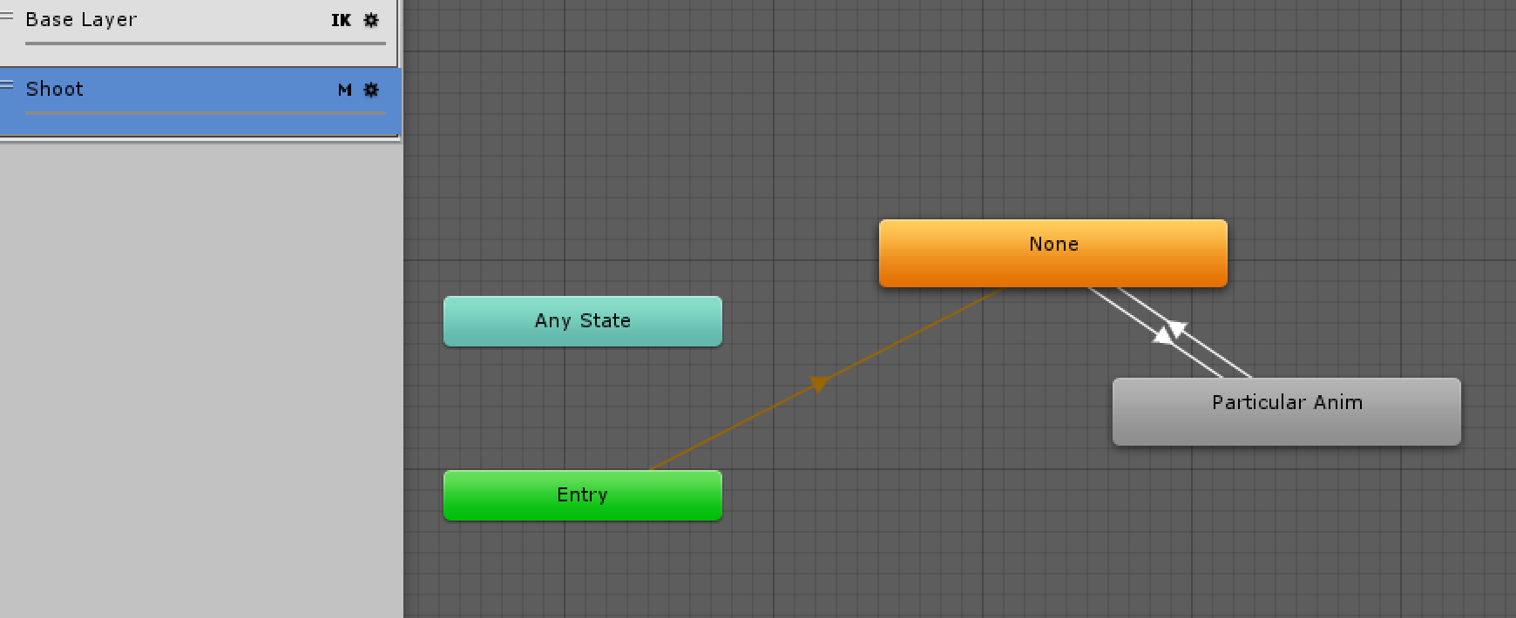
Using multi-layer animation

Slide 17
Mask
The Mask property to specify the mask used on this layer
For example if you wanted to play a throwing animation on just the upper body of your model, while having your character also able to walk, run or stand still at the same time, you would use a mask on the layer which plays the throwing animation where the upper body sections are defined

Slide 18
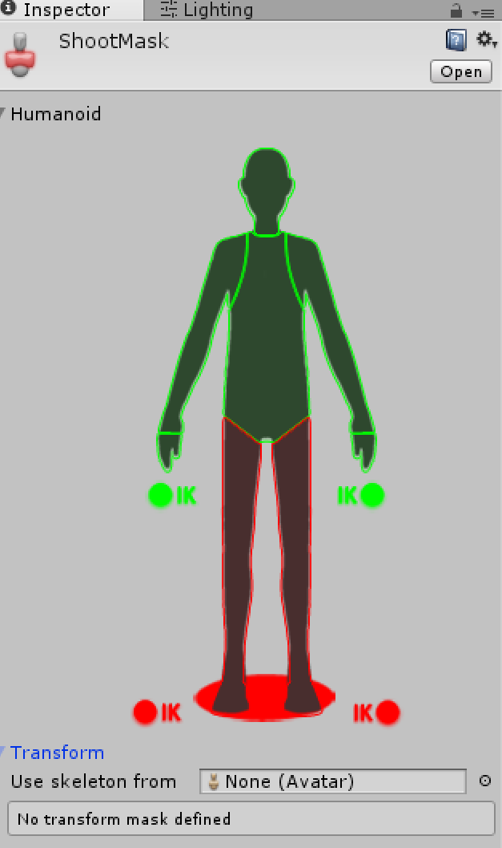

Slide 19
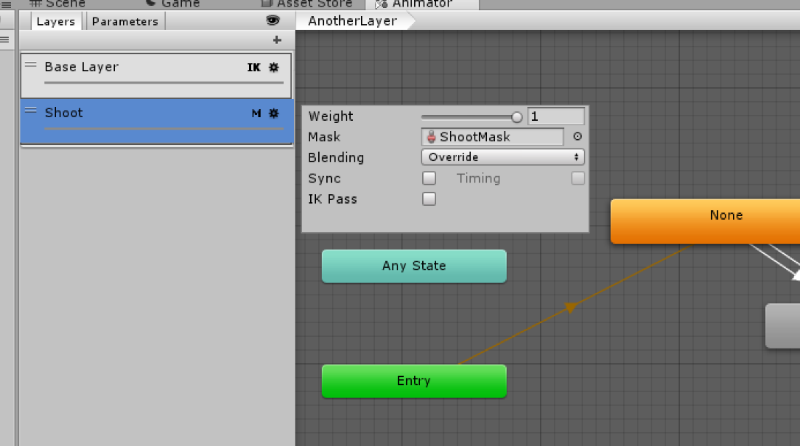
Set the mask to the new layer
Use mask in a additive layer that exclude legs
When transit to a animation clip in this layer, it would only replace the animation of upper body

Slide 20
Actor AI
Tutorial_3_AI

Slide 21
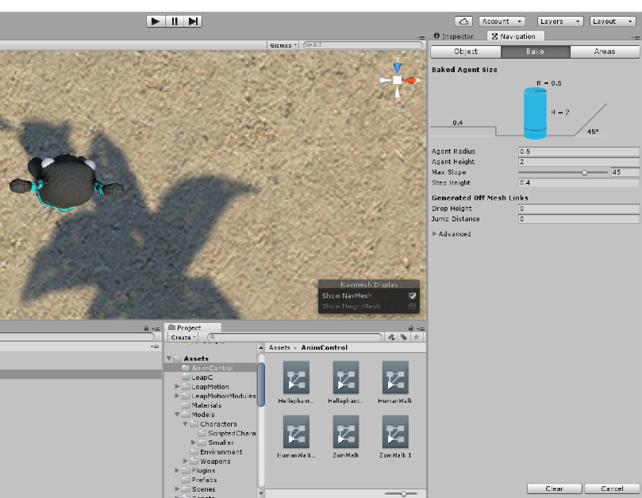
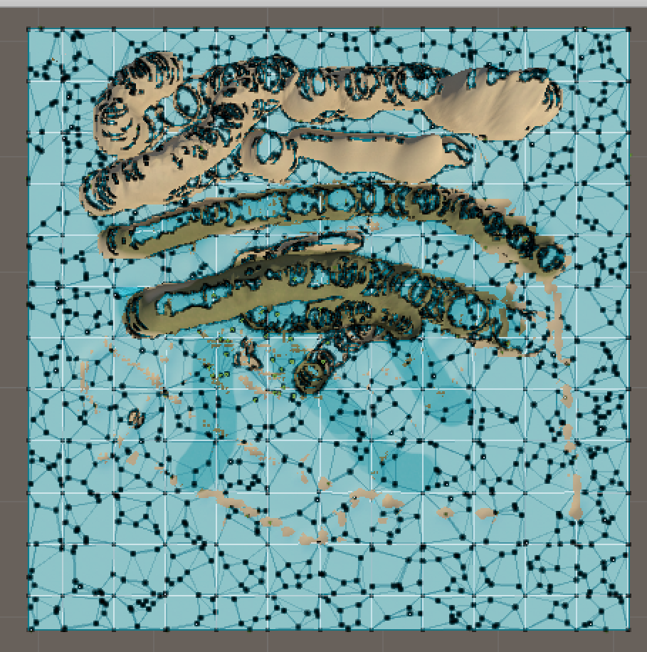
Add AI
Add AI to enemies, mainly path finding
Bake navigation first

Slide 22
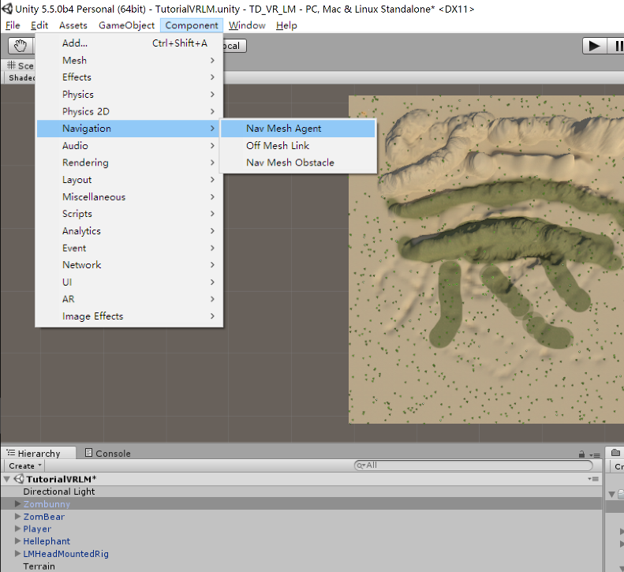
Add NavMeshAgent to AI models

Slide 23
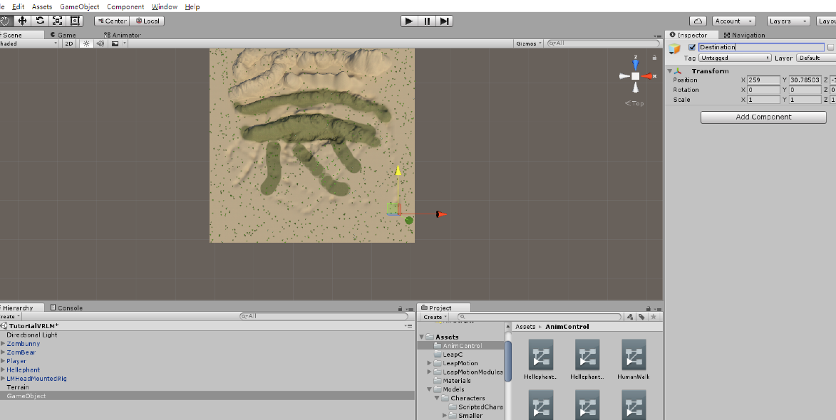
Use script to give them destination

Slide 24
To avoid polluting complete game script, all script class should be put inside namespace Tutorial
public Transform destPoint;
private NavMeshAgent nav;
void Awake()
{
nav = GetComponent<UnityEngine.AI.NavMeshAgent>();
if (!nav)
return;
Init();
}
public void Init()
{
nav.SetDestination(destPoint.position); // set nav destination
}
Notes:
Bake path finding in Navigation page first.

Slide 25
Enemy patrols
Tutorial_3_AI_2

Slide 26
The logic
The enemy patrols in a particular path
When he sees the player, he would try to chase him
If he can't catch with the player, he would go back to patrol

Slide 27
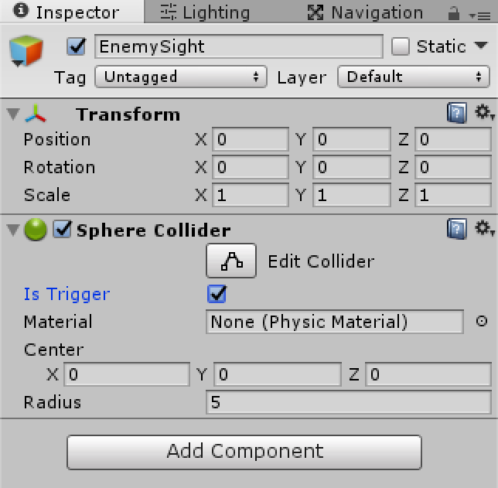
The sight of enemy
Create an empty game object named EnemySight
Add a sphere collider to it, adjust the radius, and set it as Trigger

Slide 28
Set the sight game object as the child of the enemy
Give it a script named EnemySight
The script can judge whether the player is inside the sight of the enemy or not
In Enemy script, it will be used as the option if the enemy chase the player or patrol
Notes:
// This is a collider trigger as the child of the enemy
public class EnemySight : MonoBehaviour
{
public float fieldOfViewAngle = 110f; // Number of degrees, centred on forward, for the enemy see.
public bool playerInSight; // Whether or not the player is currently sighted.
public Vector3 personalLastSighting; // Last place this enemy spotted the player.
public static Vector3 resetPos = Vector3.back;
private GameObject player; // Reference to the player.
void Awake()
{
player = GameObject.FindGameObjectWithTag("Player"/*Tags.player*/);
// Set the personal sighting and the previous sighting to the reset position.
personalLastSighting = resetPos;
}
void OnTriggerStay(Collider other)
{
// If the player has entered the trigger sphere...
if (other.gameObject == player)
{
// By default the player is not in sight.
playerInSight = false;
// Create a vector from the enemy to the player and store the angle between it and forward.
Vector3 direction = other.transform.position - transform.position;
float angle = Vector3.Angle(direction, transform.forward);
// If the angle between forward and where the player is, is less than half the angle of view...
if (angle < fieldOfViewAngle * 0.5f)
{
RaycastHit hit;
// ... and if a raycast towards the player hits something...
if (Physics.Raycast(transform.position + transform.up, direction.normalized, out hit, col.radius))
{
// ... and if the raycast hits the player...
if (hit.collider.gameObject == player)
{
// ... the player is in sight.
playerInSight = true;
// Set the last global sighting is the players current position.
//lastPlayerSighting.position = player.transform.position;
personalLastSighting = player.transform.position;
}
}
}
}
}
void OnTriggerExit(Collider other)
{
// If the player leaves the trigger zone...
if (other.gameObject == player)
// ... the player is not in sight.
playerInSight = false;
}
}

Slide 29
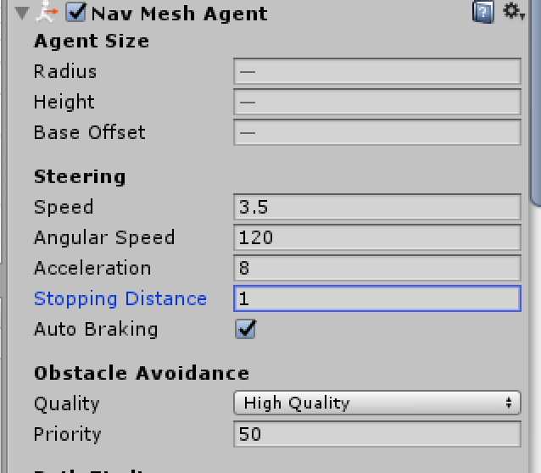
Patrol
In enemy behavior script, EnemyPatrol, use enemysight to control the enemy patrol status
Set stopping distance in NavMeshAgent component inspection to a acceptable value
Notes:
using System.Collections;
using System.Collections.Generic;
using UnityEngine;
public class EnemyPatrol : MonoBehaviour
{
public float patrolSpeed = 2f; // The nav mesh agent's speed when patrolling.
public float chaseSpeed = 5f; // The nav mesh agent's speed when chasing.
public float chaseWaitTime = 5f; // The amount of time to wait when the last sighting is reached.
public float patrolWaitTime = 1f; // The amount of time to wait when the patrol way point is reached.
public Transform patrolWayPoints; // An array of transforms for the patrol route.
public float shootRotSpeed = 5f; // Turning speed when aiming at something
public GameObject disappearEffect = null;
public float effectDurationTime = 1f;
private EnemySight enemySight; // Reference to the EnemySight script.
private UnityEngine.AI.NavMeshAgent nav; // Reference to the nav mesh agent.
private float chaseTimer; // A timer for the chaseWaitTime.
private float patrolTimer; // A timer for the patrolWaitTime.
private int wayPointIndex = 0; // A counter for the way point array.
private bool chase = false; //
void Awake()
{
// Get the enemy sight among the children
enemySight = transform.Find("EnemySight").GetComponent<EnemySight>();
Debug.Assert(enemySight);
nav = GetComponent<UnityEngine.AI.NavMeshAgent>();
}
void Update()
{
// If the player is in sight and is alive...
if (enemySight.playerInSight)
// ... shoot.
{
Shooting();
chase = true;
}
// If the player has been sighted and isn't dead...
else if (chase)
// ... chase.
Chasing();
// Otherwise...
else
// ... patrol.
{
Patrolling();
//Debug.Log("Patrol!");
}
}
void Shooting()
{
// Implement shooting function
}
void Chasing()
{
//Debug.Log("Chasing");
nav.Resume();
// Create a vector from the enemy to the last sighting of the player.
Vector3 sightingDeltaPos = enemySight.personalLastSighting - transform.position;
// If the the last personal sighting of the player is not close...
if (sightingDeltaPos.sqrMagnitude > 4f)
// ... set the destination for the NavMeshAgent to the last personal sighting of the player.
nav.destination = enemySight.personalLastSighting;
// Set the appropriate speed for the NavMeshAgent.
nav.speed = chaseSpeed;
// If near the last personal sighting...
if (nav.remainingDistance < nav.stoppingDistance)
{
// ... increment the timer.
chaseTimer += Time.deltaTime;
// If the timer exceeds the wait time...
if (chaseTimer >= chaseWaitTime)
{
// ... reset last global sighting, the last personal sighting and the timer.
//lastPlayerSighting.position = lastPlayerSighting.resetPosition;
chase = false;
chaseTimer = 0f;
}
}
else
// If not near the last sighting personal sighting of the player, reset the timer.
chaseTimer = 0f;
}
void Patrolling()
{
nav.Resume();
// Set an appropriate speed for the NavMeshAgent.
nav.speed = patrolSpeed;
// If near the next waypoint or there is no destination...
if (nav.remainingDistance < nav.stoppingDistance)
{
// ... increment the timer.
patrolTimer += Time.deltaTime;
// If the timer exceeds the wait time...
if (patrolTimer >= patrolWaitTime)
{
// ... increment the wayPointIndex.
if (wayPointIndex == patrolWayPoints.childCount - 1)
wayPointIndex = 0;
else
wayPointIndex++;
// Reset the timer.
patrolTimer = 0;
}
}
else
// If not near a destination, reset the timer.
patrolTimer = 0;
// Set the destination to the patrolWayPoint.
nav.destination = patrolWayPoints.GetChild(wayPointIndex).position;
}
}

Slide 30
The statuses of the enemy can be switched between patrol, chase, and other behaviors
Use sight, distance to the player, and other parameters to determine the status

Slide 31
Weapon and other advanced game functions
Tutorial_4_Upgrade

Slide 32
Weapon compositions
Gun + bullet
Gun: shoot frequency, ammo, fire direction
Bullet: damage, speed, damage type
Player to control it
Player script to handle weapon change, fire, and pick up items

Slide 33
Weapon
lastShootTime and freezeTime to implement weapon freeze time
public void Fire(Vector3 target)
{
if (lastShootTime < freezeTime)
return;
Vector3 dir = target - bulletPos.position;
Vector3 xyProject = Vector3.ProjectOnPlane(dir, Vector3.up);
if (num <= 0)
return;
Vector3 bulletStartPos = bulletPos.position;
bulletStartPos.y = 1;
GameObject g = (GameObject)GameObject.Instantiate(bullet, bulletStartPos, Quaternion.FromToRotation(Vector3.forward, xyProject.normalized));
num--;
lastShootTime = 0f;
}
Notes:
public GameObject bullet = null;
public Transform bulletPos = null;
public float freezeTime = 1f;
private float lastShootTime = 0f;
public int num = 10;
// Use this for initialization
void Start()
{
lastShootTime = freezeTime;
StopFire();
}
// Update is called once per frame
void Update()
{
if (lastShootTime < freezeTime)
{
lastShootTime += Time.deltaTime;
}
}
public void Fire(Vector3 target)
{
if (lastShootTime < freezeTime)
return;
Vector3 dir = target - bulletPos.position;
Vector3 xyProject = Vector3.ProjectOnPlane(dir, Vector3.up);
if (num <= 0)
return;
Vector3 bulletStartPos = bulletPos.position;
bulletStartPos.y = 1;
GameObject g = (GameObject)GameObject.Instantiate(bullet, bulletStartPos, Quaternion.FromToRotation(Vector3.forward, xyProject.normalized));
num--;
lastShootTime = 0f;
}

Slide 34
Calculate fire direction
Calculate fire direction based on mouse pos
if (Input.GetButton("Fire1"))
{
Ray ray = Camera.main.ScreenPointToRay(Input.mousePosition);
float enter = 0.0f;
Plane firePlane = new Plane(Vector3.up, weaponPos.position);
if (firePlane.Raycast(ray, out enter))
{
desPos = ray.GetPoint(enter);
}
Fire(desPos);
}

Slide 35
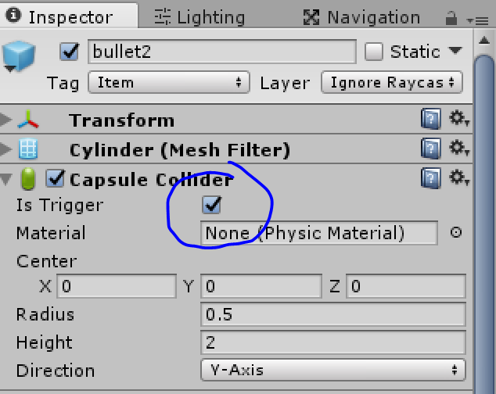
Bullet
In Update to let bullet move in a particular speed
Set bullet game object collider as trigger type
When collider with others, then check if cause damage

Slide 36
Bullet
public void Update()
{
if (bMove)
rb.MovePosition(transform.position + transform.forward * speed * Time.deltaTime);
}
public void OnTriggerEnter(Collider other)
{
switch (other.tag)
{
case Tags.obstacle:
bMove = false;
break;
case Tags.enemy:
break;
default:
return;
}
BeginDamage(other);
}
Notes:
public void Update()
{
if (bMove)
rb.MovePosition(transform.position + transform.forward * speed * Time.deltaTime);
}
public void OnTriggerEnter(Collider other)
{
switch (other.tag)
{
case Tags.obstacle:
bMove = false;
break;
case Tags.enemy:
break;
default:
return;
}
BeginDamage(other);
}
private void BeginDamage(Collider other)
{
GetComponent<Renderer>().enabled = false;
EnemyTutorial otherActor = other.GetComponent<EnemyTutorial>();
if (otherActor)
otherActor.Damage(damage);
GameObject.Destroy(gameObject);
}

Slide 37
Grab a gun
Characters can equip a particular weapon
void Start()
{
if (!weaponPos)
weaponPos = gameObject.transform;
for (int i = 0; i < weapons.Length; i++)
{
weapons[i] = (GameObject)Instantiate(weapons[i], weaponPos.position, Quaternion.identity);
if (gameObject.tag == Tags.enemy)
weapons[i].SendMessage("SetAsEnemy", true);
weapons[i].transform.SetParent(weaponPos);
//weapons[i].SendMessage("SetUsable", i == currWeapon);
weapons[i].gameObject.SetActive(i == currWeapon);
}
}
Notes:
public Transform weaponPos = null;
public GameObject[] weapons;
public int currWeapon = 0;
protected Vector3 desPos;
// Use this for initialization
void Start()
{
if (!weaponPos)
weaponPos = gameObject.transform;
for (int i = 0; i < weapons.Length; i++)
{
weapons[i] = (GameObject)Instantiate(weapons[i], weaponPos.position, Quaternion.identity);
if (gameObject.tag == Tags.enemy)
weapons[i].SendMessage("SetAsEnemy", true);
weapons[i].transform.SetParent(weaponPos);
//weapons[i].SendMessage("SetUsable", i == currWeapon);
weapons[i].gameObject.SetActive(i == currWeapon);
}
}
public void Fire(Vector3 target)
{
if (weapons.Length > 0)
{
weapons[currWeapon].SendMessage("Fire", target);
}
}
public void StopFire()
{
if (weapons.Length > 0)
{
weapons[currWeapon].SendMessage("StopFire");
}
}
// Update is called once per frame
void Update()
{
if (Input.GetButton("Fire1"))
{
Ray ray = Camera.main.ScreenPointToRay(Input.mousePosition);
float enter = 0.0f;
Plane firePlane = new Plane(Vector3.up, weaponPos.position);
if (firePlane.Raycast(ray, out enter))
{
desPos = ray.GetPoint(enter);
}
Fire(desPos);
}
if (Input.GetButtonUp("Fire1"))
{
StopFire();
}
// change weapon
float f = Input.GetAxis("Mouse ScrollWheel");
if (f > 0)
NextWeapon(1);
else if (f < 0)
NextWeapon(-1);
}
protected void Die()
{
gameObject.SetActive(false);
Application.Quit();
}
bool NextWeapon(int next)
{
weapons[currWeapon].gameObject.SetActive(false);
currWeapon = Mathf.Abs(currWeapon + next + weapons.Length) % weapons.Length;
weapons[currWeapon].gameObject.SetActive(true);
StopFire(); // stop fire when changing to a new weapon
return true;
}
bool ChangeWeapon(int idx)
{
weapons[currWeapon].gameObject.SetActive(false);
weapons[idx].gameObject.SetActive(true);
currWeapon = idx;
//Debug.Log("Changed Weapon");
return true;
}

Slide 38
Cause damage to characters
The bullet from the player will cause damage to enemies, and vice verse
Different type of bullet will cause different type of damage
Common bullet will cause instant damage
Explosion bullet will damage all characters inside the efficient region
Consistent bullet will cause damage for a while
Puncture bullet wouldn’t stop when hit a character
Notes:
public override void OnTriggerEnter(Collider other)
{
if (pickable)
{
base.OnTriggerEnter(other);
return;
}
switch (other.tag)
{
case Tags.obstacle:
bMove = false;
break;
case Tags.enemy:
if (isEnemy)
return;
break;
case Tags.player:
if (!isEnemy)
return;
break;
default:
//Explosion();
//bMove = false;
//GameObject.Destroy(gameObject);
return;
}
//Debug.Log("damage object:" + other.gameObject);
StartCoroutine("BeginDamage", other);
}
private IEnumerator BeginDamage(Collider other)
{
//Debug.Log("Called damage");
GetComponent<Renderer>().enabled = false;
//transform.SetParent(other.gameObject.transform);
Actor otherActor = other.GetComponent<Actor>();
Explosion(other);
switch (bulletType)
{
case WeaponType.Pistol:
if (!otherActor)
break;
otherActor.Damage(damage);
break;
case WeaponType.Gun:
//Debug.Log("Persistent");
bMove = false;
if (!otherActor)
break;
transform.SetParent(other.transform);
otherActor.Damage(damage);
float t = 0.0f;
while (t < effectDurationTime)
{
t += Time.deltaTime;
if (otherActor)
otherActor.Damage(damagePerSecond * Time.deltaTime);
else
break;
yield return null;
//Debug.Log("this time:" + t + "damage:" + damagePerSecond * Time.deltaTime);
}
break;
case WeaponType.Rocket:
bMove = false;
var cols = Physics.OverlapSphere(transform.position, damageRadius);
var damagedActors = new List<Actor>();
//Debug.Log("overlap" + cols.GetLength(0));
foreach (var col in cols)
{
Actor a = col.gameObject.GetComponent<Actor>();
if (a && !damagedActors.Contains(a))
{
float r = Vector3.Distance(a.transform.position, transform.position);
r = (damageRadius - r) / damageRadius;
r = r < 0f ? 0 : r;
if ((isEnemy && a.tag == Tags.player)
|| (!isEnemy && a.tag == Tags.enemy))
a.Damage(damage * r);
damagedActors.Add(a);
//Debug.Log("Damage" + a);
}
}
break;
case WeaponType.Laser:
if (!otherActor)
break;
if ((isEnemy && otherActor.tag == Tags.player)
|| (!isEnemy && otherActor.tag == Tags.enemy))
otherActor.Damage(damage);
break;
default:
break;
}
GameObject.Destroy(gameObject);
}

Slide 39
Change weapon
bool NextWeapon(int next)
{
weapons[currWeapon].gameObject.SetActive(false);
currWeapon = Mathf.Abs(currWeapon + next + weapons.Length) % weapons.Length;
weapons[currWeapon].gameObject.SetActive(true);
StopFire(); // stop fire when changing to a new weapon
return true;
}

Slide 40
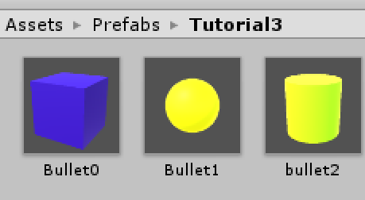
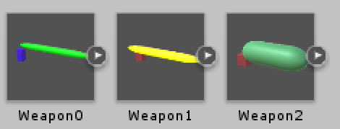
Use prefabs

Slide 41
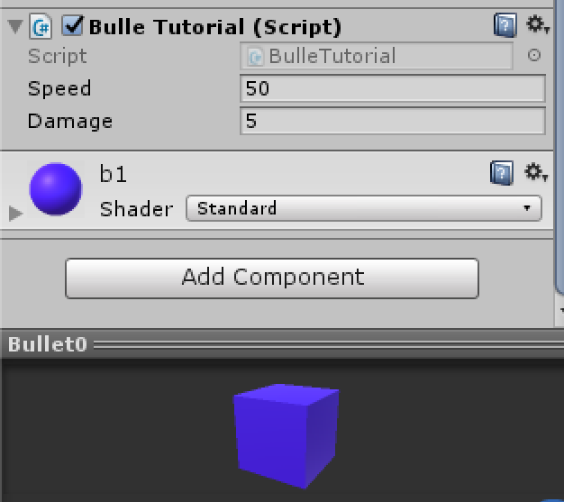
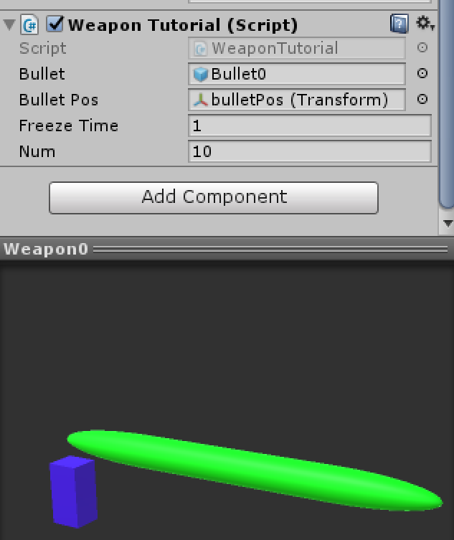
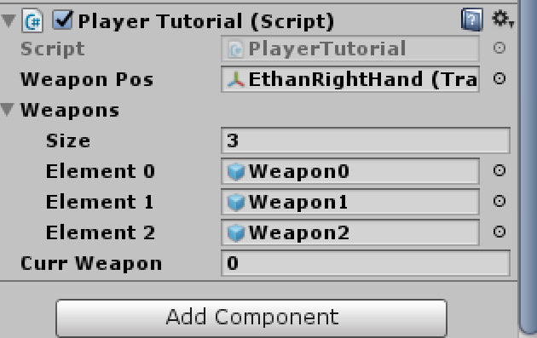

Slide 42
Weapon system logic
Instantiate all possible weapons for every character
But only one of them is currently useable
The others are disable
When the player pick up weapon, corresponding weapon in its weapon list will become usable
When fire, current weapon will try to instantiate a bullet, then bullet script will take over the following process
Enemy will fire at the player
Player will fire at the direction where the mouse point to

Slide 43
Set enemy behavior
Set the enemy tag as “Enemy”
Use enemy script to receive damage when shot
When the health of enemy below to 0, die
There is some probability to drop an item

Slide 44
protected override void Die()
{
SendMessage("DropItem");
lm.killEnemyNum++;
GameObject.Destroy(gameObject);
}

Slide 45
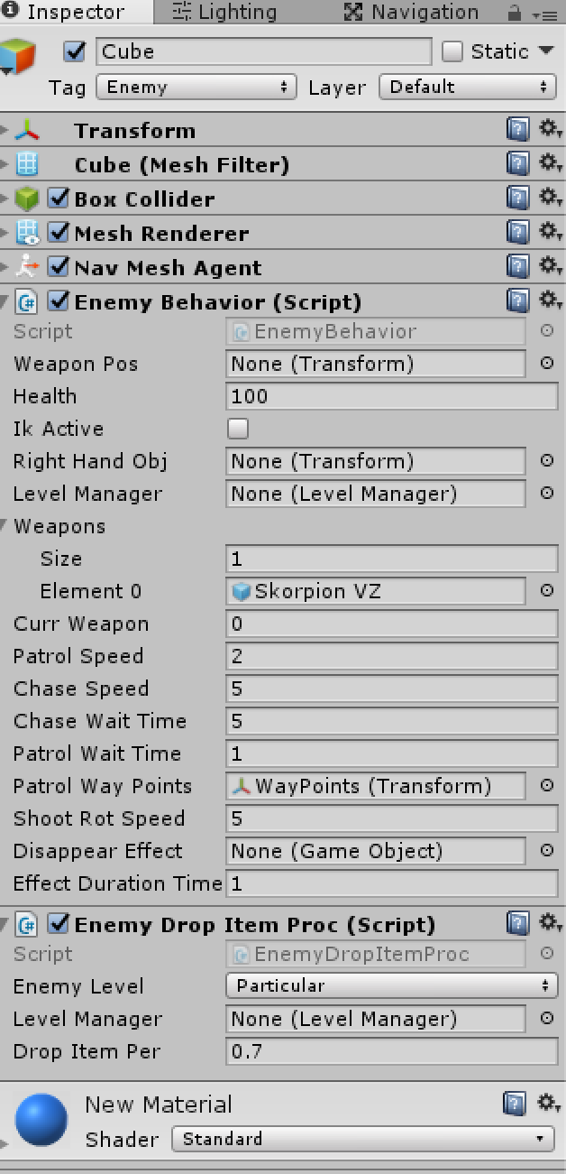

Slide 46
Make it complete

Slide 47
Optimize game framework
Use inherit of C# class to manage characters and items in the game scene
Enemy and Player are all inherited from Actor
Actor can have weapons, fire, be damaged, die
Bullet and Weapon are all inherited from Item
Item can be picked up or used, initialized randomly, used by enemy or the player

Slide 48
Use a game manager to handle global staff
Drop item system
Record some game information
Notify UI to display particular information
Set a text UI to display game information

Slide 49
Item generate system
When a item drop order is triggered
When an enemy dies
There is a particular probability to drop an item
It has a drop probability parameter
The Manager takes over the generate process
It use a strategy to decide which level item should be generated
Then use item collection in this level to finally generate a random item inside it

Slide 50
Item drop system
Write a script named EnemyDropItemProc that would be grabbed into an enemy or other item-droppable objects
There are some adjustable parameters in this class:
Enemy Level The enemies can be divided into several levels, there are 5 levels in the Shooter Example. It more likes that the enemy will drop the same level items when they killed by the player. Particular level means special.
Level Manager The pointer to the level manager in the scene. It will handle all item drop functions.
Drop Item Per The probability of the enemy to drop items when is killed.

Slide 51
EnemyDropItemProc
public ItemLevel enemyLevel = ItemLevel.Level1;
public LevelManager levelManager = null;
public float dropItemPer = 0.1f;
// Use this for initialization
void Start () {
if (!levelManager)
{
levelManager = GameObject.FindGameObjectWithTag(Tags.gameController).GetComponent<LevelManager>();
}
}
public Item DropItem()
{
if (Random.Range(0f, 1f) < dropItemPer)
{
Debug.Log("Drop an item");
return levelManager.GenerateRandomItem(transform);
}
return null;
}

Slide 52
Function DropItem will be called when the enemy is killed by the player
It would be called in Die function of Enemy script like this:
protected override void Die()
{
SendMessage("DropItem");
lm.killEnemyNum++;
GameObject.Destroy(gameObject);
}

Slide 53
In script LevelManager, the function GenerateRandomItem , that will handle all random generate items process
It can generate random items based on the enemy item percentage and level
Notes:
public Item GenerateRandomItem(Transform dropper) { float r = Random.value; int itemLevel = (int)currentLevel; int enemyLevel = (int)dropper.gameObject.GetComponent<EnemyDropItemProc>().enemyLevel; if (r < 0.8) // There is 80% to generate the same level item { itemLevel = enemyLevel; } else if (r < 0.9) // 10% to generate 1 higher level item { itemLevel += 1; } else if (r < 0.95) // 5% to generate 2 higher level item { itemLevel += 2; } else if (r < 0.96) // 1% to generate particular, menas special, level item { itemLevel = (int)ItemLevel.Particular; } else return null; // if the enemy itself is special level, it has more opportunity to drop special item if (enemyLevel == (int)ItemLevel.Particular) { if (Random.value < 0.33) { itemLevel = (int)ItemLevel.Particular; } } itemLevel = (itemLevel < allLevelItems.Length) ? itemLevel : (allLevelItems.Length - 1); // call `GenerateRandomLevelItem` to finally drop a random item in this level Item droppedItem = allLevelItems[itemLevel].GenerateRandomLevelItem(); Debug.Assert(droppedItem!=null); droppedItem = (Item)GameObject.Instantiate(droppedItem, dropper.position, Quaternion.identity); droppedItem.SetupRandomPickableItem(); return droppedItem; }

Slide 54
All droppable items would be managed in a script named ItemsCollection, it can return a random, use function GenerateRandomLevelItem, item from a particular item level list

Slide 55
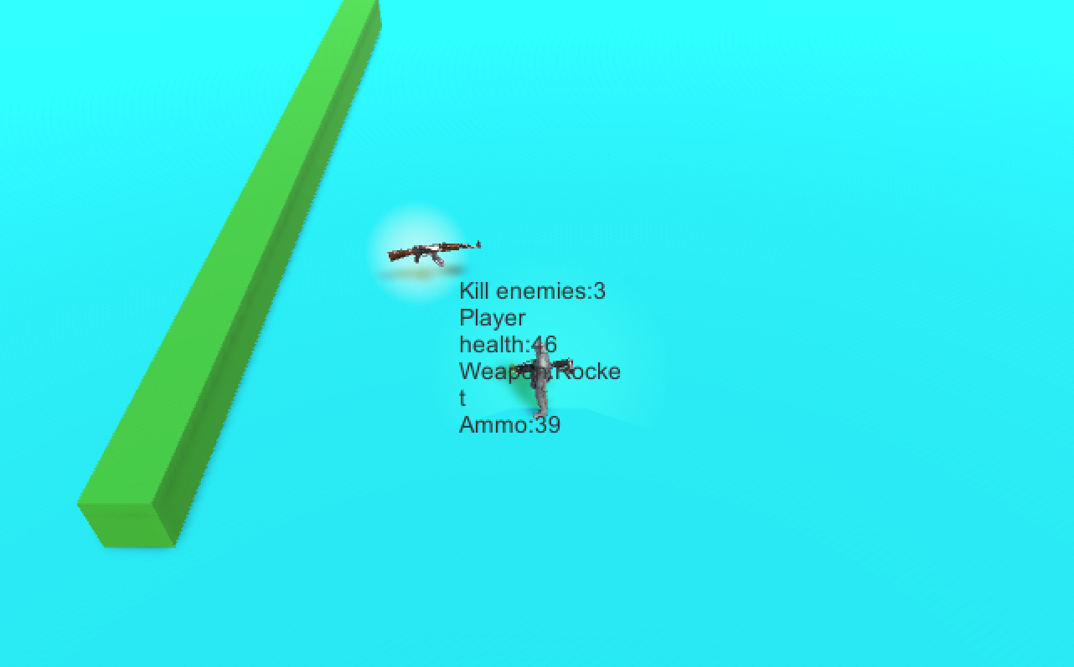

Slide 56
The end
Thanks

