Slide 1


Introduction to AI in Finance: Early-Warning Machine Learning for Corporate Financial Distress Prediction
Presented by: Marcus Möller
Master of Science Business Administration, 3. Semester

Slide 2
How we will proceed today
Motivation & Literature
Economic motivation, Research question
01.
Data & Methodology
Compustat annual panel, Workflow Overview, distress proxies, feature setup
02.
Empirical Results
Model performance (Logit vs XGBoost), ranking quality under class imbalance
03.
Discussion
Why ML wins here (nonlinearities/interactions), No Legal Bankruptcy, and key limitations
04.
Conclusion
Takeaways for early-warning selection, implications and future research
05.

Slide 3
Definition of Financial Distress
[Financial distress is] a situation in which the activity of a business is influenced by the possibility of impending insolvency¹
1) Law, 2008, p. 166
Notes:
Possibility of impending insolvency, not default or bankruptcy per se
→ Earlier thus quite interesting for decision makers

Slide 4






Economic motivation: why early warning matters
Real economic costs
Direct costs are only the start
Direct costs (Lawless and Ferris, 1997; Thorburn, 2000; Raviv and Sundgren, 1998) and Indirect costs (Titman, 1984; Opler and Titman, 1994; Pulvino, 1998)
Limited attention
Early warning is prioritization
The goal is not a perfectly timed “alarm”, but to focus monitoring: which firms deserve a closer look and where risk builds up in the background.
Risk management
Prevent avoidable losses
Timely signals enable liquidity planning, covenant talks, and restructuring before value erosion accelerates.
Changing firm fundamentals
Traditional metrics weaken
Rising leverage, shifting capital structures, and intangible-intensive business models can reduce the informativeness of classic balance-sheet ratios.
Capacity-constrained screening
Most events sit in the tail
Under a fixed review budget, screening the top 20% risk bucket captures 87.9% of transition events, motivating high-recall operating points.
Policy readiness
Avoid false positives
Strong discrimination is not enough: if outputs trigger actions, you need explicit calibration to avoid overconfident probabilities.

Slide 5

Cross Over of our Framework and the Literature
Accounting driven distress proxy
Pioneered by Altman (1968), Beaver (1966) and Ohlson, 1980.
Machine Learning
XGBoost
by (Chen & Guestrin, 2016)
Boosting ensembles outperform SVMs and are on par with the neural networks
(Lessmann et al. 2015, p. 131)
To what extent can accounting information available at fiscal year t predict which firms will transition from healthy_{t} to distressed_{t+1}

Slide 6




Workflow Overview: from raw data to actionable early warning (1/2)
Data Cleaning
Clean the panel without using any future information.
Deduplicate, winsorize, impute and standardize
Fit on train only
Model Selection
Model Selection
Ridge Regularized Logistic Regression (Baseline, and extensions)
XGBoost gbtree (considering imbalance)
01
03
02
04
Role of Data
Data Availability
Data Quality
Data Readiness
Structured historical data
Exploratory Data Analysis & Feature Engineering
Summary Statistics
Visual Checks
Generation of Proxies and Predictors
Analysis by Year and Size
…

Slide 7
Feature Map: Accounting signals used for early-warning prediction
Asset Structure
06
01
Size & scale
Flexibility, tangibility, and liquidation value. Examples: PPE/Assets, intangibles/Assets
Beaver et al. (2012), Franzen et al. (2007)
Larger firms tend to have more capital options. Examples: Assets
Ohlson (1980), Campbell et al. (2008)
05
02
Cash Flow Quality
Feature set (Accounting signals)
at time t and t-1
Liquidity & Working Capital
Cash generation Examples: Free Cash Flow /Debt, Operating Cash Flow /Debt
Beaver (1966), Beaver et al. (2005)
Short-term solvency and liquidity cushions. Examples: Cash / Assets, Net Working Capital / assets
Beaver (1966), Altman (1968)
04
03
Profitability
Leverage & Solvency
Ability to generate profits Examples: ROA, retained earnings/assets
Ohlson (1980), Campbell et al. (2008)
Debt burden and balance-sheet fragility. Examples: Total Liabilities/Assets,
Ohlson (1980), Altman (1968)

Slide 8
Proxies for Financial Distress
Transition from Healthy_{t} to Distressed_{t+1}
4%
10%
3%
Negative Common Shareholder Equity
Negative OCF and adj. Net Income
S&P Highly Leveraged Definition
Simple balance-sheet proxy for accounting insolvency
Included in classic distress models as a core signal (Ohlson, 1980, pp. 118-120; Altman, 1968)
Insufficient internal cashflow to meet fixed obligations is the primary cause of financial distress (Denis and Denis, 1995)
Deteriorating Profitability signals weak business model (Beaver, 1966, pp. 85-86)
Composite threshold screen based on funds from operations to debt (12%), debt to capital (60%), and debt to EBITDA (5x)
Following Standard & Poor’s (2009) Financial Risk Assessment

Slide 9


Workflow Overview: from raw data to actionable early warning (2/2)
Model Evaluation
Performance based on ROC AUC, PR AUC
Brier Score and Capacity Costs
Bootstrap Statistical Significance
05
06
07
Model Training
Chronological holdout 2023 and 2024
Walk Forward Cross Validation until 2021
Year 2022 for Calibration
Robustness analyses
Practical Actions
Liquidity & Payout Events and Risk Jumps
Expected Costs and Ranking

Slide 10
Hyperparameters C parameter and 100 Bayesian Optimization Trials based on weighted Brier Scores across folds
Parameter Space
Negative Equity
Negative Profits
Highly Leveraged
01.
02.
03.
C for Logistic Regression:
(0.001, 0.005, 0.0075, 0.015)
C Logistic Regression: 0.005
C Logistic Regression: 0.001
C Logistic Regression: 0.0015
Maximum Depth 2 to 5
Minimum Child Weight 10 to 100
Gamma 0.5 to 10
Moderate tree complexity (depth 4) with limited split friction (gamma ~0.9)
Deeper (5) but very conservative splits (MCW 72, γ≈2.4)
Moderate depth (4) with extremely selective splits (γ≈9.4)
Lambda 1 to 50
Alpha 0 to 2
Moderate shrinkage (λ≈2.8, α≈1.9)
Very strong L2 shrinkage dominates (λ≈19.9, α≈0.5)
L1-heavy, low L2 (α≈1.8, λ≈1.2)
Subsample 0.5 to 0.9
Feature Subsampling 0.3 to 0.8
Mid-level subsampling (0.76) and feature sampling (0.63).
Aggressive row sampling (0.50) with low feature sampling (0.37)
Moderate subsampling (0.77) and feature sampling (0.62)
Learning Rate 0.01 to 0.05
Maximum Delta Step 1 to 5
Faster learning (η≈0.043) with stabilizing max delta step (5)
Fast η≈0.046 but tighter update cap (max delta 2)
Slower learning (η≈0.032) with moderate update cap (3)
Tree complexity & Split Constrains
L1, L2 Regularization
Variance Reduction
Boosting Dynamics

Slide 11
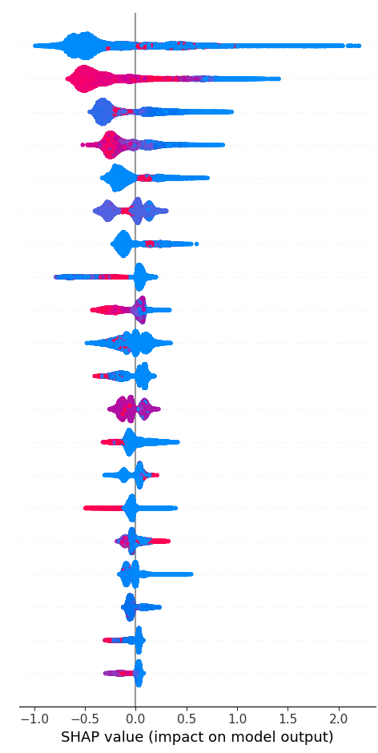
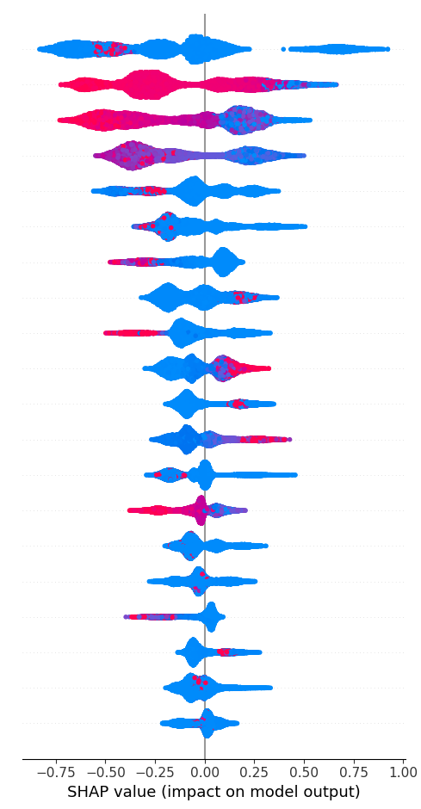
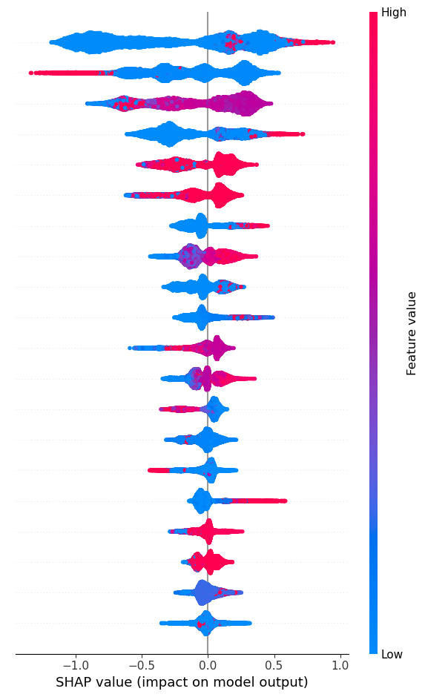
Model Evaluation: Figures
Distress Proxy
Negative Book Equity
Distress Proxy
Negative FCF and Net Income
Distress Proxy
S&P highly Leveraged
Total Liabilities / Assets
EBITDA / Assets
Total Liabilities / Assets
EBIT / Capital
Retained Earnings / Assets
Common Equity / Assets
EBITDA / Assets
Log of Assets
EBIT / Capital
Log of Assets
Total Liabilities / Assets
Interest Expense / Assets
Interest Expense / Assets
EBIT / Capital
Net Income / Assets
Interest Expense / EBITDA
Receivables / Current Assets
Retained Earnings / Assets
Short-Term Debt / Assets
Interest Expense / EBITDA
Total Liabilities / Assets (t-1)
Receivables / Current Assets
Repurchases / Assets
Log of Assets
Log of Assets (t-1)
Net Working Capital / Assets
Interest Expense / Assets (t-1)
Current Ratio
Total Debt / EBITDA
Inventories / Current Assets
Current Ratio (t-1)
Short-Term Debt / Total Debt
EBIT / Capital (t-1)
Free Cashflow / Total Debt
Interest Expense / Assets
Log of Assets
Cash /Assets
Net Working Capital / Asset (t-1)
Intangibles /Assets (t-1)
Total Liabilities / Assets (t-1)
EBITDA/ Assets (t-1)
Common Equity / Assets (t-1)
Net Working Capital / Assets
Log of Assets (t-1)
Cash / Assets
Short-Term Debt / Total Debt
Total Liabilities / Assets
Intangibles /Assets
Total Debt / EBITDA
Repurchases / Assets (t-1)
Net Income / Assets (t-1)
Operating Cashflow / Total Debt
Interest Expense / Assets (t-1)
Retained Earnings / Assets (t-1)
Total Debt / EBITDA (t-1)
Common Equity / Assets
Net Working Capital / Asset
Inventories / Current Assets
Cash / Assets (t-1)
Receivables / Current Assets

Slide 12
Capacity Threshold
Predicted Probability of Distress
Expected Cost
per observation 0.18
(1 for FP 3 for FN)
Capacity
20% of
Firms
0%
> 3.47%
100%
Firms to check

Slide 13
Model evaluation through empirical results: our three takeaways
Model performance
XGBoost vs. logistic
Out-of-time, the calibrated gradient-boosted tree clearly dominates the logistic benchmark across discrimination and probability accuracy
ROC-AUC: 0.728 → 0.923; PR-AUC: 0.124 → 0.302
Brier score improves: 0.0349 → 0.0307
(Uncertainty via firm-cluster bootstrap (resample firms, keep time series, p-values <0.01)
Nonlinear models win
(even against persistence +0.12 ROC-AUC, +0.16 PR-AUC)
Operational screening
Capacity-constrained triage
Under a realistic review budget, the model’s ranking is economically useful: most transition events sit in a manageable risk tail.
Top 20% risk bucket captures 87.9% of transition events
Cost-sensitive training reflects asymmetric losses (missing events > extra reviews)
High PR-AUC at fixed capacity
Calibration matters
Ranking vs. “true PDs”
Strong ranking does not automatically mean reliable probabilities. Even after prior correction + isotonic calibration, tail miscalibration and coarse risk tiers remain
Use the output primarily as risk tiers / triage, not as “precise PDs”
Keep calibration strictly out-of-sample and monitor drift in deployment
Rank-and-triage beats false precision

Slide 14
Discussion
The performance gap is most plausibly driven by nonlinear, state-contingent interactions:
Leverage and liquidity become sharply informative only when profitability and debt service capacity are jointly constrained
Key Limitations
Annual panel conditions on firm continuation
Transition needs adjacent
data and continuity
Managerial Implications:
Liquidity stress flags, specifically current ratio (< 1.0), quick ratio (< 0.8) breaches, positive relationship to near-term distress, accompanying approximately 58% of all large probability of distress risk-tier jumps.
Payout-policy events like dividend cuts show evidence for decreasing probability of distress.
01.
No Legal Default/Bankruptcy
No Default data or Chapter 11
Insolvency filings
Interpretation is constrained by the label:
Tail miscalibration and coarse risk-tier patterns can persist even after calibration (No real PDs)
Negative equity can mix genuinely constrained firms with high-intangible / aggressive capital structure cases
Models can learn the accounting defined definition
02.
02.
Missingness Not at Random
As Missingness Flags
for LCT, ACT provide insights
Deployability is robust to capacity tightening:
Deployed as decision support, not as an automated decision maker (Early Warning Screening Tool)
Stricter capacity mainly trades recall vs precision while ranking quality stays stable
03.

Slide 15

Conclusion
ROC-AUC 0.728/0.923
PR-AUC
0.124 → 0.302
Screening the top 20% captures
87.9% of transition events (XGB)
0.0349 → 0.0307
Brier
********************
75,005
Total Observations
Ranking ≠ perfect probabilities:
Tail miscalibration persists
even after calibration
2014-24
Next steps:
CV and Test Period
Vary FN/FP cost ratios
Firms
Test stability across macro cycles
11,403
25
Features 3 Proxies
4%
Event Rate
No legal
Bankruptcy
Add higher-frequency / market signals
Capital structure, Profitability, and Debt-service pressure as the main drivers
Monitor calibration drift under retraining

Slide 16
Thank you for listening!
Plenary discussion Introduction to AI in Finance

Slide 17
Questions for the audience
1
Distress definition
Which proxy is “correct” for your use case (negative equity vs cashflow deterioration vs leverage rating), and how much precision are you willing to trade for stakeholder transparency?
2
Operating point
In practice, what screening capacity (5-20%?) and FN/FP cost ratio would you choose, and who should own the consequences of that decision and its costs?
3
Deployment & governance
Would you deploy the output as risk tiers + event triggers (monitoring tool)

Slide 18
Appendix

Slide 19




Appendix 1: Data Cleaning
Raw Compustat panel
Annual fundamentals (US public firms), unbalanced panel across firms and years
Deduplication & consistency checks
Remove duplicates (keep latest reporting date) and drop invalid / inconsistent firm-year records
Leakage-aware preprocessing pipeline
Leakage-safe feature construction
Chronological split (train → validation → test) to mimic a real-time setting
Fit all transforms on train only (winsor bounds, imputer, scaler)
Address class imbalance via instance weights / cost-sensitive learning
Output: clean feature matrix + 1-year-ahead transition labels (healthy t → distressed t+1)
Build lagged ratios (size, liquidity, leverage, profitability, asset structure) using only information available at t
Train-only preprocessing
Winsorize (1/99), KNN-impute missing values, and standardize using the training set only; then apply to val/test

Slide 20
Bibilography
Altman, Edward I. (1968): Financial Ratios, Discriminant Analysis and the Prediction of Corporate Bankruptcy, The Journal of Finance, Vol. 23, No. 4, pp. 589–609.
Beaver, William H. (1966): Financial Ratios as Predictors of Failure, Journal of Accounting Research, Vol. 4, pp. 71–111.
Beaver, William H.; Ryan, Stephen G. (2005): Conditional and Unconditional Conservatism: Concepts and Modeling, Review of Accounting Studies, Vol. 10, No. 2–3, pp. 269–309.
Beaver, William H.; Correia, Maria; McNichols, Maureen F. (2012): Do Differences in Financial Reporting Attributes Impair the Predictive Ability of Financial Ratios for Bankruptcy?, Review of Accounting Studies, Vol. 17, No. 4, pp. 969–1010.
Campbell, John Y./Hilscher, Jens/Szilagyi, Jan (2008): In Search of Distress Risk, The Journal of Finance, Vol. 63, No. 6, pp. 2899–2939.
Denis, David J./Denis, Diane K. (1995): Performance Changes Following Top Management Dismissals, The Journal of Finance, Vol. 50, No. 4, pp. 1029–1057.
Franzen, Margaret; Borgerhoff Mulder, Monique (2007): Ecological, Economic and Social Perspectives on Cocoa Production Worldwide, Biodiversity and Conservation, Vol. 16, No. 13, pp. 3835–3849.
Law, Jonathan (2008): A Dictionary of Finance and Banking, 6th ed., Oxford University Press, Oxford.
Lawless, Robert M./Ferris, Stephen P. (1997): Professional Fees and Other Direct Costs in Chapter 7 Business Liquidations, Washington University Law Quarterly:1207–1236.
Ohlson, James A. (1980): Financial Ratios and the Probabilistic Prediction of Bankruptcy, Journal of Accounting Research, Vol. 18, No. 1, pp. 109–131.
Opler, Tim C./Titman, Sheridan (1994): Financial Distress and Corporate Performance, The Journal of Finance, Vol. 49, No. 3, pp. 1015–1040.
Pulvino, Todd C. (1998): Do Asset Fire Sales Exist? An Empirical Investigation of Commercial Aircraft Transactions, The Journal of Finance, Vol. 53, No. 3, pp. 939–978.
Raviv, Alon/Sundgren, Stefan (1998): The Comparative Efficiency of Bankruptcy Reorganization, Journal of Banking & Finance, Vol. 22, No. 4, pp. 463–485.
Standard & Poor’s (2009): Corporate Ratings Criteria, Standard & Poor’s Financial Services, New York.
Thorburn, Karin S. (2000): Bankruptcy Auctions: Costs, Debt Recovery, and Firm Survival, Journal of Financial Economics, Vol. 58, No. 3, pp. 337–368.
Titman, Sheridan (1984): The Effect of Capital Structure on a Firm’s Liquidation Decision, Journal of Financial Economics, Vol. 13, No. 1, pp. 137–151.

