Slide 1


Software Design and analysis
Votix
An E-Voting System
Presented by:
Arrij Fawad 22i-0755
Hamna Arshad 22i-1098
Maryam Masood 22i-1169

Slide 2

FUNCTIONAL REQUIREMENTS
Page 04

Slide 3

USE CASES
Register Candidates
Manage Polling Staff Account
Initiate System
Authorize Polling Staff
View Polling Staff Assignments
Capture Voter Info
7. Cast Vote
8. Monitor Systems
9. Inspect Logs
10. Issue Election Report
11. Access Election Report
12. Display Election Results
Page 10

Slide 4
NON-FUNCTIONAL REQUIREMENTS
Page 04

Slide 5
USE CASE
DIAGRAM
Page 04

Slide 6
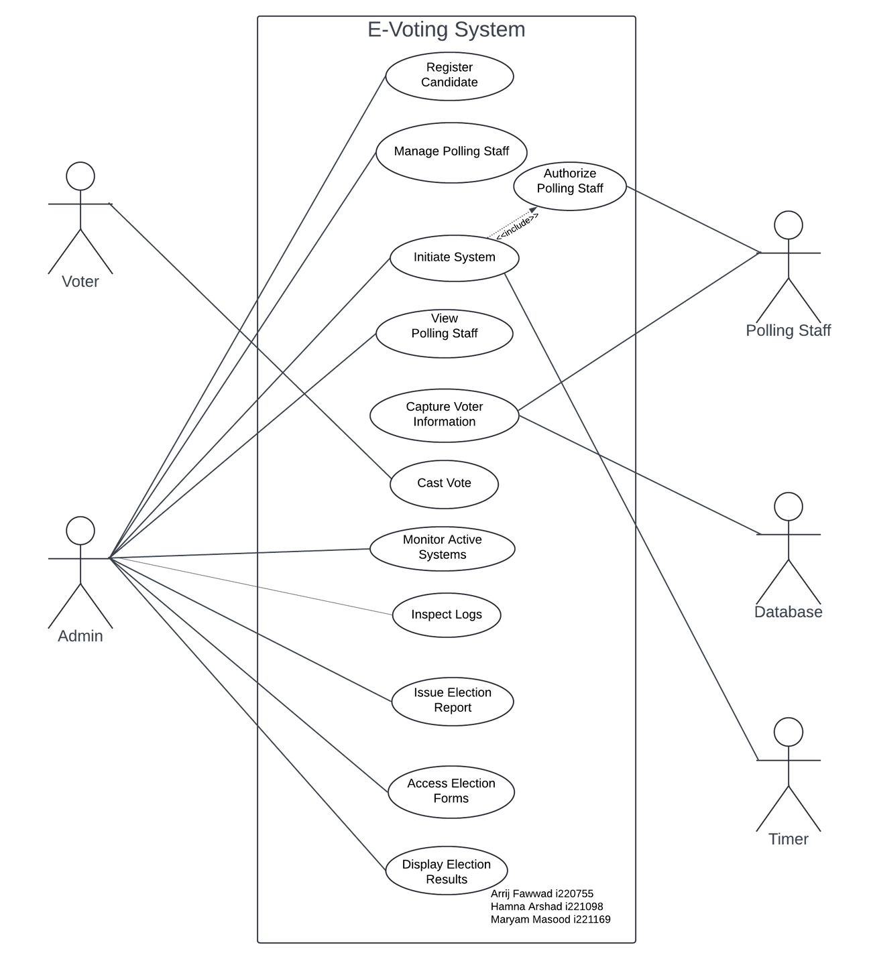
Page 10

Slide 7
CLASS DIAGRAM
Page 04

Slide 8
SEQUENCE DIAGRAMS
Page 04

Slide 9
COMPONENT DIAGRAM
Page 04

Slide 10
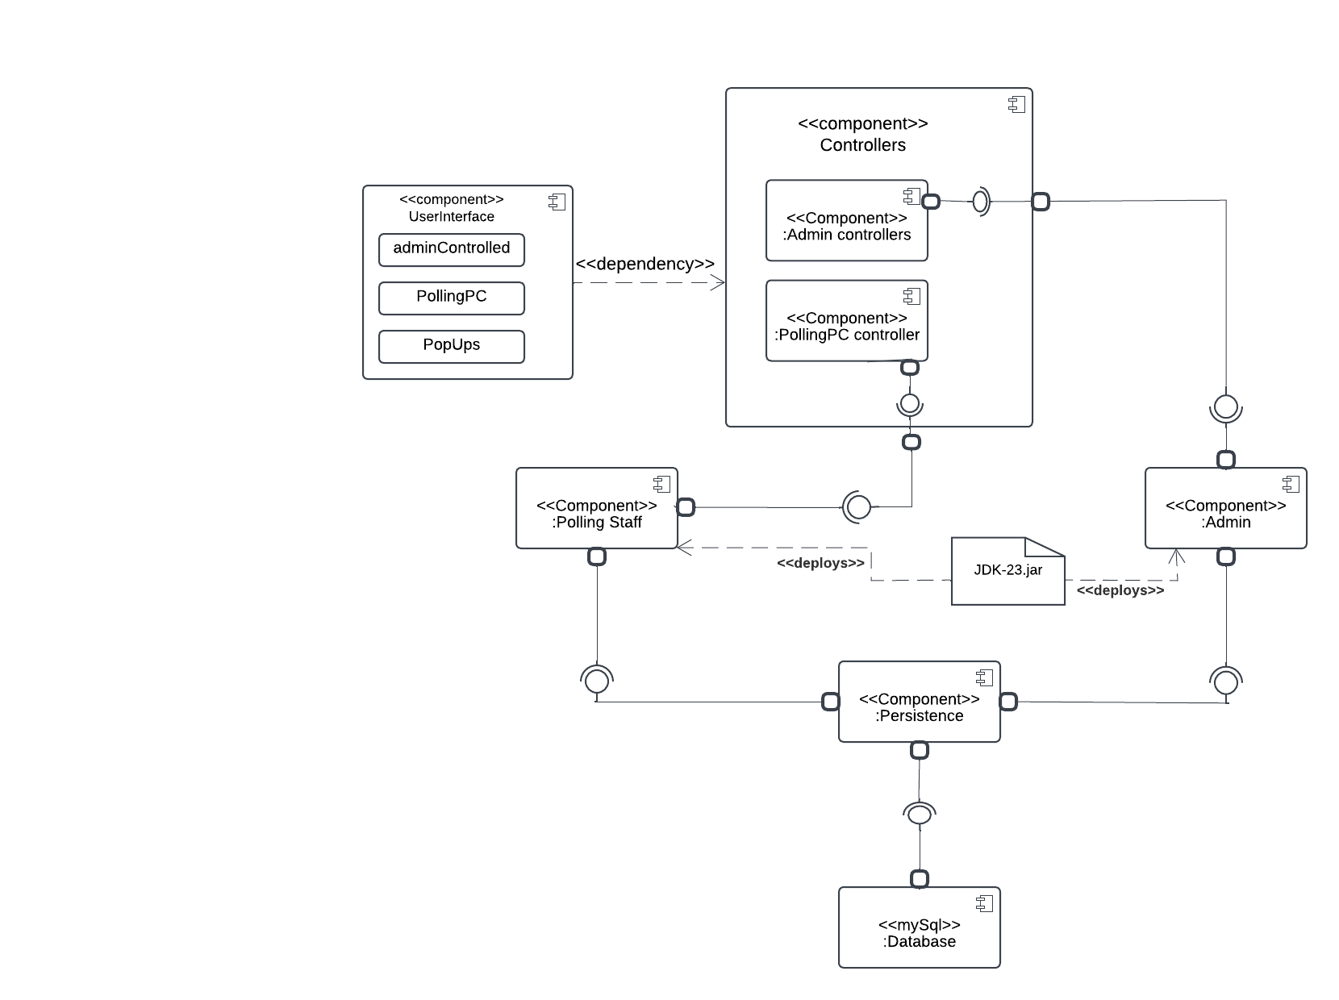
Page 10

Slide 11
PACKAGE DIAGRAM
Page 04

Slide 12
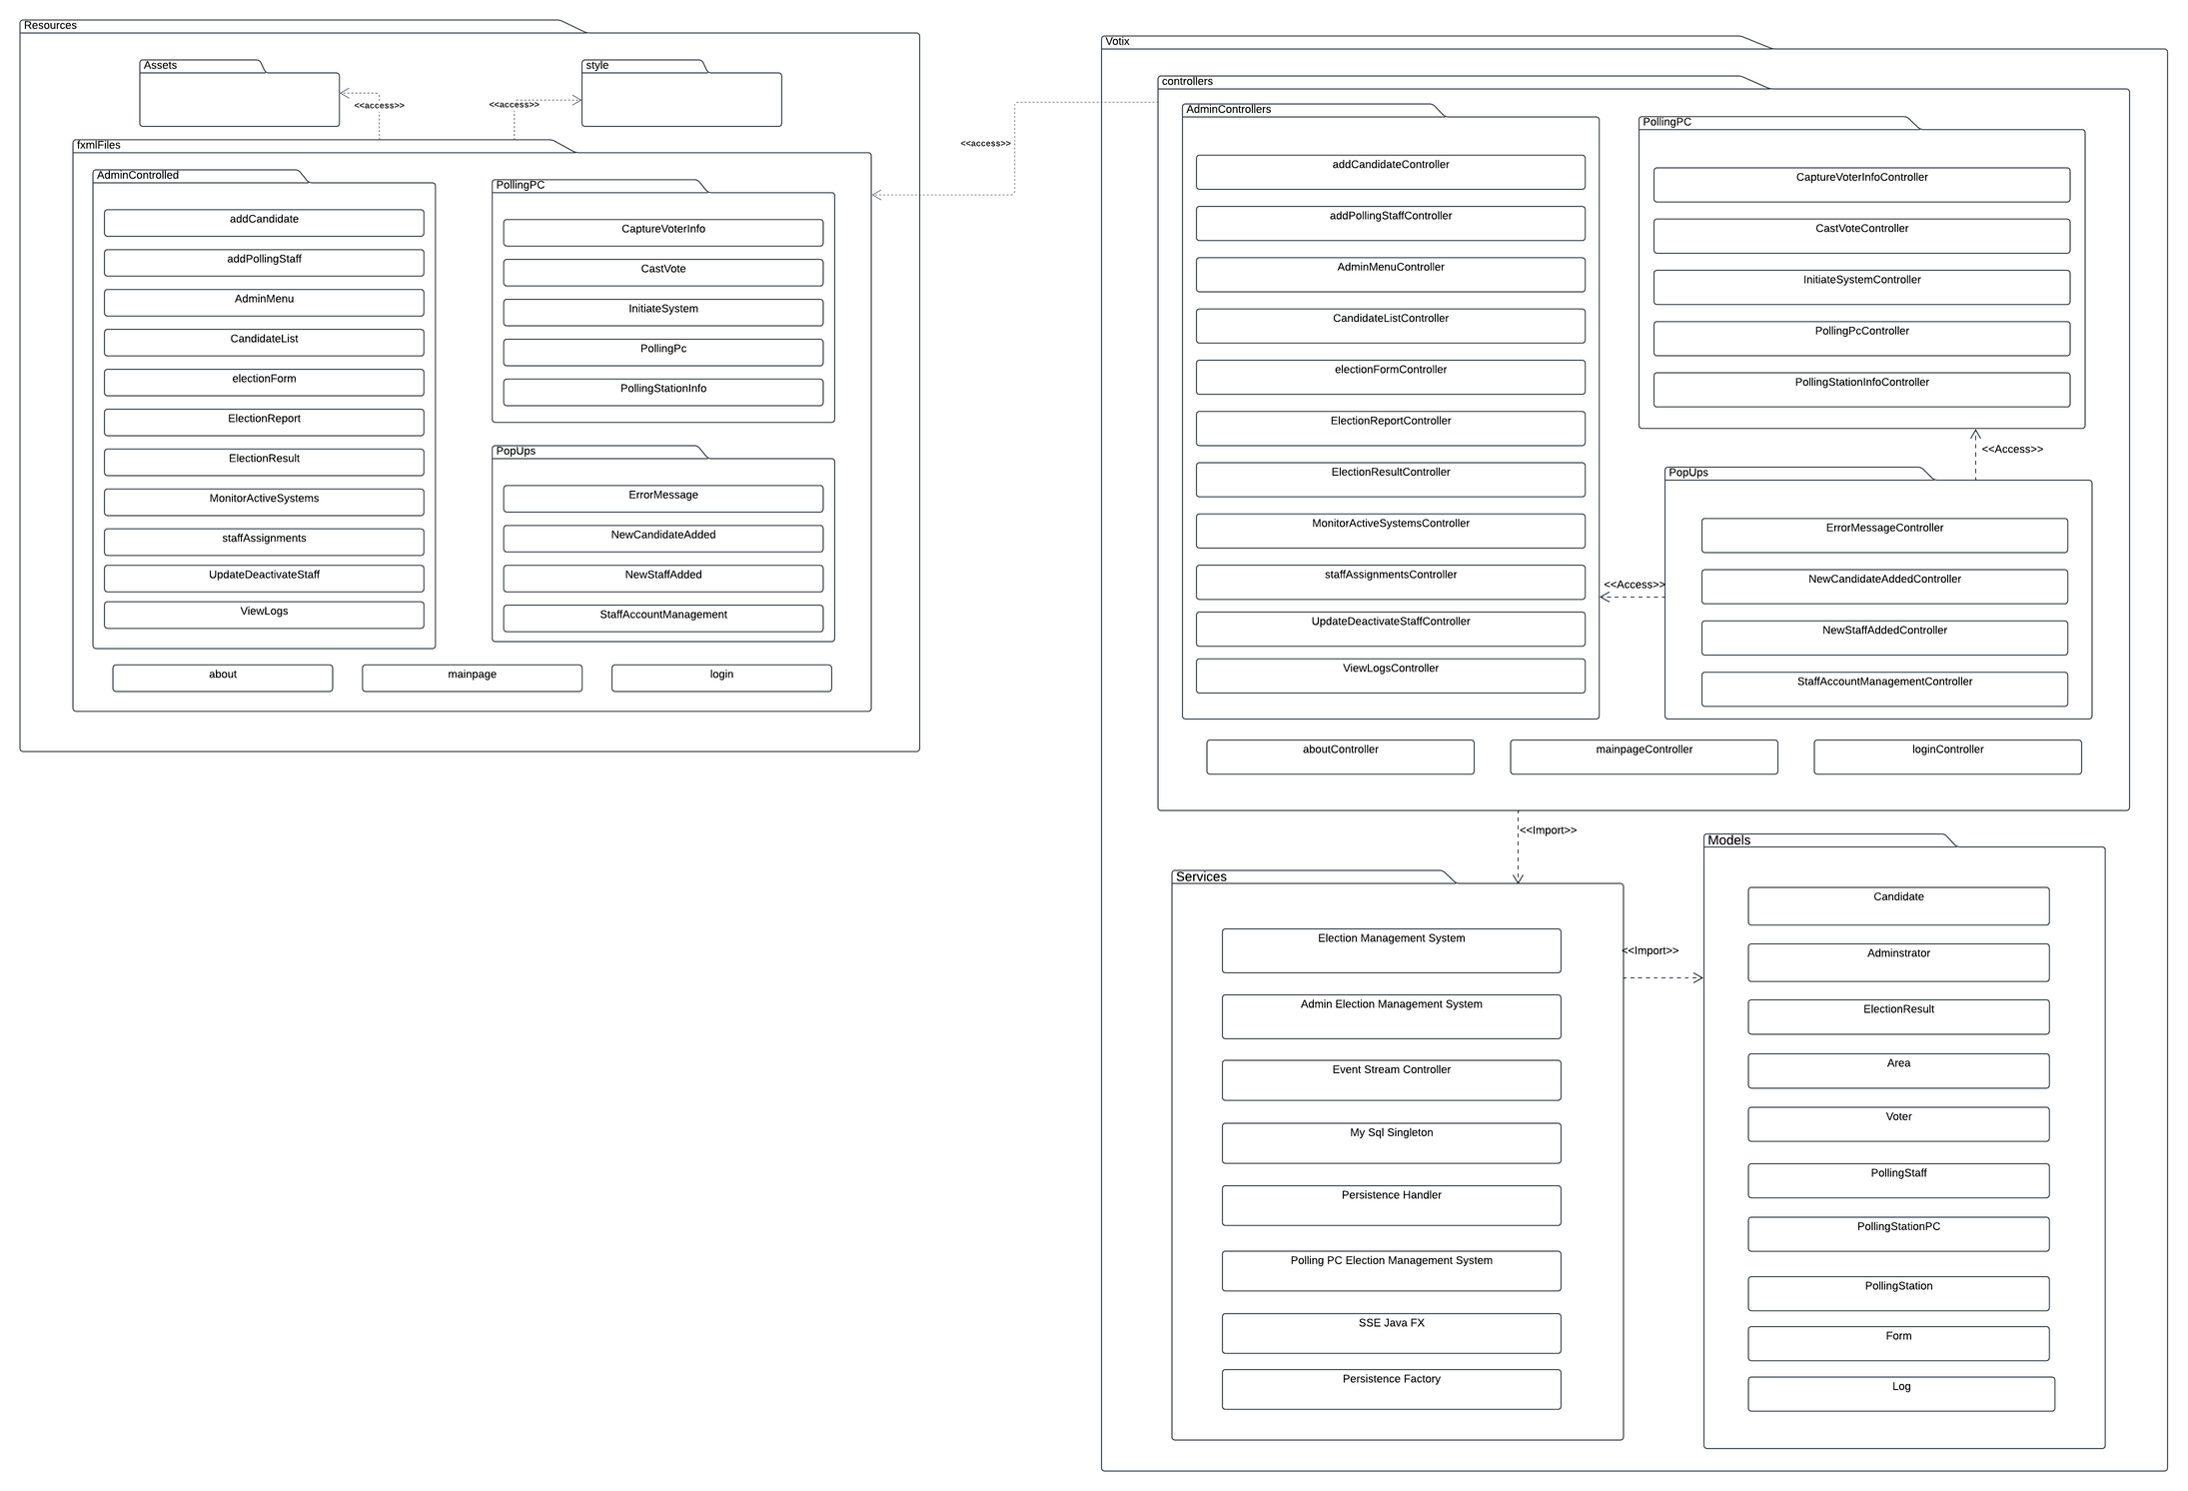
Page 10

Slide 13
DEPLOYMENT DIAGRAM
Page 04

Slide 14
DESIGN PATTERNS
Page 04

Slide 15
GOF PATTERNS
1. Singleton Pattern
used in persistence handler
Justification:
2. Factory Pattern
used in persistence handler
Page 10
Page 10

Slide 16
GOF PATTERNS
1. Singleton Pattern
used in persistence handler
2. Factory Pattern
used in persistence handler
Page 10
Page 10

Slide 17
GUI SCREENS
Page 04

Slide 18
MAIN PAGE
Page 04

Slide 19
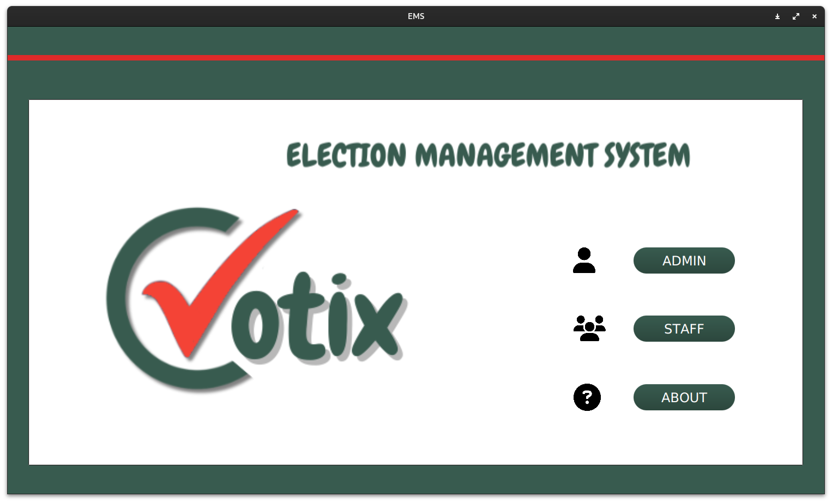
MAIN PAGE
Page 10

Slide 20
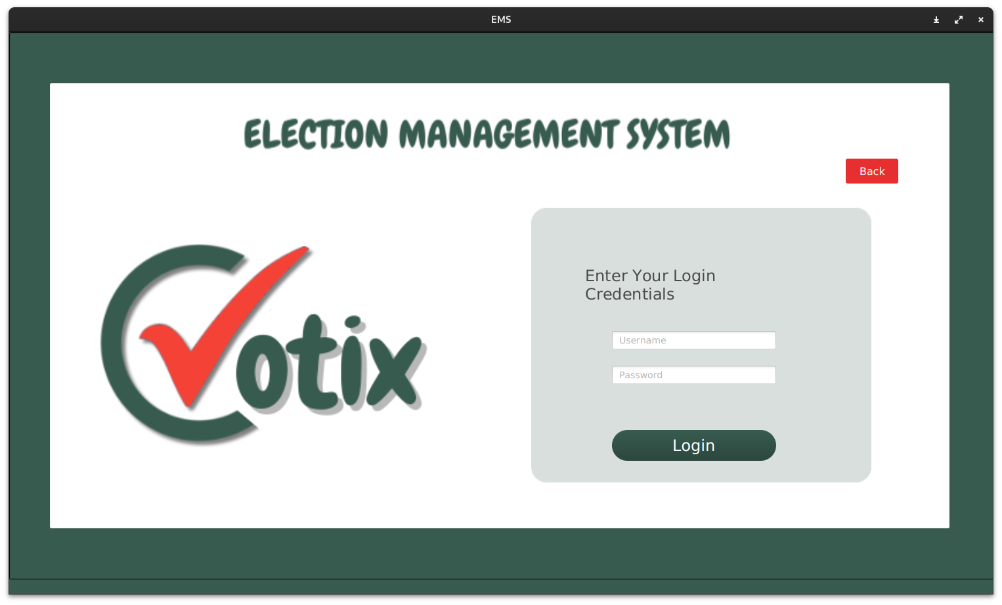
LOGIN PAGE
Page 10

Slide 21
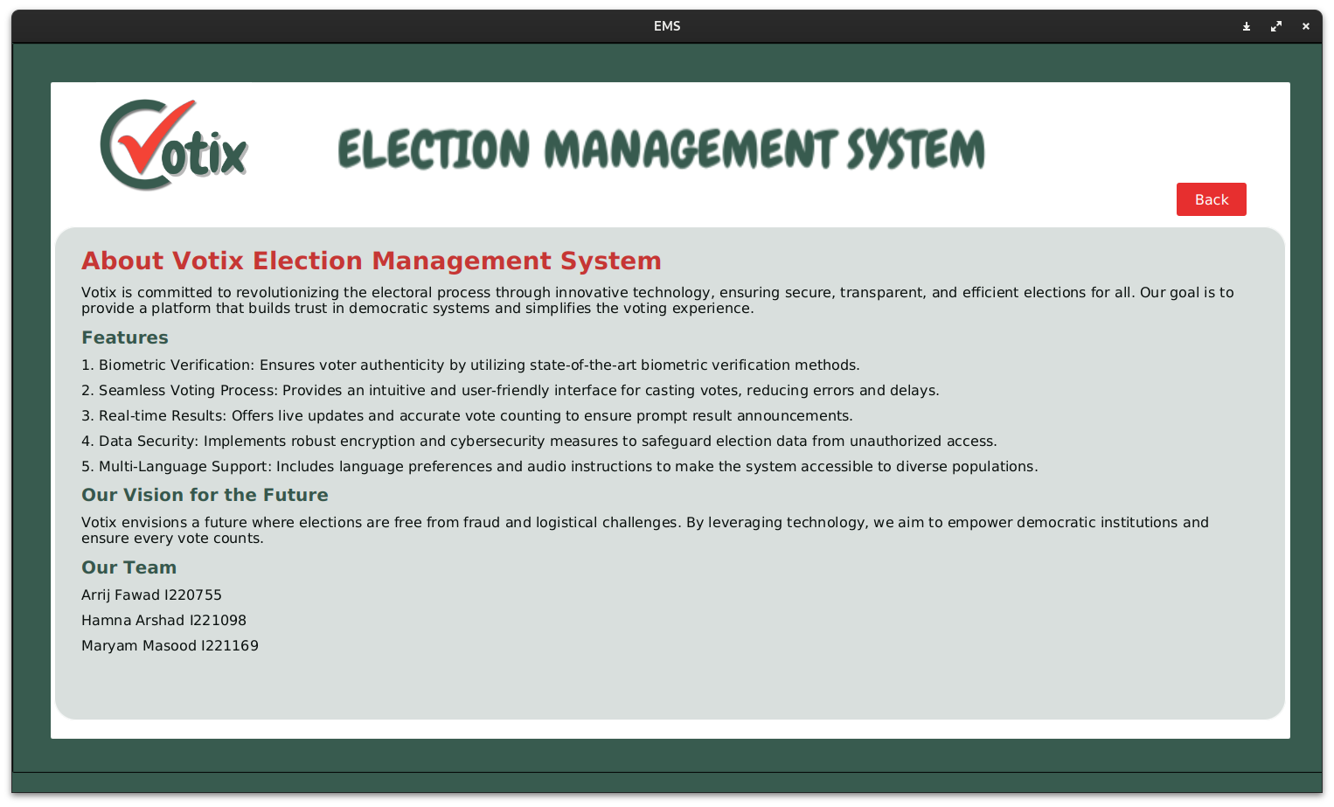
ABOUT PAGE
Page 10

Slide 22
POLLING PC SCREENS
Page 04

Slide 23
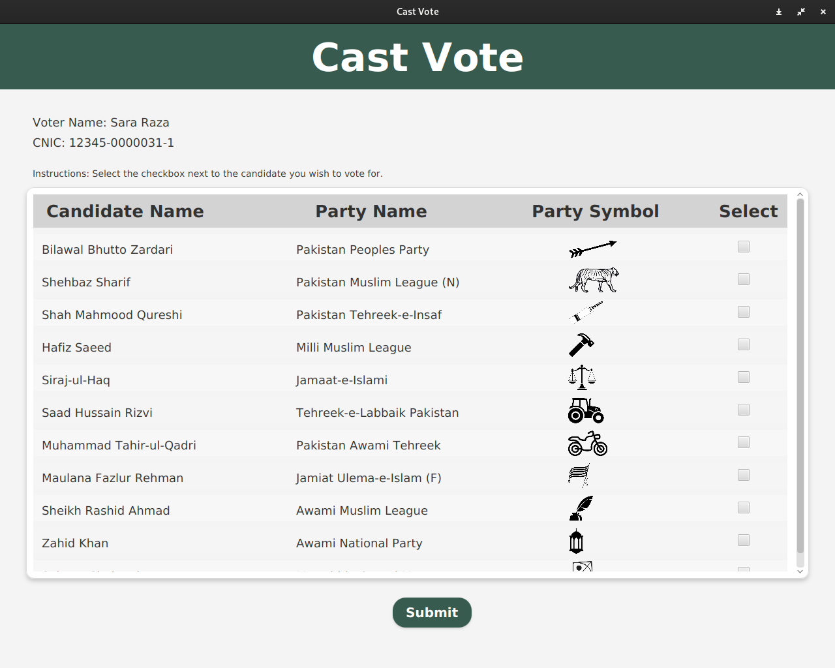
CAST VOTE SCREEN
Page 10

Slide 24
ADMIN SCREENS
Page 04

Slide 25
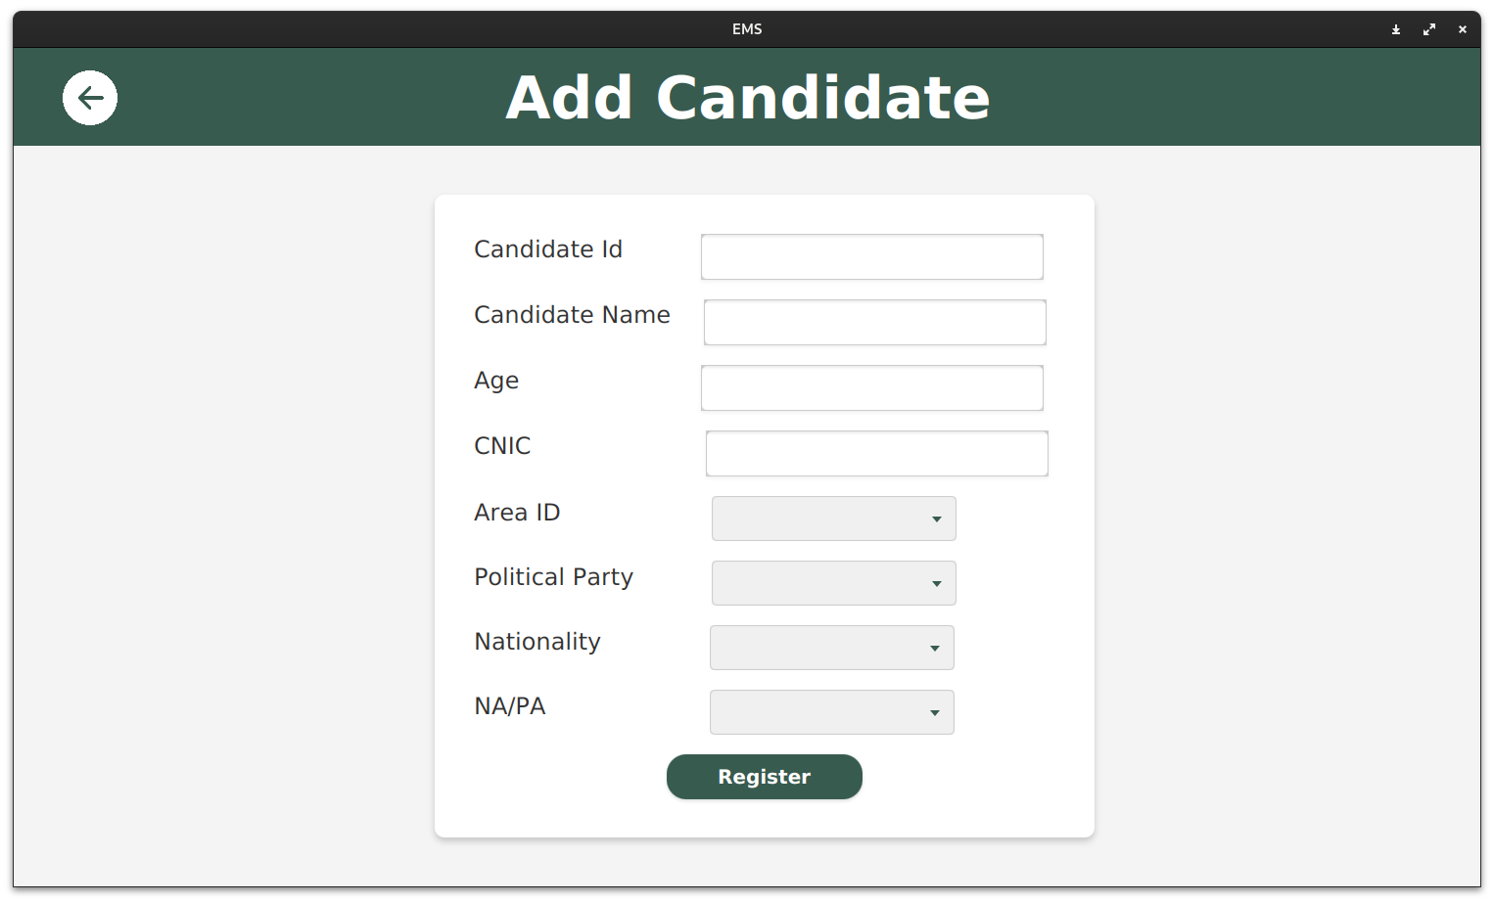
ADD CANDIDATE SCREEN
Page 10

Slide 26
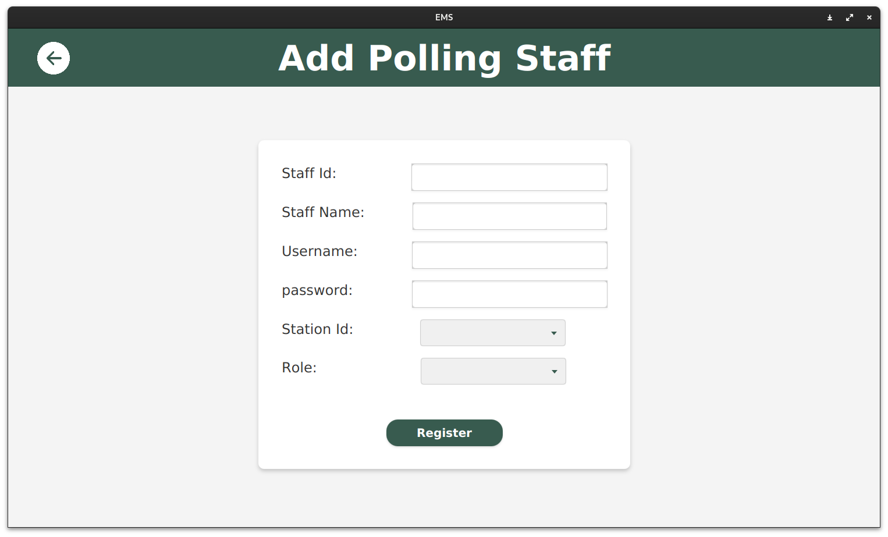
ADD POLLING STAFF SCREEN
Page 10

Slide 27
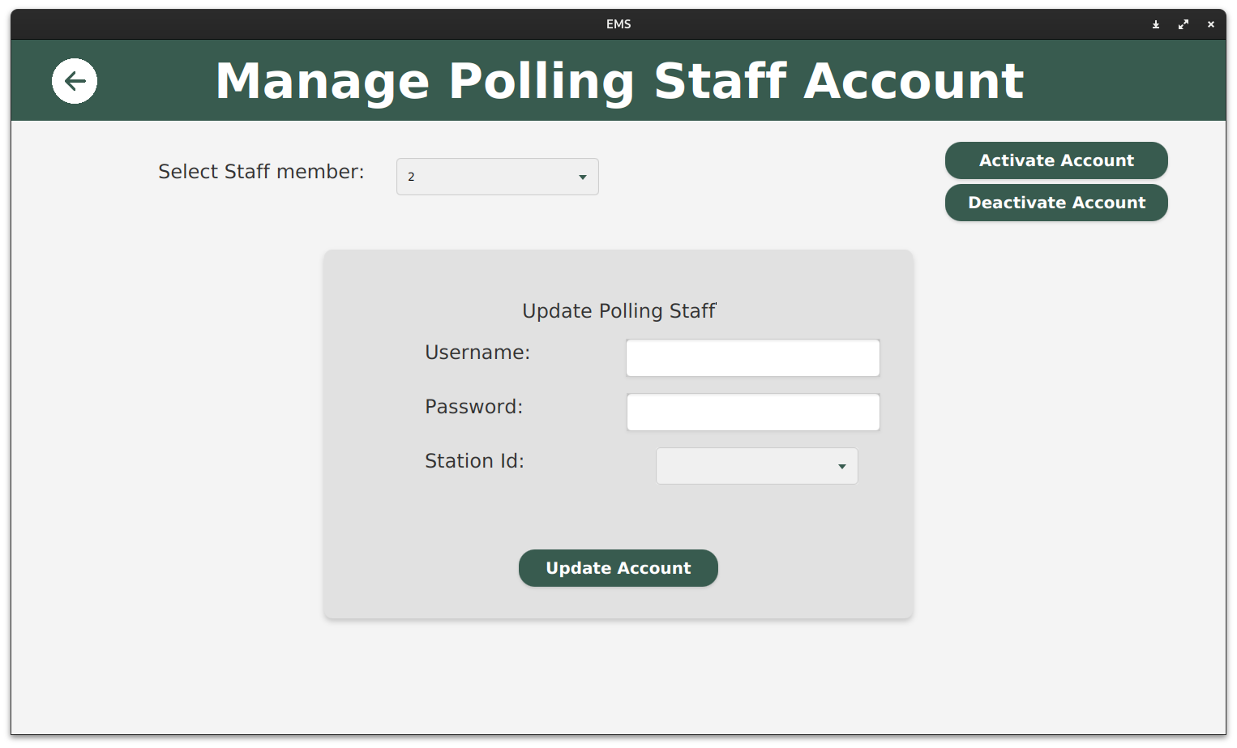
UPDATE POLLING STAFF SCREEN
Page 10

Slide 28
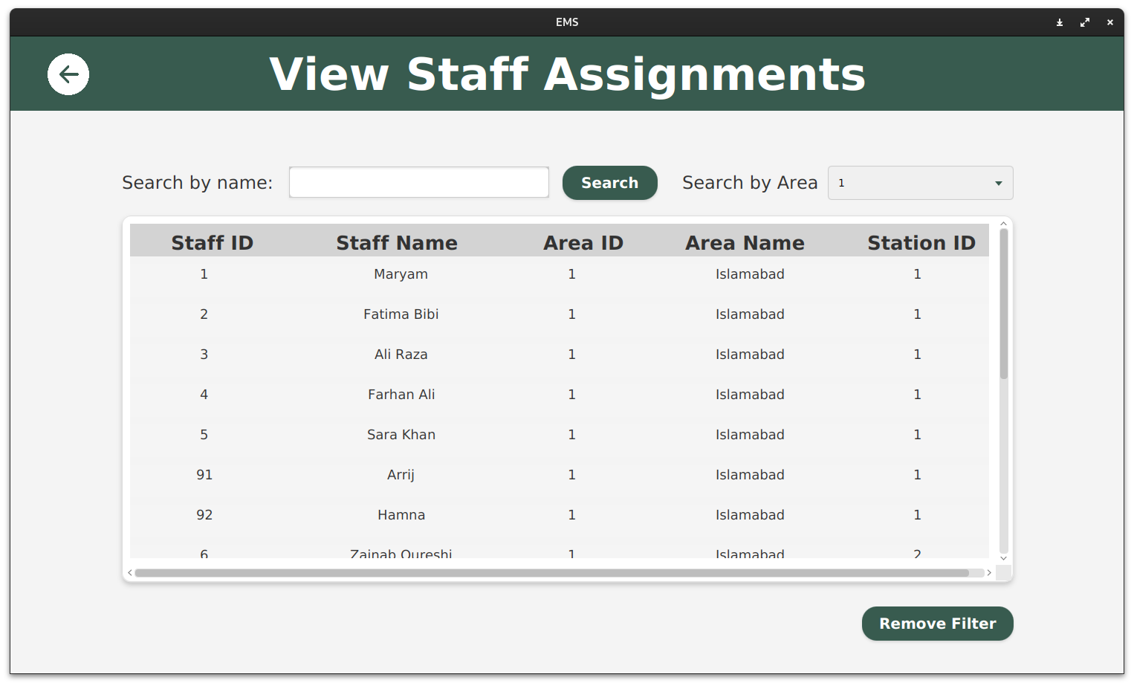
VIEW STAFF ASSIGNMENTS SCREEN
Page 10

Slide 29
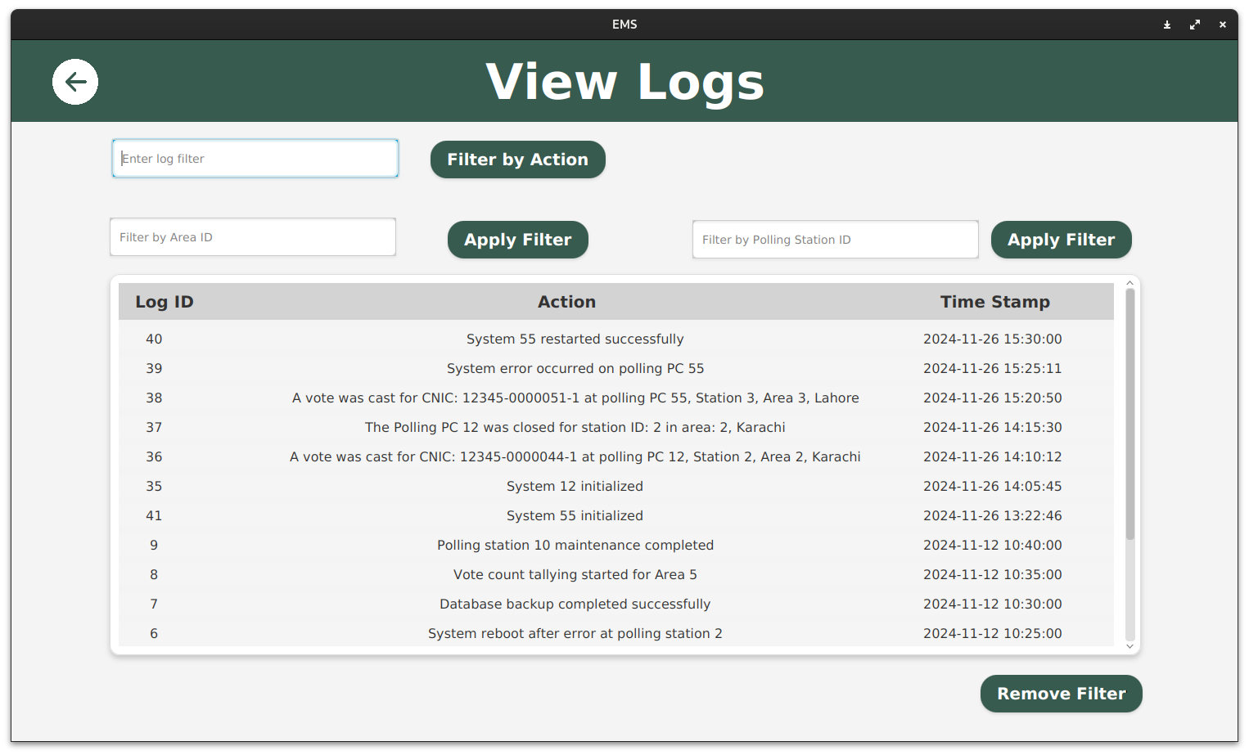
INSPECT LOGS
Page 10

Slide 30
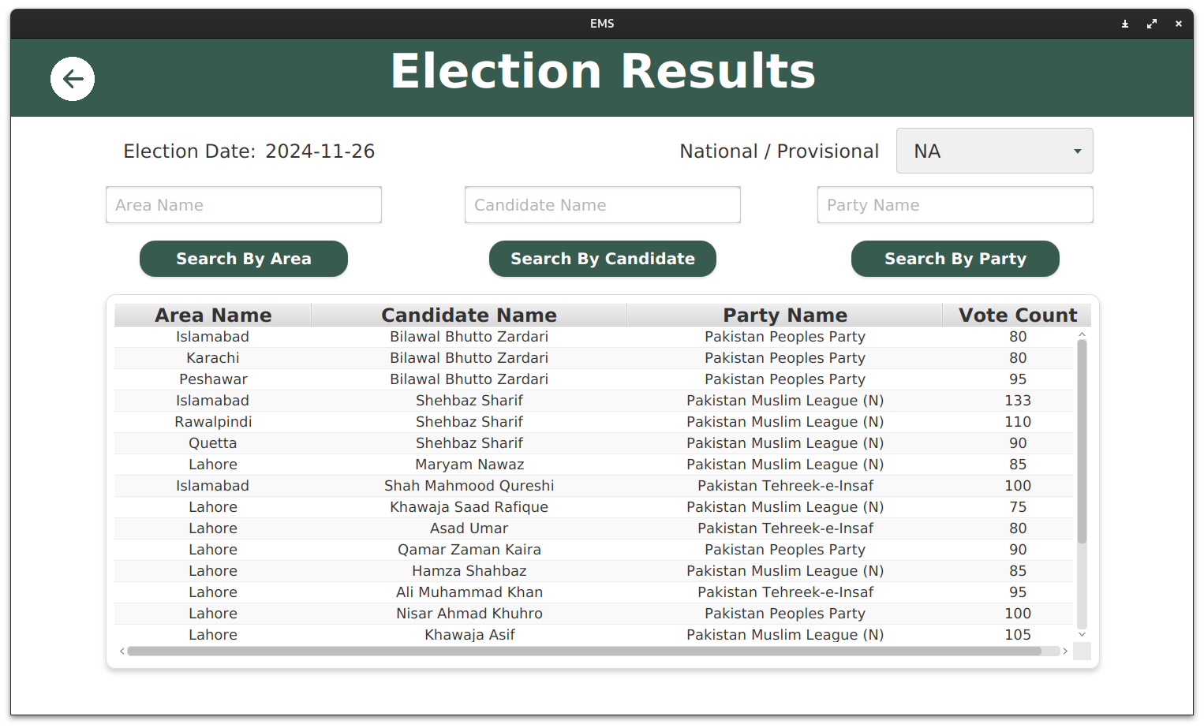
VIEW ELECTION RESULTS
Page 10

Slide 31
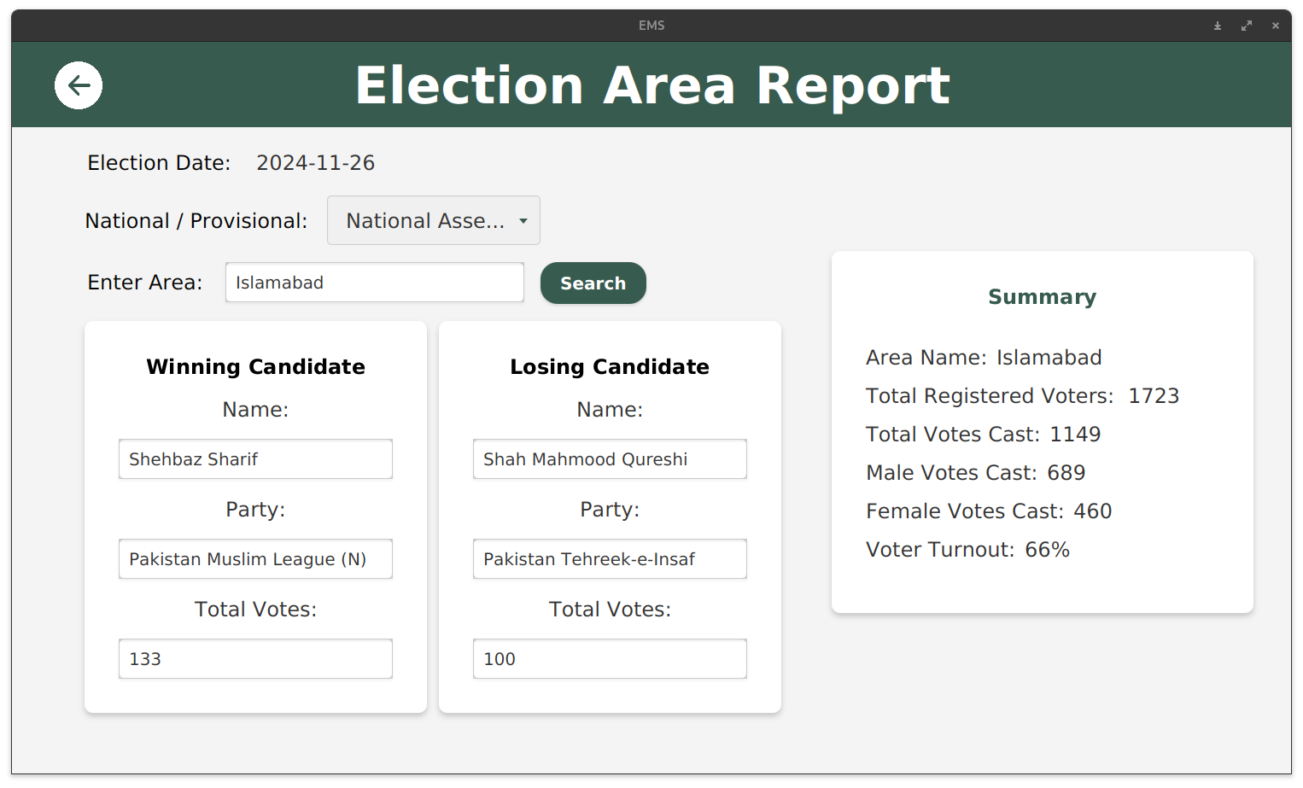
ELECTION REPORT
Page 10

Slide 32
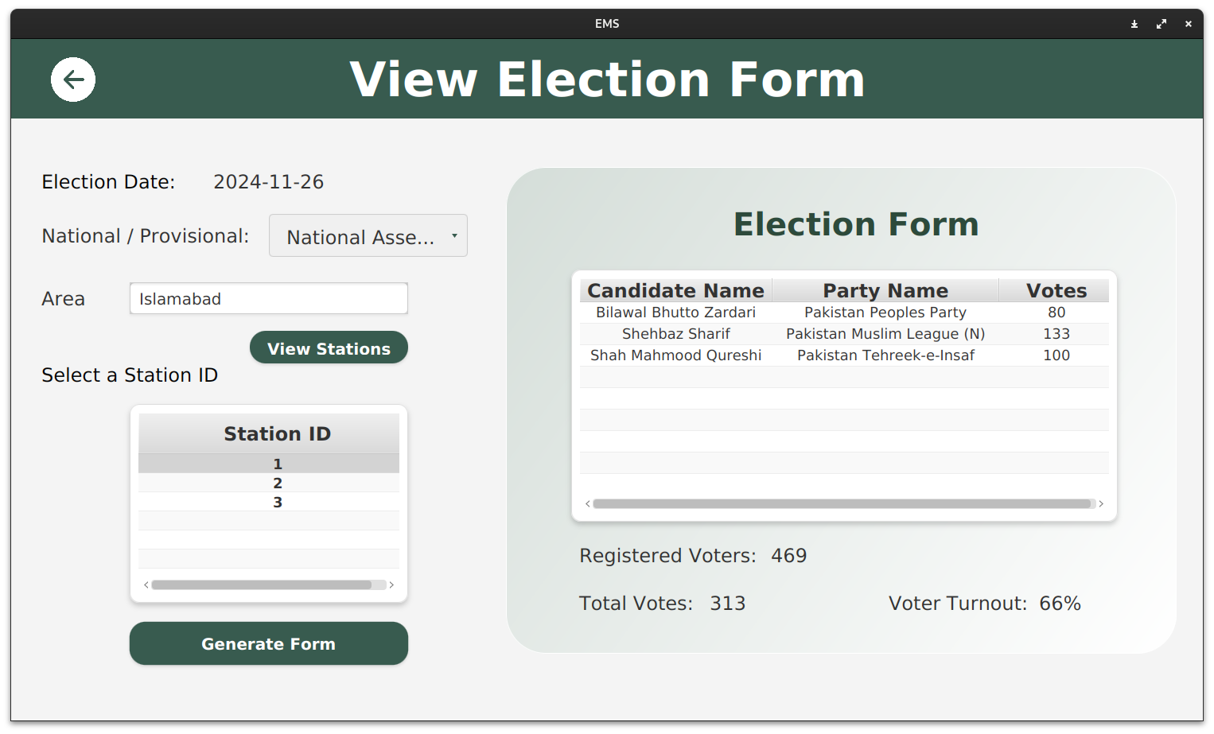
ELECTION FORMS
Page 10

