Slide 1
Mary Wang’s Machine Learning Projects & Experiences
Menglu (Mary) Wang
Graduate Diploma of Data Analytics
Faculty of Engineering

Slide 2
The following slides provide my top Machine Learning Algorithms Experiences:
Linear Regression
Logistic Regression
Time Series Model (ARIMA)
K-NN: K Nearest Neighbors (Classification)
SVM : Support Vector Machine (Classification)
Neural Network (Classification)
K-Means: K nearest Mean Centroids
Big Data Mining Project (Life Insurance Data)
Text Mining Chatbot (Chat Robots) Project
My Data Analyst Profile

Slide 3
1.1 Linear Regression
Business Problem 1: predict future value
Vanderbilt University Medical Center (VUMC) need to predict daily surgery number in advance
Model: ŷ= X * B * Dummy Variables
Output: R^2 (Model Performance): 81.9%
GitHub Code:
https://github.com/Mary268/Linear_Regression

Slide 4
1.2 Linear Regression
Business Problem 2: Market Pricing Problem
Forecast Sales Units based on different Discount % (elasticity of demand) in different seasons
Model:
Log(ŷi)=b0+ Log(X_{1i}) *B1+ b3 +2* (Holt's Winter Time Series Adjustment)
GitHub Code:
https://github.com/Mary268/Log_Transformed_Linear_Regression

Slide 5
2. Logistic Regression
Business Problem: identify the Effectiveness (1/0) of Advertisements
Model: Probability(y=1) = 1/(1+ e^(-(X*B)))
Output Accuracy
GitHub Code:
https://github.com/Mary268/Logistic_Regression

Slide 6
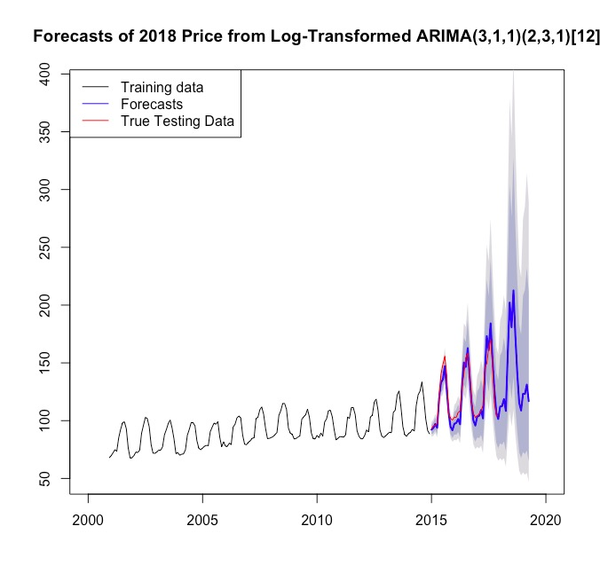
3. Time Series
Business Problem: Forecast Accommodation Pricing in British Columbia by ARIMA model
Model: log transformed ARIMA (3,1,1) (2,3,1) [12]
Output:
GitHub Code:
https://github.com/Mary268/Time-Series-Forecasting
tiny errors: RMSE < 8
Residuals: stationary

Slide 7
4. K-NN & 5. SVM Classification
Business Problem: Classification of Courses based on variables like: instructor, difficulty level, attendance and etc.
K-NN (Nearest Neighbors) Model (k = 9) Accuracy: 90%
GitHub Code:
https://github.com/Mary268/K-NN-Classification
SVM (Support Vector Machine) Model Accuracy: 98%
GitHub Code:
https://github.com/Mary268/SVM-Classification

Slide 8
6. Neural Network
Business Problem: Classification of Courses
Model: 1 layer and 3 neurons with 0.98 accuracy
Potential Problem:
Accuracy is unstable because of the randomness of initial points
GitHub Code:
https://github.com/Mary268/Neural-NetWork

Slide 9
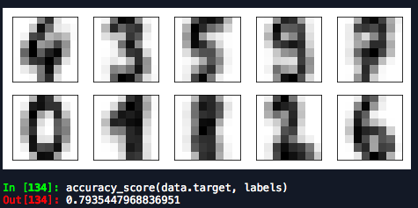
7. K-Means Clustering
Business Problem: image recognition of the 26 alphabets, 10 digits and etc.
Model: K-Means(Nearest Mean Centroid) builds 10 image digit clusters (0 - 9) with 80% accuracy
Output:
GitHub Code:
https://github.com/Mary268/K-Means-Clustering

Slide 10
10. My Data Analytic Profile
This document discusses my Machine Learning expertise.
For other expertise, please refer:
Statistics:
Transcript of UW:
Average 96
Computer Science:
Software Engineering work experiences (2 years)

Slide 11
Thank You
Email: m343wang@waterloo.ca
Phone: 519-588-8885
LinkedIn: https://www.linkedin.com/in/mary-wang-927aa6126/

