Slide 1
Wk. 4 Lab
Mary Hager

Slide 2
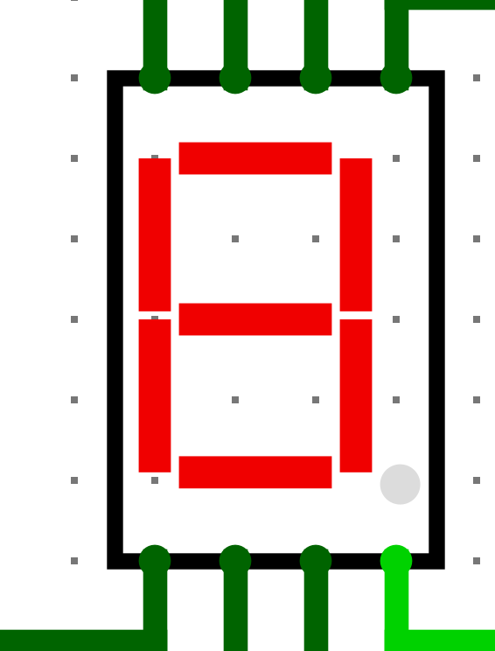
Outline of corresponding numbers to LED display.
0
1
6
5
2
7
4
3

Slide 3
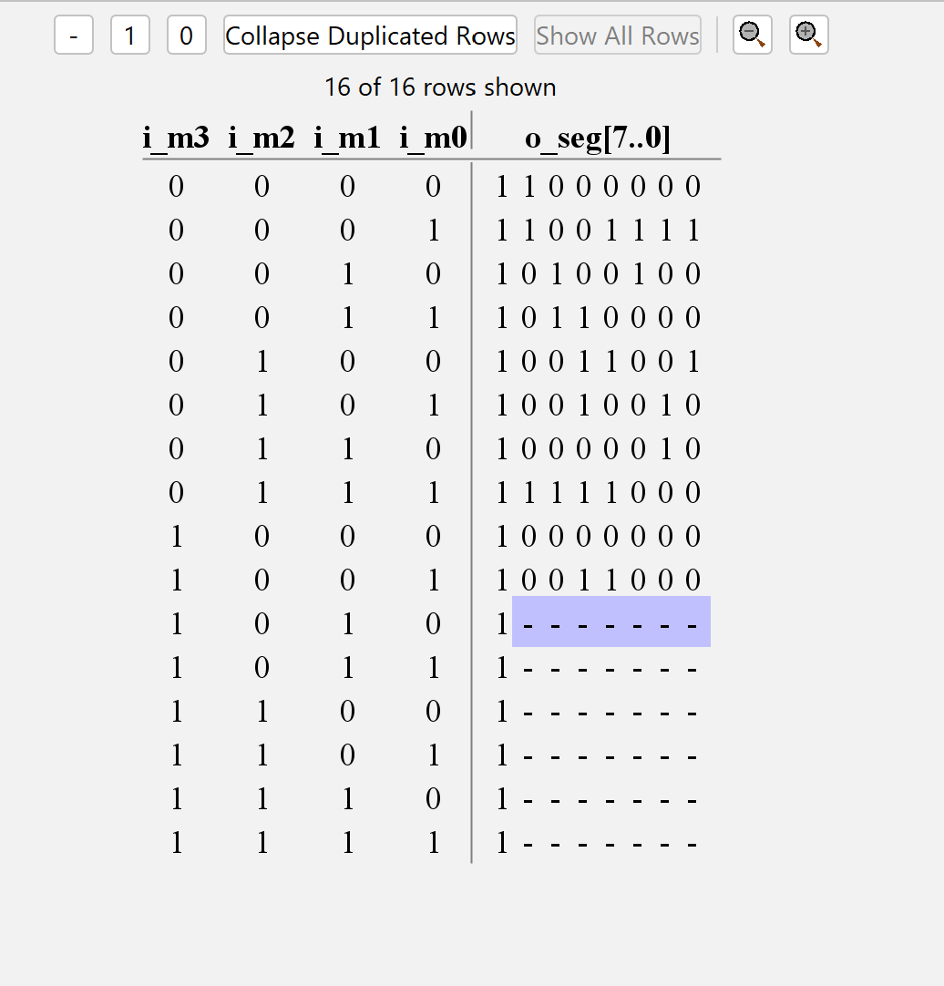
Truth table for 0-9

Slide 4
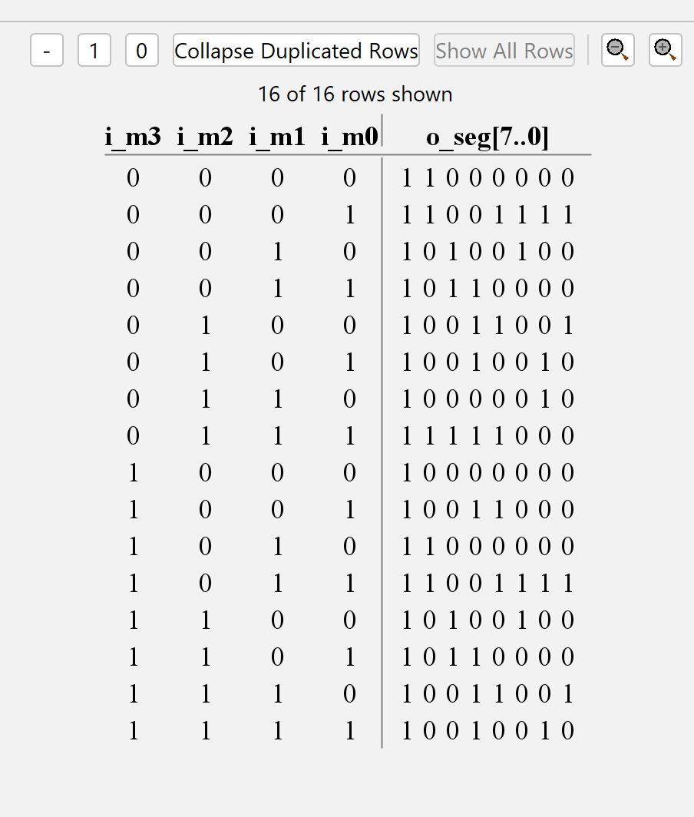
Full truth table for LED display
Note that max value is 15

Slide 5
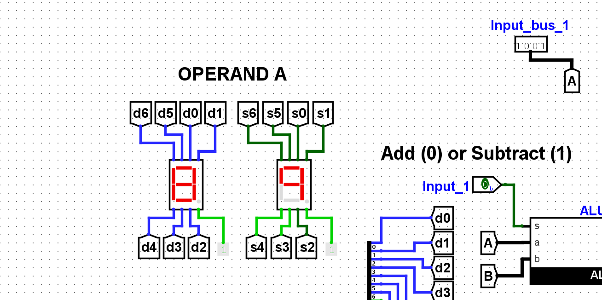
Testing value 0-9 on operand A
All worked accordingly

Slide 6
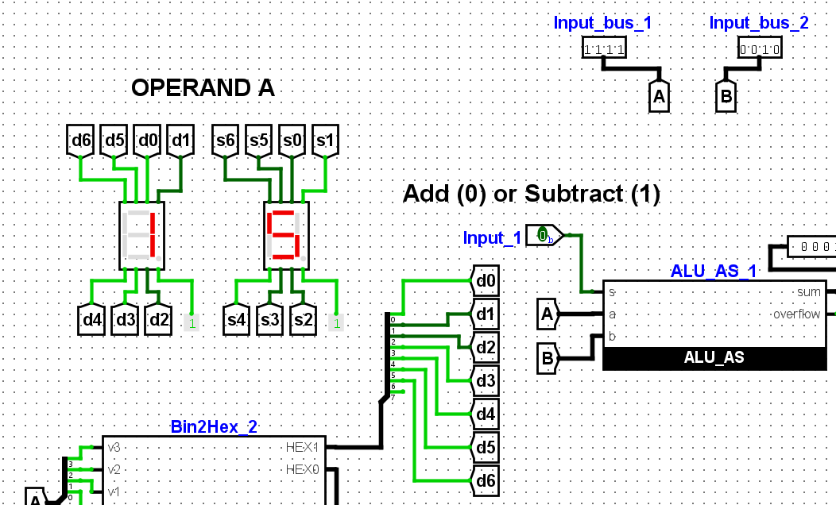
Max value of 15 accurately displayed on Operand A

Slide 7
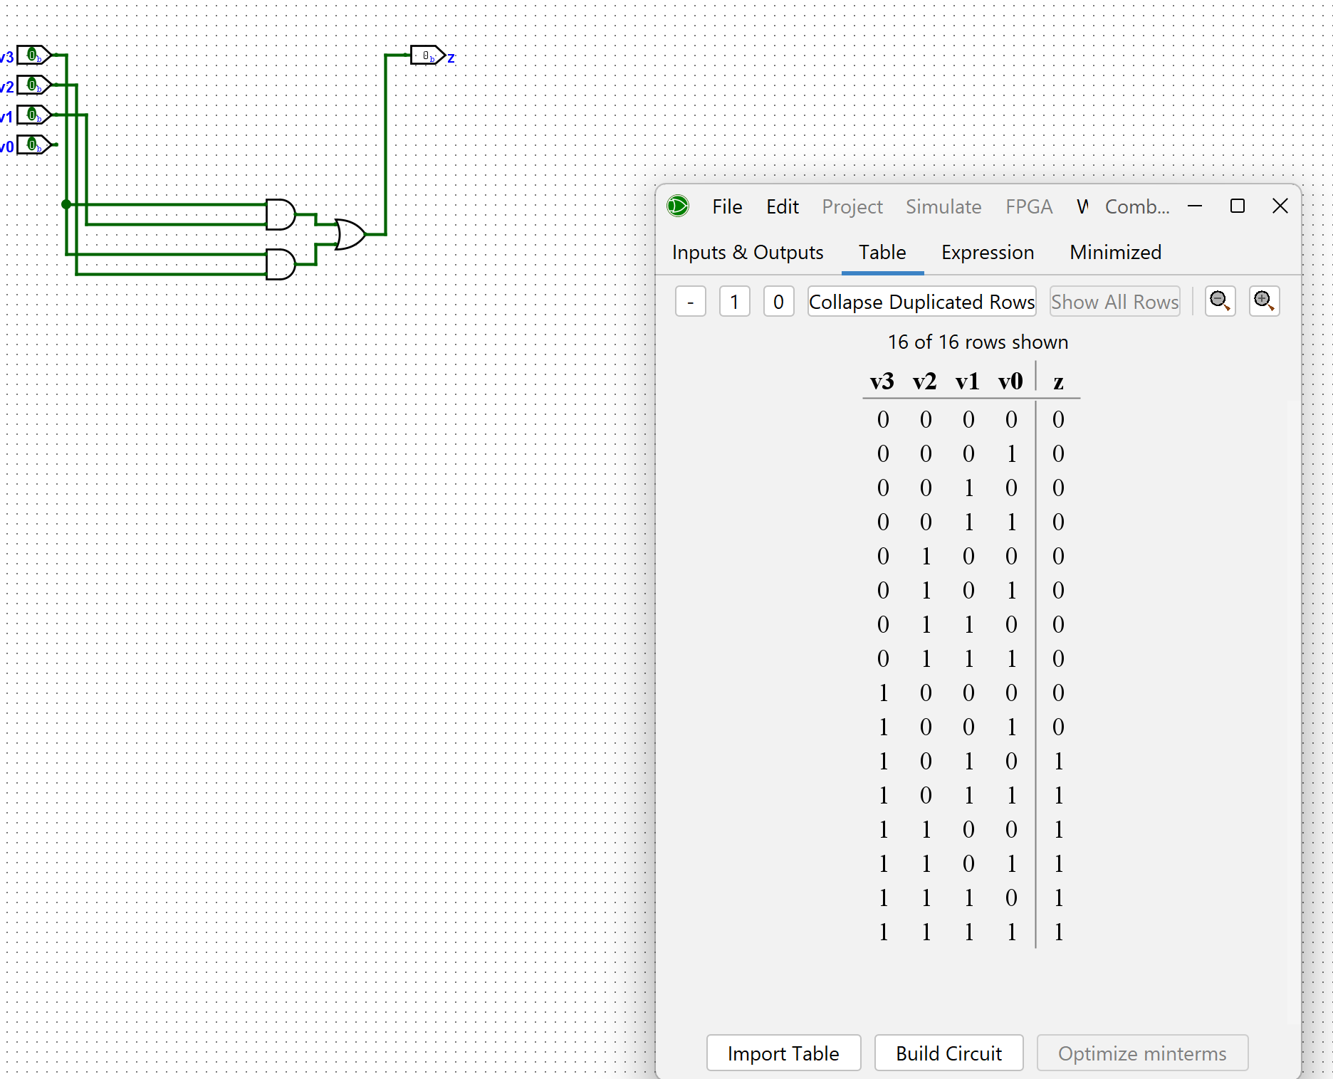
Comparator for when 10’s diget is ON

Slide 8
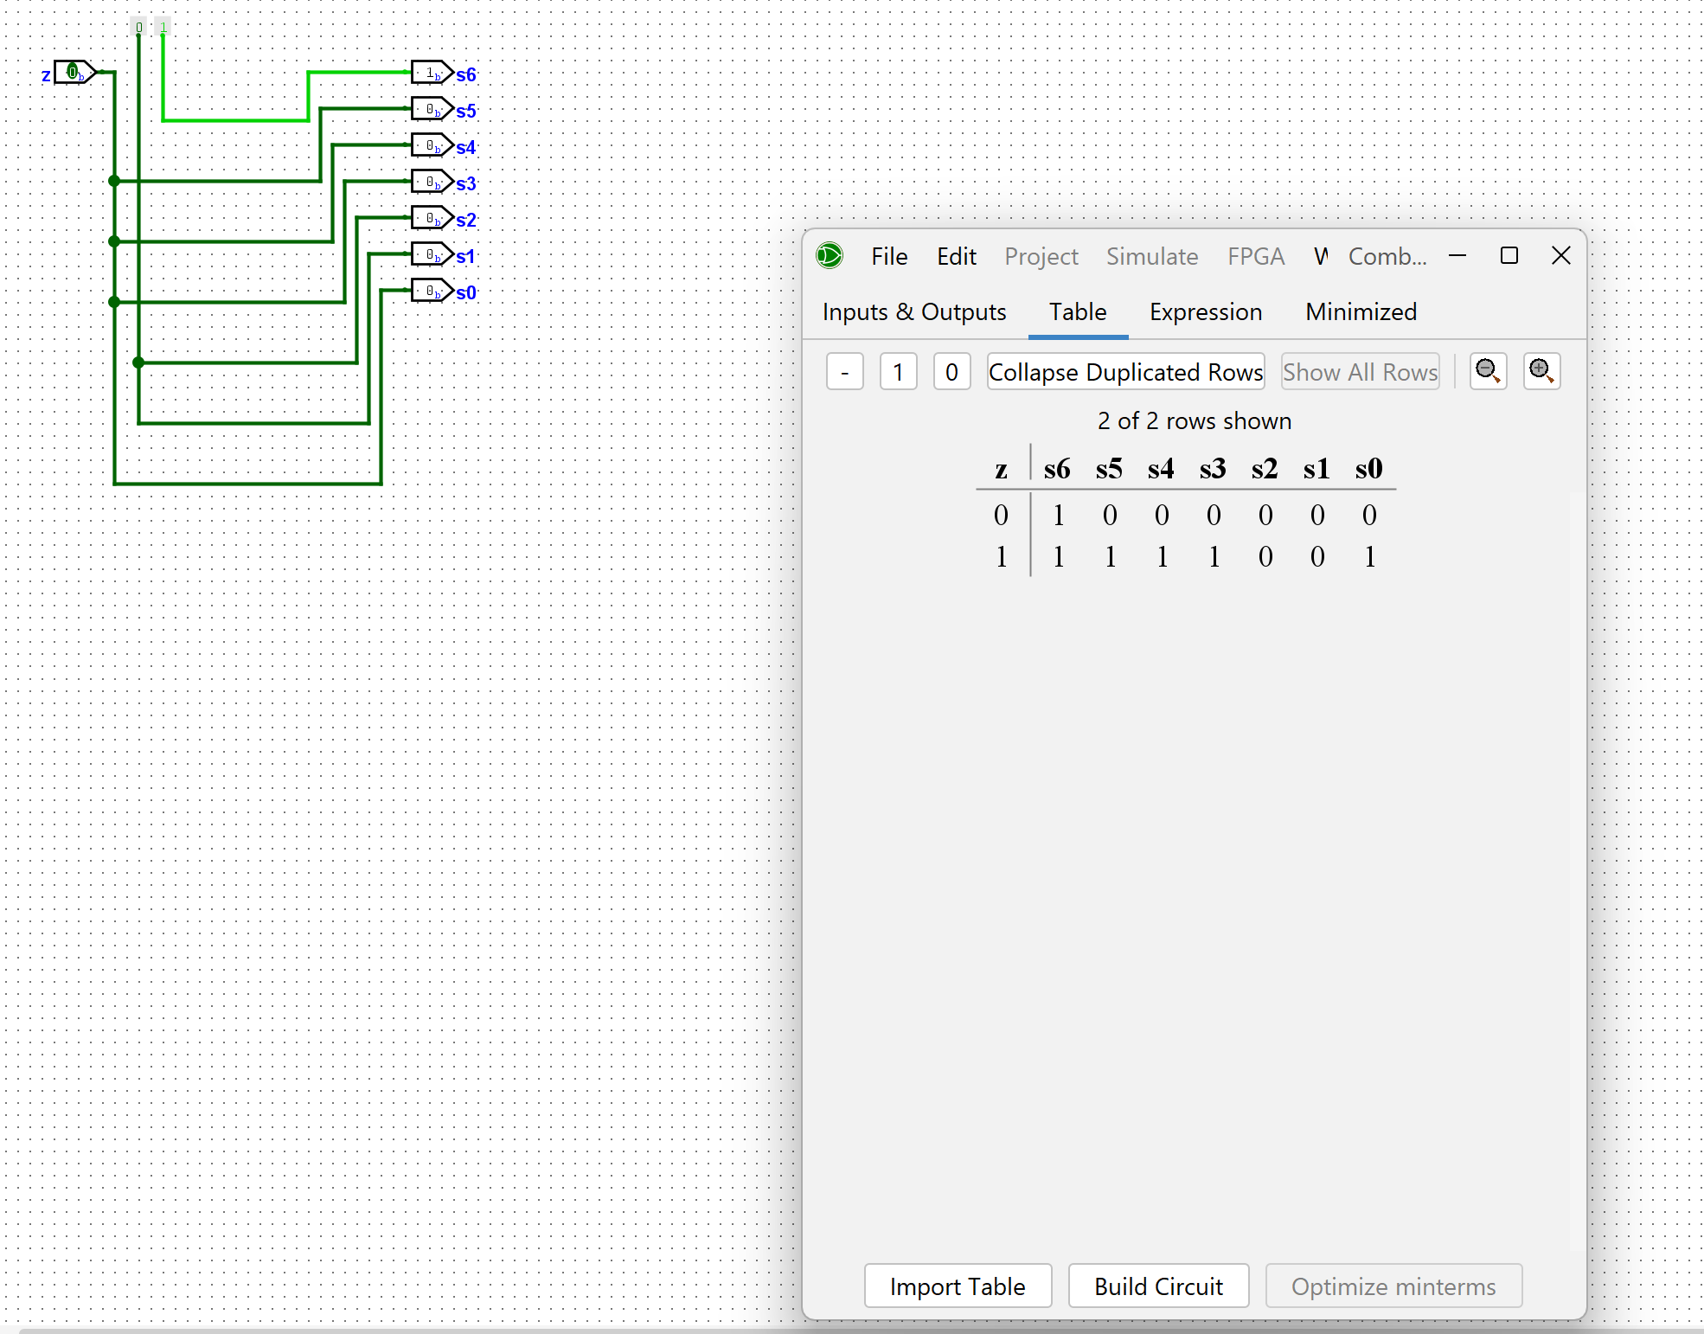
Truth table and circuit for when 10’s diget is displayed as 1 vs. 0

Slide 9
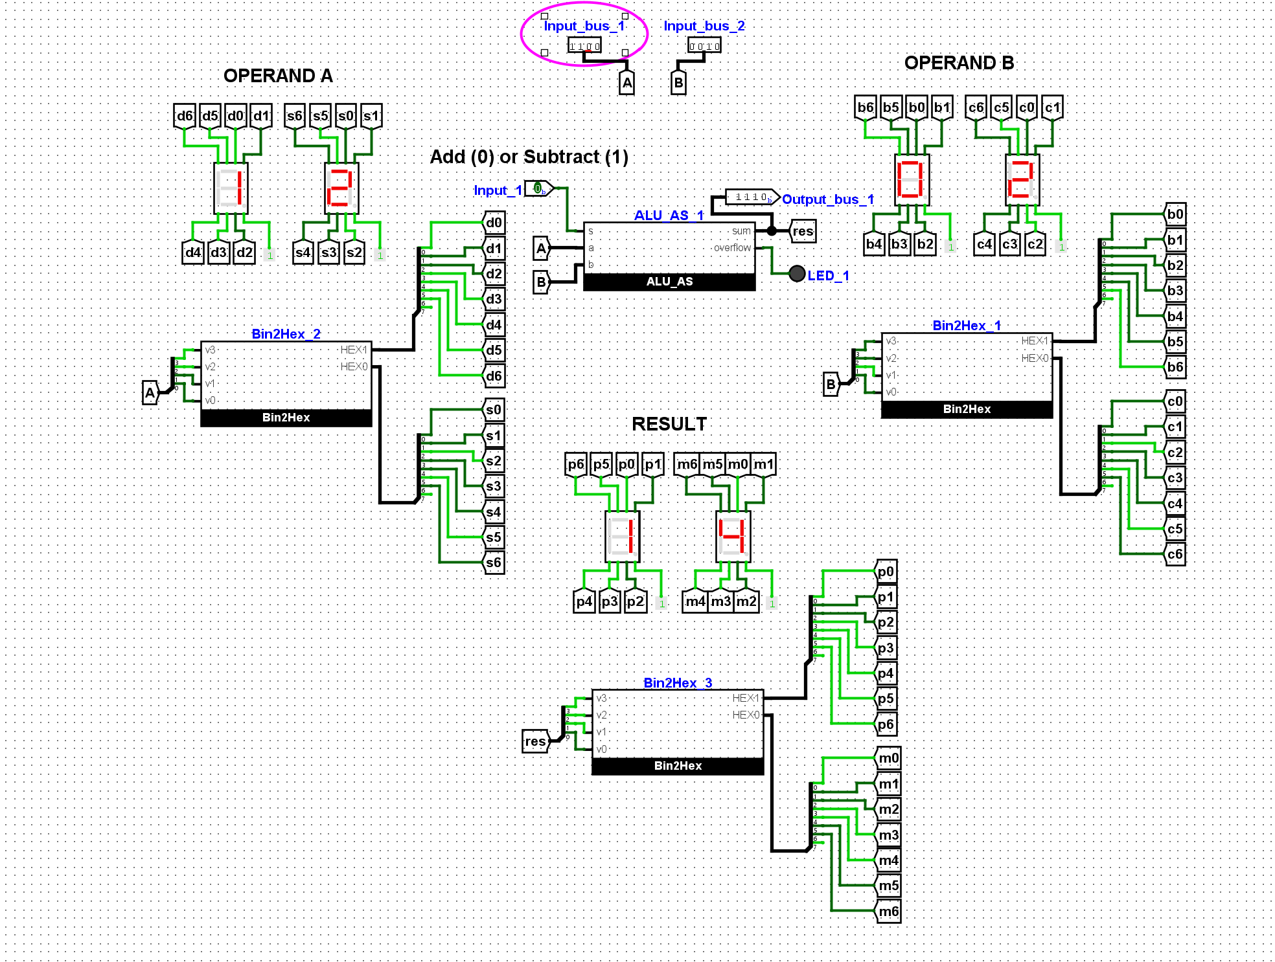
Full adding components
test no. 1
All working as expected

Slide 10
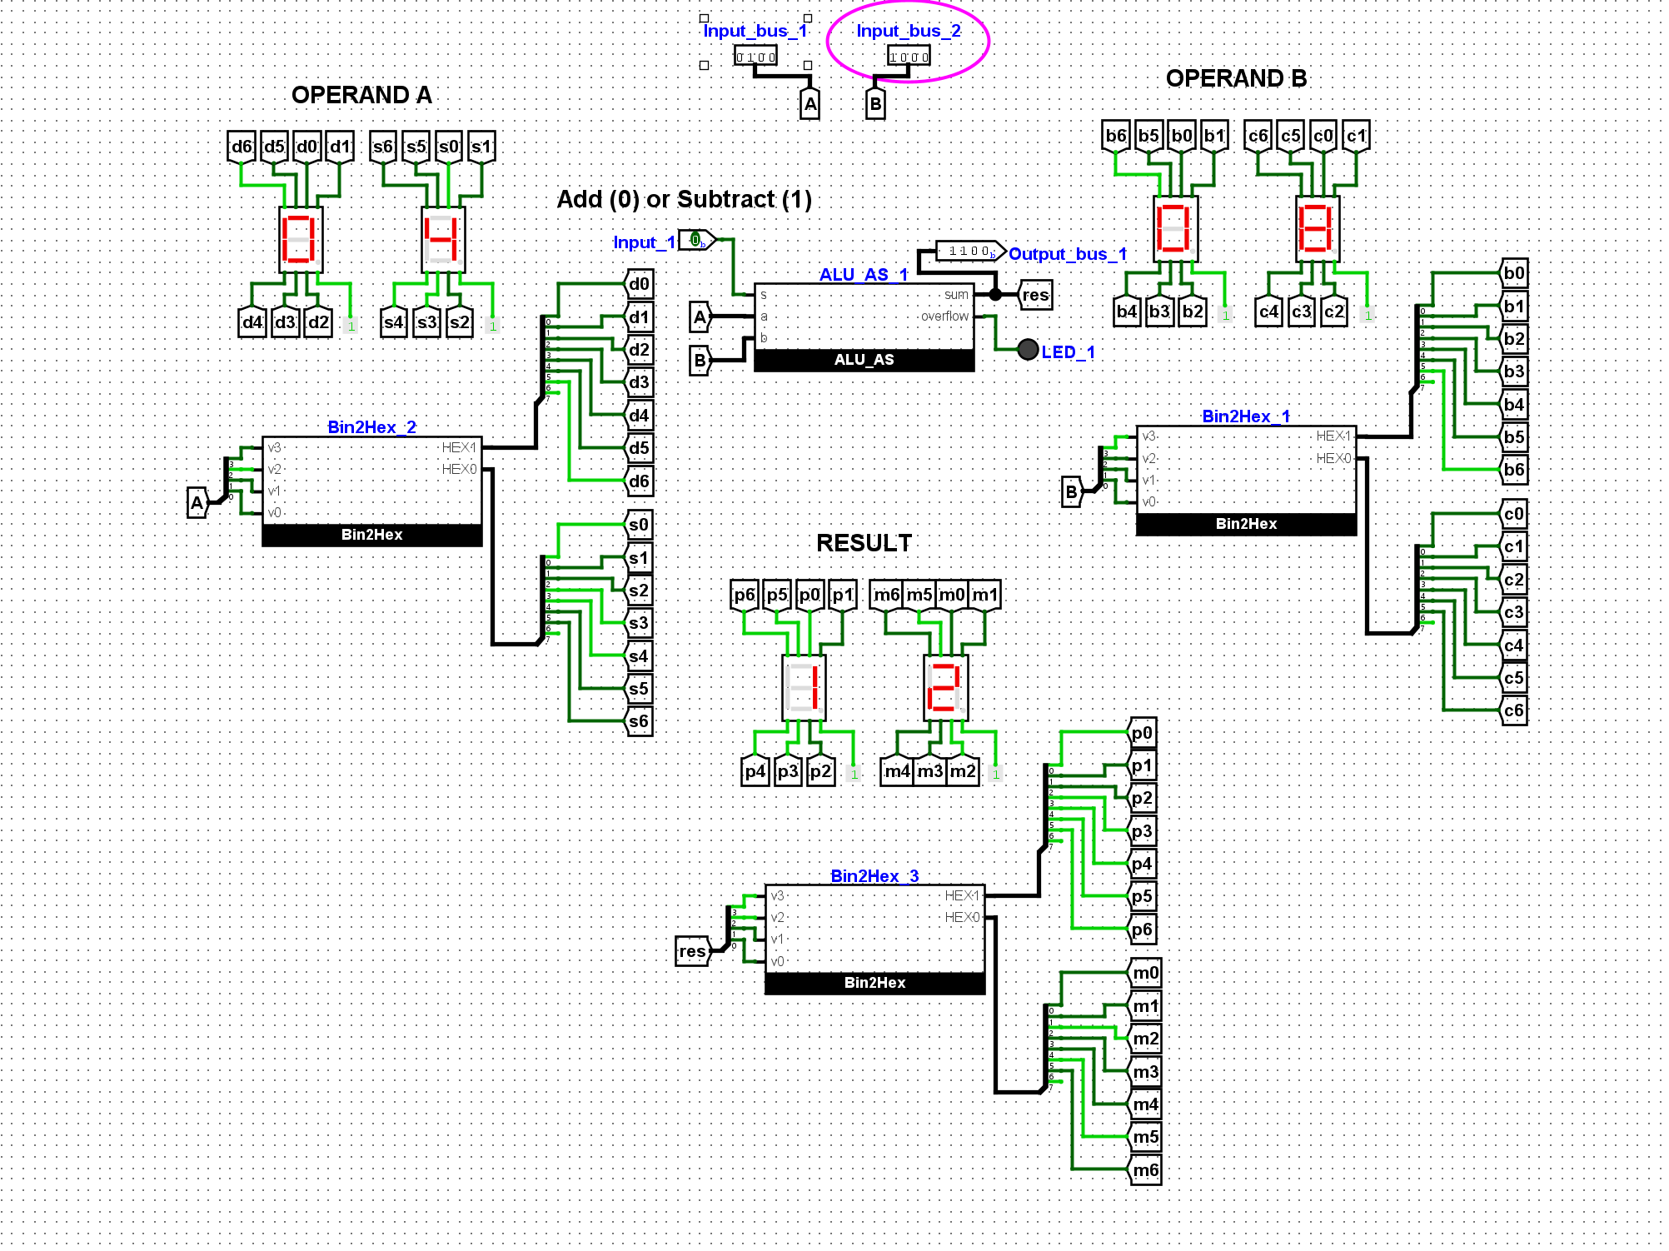
Full adding components test 2
All working as expected

