Slide 1
Research & Documentation Workshop on the art of Research Writing
Omdena-Australia Chapter
Mary Adewunmi

Slide 2

Bibliography
My name is Mary Adewunmi
I have been a Policy Researcher in a Research & Development Institute for 11years
Switched to data science 2 years ago during COVID Lockdown
One of the 49 grantee of Kaggle BIPOC 2021
Masters in Computer Science
About to enrol for a PhD position in AI for health diagnosis – looking for scholarship
First time on Omdena project
Linkedln:https://www.linkedin.com/in/mary-adewunmi/
Github: https://github.com/MaryAdewunmi
Email: mary@moaanalytic.com

Slide 3
Learning Outcomes
Know how to write a Research paper for Journal Publication
Understand the Format for writing a paper
Ways of writing paper to avoid plagiarism
Necessary tools for writing a paper
Reasons why we write paper

Slide 4
Tools for writing Research Paper
Referencing app – Mendeley, Endnote, Zotero etc
Paraphrazing tool – Quilbot
Grammar check apps – Grammarly
Publications Database – Google Scholar, Web of Science etc

Slide 5
What is a Research article?
Scientists use scientific research publications to communicate with other scientists about the findings of their research.
The genuine worth of any research is only realized once it has gone through peer review and has been published in journals.
The beauty of research article is researcher would not need to do what others have done but to continue from where a researcher stopped - Continuity

Slide 6
Research Paper Format
Title
Authors and Affliations
Abstract
Background/Introduction
Significance of the Research
Related works/Literature review
Methods
Results and Discussion
Limitation
Conclusion
Acknowledgment
Conflict of Interest
References
Appendices

Slide 7
Title
Should be specific enough to describe the contents without being too technical for non-specialists to understand.
Should be suitable for the target audience.
The article's topic matter is usually described in the title.
A title that describes the results is sometimes more effective.
It should be eye-catchy.

Slide 8
Authors
The first author of a research article is usually the person who did the work and wrote the paper.
Other people who made significant contributions to the work are listed as co-authors in published articles – by noting the contributions of each author
Ps – avoid gift authorship for future integrity of the paper

Slide 9
Abstract
An abstract, or summary, is published alongside a research article, allowing the reader a "preview" of what's to come.
Allow other scientists to swiftly scan the body of scientific literature and determine which articles to read in depth.
Should be less technical than the article. The purpose, methods, findings, and conclusions of the article should be summarized in one paragraph of 100-250 words.
The abstract does not include any abbreviations or references.
It should be self-contained, with no need for footnotes.
Always written after the end of the paper writing

Slide 10
Abstract format
Introduction - This is the first part of the abstract, and should be brief and attractive to the reader at the same time. After reading a well written intro, the reader would be eager to read more.
Research significance - This usually answers the question: Why did you do this research?
Methodology - This usually answers the questions: What did you do? How did you do it?
Results - This answers the question: What did you find out after doing the research? Or what are the advantages of your method based on the results?
Conclusion - This usually answers the question: What do your findings mean? What have you contributed?
Read the abstract carefully and try to eliminate any sentence that doesn’t fit into any of the categories above. Make sure all of your sentences contribute to explain the whole picture.

Slide 11
Introduction/Background
Summarizes relevant literature so that the reader could see why the researcher was interested in the subject presented.
Only one to four paragraphs should suffice. Finish with a statement that explains the exact question that the researcher was trying to answer in the research.

Slide 12
Related works/Literature review
Include all the works that have been done in that field depending on the type of paper you are planning to write
It has to be structured accordingly to avoid ambiguity
Sometimes, we include details about the methods we will use in the Code Implementation

Slide 13
Materials and Methods
There should be enough details here for another scientist to carry out the experiment. Examine other articles in the field to get a sense of what is covered in this section.
To clarify the approaches used, a diagram, table, or flowchart may be useful.
Include framework which explain how you arrive at the results, preliminary findings that were used to plan the major experiment being reported on - Like Adish said the other time – we should note the reasons for using each methods
Mention any ethical concerns that come to mind –

Slide 14
Results
Graphs and tables can be included if necessary, but the major findings should also be summarized in the text.
Discussing the results or speculating on why anything happened belongs in the Discussion section.
It is not necessary to provide all of the data collected throughout the project. Use proper data visualization methods; there is no need to modify the data.
Tables And Graphs
Include a title that describes what's in the table or graph if the data is presented in a table or graph.
The x and y axes of graphs should also be identified.
There's no need to be "fancy" by using a table or graph

Slide 15
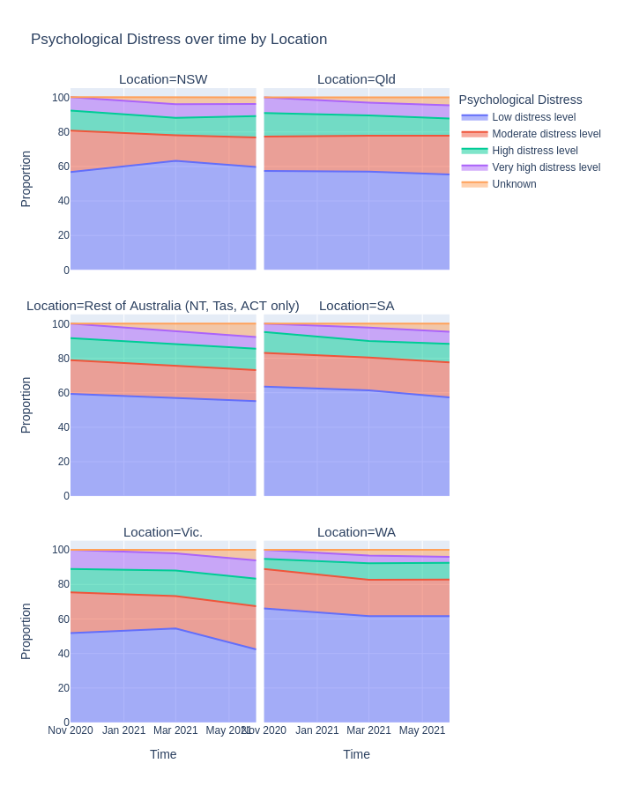
Title and Content Layout with Chart
This chart shows the psychological distress of Australians over time by location as seen in Figure …(insert reference if there is any)
Figure 1: Psychological distress over time by location

Slide 16
Discussion
Highlight the most important results, but don't just restate what's already been said in the Results section.
What is the relationship between these results and the original question?
Is the data consistent with the hypothesis?
Are the results in line with what other researchers have reported? 
Try to explain why the results were surprising.
Is there another way to look at your results? What additional study would be required to address the issues indicated by the results?
What role do the results have in the overall picture?
Finish with a one-sentence description of the conclusion, emphasizing how important it is

Slide 17
Acknowledgement
This part is optional, although it should be used to acknowledge anyone who assisted with the experiments or provided other significant contributions.
Like all the contributors on this ongoing project like Omdena-Australia Chapter Collaborators
Conflict of Interest
When what is in a person's best interest is not in the best interest of another person or organization to which that person owes loyalty, a conflict of interest emerges.
For example, a researcher may want all for oneself by harming his employer – financial gain, reviewing issues etc
References
Once you use the reference app, it automatically insert the references – cite while you write, then you can edit from the References style

Slide 18
References
https://www.slideshare.net/MdShahnulIslam/writing-scientific-research-article

Slide 19


