Slide 1
Airbnb Price Prediction
Final Machine Learning Project | ITAI 1371 | Mary Balemba
Clean Data
Goal: Predict Airbnb listing price using regression models.
Target: price (numeric) → Regression problem.
Dataset: Airbnb Open Data; cleaned dataset used for final modeling.
Required split: 70% Train / 15% Validation / 15% Test.
Remove Leakage
Train 5 Models
Ensemble + Bayesian
Test & Select

Slide 2
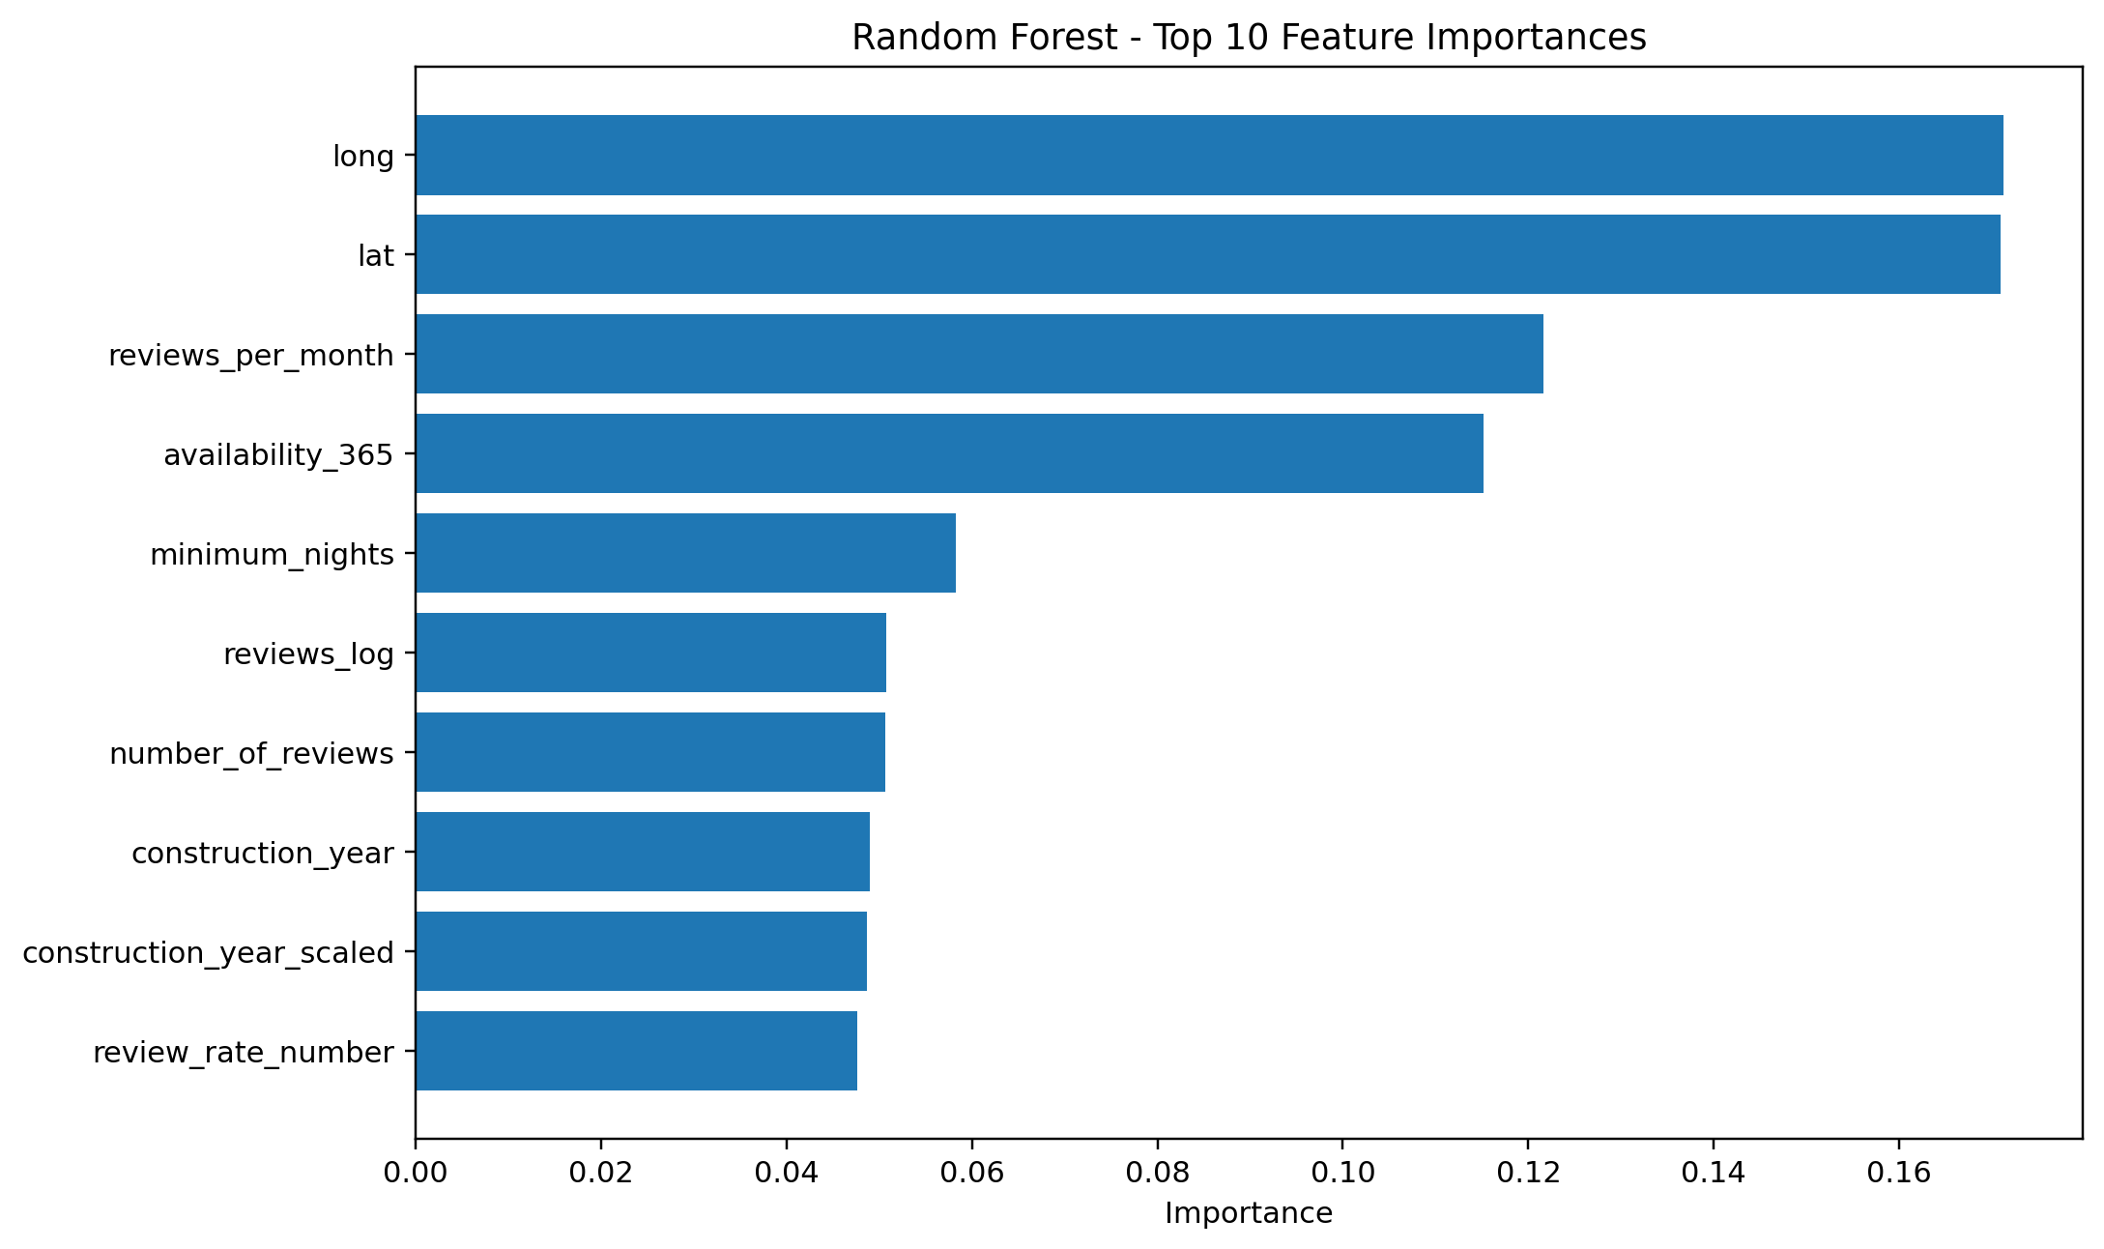
Methodology and Data Correction
Models: Linear Regression, Decision Tree, Random Forest, Gradient Boosting, and KNN.
Metrics: MAE, MSE, and R² on Validation and Test sets.
Average ensemble used predictions from the top 3 validation models.
Bayesian Ridge used for the Bayesian comparison.
Sanity check found target leakage: service_fee correlated ≈ 0.998 with price; fee_to_price_ratio was price-derived.
Both leakage variables were removed and every model was retrained.

Slide 3
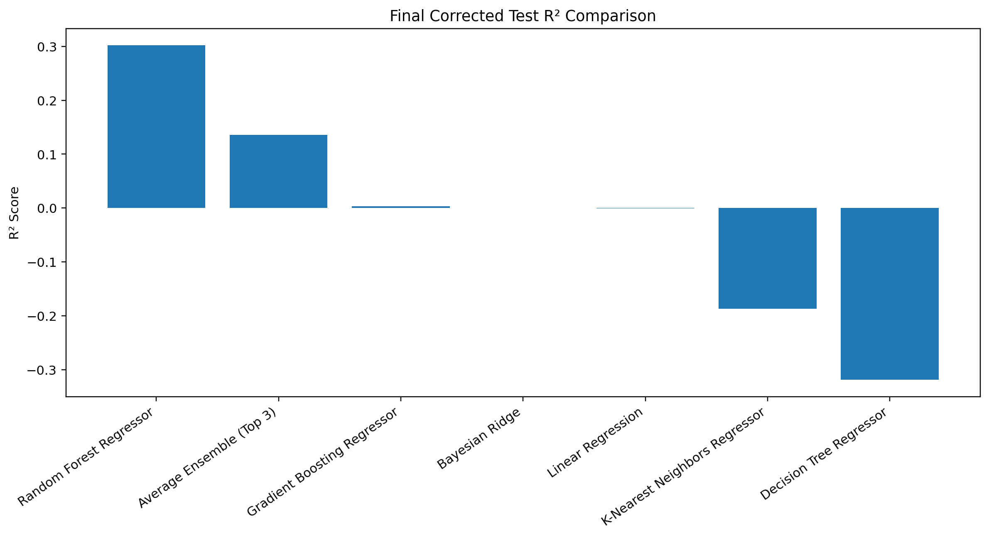
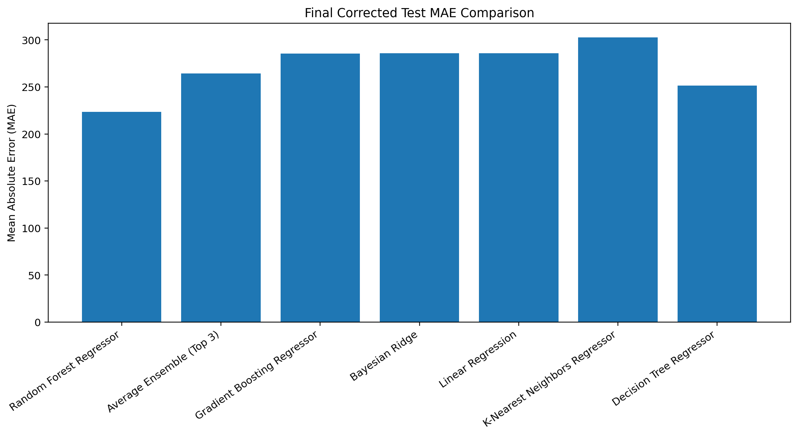
Final Model Results
Winner: Random Forest — Test MAE 223.6204 | Test MSE 76,230.0658 | Test R² 0.3022

Slide 4
Conclusion and Lessons Learned
Random Forest was the best model: highest Test R² and lowest Test MAE/MSE.
Test R² = 0.3022 → the model explained about 30.22% of price variance.
Validation R² (0.3031) and Test R² (0.3022) were very close, showing stable generalization.
The Top-3 Average Ensemble ranked second but did not outperform Random Forest.
Main lesson: unusually high scores must be checked for target leakage before accepting the result.
Future work: richer location/amenity features, cross-validation, tuning, XGBoost/LightGBM.
Final selected model: Random Forest Regressor

