Slide 1
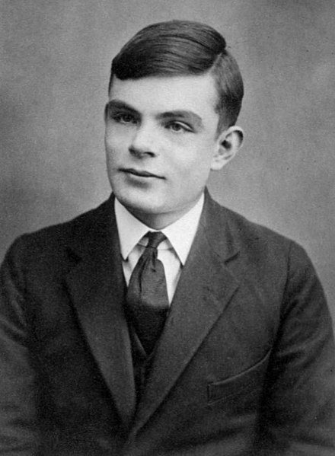
Delay Line

Slide 2
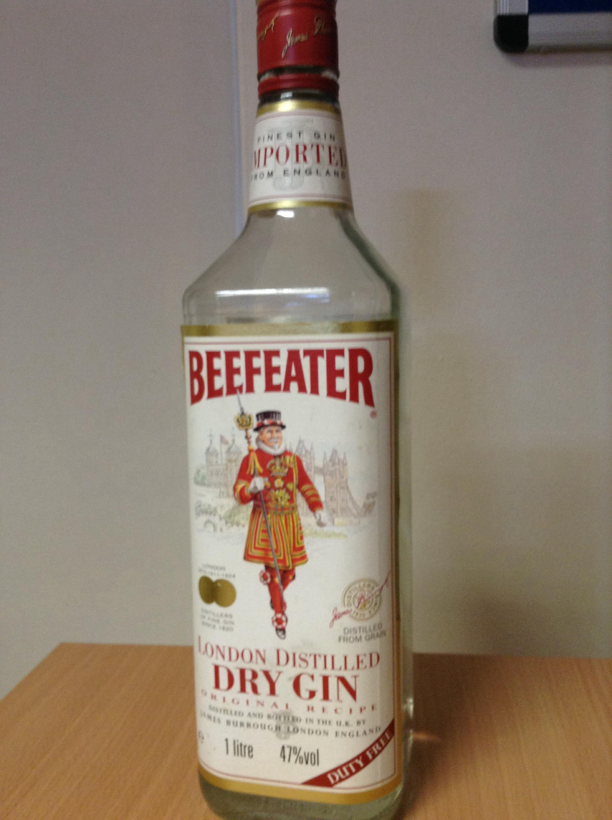
Delay Line

Slide 3
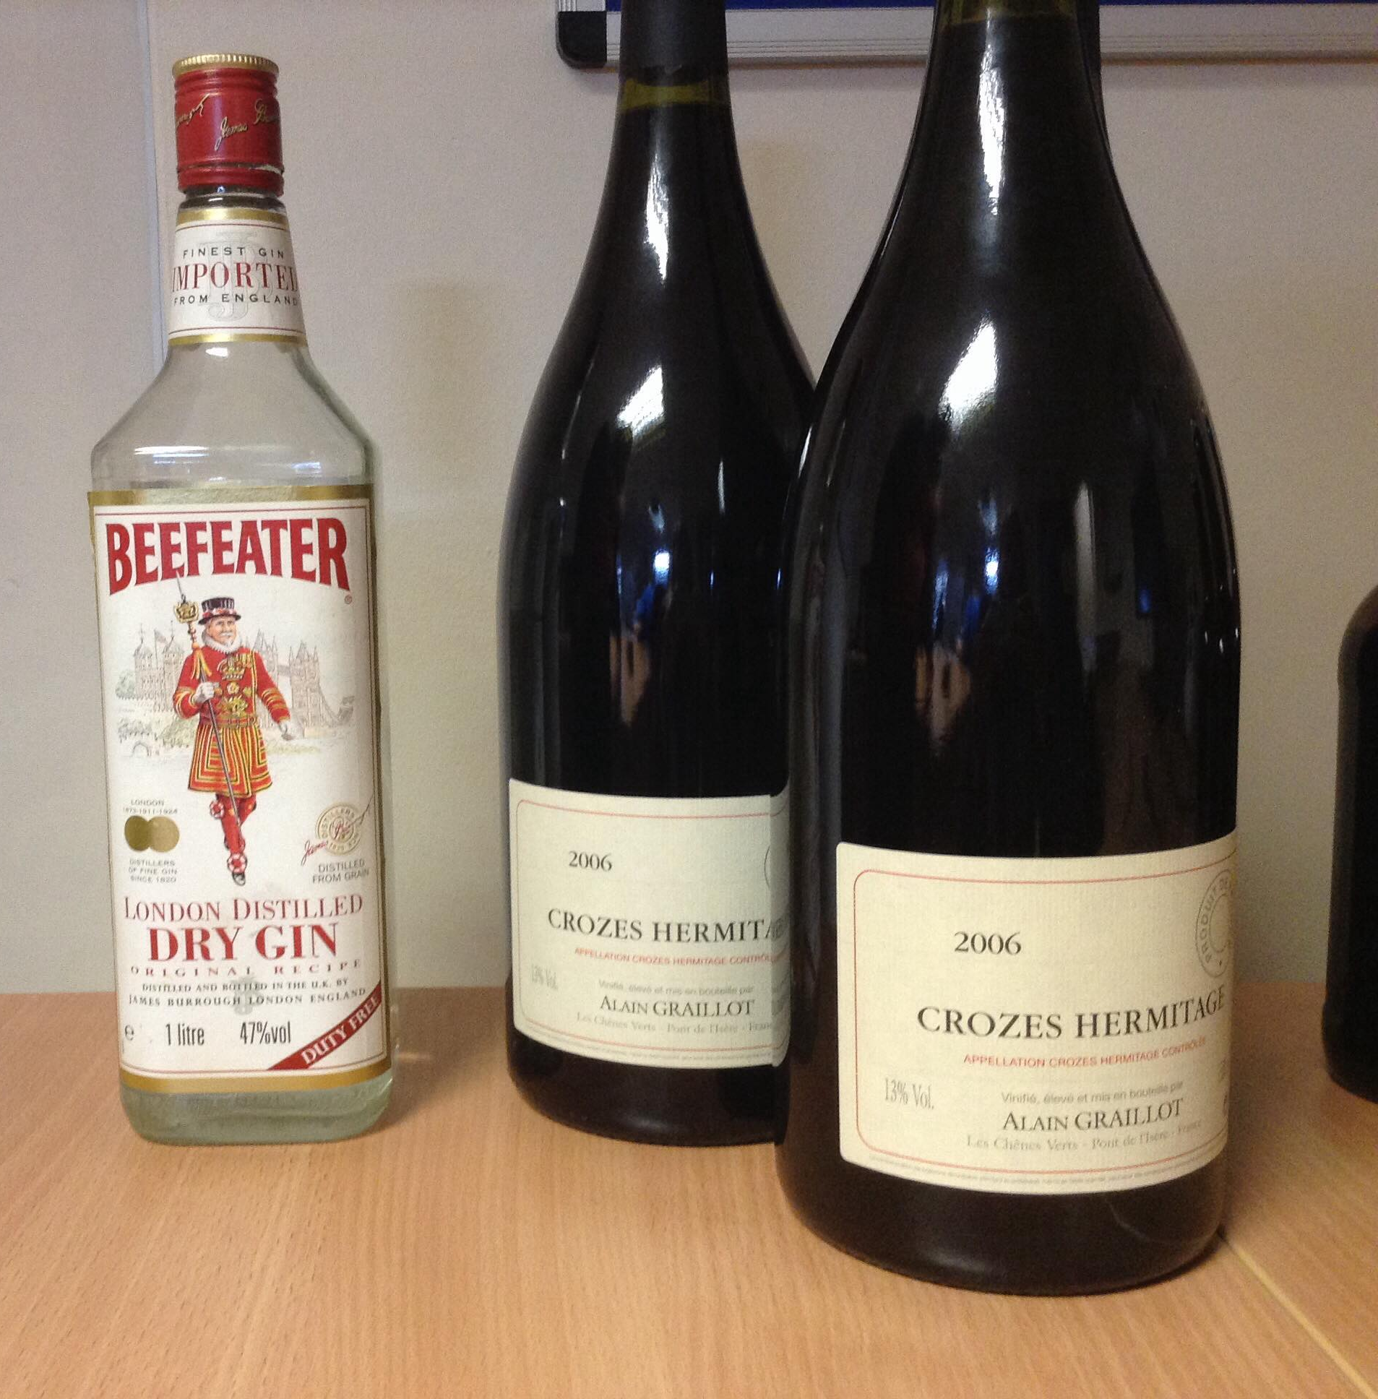
Delay Line

Slide 4
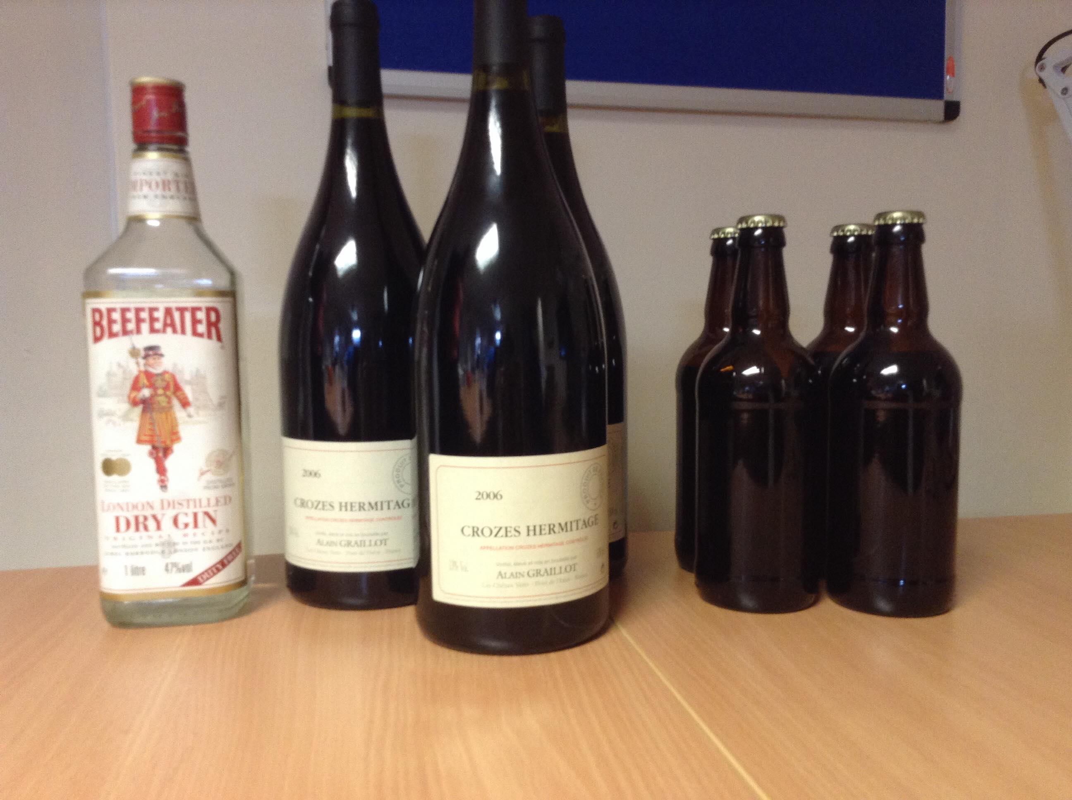
Delay Line

Slide 5
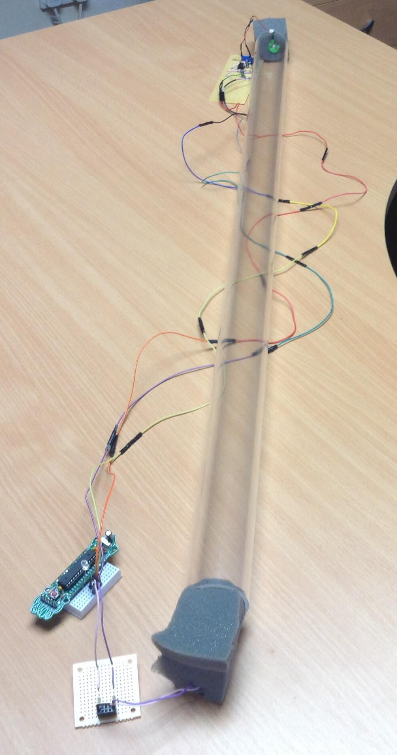
Reimagined Delay Line
Arduino Cuttlefish
Acoustic Foam
Microphone
Speaker
Lots of wire

Slide 6
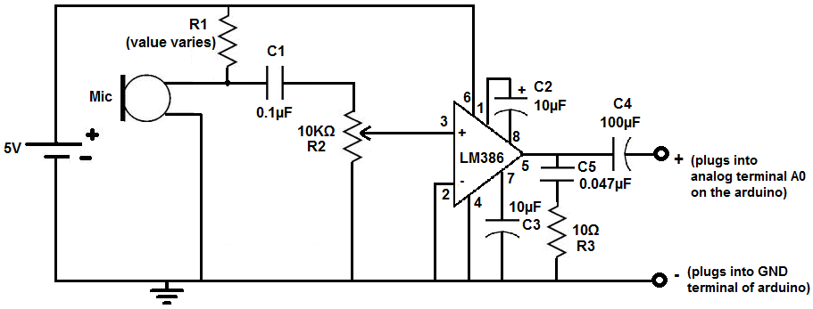
Microphone Circuit

Slide 7
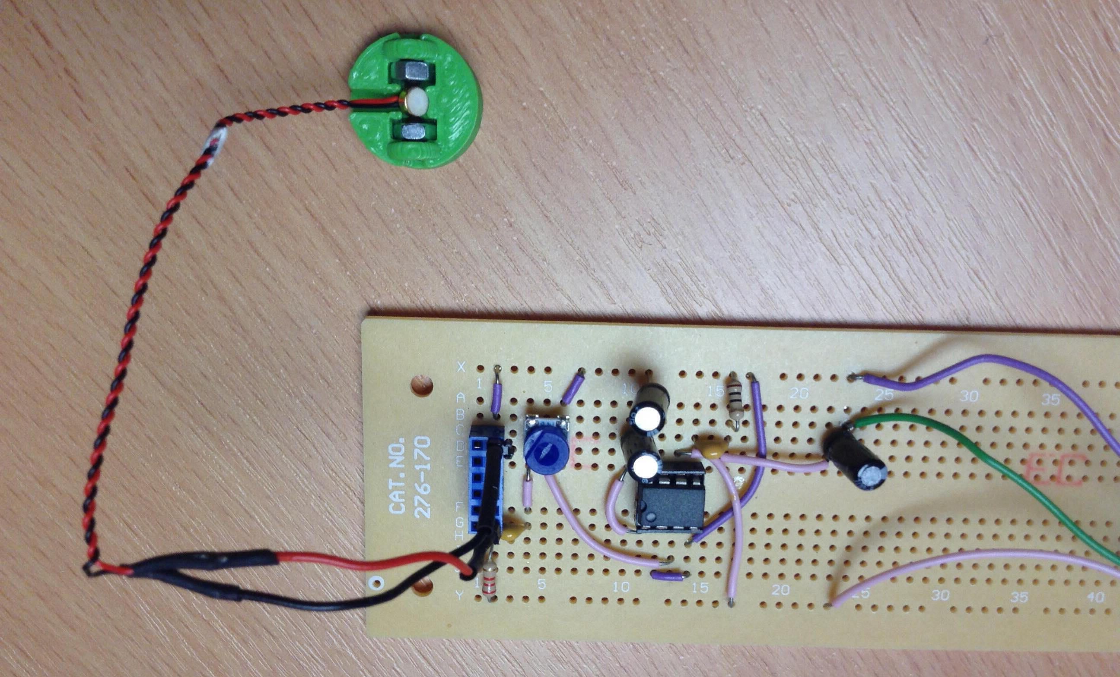
Microphone Circuit

Slide 8
Microphone Circuit
Oscilloscope

Slide 9
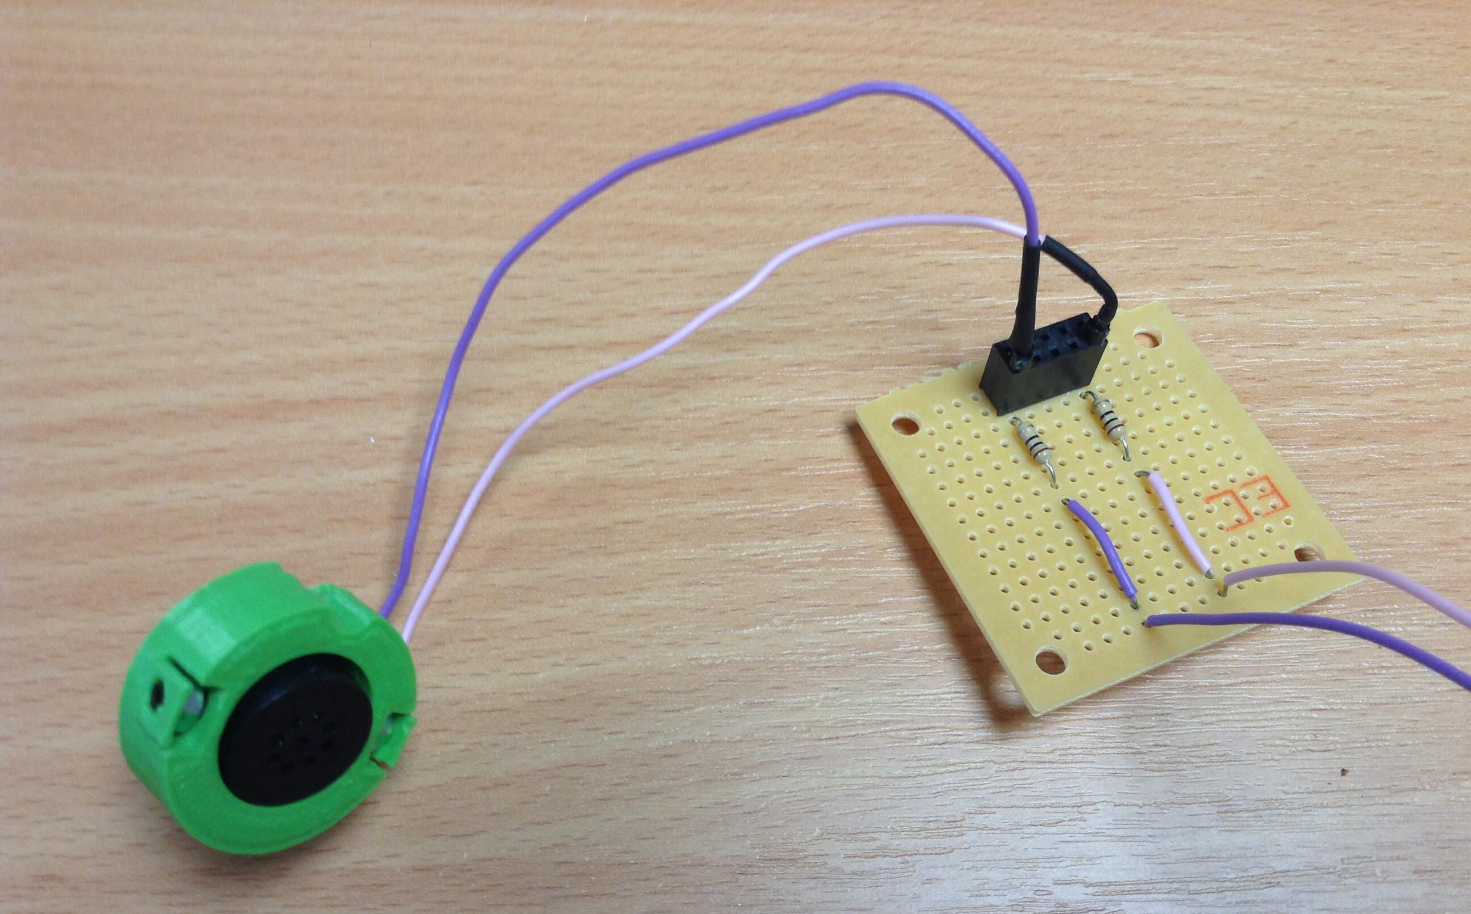
Speaker Circuit

Slide 10
Reimagined Delay Line
Picture of mess

Slide 11
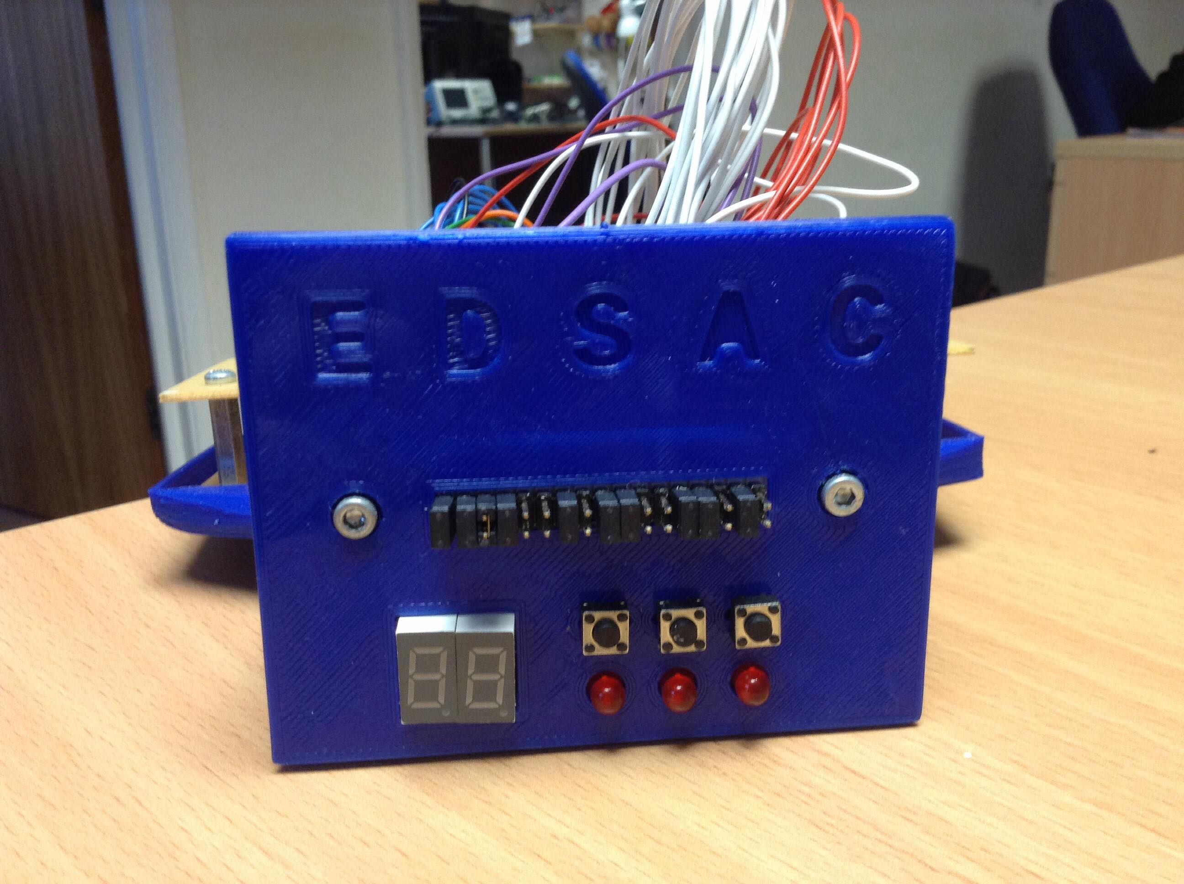
Initial Orders

Slide 12
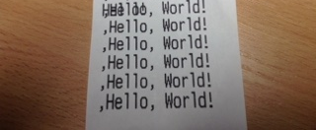
Teleprinter

Slide 13
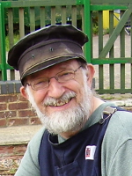
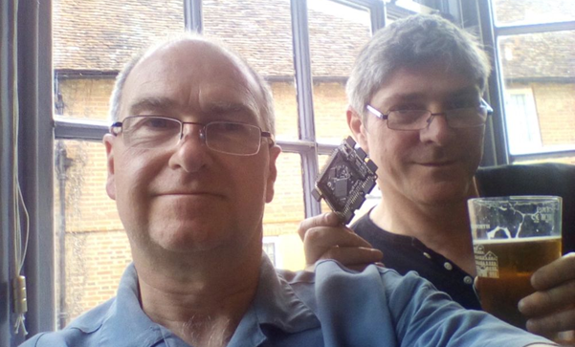

Thank You

Slide 14
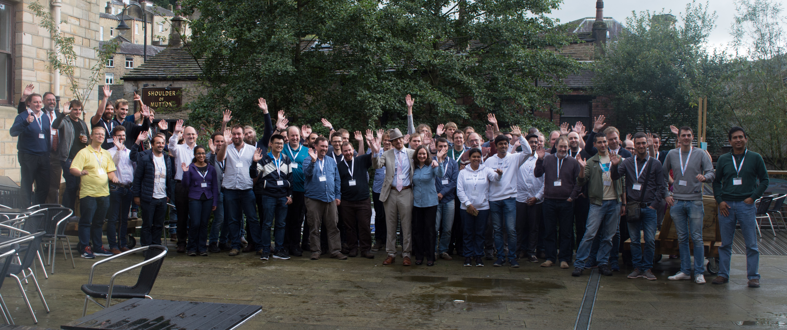
Thank You

Slide 15
Contact
Make your own EDSAC peripherals:
  github.com/embecosm/edsac-peripherals
Hatim Kanchwala Verilog EDSAC:
  github.com/librecores/gsoc-museum-edsac
Bill Purvis Verilog EDSAC:
  http://www.billp.org/ccs/Edsac/index.php
More information on the MyStorm:
  https://mystorm.uk/

