Slide 1
Biases in AI Recruitment Tool
Priyanka Saha
MSDS640
Regis University

Slide 2
Objective
Mitigating biases from AI recruitment tools.
Biases can be Gender, Race, Age or social status based.
Our main focus will be mitigating Gender bias and at the same time we will look for other biases too.
We will keep in mind that we will not introduce new biases when mitigating one.

Slide 3
Dataset
Dataset is taken from Kaggle - https://www.kaggle.com/datasets/surendra365/recruitement-dataset
Features are - Job Applicant Name, Age, Gender, Race, Ethnicity, Resume, Job Roles, Job Description, Best Match.
The data is labeled.
There are two decision making features: Best Match - denotes whether a candidate is selected or not, Job Roles - denotes the role based on resume.

Slide 4
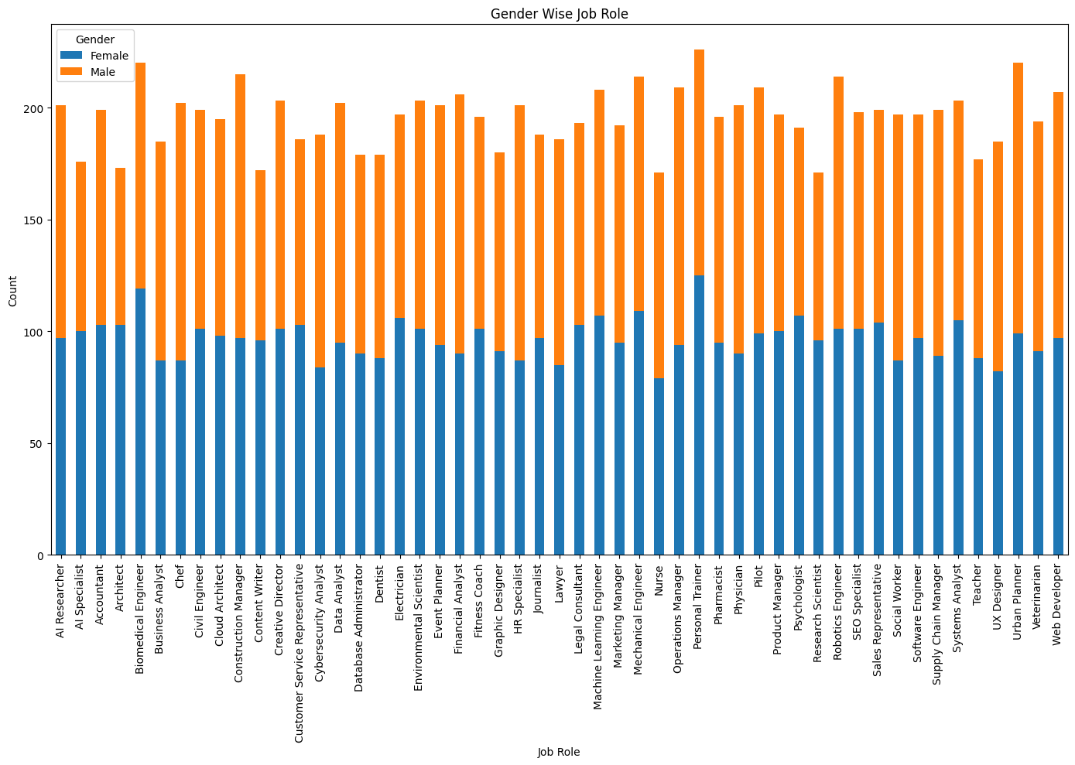
EDA
The dataset looked well balanced with different gender, race, ethnicity and job role.
Gender wise job role is shown beside.

Slide 5
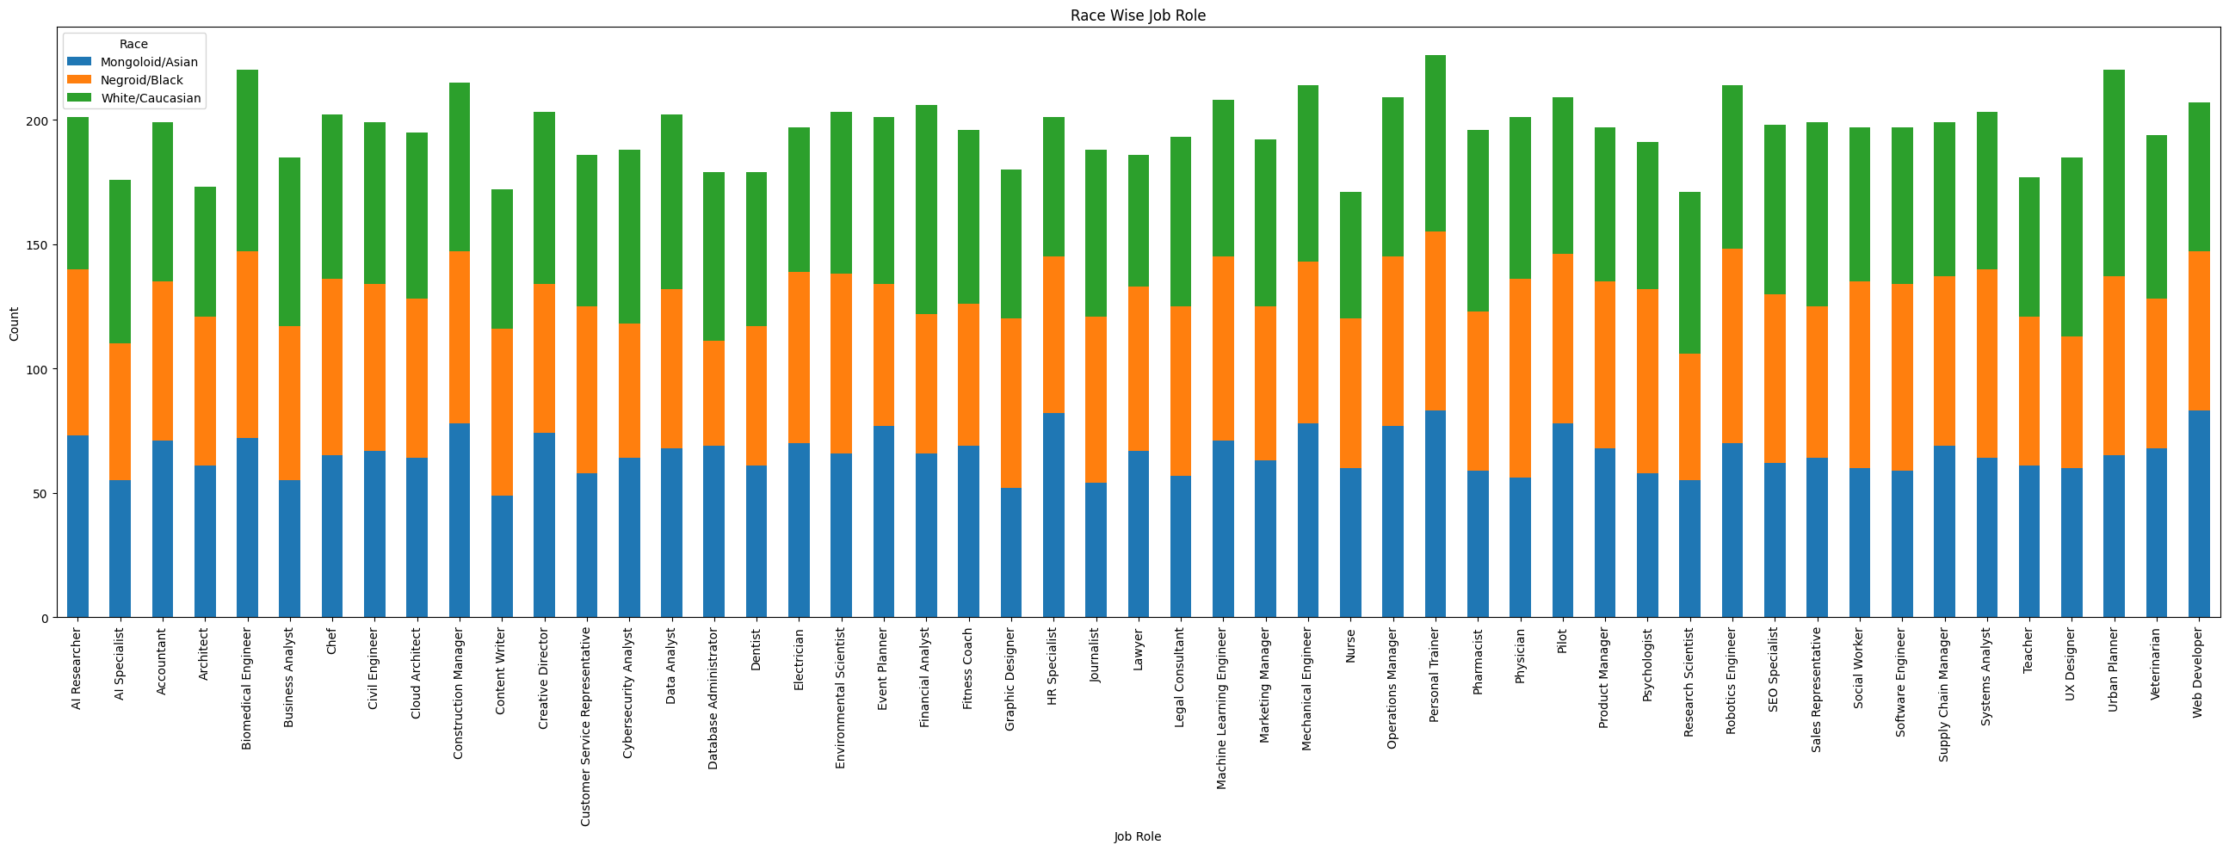
Race wise Job Role

Slide 6
Process
As the dataset is labeled, we have used supervised learning.
Learning models used:
Logistic Regression
Decision Tree
Gradient Boosting
KNN
Two types of models created:
Models with target as Best Match
Models with target as Job Roles

Slide 7
Data Cleaning and Pre-process – Target as Best Match
Removed urls, punctuations, extra space etc.
Removed stop words.
Removed most common words.
Applied stemming.
Ran the supervised learning models using this dataset.

Slide 8
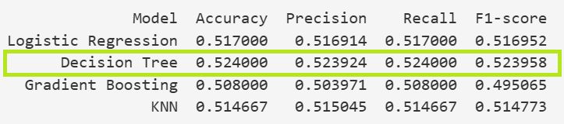
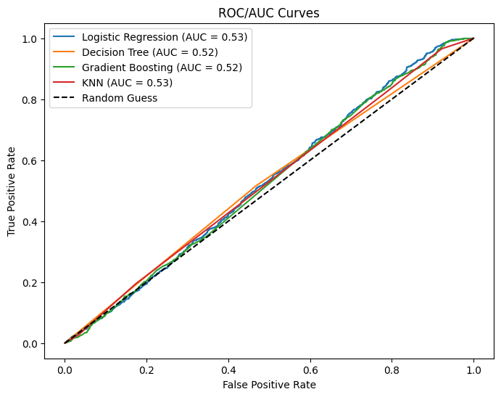
Result – Target as Best Match
Decision Tree has the highest accuracy.
However, none of the accuracy are high.

Slide 9
Fairness Metric
We used Logistic Regression to check the fairness metrics.
First, we checked the fairness metrics.
Applied mitigator.
Then we again checked fairness metrics.

Slide 10
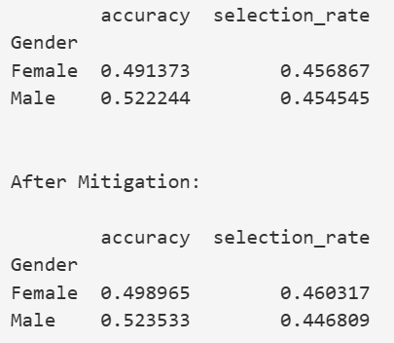
Result on Gender
We can see there are almost no difference between the selection rate of Male and Female.
We still applied mitigator on top of it.
Mitigator only worsened the gap between the selection rates.

Slide 11
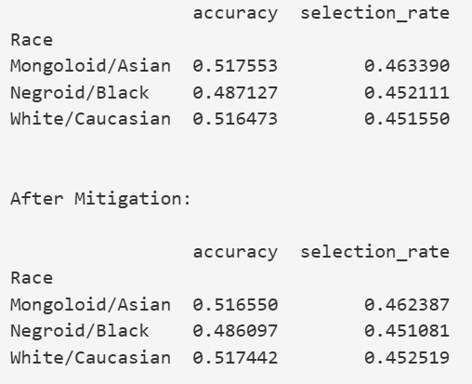
Result on Race
We can see there are almost no difference between the selection rate of Male and Female.
We still applied mitigator on top of it.
Mitigator did not change much.

Slide 12
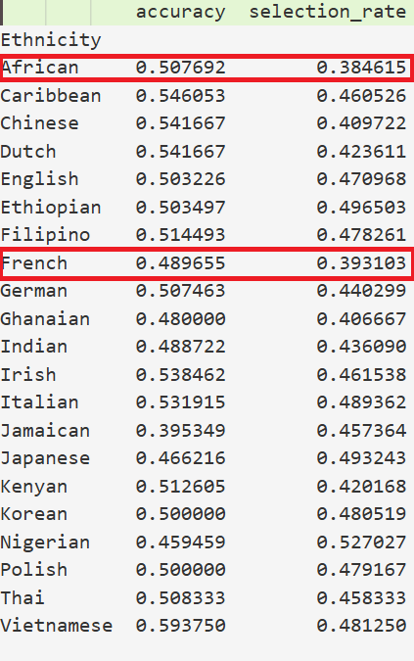
Result on Ethnicity - Before Applying Mitigator
We can see African and French Candidates has less selection rate than candidates of other ethnicity.

Slide 13
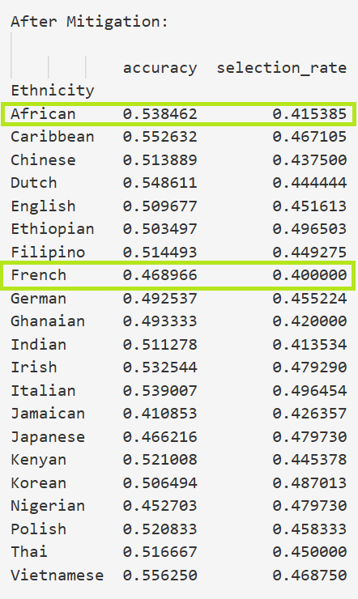
Result on Ethnicity - After Applying Mitigator
The selection rate of African and French candidates has increased.
Mitigator balanced the gap of selection rates for African and French candidates.

Slide 14
Data Cleaning and Pre-process – Target as Job Roles
Removed urls, punctuations, extra space etc.
Removed stop words, biased words like "Women", "Male" etc.
Applied stemming.
Removed the most common words in the dataset.
Checked for similar resumes in same Job Role and if found a 70% match or more, removed the second record.
Dropped unnecessary features - "Job Applicant Name", "Age", "Gender", "Race", "Ethnicity", "Job Description", "Best Match" from the dataset.
Then we ran the supervised learning models using this processed dataset.

Slide 15
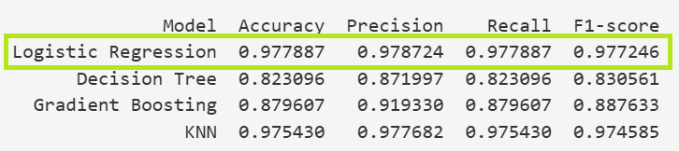
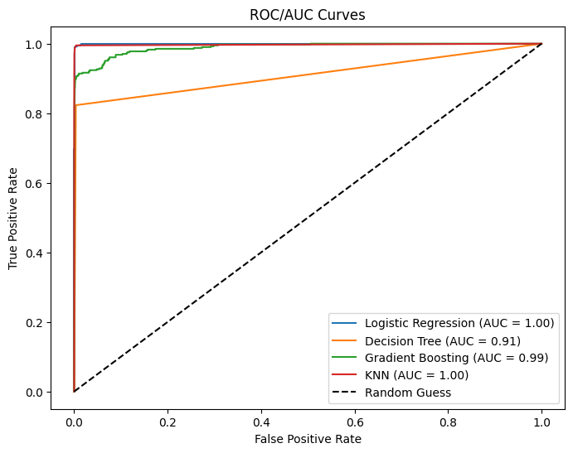
Result – Target as Job Roles
Logistic Regression gave the highest accuracy.
Accuracy looks good.

Slide 16
Conclusions
Mitigator may not perform well always.
We should check the before and after result for mitigator.
Models with Job Role as target performed much better than models with Best Match as target.
Models with Job Roles as target trained on dataset where sensitive keywords are removed. These models did not learn about sensitive groups.
Logistic Regression model with Job Roles as target gave the highest accuracy.

Slide 17
Thank You!

