Slide 1

Evaluating Fairness in Mortgage Markets
Craig Rudman
Marketing and Data Science Department
Regis University
MSDS 640
Prof. Ghulam Mujtaba
August 22, 2025
Insights from 2024 HMDA Data

Slide 2
Background: The Home Mortgage Disclosure Act (HMDA)
Enacted 1975 → to bring transparency to mortgage lending.
Purpose → requires lenders to disclose loan application and outcome data.
Relationship to civil rights laws → complements the Fair Housing Act (1968) & Equal Credit Opportunity Act (1974).
Congressional expansions → added reporting of race, sex, income in response to discrimination, savings & loan crisis, and predatory lending.
2010 Dodd-Frank Act reforms → authority shifted to CFPB; added detailed loan-level data (e.g., age, credit score, loan terms).
Impact → strengthened tools for regulators, researchers, and the public to detect discrimination, assess risks, and ensure accountability.
“HMDA data are the only publicly available source of nationwide loan-level data on the supply and demand for mortgage credit. (GAO, 2021)”
Notes:
The Fair Housing Act of 1968 prohibited discrimination in housing.
The Equal Credit Opportunity Act of 1974 extended those protections to credit transactions.
In 1975, the Home Mortgage Disclosure Act, or HMDA, was enacted. Its purpose was to increase transparency by requiring financial institutions to report data on mortgage applications and outcomes.
Over time, Congress expanded HMDA to require reporting of borrower race, sex, and income in response to evidence of discrimination, the savings and loan crisis, and predatory lending.
In 2010, the Dodd-Frank Act transferred authority over HMDA to the CFPB and required more detailed loan-level data, such as age, credit score, and loan terms.
Together, these laws provide the framework for identifying discrimination, monitoring systemic risk, and ensuring accountability in the mortgage market.
HMDA data are the only publicly available source of nationwide loan-level data on the supply and demand for mortgage credit.

Slide 3
Purpose of this Study
This study attempts to call attention to the persistent disparities in lending outcome by race and ethnicity and highlight some of the nuances involved in interpreting the HMDA data.
It address the question, how do approval rates vary by race/ethnicity and loan type?

Slide 4
2024 HMDA Modified Loan/Application Register (LAR) dataset

Slide 5
2024 HMDA Modified Loan/Application Register (LAR) dataset
12.2 million observations of loan applications
4,908 lending institutions
4 different loan types
Conventional (not insured or guaranteed by FHA, VA, RHS, or FSA)
FHA insured VA guaranteed
RHS or FSA guaranteed

Slide 6
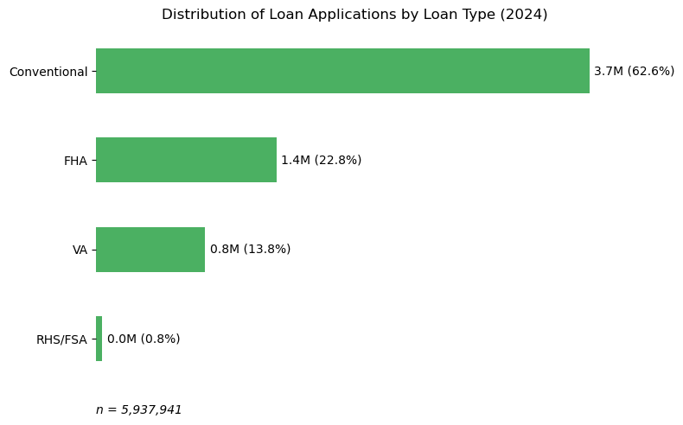
Scope of this study
Dataset: 5.9M closed-end, first-lien, site-built principal-residence applications
Variables examined: denial rates, approval outcomes, loan types, race and ethnicity

Slide 7
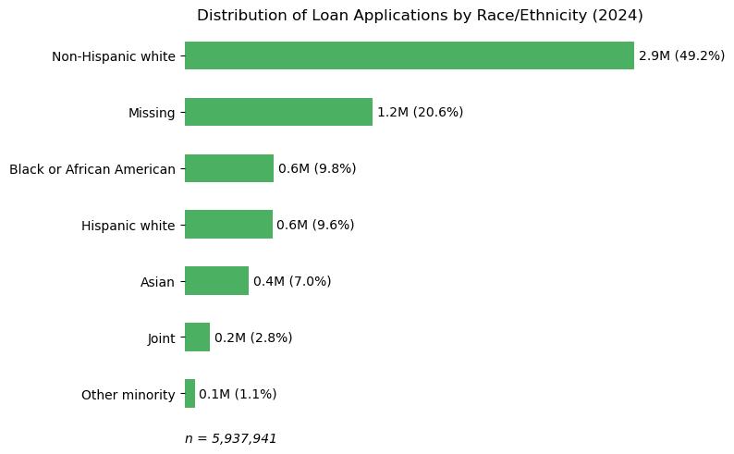
Race and Ethnicity
Race and ethnicity are aggregated following conventions used by the CFPB

Slide 8
Loan Types described
Conventional: any mortgage loan that is not insured or guaranteed by the government
FHA: The Federal Housing Administration (FHA) provides mortgage insurance to FHA-approved lenders to protect these lenders against losses if the homeowner defaults on the loan.
VA: The Department of Veterans Affairs (VA) offers loan programs to help service members, veterans, and their families buy homes.
RHS/FSA: The Rural Housing Service (RHS) offers mortgage programs that can help low- to moderate-income rural residents purchase, construct, and repair homes.

Slide 9
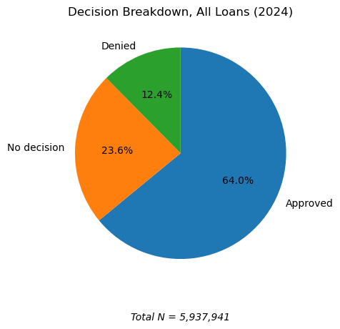
Decision status
Maps action taken to a decision.
1 - Loan originated
2 - Application approved but not accepted
3 - Application denied
4 - Application withdrawn by applicant
5 - File closed for incompleteness
6 - Purchased loan
7 - Preapproval request denied
8 - Preapproval request approved but not accepted

Slide 10
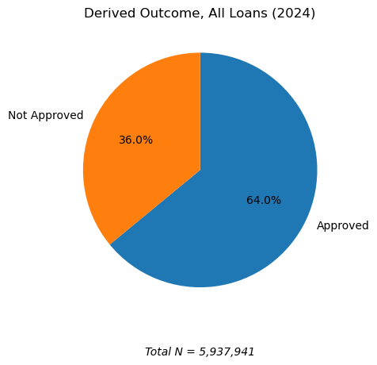
Outcome
Maps Decision to an Outcome
Approved
Denied
No Decision

Slide 11
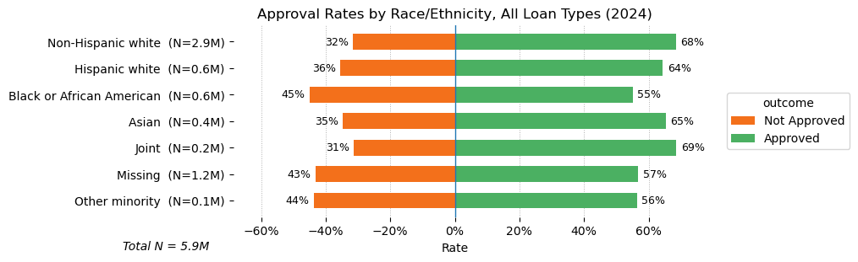
Approval Rates by Race/Ethnicity
Significant disparities across groups

Slide 12
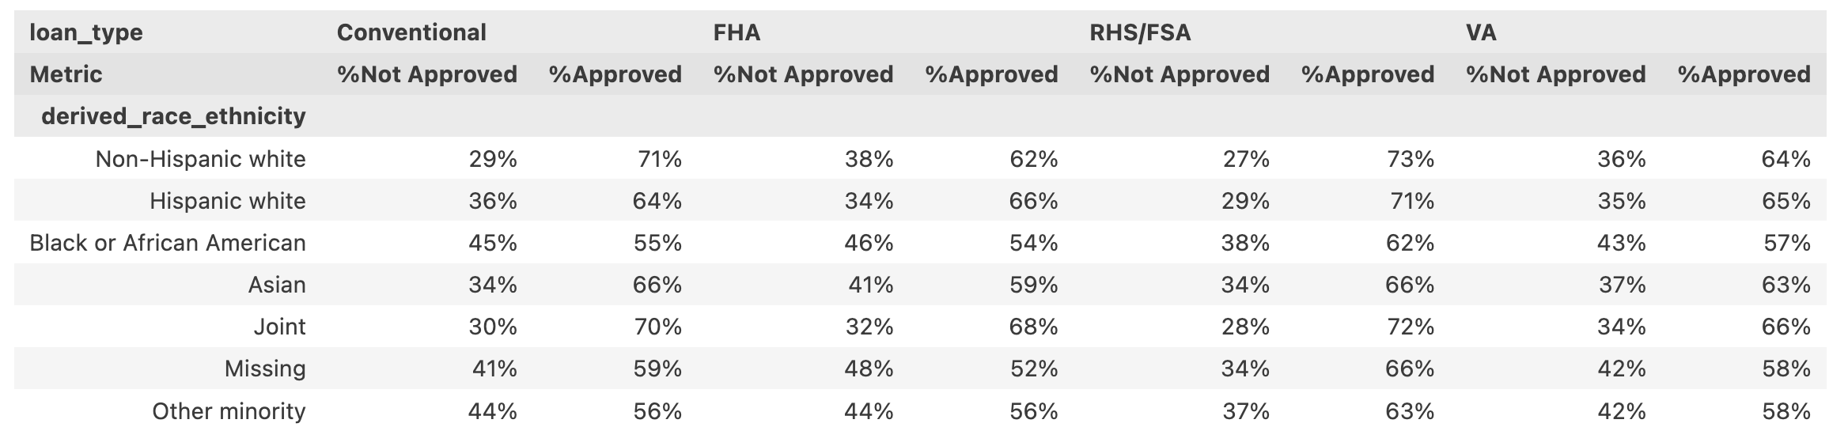
Approval rates by Race/Ethnicity and Loan Type
Approvals of Black or African American Conventional loan applications lag behind those coded as Non-Hispanic white by 16 points.

Slide 13
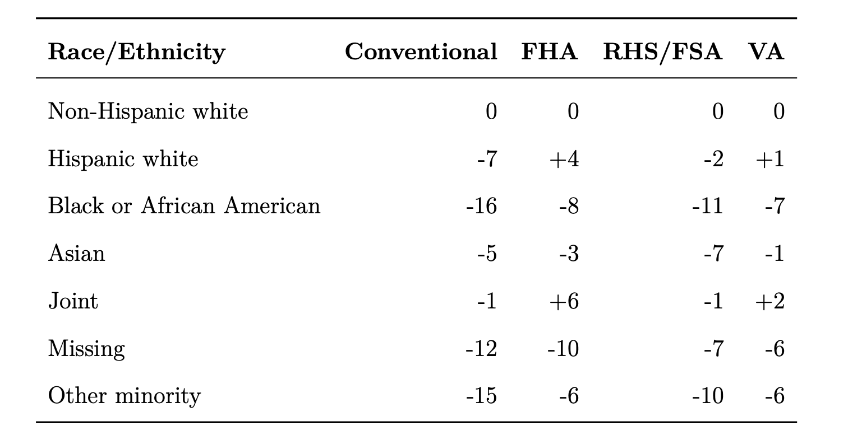
Disparity Gap by Race/Ethnicity and Loan Type

Slide 14
Key Insights
Conventional loans show the largest inequities
Government-backed (VA, FHA) show narrower gaps but not elimination
“No decision” outcomes complicate data analysis

Slide 15
Conclusion
Takeaway: Disparities persist in 2024 lending outcomes
Implication: HMDA remains vital for transparency
Next Steps: Improved analytic methods, better public data access

