Slide 1
Status and Messaging
ABC COMPANY
Task 2 Executive Summary to Senior Leadership by Mary Donovan Martello
AIRLINE SAFETY

Slide 2
Introduction
Issue Addressed: The media has been promoting statistics stating air is no longer a safe way to travel and is representing to the public that air travel is now as least as dangerous as automobile travel.
Recommendation: Company should address the change in media coverage of air safety.

Slide 3
Overview
Issue Addressed:
Air travel is important to the US economy and the Company.
The COVID-19 pandemic is impacting the use of air travel and it is important that non-virus safety issues should not add to that decline in air travel because the data shows that air travel recovers after major economic downturns.
Social media is spreading false and negative media news reports at increasingly alarming rates.
Air fatalities are declining as passenger use of air travel increases.
US airlines have much better safety records than foreign airlines.
Air fatalities in fact occur at a much lower rate than automobile fatalities.

Slide 4
THE AIRLINE INDUSTRY IS IMPORTANT TO THE US ECONOMY
$10,000,000
JOBS SUPPORTED

Slide 5
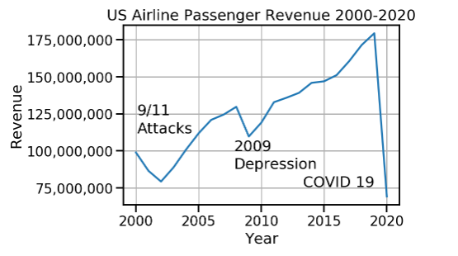
Long-Term Revenue Threat
COVID-19 is a Short-Term Revenue Threat
Misleading Media Messages is a Long-Term Revenue Threat
The COVID-19 pandemic is impacting the use of air travel but the air industry recovers after major economic downturns.
  9/11 dip reversed after economy recovered and hijacking security issues fixed.
  2009 Depression dip reversed after economy recovered.
However, misleading media reports on air travel safety could have long-term negative effects on airline revenue.

Slide 6
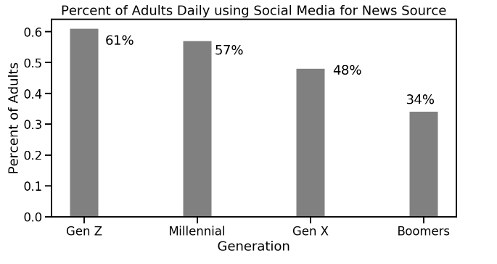
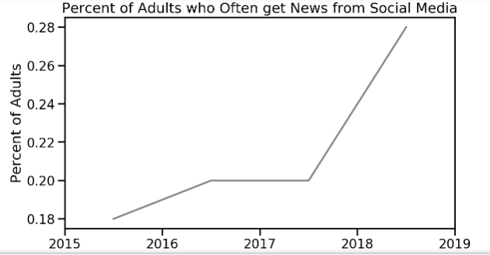
Social Media Threat
Misleading Media Messages Must be Addressed on Social Media
Adult Americans are getting their news from social media platforms at increasing frequency.
61% of young adults use social media for a news source – DAILY
Even 34% of Boomers use social media for a news source – DAILY
The % of American adults who “often” use social media as a news source is increasing --QUICKLY.

Slide 7
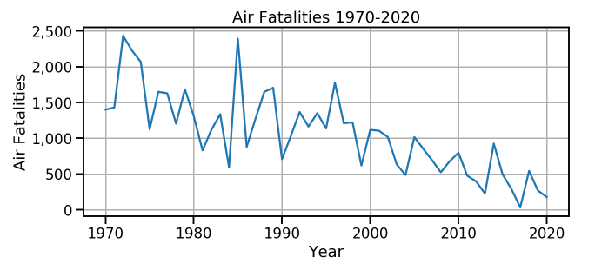
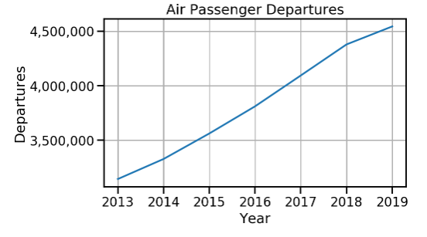
Fatalities DOWN; Use UP
Air fatalities are declining as passenger use of air travel increases.
Trend of fatalities have been decreasing for years – not up.
  Despite spikes in certain years, the trend line shows improvements in airline safety.
  Media may be focusing on spikes or simply 2019 (542 fatalities) vs 2018 (267 fatalities).
As fatalities have decreased, the number of passengers traveling by air is steadily increasing – improving safety ratios.

Slide 8
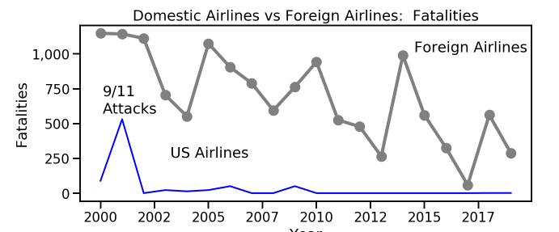
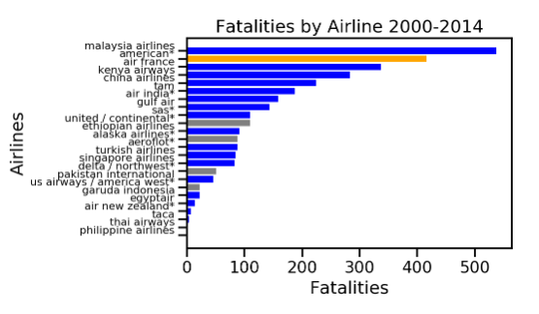
US Airlines Safer than Foreign Airlines
US airlines have much better safety records than foreign airlines.
Foreign airline fatalities counts much higher than US airlines.
8 of the ten airlines with the most fatalities in recent years are foreign airlines.
20 of the 24 airlines that had fatalities between 2000-2014 were foreign airlines.
7 airlines accounted for 69% of fatalities during this period.
American Airlines and United Airlines counts include 4 planes in the 9/11 attacks.

Slide 9
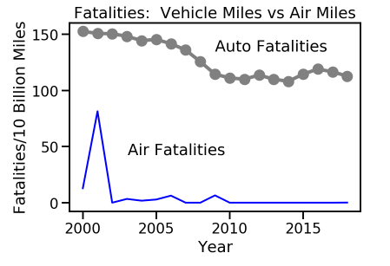
Auto Fatality Rate Much Higher than Air
Air fatalities in fact occur at a much lower rate than automobile fatalities
Comparison is the fatalities per 10 Billion miles traveled of auto vs air travel.
Auto travel fatality rate is much higher than the air travel fatality rate.
100 to 150 times LARGER.

Slide 10
Summary
Misleading media reports of air travel safety should be addressed as air travel is important to the US economy and ABC Company.
Misleading media reports is a long-term threat to Company’s revenue.
Travel will rebound from the COVID 19 pandemic and before then the Company’s and US airline safety performance should be promoted.
Promotions should absolutely include promotions on social media.
US air travel is safe and should be promoted to the media and on social media.

