Slide 1
Are you ready to start?
Conditionals

Slide 2
Agenda of the class
Recap of last session
if statement
else statement
elif statement
try/except
finally clause
pass statement

Slide 3

Recap lesson 3

Slide 4
Get input
Get input using the input() - function

Slide 5
Convert variables, type()
Convert variables into other data types using:
int()
str()
…
Use type() to get the type of a variable

Slide 6
Assignment operators
Use “=” to assign a value to a variable
Use “+=” or “-=” to increase/decrease the value of a variable

Slide 7
Logical operators
Use and, or and not to combine conditional statements
relevant for this lesson

Slide 8
if statement

Slide 9
if statement
Is used to determine the execution of code based on the evaluation of a boolean expression
If the expression evaluates to True, the following indented code is executed
If the expression evaluated to False, the indented code following the if statement is skipped

Slide 10
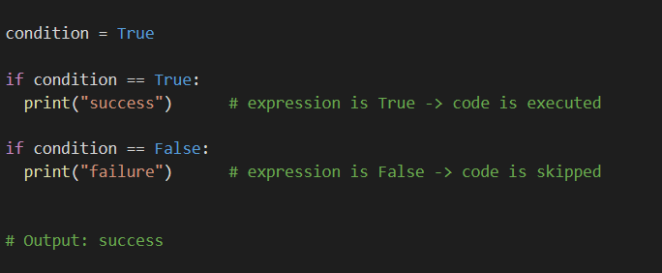
if statement

Slide 11
Nested if statement
When you have an if statement inside another if statement this is called a nested if statement

Slide 12
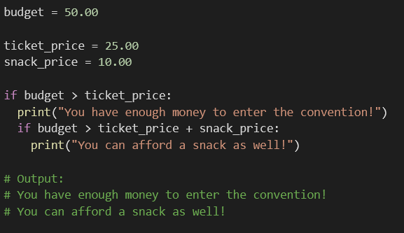
Nested if statement

Slide 13
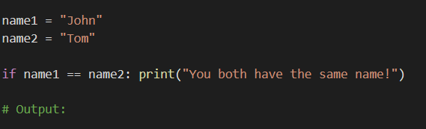
shorthand if statement
If you only want to execute one statement, you can put it on the same line as the if statement

Slide 14
else statement

Slide 15
else statement
The else statement provides an alternate code to execute if the expression in the if statement evaluates to False
The indented code following the else statement is only executed if the expression evaluates to False

Slide 16
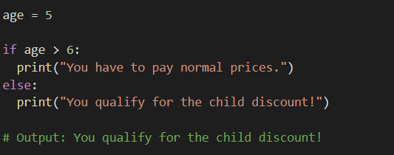
else statement

Slide 17
elif statement

Slide 18
elif statement
The elif statement allows you to perform additional checks after an initial of statement
The difference between an elif and an else statement is that you can provide another condition to be checked

Slide 19
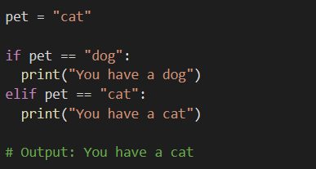
elif statement

Slide 20
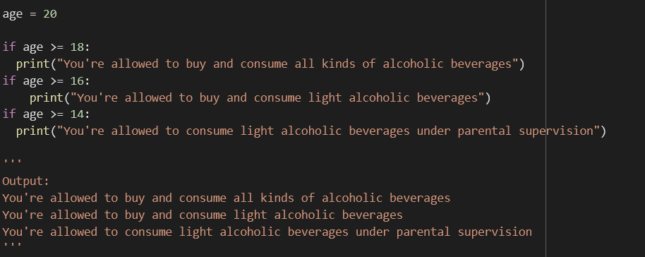
When to use the elif statement
several if statements

Slide 21
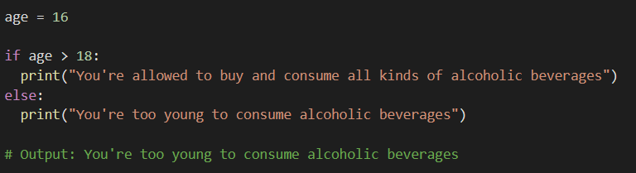
When to use the elif statement
if - else switch

Slide 22
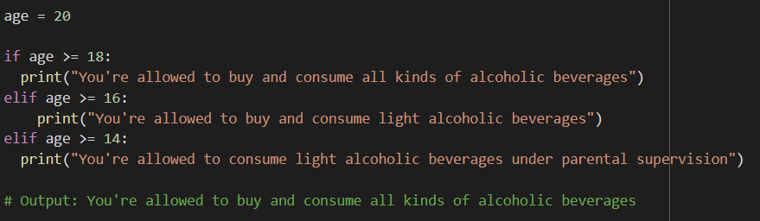
When to use the elif statement
elif statement

Slide 23
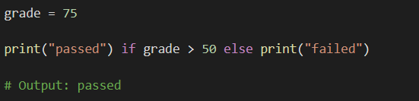
shorthand if - else statement
If you have only one if and one else statement you can put it on the same line:

Slide 24
try/except

Slide 25
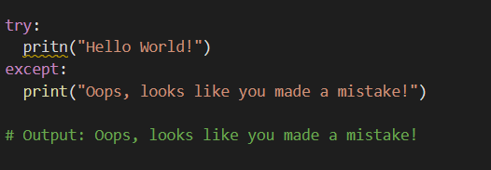
try/except
The try-except clause is used to prevent our program from crashing if an exception is raised

Slide 26
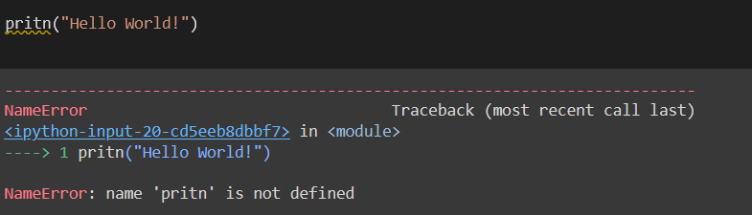
try/except

Slide 27
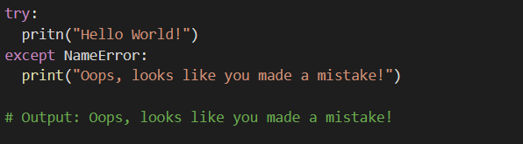
try/except
You should always try to use specific exception when working with try/except
You will learn about exceptions later in the semester

Slide 28
try/except
Note: The try/except clause can only catch runtime errors !
This means that you cannot catch Syntax Errors using try/except
runtime error: error that occurs during a programs execution

Slide 29
Background knowledge:
How a Python program is executed
Python program is created
Compilation
program is converted into byte code
Interpretation
byte code is is converted into machine code by PVM
machine code instructions are executed by processor and results are displayed

Slide 30
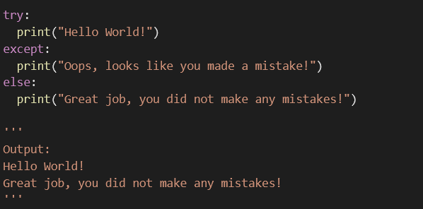
try/except/else
We can also use the else statement if we only want to run certain code when we do not encounter an exception

Slide 31
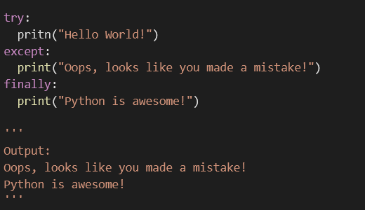
finally clause
The finally clause is a way to always execute code no matter if an exception occurs or not

Slide 32
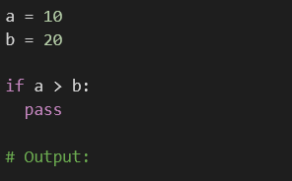
pass statement
If you use an if statement and for some reason you want it to do nothing you can use the pass statement

