Slide 1

TO configure DNS(Domain Name System) DHCP Web Server
Presented by
Razia(02)
Syed Mushtaque Shah(20)
Saifullah (26)
Mary Florence(46)
Musain(56)

Slide 2
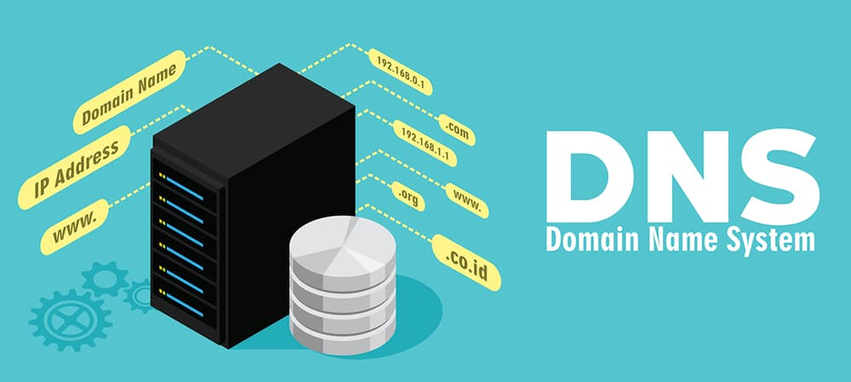

Slide 3
It is like a phonebook for internet,translating human-readable domain names(like[invalid URL removed]) into machine readable IP addresses that computer can understand.
DNS is a critical infrastructure that enables communication between human and computers on the internet.
DNS is essential for:
Load balacing: (Distributing traffic across multiple servers)
Domain name resolution: (Translating domain names into IP addresses)
Reduncacy: (Ensuring high availability and fault tolerance)
Security: (helping to prevent cyber attacks and malware spread)
DNS records come in various tyes:
A(Address), CNAME(Canonical Name),MX(Mail Exchange),NS(Name Server),PTR(Pointer)

Slide 4
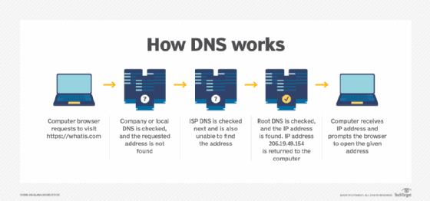

Slide 5
cONFIGURING DNS ON LINUX
Install BIND:
Bash
sudo apt install bind9
Use code with caution.
Configure BIND:
Edit the configuration files: /etc/bind/named.conf, /etc/bind/named.conf.options, /etc/bind/named.conf.local.
Define zones (forward and reverse lookup), resource records (A, NS, MX, etc.), and other parameters.
Example configuration:
zone "example.com" IN {
type master;
file "/etc/bind/db.example.com";
};

Slide 6
Create zone files:
Create files like /etc/bind/db.example.com to define domain-specific records.
Start and enable BIND service:
Bash
sudo systemctl start bind9
sudo systemctl enable bind9

Slide 7

DYNAMIC HOST CONFIGURATION PROTOCOL

Slide 8
DHCP is network protocol that assigns IP addresses and other network settings to devices on a network automatically
Dynamic: IP addresses are assigned dynamically,meaning they can changew each time a device connects to network.
Host:Refers to device on the network ,like computer etc
Configuration:DHCP sets up the necessary network settings for each device.
Protocol: A set of rules govering how data is transmitted and recieved
DHCP simplifies the network administration by:
Assigning IP addresses automatically.
Eliminating IP addresses conflicts.
Providing additional network settings.

Slide 9
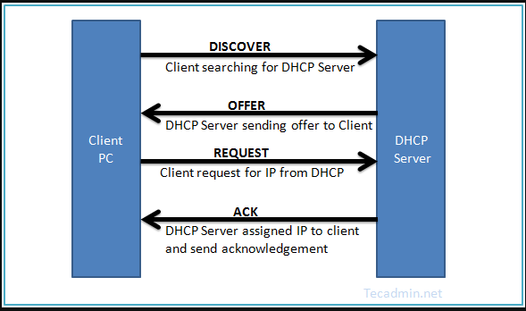
HOW DHCP WORKS?

Slide 10
CONFIGURING DHCP
Install ISC DHCP:
Bash
sudo apt install isc-dhcp-server
Use code with caution.
Configure DHCP:
Edit the configuration file: /etc/dhcp/dhcpd.conf.
Define network ranges, subnet masks, default gateways, DNS servers, and lease times.
Example configuration:
subnet 192.168.1.0 netmask 255.255.255.0 {
range 192.168.1.100 192.168.1.200;
option routers 192.168.1.1;
option domain-name-servers
8.8.8.8, 8.8.4.4;
}

Slide 11
Start and enable DHCP service:
Bash
sudo systemctl start isc-dhcp-server
sudo systemctl enable isc-dhcp-server

Slide 12
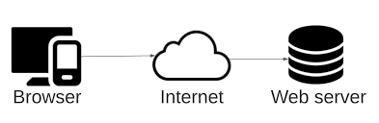
WEB SERVER

Slide 13
Web servers are computers that store and manage websites, handling incoming requests from clients (web browsers) and sending responses.
They use HTTP(Hyper Text Transfer Protocol) to communicate with clients.
Delivers wrb contents (browsers) to client over HTTP protocol.
Key features are:
hosting
request handling
resonse sending
security
performance optimization
Web servers can be classified into :
shared web server
Dedicated web server
Cloud web server
Load balancing

Slide 14
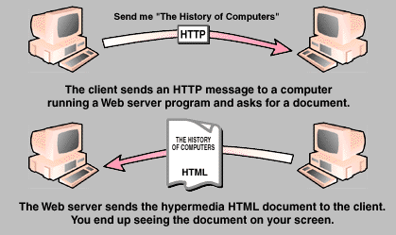

Slide 15
CONFIGURING WEB SERVER ON LINUX
Configuring Web Server
Popular web server software: Apache, Nginx
Steps:
Install web server:
Bash
sudo apt install apache2
``` (for Apache)
```bash
sudo apt install nginx
``` (for Nginx)
Use code with caution.
Configure web server:
Edit the configuration file (e.g., /etc/apache2/apache2.conf for Apache, /etc/nginx/nginx.conf for Nginx).
Define document root, virtual hosts, error pages, and other settings.
Notes:
⁷Conversation with Gemini Give me solution for this exercise and tell me about it I'm sorry, I don't have access to image information yet. I'm still under development and learning how to process image information. Give me explanation about configuring DNS,DHCP and web server on Linux Show drafts Configuring DNS, DHCP, and Web Server on Linux Understanding the Components Before diving into the configuration, let's briefly understand what each component does: DNS (Domain Name System): Translates human-readable domain names (like [invalid URL removed]) into machine-readable IP addresses. DHCP (Dynamic Host Configuration Protocol): Automatically assigns IP addresses, subnet masks, default gateways, and DNS server addresses to devices on a network. Web Server: Delivers web content (HTML, images, etc.) to clients (browsers) over the HTTP protocol. Configuring DNS Popular DNS software: BIND (Berkeley Internet Name Domain) Steps: Install BIND: Bash sudo apt install bind9 Use code with caution. Configure BIND: Edit the configuration files: /etc/bind/named.conf, /etc/bind/named.conf.options, /etc/bind/named.conf.local. Define zones (forward and reverse lookup), resource records (A, NS, MX, etc.), and other parameters. Example configuration: zone "example.com" IN { type master; file "/etc/bind/db.example.com"; }; Create zone files: Create files like /etc/bind/db.example.com to define domain-specific records. Start and enable BIND service: Bash sudo systemctl start bind9 sudo systemctl enable bind9 Use code with caution. Configuring DHCP Popular DHCP software: ISC DHCP Steps: Install ISC DHCP: Bash sudo apt install isc-dhcp-server Use code with caution. Configure DHCP: Edit the configuration file: /etc/dhcp/dhcpd.conf. Define network ranges, subnet masks, default gateways, DNS servers, and lease times. Example configuration: subnet 192.168.1.0 netmask 255.255.255.0 { range 192.168.1.100 192.168.1.200; option routers 192.168.1.1; option domain-name-servers 8.8.8.8, 8.8.4.4; } Start and enable DHCP service: Bash sudo systemctl start isc-dhcp-server sudo systemctl enable isc-dhcp-server Use code with caution. Configuring Web Server Popular web server software: Apache, Nginx Steps: Install web server: Bash sudo apt install apache2 ``` (for Apache) ```bash sudo apt install nginx ``` (for Nginx) Use code with caution. Configure web server: Edit the configuration file (e.g., /etc/apache2/apache2.conf for Apache, /etc/nginx/nginx.conf for Nginx). Define document root, virtual hosts, error pages, and other settings. Create web content: Place your website files in the document root (usually /var/www/html for Apache). Start and enable web server service: Bash sudo systemctl start apache2 sudo systemctl enable apache2 ``` (for Apache) ```bash sudo systemctl start nginx sudo systemctl enable nginx ``` (for Nginx) Use code with caution. Additional Considerations Firewall: Configure your firewall (e.g., ufw) to allow traffic for DNS, DHCP, and web services. Network interfaces: Ensure correct network interface configuration (e.g., IP addresses, routing). Testing: Thoroughly test the configuration of each service to ensure proper functionality. Security: Implement security measures to protect your servers (e.g., strong passwords, regular updates, firewalls). Note: This is a basic overview. The actual configuration will vary depending on your specific requirements and Linux distribution. Refer to the official documentation for detailed instructions and troubleshooting. Would you like to focus on a specific component or do you have a particular use case in mind? I can provide more detailed instructions and examples based on your needs. Sources and related content www.tutorialspoint.com www.tutorialspoint.com

Slide 16
Create web content:
Place your website files in the document root (usually /var/www/html for Apache).
Start and enable web server service:
Bash
sudo systemctl start apache2
sudo systemctl enable apache2
``` (for Apache)
```bash
sudo systemctl start nginx
sudo systemctl enable nginx
``` (for Nginx)

