Slide 1
LinkedIn Messaging - Egypt
Members :
Takwa Mohamed
Ehab Naga
Pavly
Mary Girgis
Samer Wagdy
Raghda Rashed

Slide 2
The aim
People have started to abandon LinkedIn messages given that they rarely get any reply to any of their messages. As a LinkedIn messaging product team the aim is managed to enhance the messages current response rate to continue creating economic opportunity for every member of the global workforce.
There were 5 762 000 Linkedin users in Egypt in May 2021, which accounted for 5.4% of its entire population.
Current LinkedIn Users globally | LinkedIn users in Egypt | Average Daily visit duration
756 000 000 | 5 762 000 | 8.5 mins per user.

Slide 3
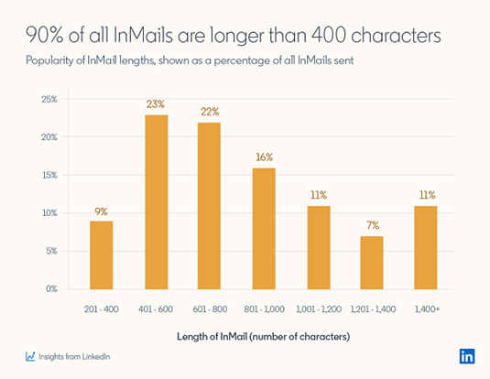
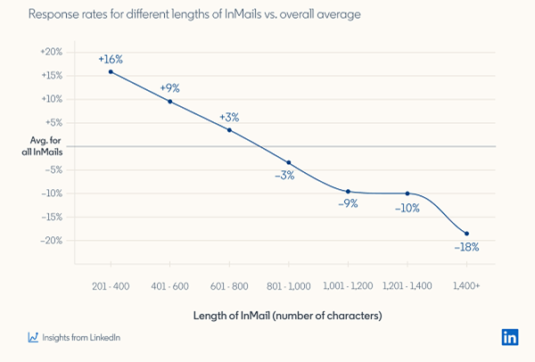
Problems of response rate of LinkedIn Messages
Longer Messages get below-average response rate.
Longest InMails (those over 1,400 characters).

Slide 4
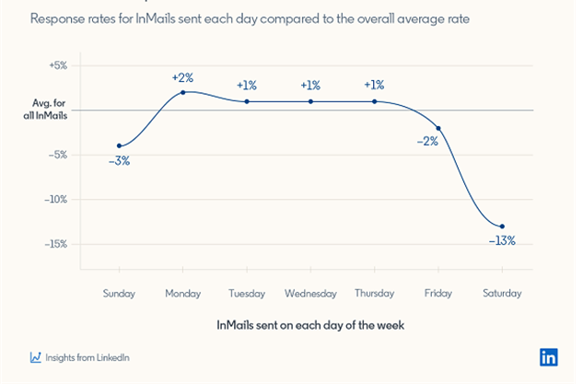
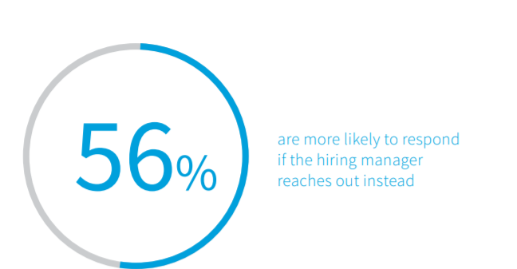
Problems of response rate of LinkedIn Messages(Cont.)
The worst response rate on weekends.
InMail doesn’t include the title of a sender .

Slide 5
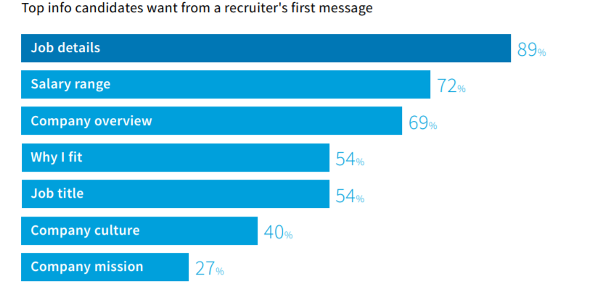
Problems of response rate of LinkedIn Messages(Cont.)
Candidates want lots of information in your first message.

Slide 6
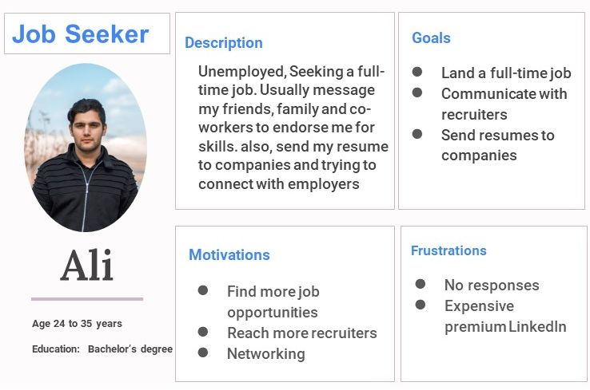
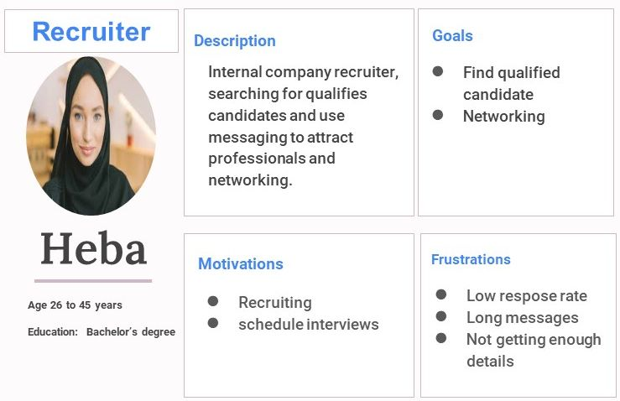
Defining User Persona

Slide 7
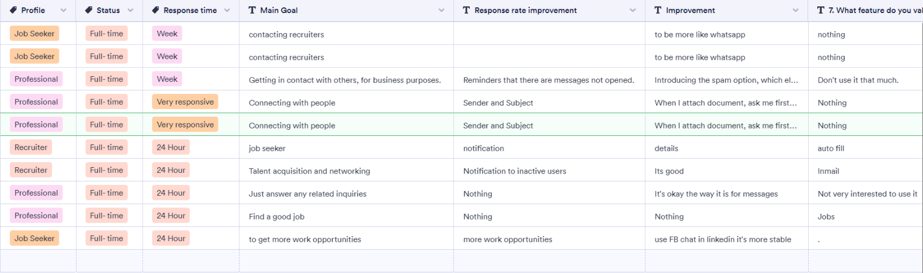
User Interviews ( LinkedIn Survey )
Which profile category describe you most?
What is your employment type
How often do you use the LinkedIn messaging?
In how much time you usually response to your messages?
What may improve your response rate to messages?
What improvements could be made to make LinkedIn messaging better?
How would you describe your experience with LinkedIn messaging?
What feature do you value most about the LinkedIn messaging?
What is your main goal from using the LinkedIn Messaging?
What would prevent you from achieving your goals?

Slide 8
Interview Results
00
Findings
Causes
01
Long messages
Not suitable time
Not responsive to messages
02
Missing information about the sender like location, job title … etc
Couldn’t identify the sender
03
Cannot block profiles
No way to detect spammers
Receive a lot of spams and ads

Slide 9
Hypothesis
LinkedIn Message receivers are not preferring messages with long characters, that why they’re mostly either respond in exaggerated time or eventually not respond.
Weekends are not the suitable for sending messages either from recruiter or job seeker.
Message details( Sender Job title, Salary Range, Company overview, refer common employer, etc ) are very effective factors that give interest to the receiver to reply.

Slide 10
Jobs-to-be-Done
Build engine that can paraphrase messages to shorten the message to increase opportunity of fast response User Story When trying to send job offer I need a tool to rephrase the email body to the minimum character Job Story
- start integration with Paraphrase tool - Apply the integration to linkedin DM. - Give The user the option to enable/Disable the paraphrase tool - After finish writing the email and pressing send a pop up will show to offer using the paraphrase tool - paraphrased email ( Apply, Ignore & Send)
Perform message format including the valuable details. User Story - When sending a job offer make sure to show the valuable info for the user to review Job Story
Valuable Info
- Job Detail - Recruiter Name - Recruiter Title - Recruiter Email - Salary Range - Company Overview " Link "
Perform Validator will check suitable time to send the message between 9 a.m. and 10 a.m. on a weekday if not then message can be scheduled to be sent on the suitable time. User Story
Based on linkedin expertise the best time to send DM is between 9 to 10 am and the worst time to send is weekends ( Sat , Sun ) , so I Ineed to notify the user if the time is suitable or not Job story
- Give The user the option to enable/Disable the tool - After paraphase option - if enabled - a pop up will appear to notify me that this is not the best time to send message and suggest better time with two option to schedules to diff time or to ignore and send

Slide 11
Jobs-to-be-Done
Customer can be able to set specific suitable time to receive Messages
----- For Receiver ----- - Give The user the option to enable/Disable the tool - set a specific time to receive notification for pending messages Example = Between 9 AM and 12 AM - When trying to send message to a user who enabled the suitable time tool a pop will show to suggest better time to send your message upon the receiver settings
Opened to new job to be option marked yes or no and predictive model to start propose to the recruiter the opened to work members to increase chance of fast response. “Eight out of nine professionals are at least willing to consider a new job opportunity” User Story - new flag for open for new job. - Give the open for new job candidates the priority to show first in the search Job Story I'm a recruiter wants to send job offer for user, first I will search per job title, the search will show all the users with the title needed and will list them by availability ( Open For work. Choose the proper candidate: When sending the Job Offer you will be able to choose job offer template from the + button, after choosing the template start entering the required fields - No mandatory fields are required - When entering send a pop will appear to suggest using the paraphraser if enabled - A second pop up will show to suggest better time to send the message according to the end user settings - you can ignore both options and send the message any ways

Slide 12
Jobs-to-be-Done
build engine that can paraphrase messages to shorten the message to increase opportunity of fast response
Perform message format including the valuable details.
Perform Validator will check suitable time to send the message in from is between 9 a.m. and 10 a.m. on a weekday if not then message can be scheduled to be sent on the suitable time.
Customer can be able to set specific suitable time to receive SMSs.
Opened to new job to be option marked yes or nor and machine learning to start propose to the recruiter the opened to work members to increase chance of fast response. “Eight out of nine professionals are at least willing to consider a new job opportunity”

Slide 13
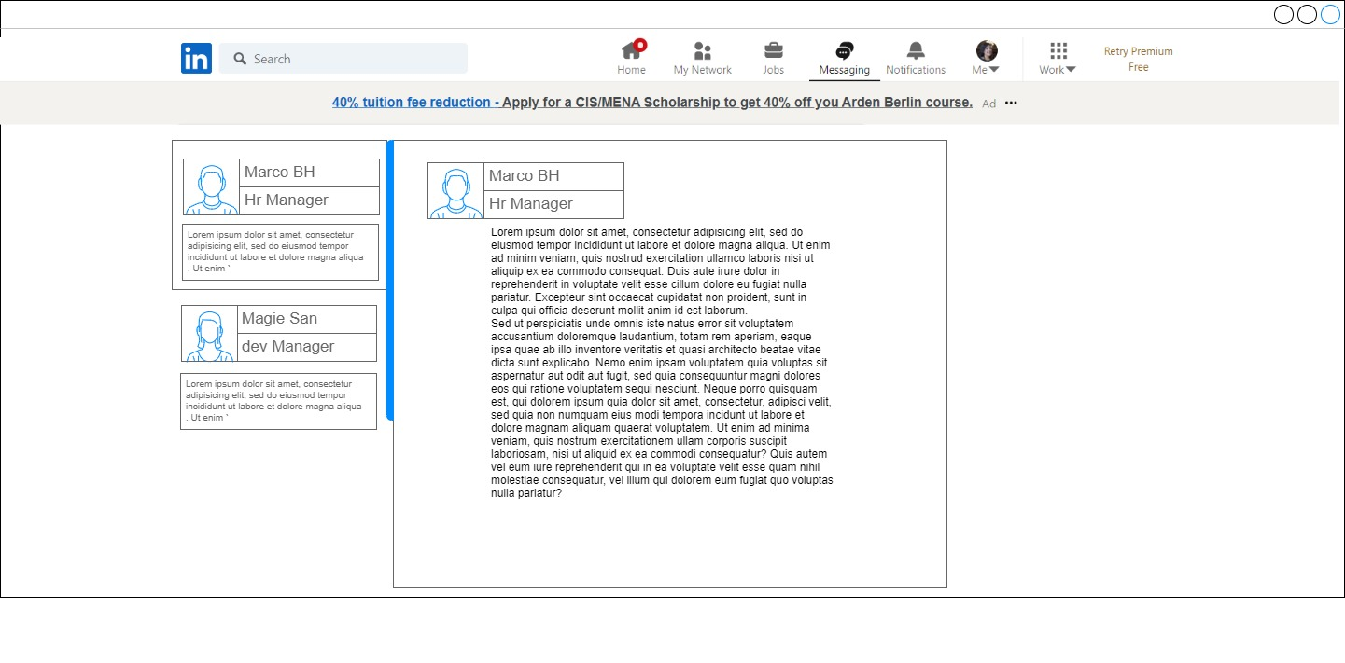
InMail Include the title of a Sender - Wireframe

Slide 14
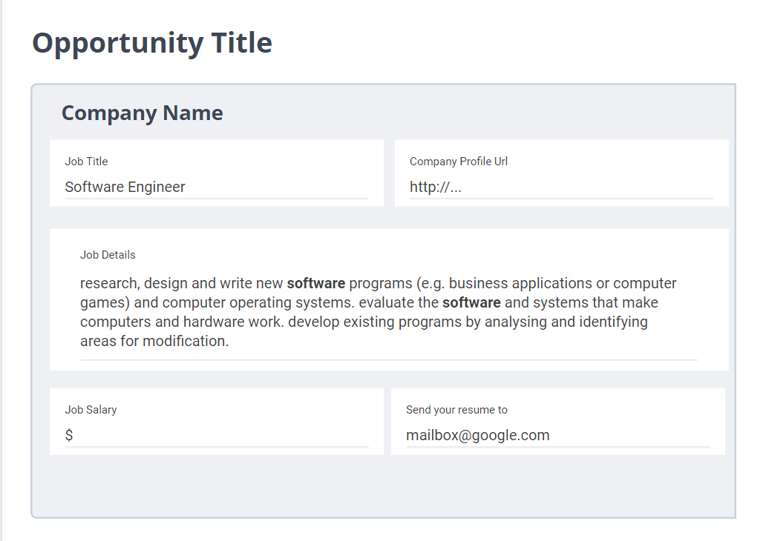
InMail Message Details -Wireframe

Slide 15
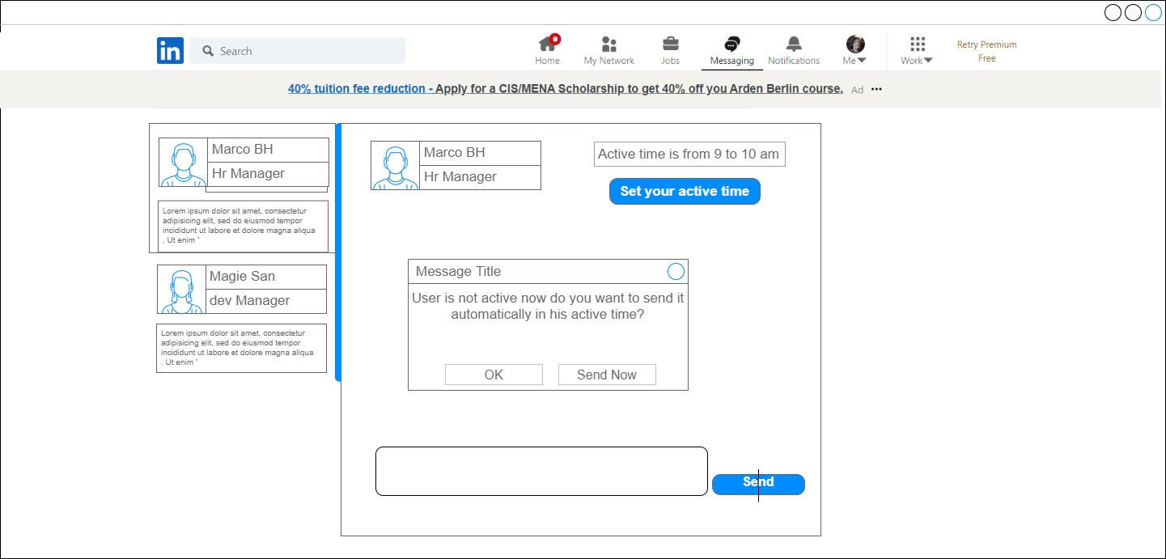
Set Specific suitable time to receive messages -Wireframe

Slide 16
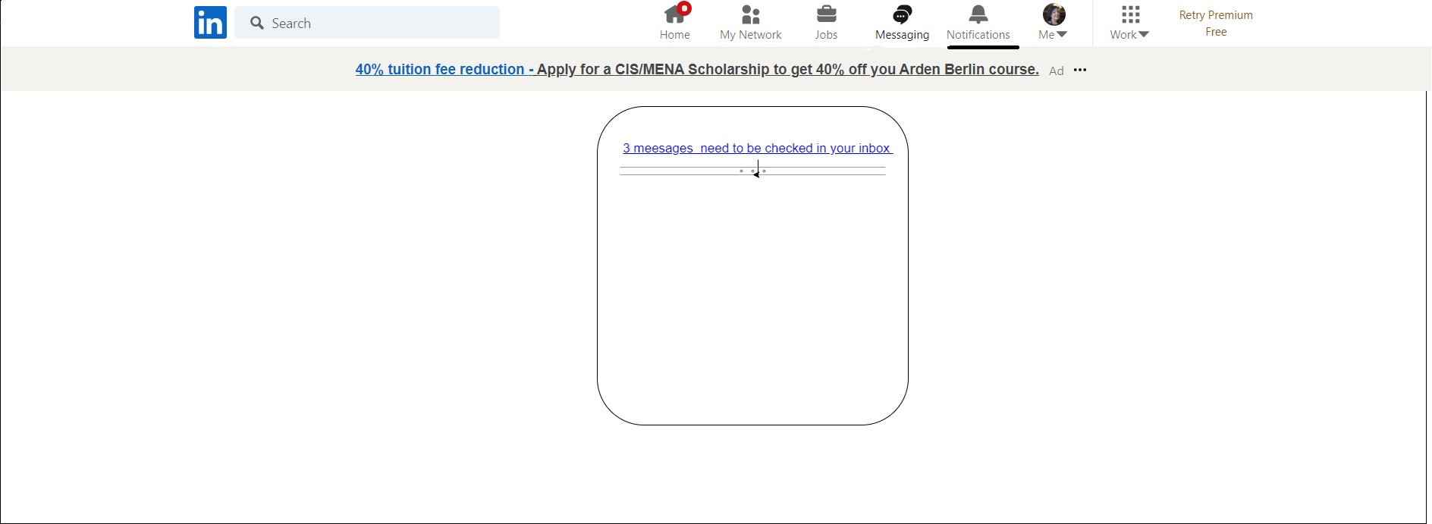
Send Notification to check unopened Message - Wireframe

Slide 17
Roadmap
Applied KPI’s
Opening messages rate (by google analytics)
Response rate (by google analytics)
How informative the InMail (by surveys )
Based on the analysis on slide 5 We expect it to be >90%
Applied KPI’s
Opening messages rate (by google analytics)
Response rate
Bounce rate (for the notification link)
Feature of Setting Suitable time
Feature of Including InMail Details
Feature Of Sending Notification for unopened messages
Applied KPI’s
Opening messages rate (by google analytics)
Response time (by google analytics)
Based on slide 2 we expect it to be +2%
Response rate (by google analytics)

Slide 18
Timeline
Sprint 1 | Sprint 2 | Sprint 3 | Sprint 4
Mobile & Desktop UX/UI: Job Offer Template Add template Option in the + Button in the DM Add toggle to enable paraphraser in settings Add toggle to enable suitable time >> Expand >> from To Valuable details in the DM for sender | Frontend: in search page make sure that the open for work show first Job offer template as designed Button for templates in the + Button Valuable details to be shown as design | Frontend: Implement message format including the valuable details. Implement suitable time popup for the sender. Implement configurable suitable time | Backend: Optimize the search engine to list the search result with the priority to the opened to new job candidate. Implement push notification for unopened messages.
Backend: Integrate with paraphrasing tool - standalone tool Implement checker to validate the suitable time to send messages for user | Perform A/B testing phase for the new changes | Perform A/B testing phase for the new changes | Perform unit testing phase for the Backend changes Perform A/B testing phase for the new changes
Perform unit testing phase for the Backend changes | Analyse the feedback and data sent from recruiters and users, make some updates upon | Analyse the feedback and data sent from recruiters and users, make some updates upon | Analyse the feedback and data sent from recruiters and users, make some updates upon.

Slide 19
Timeline
1 Nov
1 Sep
Sprint 1
Sprint 2
Sprint 3
Sprint 4
Iteration on previous sprints and determine the way forward
1 Aug
1 Oct

